Slide 1
Quiz Game
Presenting to our honorable course
teacher Nasrin Akter (Mam)

Slide 2
Group Name: Catholic
Group Members:
Sharmin Jahan Shama (162-15-7879)
Imran Hossain (162-15-7741)
Firoj Islam (162-15-7825)
Kazi Tasnim Binta Mustafa Mohona(162-15-8162)

Slide 3


Project description:

Slide 4


Purpose:
Learning with fun by the means of game is the goal of this project and also to share knowledge.

Slide 5
Overview:
Home page
Start
Level
Instructions
Exit
score

Slide 6
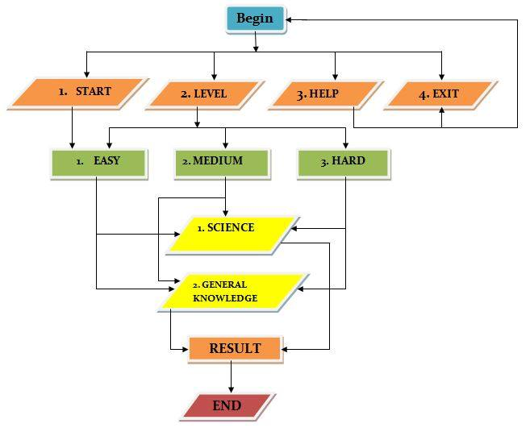
Flowchart:
Fig: flowchart

Slide 7
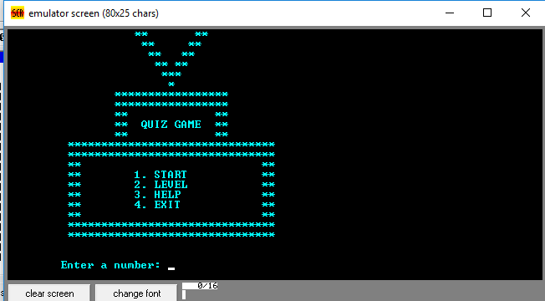
Project analysis:

Slide 8
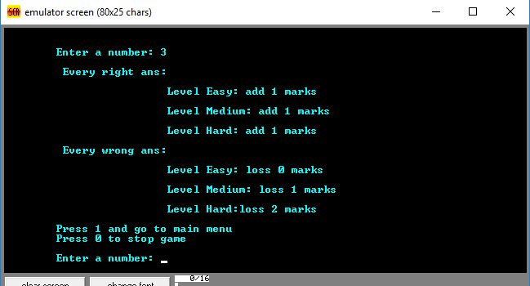

Slide 9
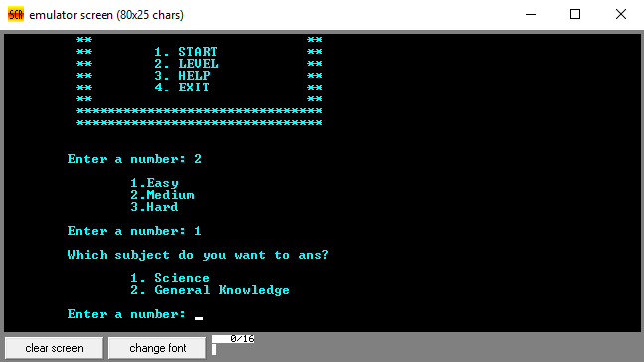

Slide 10
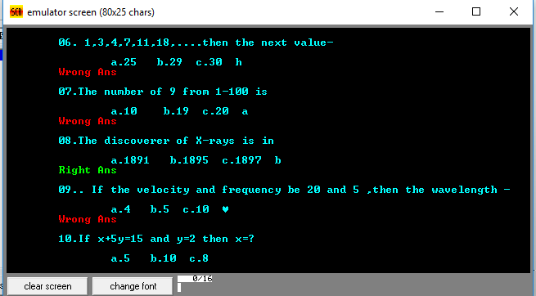

Slide 11
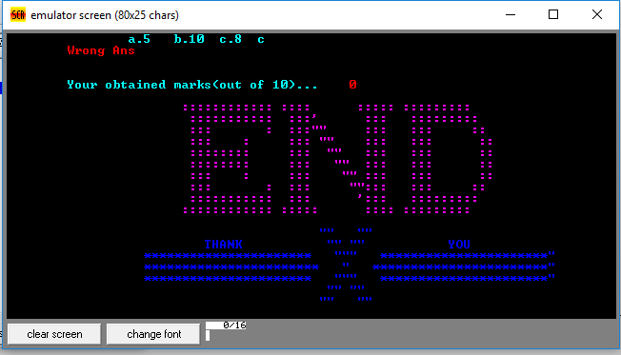

Slide 12
Benefits:
Learning
Entertainment
Easy to play
Multiple levels
Multiple choices

Slide 13
Lackings:
Time consuming
Lazy game
Fixed questions
Graphical interface
Resources
Informations

Slide 14
Future plan:
Improve sound variations
Add images
Improve design
Increase varities in subjects

Slide 15

☺

