Slide 1

Determining the most ideal Toronto neighborhood to start an Indian restaurant

Slide 2
Understanding the problem
A Canadian client owns a chain of Indian restaurants across major Canadian cities – including Montreal & Vancouver
He wants to open an Indian restaurant in Toronto
Toronto is one of world’s most popular and commercially sound cities
The challenge is to identify the best neighborhood in Toronto to start the client’s Indian restaurant

Slide 3
Client’s Expectations
The client prefers the restaurant to be in Downtown Toronto
Second preference for the restaurant is West Toronto
The neighborhood should not have any eatery or restaurant among its top 2 commonly visited venues
Any café or coffee shop is assumed to fall under an eatery

Slide 4
Data Acquisition and Pre-processing
Wikipedia page for the list of postal codes for all Toronto boroughs (https://en.wikipedia.org/wiki/List_of_postal_codes_of_Canada:_M)
The geospatial co-ordinates of all Toronto boroughs (http://cocl.us/Geospatial_data)
Foursquare API to get top venues associated with each neighborhood
The obtained data was modified and pre-processed to remove unassigned or blank values
Similar rows were merged together to consolidate the data

Slide 5
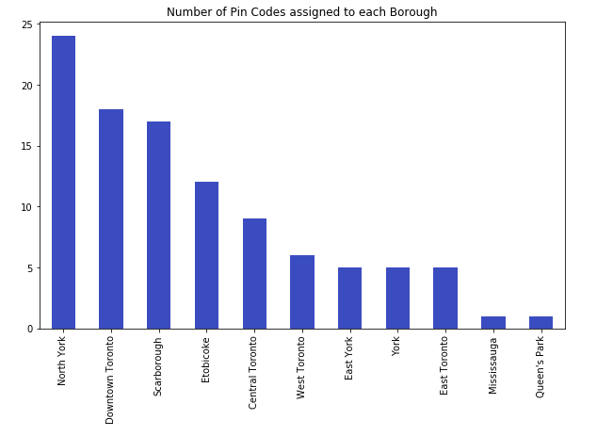
Initial Exploratory analysis
Downtown Toronto has the second most number of pin codes assigned to any borough in Toronto
Downtown Toronto is the densest borough in Toronto

Slide 6
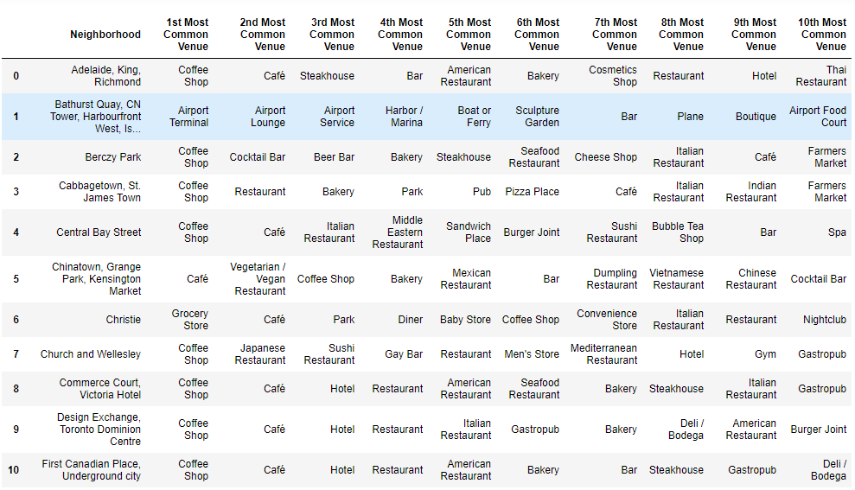
Identifying The Most Common Venues in Each Downtown Toronto Neighborhood

Slide 7
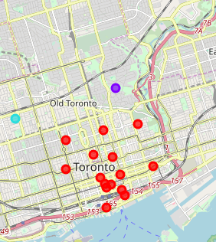
Visualizing neighborhoods after Clustering Them Using K-Means
We chose to segregate all the Toronto neighborhoods into 4 clusters
These clusters were formed on the basis of the similarity of the most common venues

Slide 8
Takeaways from the analysis
The clusters in red are situated in the heart of Downtown Toronto
Each of the neighborhoods in this cluster have either a café or a coffee shop as the most common visited venue
The clusters with pin codes M4W and M5V fit the client’s requirements and can be considered for decision-making
M4W (Rosedale) is more preferable due to its geographic location being more suited to the client’s business. M5V is more isolated than the rest of Downtown Toronto.

Slide 9
Conclusion & Future Directions
We were able to accurately cluster the neighborhoods and identify the best possible neighborhood for the client’s restaurant meeting the client’s current requirements.
The analysis can be further improved by considering various other factors such as:
Population of the neighborhoods
Geographical coordinates of the neighborhoods as opposed to boroughs
Average per-capita income of the population
Ratings of the restaurants in the neighborhood
Crime rate of the neighborhoods
Real-estate prices of the neighborhoods

