Slide 1
ClinIQ
Pattern Recognition
Agentic Clinical Pattern Recognition and Decision Support Platform
Online RAG
Evidence-aware healthcare claim review support - not automated adjudication
Verification-Aware Reasoning
Reviewer Report
Shashidhar Reddy Kanaparthi | Cotiviti Intern Assessment
ClinIQ | Agentic Clinical Decision Intelligence
1
Notes:
Open with the problem: healthcare claim review needs evidence, transparency, and human oversight. Introduce ClinIQ as a proof of concept, not a production adjudication tool.

Slide 2
Selected Topic and Interpretation
Clinical Decision Making and Pattern Recognition in Healthcare
Official topic focus
Our scoped interpretation
Chain reasoning, agentic generative AI, classification, prediction, inference, clustering, and anomaly detection for Treatment, Payment, and Operations.
ClinIQ focuses on decision support for healthcare claim review: pattern recognition, evidence retrieval, verification-aware reasoning, and reviewer recommendations.
Topic mapping
Treatment evidence
(clinical facts)
Payment context
(claim review)
Operations context
(manual verification)
ClinIQ | Agentic Clinical Decision Intelligence
2
Notes:
Explain that TPO does not mean the prototype must treat patients or pay claims. It means the evidence supports treatment, payment review, and operational reviewer action.

Slide 3
Problem: Evidence Review Is Hard to Scale
Claim reviewers must compare clinical facts, coding, policy, and verification gaps.
Manual burden
Information gaps
Risk of over-automation
Reviewers must inspect diagnosis, procedures, medical necessity, payer policy, benefits, provider status, and authorization records.
Public evidence can support coding and clinical context, but internal payer systems are needed for member benefits, authorization, and provider validation.
A system that hides uncertainty can produce unsafe or unsupported conclusions. Human review must remain final.
Design response
Evidence first. Recommendations second. Human decision ultimatum.
ClinIQ | Agentic Clinical Decision Intelligence
3
Notes:
Use this slide to show why the project intentionally avoids final approve or deny language. The core design is transparency.

Slide 4
ClinIQ Product Vision
A decision intelligence assistant for evidence-aware healthcare claim review.
Structured Claim JSON
Agentic Workflow
Evidence + Verification
Decision Intelligence Report
What ClinIQ does
What ClinIQ does not do
Detects claim-level clinical and coding patterns
Does not approve, deny, or adjudicate claims
Retrieves public evidence with online RAG
Does not access private payer/provider systems
Separates public evidence from internal verification needs
Does not replace authorized reviewers
Produces reviewer-oriented recommendations only
ClinIQ | Agentic Clinical Decision Intelligence
4
Notes:
Explain the proof-of-concept boundary. The system starts from structured JSON, not raw PDFs. This keeps it focused on Topic 2.

Slide 5
System Architecture
The prototype demonstrates the full evidence-analysis chain.
Validate
JSON
Pattern
Recognition
Query
Planning
Online RAG
Retrieval
Evidence
Quality
Verification
Agent
Decision
Intelligence
PDF
Report
Retry retrieval once if evidence quality is weak
Main idea
The project is not a single LLM prompt. It is a chain of specialized stages that inspect, retrieve, verify, reason, and report.
ClinIQ | Agentic Clinical Decision Intelligence
5
Notes:
Walk through the exact workflow you implemented. Emphasize retry and verification as the agentic improvements.

Slide 6
Agentic Workflow
Each stage has a specific responsibility.
Pattern Agent
Query Planner
Evidence Quality
Detects clinical/coding patterns, missing internal-review items, and documentation triggers.
Creates case-specific online retrieval queries for clinical, policy, coding, and medical necessity evidence.
Checks whether retrieved evidence is adequate and can trigger one retry when evidence is weak.
Verification Agent
Decision Intelligence
Report Agent
Separates public evidence from internal checks such as payer policy, authorization, provider/NPI, and benefits.
Synthesizes patterns + evidence + verification status into a reviewer-oriented recommendation.
Creates a concise PDF report with evidence, verification gaps, and suggested reviewer actions.
ClinIQ | Agentic Clinical Decision Intelligence
6
Notes:
Explain that agentic does not mean many chatbots. It means staged reasoning with tool use, quality checks, retries, and verification boundaries.

Slide 7
RAG and Verification-Aware Design
Public evidence helps, but internal verification remains necessary.
Online RAG retrieves
public evidence
Evidence Quality
checks relevance
Verification Agent
flags internal gaps
Knowledge categories used in the POC
Clinical
Policies
Coding
Medical Necessity
diagnosis and treatment context
public coverage and policy guidance
ICD/CPT code references
documentation and support criteria
Key transparency principle: ClinIQ never treats missing internal data as if it were verified.
ClinIQ | Agentic Clinical Decision Intelligence
7
Notes:
This is the most important slide for limitations. Say the limitation is intentional and transparent, not a failure.

Slide 8
Prototype Demonstration Flow
Streamlit is used for a simple, understandable live demo.
1. Select case
2. Run agents
3. Inspect output
Choose one of 10 structured claim JSON demo cases.
The workflow shows progress through pattern, retrieval, verification, decision, and report stages.
Review evidence, verification status, recommended next action, and download the PDF.
Demo narrative
The demo should use CASE-HIP-006. It shows an orthopedic claim where public evidence supports the clinical relationship, but payer/provider/authorization checks require internal verification. The system recommends manual review, not approval.
What to show live
Workflow progress logs
Evidence retrieved and categorized
PDF report download
ClinIQ | Agentic Clinical Decision Intelligence
8
Notes:
This slide is for demo setup. Keep it short and then switch to Streamlit during the video.

Slide 9
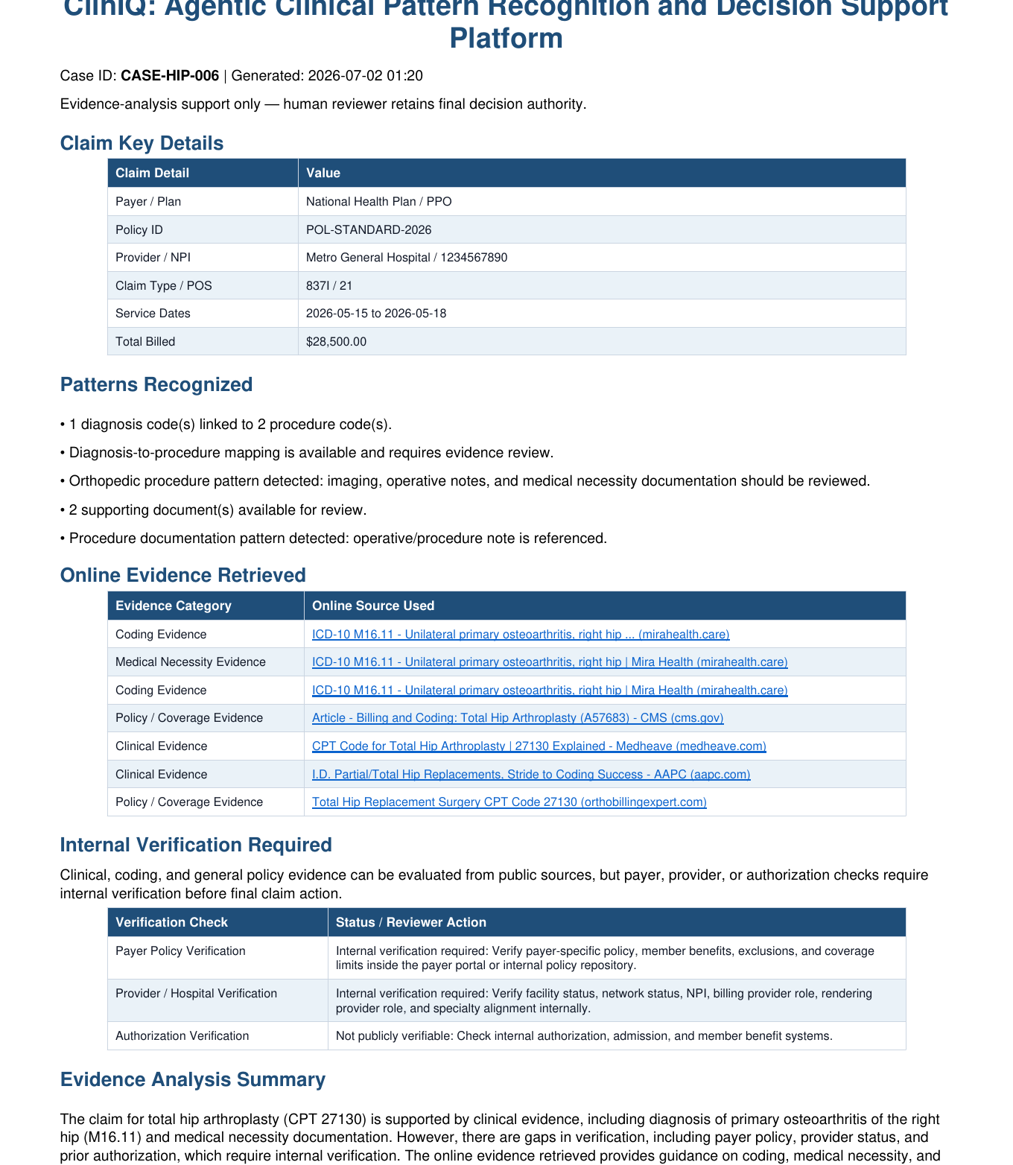
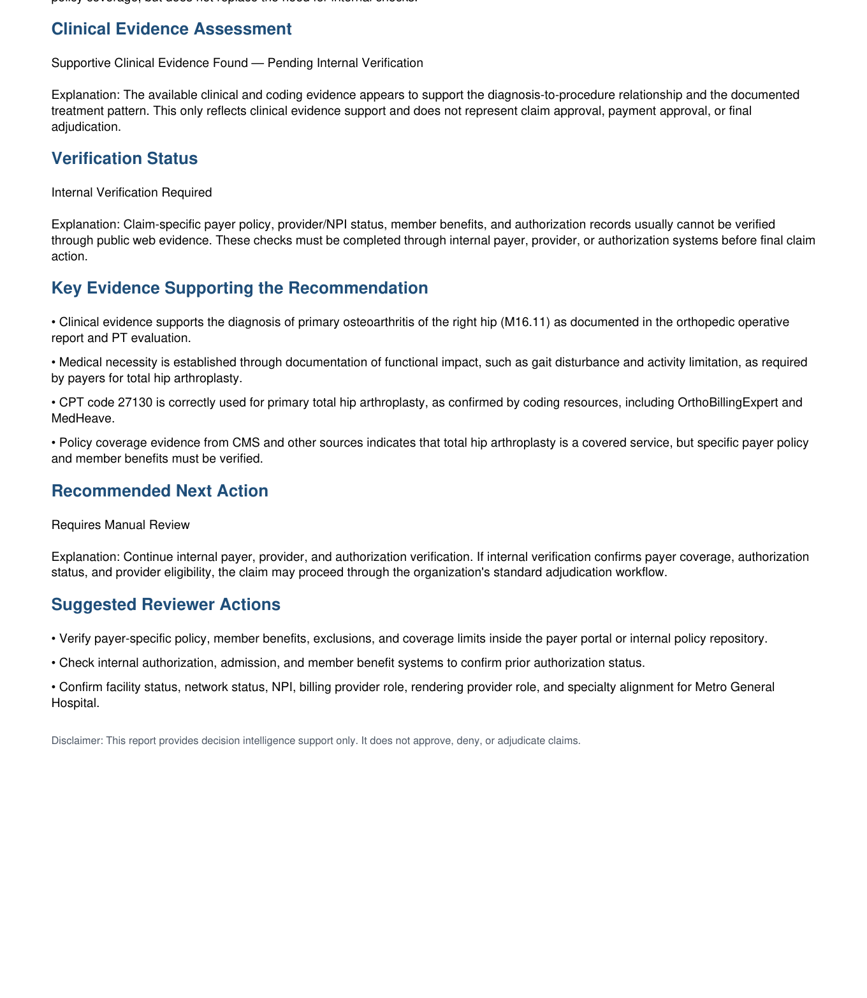
Generated Decision Intelligence Report
The final artifact is reviewer-oriented and transparent.
Report highlights
Claim key details
Patterns recognized
Online evidence
Internal verification
Recommended next action
ClinIQ | Agentic Clinical Decision Intelligence
9
Notes:
Use this slide to show the report format. Say the report is a decision-support artifact and does not approve, deny, or adjudicate claims.

Slide 10
Transparency and Boundaries
The prototype is honest about what public RAG can and cannot verify.
Publicly retrievable
Requires internal systems
Design choice
Clinical guidelines, coding references, public policy pages, medical necessity context.
Payer-specific benefits, authorization status, provider network status, member eligibility, contract terms.
ClinIQ labels these gaps explicitly and recommends human verification before final action.
Responsible AI position
The project prioritizes transparency over unsupported automation. It is intentionally a decision-support platform, not a decision maker.
ClinIQ | Agentic Clinical Decision Intelligence
10
Notes:
This slide should answer limitations before they ask. Make the limitation sound like an intentional safety and governance feature.

Slide 11
Future Roadmap
Natural extensions after the proof of concept.
Local vector KB
FHIR/EHR integration
Curated payer policy and medical necessity repository
Replace synthetic JSON with standardized healthcare data feeds
Historical analytics
Reviewer workbench
Provider behavior, clustering, and time-series anomaly detection
Case queue, audit trail, reviewer feedback, and final disposition capture
Important: these are future extensions, not claims about the current hackathon demo.
ClinIQ | Agentic Clinical Decision Intelligence
11
Notes:
Use this slide to address prediction, clustering, and time-series anomaly detection as future work requiring longitudinal datasets.

Slide 12
Conclusion
ClinIQ proves the concept with a practical, transparent workflow.
What the prototype demonstrates
Agentic workflow for healthcare decision support
Pattern recognition over structured claim data
Thank you !!
Online RAG with evidence-quality checks
Verification-aware recommendations
PDF reporting for human reviewers
ClinIQ | Agentic Clinical Decision Intelligence
12
Notes:
End with confidence. The prototype is not production-grade, but it clearly proves the core idea.

