Slide 1
Tracking Objects in Video Using Particle Filters
Student Frolovskaya Elena
Supervisor Shlyaeva Anna Viktorovna

Slide 2
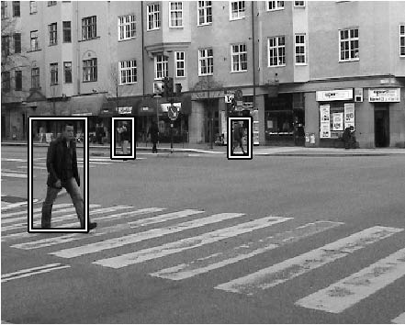
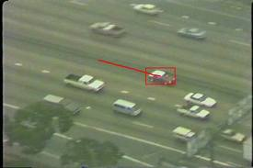
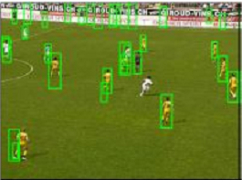
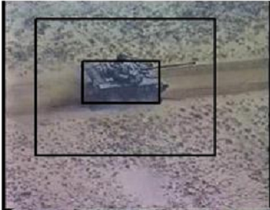
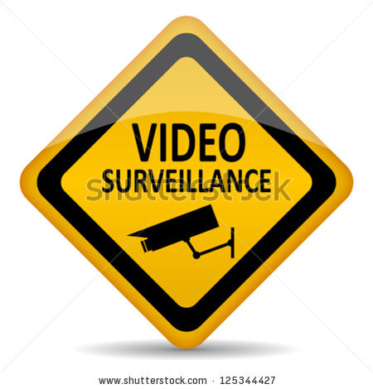
Object Tracking

Slide 3
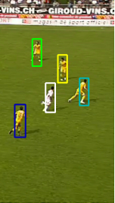
State space
State vector
Motion equation
Measurement equation

Slide 4
Probabilistic tracking
Goal: estimate posterior density
Two stages:
prediction
updating (filtering)
at time is available

Slide 5
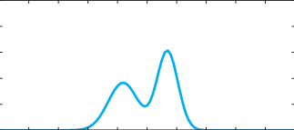
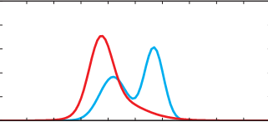
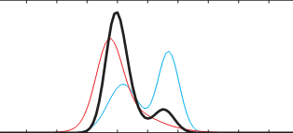
Probabilistic tracking
Prediction stage
Prior pdf
New measurement
Likelihood function
Updating stage
Posterior pdf

Slide 6
Particle filter
Approximate pdf by weighted set of samples
Stages
evolution
re-sampling
propagation

Slide 7
Particle filter
distributed according to
Generate new particles from proposal distribution
Compute new weights
distributed according to

Slide 8
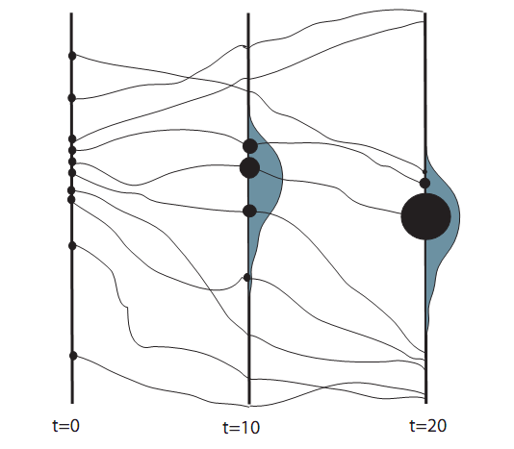
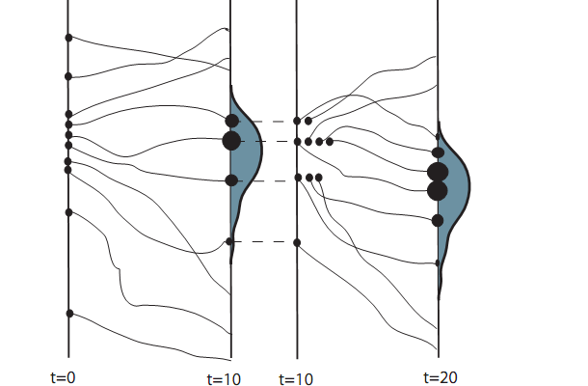
Particle filter
Degeneracy
Re-sampling

Slide 9
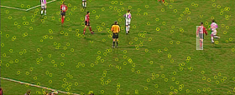
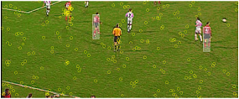
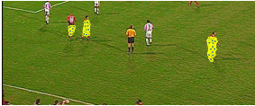
Particle filter

Slide 10
THANKS FOR YOUR ATTENTION
The end…

