Slide 1
Rocket Vertical Takeoff and Precision Landing
Team: [Siddharth Bathija], [Jayhan Bhagvati], [Jimit Kacha], [Shehzad Khan]
Course: Dynamic System Modeling (702MH0C023)
B.Tech Mechatronics, Sem IV | NMIMS MPSTME Mumbai
Category: [B(Aerial Systems)] | Complexity: [Very High]
COs Exercised: [CO1, CO2, CO3, CO4, CO5] | Date: [19/04/2026]

Slide 2
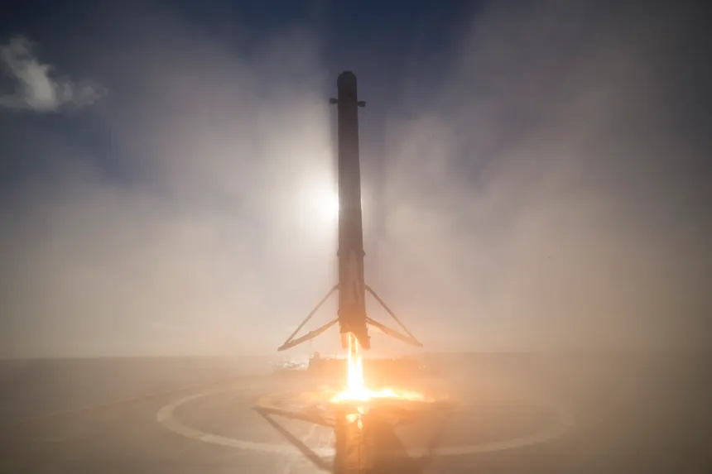
1. System Introduction & Motivation
System: Vertical Takeoff and Landing (VTOL)
Rocket Application: Reusable launch systems (SpaceX Falcon 9, ISRO RLV)
Objective: To model and control a rocket that performs stable ascent, hover, and lands back at the same position under disturbances.
Problem Statement: Design a dynamic model and control strategy to achieve stable flight and precise landing of a rocket subject to gravity, drag, and external disturbances.
Notes:
TIMING: 0:00-1:00 (1 min)
FOCUS: Introduce your system and its real-world engineering relevance.
TIP: Start with a compelling application, not a textbook definition.
SHOW: An image or short video of the actual system.

Slide 3
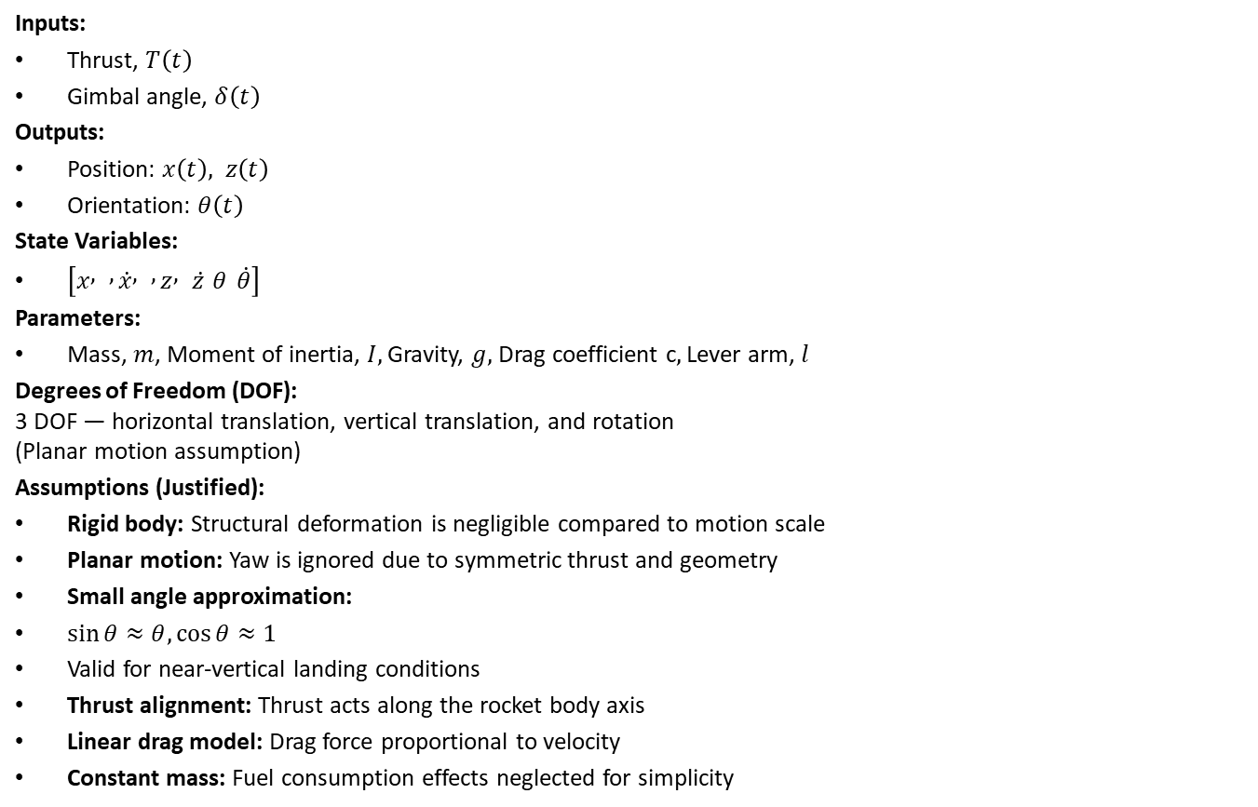
2. Problem Formulation & Assumptions
Inputs:
Thrust, $T\left(t\right)$
Gimbal angle, $δ\left(t\right)$
Outputs:
Position: $x\left(t\right), z\left(t\right)$
Orientation: $θ\left(t\right)$
State Variables:
$\left[x , , \dot{x} , , z , \dot{z} θ \dot{θ}\right]$
Parameters:
Mass, $m$, Moment of inertia, $I,$Gravity, $g,$Drag coefficient c$,$Lever arm, $l$
Degrees of Freedom (DOF):
3 DOF — horizontal translation, vertical translation, and rotation
(Planar motion assumption)
Assumptions (Justified):
Rigid body: Structural deformation is negligible compared to motion scale
Planar motion: Yaw is ignored due to symmetric thrust and geometry
Small angle approximation:
$\sin{θ}≈θ, \cos{θ}≈1$
Valid for near-vertical landing conditions
Thrust alignment: Thrust acts along the rocket body axis
Linear drag model: Drag force proportional to velocity
Constant mass: Fuel consumption effects neglected for simplicity
Notes:
TIMING: 1:00-2:30 (1.5 min)
FOCUS: Clearly define I/O, states, parameters, DOF, and justify every assumption.
TIP: Explain WHY each assumption is physically valid.
BE PREPARED: You may be asked 'Why this assumption? What if it changes?'

Slide 4
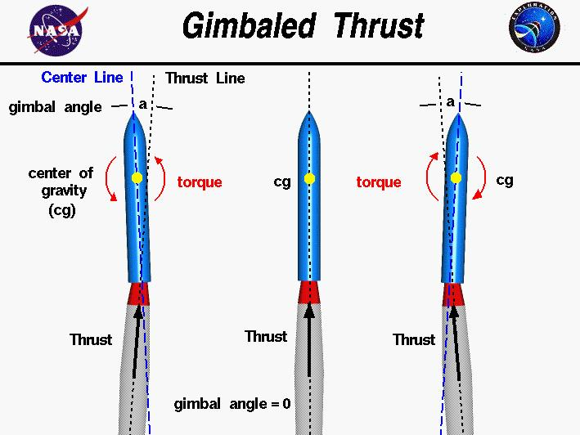
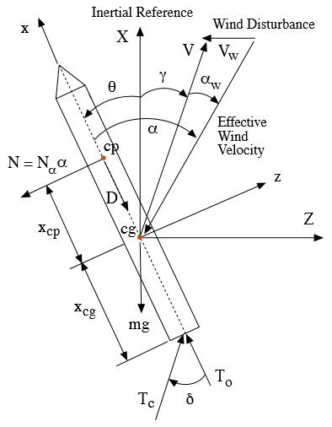
3. Free Body Diagram / System Schematic

Slide 5
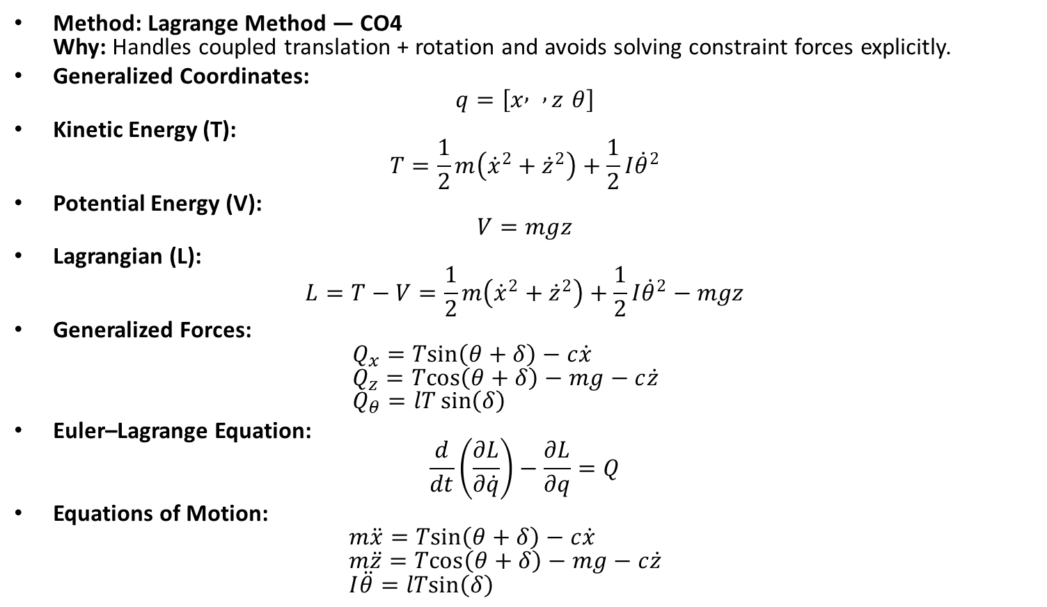
4. Mathematical Derivation (Part 1)
Method: Lagrange Method — CO4
Why: Handles coupled translation + rotation and avoids solving constraint forces explicitly.
Generalized Coordinates:
$q=\left[x , , z θ\right]$
Kinetic Energy (T):
$T=\frac{1}{2}m\left({\dot{x}}^{2}+{\dot{z}}^{2}\right)+\frac{1}{2}I{\dot{θ}}^{2}$
Potential Energy (V):
$V=mgz$
Lagrangian (L):
$L=T−V=\frac{1}{2}m\left({\dot{x}}^{2}+{\dot{z}}^{2}\right)+\frac{1}{2}I{\dot{θ}}^{2}−mgz$
Generalized Forces:
$Q_{x}=Tsin⁡\left(θ+δ\right)−c\dot{x}$
$Q_{z}=Tcos⁡\left(θ+δ\right)−mg−c\dot{z}$
$Q_{θ}=lT\sin\left(δ\right)$
Euler–Lagrange Equation:
$\frac{d}{dt}\left(\frac{∂L}{∂\dot{q}}\right)−\frac{∂L}{∂q}=Q$
Equations of Motion:
$m\ddot{x}=Tsin⁡\left(θ+δ\right)−c\dot{x}$
$m\ddot{z}=Tcos⁡\left(θ+δ\right)−mg−c\dot{z}$
$I\ddot{θ}=lTsin⁡\left(δ\right)$
Notes:
TIMING: 2:30-3:45 (1.25 min)
FOCUS: Walk through EVERY step of the derivation. This is the most important section.
TIP: Show the algebra — don't skip to the final equation.
BE PREPARED: You may be asked to explain any step in detail.

Slide 6

5. Final Equations & State-Space
Final Equations of Motion:
EOM 1: $m\ddot{x}+c\dot{x}=Tsin⁡\left(θ+δ\right)$
EOM 2: $m\ddot{z}+c\dot{z}+mg=Tcos⁡\left(θ+δ\right)$
EOM 3: $I\ddot{θ}=lT\sin\left(δ\right)$
State-Space Form (nonlinear):
Let state vector:
$X={\left[x , , \dot{x} , , z , \dot{z} θ \dot{θ}\right]}^{T}$
$\dot{X}=\left[\begin{matrix}\dot{x} \\ \frac{1}{m}(Tsin⁡\left(θ+δ\right)−c\dot{x}) \\ \dot{z} \\ \frac{1}{m}(Tcos⁡\left(θ+δ\right)−mg−c\dot{z}) \\ \dot{θ} \\ \frac{lTsin⁡\left(δ\right)}{I}\end{matrix}\right]$
Output (example):
$y={\left[x , , z θ\right]}^{T}$
Physical Meaning of Each Term — CO3:
$Tsin⁡\left(θ+δ\right)$= horizontal thrust component
$Tcos⁡\left(θ+δ\right)$= vertical thrust component
$c\dot{x}, c\dot{z}$= viscous drag opposing motion
$mg$= gravitational force acting downward
$lTsin⁡\left(δ\right)$= torque generated by gimbaled thrust
Energy Expression (CO5):
Kinetic Energy:
$T=\frac{1}{2}m\left({\dot{x}}^{2}+{\dot{z}}^{2}\right)+\frac{1}{2}I{\dot{θ}}^{2}$
Potential Energy:
$V=mgz$
Total Energy:
$E\left(t\right)=T+V$
Notes:
TIMING: 3:45-5:00 (1.25 min)
FOCUS: Present final EOM and state-space. Explain the physical meaning of EVERY term.
TIP: 'c*x_dot = viscous damping force' is stronger than just showing the equation.

Slide 7
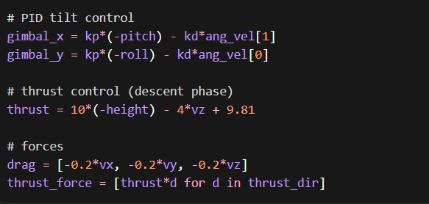
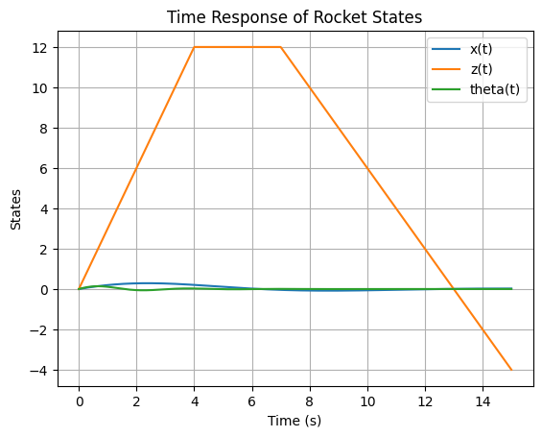
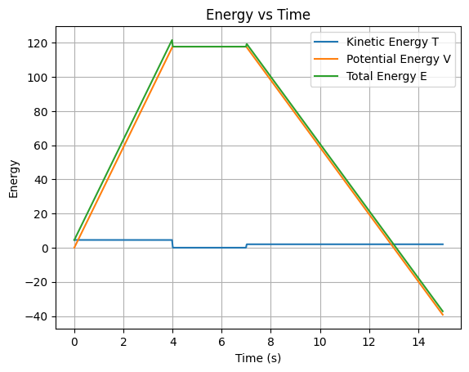
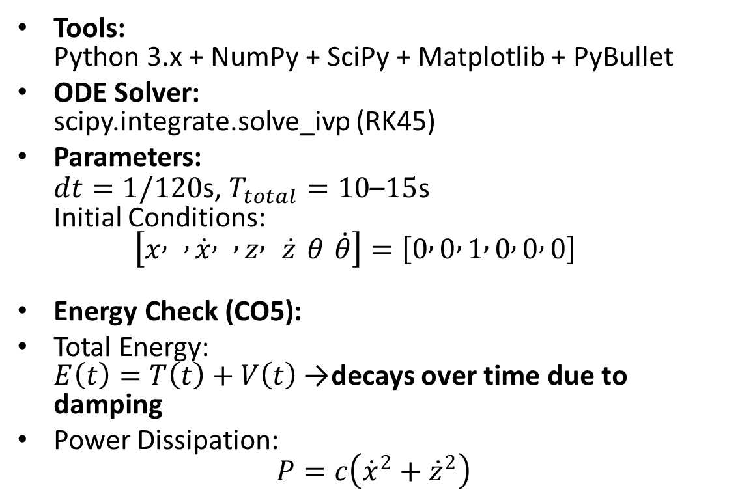
6. Simulation & Energy Analysis
Tools:
Python 3.x + NumPy + SciPy + Matplotlib + PyBullet
ODE Solver:
scipy.integrate.solve_ivp (RK45)
Parameters:
$dt=1/120$s, $T_{total}=10\text{–}15$s
Initial Conditions:
$\left[x , , \dot{x} , , z , \dot{z} θ \dot{θ}\right]=\left[0 , 0 , 1 , 0 , 0 , 0\right]$
Energy Check (CO5):
Total Energy:
$E\left(t\right)=T\left(t\right)+V\left(t\right)$→ decays over time due to damping
Power Dissipation:
$P=c\left({\dot{x}}^{2}+{\dot{z}}^{2}\right)$
Notes:
TIMING: 5:00-7:00 (2 min)
FOCUS: Show your simulation setup, key code snippet, and output plots.
INCLUDE: Energy vs time plot — this validates your model physically.
BE PREPARED: You may be asked 'Why does the oscillation decay?' or 'How does energy change?'

Slide 8
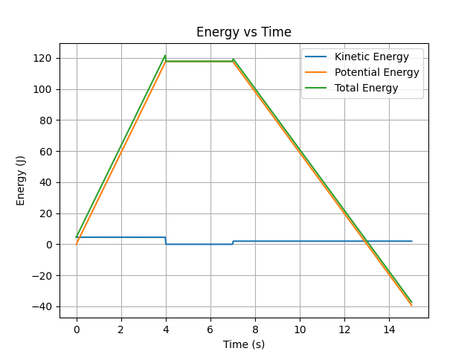
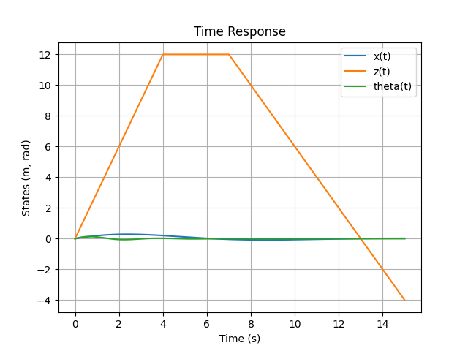
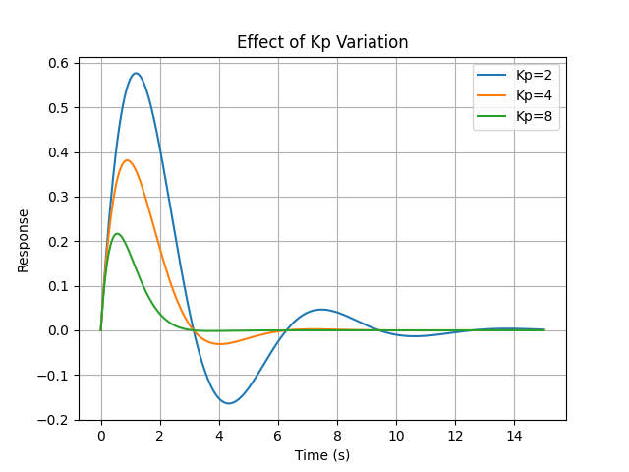
7. Simulation Visualization

Slide 9
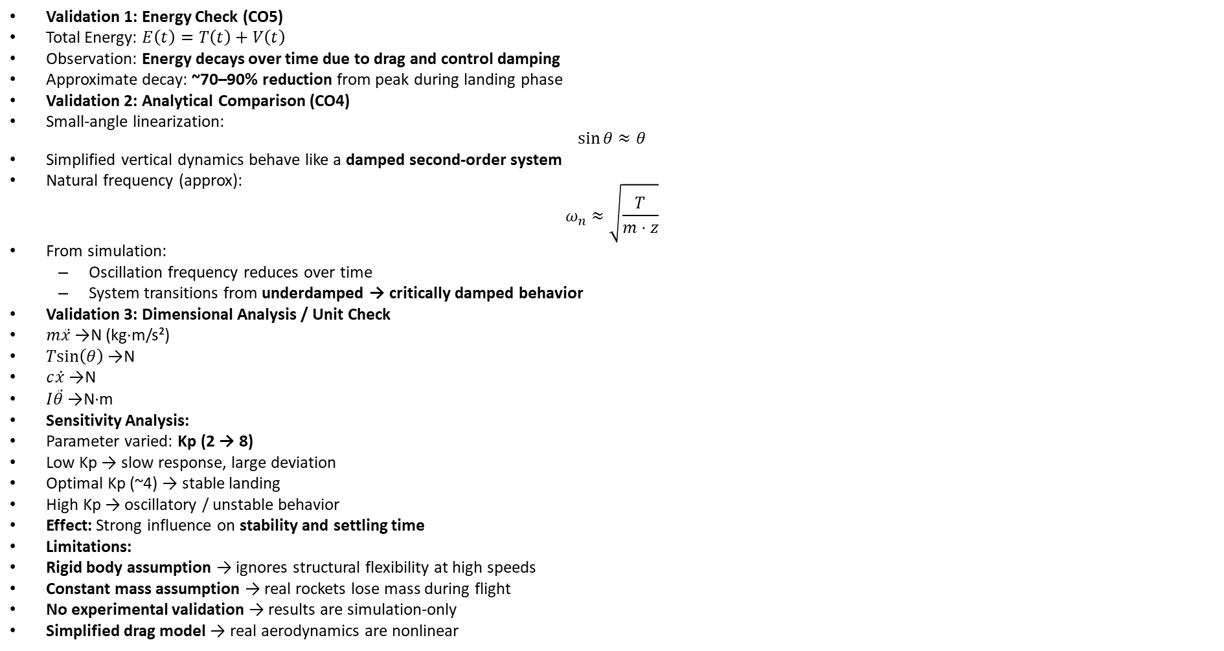
8. Validation & Analysis
Validation 1: Energy Check (CO5)
Total Energy: $E\left(t\right)=T\left(t\right)+V\left(t\right)$
Observation: Energy decays over time due to drag and control damping
Approximate decay: ~70–90% reduction from peak during landing phase
Validation 2: Analytical Comparison (CO4)
Small-angle linearization:
$\sin{θ}≈θ$
Simplified vertical dynamics behave like a damped second-order system
Natural frequency (approx):
$ω_{n}≈\sqrt{\frac{T}{m⋅z}}$
From simulation:
  Oscillation frequency reduces over time
  System transitions from underdamped → critically damped behavior
Validation 3: Dimensional Analysis / Unit Check
$m\ddot{x}$→ N (kg·m/s²)
$Tsin⁡\left(θ\right)$→ N
$c\dot{x}$→ N
$I\ddot{θ}$→ N·m
Sensitivity Analysis:
Parameter varied: Kp (2 → 8)
Low Kp → slow response, large deviation
Optimal Kp (~4) → stable landing
High Kp → oscillatory / unstable behavior
Effect: Strong influence on stability and settling time
Limitations:
Rigid body assumption → ignores structural flexibility at high speeds
Constant mass assumption → real rockets lose mass during flight
No experimental validation → results are simulation-only
Simplified drag model → real aerodynamics are nonlinear
Notes:
TIMING: 7:00-8:30 (1.5 min)
FOCUS: Show HOW you verified your results. Energy check, textbook comparison, sensitivity.
TIP: A strong answer = 'We compared natural frequency with Ginsberg Ch.3.'
A weak answer = 'It runs and produces output.'

Slide 10
9. Conclusions & Reflections
Key Finding:
A PID-controlled thrust vectoring system can achieve stable hover and precise vertical landing under disturbances such as wind and drag.
What we learned that a textbook couldn’t teach:
Correct sign conventions and force directions in FBD and Lagrange formulation required multiple iterations
Real systems need controller tuning (Kp, Kd) — theory alone is not sufficient
Coupling between rotation and translation significantly affects stability (CO4 most challenging)
What we would do differently:
Implement real-time data logging for accurate plots instead of approximations
Include variable mass model (fuel consumption)
Add advanced controller (PID + feedforward / LQR) for better stability
Course units most critical:
Kinematics of rigid bodies (CO1)
Free Body Diagrams and force analysis (CO2, CO3)
Lagrange/Newton modeling (CO4)
Energy methods and validation (CO5)
Notes:
TIMING: 8:30-10:00 (1.5 min)
FOCUS: Be specific about what you learned and what was hardest.
TIP: 'Getting the sign convention right in the Lagrangian took 3 iterations' is much stronger than 'teamwork was hard.'
INCLUDE: CO self-assessment — which COs did you exercise most?

Slide 11
10. References & AI Disclosure
Textbook References:
[1] Ginsberg, J. H. (2008). Engineering Dynamics. Cambridge University Press
[2] Ogata, K. (2010). Modern Control Engineering. Prentice Hall
Online Resources:
[3] PyBullet Documentation — https://pybullet.org
[4] SciPy Documentation — https://docs.scipy.org
[5] NumPy Documentation — https://numpy.org
[6] Matplotlib Documentation — https://matplotlib.org
AI Tools (MANDATORY Disclosure):
Tool: ChatGPT
Purpose:
  Python code structuring and debugging
  Assistance in organizing presentation content
  Clarification of concepts (control systems, dynamics)
NOT used for:
  Final derivation of equations (done manually)
  Core conceptual understanding and modeling decisions
Notes:
AI disclosure is MANDATORY but NOT penalized.
Be honest about what tools you used and for what purpose.
Good: 'Used ChatGPT for Python syntax debugging, derivation done by hand.'
Non-disclosure IS penalized if uncovered during Q&A.

Slide 12
Thank You — Questions?
Team: : [Siddharth Bathija], [Jayhan Bhagvati], [Jimit Kacha], [Shehzad Khan]
Project: [Rocket Vertical Takeoff and Precision Landing]
Category: [B]
COs: [CO1-CO5]

