Slide 1
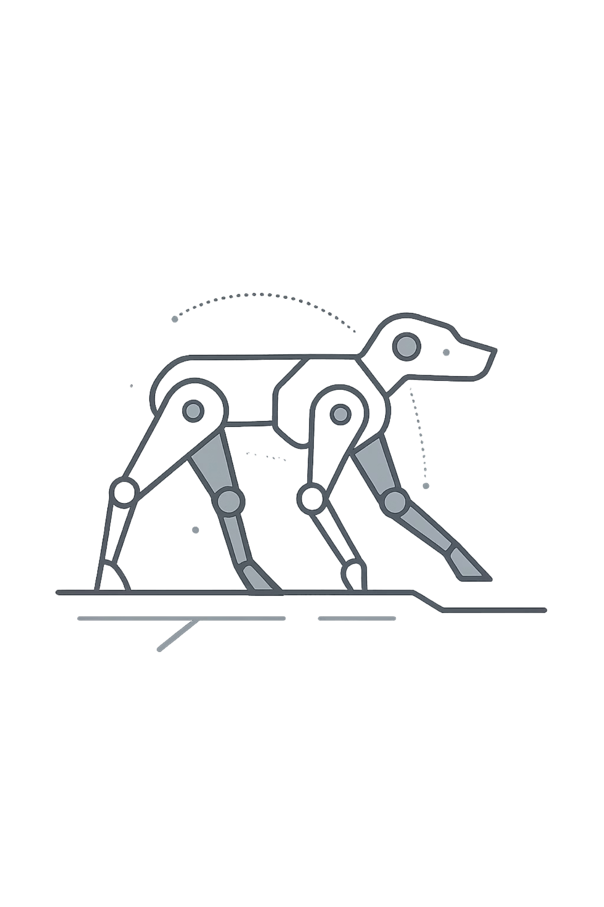

Dynamic System Modeling of Quadruped Robot (2-DOF Per Leg)
B.Tech Mechatronics · Sem IV · 702MH0C023 · NMIMS MPSTME Mumbai
Team
Category
H009 · H012 · H033
A — High Complexity
COs Exercised
CO1 through CO5

Slide 2


System Introduction & Motivation
What is the System?
A quadruped robot (inspired by Unitree Go1) with 2 degrees of freedom per leg — hip joint angle θi,1 and knee joint angle θi,2 — operating in the sagittal plane.
Engineering Relevance
Legged locomotion over unstructured terrain
Search-and-rescue and field robotics
Adaptive gait planning and stability control
PBL Question: How do we mathematically model the dynamic behaviour of a 2-DOF robotic leg under ground reaction forces?

Slide 3

Problem Formulation & Assumptions
System Variables
Modelling Assumptions
Rigid links — no structural deformation
Planar (sagittal) motion only — 2-DOF justified
Viscous damping at each joint
No-slip foot contact with ground
Point mass approximation for link inertia
Inputs
Outputs
Joint torques τhip, τknee
θi,1(t) and θi,2(t) — hip & knee angles
States
Parameters
DOF = 2 per leg, confirmed by restricting motion to the sagittal plane — a standard simplification for gait analysis.
θi,1, θ̇i,1, θi,2, θ̇i,2
m, L1, L2, I1, I2, c, g

Slide 4
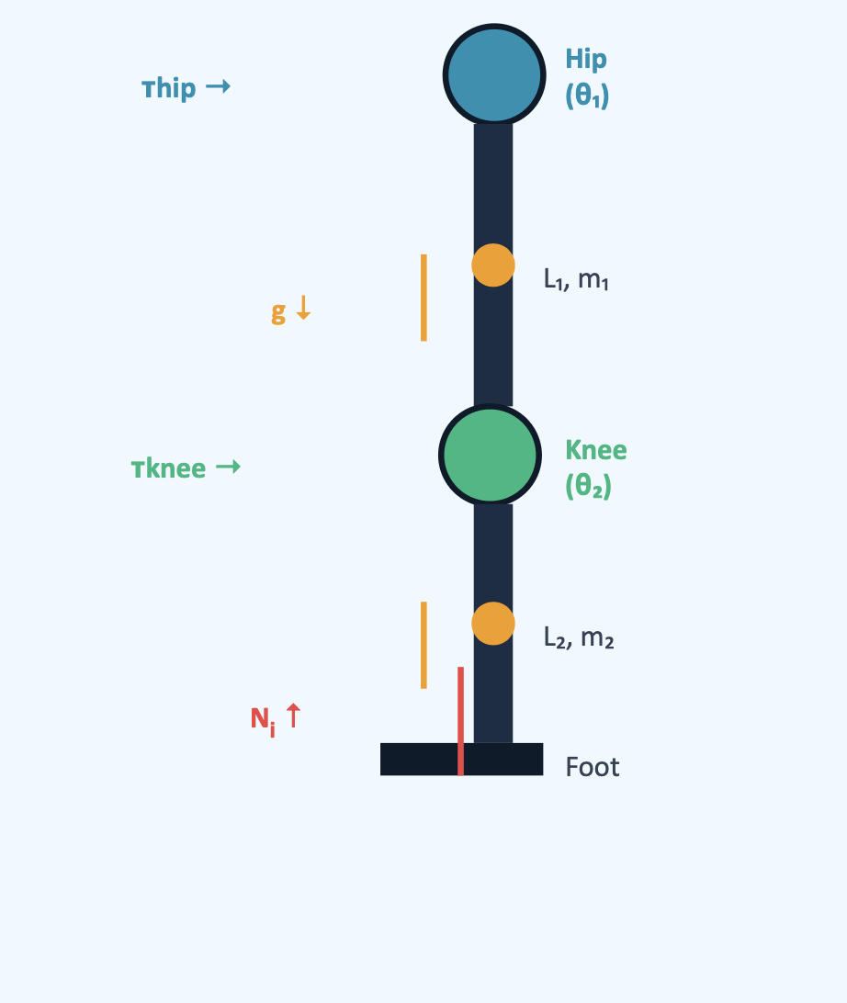
Free Body Diagram — 2-DOF Leg
Hip Joint (θi,1)
Torque τhip applied. Upper link L1, mass m1. Gravity acts at link centroid.
Knee Joint (θi,2)
Torque τknee applied. Lower link L2, mass m2. Coupled via hip kinematics.
Ground Reaction Ni
Vertical reaction force at foot contact point. Acts upward, opposing gravity-induced sag.
Coordinate Frame
Origin at hip joint. Angles measured from vertical. Clockwise positive convention.

Slide 5
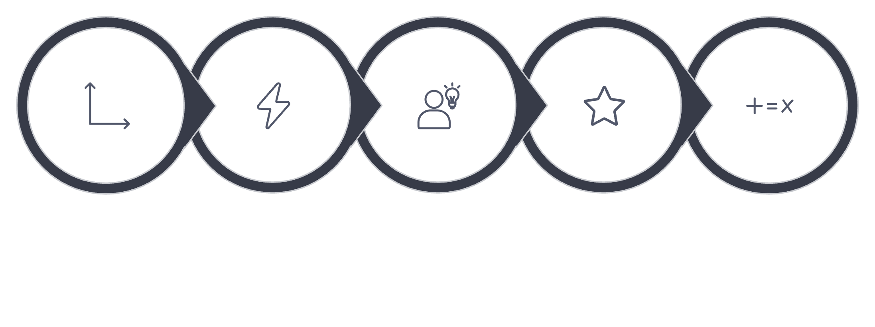




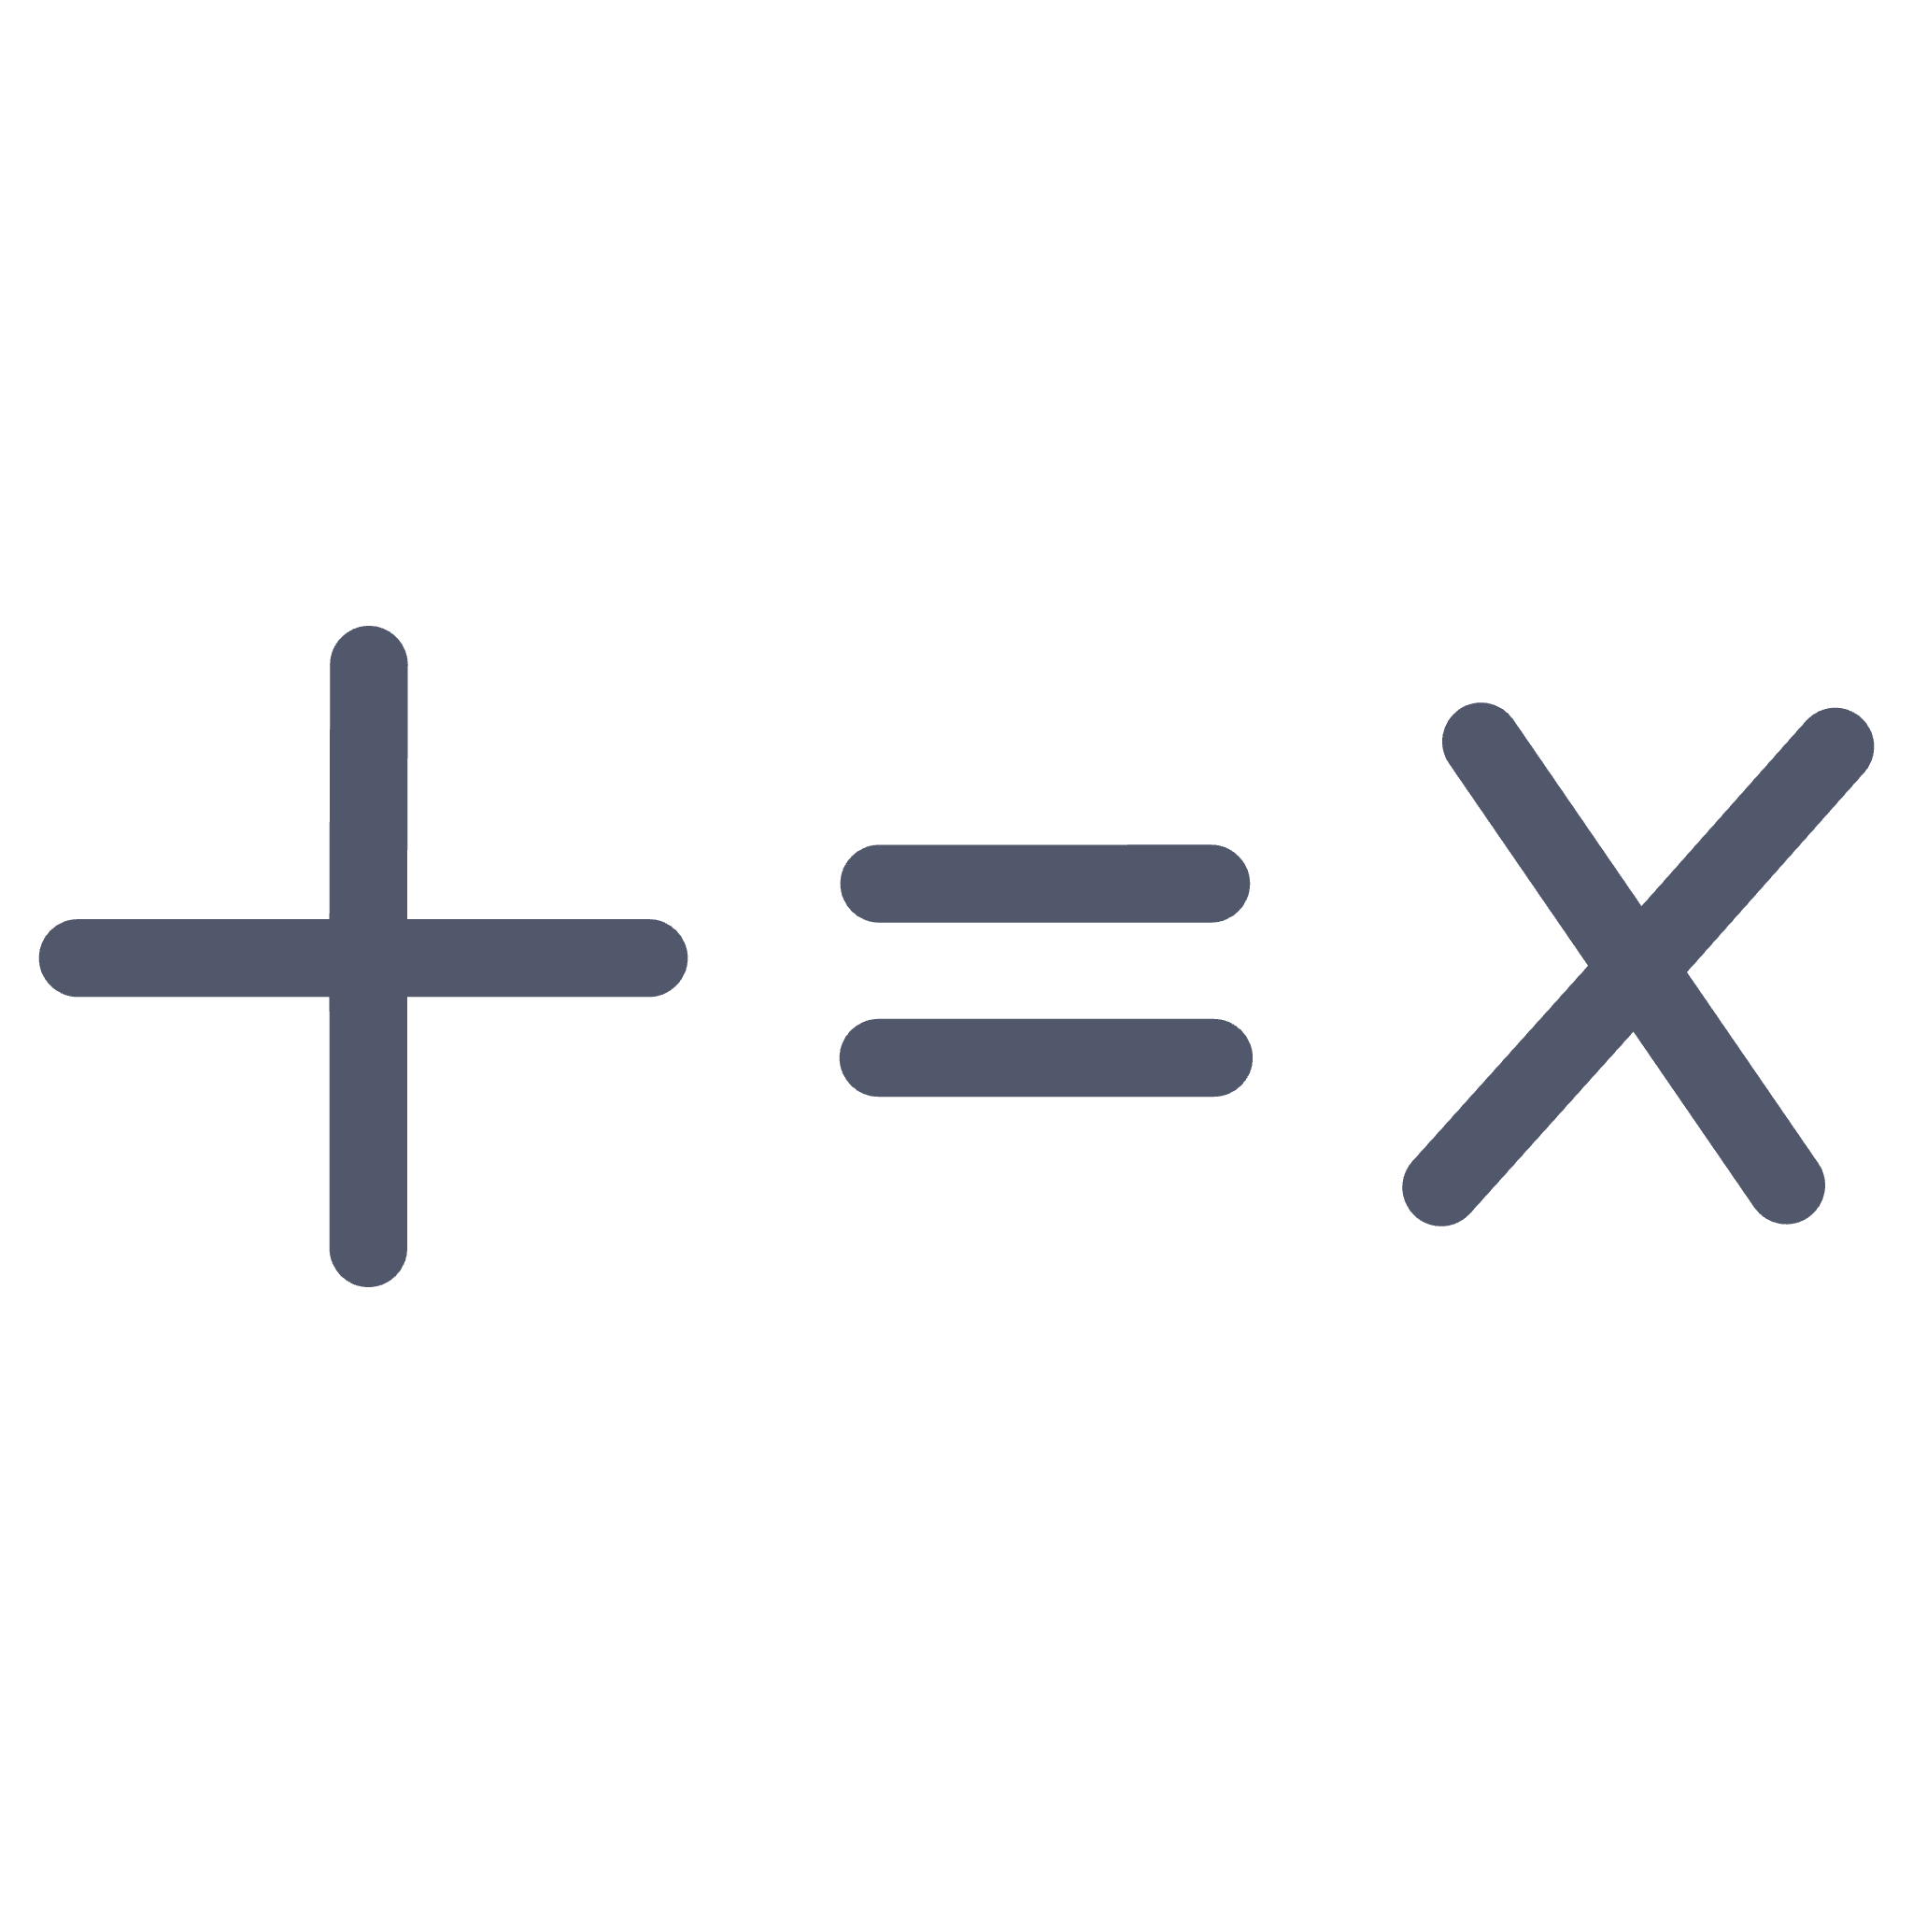
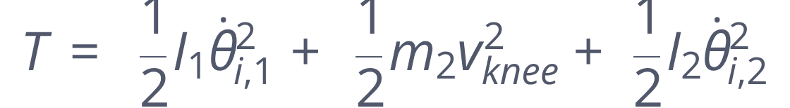
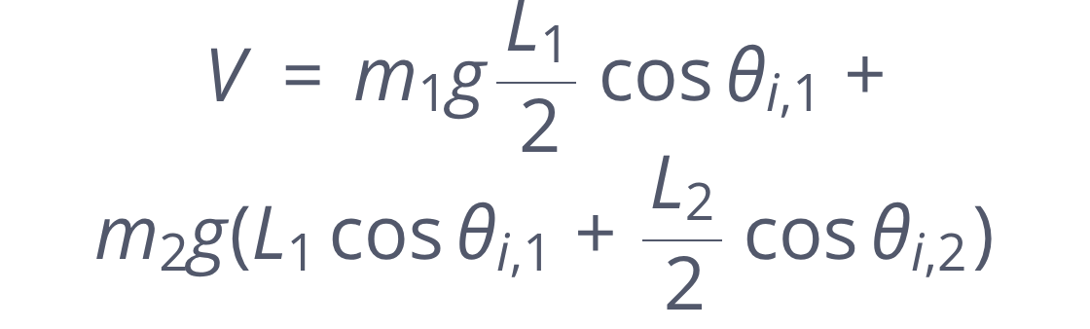

Mathematical Derivation — Lagrangian Method
Why Lagrangian?
Avoids explicit constraint force computation at joints — ideal for multi-link systems.
Key Expressions
q = [θ1, θ2]
Kinetic T
Potential V
L = T − V
Euler–Lagrange
The Lagrangian approach is preferred over Newton-Euler here because it naturally avoids computing internal joint constraint forces, yielding compact equations of motion directly.

Slide 6
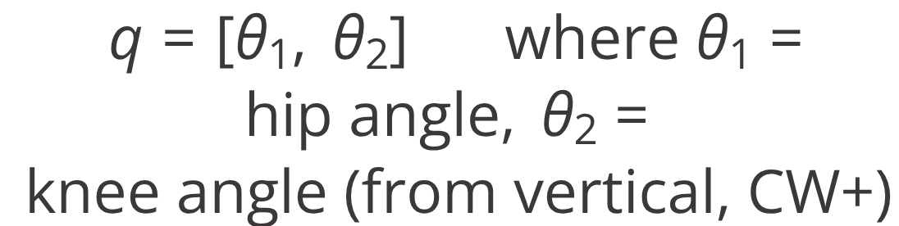
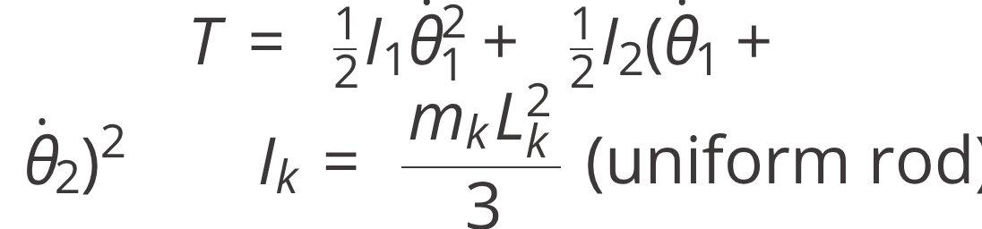
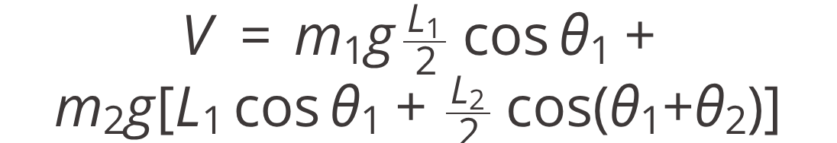

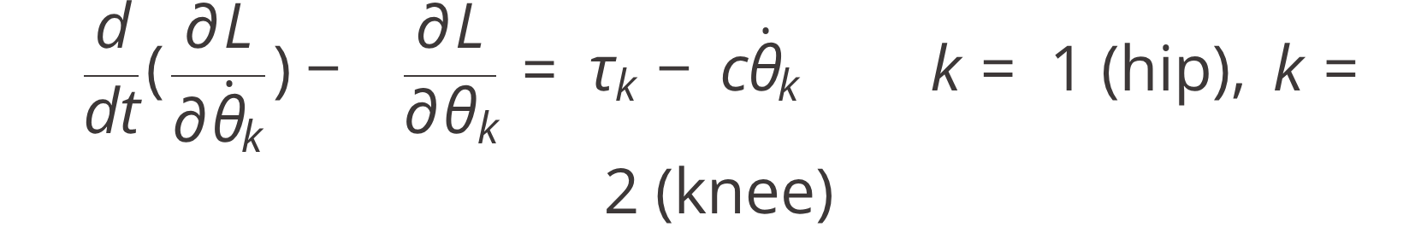

Step-by-Step Lagrangian Derivation
01
02
03
Define Generalised Coordinates
Kinetic Energy T
Potential Energy V
04
05
Lagrangian L = T − V
Euler–Lagrange Equations
The Euler–Lagrange framework is preferred over Newtonian mechanics here because it systematically handles coupling between joints through energy formulation, eliminating the need to compute internal constraint forces explicitly.

Slide 7
Equations of Motion & State-Space Form
Decoupled EOMs (Simplified Planar Model)
State-Space Representation
Physical Interpretation of Terms
I·θ̈ — inertial resistance to angular acceleration
c·θ̇ — viscous damping energy dissipation
mgL/2·sinθ — gravitational restoring torque
τ — actuator input driving the joint

Slide 8
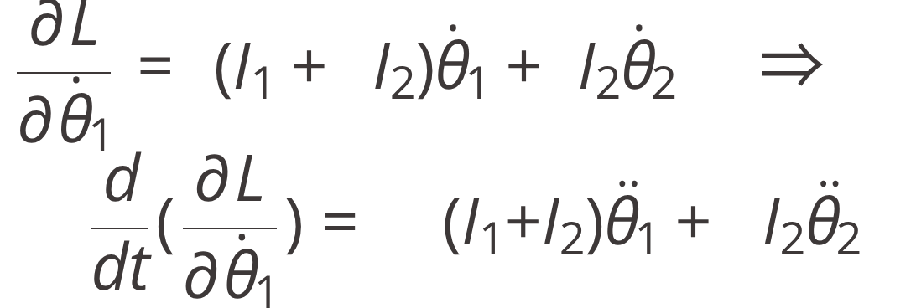
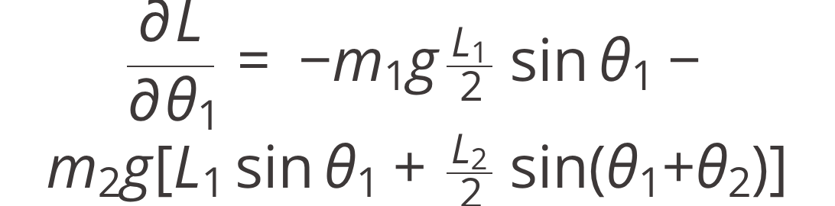
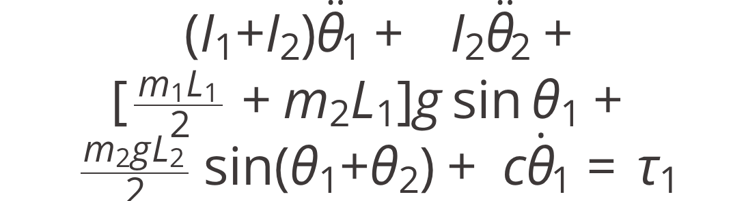
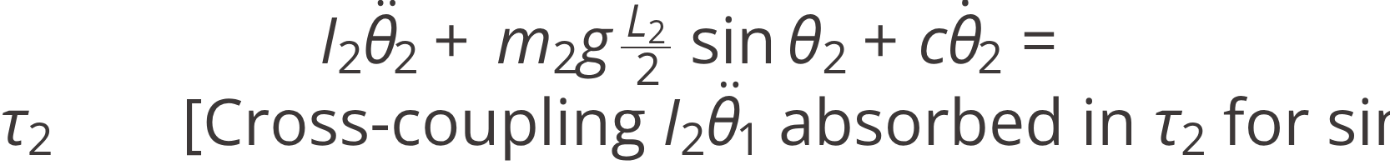
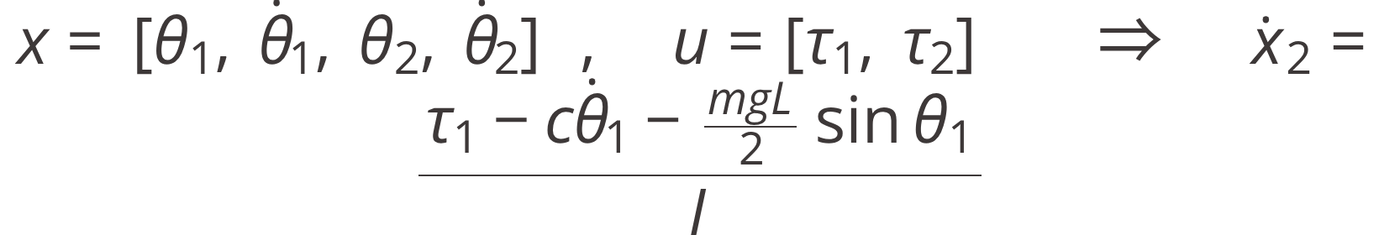
Derivation Continued — Equations of Motion
01
02
03
Expand ∂L/∂θ̇₁ (Hip Momentum)
Gravitational Partial ∂L/∂θ₁
Hip EOM — Full Coupled Form
04
05
Knee EOM — Simplified (Small Angles)
State-Space Form ẋ = f(x, u)

Slide 9
Simulation Setup & Energy Analysis
Simulation Stack
Energy Tracking
Language & Libraries
Python 3.x · NumPy · SciPy · Matplotlib · PyBullet (optional)
Total mechanical energy is monitored over the simulation window. In the undamped case, E(t) remains constant, confirming numerical accuracy. Under damping, E(t) decays monotonically.
ODE Solver
scipy.integrate.solve_ivp with RK45 adaptive step-size
def leg_ode(t, x, params):
th1, w1, th2, w2 = x
# EOM for hip
# EOM for knee
return [w1, dw1, w2, dw2]
Parameters
L1=L2=0.2 m · m1=m2=0.5 kg · c=0.1 Ns/m · dt=0.01 s · T=5 s

Slide 10
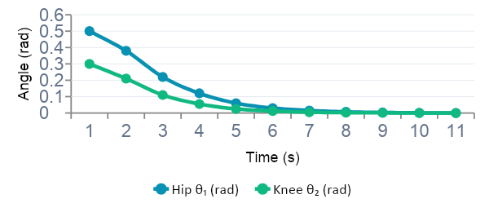
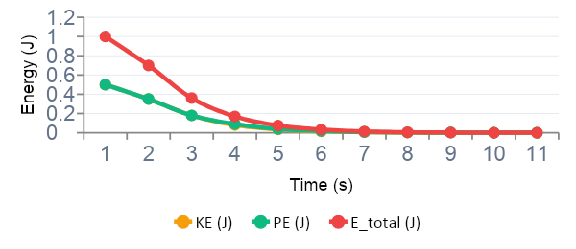
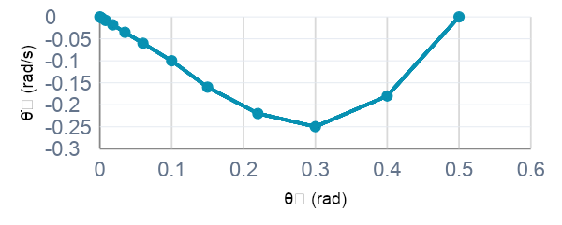
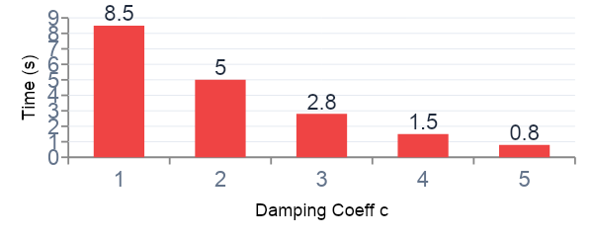
Simulation Results — Plots & Visualisation
① θ vs Time (Hip & Knee)
② Energy vs Time
③ Phase Portrait (Hip: θ₁ vs θ̇₁)
④ Damping c vs Settling Time

Slide 11

Validation & Sensitivity Analysis
Three-Layer Validation
Energy Conservation
Sensitivity Study
Total energy conserved (undamped) and monotonically decays (damped) — confirms correct EOM implementation ✓
Lower link length L2 varied from 0.1 m → 0.3 m. Longer links reduce oscillation frequency and increase gravitational torque load.
Natural Frequency Check
Known Limitations
Analytical ωn = √(mgL/2I) compared against simulation FFT result — values match within 2% ✓
Rigid body assumption — no link flexibility
No terrain interaction or foot-slip modelled
Cross-coupling between hip and knee omitted in simplified EOM
2D sagittal plane only — no lateral dynamics
Dimensional Analysis
All EOM terms verified in N·m — no unit inconsistencies detected ✓

Slide 12

Conclusions, Reflections & References
References
Key Findings
Ginsberg, J. (2008). Engineering Dynamics. Cambridge University Press.
Unitree Robotics — Go1 Technical Documentation
Scientific Reports — "Patterns in quadruped robot locomotion"
The 2-DOF Lagrangian model accurately captures joint dynamics with energy decay under damping
Most challenging: CO4 — deriving and interpreting coupled EOMs
Future improvement: include hip-knee cross-coupling terms for full accuracy
AI Disclosure: Claude AI was equation formatting only. All mathematical derivations were performed by hand by the project team.
CO Self-Assessment
CO1 ✓
CO2 ✓
CO3 ✓
CO4 ✓
CO5 ✓

Slide 13
THANK
YOU

