Slide 1
Determination of Skidding Speed of a Model Car on a Curved Path
Team: Roshan Jahan (25), Parth Dorugade(15), Raj Desai(14), Nirek Doshi(16)
Course: Dynamic System Modeling (702MH0C023)
B.Tech Mechatronics, Sem IV | NMIMS MPSTME Mumbai
Category: [A/B/C/D/E] | Complexity: [Medium/High/Very High]
COs Exercised: [CO1, CO2, CO3, CO4, CO5] | Date: [DD/MM/YYYY]

Slide 2
1. System Introduction & Motivation
This project studies vehicle skidding on curved roads using a model car.
Skidding occurs when friction is not enough to provide required centripetal force.
Important for:
  Road safety
  Accident prevention
  Designing safe speed limits
Problem Statement:
At what speed does a car start skidding on a curved path?
Notes:
TIMING: 0:00-1:00 (1 min)
FOCUS: Introduce your system and its real-world engineering relevance.
TIP: Start with a compelling application, not a textbook definition.
SHOW: An image or short video of the actual system.

Slide 3
2. Problem Formulation & Assumptions
Inputs: Speed (v), Radius (r), Friction (μ)
Outputs: Skidding condition / Safe speed
State Variables: Velocity (v), Position
Parameters:
Mass (m)
Radius (r)
Coefficient of friction (μ)
Gravity (g)
Assumptions:
Motion is circular
Surface is uniform
Air resistance is negligible
Friction is constant
Notes:
TIMING: 1:00-2:30 (1.5 min)
FOCUS: Clearly define I/O, states, parameters, DOF, and justify every assumption.
TIP: Explain WHY each assumption is physically valid.
BE PREPARED: You may be asked 'Why this assumption? What if it changes?'

Slide 4
3. Free Body Diagram / System Schematic
Forces acting on car:
Frictional force (towards center)
Weight (mg) downward
Normal reaction upward
Friction provides centripetal force

Slide 5

4. Mathematical Derivation (Part 1)
Centripetal Force:
$F_{c}=\frac{mv^{2}}{r}$
Frictional Force:
$F_{f}=μmg$
At skidding point:
$\frac{mv^{2}}{r}=μmg$
Notes:
TIMING: 2:30-3:45 (1.25 min)
FOCUS: Walk through EVERY step of the derivation. This is the most important section.
TIP: Show the algebra — don't skip to the final equation.
BE PREPARED: You may be asked to explain any step in detail.

Slide 6
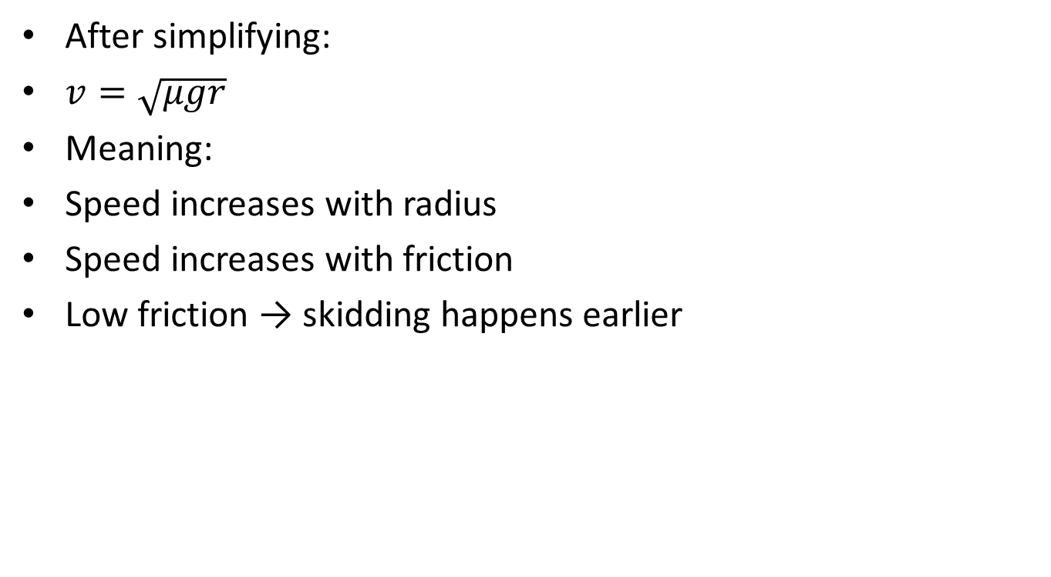
5. Final Equations & State-Space
After simplifying:
$v=\sqrt{μgr}$
Meaning:
Speed increases with radius
Speed increases with friction
Low friction → skidding happens earlier
Notes:
TIMING: 3:45-5:00 (1.25 min)
FOCUS: Present final EOM and state-space. Explain the physical meaning of EVERY term.
TIP: 'c*x_dot = viscous damping force' is stronger than just showing the equation.

Slide 7
6. Simulation & Energy Analysis
Tools: Python 3.x + NumPy + SciPy + Matplotlib [+ PyBullet]
ODE Solver: scipy.integrate.solve_ivp (RK45/BDF)
Parameters: dt=..., T_total=..., ICs=[...]
[INSERT: Key code snippet — ODE function]
[INSERT: Time response plot (states vs time)]
[INSERT: Energy vs time plot — CO5 validation]
Energy Check (CO5):
Total energy E(t) = T(t) + V(t) = [conserved / decays due to damping]
Power dissipated P = c*(dx/dt)^2 = [value] W
Notes:
TIMING: 5:00-7:00 (2 min)
FOCUS: Show your simulation setup, key code snippet, and output plots.
INCLUDE: Energy vs time plot — this validates your model physically.
BE PREPARED: You may be asked 'Why does the oscillation decay?' or 'How does energy change?'

Slide 8
7. Simulation Visualization
[INSERT simulation output plots]
REQUIRED (minimum):
- Time response: all states vs time (labels, units, legend)
- Energy vs time: T(t), V(t), E(t) on same plot (CO5 validation)
- Parameter variation: effect of changing key parameter
[OPTIONAL but valuable]:
- Phase portrait: velocity vs position
- PyBullet 3D animation screenshot
- Power dissipation vs time (CO5)
- Bode/frequency response (Cat E projects)

Slide 9
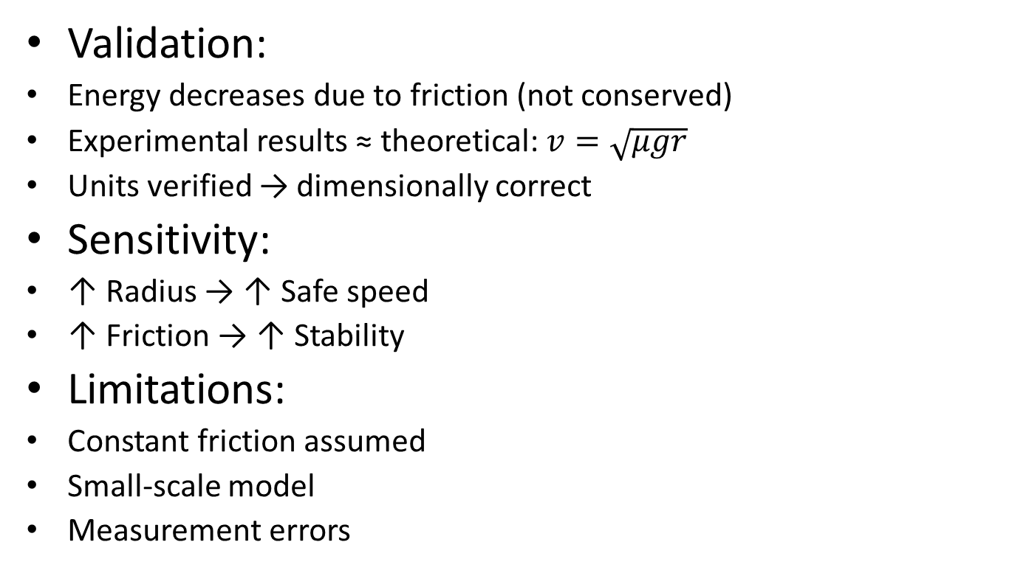
8. Validation & Analysis
Validation:
Energy decreases due to friction (not conserved)
Experimental results ≈ theoretical: $v=\sqrt{μgr}$
Units verified → dimensionally correct
Sensitivity:
↑ Radius → ↑ Safe speed
↑ Friction → ↑ Stability
Limitations:
Constant friction assumed
Small-scale model
Measurement errors
Notes:
TIMING: 7:00-8:30 (1.5 min)
FOCUS: Show HOW you verified your results. Energy check, textbook comparison, sensitivity.
TIP: A strong answer = 'We compared natural frequency with Ginsberg Ch.3.'
A weak answer = 'It runs and produces output.'

Slide 10
9. Conclusions & Reflections
Conclusion:
Skidding depends on speed, friction, and radius
Higher friction → safer motion
Lower friction → higher risk
Applications:
Road design
Speed limit planning
Tire manufacturing
Accident prevention
Notes:
TIMING: 8:30-10:00 (1.5 min)
FOCUS: Be specific about what you learned and what was hardest.
TIP: 'Getting the sign convention right in the Lagrangian took 3 iterations' is much stronger than 'teamwork was hard.'
INCLUDE: CO self-assessment — which COs did you exercise most?

Slide 11
10. References & AI Disclosure
Slide 11: References & AI Disclosure
References:
NCERT Physics
Circular motion resources
Internet sources
AI Usage(Claude, GPT):
Used for formatting & explanation
Not used for derivations
Notes:
AI disclosure is MANDATORY but NOT penalized.
Be honest about what tools you used and for what purpose.
Good: 'Used ChatGPT for Python syntax debugging, derivation done by hand.'
Non-disclosure IS penalized if uncovered during Q&A.

Slide 12
Thank You — Questions?
Team: [Name 1], [Name 2], [Name 3], [Name 4]
Project: [Project Title]
Category: [A/B/C/D/E]
COs: [CO1-CO5]
[ALL members prepared for Q&A — evaluators may direct to specific members]

