Slide 1
Dynamic Analysis of
a 12-DOF Humanoid Biped Robot Using Euler-Lagrange Mechanics
Project Snapshot
• Robot model: 12 actuated joints
• Per leg: hip yaw, hip roll, hip pitch, knee pitch, ankle pitch, ankle roll
• Total mass from URDF: 5.956 kg
• Simulation step: 1/240 s
• Modeling basis: Euler-Lagrange, not Newtonian force balance
By:
Daaris Ahmed H003
Hushan Bhimani H006
Aryan Hiware H024
Jerome Jose H029
Notes:
Cover slide for the biped project presentation.
[Sources]
- Reference presentation format: DSM_H035,40,46,47_MINIPROJECT.pptx
- Local project repository: Biped-Pybullet-main
- Local generated reports: Biped_System_Identification_Report.docx, Biped_Validation_Analysis_Report.docx, Biped_Euler_Lagrange_Model_Report.docx

Slide 2
SECTION 01
02 / 13
1. System Introduction & Motivation
The project studies the lower-body dynamics of a simulated humanoid biped and focuses on analysis-ready outputs rather than animation alone.
System
Motivation
Outcome
A PyBullet humanoid lower body is modeled from URDF link masses, inertias, and joint limits. Each leg carries six actuated joints, while the analysis groups behavior into Hip, Knee, and Ankle levels.
Dynamic systems analysis needs measurable signals such as GRF, joint stress proxies, angles, torques, and energies. The project turns the simulator into a repeatable validation environment for those signals.
Instead of only watching the robot move, we collect and save plots for walk, squat, jump without twist, and jump with twist. Those plots are then used to validate trends against the Euler-Lagrange model.
Notes:
Introduce the problem as a dynamic systems analysis task built on top of the simulator.
[Sources]
- Local project repository: Biped-Pybullet-main
- biped.urdf and mesh/inertial data from the local project workspace
- PyBullet simulation outputs in Simulation_analysis/*.csv and *.png

Slide 3
SECTION 02
03 / 13
2. Problem Formulation & Assumptions
The model combines a detailed URDF robot with grouped validation channels so that the simulation remains interpretable at the report level.
Formulation
12
5.96 kg
240 Hz
• Generalized coordinates are taken from the biped joint coordinates, with one leg often represented by q = [q1 ... q6]^T for derivation.
• Dynamic behavior is analyzed through total ground reaction force, joint stress proxy, joint angle, joint torque, kinetic energy, potential energy, and total energy.
• Validation plots are saved after simulation closure so every action produces a stable analysis folder output.
Actuated joints
Total robot mass
Simulation rate
6 per leg
from URDF inertial data
dt = 1/240 s
Assumptions
• Euler-Lagrange mechanics are used for derivation; Newtonian joint-force balance is not the primary framework.
• Hip, Knee, and Ankle are grouped for validation plots, even though the full simulation has more detailed joint coordinates.
• Stress is represented by a PyBullet reaction-force magnitude proxy because material stress data are not available in the URDF.
Notes:
Clarify how the project balances a detailed robot model with grouped validation signals.
[Sources]
- Local project repository: Biped-Pybullet-main
- biped.urdf and mesh/inertial data from the local project workspace
- PyBullet simulation outputs in Simulation_analysis/*.csv and *.png
- Local generated reports: Biped_System_Identification_Report.docx, Biped_Validation_Analysis_Report.docx, Biped_Euler_Lagrange_Model_Report.docx

Slide 4
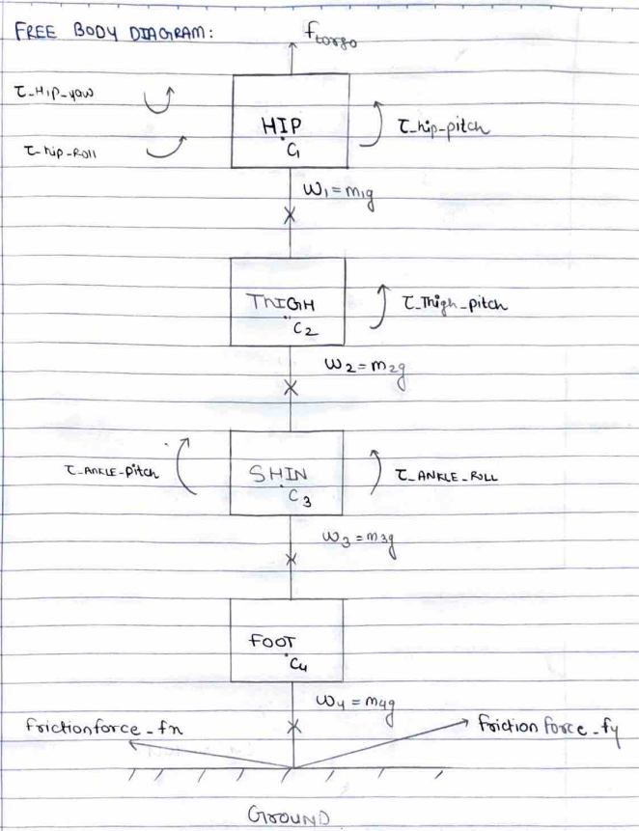
SECTION 03
04 / 13
3. Free Body Diagram / System Schematic
The project uses a Lagrangian-style free body diagram to define generalized coordinates, grouped masses, and external contact effects.
Generalized Coordinates
• q1: hip yaw
• q2: hip roll
• q3: hip pitch
• q4: knee pitch
• q5: ankle pitch
• q6: ankle roll
Physical Meaning
• Weight acts at each link center of mass.
• Ground reaction force acts at the foot-ground contact.
• Generalized torques are associated with the actuated coordinates.
• The validation stage later collapses detailed joint channels into Hip, Knee, and Ankle groups.
• The same FBD also anchors the grouped energy interpretation used in the analysis reports.
Notes:
Show the free body diagram and connect it to the generalized coordinates used in the derivation.
[Sources]
- Local generated reports: Biped_System_Identification_Report.docx, Biped_Validation_Analysis_Report.docx, Biped_Euler_Lagrange_Model_Report.docx
- Local project repository: Biped-Pybullet-main

Slide 5
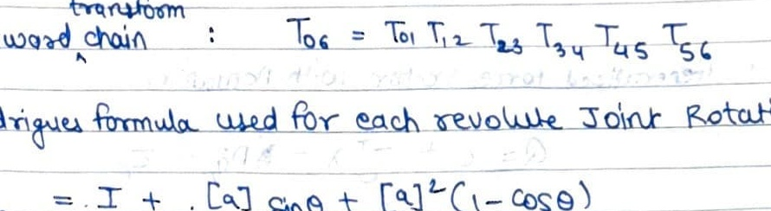
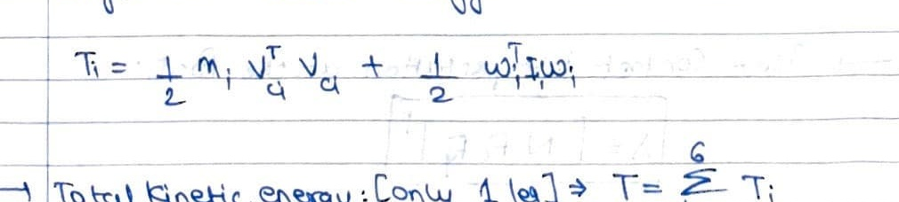
SECTION 04
05 / 13
4. Mathematical Derivation (Euler-Lagrange)
The main derivation slides use equation snapshots taken from the project EOM document instead of typed equation blocks.
How It Maps to the Project
• The handwritten derivation follows the same 6-coordinate leg description used in the simulator.
• URDF masses, centers of mass, and inertias provide the physical data used in the energy terms.
• These expressions support the grouped energy plots used later in validation.
Interpretation
• Forward kinematics links the joint coordinates to the foot pose and link-center positions.
• Energy terms define the Lagrangian and motivate the later manipulator equation.
• The derivation is presented in Euler-Lagrange form throughout this project.
Notes:
State clearly that the project uses Euler-Lagrange mechanics and connect the energies to the simulator parameters.
[Sources]
- biped.urdf and mesh/inertial data from the local project workspace
- Local generated reports: Biped_System_Identification_Report.docx, Biped_Validation_Analysis_Report.docx, Biped_Euler_Lagrange_Model_Report.docx
- Local project repository: Biped-Pybullet-main

Slide 6
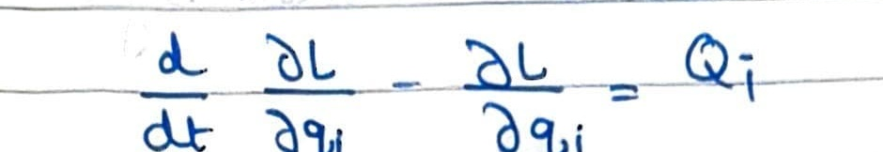
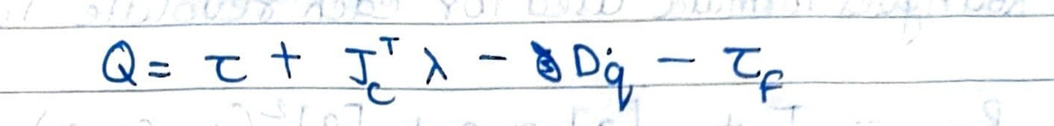
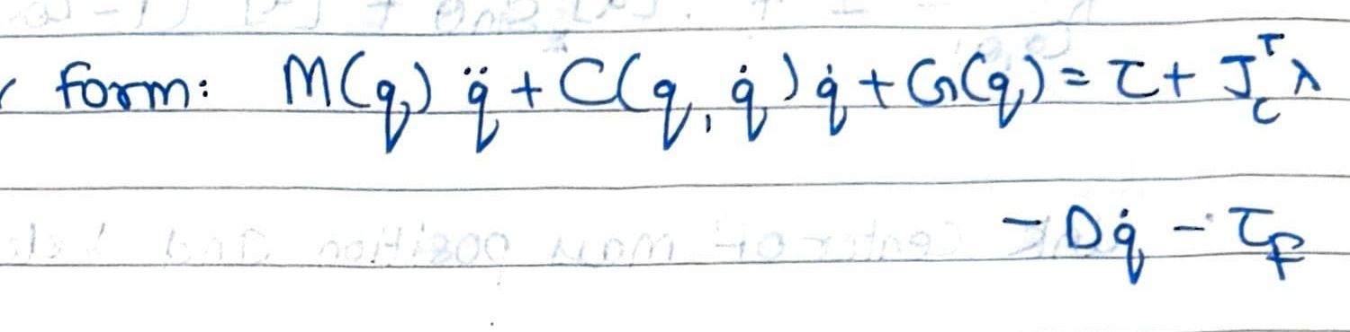
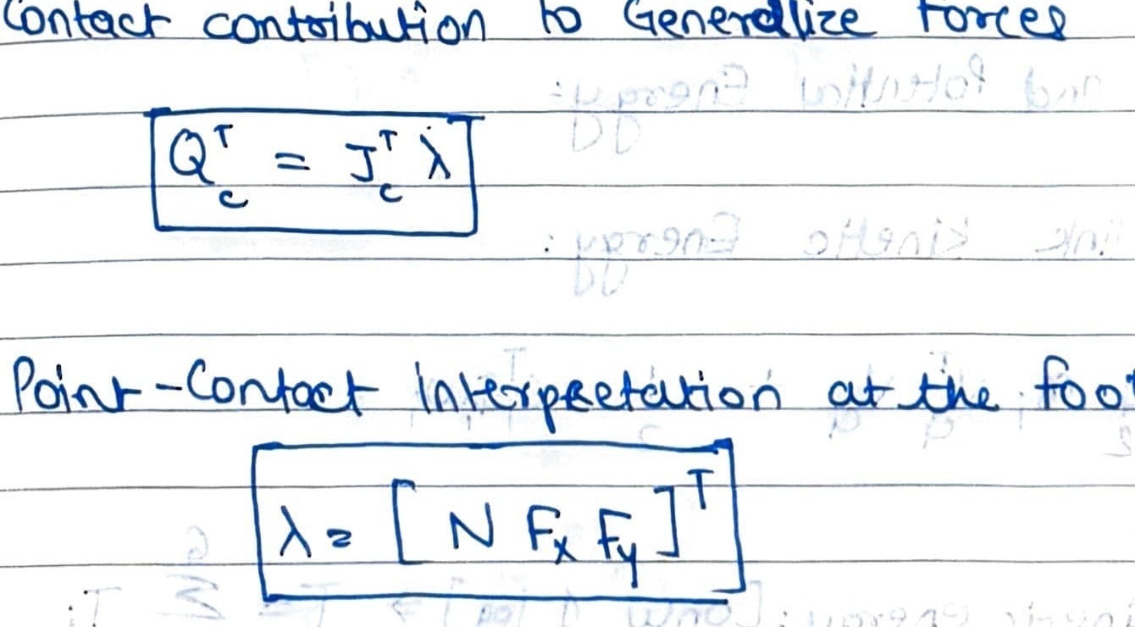
SECTION 05
06 / 13
5. Final Equations & State-Space
The final motion equations are shown using cropped equation photos from the submitted EOM PDF.
Physical Meaning
• The first relation gives the coordinate-wise Euler-Lagrange form.
• The generalized-force expression adds actuator, damping, friction, and contact terms.
• The manipulator form summarizes the full multibody dynamics compactly.
General Euler-Lagrange equation from the EOM sheet.
Contact and Constraints
Generalized force relation with actuator and contact contribution.
• Ground contact enters the equations through the Jacobian-transpose force mapping.
• This matches the ground-reaction interpretation used in the simulation analysis.
• The same framework is compatible with walk, squat, and jump cases.
Manipulator-form dynamics relation from the EOM sheet.
n = 12 DOF
4 validation actions
Contact-force mapping from the EOM sheet.
Notes:
Present the manipulator equation and first-order state-space form used to explain the dynamics.
[Sources]
- Local generated reports: Biped_System_Identification_Report.docx, Biped_Validation_Analysis_Report.docx, Biped_Euler_Lagrange_Model_Report.docx
- Local project repository: Biped-Pybullet-main
- PyBullet simulation outputs in Simulation_analysis/*.csv and *.png

Slide 7
SECTION 06
07 / 13
6. Simulation & Energy Analysis
The analysis pipeline records grouped Hip, Knee, and Ankle energies together with total GRF and grouped joint signals for every action.
2420.1 N
2.89 J
0.59 J
0.47 J
Peak total GRF in walk
Peak hip total energy
Peak knee total energy
Peak ankle total energy
from saved analysis CSV
grouped Hip channel
grouped Knee channel
grouped Ankle channel
Recorded Plot Families
Interpretation
• Total ground reaction force versus time
• Grouped stress proxy for Hip, Knee, and Ankle
• Grouped angle for Hip, Knee, and Ankle
• Grouped torque for Hip, Knee, and Ankle
• Grouped kinetic, potential, and total energy
• Hip energy dominates because the upper links carry more mass and larger coordinated motion.
• Knee and ankle energy channels remain smaller but still show clear event-driven changes.
• The energy view complements GRF and torque plots, which is why the Euler-Lagrange framing is useful.
Notes:
Summarize what signals are collected and show walk-based energy metrics as the main example.
[Sources]
- PyBullet simulation outputs in Simulation_analysis/*.csv and *.png
- Local generated reports: Biped_System_Identification_Report.docx, Biped_Validation_Analysis_Report.docx, Biped_Euler_Lagrange_Model_Report.docx

Slide 8
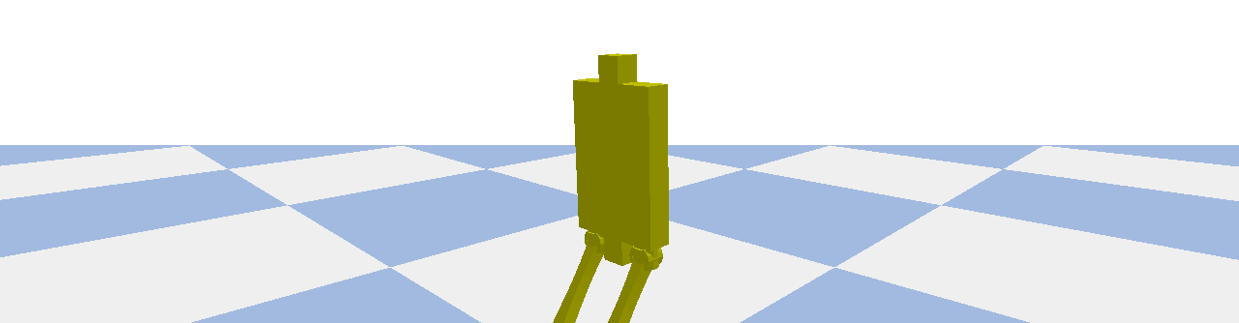
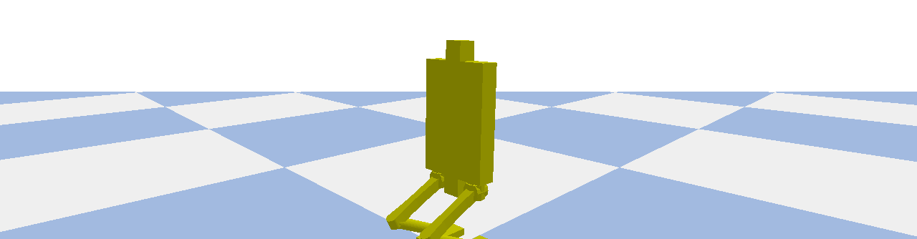
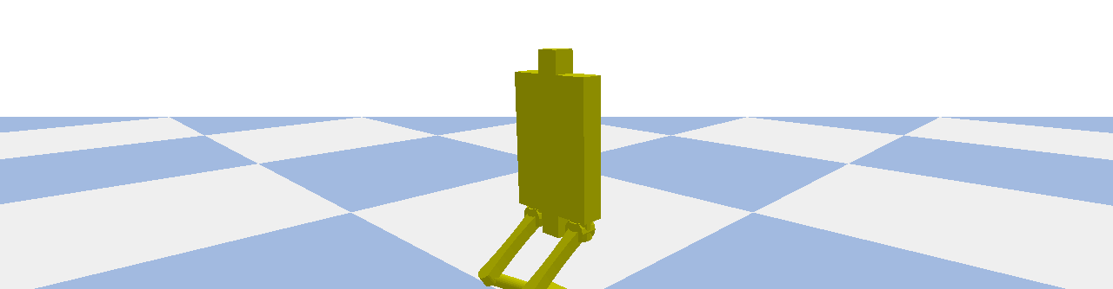
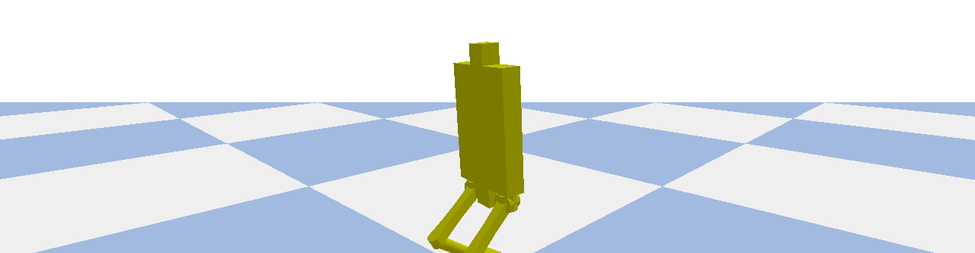
SECTION 07
08 / 13
7. Simulation Scenario Photos
This slide shows actual PyBullet scene captures for walk, squat, jump without twist, and jump with twist.
Walk scenario
Squat scenario
Jump without twist scenario
Jump with twist scenario
Notes:
Scenario comparison slide built from actual PyBullet scene screenshots for walk, squat, jump without twist, and jump with twist.
[Sources]
- PyBullet simulation outputs in Simulation_analysis/*.csv and *.png
- Local project repository: Biped-Pybullet-main

Slide 9
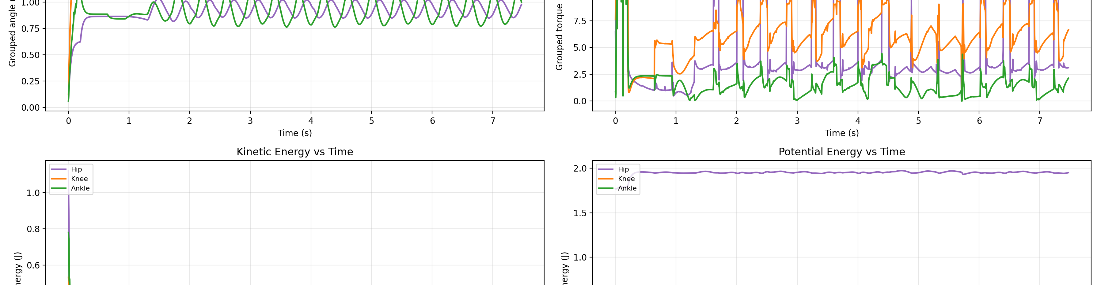
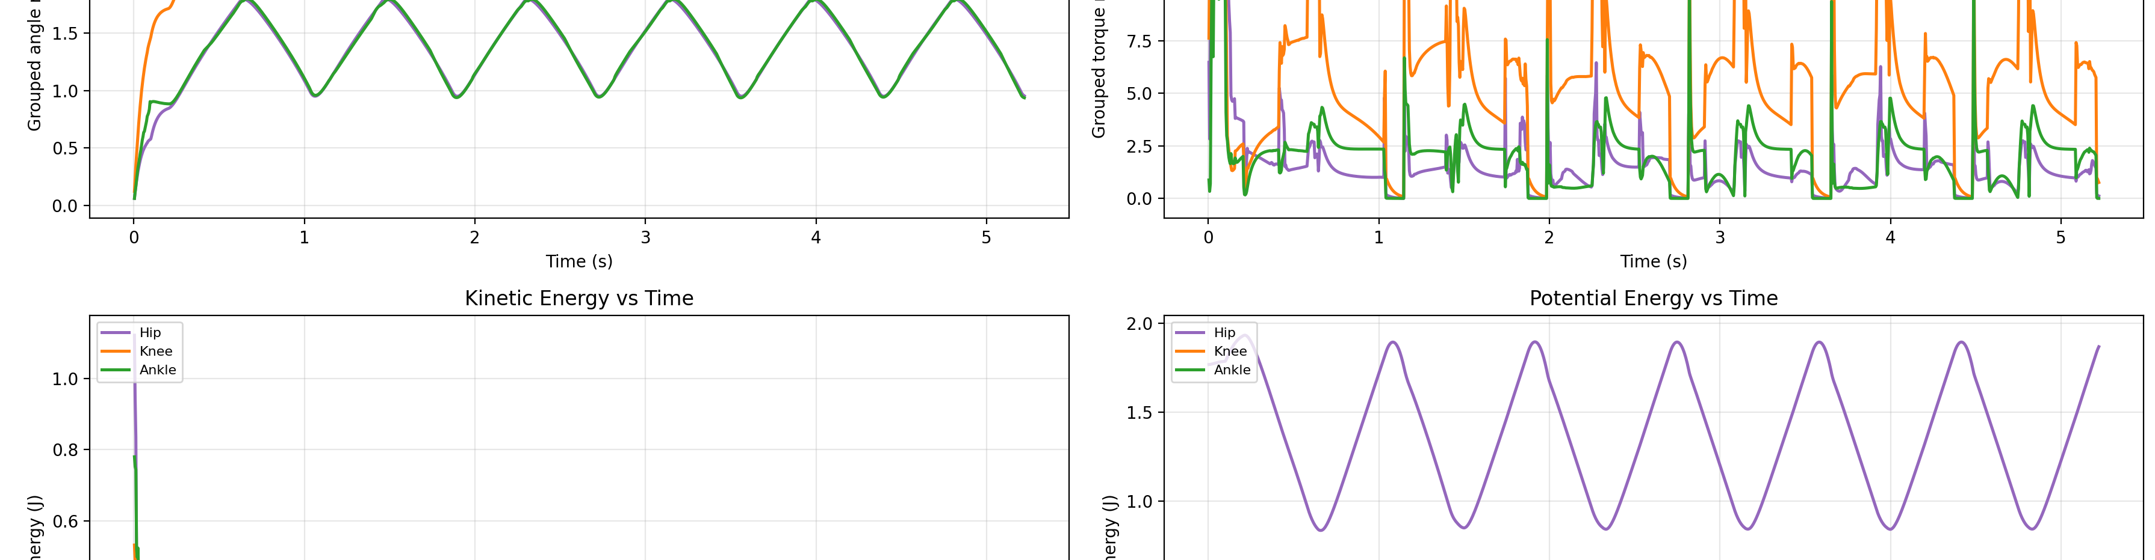
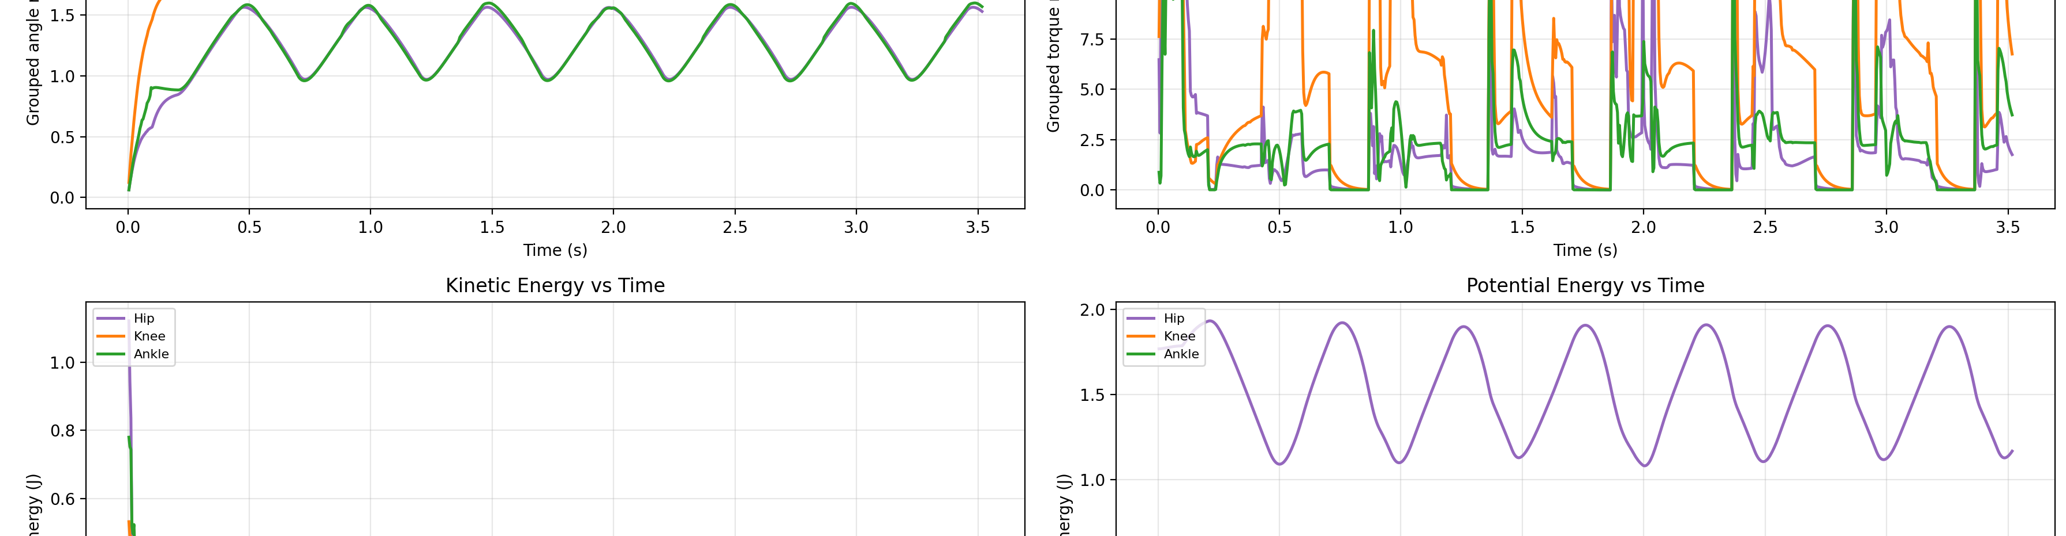
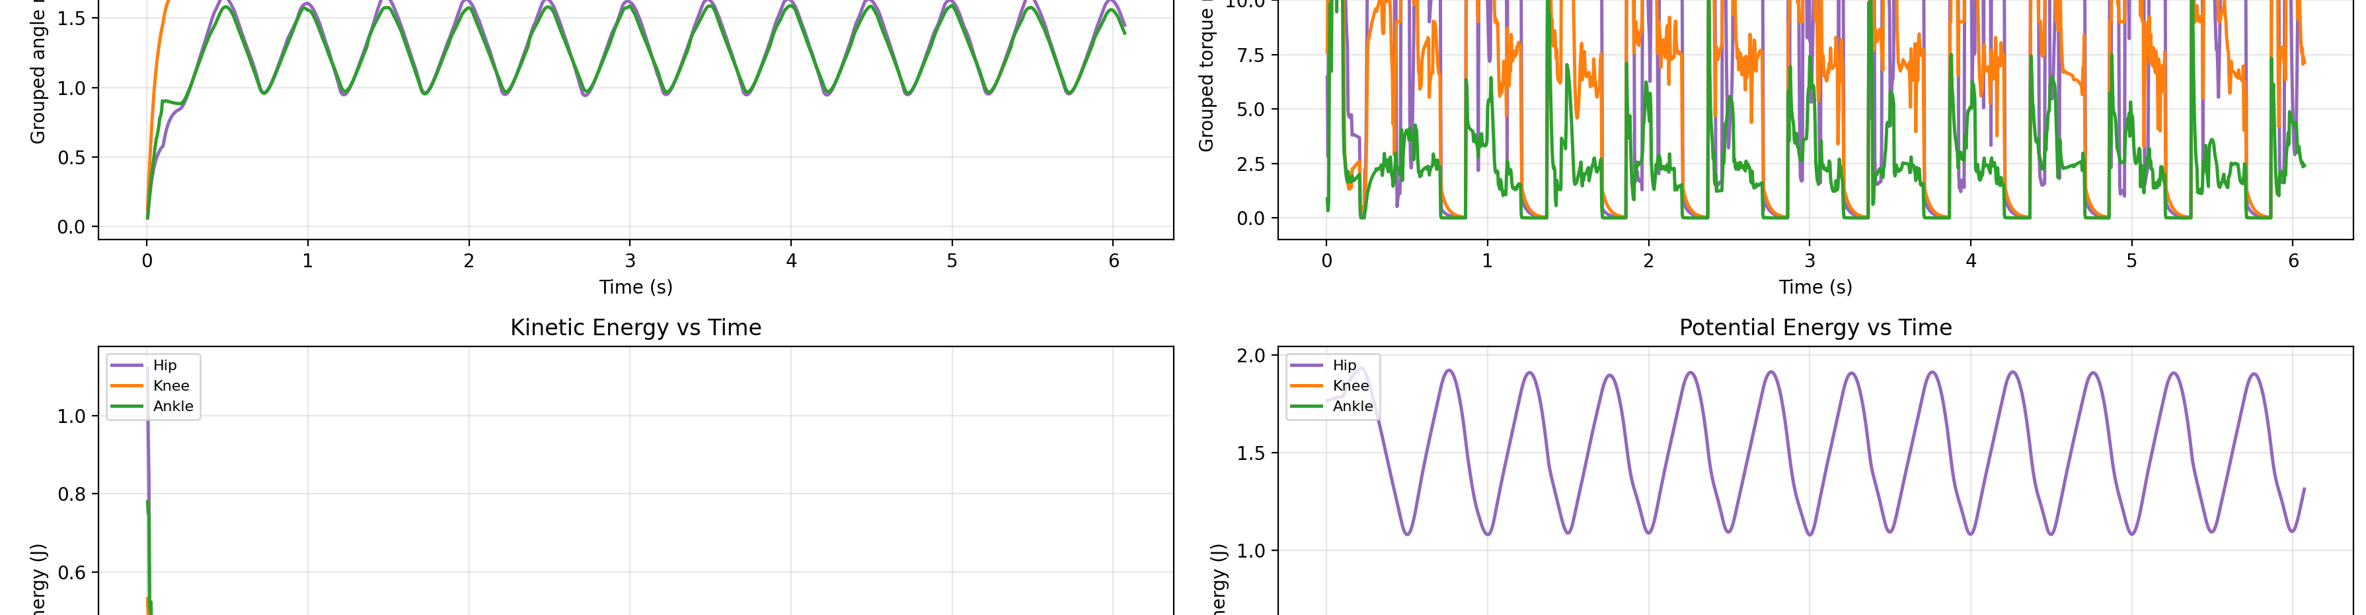
SECTION 08
09 / 13
8. Simulation Visualization
Saved dashboards make it easy to compare action signatures after closing the simulation window.
Walk dashboard
Squat dashboard
Jump without twist dashboard
Jump with twist dashboard
Notes:
Show the saved dashboard views for the four action classes.
[Sources]
- PyBullet simulation outputs in Simulation_analysis/*.csv and *.png

Slide 10
SECTION 09
10 / 13
9. Validation & Analysis
The saved plots are used to compare action duration, force peaks, and grouped energy behavior across motions.
7.47 s
5.22 s
3.52 s
6.07 s
Walk duration
Squat duration
Jump w/o twist
Jump with twist
saved run length
saved run length
saved run length
saved run length
Validation Observations
Limitations
• Walking produces sustained periodic GRF and energy variation over the longest duration.
• Squat stays mostly symmetric and is useful for checking vertical energy exchange.
• Jump actions compress the time horizon and highlight large event-driven torque and GRF changes.
• The project uses parameter extraction from URDF rather than experimental parameter estimation, so it is a model-based system description more than classical system identification.
• Stress is a reaction-force proxy, not a material stress computation.
• Grouped Hip, Knee, and Ankle channels trade detail for interpretability at report scale.
Notes:
Use durations and grouped observations to describe the validation stage honestly and clearly.
[Sources]
- PyBullet simulation outputs in Simulation_analysis/*.csv and *.png
- Local generated reports: Biped_System_Identification_Report.docx, Biped_Validation_Analysis_Report.docx, Biped_Euler_Lagrange_Model_Report.docx

Slide 11
SECTION 10
11 / 13
10. Conclusions & Reflections
The project now behaves like a dynamic analysis platform: it simulates motion, extracts interpretable signals, and saves post-run evidence for reporting.
What Worked
Current Limits
Next Steps
Euler-Lagrange mechanics provide a consistent analytical frame for masses, energies, and generalized torques. The saved analysis folder closes the loop between simulation and reporting.
The simulator still relies on PyBullet for detailed contact dynamics, and the grouped validation plots intentionally simplify the full 12-joint behavior into Hip, Knee, and Ankle trends.
Future work could add experimental identification, symbolic derivation of full M-C-G terms, or controller comparisons under the same saved validation pipeline.
Notes:
Close the technical arc and point to next-step improvements.
[Sources]
- Local project repository: Biped-Pybullet-main
- Local generated reports: Biped_System_Identification_Report.docx, Biped_Validation_Analysis_Report.docx, Biped_Euler_Lagrange_Model_Report.docx
- PyBullet simulation outputs in Simulation_analysis/*.csv and *.png

Slide 12
SECTION 11
12 / 13
11. References
External references used for the simulation framework, robot dynamics background, and walking-control context.
Simulation and Dynamics
AI Disclosure
• Coumans, E., Bai, Y. PyBullet Quickstart Guide. Bullet Physics / GitHub.
• Tedrake, R. Underactuated Robotics: Multi-Body Dynamics. MIT.
• Lynch, K. M., Park, F. C. Modern Robotics, Chapter 8: Dynamics of Open Chains.
• Kajita, S. et al. Biped walking pattern generation by using preview control of zero-moment point. IEEE/RSJ IROS 2003.
• Project equations and parameter values were adapted to the local biped model and its URDF data.
AI tools (ChatGPT and Claude) were used for:
• Structuring derivations
• Debugging Python code
• Extracting physical and mathematical data from the urdf file
AI was not used for core derivation logic and writing and formatting of the report everything done on paper which was done manually based on course concepts.
Notes:
Cite the local sources and provide a short, honest AI disclosure.
[Sources]
- Reference presentation format: DSM_H035,40,46,47_MINIPROJECT.pptx
- Local project repository: Biped-Pybullet-main
- PyBullet simulation outputs in Simulation_analysis/*.csv and *.png
- Local generated reports: Biped_System_Identification_Report.docx, Biped_Validation_Analysis_Report.docx, Biped_Euler_Lagrange_Model_Report.docx

Slide 13
Thank You
Questions?
Notes:
Closing slide.
[Sources]
- Reference presentation format: DSM_H035,40,46,47_MINIPROJECT.pptx

