Slide 1
HEXAPOD ROBOT
Team: Prachi Gopani | H021 , Hrishikesh Gudekar | H022 , Daksh Hariya | H023
Course: Dynamic System Modeling (702MH0C023)
B.Tech Mechatronics, Sem IV | NMIMS MPSTME Mumbai
Category: [A] | Complexity: [High]
COs Exercised: [CO1, CO2, CO3, CO4, CO5] | Date: [19/04/2026]

Slide 2
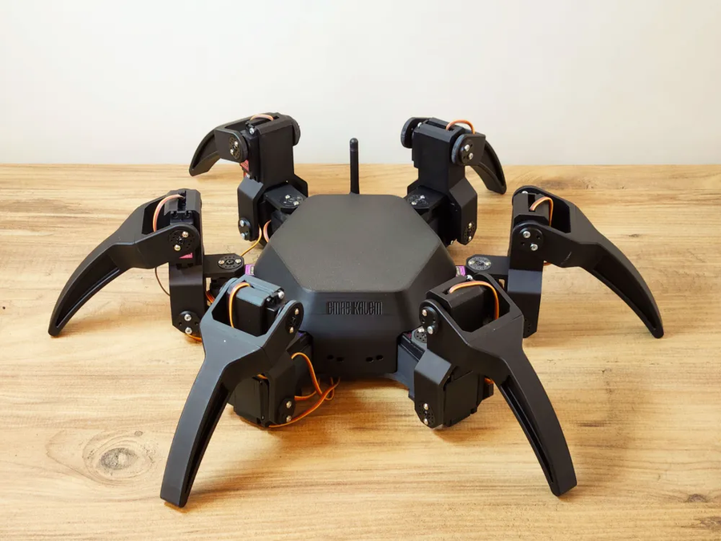
1. SYSTEM INTRODUCTION & MOTIVATION
What is the system? (Real-world description)
  A hexapod robot is a six-legged walking robot inspired by insects. Each leg has multiple joints (typically 3 DOF), enabling stable and adaptive locomotion over uneven terrain.
Why does it matter? (Engineering application)
  Used in search & rescue (disaster zones)
  Suitable for rough terrain exploration where wheels fail
  High stability (tripod gait) → always 3 legs on ground
What question are we answering? (PBL problem statement)
  To develop a dynamic model and simulation of a hexapod robot and analyze its motion, forces, and energy behavior under different gait patterns.

Slide 3
2. PROBLEM FORMULATION & ASSUMPTIONS
Inputs:
  Joint torques: τ₁, τ₂, τ₃ (per leg)
  Control signals (gait timing)
Outputs:
  Foot position (x, y, z)
  Body displacement and orientation
State Variables:
  Joint angles: θ₁, θ₂, θ₃
  Angular velocities: θ̇₁, θ̇₂, θ̇₃
Parameters:
  Link lengths: L₁, L₂, L₃
  Mass of links: m
  Gravity: g
  Inertia: I
DOF:
  Each leg = 3 DOF
  Total = 6 × 3 = 18 DOF
  (Justified: each joint rotates independently)
Assumptions:
  Links are rigid bodies
  Motion analyzed in quasi-static gait (slow walking)
  Friction sufficient → no slipping
  Actuators provide ideal torque (no delay)

Slide 4
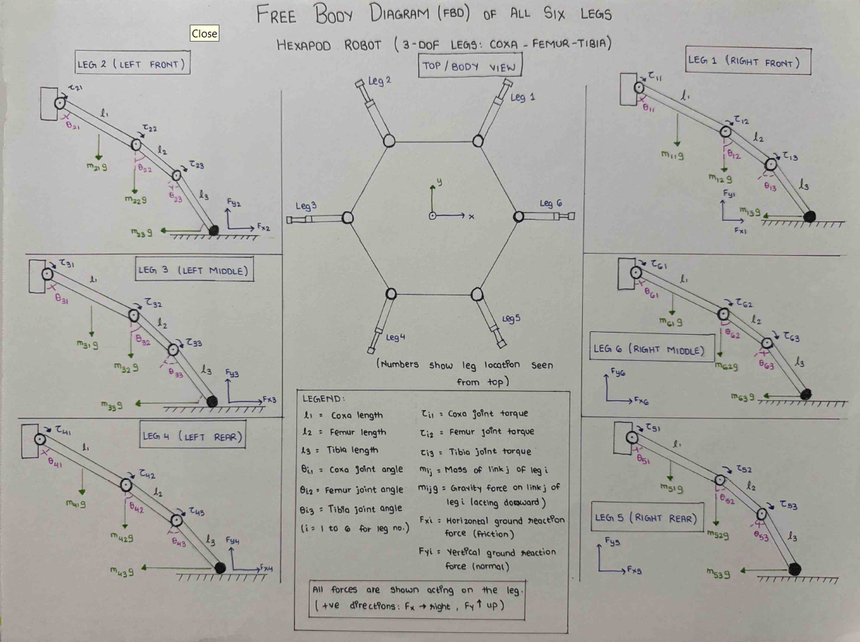
3. FREE BODY DIAGRAM / SYSTEM SCHEMATIC

Slide 5
4. MATHEMATICAL DERIVATION
Method: Lagrange (better for multi-DOF systems like hexapod)
Why?
Avoids calculating constraint forces → simplifies multi-joint system
Step 0: Generalized Coordinates
Let one leg have 3 joints:
q=[θ1,θ2,θ3]
Where:
  θ₁ → hip joint
  θ₂ → knee joint
  θ₃ → ankle joint

Slide 6
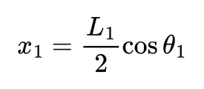
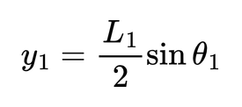
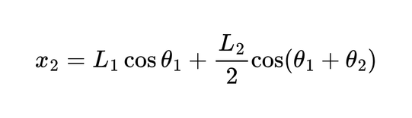
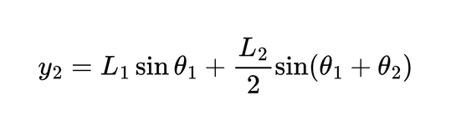
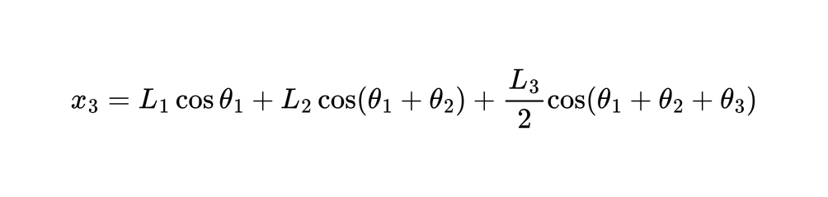
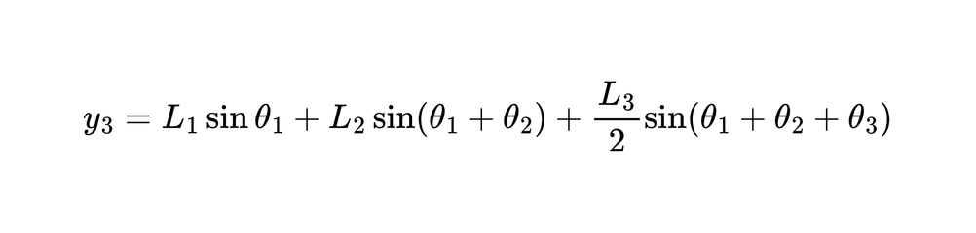
4. MATHEMATICAL DERIVATION
Step 1: Position of Each Link COM
Assume: Link lengths: L1,L2,L3 | ​COM at half length
Link 1 (Hip)
Link 2 (Thigh)
Link 3 (Tibia)

Slide 7
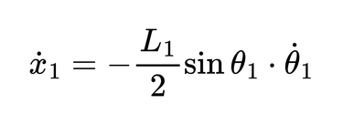
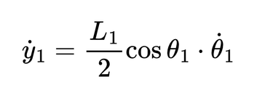
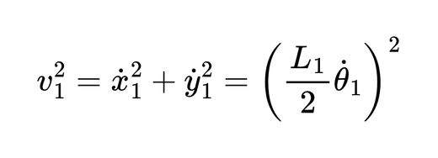
4. MATHEMATICAL DERIVATION
Step 2: Velocities (Differentiate)
Example for Link 1:
Velocity magnitude:
Similarly derived for link 2 and 3

Slide 8
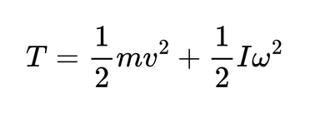
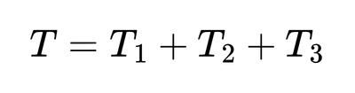
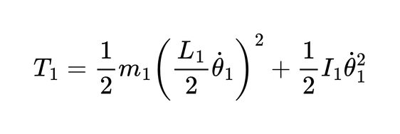
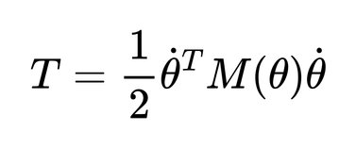
4. MATHEMATICAL DERIVATION
Step 3: Kinetic Energy (T)
For each link:
Total Kinetic Energy:
Example (Link 1):
​Final compact form:

Slide 9


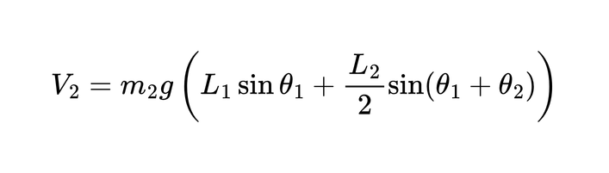
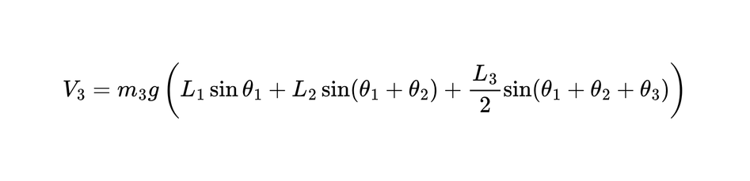
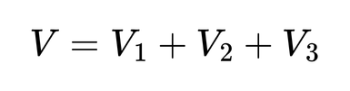
4. MATHEMATICAL DERIVATION
Step 4: Potential Energy (V)
Due to gravity:
Link 1:
Link 2:
Link 3:
Total:

Slide 10

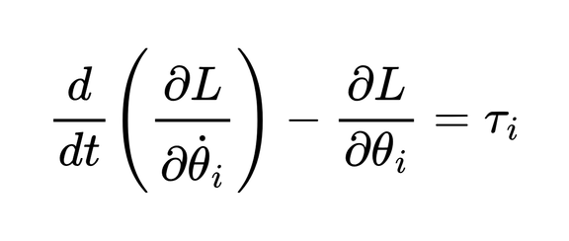
4. MATHEMATICAL DERIVATION
Step 5: Lagrangian
Step 6: Apply Euler–Lagrange Equation
For each coordinate θi:

Slide 11
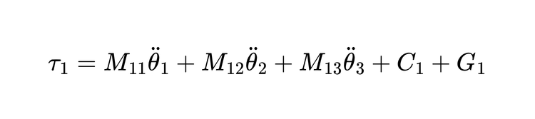
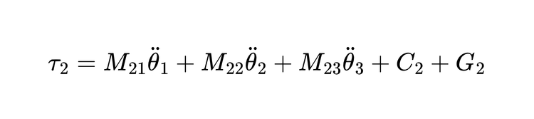
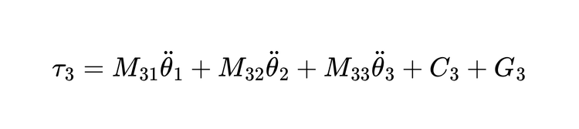
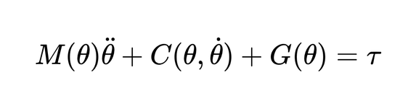
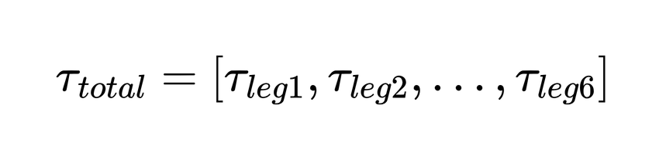
4. MATHEMATICAL DERIVATION
Step 7:Solve for Each Joint
After simplification:
​Similarly:
​
Step 8: Final Matrix Form
Step 9: Extend to Full Hexapod
  Each leg → same derivation
  Total system:

Slide 12
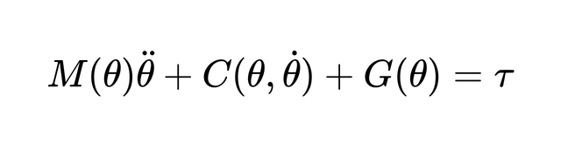


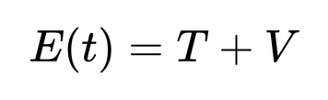
5. FINAL EQUATIONS & STATE-SPACE
Equations of Motion
Where:
  M(θ) → inertia matrix
  C(θ, θ̇) → Coriolis & centrifugal forces
  G(θ) → gravity terms
State-Space Form:
Let:
Then:
Physical Meaning (CO3 important):
  G(θ) → gravitational torque
  C(θ,θ˙) → motion coupling between joints
  M(θ)θ¨ → inertia resistance
Energy Expression:

Slide 13
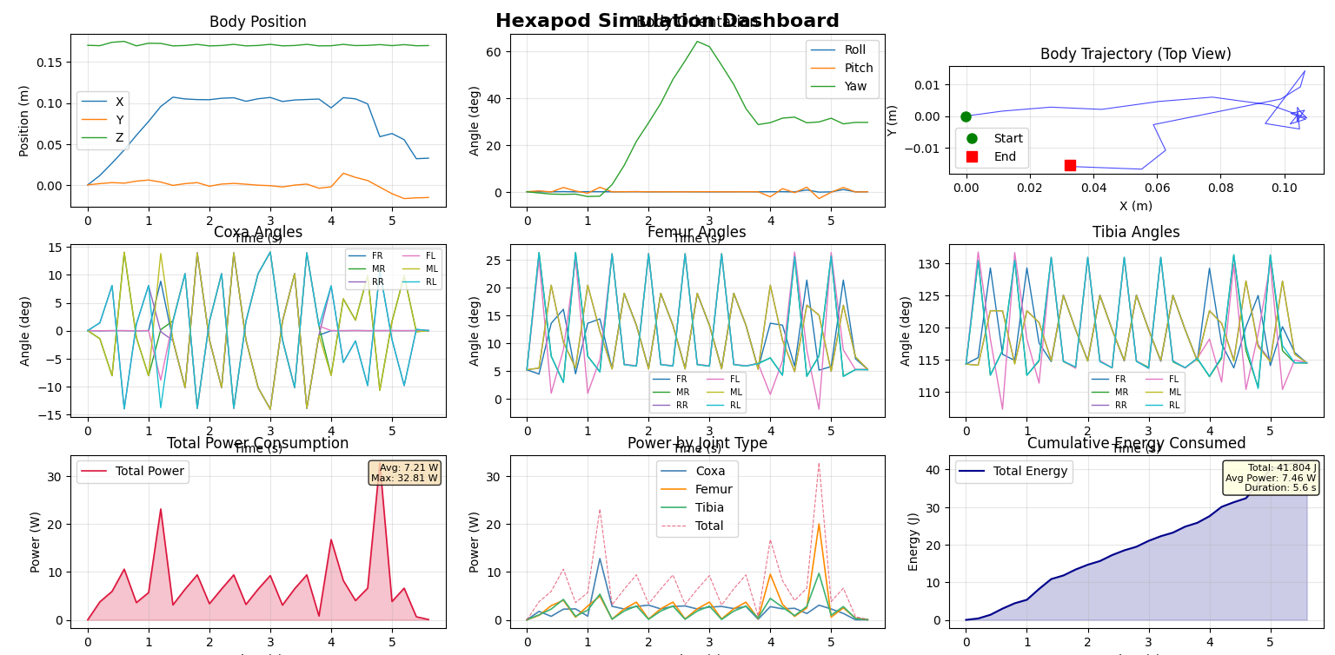
6. SIMULATION & ENERGY ANALYSIS

Slide 14
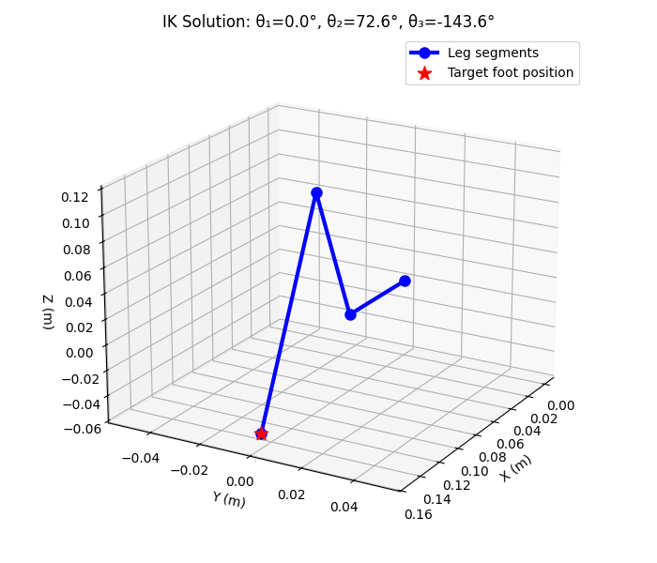
7. SIMULATION VISUALIZATION

Slide 15
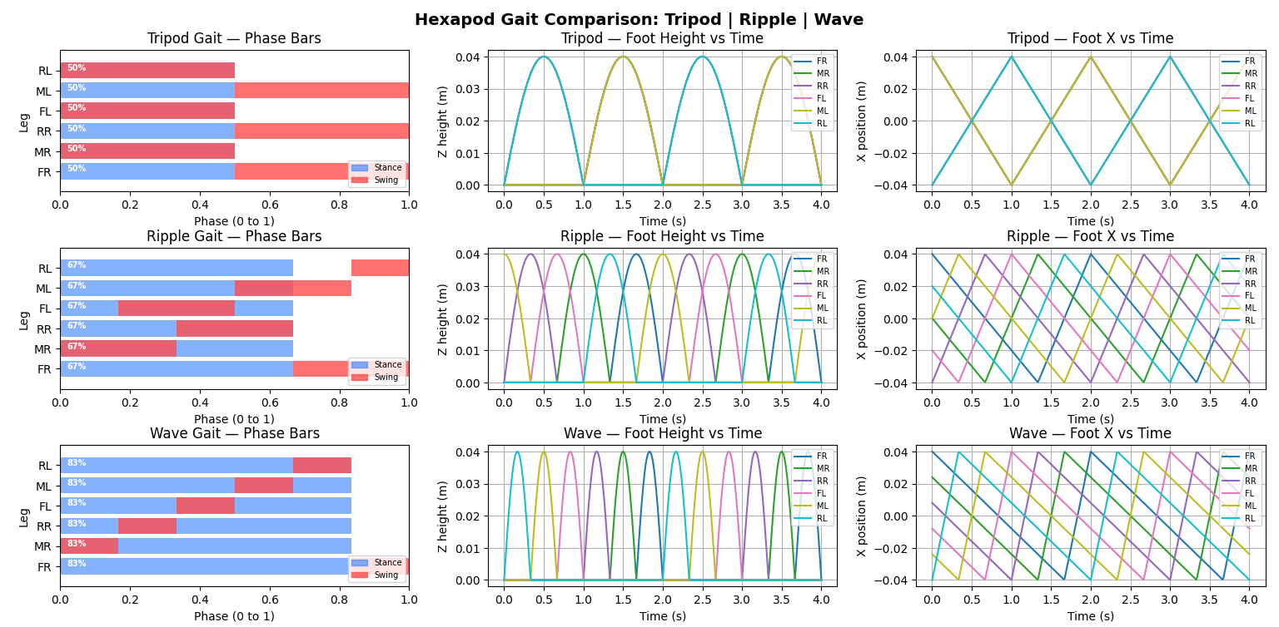
7. SIMULATION VISUALIZATION

Slide 16
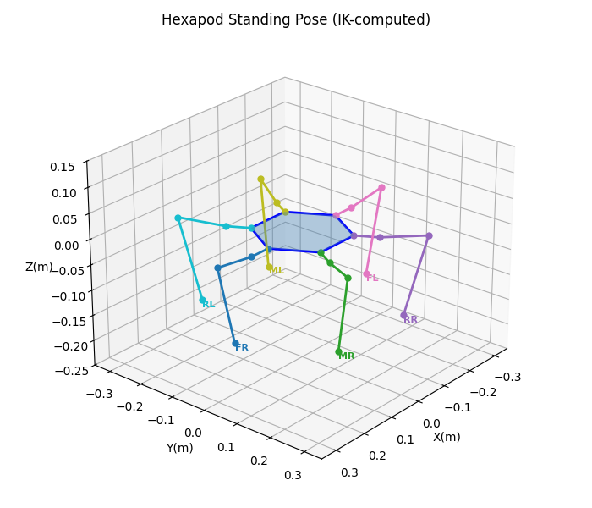
7. SIMULATION VISUALIZATION

Slide 17
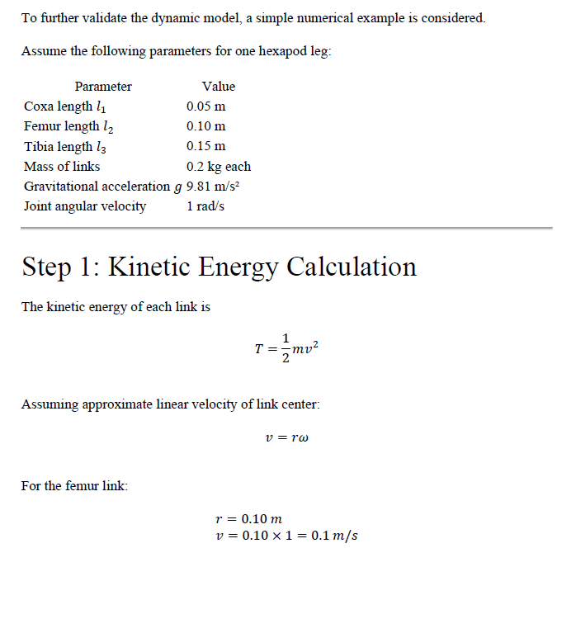
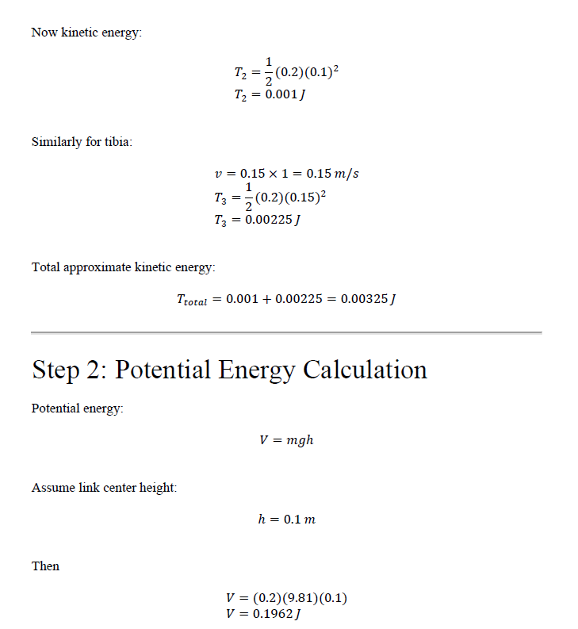
8. VALIDATION & ANALYSIS

Slide 18
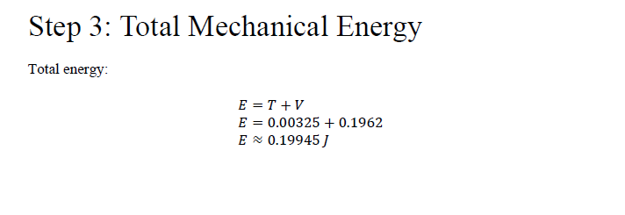
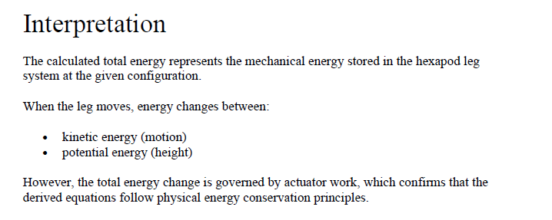
8. VALIDATION & ANALYSIS

Slide 19
9. CONCLUSIONS & REFLECTIONS
Key Finding
The hexapod robot achieves highly stable locomotion using a tripod gait, while the derived dynamic model accurately captures joint interactions, forces, and energy behavior during motion.
What we learned that a textbook couldn't teach
Understanding how multi-DOF systems behave in real simulations showed us that joint coupling and numerical instability are significant challenges, which are not evident in simplified textbook problems.
Most challenging CO: CO4 (Applying Lagrangian dynamics to a complex multi-body system).
What we would do differently
We would begin simulation earlier instead of completing full derivations first. Not testing it on PyBullet in the earlier stage caused more problem as the leg geometry was correct but at the time of simulation the bot could not stand in proper stance.
Follow a modular approach (one leg -> gait -> full robot).
Course units most critical
  Kinematics of multi-body systems
  Free Body Diagram analysis
  Newtonian and Lagrangian dynamics
  Energy methods in dynamic systems
  Numerical methods for ODE solving
CO Self-Assessment
  CO1 (Kinematics): ✓
  CO2 (FBD): ✓
  CO3 (Forces): ✓
  CO4 (Laws): ✓
  CO5 (Energy): ✓

Slide 20
10. REFERENCES & AI DISCLOSURE
Textbook References:
[1] Ginsberg, J. (2008). Engineering Dynamics. Cambridge UP.
Online Resources:
[1] Youtube Video for hardware files -
[2] Hardware Modeling(3D Model File) -
AI Tools :
We used AI tools like ChatGPT/Claude/GLM(Z.ai) for:
  Understanding complex concepts like inverse kinematics and modeling.
  Writing Python/PyBullet code from MATLAB code (Prompt based coding).
  Structuring explanations and documentation.
We did NOT use AI for:
  Deriving problem, it’s mathematical modeling concept and FBDs.
  Simulation validation.
  Core conceptual learning.
https://youtu.be/ciE2Z_92T7s?si=EKsPSDTH10j7Pghe
https://makerworld.com/en/models/1973965-hexapod-spider-robot-with-servo-arduino#profileId-2122819

Slide 21
THANK
YOU

