Slide 1
Dynamic Modelling of a Ball Balancing Stewart Platform
Team: Aditya Rajkotia, Shaurya S. Salian, Swapnil Rajuri
Course: Dynamic System Modeling (702MH0C023)
B.Tech Mechatronics, Sem IV | NMIMS MPSTME Mumbai
Category: C | Complexity: High
COs Exercised: CO1, CO2, CO3, CO4, CO5 | Date: 19/04/2026

Slide 2
1. System Introduction & Motivation
What is the system?
A Stewart platform simulation that tilts using servo control to balance a ball via a PID feedback loop.
Why does it matter?
Demonstrates key concepts in control systems, robotics, and real-time stabilization used in practical engineering applications.
Problem Statement:
Develop a control system that maintains the ball at the center by dynamically correcting its position under external disturbances.
Notes:
TIMING: 0:00-1:00 (1 min)
FOCUS: Introduce your system and its real-world engineering relevance.
TIP: Start with a compelling application, not a textbook definition.
SHOW: An image or short video of the actual system.

Slide 3
2. Problem Formulation & Assumptions
Inputs:
u = [α (tilt about x-axis), β (tilt about y-axis)]
(Controlled via PID → converted to servo angles)
Outputs:
Ball position (x, y, z)
Ball velocity (vx, vy, vz)
Platform orientation (roll ≈ β, pitch ≈ α)
Error (distance from center)
Control response (tilt angles)
State Variables:
X = [x, y, vx, vy, α, β, ∫e, de/dt]
Parameters:
Ball mass ≈ 0.0027 kg
Gravity = 9.81 m/s²
Platform height (H₀)
Friction coefficient
Restitution factor
PID gains (Kp, Ki, Kd)
Forces:
Gravitational force
Normal reaction from platform
Frictional force
External disturbance forces (user input)
DOF:
DOF = 2 (ball motion on surface) + 2 (platform tilt)
Translational: x, y
Rotational: α (pitch), β (roll)
Key Assumptions (JUSTIFIED):
(1) Platform behaves as a rigid body
(2) Small-angle tilt approximation
(3) Rolling with limited slip (friction modeled)
(4) Ideal actuator response (instant tilt change)
(5) Uniform gravity, no air resistance
Notes:
TIMING: 1:00-2:30 (1.5 min)
FOCUS: Clearly define I/O, states, parameters, DOF, and justify every assumption.
TIP: Explain WHY each assumption is physically valid.
BE PREPARED: You may be asked 'Why this assumption? What if it changes?'

Slide 4
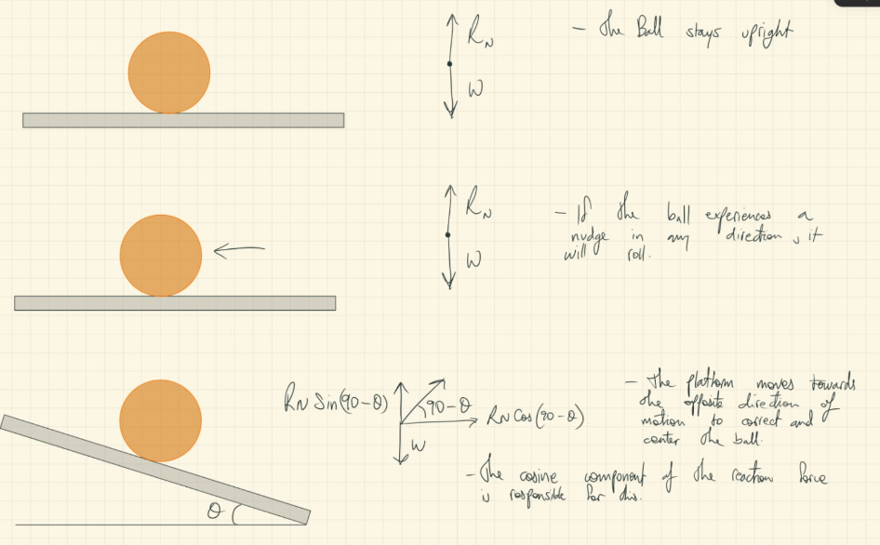
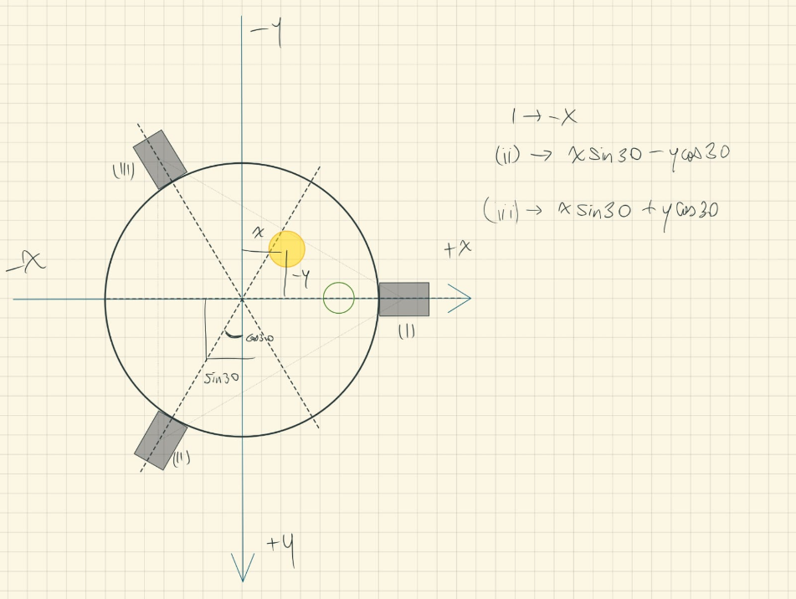
3. Free Body Diagram / System Schematic

Slide 5
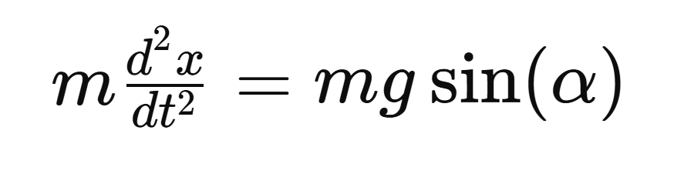


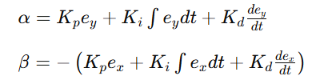
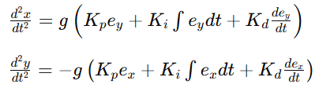
4. Mathematical Derivation (Part 1)
Method: Newton’s Second Law (Ball Dynamics on Inclined Plane
Why: Newtonian mechanics is used because the ball motion is governed by forces due to gravity and platform tilt, making it a direct and intuitive force-based model.
Step 1: Apply Newton’s Second Law
Step 2: Small Angle Approximation
Step 3: Similarly for y-direction
Step 4: Include Control (PID Controller)
Final Solution:
Notes:
TIMING: 2:30-3:45 (1.25 min)
FOCUS: Walk through EVERY step of the derivation. This is the most important section.
TIP: Show the algebra — don't skip to the final equation.
BE PREPARED: You may be asked to explain any step in detail.

Slide 6
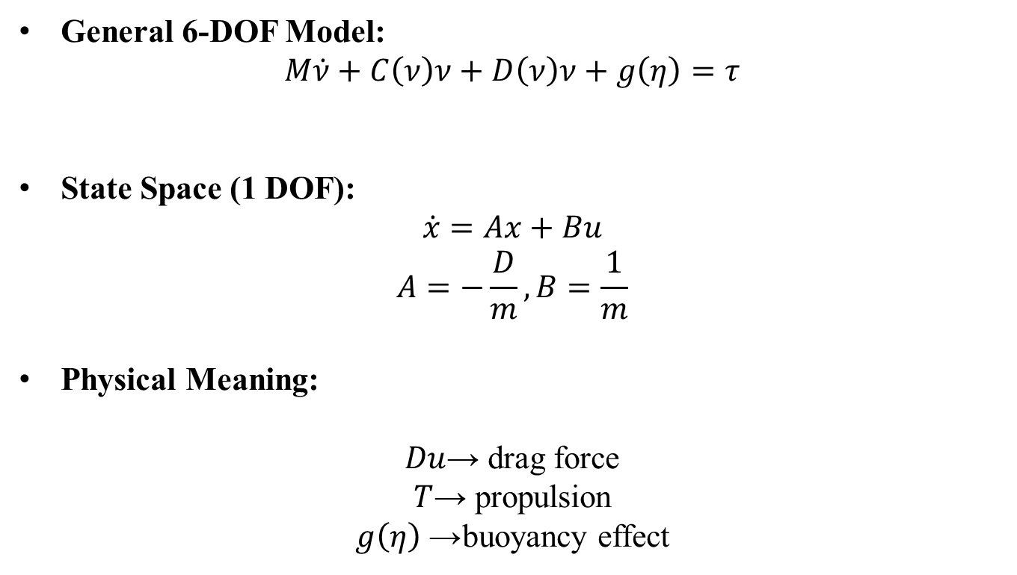
5. Final Equations & State-Space
General 6-DOF Model:
$$M\dot{ν}+C\left(ν\right)ν+D\left(ν\right)ν+g\left(η\right)=τ$$
State Space (1 DOF):
$$\dot{x}=Ax+Bu$$
$$A=−\frac{D}{m}, B=\frac{1}{m}$$
Physical Meaning:
$Du$→ drag force
$T$→ propulsion
$g\left(η\right)$→ buoyancy effect
Notes:
TIMING: 3:45-5:00 (1.25 min)
FOCUS: Present final EOM and state-space. Explain the physical meaning of EVERY term.
TIP: 'c*x_dot = viscous damping force' is stronger than just showing the equation.

Slide 7
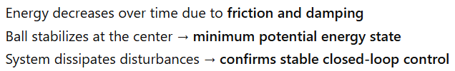

6. Simulation & Energy Analysis
Tools:
Python, NumPy, PyBullet
Solver:
Real-time physics simulation (PyBullet engine)
Energy Equations:
Kinetic Energy:
$$KE=\frac{1}{2}m\left(u^{2}+v^{2}+w^{2}\right)$$
Potential Energy:
$$PE=mgh$$
Observation:
Notes:
TIMING: 5:00-7:00 (2 min)
FOCUS: Show your simulation setup, key code snippet, and output plots.
INCLUDE: Energy vs time plot — this validates your model physically.
BE PREPARED: You may be asked 'Why does the oscillation decay?' or 'How does energy change?'

Slide 8
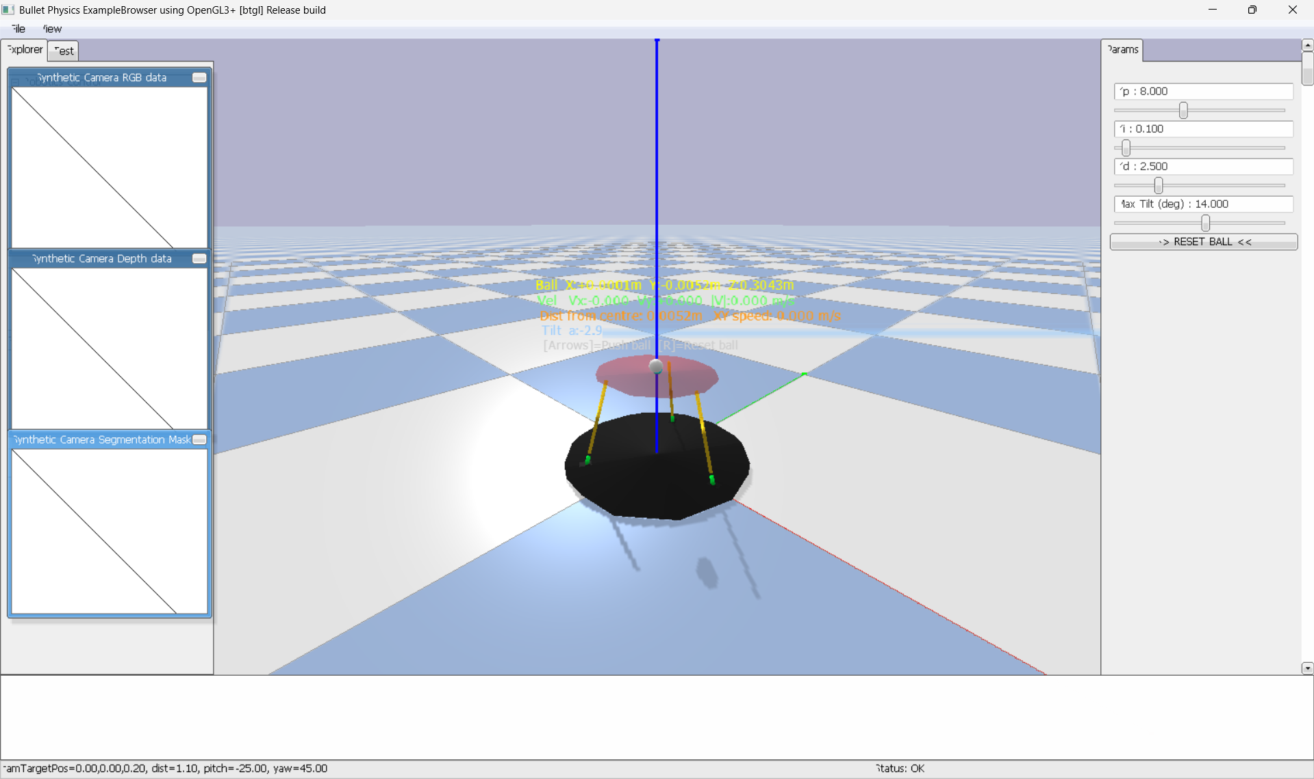
7. Simulation Visualization

Slide 9

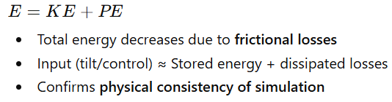
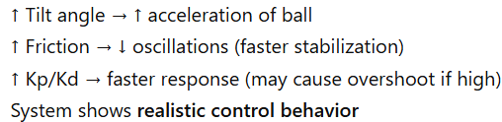
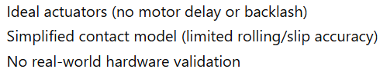
8. Validation & Analysis
Textbook Comparison
Energy Validation (CO5)
Sensitivity Analysis
Limitations
Notes:
TIMING: 7:00-8:30 (1.5 min)
FOCUS: Show HOW you verified your results. Energy check, textbook comparison, sensitivity.
TIP: A strong answer = 'We compared natural frequency with Ginsberg Ch.3.'
A weak answer = 'It runs and produces output.'

Slide 10

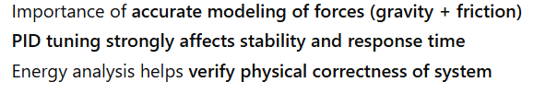

9. Conclusions & Reflections
Key Findings
ROV dynamics follow a first-order thrust–drag model
Energy decreases due to hydrodynamic drag losses
Model captures realistic underwater behaviour
What We Learned
Importance of accurate force modelling (drag + buoyancy)
Small assumptions impact system response
Energy analysis validates physical correctness
Challenges Faced
Maintaining correct sign conventions in derivation
Matching simulation with theoretical results
Modelling buoyancy and drag accurately
CO Self-Assessment
CO1 (Kinematics): ✓
CO2 (FBD): ✓
CO3 (Forces): ✓
CO4 (Laws & Derivation): ✓
CO5 (Energy Analysis): ✓
Notes:
TIMING: 8:30-10:00 (1.5 min)
FOCUS: Be specific about what you learned and what was hardest.
TIP: 'Getting the sign convention right in the Lagrangian took 3 iterations' is much stronger than 'teamwork was hard.'
INCLUDE: CO self-assessment — which COs did you exercise most?

Slide 11
10. References & AI Disclosure
Textbook References:
[1] Ginsberg, J. (2008). Engineering Dynamics. Cambridge University Press.
[2] Ogata, K. (2010). Modern Control Engineering. Prentice Hall.
[3] Siciliano, B. et al. (2010). Robotics: Modelling, Planning and Control. Springer.
Online Resources:
https://en.wikipedia.org/wiki/PID_controller
https://en.wikipedia.org/wiki/Stewart_platform
Tool: ChatGPT, Anti-Gravity
Purpose:
Python syntax debugging, Classifying content according to rubrics, Formatting presentation and word documents.
NOT used for: Derivation done by hand, FBD Diagram drawn by hand
Notes:
AI disclosure is MANDATORY but NOT penalized.
Be honest about what tools you used and for what purpose.
Good: 'Used ChatGPT for Python syntax debugging, derivation done by hand.'
Non-disclosure IS penalized if uncovered during Q&A.

Slide 12
Thank You — Questions?
Team: Aditya Rajkotia, Shaurya S. Salian, Swapnil Rajuri
Project: Dynamic Modelling of a Ball Balancing Stewart Platform
Category: C
COs: CO1-CO5

