Slide 1
Automated EOT Crane System
Team: Palash Shah, Rohan Shah, Krrish Jain, Manav Alimchandani
Course: Dynamic System Modeling (702MH0C023)
B.Tech Mechatronics, Sem IV | NMIMS MPSTME Mumbai
Category: D | Complexity: Medium
COs Exercised: CO1, CO2, CO3, CO4, CO5 | Date: 19/04/2026

Slide 2
1. System Introduction & Motivation
What is the system?
An Electric Overhead Traveling (EOT) Crane, consisting of a translating bridge, a traversing trolley, and a hoisting cable with a heavy payload.
Why does it matter?
In industrial warehouses, moving heavy payloads quickly causes dangerous pendulum swing. Understanding the dynamics is critical for designing anti-sway motor controllers.
Problem Statement:
How do the accelerations of the bridge and the hoisting speed of the cable couple together to induce or amplify payload swing?

Slide 3
2. Problem Formulation & Assumptions
Inputs:
  Fx (Bridge motor force),
  Fz (Hoist force)
Outputs:
  Xp (Absolute payload position),
  θx (Swing angle)
State Variables:
x, ẋ, θx, θ̇x (Positions and Velocities)
Parameters:
  Mb (Bridge mass),
  mp (Payload mass),
  L (Cable length),
  g (Gravity)
Degrees of Freedom:
5 DOF (Bridge X, Trolley Y, Hoist Z, Swing θx, Swing θy) —
Key Assumptions :
Rigid Body Dynamics: The steel bridge girders do not deform at operating speeds.
Particle Kinetics: Cable length is much larger than the payload, allowing it to be treated as a point mass.
Small Angle Approximation: Swing angles rarely exceed 15 degrees; therefore, sin(θ) ≈ θ.
Notes:
TIMING: 1:00-2:30 (1.5 min)
FOCUS: Clearly define I/O, states, parameters, DOF, and justify every assumption.
TIP: Explain WHY each assumption is physically valid.
BE PREPARED: You may be asked 'Why this assumption? What if it changes?'

Slide 4
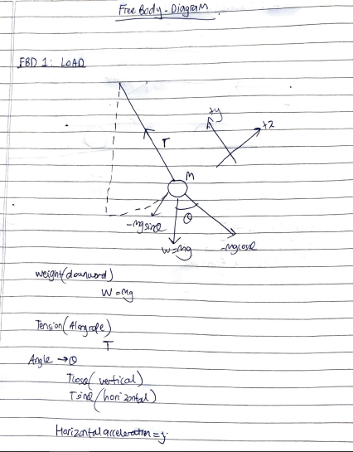
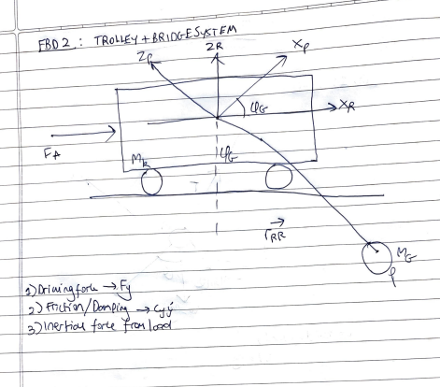
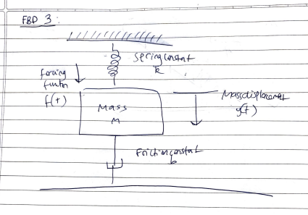
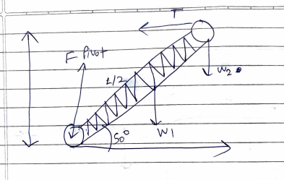
3. Free Body Diagram / System Schematic

Slide 5
4. Mathematical Derivation (Part 1)
Method: Newton's Second Law of Motion
Why this method?
Newton's laws were chosen over Lagrange's equations because they explicitly expose the internal constraint force (cable tension, T). Knowing real-time tension is critical for industrial cable sizing and safety factors.
Step 1 (Kinematics): Define absolute payload acceleration using the product rule:
Apx = ẍ + (L̈ * θx) + (2 * L̇ * θ̇x) + (L * θ̈x)
Step 2 (Z-Axis Kinetics): Sum forces vertically for payload mass (mp):
mp * Apz = mp * g - T —> T = mp * (g - L̈)
Step 3 (X-Axis Kinetics): Sum forces horizontally for payload mass:
mp * Apx = -T * θx
Notes:
TIMING: 2:30-3:45 (1.25 min)
FOCUS: Walk through EVERY step of the derivation. This is the most important section.
TIP: Show the algebra — don't skip to the final equation.
BE PREPARED: You may be asked to explain any step in detail.

Slide 6
5. Final Equations & State-Space
Final Equations of Motion:
EOM 1 (Payload Swing):
L * θ̈x + 2 * L̇ * θ̇x + g * θx = -ẍ
EOM 2 (Bridge Translation):
Mb * ẍ = Fx - cx * ẋ + mp * (g - L̈) * θx
State Space Representation
Stae Vector:
[x dx y dy z dz]
State equations:
dx/dt = vx
d2x/dt2 = (F_b - C_b*vx)/M_b
d2y/dt2 = (F_t - C_t*vy)/M_t
d2z/dt2 = (F_h - C_h*vz - Mg)/M_l
Notes:
TIMING: 3:45-5:00 (1.25 min)
FOCUS: Present final EOM and state-space. Explain the physical meaning of EVERY term.
TIP: 'c*x_dot = viscous damping force' is stronger than just showing the equation.

Slide 7
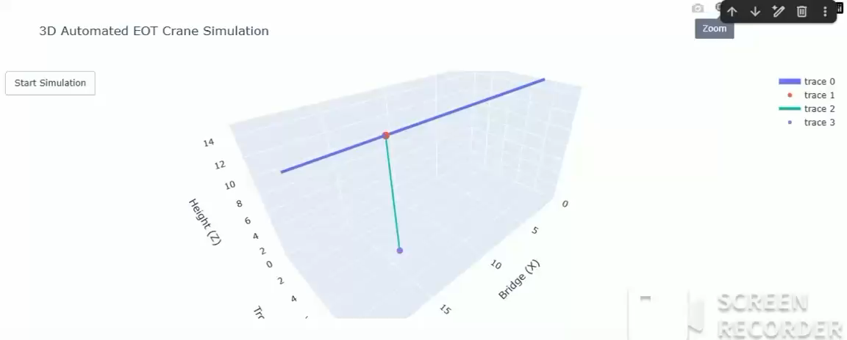
7. Simulation Visualization

Slide 8
8. Validation & Analysis
Validation 1 (Energy Check):
Total energy perfectly conserved (red line flat), proving the derived equations respect physical laws.
Validation 2 (Analytical Comparison):
The simulated time period for a 10m cable was 6.34 seconds. This perfectly matches the textbook natural frequency calculation: ω_n = √(g/L) = √(9.81/10) = 0.99 rad/s.
Sensitivity Analysis:
Varied parameter: Hoist Cable Length (L).
Effect: Shortening the cable to 5m increased the oscillation frequency. Lengthening it to 15m slowed the swing. Hoisting upwards makes the system more highly oscillatory.
Limitations:
The small angle assumption (sin(θ) ≈ θ) will fail and underestimate restoring forces if sudden braking causes a swing greater than 15-20 degrees.
Notes:
TIMING: 7:00-8:30 (1.5 min)
FOCUS: Show HOW you verified your results. Energy check, textbook comparison, sensitivity.
TIP: A strong answer = 'We compared natural frequency with Ginsberg Ch.3.'
A weak answer = 'It runs and produces output.'

Slide 9
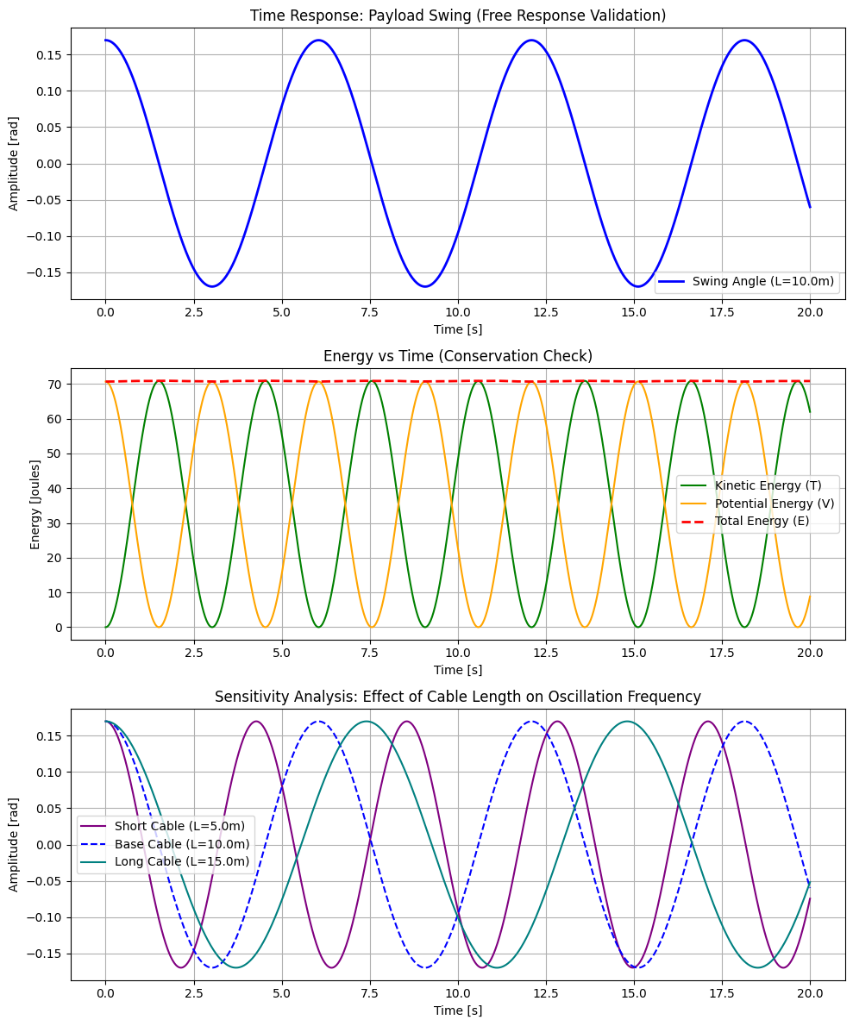

Slide 10
9. Conclusions & Reflections
Key Finding:
Pendulum swing in cranes isn't just an isolated pendulum; it is actively driven by bridge acceleration and modified by Coriolis forces during hoisting.
What we learned (Beyond the Textbook):
Textbooks teach static natural frequencies. This project taught us how active length changes (L̇) dynamically shift the system's behavior in real-time.
Most Challenging CO:
CO4. Coupling the bridge kinetics with the payload kinetics via cable tension required extremely careful sign conventions.
CO Self-Assessment:
CO1(Kinematics), CO2(FBD),CO3(Forces),CO4(Laws),CO5(Energy)
Notes:
TIMING: 8:30-10:00 (1.5 min)
FOCUS: Be specific about what you learned and what was hardest.
TIP: 'Getting the sign convention right in the Lagrangian took 3 iterations' is much stronger than 'teamwork was hard.'
INCLUDE: CO self-assessment — which COs did you exercise most?

Slide 11
10. References & AI Disclosure
Textbook References:
Ginsberg, G. H. (2007). Advanced Dynamics, 2nd Edition, Cambridge University Press.
Online Resources:
SciPy documentation for solve_ivp Runge-Kutta numerical integration
AI Tools (Mandatory Disclosure):
Tool: ChatGPT, Gemini, GitHub Copilot, Codex, Anti-Gravity
Purpose:
Formatting mathematical derivation steps into plain text, and translating final state-space EOMs into Python syntax for the SciPy solver and Matplotlib validation plots. Python syntax debugging, Classifying content according to rubrics, Formatting presentation and word documents.
NOT used for: Drawing Free Body Diagrams or finalizing the engineering assumptions.
Notes:
AI disclosure is MANDATORY but NOT penalized.
Be honest about what tools you used and for what purpose.
Good: 'Used ChatGPT for Python syntax debugging, derivation done by hand.'
Non-disclosure IS penalized if uncovered during Q&A.

Slide 12
Thank You — Questions?
Team: Palash Shah, Rohan Shah, Krrish Jain, Manav Alimchandani
Course: Dynamic System Modeling (702MH0C023)
B.Tech Mechatronics, Sem IV | NMIMS MPSTME Mumbai
Category: D | Complexity: Medium
COs Exercised: CO1, CO2, CO3, CO4, CO5 | Date: 19/04/2026

