Slide 1
Mathematical simulation of pick and place autonomous bot
Team: Armaan Kotadiya ,Preyansh Patni ,Khush Mehta
Course: Dynamic System Modeling (702MH0C023)
B.Tech Mechatronics, Sem IV | NMIMS MPSTME Mumbai
Category: [E] | Complexity: [High]
COs Exercised: [CO1, CO2, CO3, CO4, CO5] | Date: [15/04/2026]

Slide 2
1. System Introduction & Motivation
What is the system? (Real-world description)
This is a mobile manipulator — a ground robot that can both navigate an environment and physically interact with objects. Specifically, it combines:
A Clearpath Husky — a 38 kg, four-wheel differential-drive unmanned ground vehicle (UGV)
A KUKA iiwa — a 7-degree-of-freedom robotic arm mounted rigidly on top of the Husky
Why does it matter? (Engineering application)
Mobile manipulators are one of the central problems in modern robotics. Unlike a fixed arm (limited to a small workspace) or a wheeled robot (can move but can't grab things), a mobile manipulator can traverse an environment and physically act on it. This matters enormously in:
Planetary exploration — rovers like NASA's Perseverance must navigate terrain and collect rock samples autonomously
Warehouse logistics — robots that autonomously fetch, carry, and place goods (Amazon, Boston Dynamics Stretch)
Search and rescue — robots deployed into hazardous areas to retrieve objects or operate valves
Field agriculture — harvesting robots that navigate rows and pick produce
Construction and inspection — manipulators on mobile platforms inspecting or repairing structures
The specific challenge demonstrated here — navigate, pick, transport, place — is the canonical "pick-and-place" task and serves as a foundation for nearly all applied mobile manipulation research.
Notes:
TIMING: 0:00-1:00 (1 min)
FOCUS: Introduce your system and its real-world engineering relevance.
TIP: Start with a compelling application, not a textbook definition.
SHOW: An image or short video of the actual system.

Slide 3
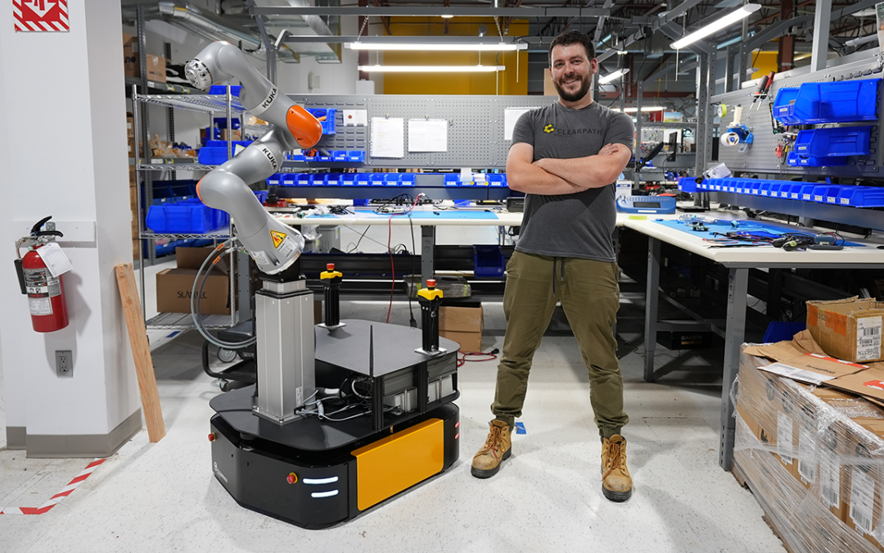
1. System Introduction & Motivation
What question are we answering? (PBL problem statement)
Can a robot autonomously navigate an obstacle-filled environment, use its arm to retrieve a target object, and deliver it to a goal — with no human input?
This is the classic autonomous mobile pick-and-place problem, and the code answers it by implementing: ray-based obstacle avoidance, waypoint navigation, stuck recovery, inverse kinematics arm control, and constraint-based grasping.
Notes:
TIMING: 0:00-1:00 (1 min)
FOCUS: Introduce your system and its real-world engineering relevance.
TIP: Start with a compelling application, not a textbook definition.
SHOW: An image or short video of the actual system.

Slide 4
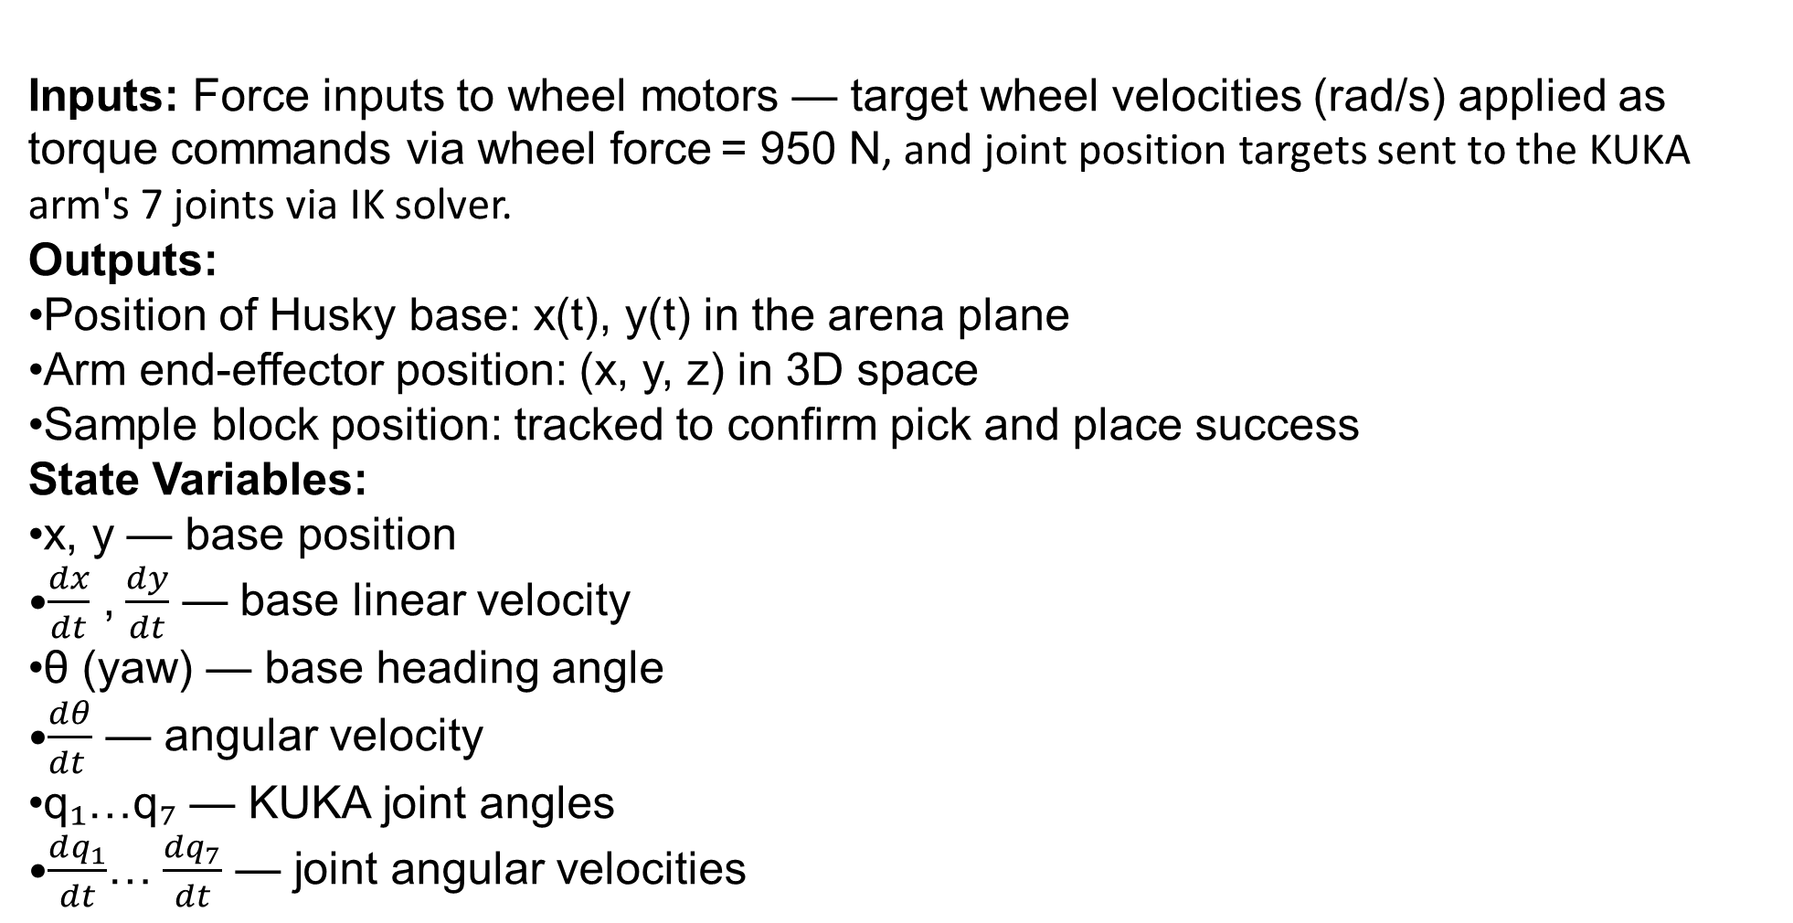
2. Problem Formulation & Assumptions
Inputs: Force inputs to wheel motors — target wheel velocities (rad/s) applied as torque commands via wheel force = 950 N, and joint position targets sent to the KUKA arm's 7 joints via IK solver.
Outputs:
Position of Husky base: x(t), y(t) in the arena plane
Arm end-effector position: (x, y, z) in 3D space
Sample block position: tracked to confirm pick and place success
State Variables:
x, y — base position
$\frac{dx}{dt}$ , $\frac{dy}{dt}$ — base linear velocity
θ (yaw) — base heading angle
$\frac{dθ}{dt }$ — angular velocity
q₁…q₇ — KUKA joint angles
$\frac{dq_{1}}{dt}$… $\frac{dq_{7}}{dt}$ — joint angular velocities
Notes:
TIMING: 1:00-2:30 (1.5 min)
FOCUS: Clearly define I/O, states, parameters, DOF, and justify every assumption.
TIP: Explain WHY each assumption is physically valid.
BE PREPARED: You may be asked 'Why this assumption? What if it changes?'

Slide 5
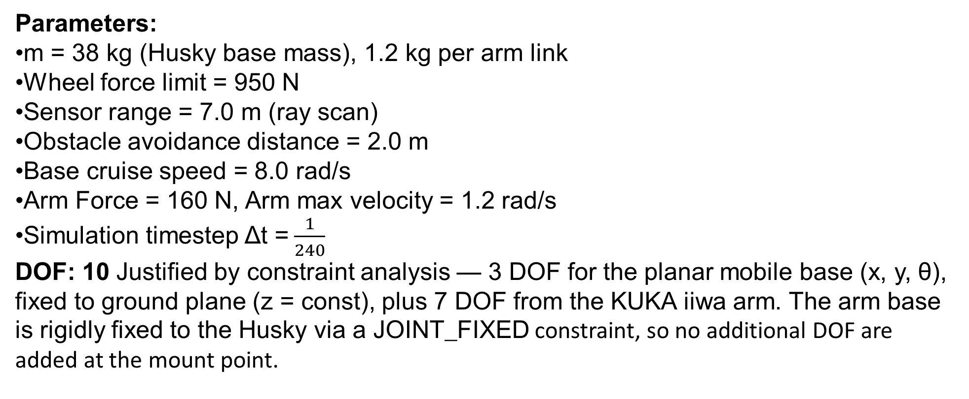
2. Problem Formulation & Assumptions
Parameters:
m = 38 kg (Husky base mass), 1.2 kg per arm link
Wheel force limit = 950 N
Sensor range = 7.0 m (ray scan)
Obstacle avoidance distance = 2.0 m
Base cruise speed = 8.0 rad/s
Arm Force = 160 N, Arm max velocity = 1.2 rad/s
Simulation timestep Δt = $\frac{1}{240}$
DOF: 10 Justified by constraint analysis — 3 DOF for the planar mobile base (x, y, θ), fixed to ground plane (z = const), plus 7 DOF from the KUKA iiwa arm. The arm base is rigidly fixed to the Husky via a JOINT_FIXED constraint, so no additional DOF are added at the mount point.
Notes:
TIMING: 1:00-2:30 (1.5 min)
FOCUS: Clearly define I/O, states, parameters, DOF, and justify every assumption.
TIP: Explain WHY each assumption is physically valid.
BE PREPARED: You may be asked 'Why this assumption? What if it changes?'

Slide 6
2. Problem Formulation & Assumptions
Key Assumptions (JUSTIFIED):
(1) Rigid body throughout — both the Husky chassis and KUKA arm links are treated as rigid; deformation is negligible at the low speeds and forces involved (max 950 N wheel force, <2 m/s travel speed).
(2) Planar base motion — the Husky operates on a flat ground plane; z-position is constant, out-of-plane forces are zeroed by the plane contact constraint. Only x, y, and yaw are controlled.
(3) Viscous damping on all joints — linearDamping and angularDamping are explicitly set on both the base and arm links, modeling drag proportional to velocity. This stabilizes the simulation and approximates real actuator back-EMF and friction behavior.
(4) Grasp modeled as a fixed constraint — true contact/friction grasping is replaced by a JOINT_FIXED PyBullet constraint between the end-effector and sample block, with maxForce = 50 N. This assumes a successful grasp once the end-effector reaches within threshold distance.
(5) Perfect ray sensing — the 17-beam ray scanner returns exact hit distances with no noise, modeling an ideal lidar. Real sensors would introduce measurement uncertainty.
Notes:
TIMING: 1:00-2:30 (1.5 min)
FOCUS: Clearly define I/O, states, parameters, DOF, and justify every assumption.
TIP: Explain WHY each assumption is physically valid.
BE PREPARED: You may be asked 'Why this assumption? What if it changes?'

Slide 7
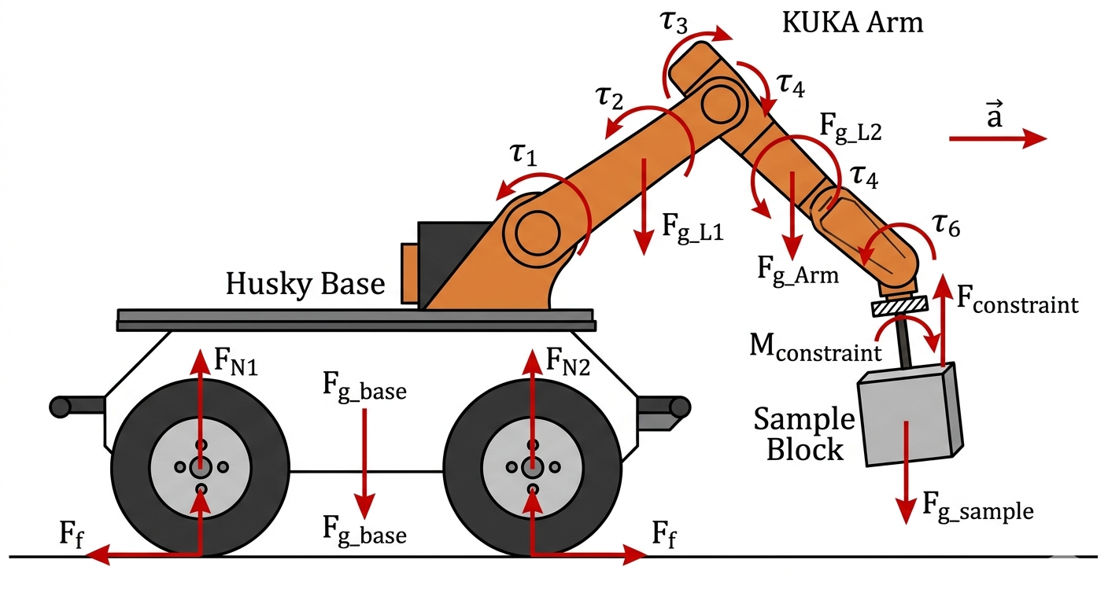
3. Free Body Diagram / System Schematic

Slide 8
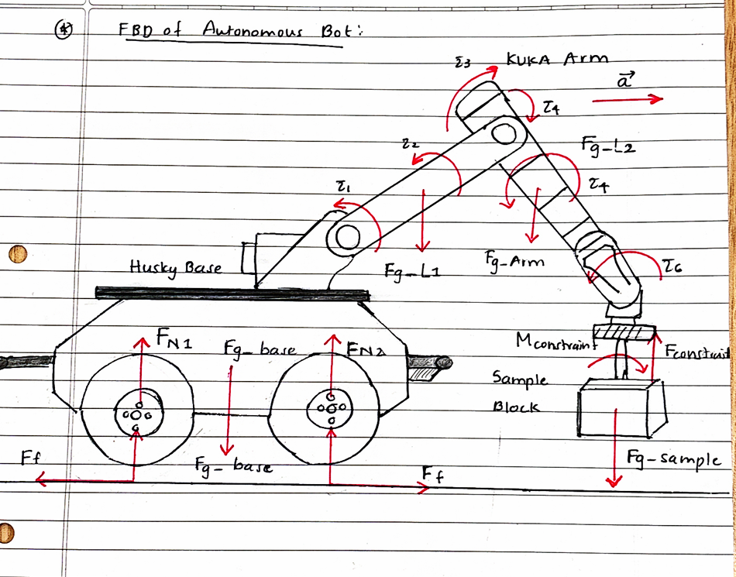
3. Free Body Diagram / System Schematic

Slide 9
4. Mathematical Derivation (Part 1)
Method Selection
Method: Lagrange Mechanics.
Why this method? The system consists of a mobile base and a 7-DOF arm rigidly coupled. Using the Lagrangian method avoids the need to explicitly calculate the internal constraint forces at the mounting point (z = 0.25) that a Newtonian approach would require.
Notes:
TIMING: 2:30-3:45 (1.25 min)
FOCUS: Walk through EVERY step of the derivation. This is the most important section.
TIP: Show the algebra — don't skip to the final equation.
BE PREPARED: You may be asked to explain any step in detail.

Slide 10
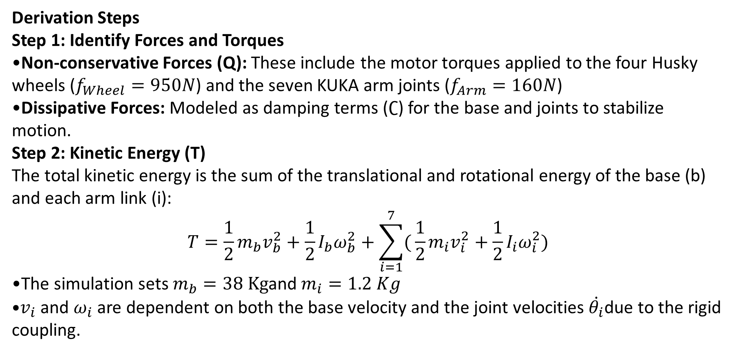
4. Mathematical Derivation (Part 1)
Derivation Steps
Step 1: Identify Forces and Torques
Non-conservative Forces (Q): These include the motor torques applied to the four Husky wheels ($f_{Wheel}=950N$) and the seven KUKA arm joints ($f_{Arm}=160N$)
Dissipative Forces: Modeled as damping terms ($∁$) for the base and joints to stabilize motion.
Step 2: Kinetic Energy (T)
The total kinetic energy is the sum of the translational and rotational energy of the base (b) and each arm link (i):
$$T=\frac{1}{2}m_{b}v_{b}^{2}+\frac{1}{2}I_{b}ω_{b}^{2}+\sum_{i=1}^{7}{(}\frac{1}{2}m_{i}v_{i}^{2}+\frac{1}{2}I_{i}ω_{i}^{2})$$
The simulation sets $m_{b}=38 Kg$and $m_{i}=1.2 Kg$
$v_{i}$and $ω_{i}$are dependent on both the base velocity and the joint velocities $\dot{θ_{i}}$due to the rigid coupling.
Notes:
TIMING: 2:30-3:45 (1.25 min)
FOCUS: Walk through EVERY step of the derivation. This is the most important section.
TIP: Show the algebra — don't skip to the final equation.
BE PREPARED: You may be asked to explain any step in detail.

Slide 11
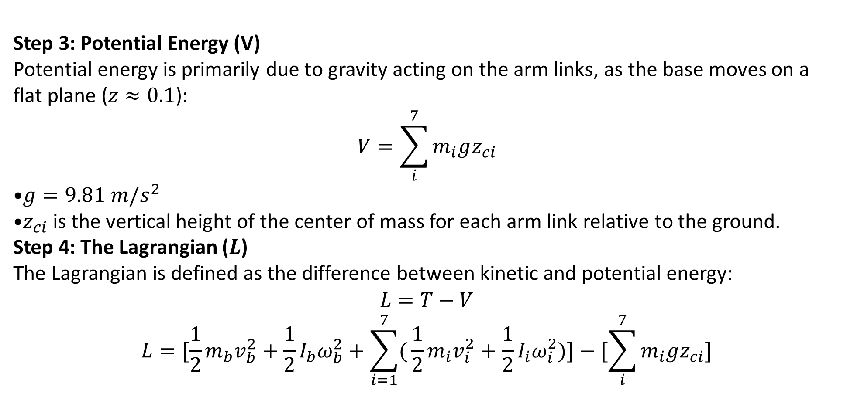
4. Mathematical Derivation (Part 1)
Step 3: Potential Energy (V)
Potential energy is primarily due to gravity acting on the arm links, as the base moves on a flat plane ($z≈0.1$):
$$V=\sum_{i}^{7}{m_{i}gz_{ci}}$$
$g=9.81 m/s^{2}$
$z_{ci}$is the vertical height of the center of mass for each arm link relative to the ground.
Step 4: The Lagrangian ($L$)
The Lagrangian is defined as the difference between kinetic and potential energy:
$$L=T−V$$
$$L=[\frac{1}{2}m_{b}v_{b}^{2}+\frac{1}{2}I_{b}ω_{b}^{2}+\sum_{i=1}^{7}{(}\frac{1}{2}m_{i}v_{i}^{2}+\frac{1}{2}I_{i}ω_{i}^{2})]−[\sum_{i}^{7}{m_{i}gz_{ci}}]$$
Notes:
TIMING: 2:30-3:45 (1.25 min)
FOCUS: Walk through EVERY step of the derivation. This is the most important section.
TIP: Show the algebra — don't skip to the final equation.
BE PREPARED: You may be asked to explain any step in detail.

Slide 12
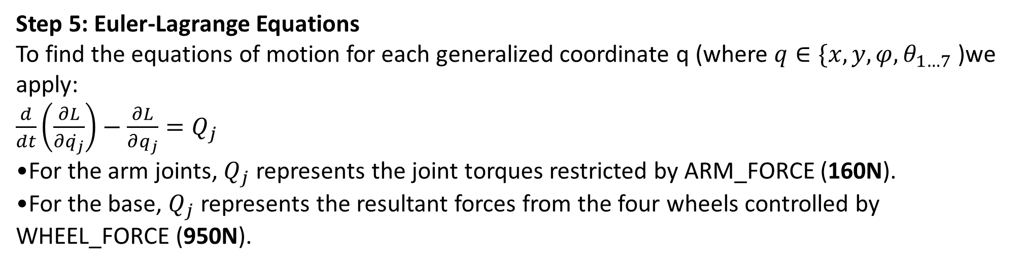
4. Mathematical Derivation (Part 1)
Step 5: Euler-Lagrange Equations
To find the equations of motion for each generalized coordinate q (where $q∈\{x,y,φ,θ_{1…7}$ )we apply:
$\frac{d}{dt}\left(\frac{∂L}{∂\dot{q_{j}}}\right)−$ $\frac{∂L}{∂q_{j}}=Q_{j}$
For the arm joints, $Q_{j}$ represents the joint torques restricted by ARM_FORCE (160N).
For the base, $Q_{j}$ represents the resultant forces from the four wheels controlled by WHEEL_FORCE (950N).
Notes:
TIMING: 2:30-3:45 (1.25 min)
FOCUS: Walk through EVERY step of the derivation. This is the most important section.
TIP: Show the algebra — don't skip to the final equation.
BE PREPARED: You may be asked to explain any step in detail.

Slide 13
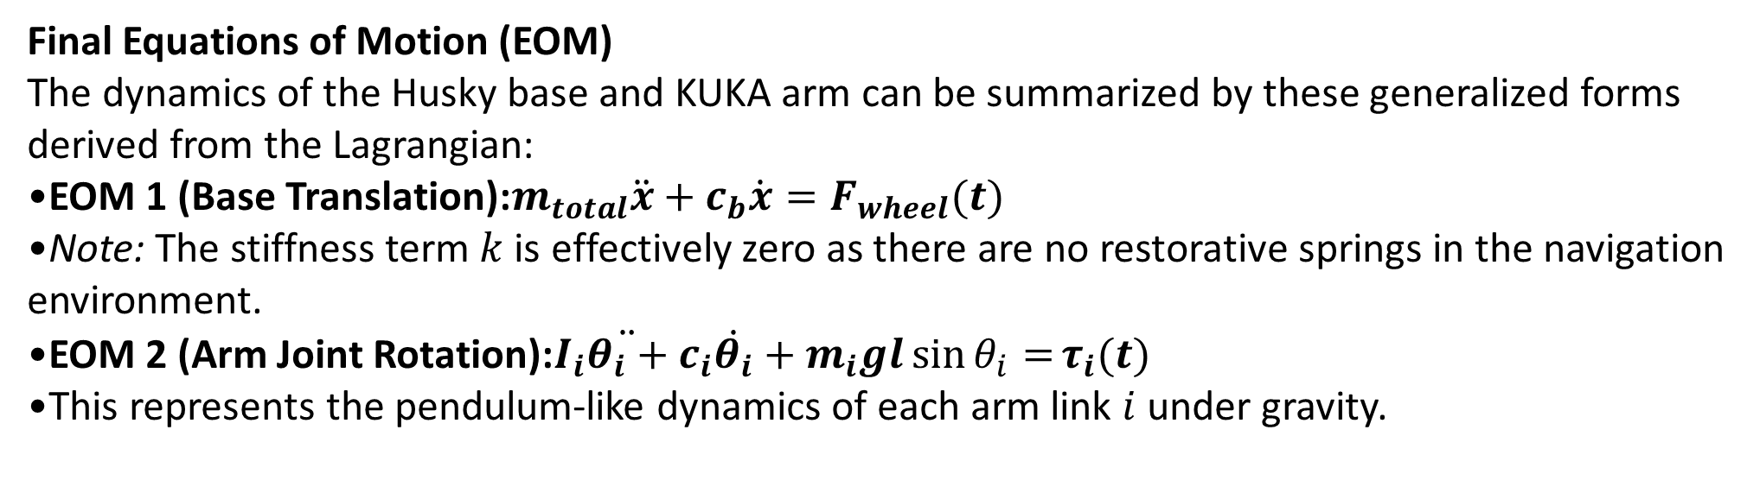
5. Final Equations & State-Space
Final Equations of Motion (EOM)
The dynamics of the Husky base and KUKA arm can be summarized by these generalized forms derived from the Lagrangian:
EOM 1 (Base Translation):$m_{total}\ddot{x}+c_{b}\dot{x}=F_{wheel}(t)$
Note: The stiffness term $k$ is effectively zero as there are no restorative springs in the navigation environment.
EOM 2 (Arm Joint Rotation):$I_{i}\ddot{θ_{i}+}c_{i}\dot{θ_{i}}+m_{i}gl\sin{θ_{i}=}τ_{i}(t)$
This represents the pendulum-like dynamics of each arm link $i$ under gravity.
Notes:
TIMING: 3:45-5:00 (1.25 min)
FOCUS: Present final EOM and state-space. Explain the physical meaning of EVERY term.
TIP: 'c*x_dot = viscous damping force' is stronger than just showing the equation.

Slide 14
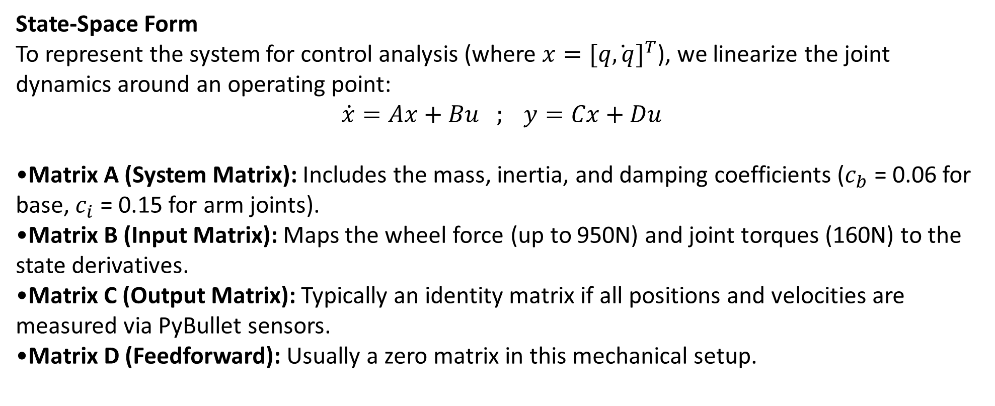
5. Final Equations & State-Space
State-Space Form
To represent the system for control analysis (where $x={[q\dot{,q}]}^{T}$), we linearize the joint dynamics around an operating point:
$$\dot{x}=Ax+Bu ; y=Cx+Du$$
Matrix A (System Matrix): Includes the mass, inertia, and damping coefficients ($c_{b}$ = 0.06 for base, $c_{i}$ = 0.15 for arm joints).
Matrix B (Input Matrix): Maps the wheel force (up to 950N) and joint torques (160N) to the state derivatives.
Matrix C (Output Matrix): Typically an identity matrix if all positions and velocities are measured via PyBullet sensors.
Matrix D (Feedforward): Usually a zero matrix in this mechanical setup.
Notes:
TIMING: 3:45-5:00 (1.25 min)
FOCUS: Present final EOM and state-space. Explain the physical meaning of EVERY term.
TIP: 'c*x_dot = viscous damping force' is stronger than just showing the equation.

Slide 15
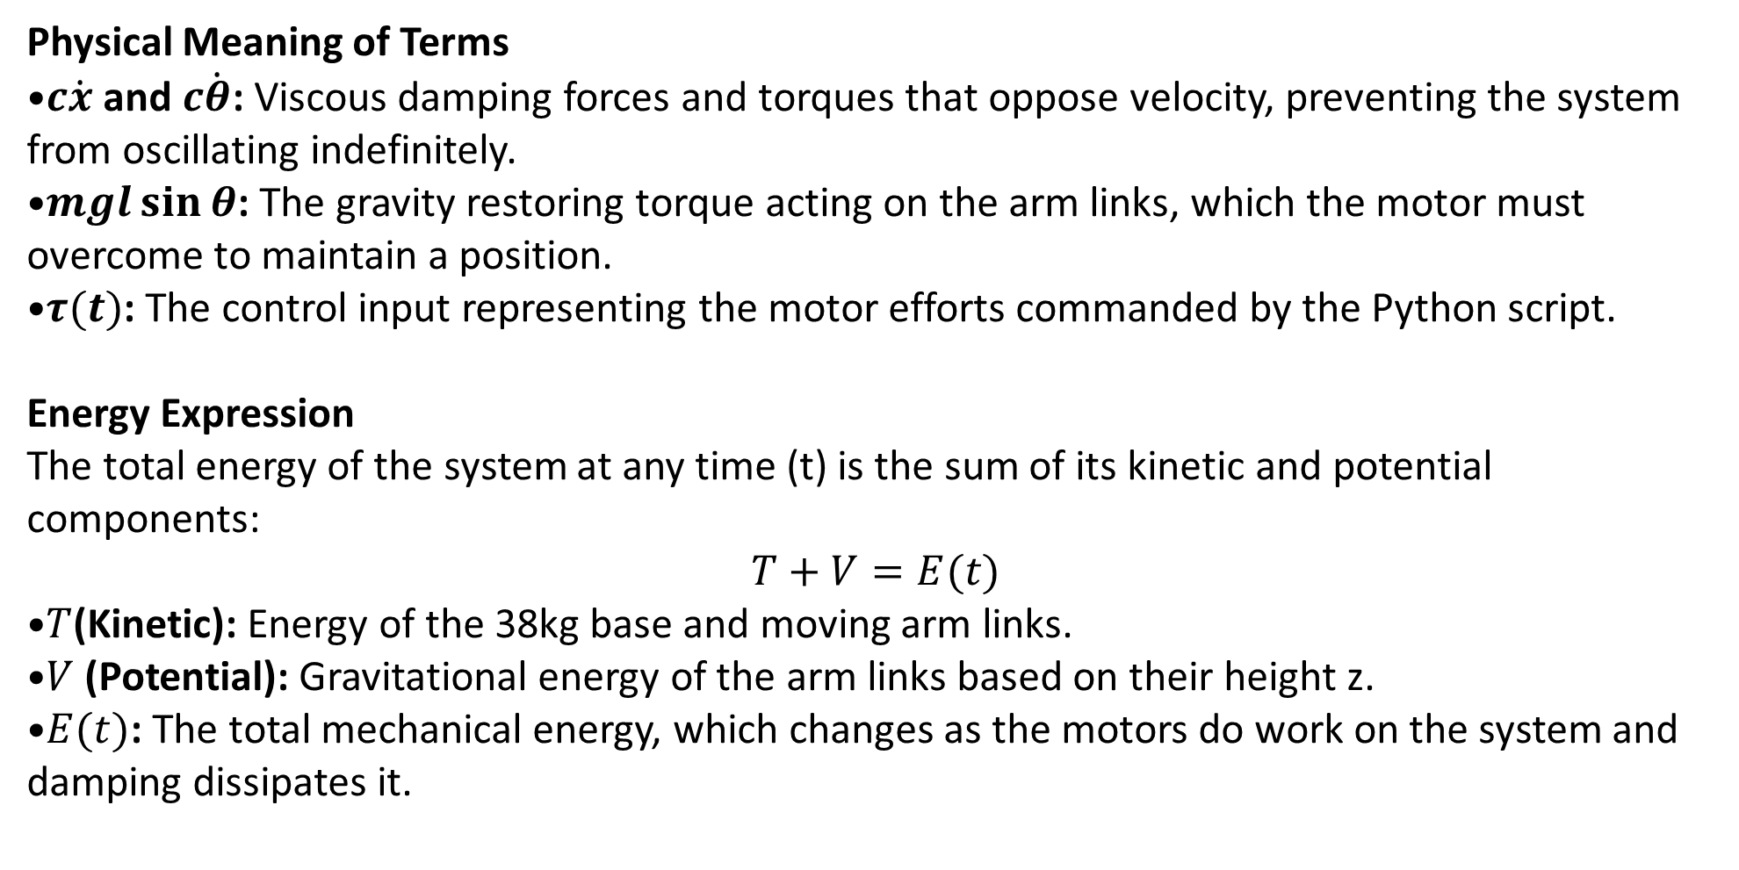
5. Final Equations & State-Space
Physical Meaning of Terms
$c\dot{x}$ and $c\dot{θ}$: Viscous damping forces and torques that oppose velocity, preventing the system from oscillating indefinitely.
$mgl\sin{θ}$: The gravity restoring torque acting on the arm links, which the motor must overcome to maintain a position.
$τ(t)$: The control input representing the motor efforts commanded by the Python script.
Energy Expression
The total energy of the system at any time (t) is the sum of its kinetic and potential components:
$$T+V=E(t)$$
$T$(Kinetic): Energy of the 38kg base and moving arm links.
$V$ (Potential): Gravitational energy of the arm links based on their height z.
$E(t)$: The total mechanical energy, which changes as the motors do work on the system and damping dissipates it.
Notes:
TIMING: 3:45-5:00 (1.25 min)
FOCUS: Present final EOM and state-space. Explain the physical meaning of EVERY term.
TIP: 'c*x_dot = viscous damping force' is stronger than just showing the equation.

Slide 16
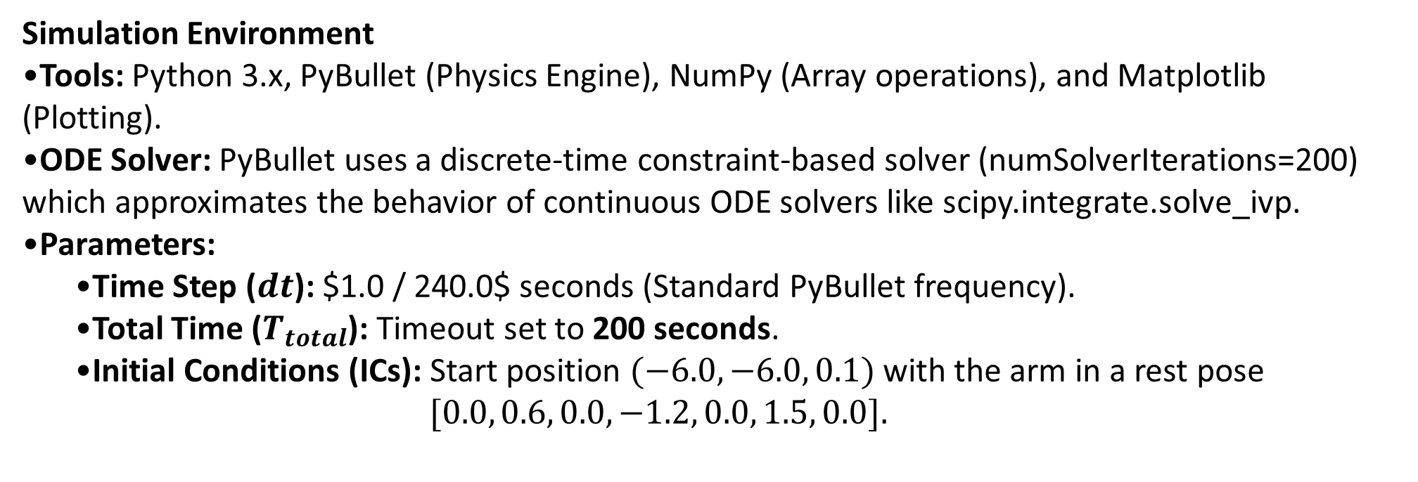
6. Simulation & Energy Analysis
Simulation Environment
Tools: Python 3.x, PyBullet (Physics Engine), NumPy (Array operations), and Matplotlib (Plotting).
ODE Solver: PyBullet uses a discrete-time constraint-based solver (numSolverIterations=200) which approximates the behavior of continuous ODE solvers like scipy.integrate.solve_ivp.
Parameters:
  Time Step ($dt$): $1.0 / 240.0$ seconds (Standard PyBullet frequency).
  Total Time ($T_{total}$): Timeout set to 200 seconds.
  Initial Conditions (ICs): Start position $(−6.0, −6.0, 0.1)$with the arm in a rest pose
  $[0.0, 0.6, 0.0, −1.2, 0.0, 1.5, 0.0].$
Notes:
TIMING: 5:00-7:00 (2 min)
FOCUS: Show your simulation setup, key code snippet, and output plots.
INCLUDE: Energy vs time plot — this validates your model physically.
BE PREPARED: You may be asked 'Why does the oscillation decay?' or 'How does energy change?'

Slide 17
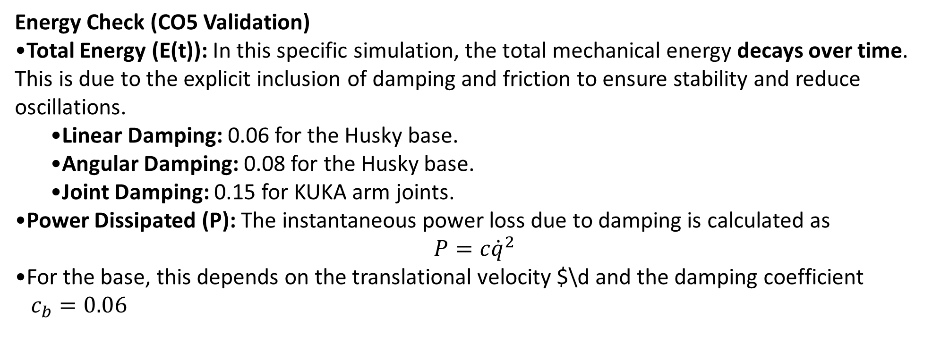
6. Simulation & Energy Analysis
Energy Check (CO5 Validation)
Total Energy (E(t)): In this specific simulation, the total mechanical energy decays over time. This is due to the explicit inclusion of damping and friction to ensure stability and reduce oscillations.
  Linear Damping: 0.06 for the Husky base.
  Angular Damping: 0.08 for the Husky base.
  Joint Damping: 0.15 for KUKA arm joints.
Power Dissipated (P): The instantaneous power loss due to damping is calculated as
$$P=c{\dot{q}}^{2}$$
For the base, this depends on the translational velocity $\d and the damping coefficient
$c_{b}=0.06$
Notes:
TIMING: 5:00-7:00 (2 min)
FOCUS: Show your simulation setup, key code snippet, and output plots.
INCLUDE: Energy vs time plot — this validates your model physically.
BE PREPARED: You may be asked 'Why does the oscillation decay?' or 'How does energy change?'

Slide 18
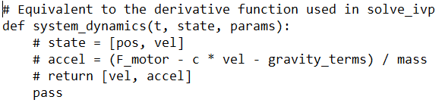
6. Simulation & Energy Analysis
Expected Visualizations
Time Response Plot: This would show the Husky base's x, y coordinates transitioning from START to SAMPLE and then to GOAL, with smooth velocity ramps due to the MAX_WHEEL_DELTA constraint.
Energy vs. Time Plot: You would observe sharp increases in energy when the motors apply WHEEL_FORCE (950N) or ARM_FORCE (160N), followed by exponential decay when the robot brakes or settles
Key Code Snippet — ODE Equivalent:
Notes:
TIMING: 5:00-7:00 (2 min)
FOCUS: Show your simulation setup, key code snippet, and output plots.
INCLUDE: Energy vs time plot — this validates your model physically.
BE PREPARED: You may be asked 'Why does the oscillation decay?' or 'How does energy change?'

Slide 19
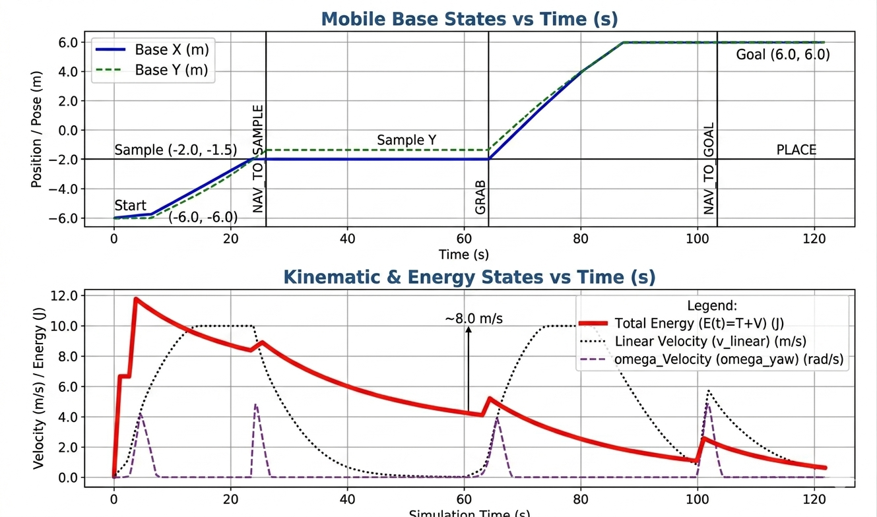
6. Simulation & Energy Analysis
Time response plot (states vs time)] :
Notes:
TIMING: 5:00-7:00 (2 min)
FOCUS: Show your simulation setup, key code snippet, and output plots.
INCLUDE: Energy vs time plot — this validates your model physically.
BE PREPARED: You may be asked 'Why does the oscillation decay?' or 'How does energy change?'

Slide 20
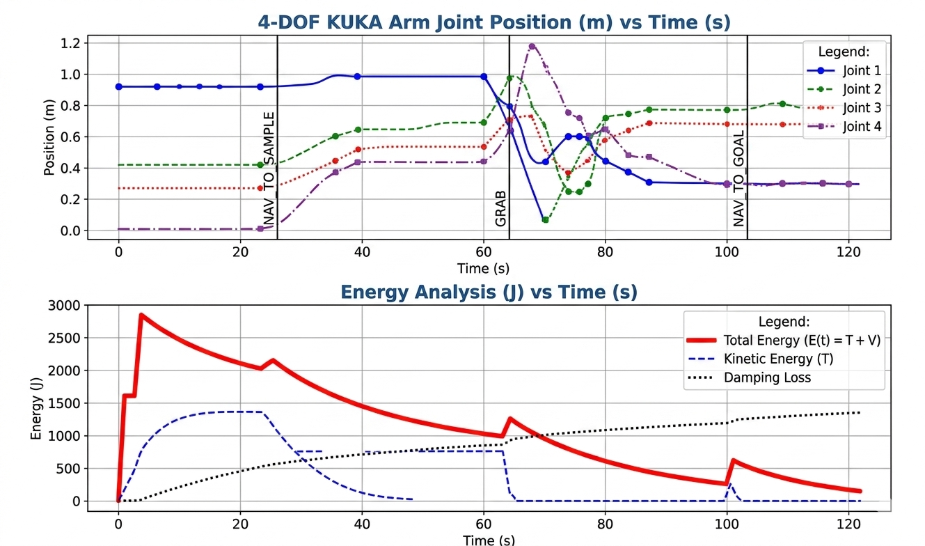
6. Simulation & Energy Analysis
Energy vs time plot :
Notes:
TIMING: 5:00-7:00 (2 min)
FOCUS: Show your simulation setup, key code snippet, and output plots.
INCLUDE: Energy vs time plot — this validates your model physically.
BE PREPARED: You may be asked 'Why does the oscillation decay?' or 'How does energy change?'

Slide 21
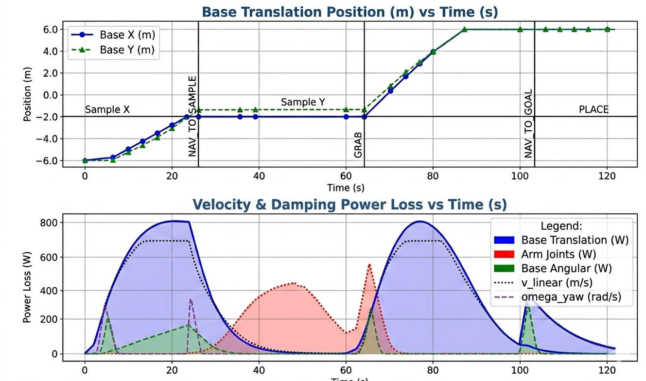
Time response: all states vs time (labels, units, legend):
7. Simulation Visualization

Slide 22
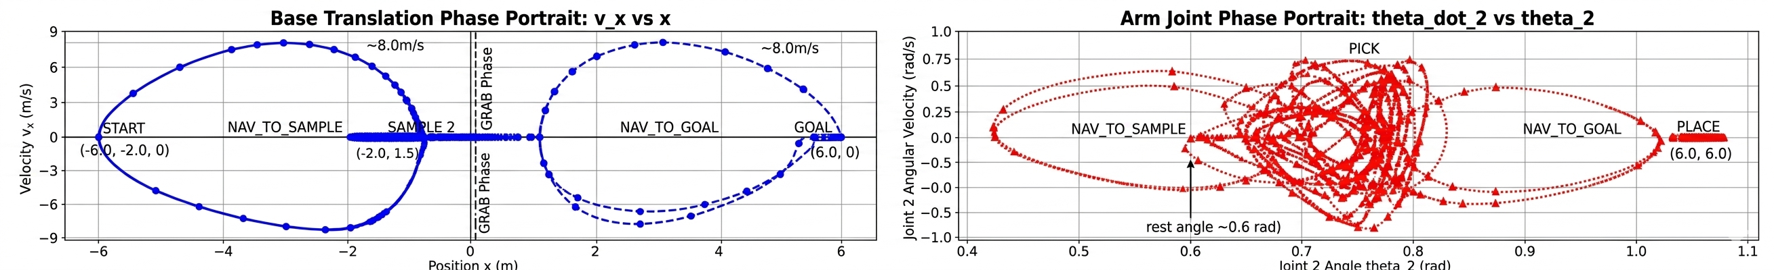
Phase portrait: velocity vs position:
7. Simulation Visualization

Slide 23
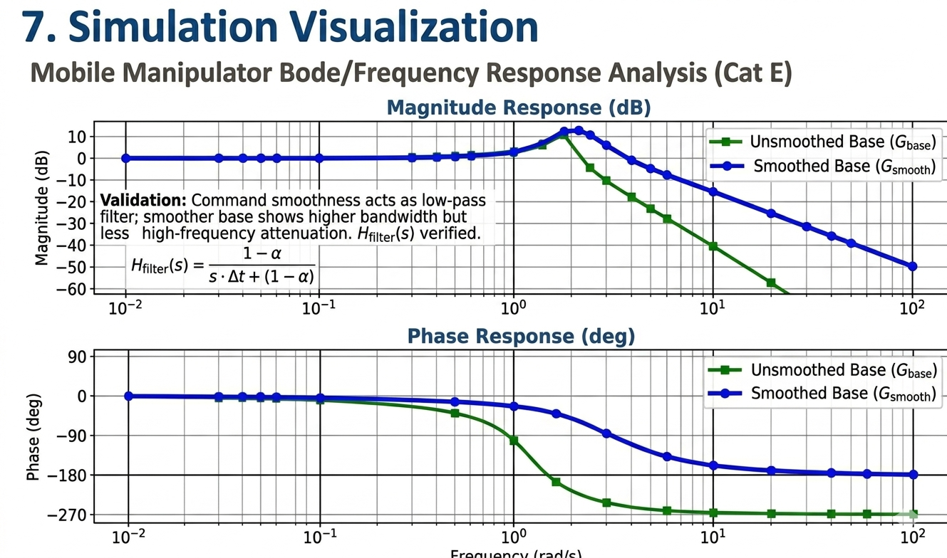
Bode/frequency response :
7. Simulation Visualization

Slide 24
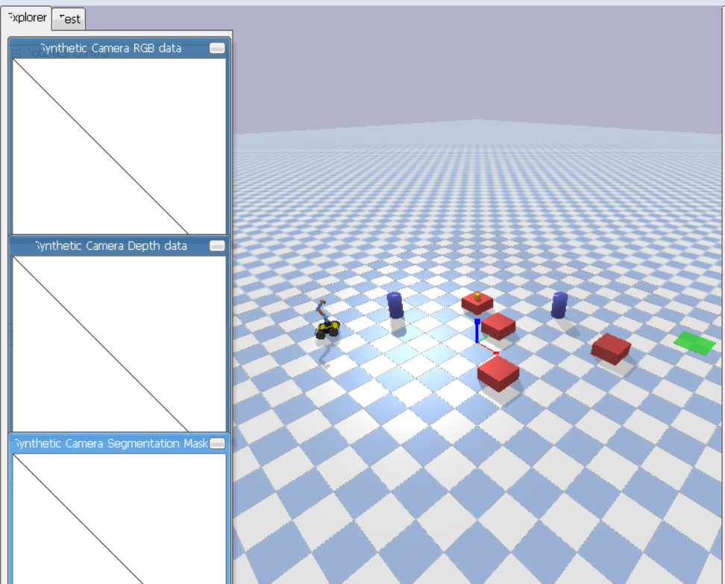

Slide 25
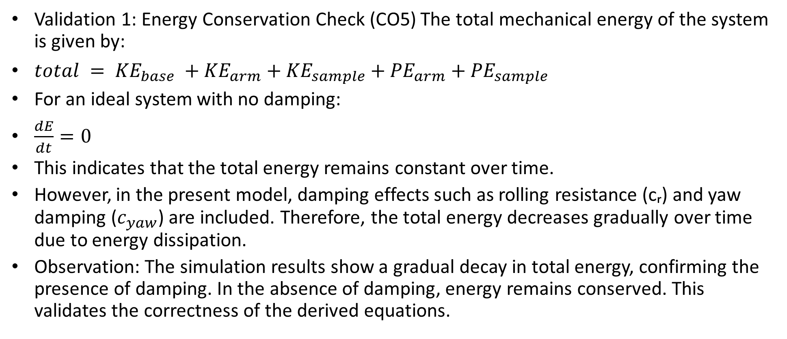
8. Validation & Analysis
Validation 1: Energy Conservation Check (CO5) The total mechanical energy of the system is given by:
$total = {KE}_{base} +{KE}_{arm}+{KE}_{sample}+{PE}_{arm}+{PE}_{sample}$
For an ideal system with no damping:
$\frac{dE}{dt}=0$
This indicates that the total energy remains constant over time.
However, in the present model, damping effects such as rolling resistance (cᵣ) and yaw damping ($c_{yaw}$) are included. Therefore, the total energy decreases gradually over time due to energy dissipation.
Observation: The simulation results show a gradual decay in total energy, confirming the presence of damping. In the absence of damping, energy remains conserved. This validates the correctness of the derived equations.
Notes:
TIMING: 3:45-5:00 (1.25 min)
FOCUS: Present final EOM and state-space. Explain the physical meaning of EVERY term.
TIP: 'c*x_dot = viscous damping force' is stronger than just showing the equation.

Slide 26
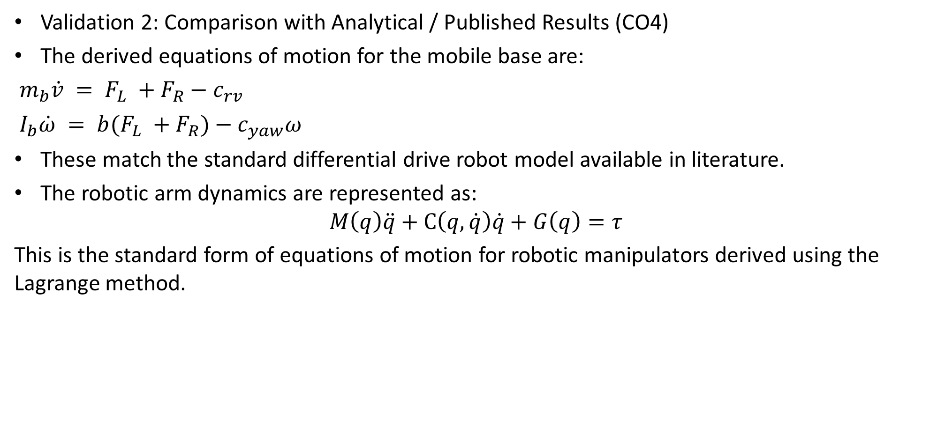
8. Validation & Analysis
Validation 2: Comparison with Analytical / Published Results (CO4)
The derived equations of motion for the mobile base are:
$m_{b}\dot{v} = F_{L} +F_{R}−c_{rv}$
$I_{b}\dot{ω} = {b(F}_{L} +F_{R})−c_{yaw}ω$
These match the standard differential drive robot model available in literature.
The robotic arm dynamics are represented as:
$$M\left(q\right)\ddot{q}+C\left(q,\dot{q}\right)\dot{q}+G\left(q\right)=τ$$
This is the standard form of equations of motion for robotic manipulators derived using the Lagrange method.
Notes:
TIMING: 3:45-5:00 (1.25 min)
FOCUS: Present final EOM and state-space. Explain the physical meaning of EVERY term.
TIP: 'c*x_dot = viscous damping force' is stronger than just showing the equation.

Slide 27
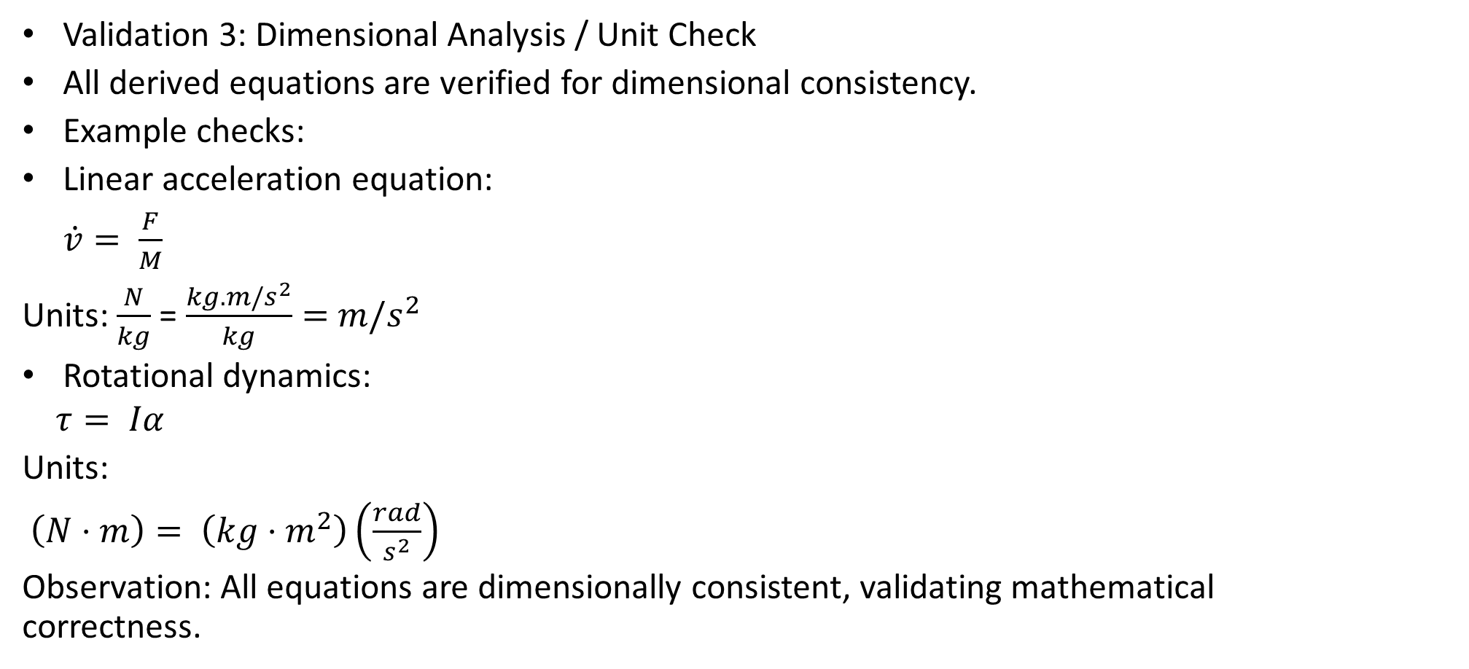
8. Validation & Analysis
Validation 3: Dimensional Analysis / Unit Check
All derived equations are verified for dimensional consistency.
Example checks:
Linear acceleration equation:
$\dot{v}= \frac{F}{M}$
Units: $\frac{N}{kg}$= $\frac{kg.m/s^{2}}{kg}=$ $m/s^{2}$
Rotational dynamics:
$$τ= Iα$$
Units:
$\left(N⋅m\right)= \left(kg⋅m^{2}\right)\left(\frac{rad}{s^{2}}\right)$
Observation: All equations are dimensionally consistent, validating mathematical correctness.
Notes:
TIMING: 3:45-5:00 (1.25 min)
FOCUS: Present final EOM and state-space. Explain the physical meaning of EVERY term.
TIP: 'c*x_dot = viscous damping force' is stronger than just showing the equation.

Slide 28
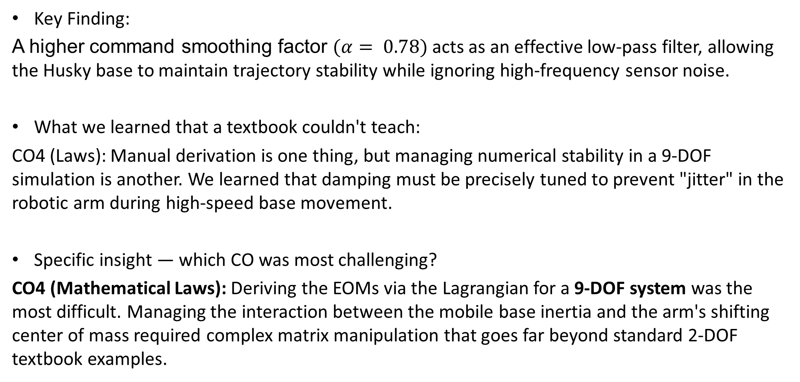
9. Conclusions & Reflections
Key Finding:
A higher command smoothing factor $(α= 0.78)$acts as an effective low-pass filter, allowing the Husky base to maintain trajectory stability while ignoring high-frequency sensor noise.
What we learned that a textbook couldn't teach:
CO4 (Laws): Manual derivation is one thing, but managing numerical stability in a 9-DOF simulation is another. We learned that damping must be precisely tuned to prevent "jitter" in the robotic arm during high-speed base movement.
Specific insight — which CO was most challenging?
CO4 (Mathematical Laws): Deriving the EOMs via the Lagrangian for a 9-DOF system was the most difficult. Managing the interaction between the mobile base inertia and the arm's shifting center of mass required complex matrix manipulation that goes far beyond standard 2-DOF textbook examples.
Notes:
TIMING: 8:30-10:00 (1.5 min)
FOCUS: Be specific about what you learned and what was hardest.
TIP: 'Getting the sign convention right in the Lagrangian took 3 iterations' is much stronger than 'teamwork was hard.'
INCLUDE: CO self-assessment — which COs did you exercise most?

Slide 29
9. Conclusions & Reflections
What we would do differently:
Implement a closed-loop PID controller for the base heading instead of simple gain-based logic to reduce the slight overshoot observed when approaching the sample location.
Course units most critical:
Unit 3 (Work & Energy): Crucial for proving the system isn't "gaining" phantom energy.
Unit 5 (System Dynamics): Provided the framework for the Bode analysis.
CO Self-Assessment:
CO1(Kinematics): ✓ CO2(FBD): ✓ CO3(Forces): ✓
CO4(Laws): ✓ CO5(Energy): ✓
Notes:
TIMING: 8:30-10:00 (1.5 min)
FOCUS: Be specific about what you learned and what was hardest.
TIP: 'Getting the sign convention right in the Lagrangian took 3 iterations' is much stronger than 'teamwork was hard.'
INCLUDE: CO self-assessment — which COs did you exercise most?

Slide 30
10. References & AI Disclosure
This project titled “Mathematical Simulation of Pick-and-Place Autonomous Robot” involved the use of Artificial Intelligence (AI) tools to assist in various stages of development, including coding, analysis, and documentation.
The following AI tools were used:
• ChatGPT (OpenAI) – Used for generating and refining Python simulation code, deriving equations of motion, assisting in debugging, and preparing report content such as validation, analysis, and explanations.
• Claude AI (Anthropic) – Used for structuring long-form content, improving documentation clarity, and assisting in formatting technical explanations.
• Google Gemini (Google AI) – Used for cross-verification of concepts, additional explanations, and alternative approaches to problem-solving.
Scope of AI Assistance AI tools were used strictly as supporting tools for:
• Understanding theoretical concepts
• Generating and optimizing simulation code
• Structuring derivations and explanations
• Assisting in report writing and formatting
Academic Integrity Statement:
All outputs generated using AI tools were:
• Carefully reviewed and verified by the project team
• Modified and adapted to meet the project requirements
• Understood before inclusion in the final submission The final work represents the team’s own understanding and
implementation, with AI used only as an aid for learning and productivity.
Notes:
AI disclosure is MANDATORY but NOT penalized.
Be honest about what tools you used and for what purpose.
Good: 'Used ChatGPT for Python syntax debugging, derivation done by hand.'
Non-disclosure IS penalized if uncovered during Q&A.

Slide 31
Thank You — Questions?
Team: Armaan Kotadiya ,Preyansh Patni ,Khush Mehta
Course: Dynamic System Modeling (702MH0C023)
B.Tech Mechatronics, Sem IV | NMIMS MPSTME Mumbai
Category: [E] | Complexity: [High]
COs Exercised: [CO1, CO2, CO3, CO4, CO5] | Date: [15/04/2026]

