Slide 1

DEPARTMENT OF ELECTRONICS AND COMMUNICATION ENGINEERING
Wien Bridge Oscillator with Automatic Gain Control
Presented by :
S.Sreeteja varma R200139
K.Harinath R200662
project guide :- Shaik Riyazun
P.Vasu R200490

Slide 2
Table of Contents
Abstract
1
2
Circuit design
Block diagram
3
4
Results
Advantages and disadvantages
5
6
Applications
Future Scope
7

Slide 3
Abstract :-
This paper presents a novel Wien Bridge oscillator design that achieves amplitude stability using diodes and a op-amp configuration.
The proposed oscillator features negative feedback path, enabling automated loop gain control.
This
design guarantees oscillation when the loop gain exceeds 1, and stabilizes at a loop gain of exactly 1
Simulation results demonstrate the effectiveness of the proposed design in achieving stable oscillations with improved accuracy.
The oscillator's automated loop gain adjustment makes it suitable for various applications.

Slide 4
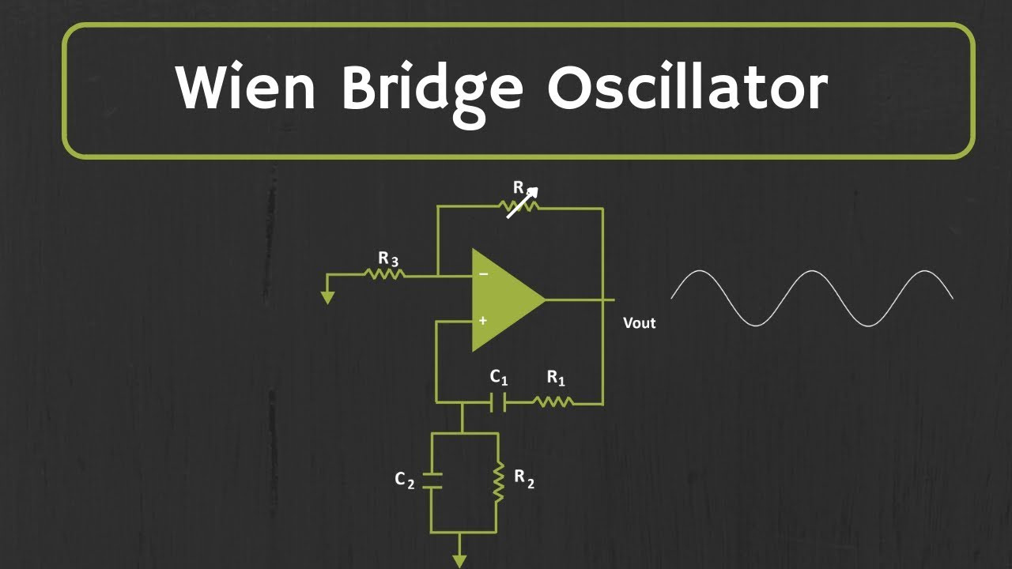
Existing Circuit :-

Slide 5
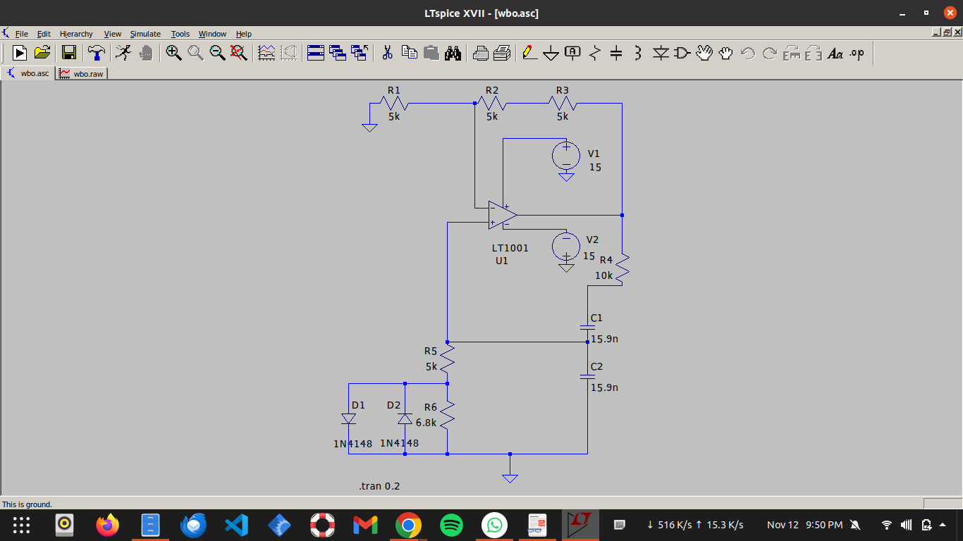
Proposed Technique :-

Slide 6
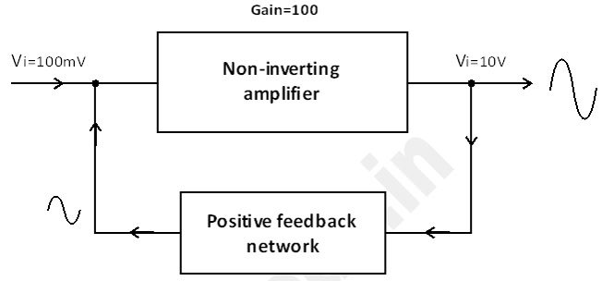
Block Diagram :-
For wein oscillators (see the figure) it is common practice to use the gain stage for limiting the amplitudes before supply voltages can cause hard clipping (and heavy distortions).
Amplitudes are continuously rising because
during the start-up period the loop gain must be larger than the theoretical value of 0dB.
The start-up loop gain is LoopGain > 1 for generation of oscillations and the Loop Gain should be equal to 1(i.e LG = 1).

Slide 7
Wien oscillator: Is automatic gain control the best (the only) choice?
Amplitudes are continuously rising because during the start-up period the loop gain must be larger than the theoretical value of 0dB. For this purpose to start with LG>0 db and to reduce the loop gain LG for rising amplitudes: R1=(R11+R12)>R2 (ideal gain stage with RB=2RA).
Such a modification will cause a small mismatch (mistuning) within the WIEN network - but during start-up the loop gain is slightly increased above 0 dB and the phase cross-over will be slightly reduced. As a consequence, we can expect a safe start of oscillations at a slightly reduced oscillation frequency.
However, we also can expect that a pair of diodes across R12 will bring the loop gain and the oscillation frequency for rising amplitudes back to the nominal case.
RB1=RB2=5k; two diodes across R12=6.8k.

Slide 8
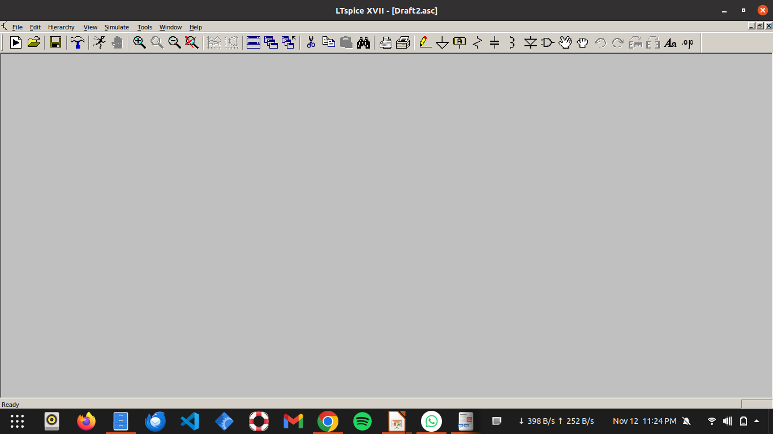
Software used :-
LTspice is a high-performance SPICE simulation software used for analog circuit design and simulation. Developed by Analog Devices, it is widely used for analyzing the behavior of electronic circuits, including oscillators, amplifiers, and filters.
Key Features :
Efficient SPICE engine with fast simulation times.
Support for time-domain, AC analysis, and transient simulations.
Built-in component library with customizable models.
Allows waveform analysis and circuit optimization.

Slide 9
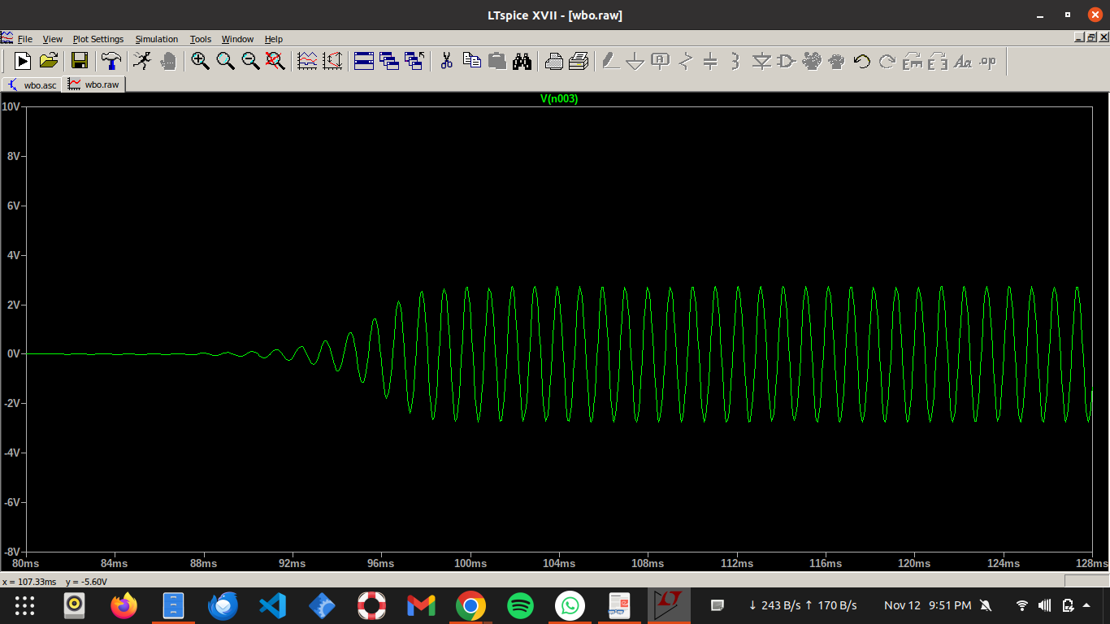
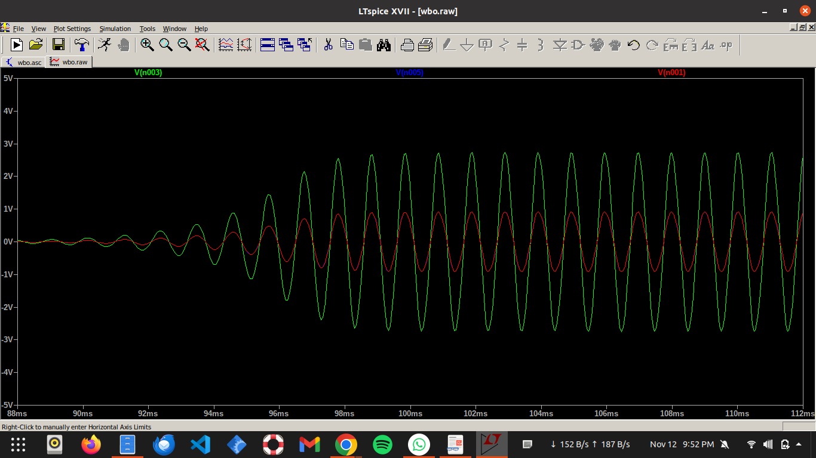
Results :-
AC analysis: Loop gain LG=+0.45dB dB at fo=920.6 Hz.
TRAN analysis: f=990 Hz, amplitude 3.0V, THD=2.82%.

Slide 10
Applications :-
1. Audio processing applications
2. Integration with analog circuits
3. Audio frequency generators
4. Higher frequency range exploration

Slide 11
Future scope :-
Novel Wien Bridge oscillator design with automatic gain control, improved accuracy, and circuit miniaturization.
In future work, this oscillator design could be adapted for higher frequency applications, including RF signal generation. Additional improvements could involve integrating the oscillator into mixed-signal.
Additional improvements could involve integrating the oscillator into mixed-signal ICs for
applications in audio processing, signal generation, and phase-locked loops (PLLs).
Prototype development and further miniaturization of the design will also be explored, along with integration with digital tuning methods for more precise frequency control in real-time applications.

