Slide 1
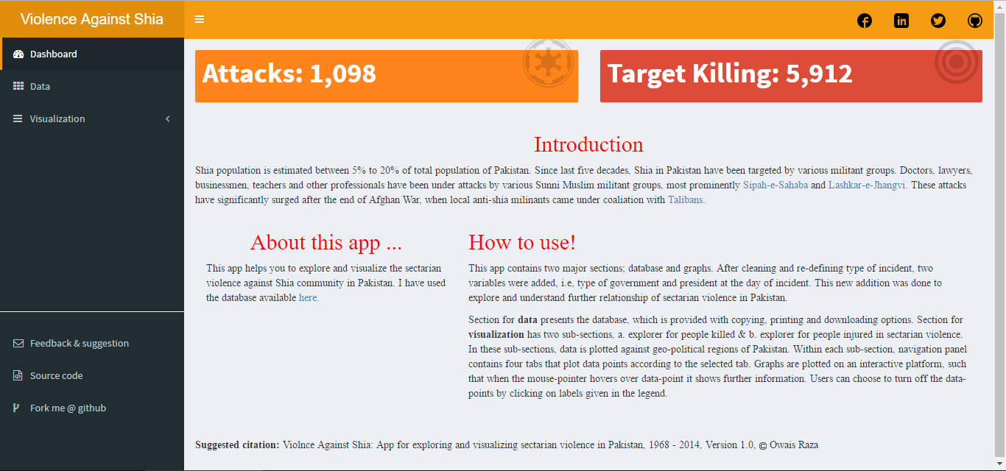


Slide 2
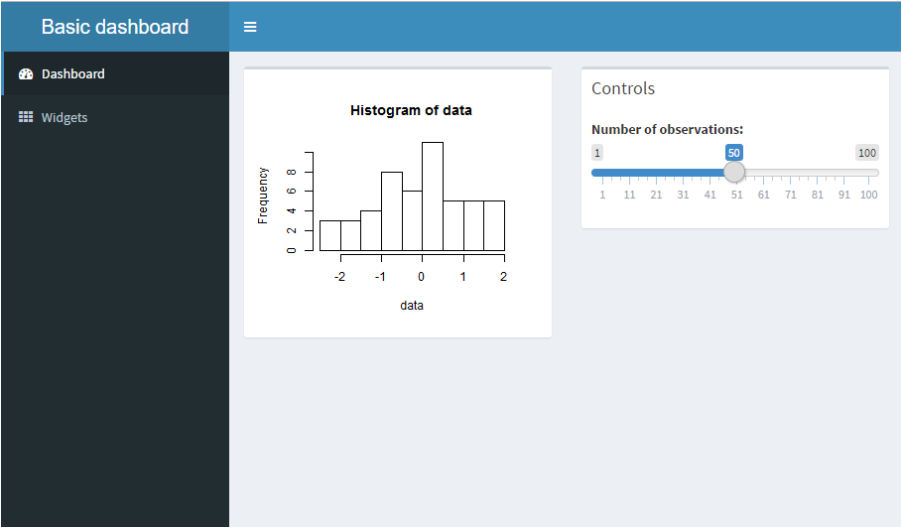
1.Header
4.
5.
2.Sidebar
3.Body

Slide 3
library(shinydashboard)
ui <- dashboardPage(
dashboardHeader(title = “Basic dashboard”),
dashboardSidebar(
sidebarMenu(
menuItem("Dashboard", tabName = "dashboard", icon = icon("dashboard")),
menuItem("Widgets", tabName = "widgets", icon = icon("th"))
)
) ,
dashboardBody(
tabItems(
# First tab content
tabItem(tabName = "dashboard",
fluidRow(
box(plotOutput("plot1", height = 250)),
box(
title = "Controls",
sliderInput("slider", "Number of observations:", 1, 100, 50)
)
)
),
# Second tab content
tabItem(tabName = "widgets",
h2("Widgets tab content")
)
)
)
)
1.Header
2.Sidebar
4.
5.
3.Body

Slide 4
server <- function(input, output) {
set.seed(122)
histdata <- rnorm(500)
output$plot1 <- renderPlot({
data <- histdata[seq_len(input$slider)]
hist(data)
})
}
shinyApp(ui, server)

Slide 5
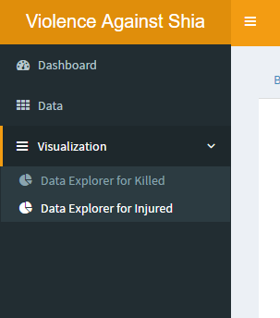
menuItem("Data", tabName = "datafile", icon = icon("th")),
menuItem("Visualization", icon = icon("navicon"), tabName = "graphs",
menuSubItem("Data Explorer for Killed", tabName = "kill"
, icon = icon("pie-chart")),
menuSubItem("Data Explorer for Injured", tabName = "inj"
, icon = icon("pie-chart"))
),

Slide 6
https://rstudio.github.io/shinydashboard/

Slide 7
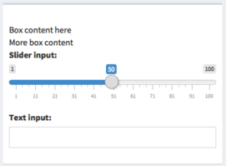
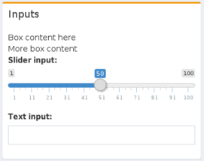
box(
"Box content here", br(), "More box content",
sliderInput("slider", "Slider input:", 1, 100, 50),
textInput("text", "Text input:")
)
box(
title = "Inputs", status = "warning",
"Box content here", br(), "More box content",
sliderInput("slider", "Slider input:", 1, 100, 50),
textInput("text", "Text input:")
)

Slide 8
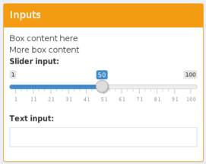
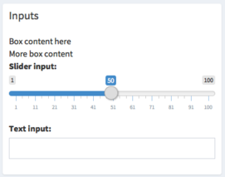
box(
title = "Inputs", status = "warning", solidHeader = TRUE,
"Box content here", br(), "More box content",
sliderInput("slider", "Slider input:", 1, 100, 50),
textInput("text", "Text input:")
)
box(
title = "Inputs", solidHeader = TRUE,
"Box content here", br(), "More box content",
sliderInput("slider", "Slider input:", 1, 100, 50),
textInput("text", "Text input:")
)

Slide 9
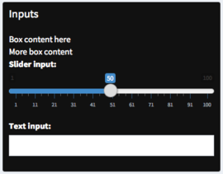
box(
title = "Inputs", background = "black",
"Box content here", br(), "More box content",
sliderInput("slider", "Slider input:", 1, 100, 50),
textInput("text", "Text input:")
)
collapsible = TRUE,
-> 縮小

Slide 10
fluidRow( ),
column(width = 12, ),
1
2
3
4
5
6
7
8
9
10
11
12

Slide 11
fluidRow(
column(width = 2, ),
column(width = 3, ),
column(width = 7, ),
),
fluidRow(
column(width = 3, ),
column(width = 4, ),
column(width = 5, ),
),

Slide 12
練習
shiny::runGitHub('sunny1229/shinydashboard', subdir = 'sunny')

