Slide 1
範例(簡介)
https://jjames.shinyapps.io/shinyHome/
https://databiomics.shinyapps.io/rsciencexplorer2016/
https://www.showmeshiny.com/

Slide 2
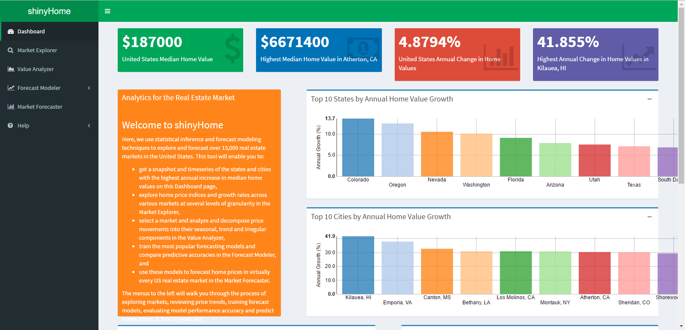
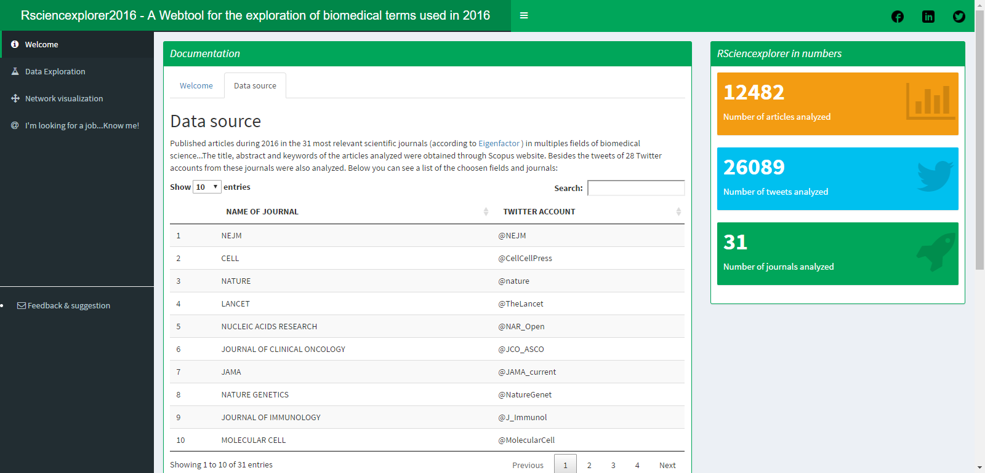


Slide 3
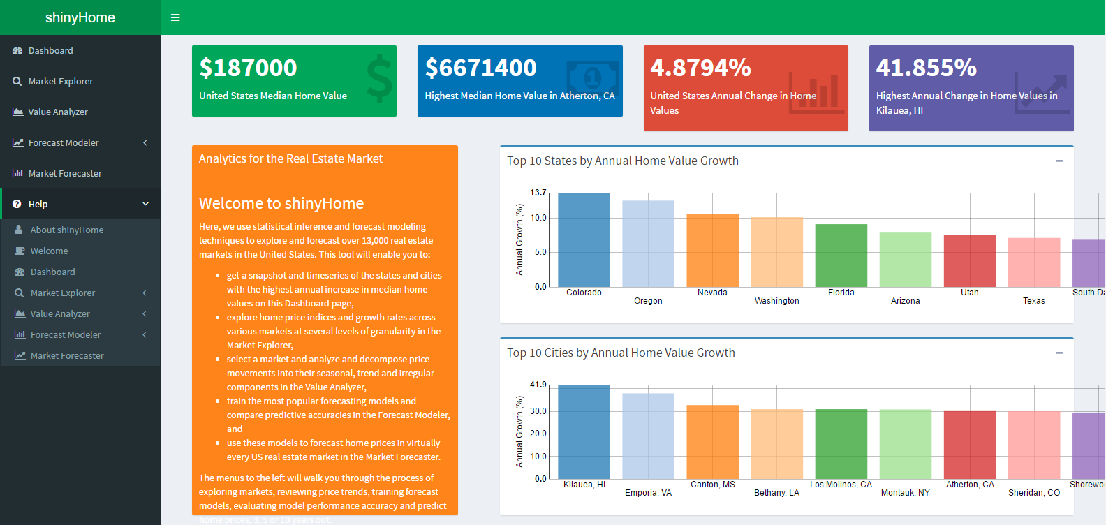
Header
Sidebar
Body

Slide 4
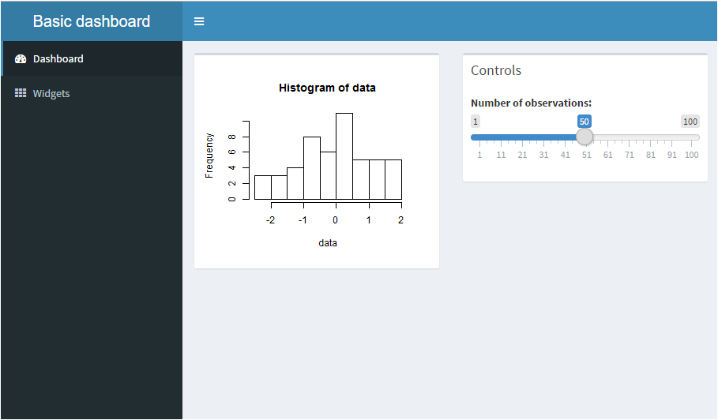
1.Header
4.
5.
2.Sidebar
3.Body

Slide 5
install.packages("shinydashboard")
library(shinydashboard)
ui <- dashboardPage(
dashboardHeader(title = “Basic dashboard”),
dashboardSidebar(
sidebarMenu(
menuItem("Dashboard", tabName = "dashboard", icon = icon("dashboard")),
menuItem("Widgets", tabName = "widgets", icon = icon("th"))
)
) ,
dashboardBody(
tabItems(
# First tab content
tabItem(tabName = "dashboard",
fluidRow(
box(plotOutput("plot1", height = 250)),
box(
title = "Controls",
sliderInput("slider", "Number of observations:", 1, 100, 50)
)
)
),
# Second tab content
tabItem(tabName = "widgets",
h2("Widgets tab content")
)
)
)
)
1.Header
2.Sidebar
4.
5.
3.Body

Slide 6
server <- function(input, output) {
set.seed(122)
histdata <- rnorm(500)
output$plot1 <- renderPlot({
data <- histdata[seq_len(input$slider)]
hist(data)
})
}
shinyApp(ui, server)

Slide 8
shiny::runGitHub('sunny1229/shinydashboard', subdir = 'sunny')

