Slide 1
CSE7000 - INTERNSHIP A Presentation on AI GPU SUMMER INTERNSHIP
Student Details
Name | Sunny Kumar Dharmendra
Roll No | 20241CSE0743
Section | 5CSE11
Under the Supervision of,
Dr. Anand Prakash
Associate Professor
Presidency School of Computer Science and Engineering
Presidency University
Name of the Program: Computer Science and Engineering (CSE)
Name of the HoD: Dr. Asif Mohamed
Name of the Program Internship Coordinator: Dr. R. Balakrishnan
Name of the School Internship Coordinators: Dr. Bhuvaneshwari Patil

Slide 2
Content
About Company or Organization
Working domain or the Technology
Objectives of the work
Methodology Used / Course Description
Results
Conclusion

Slide 3
About Company or Organization
AI GPU Summer Internship Program
Conducted by Presidency University – School of AI and Advanced Computing (GPU Computing Lab).
Focused on Artificial Intelligence, High-Performance Computing (HPC), GPU programming, and modern AI application development.
Provided hands-on training in deep learning, Large Language Models (LLMs), computer vision, NLP, and GPU-accelerated computing.
Students gained practical experience using NVIDIA H200 Tensor Core GPUs and industry-standard AI development tools.
The internship emphasized solving real-world problems through end-to-end AI project development.

Slide 4
Training Technologies
CUDA Programming
PyTorch Deep Learning
QLoRA Fine-Tuning
Retrieval-Augmented Generation (RAG)
LangGraph Multi-Agent Framework
FastAPI (Python)
React & TypeScript
Qdrant Vector Database
Hugging Face Transformers & PEFT
NVIDIA RTX 4060 GPU Deployment

Slide 5
Working domain or the technology
Domain: Artificial Intelligence (AI), Explainable AI (XAI), Legal AI, Large Language Models (LLMs), Retrieval-Augmented Generation (RAG), Multi-Agent Systems, and High-Performance Computing (HPC).
Technologies Used
Python, FastAPI, React & TypeScript
Qwen2.5-3B-Instruct (Fine-tuned using QLoRA)
Hugging Face Transformers & PEFT
LangGraph Agent Orchestration
Hybrid RAG (Qdrant + BM25)
Ollama & llama.cpp
Docker Compose
NVIDIA RTX 4060 GPU
Git & GitHub
IRAC-based Explainable Legal Reasoning

Slide 6
Objectives of the work
Develop LEXA, an AI-powered autonomous multi-agent courtroom intelligence system for Indian legal assistance.
Provide accurate and explainable legal reasoning based on the Bharatiya Nyaya Sanhita (BNS), Bharatiya Nagarik Suraksha Sanhita (BNSS), and Bharatiya Sakshya Adhiniyam (BSA).
Integrate a Hybrid Retrieval-Augmented Generation (RAG) framework to retrieve verified statutory information and minimize AI hallucinations.
Simulate courtroom proceedings using specialized AI agents such as Judge, Prosecutor, Defense, Jury, Evidence, and Legal Research agents.
Generate structured legal responses following the Issue, Rule, Analysis, and Conclusion (IRAC) methodology with deterministic statutory citations.
Enable complete local deployment to ensure data privacy, offline accessibility, and secure processing of sensitive legal information.
Provide a scalable foundation for future expansion into additional legal domains and multilingual legal assistance.

Slide 7
Methodology Used / Course Description
LEXA Workflow
User submits legal query or case details.
Hybrid RAG retrieves relevant legal statutes.
Legal documents are processed and reranked.
LangGraph coordinates eight specialized AI agents.
Fine-tuned Qwen2.5-3B generates IRAC-based legal reasoning.
Deterministic citation engine verifies statutory references.
Final explainable legal verdict with confidence score is displayed.

Slide 8
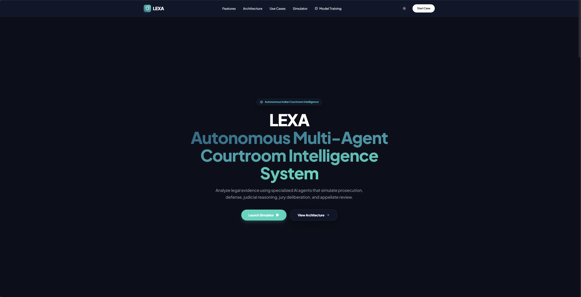
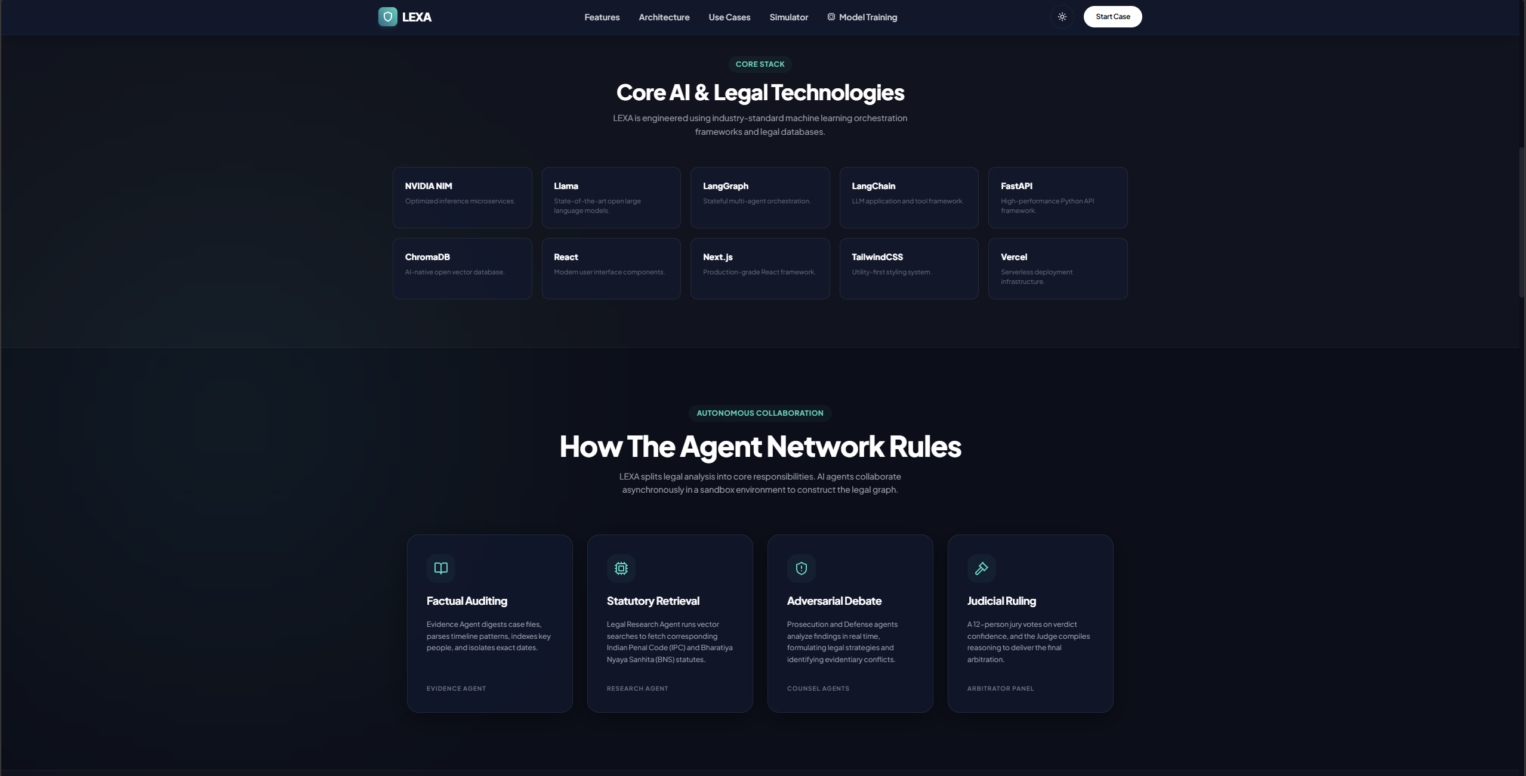
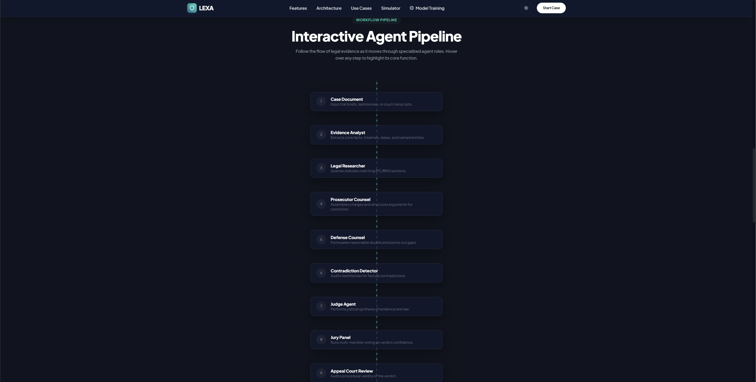
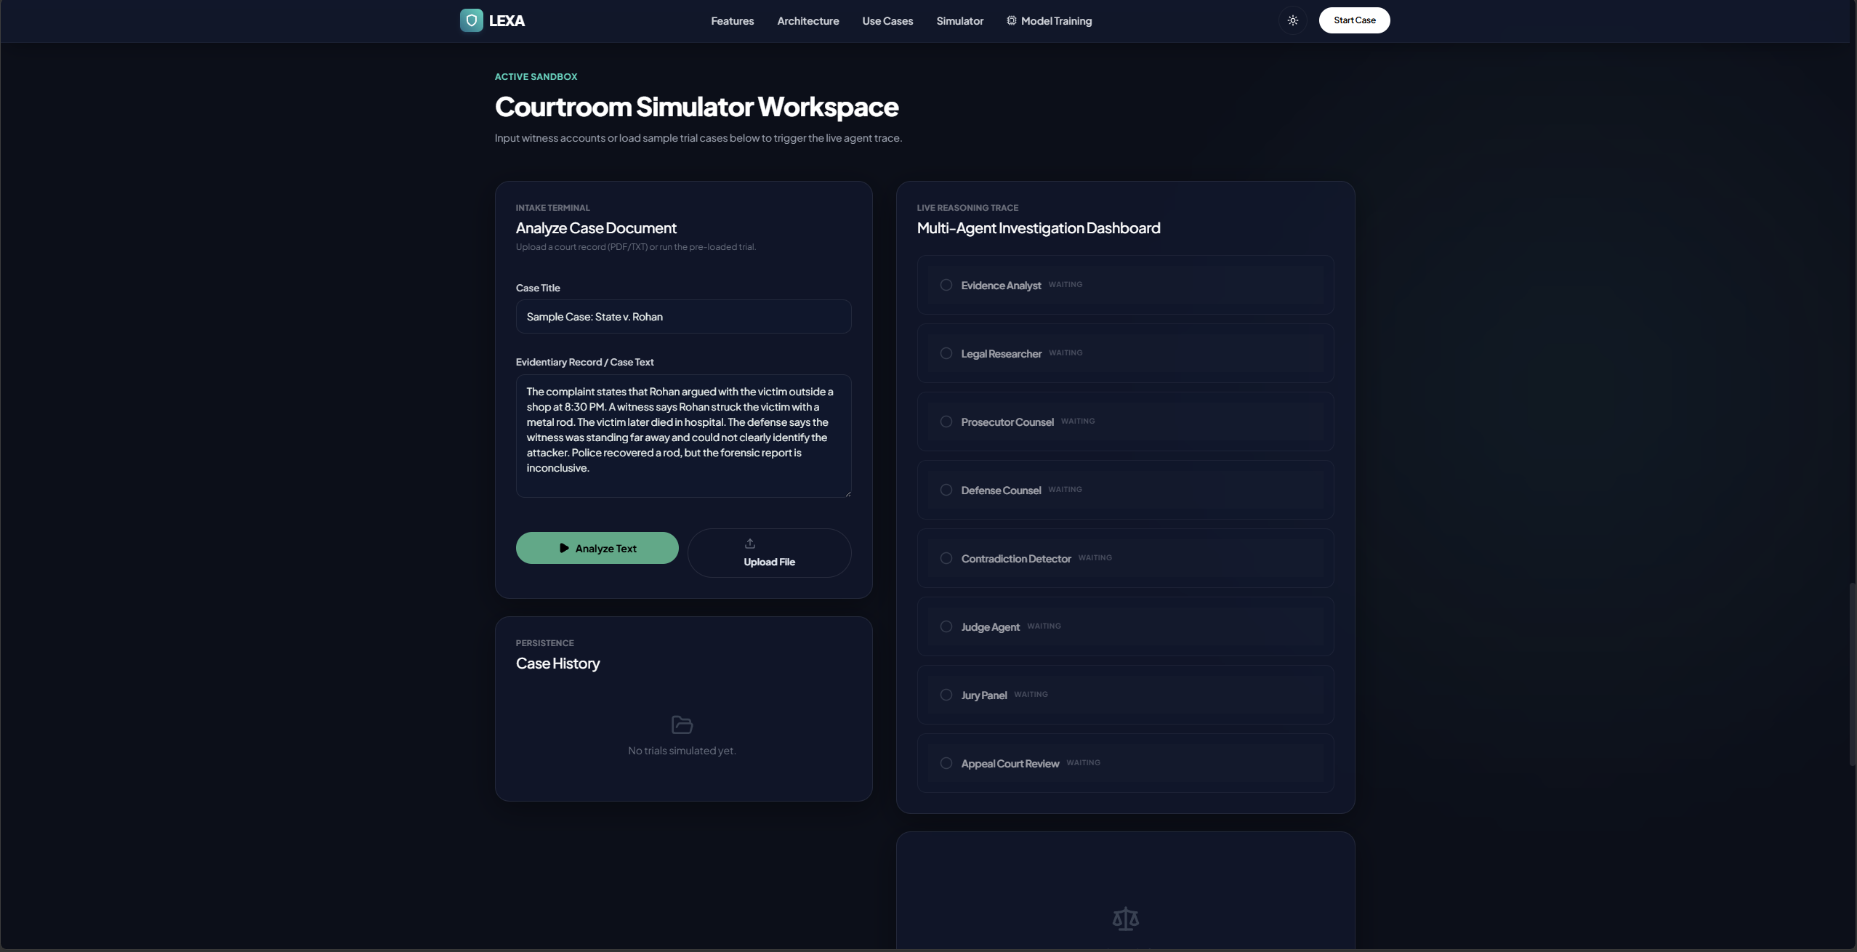
Results

Slide 9
Conclusion
Successfully developed LEXA, an autonomous multi-agent courtroom intelligence system for Indian legal assistance.
Integrated a Hybrid Retrieval-Augmented Generation (RAG) framework with a fine-tuned Qwen2.5-3B-Instruct model to provide accurate, explainable, and citation-backed legal reasoning.
Implemented eight specialized AI agents to simulate courtroom proceedings, including legal research, evidence analysis, prosecution, defense, judgment, jury evaluation, contradiction detection, and appeal review.
Achieved reliable performance through deterministic citation mapping, structured IRAC-based reasoning, and significantly reduced AI hallucinations.
Enabled complete local deployment using FastAPI, React, LangGraph, Qdrant, Ollama, and Docker, ensuring data privacy and offline accessibility.
Demonstrated the practical application of Artificial Intelligence, Large Language Models, Retrieval-Augmented Generation, and Multi-Agent Systems in solving real-world legal research and decision-support challenges.

Slide 10
Q&A

Slide 11
Thank you !!

