Slide 1
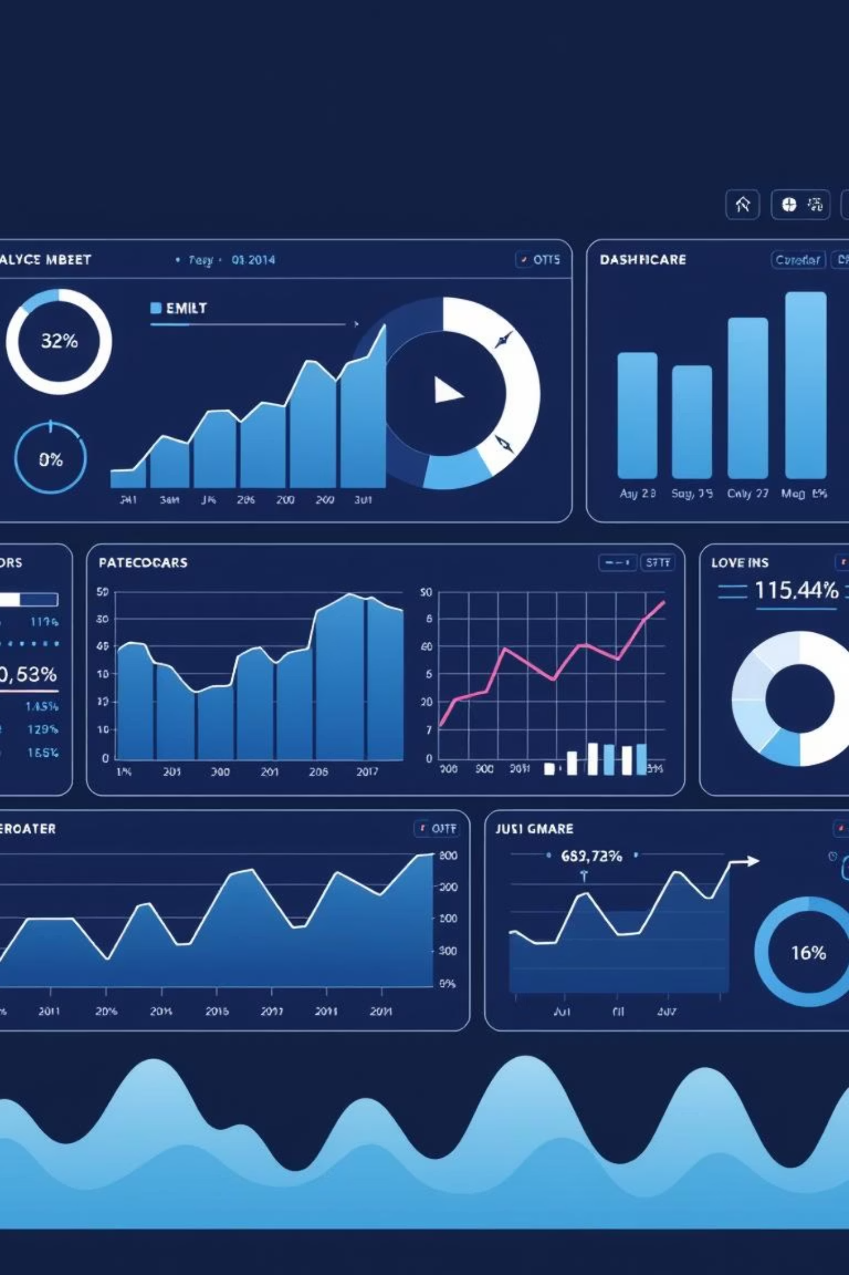
ANALYZING AND PREDECTING:
Predicting Inflation, Unemployment, and Rural Development with Machine Learning
TEAM NAME:VAR

Slide 2
Project Overview
Our project delivers an interactive dashboard built with Streamlit, designed to empower policy analysts, data scientists, and product stakeholders. It leverages robust machine learning models to forecast critical economic indicators and visualize key development metrics. This tool provides actionable insights for informed decision-making.
1
Predict Inflation Rates
Accurate forecasting of future inflation trends.
2
Forecast Unemployment Rates
Insightful predictions for labor market dynamics.
3
Visualize Rural Development
Comprehensive overview of growth metrics in rural areas.

Slide 3





Dashboard Navigation & Key Features
The dashboard is intuitively designed with a sidebar navigation system, ensuring seamless access to all functionalities. Each section is tailored to provide either precise predictions or rich visual analytics, catering to diverse analytical needs.
Home
Predict Inflation
Predict Unemployment
Rural Development Dashboard
Prediction History
About

Slide 4
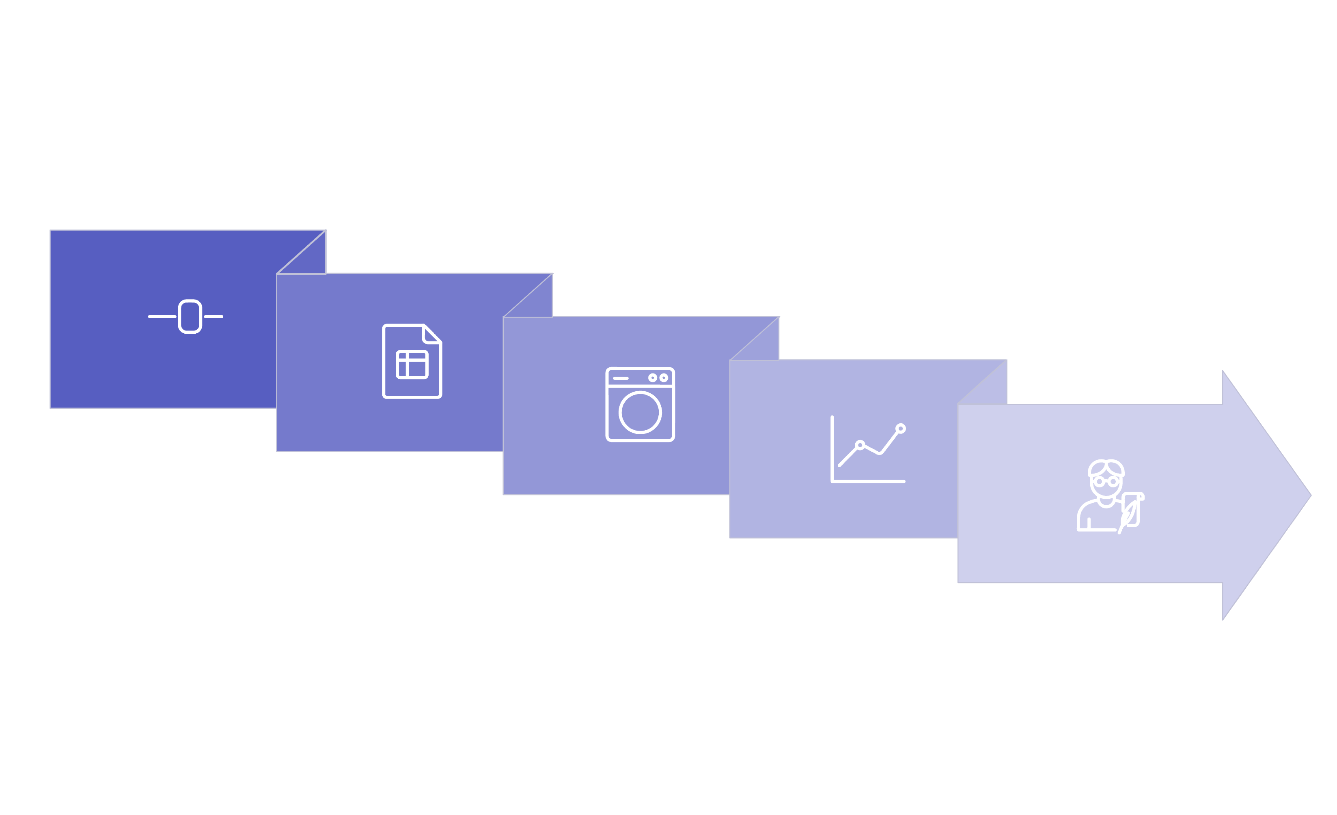





The Prediction Workflow
Our dashboard simplifies complex economic forecasting into a streamlined, user-friendly process. From data input to insightful visualization, every step is automated to deliver accurate and timely results, enhancing analytical efficiency.
Select Input
Predict
Save History
Load Data
Visualize

Slide 5
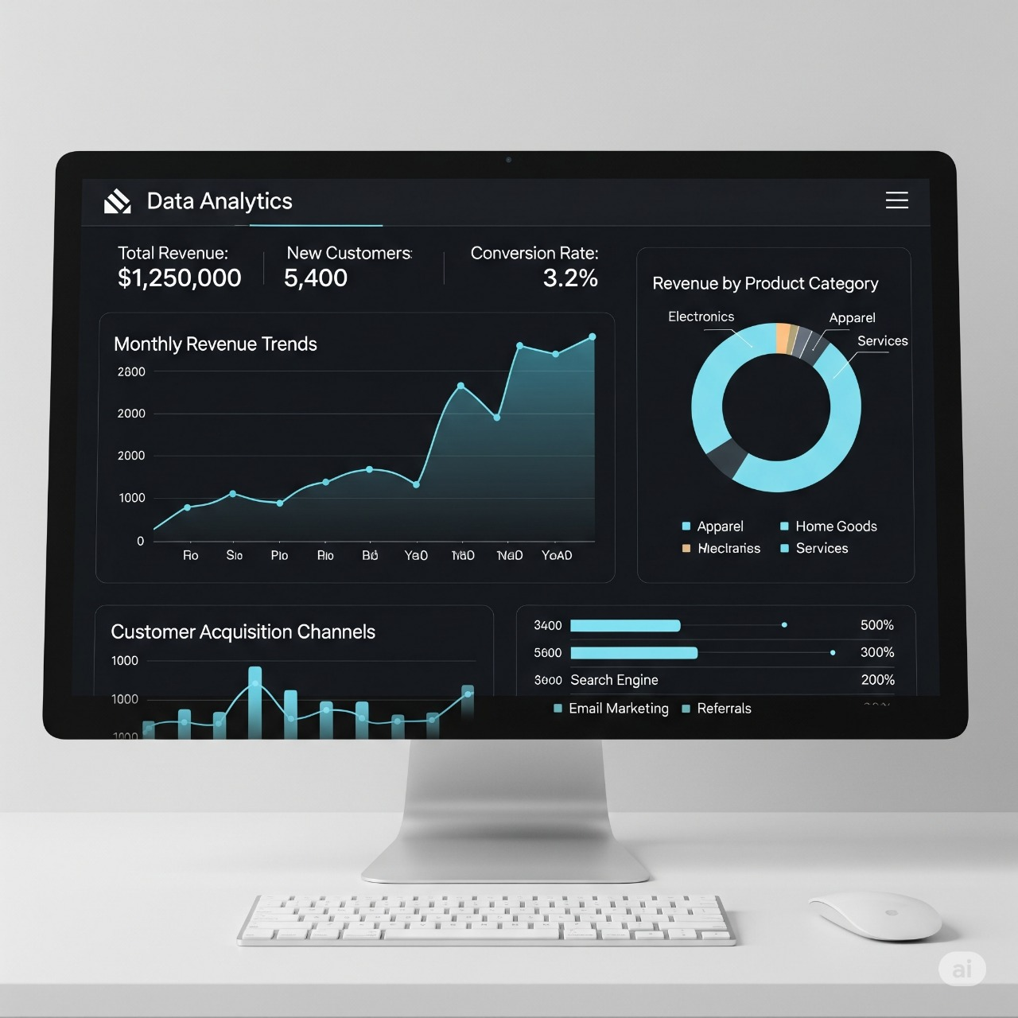
Inflation Rate Prediction: Global Insights
Harnessing the power of machine learning, our dashboard accurately
forecasts inflation rates, providing a crucial tool for economic analysis.
By leveraging the RandomForestRegressor model, we offer precise
predictions that can inform policy and investment decisions worldwide.
Model: RandomForestRegressor
Inputs: Country, Future Year (>2024)
Output: Predicted Inflation Rate, Historical Comparison Chart
Data Source: global_inflation_data.csv
The line chart illustrates historical inflation trends alongside our model's predictions, offering a clear visual comparison.

Slide 6
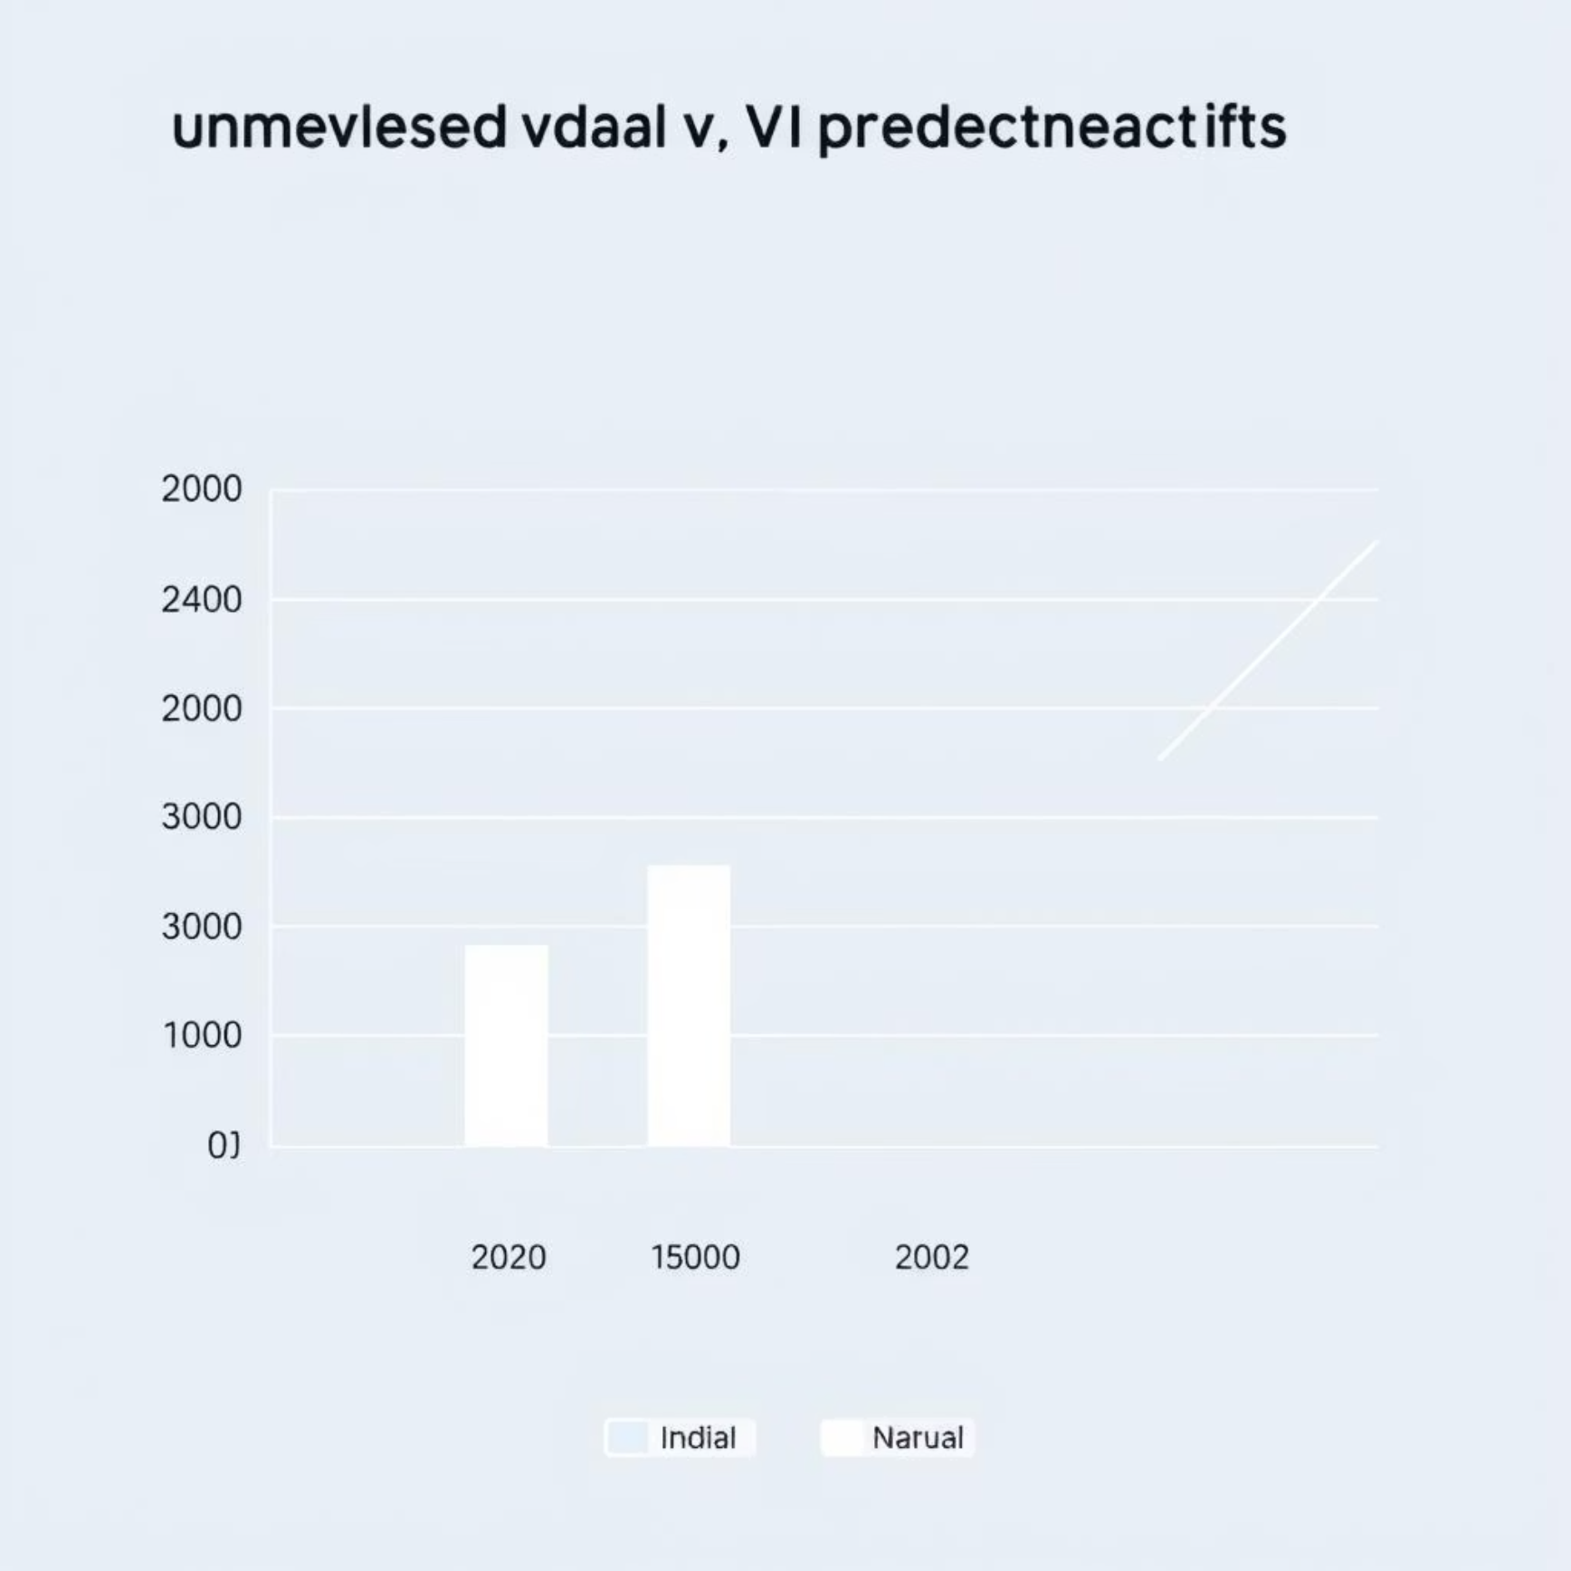
Unemployment Rate Prediction: Focusing on India
For unemployment rate forecasting, we employ a Linear Regression model with a lag feature, focusing specifically on Indian states. This method utilizes the last known unemployment rate to predict monthly trends, providing granular insights for regional policy-making.
Model: Linear Regression with Lag Feature
Inputs: Indian State/Region, Future Year
Method: Uses last known rate as lag variable to predict monthly unemployment.
Output: Actual vs. Predicted Bar Chart
Data Source: Cleaned_Unemployment_in_India.csv
The bar chart visually compares actual and predicted unemployment rates, highlighting the model's accuracy.

Slide 7
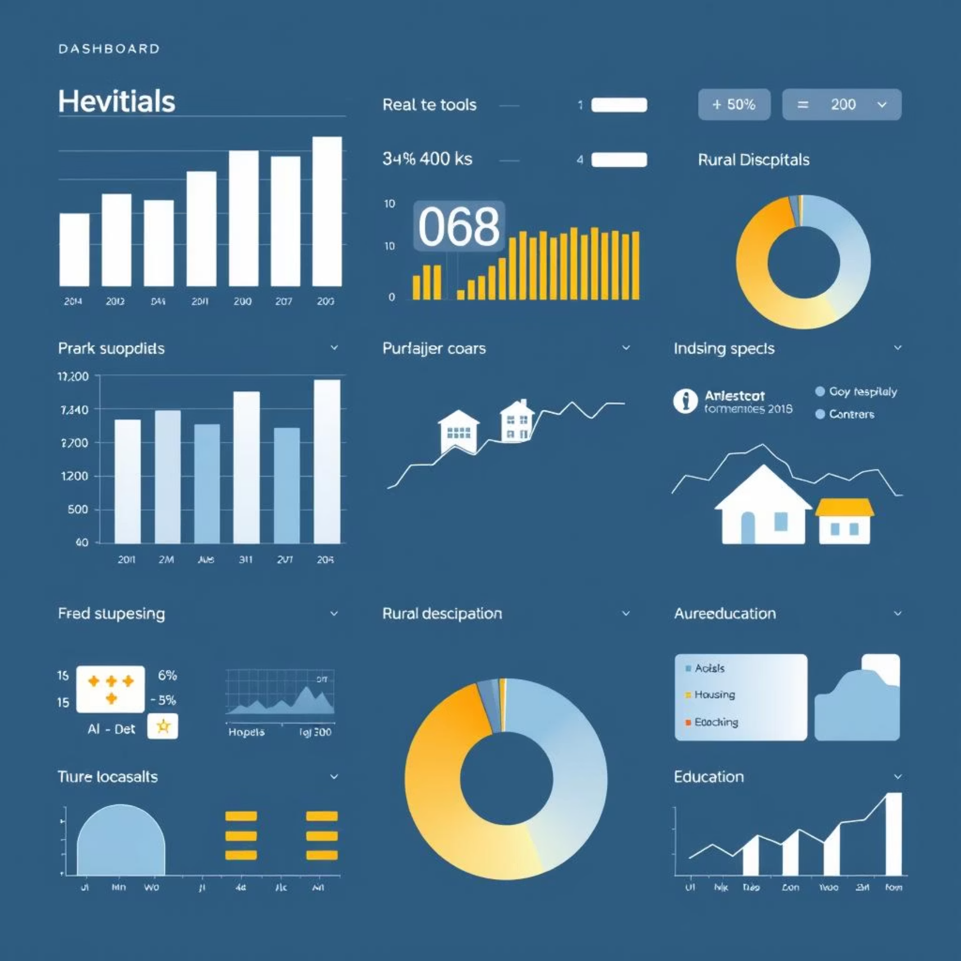
Rural Development Dashboard: Visualizing Progress
The Rural Development Dashboard provides a comprehensive
visual overview of key developmental metrics
across different states and years.
It tracks progress in essential areas, offering critical insights
for targeted interventions and policy evaluation.
Visualizes 4 key metrics: Roads, Hospitals, Housing, Education
Charts displayed: Column, Bar, Pie, and Line (for trends over years)
Data source: Rural_Development.csv
Inputs: State & Year

Slide 8
Tool Stack & AI Assistance
Our dashboard is built on a robust foundation of cutting-edge technologies, augmented by powerful AI tools that accelerated development and ensured high performance. This blend of established libraries and advanced AI support enabled us to deliver a sophisticated and reliable solution.
Core Technologies
AI Tools Used
Streamlit: Frontend UI framework for interactive dashboards.
ChatGPT (OpenAI): Facilitated code generation, debugging, and documentation.
Pandas, NumPy: Essential for efficient data loading and processing.
Gemini (Google): Aided in ML model design and performance optimization ideas.
Scikit-learn: Powers our ML models (RandomForestRegressor, Linear Regression).
Quadratic: Utilized for spreadsheet-like data exploration and rapid ML prototyping.
Matplotlib, Plotly: For creating compelling data visualizations.
Data Files
global_inflation_data.csv, Cleaned_Unemployment_in_India.csv, Rural_Development.csv

Slide 9
Prediction History & Session State
A core feature of our dashboard is the persistent prediction history, managed through Streamlit's session state. This functionality allows users to track and compare all predictions made during their session, facilitating comprehensive analysis and evaluation over time.
Inflation
USA
2025
3.2%
Unemployment
Maharashtra
2024
7.1%
Inflation
Germany
2026
2.5%
The table provides a clear overview of previously generated forecasts, enabling easy review and comparison of economic indicators.

Slide 10

Summary & Future Scope
Summary
Future Enhancements
This dashboard unifies data, machine learning, and an interactive user interface to create a powerful economic forecasting tool. It effectively predicts and visualizes key development indicators, empowering users with data-driven insights for strategic planning.
Integrate more ML models for comparative accuracy analysis.
Implement user authentication for personalized data saving and access.
Develop functionality for generating and downloading detailed reports.
Our commitment is to continuously evolve this dashboard, ensuring it remains at the forefront of economic forecasting technology and continues to deliver unparalleled value.
INSTITUTION NAME:VIKAS GROUP OF INSITUTIONS

