Slide 1
WELCOME

Slide 2


PRESENTATION ON ETHICAL HACKING
By
Sunny Gupta

Slide 3
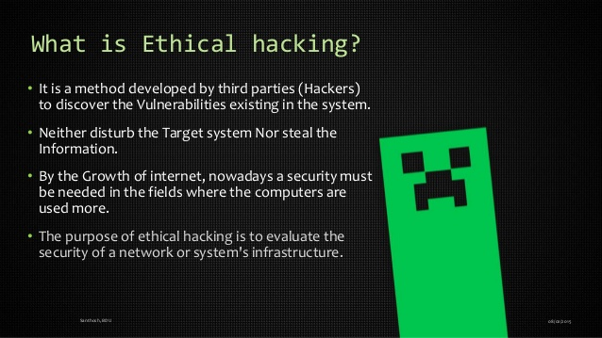

Difference Between Security and Protection
Security and protection are extremely close concepts though not same.
Security measures are adopted to increase the level of protection
The feeling of protection arises when one has enough security measures
Security is a type of protection against external threats.

Slide 4
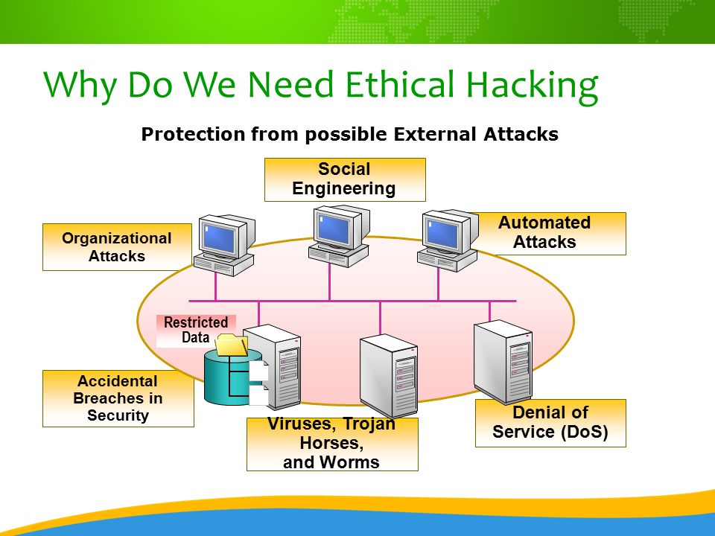

WHAT IS SECURITY
It is used to provide confidentiality, Integrity and protects us from .
It is the state of being free from danger or threat.

Slide 5
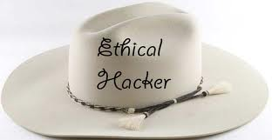


Types of Hacker
White Hat Hacker
Good guys
Don’t use their skill for illegal purpose
Computer security experts and help to protect from Black Hats.
Black Hat Hacker
Bad guys
Use their skill maliciously for personal gain
Hack banks, steal credit cards and deface websites
Grey Hat Hacker
It is a combination of White hat n Black Hat Hackers
Goal of grey hat hackers is to provide national security

Slide 6
Hacking Process
Footprinting
Scanning
Enumeration
Attack and Gaining Access
Escalating Privilege, Covering Tracks and Creating Backdoors

Slide 7
Some Tools
Footprinting
Who is, ping
Traceroot, nslookup
Scanning
nessus
nmap
Enumeration
Netcat. tcpdump
Telnet, firewalk

Slide 8

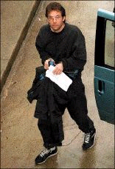
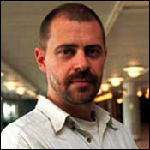
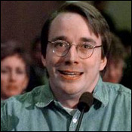
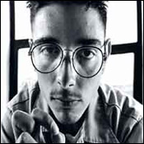
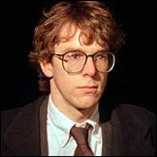
Some Famous Hacker
Ian Murphy
Kevin Mitnick
Johan Helsinguis
Linus Torvald
Mark Abene
Robert Morris

Slide 9
Recent news of Hacking
Next generation patch management tool released- Secunia CSI 7.0
Anonymity tool TOR gains more than 1.2 million users since NSA PRISM Scandal
Fear of NSA PRISM : Indian Government may ban US email services for official Communication
CISCO vulnerability allows remote attacker to take control of Windows System
New York Times. Twitter and Huffington Post Domains hijacked by Syrian Electronic Army
FBI uses Anonymous Hackers to attack foreign Governments
Palestinian Hacker , who hacked Zuckerberg’s Facebook Account to be awarded with $12000

Slide 10
When solving problems, dig at the roots instead of just hacking at the leaves.
Thank You

