Slide 1
Design Patterns

Slide 2
Categories of Design Patterns
Creational Patterns
Structural Patterns
Behavioral Patterns

Slide 3
Creational Patterns
Helps to make a system independent of how objects are created, composed and represented
Emphasizes more on object composition rather than inheritance

Slide 4
Structural Patterns
Deals with the purpose of organizing groups of Classes and object to form larger structures

Slide 5
Behavioral Patterns
These patterns are concerned with algorithms and the assignment of responsibilities between objects.
These patterns characterize the control flow.

Slide 6
Creational Patterns -- Abstract Factory
Intent
Provide and interface for creating a families of related or dependant objects without specifying their concrete class.

Slide 7
Creational Patterns -- Abstract Factory
Applicability
This pattern is used when a system
must be independent of how its products are created, composed and represented.
Should be configured with one of multiple families of products

Slide 8
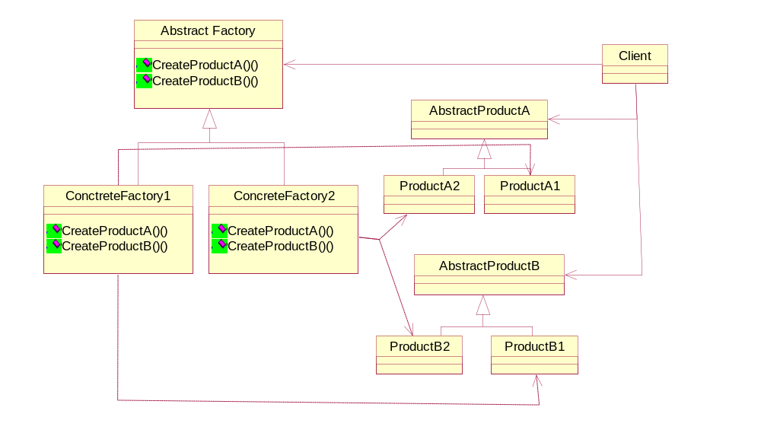
Creational Patterns -- Abstract Factory
Structure

Slide 9
Creational Patterns -- Builder
Intent
Separate the construction of a complex object from its representation so that the same construction process can create different representations

Slide 10
Creational Patterns -- Builder
Applicability
This pattern is used when
The algorithm for creating complex object must be independent of Object parts
Construction must allow different representations for the object

Slide 11
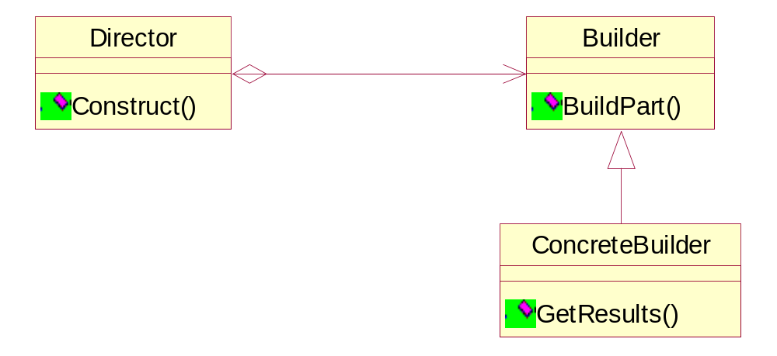
Creational Patterns --Builder
Structure

Slide 12
Creational Patterns – Factory Method
Intent
Define the interface for creating object, but let subclasses decide which class to instantiate.

Slide 13
Creational Patterns -- Factory Method
Applicability
This pattern is used when
A class can’t anticipate the class of objects it must create
A class wants its subclasses to specify the objects it creates.

Slide 14
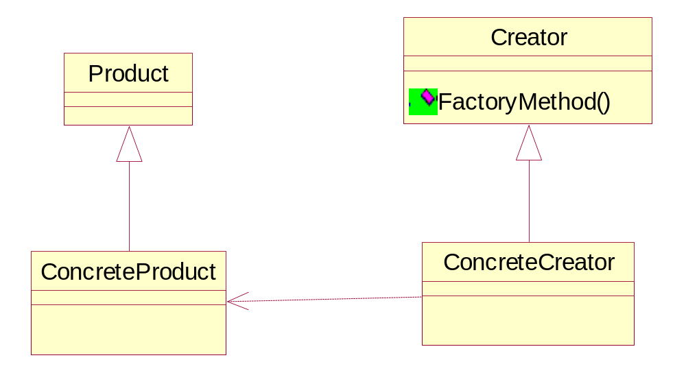
Creational Patterns -- Factory Method
Structure

Slide 15
Creational Patterns – Prototype
Intent
Specifies the kinds of Objects to create using prototypical instance, and create new object by copying this prototype.

Slide 16
Creational Patterns -- Prototype
Applicability
This pattern is used when
The class to instantiate are specified at run-time.
We have to avoid building hierarchies of factories that parallels with hierarchy of products.
Instances of a class can have one of a few different combination of states.

Slide 17
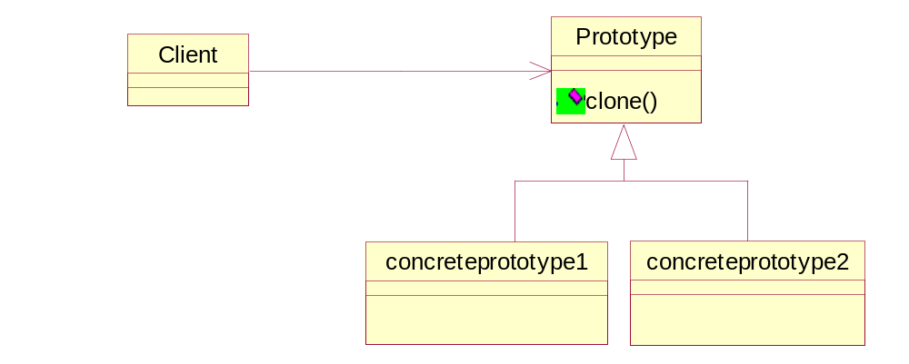
Creational Patterns -- Prototype
Structure

Slide 18
Creational Patterns – Singleton
Intent
Ensures that a class has only one instance and provide a global point of access.

Slide 19
Creational Patterns -- Singleton
Applicability
This pattern is used when
There must be only one instance of a class and must be accessible from a common access point
Sole instance must be extensible by sub classing, and clients must be able to extend instance with out changing code.

Slide 20
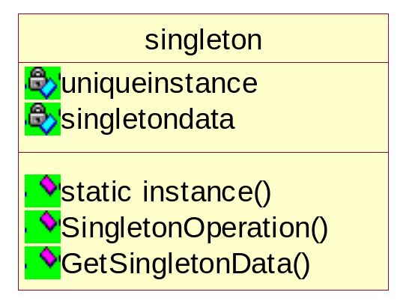
Creational Patterns -- Singleton
Structure

Slide 21
Structural Patterns – Adapter
Intent
Convert the interface of a class to another interface the client expects. Adapter lets class work together that couldn't otherwise because of incompatible interfaces

Slide 22
Structural Patterns – Adapter
Applicability
This pattern is used when
You want to use an existing class, and its interface does not match the one you need.
You want to create reusable classes that don’t necessarily have compatible interfaces

Slide 23
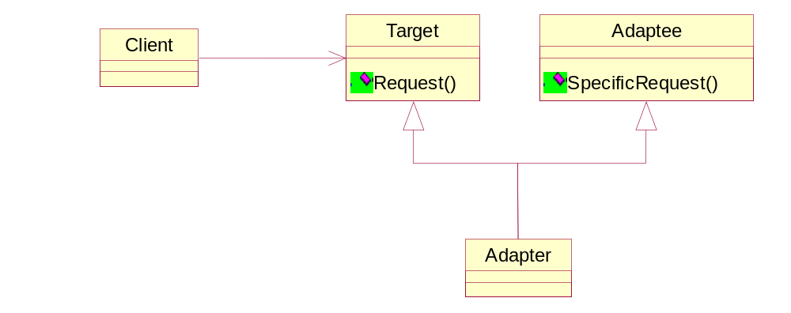
Structural Patterns – Adapter
Structure

Slide 24
Structural Patterns – Bridge
Applicability
This pattern is used when
You want to avoid permanent binding between abstraction and implementation
Changes in the implementation of an abstraction must have no effect on the client
Implementation has to be shared across multiple objects

Slide 25
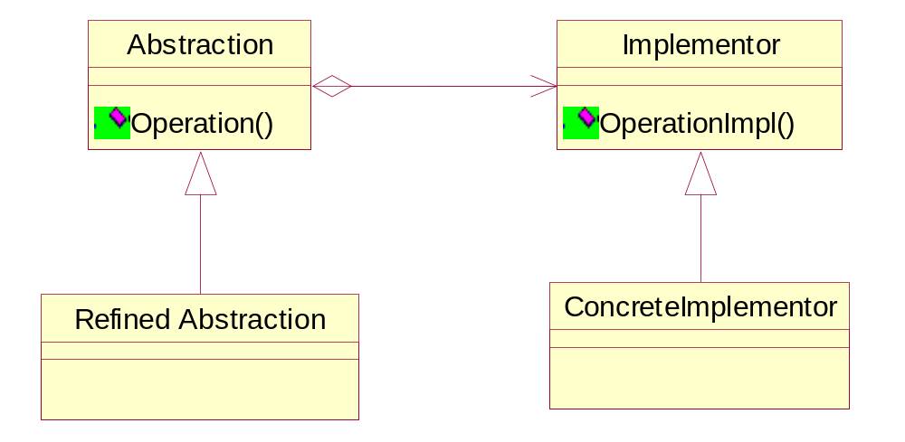
Structural Patterns – Bridge
Structure

Slide 26
Structural Patterns – Composite
Intent
Compose object into tree structures to represent part-whole hierarchies This lets clients treat individual objects and group of object uniformly

Slide 27
Structural Patterns – Composite
Applicability
This pattern is used when
You want to represent part-whole hierarchy of objects.
Client must be made ignorant of of individuality or composition of objects.

Slide 28
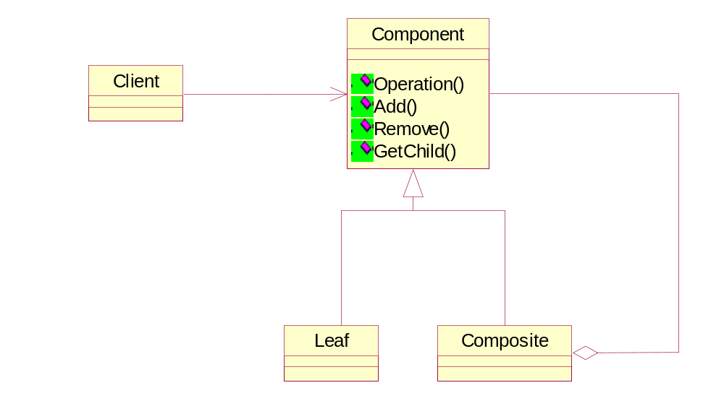
Structural Patterns – Composite
Structure

Slide 29
Structural Patterns – Decorator
Intent
Attach additional responsibilities to an object dynamically. This provides flexible alternative to sub classing for extending functionality.

Slide 30
Structural Patterns – Decorator
Applicability
This pattern is used when
You want to add responsibilities to objects dynamically without affecting other objects.
Extensions by sub classing are impractical

Slide 31
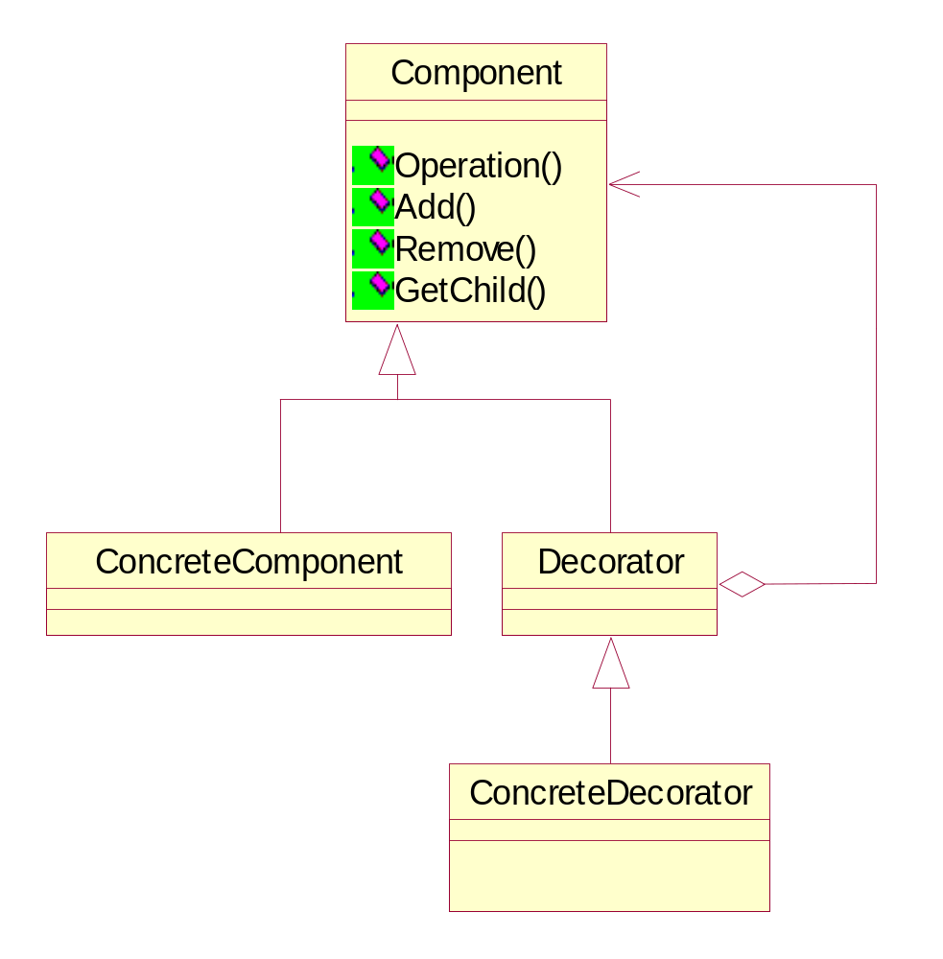
Structural Patterns – Decorator
Structure

Slide 32
Structural Patterns – Facade
Intent
Provide a unified interface to a set of interfaces in a sub system. This defines a higher level of interfacing that makes the sub systems easier to use

Slide 33
Structural Patterns – Facade
Applicability
This pattern is used when
You want to provide a simple interface to a complex sub system.
Client must be decoupled from the subsystems

Slide 34
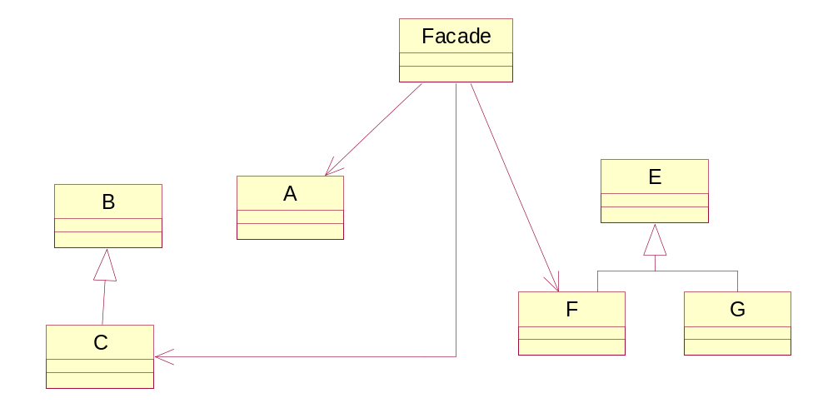
Structural Patterns – Facade
Structure

Slide 35
Structural Patterns – FlyWeight
Intent
Use sharing to support a large number of fine grained objects efficiently.

Slide 36
Structural Patterns – FlyWeight
Applicability
This pattern is used when
An application used a large number of objects
Storage costs are high because of the sheer quantity of objects
Most object states can be made extrinsic

Slide 37
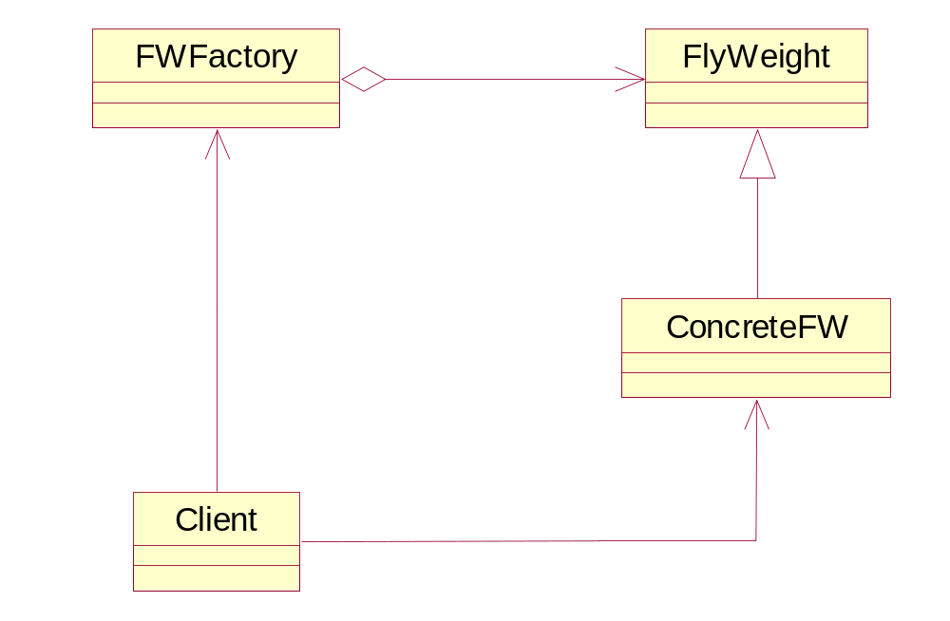
Structural Patterns – FlyWeight
Structure

Slide 38
Structural Patterns – Proxy
Intent
Provide a surrogate or placeholder for another object to control access to it.

Slide 39
Structural Patterns – Proxy
Applicability
This pattern is used when
A remote proxy provides a local representative for and object in a different address space
A virtual proxy create an expensive object on demand.
A protection proxy controls access to the original object.

Slide 40
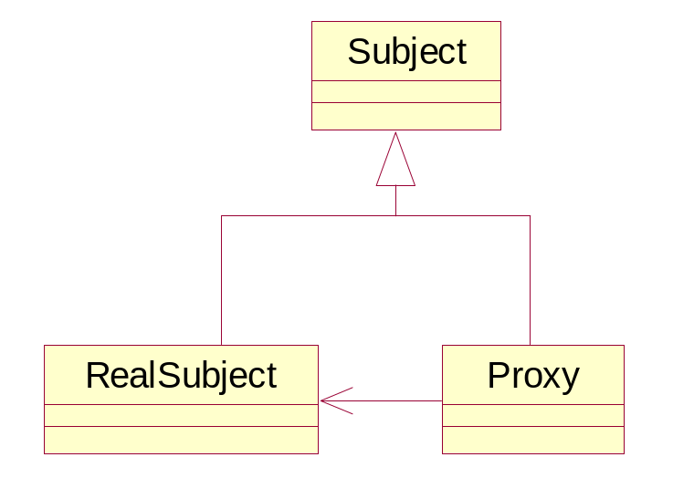
Structural Patterns – Proxy
Structure

Slide 41
Behavioral Patterns – Chain Of Responsibility
Intent
Avoid coupling the sender of the request with the receiver by giving more than one object a chance to handle the request. Chain the receiving object and pass the request along the chain until the object handles it.

Slide 42
Behavioral Patterns – Chain Of Responsibility
Applicability
This pattern is used when
More than one objects can handle the request and the handler is not known.
You want to issue a request to one of the several objects without specifying the receiver explicitly

Slide 43
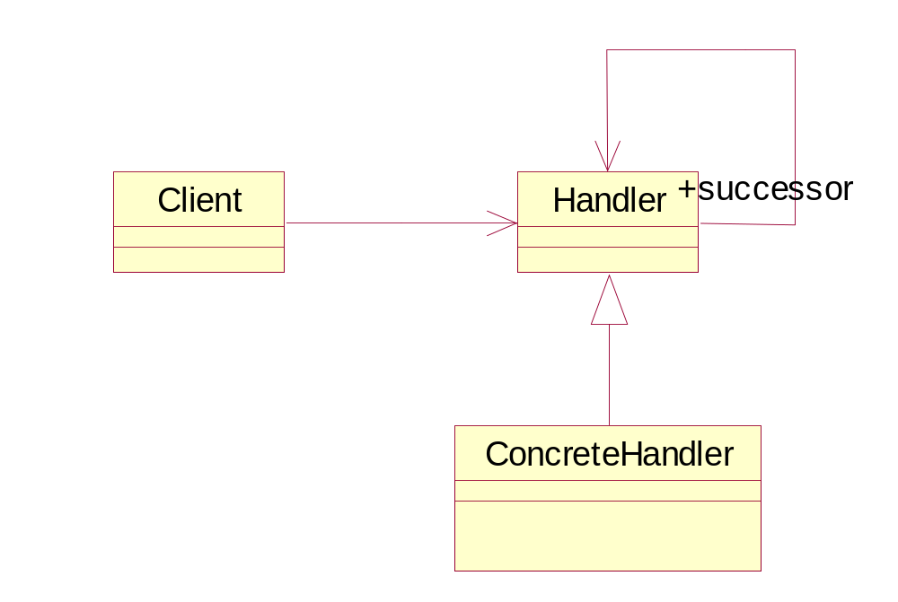
Behavioral Patterns – Chain Of Responsibility
Structure

Slide 44
Behavioral Patterns – Command
Intent
Encapsulates a request as an object, thereby letting you parameterize the clients with the different requests, queue or log the request, and support undoable operations.

Slide 45
Behavioral Patterns – Command
Applicability
This pattern is used when
You have to parameterize objects by an action to perform
Specify, queue and execute requests at different times.
Support undo.

Slide 46
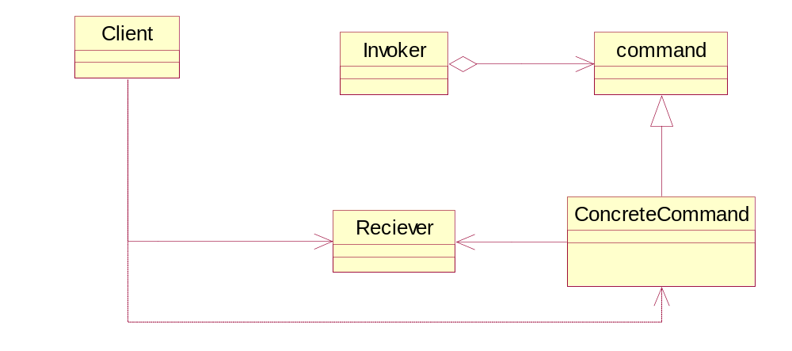
Behavioral Patterns – Command
Structure

Slide 47
Behavioral Patterns – Interpreter
Intent
Given a language, define a representation for its grammar along with an interpreter that uses the representations to interpret sentences in the language.

Slide 48
Behavioral Patterns – Interpreter
Applicability
This pattern is used when
You have to define a grammar that is simple.
Efficiency is not a critical concern

Slide 49
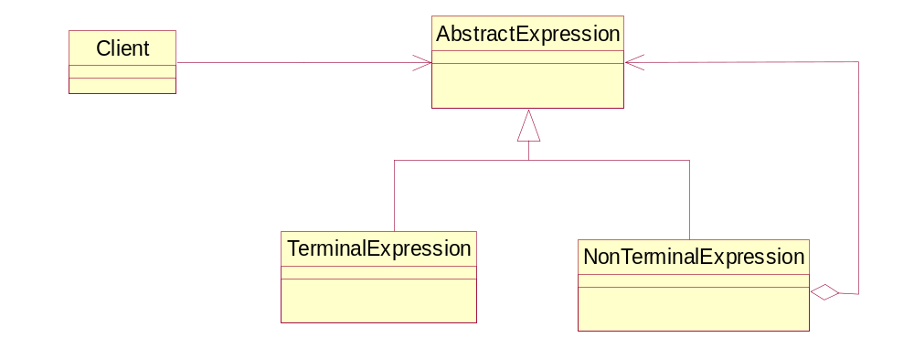
Behavioral Patterns – Interpreter
Structure

Slide 50
Behavioral Patterns – Iterator
Intent
Provide a way of accessing elements of an aggregate object sequentially without exposing its underlying representations

Slide 51
Behavioral Patterns – Iterator
Applicability
This pattern is used when
You have to support multiple traversals of aggregate objects.
Provides uniform interface for traversing different aggregate structures.

Slide 52
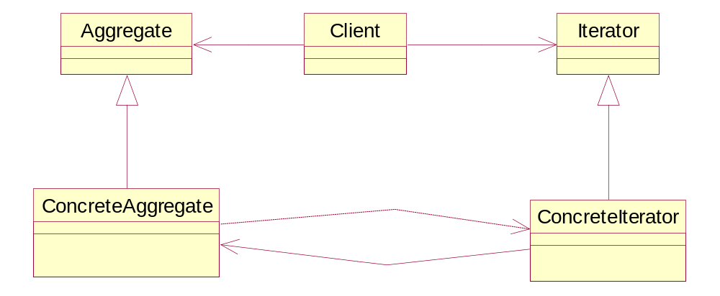
Behavioral Patterns – Iterator
Structure

Slide 53
Behavioral Patterns – Mediator
Intent
Define an object that encapsulates how a set of object interact. Mediator promotes loose coupling by keeping object from referring to each other explicitly and it allows the varying the interactions independently.

Slide 54
Behavioral Patterns – Mediator
Applicability
This pattern is used when
A set of object communicate in a well defined but complex ways.
Reusing a object is difficult because it refers to and communicates with many objects
A behavior that’s distributed between several classes should be customizable without lot of sub classing.

Slide 55
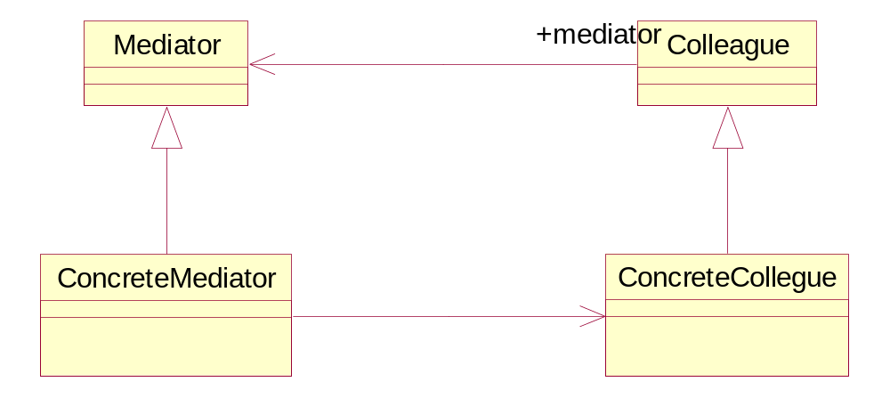
Behavioral Patterns – Mediator
Structure

Slide 56
Behavioral Patterns – Memento
Intent
Without violating encapsulation, capture and externalize an object’s internal state so that the object can be restored to this state later.

Slide 57
Behavioral Patterns – Memento
Applicability
This pattern is used when
A snapshot of an object’s state must be saved so that it can be restored to that state later, and
A direct interface to obtaining the state would expose the implementation details and break the objects encapsulation.

Slide 58
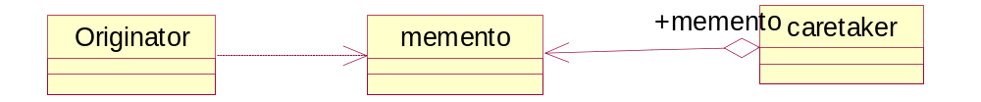
Behavioral Patterns – Memento
Structure

Slide 59
Behavioral Patterns – Observer
Intent
Define a one-to-many dependency between objects so that when one object changes state, all dependants are notified and updated automatically.

Slide 60
Behavioral Patterns – Observer
Applicability
This pattern is used when
An abstraction has two aspects, one dependant on the other.
A change to one object requires changing others and you don’t know how many object have to be changed.

Slide 61
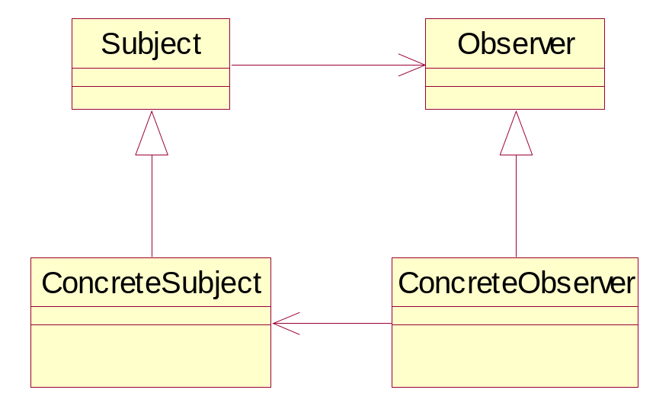
Behavioral Patterns – Observer
Structure

Slide 62
Behavioral Patterns – State
Intent
Allow a object to alter its behavior when its internal state changes. The object will appear to change its class.

Slide 63
Behavioral Patterns – State
Applicability
This pattern is used when
An objects behavior depends on its state and it has to modify its behavior at run-time.

Slide 64
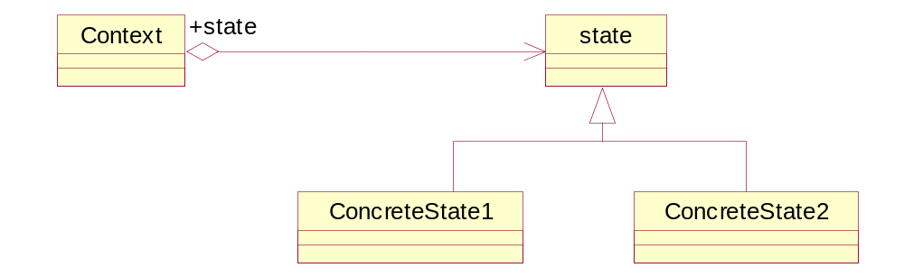
Behavioral Patterns – State
Structure

Slide 65
Behavioral Patterns – Strategy
Intent
Define a family of algorithms, encapsulate each one, and make them interchangeable. Strategy lets algorithms vary independently from the clients that use it.

Slide 66
Behavioral Patterns – Strategy
Applicability
This pattern is used when
Many related classes differ only in their behavior.
You need different variants of an algorithm

Slide 67
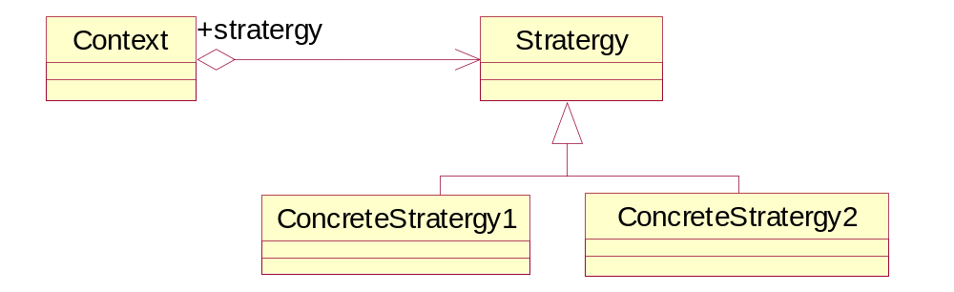
Behavioral Patterns – Strategy
Structure

Slide 68
Behavioral Patterns – Template Method
Intent
Define the skeleton of an algorithm in an operation, deferring some steps to subclasses

Slide 69
Behavioral Patterns – Template Method
Applicability
This pattern is used when
You define invariant parts of the algorithm once and let the sub classes implement the behavior that can vary.
Common behavior among subclasses should be factored and localized in a common class to avoid duplication.
To control subclass extensions

Slide 70
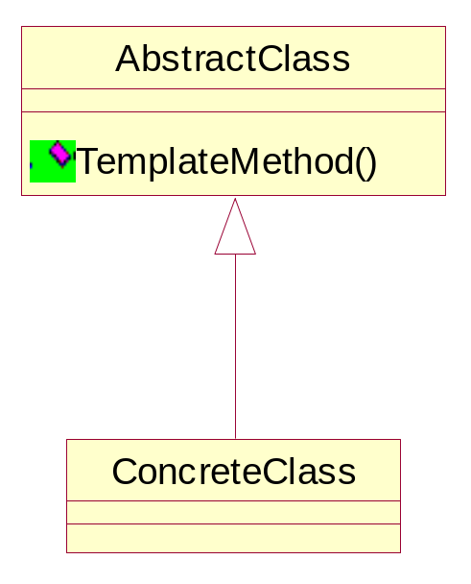
Behavioral Patterns – Template Method
Structure

Slide 71
Behavioral Patterns – Visitor
Intent
Represents an operation to be performed on elements of an object structure. Visitor lets you define a new operation without changing the classes of the elements on which it operates.

Slide 72
Behavioral Patterns – Visitor
Applicability
This pattern is used when
An object structure contains many classes of objects with differing interfaces
Many distinct and unrelated operations are to be performed on objects in an object structure, and you want to avoid polluting their classes with operations.

Slide 73
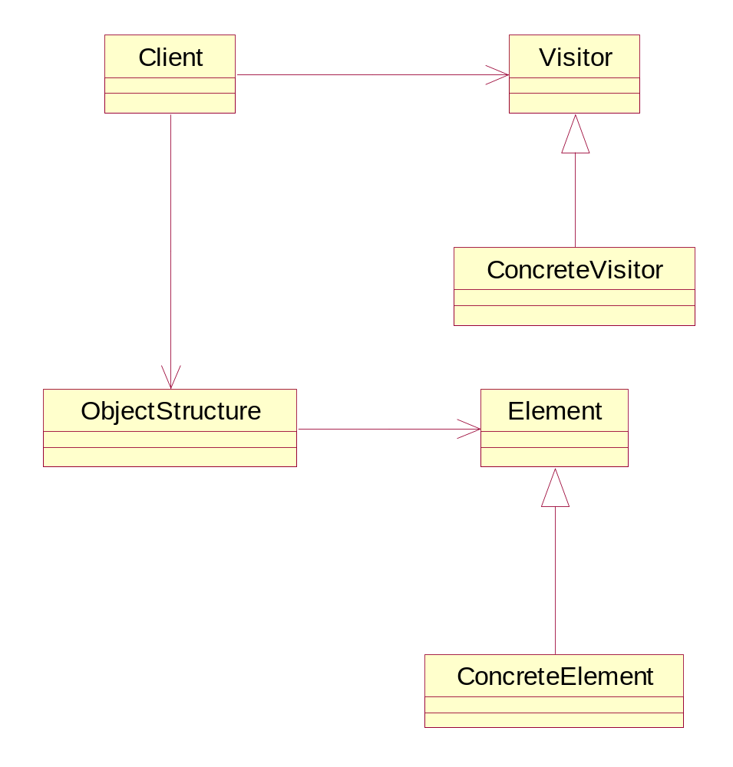
Behavioral Patterns – Visitor
Structure

Slide 74
Behavioral Patterns – Observer
Intent
Define a one-to-many dependency between objects so that when one object changes state, all dependants are notified and updated automatically.

Slide 75
Behavioral Patterns – Observer
Applicability
This pattern is used when
An abstraction has two aspects, one dependant on the other.
A change to one object requires changing others and you don’t know how many object have to be changed.

Slide 76
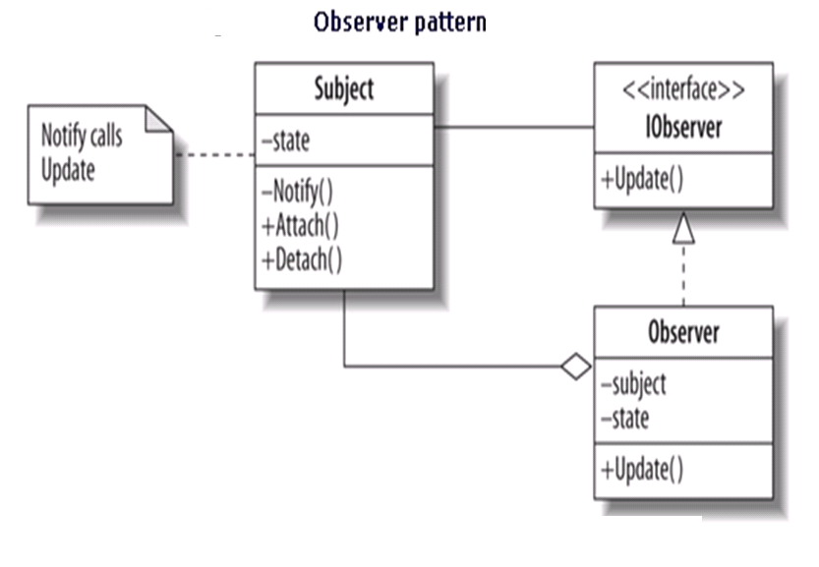

Slide 77
Behavioral Patterns – Interpreter
Intent
Given a language, define a representation for its grammar along with an interpreter that uses the representations to interpret sentences in the language.

Slide 78
Behavioral Patterns – Interpreter
Applicability
This pattern is used when
You have to define a grammar that is simple.
Efficiency is not a critical concern

Slide 79
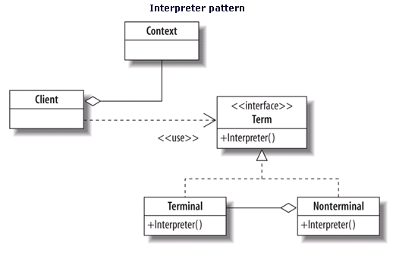

Slide 80
Behavioral Patterns – State
Intent
Allow a object to alter its behavior when its internal state changes. The object will appear to change its class.

Slide 81
Behavioral Patterns – State
Applicability
This pattern is used when
An objects behavior depends on its state and it has to modify its behavior at run-time.

Slide 82
