Slide 1
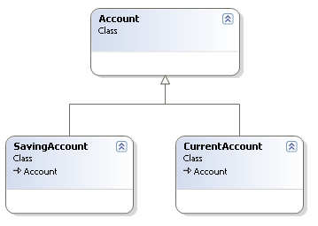
void DoJob(Account obj)
{
if(type(obj) == type(Account))
{
//…. Code
}
if(type(obj) == type(SavingAccount))
{
//…. Code
}
if(type(obj) == type(CurrentAccount))
{
//…. Code
}
}

Slide 2
Polymorphism:
Problem: How to handle alternatives based on type? How to create pluggable software components?
Solution: when related alternatives or behaviors vary by type(class), assign responsibility for the behavior - using polymorphic operations - to the types for which the behavior varies.
Corollary: Do not test for the type of an object and use conditional logic to perform varying alternatives based on type.

Slide 3
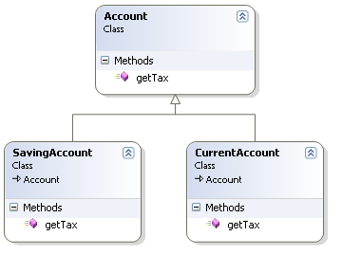
void DoJob(Account obj)
{
obj.getTax();
}

Slide 4

Single-Responsibility Principle (SRP)
A class should have only one reason to change.
If a class assumes more than one responsibility, that class will have more than one reason to change.
If the application is not changing in ways that cause the two responsibilities to change at different times, there is no need to separate them.
Example : User Interface logic should be separated from a business class.
Notes:
This principle was described in the work of Tom DeMarco and Meilir Page-Jones.They called it cohesion

Slide 5
High Cohesion
Problem: How to keep complexity manageable?
Solution : Assign a responsibility so that cohesion remains high.
Cohesion is a measure of how strongly related and focused the responsibilities of a class are in brief class should do only highly related responsibilities.
Disadvantages of low cohesive classes
hard to reuse
hard to maintain
constantly effected by change.

Slide 6
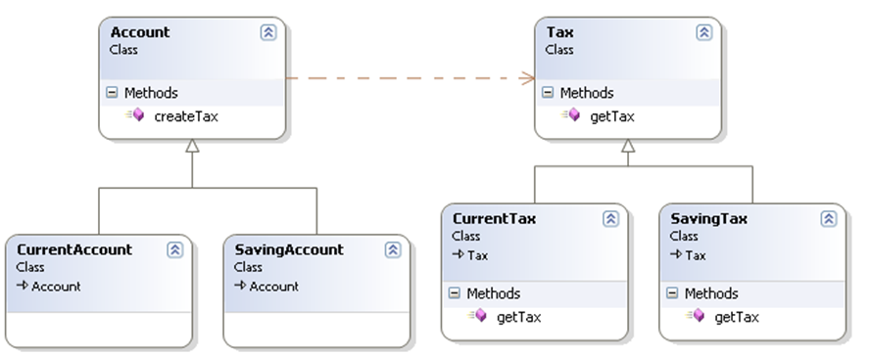
Tax createTax(Account)
{
if(type(this) == type(Account))
return new Tax();
if(type(this) == type(SavingAccount))
return new SavingTax();
if(type(this) == type(CurrentAccount))
return new CurrentTax();
}
void DoJob(Account obj)
{
Tax tax = createTax(obj);
tax.getTax();
}

Slide 7
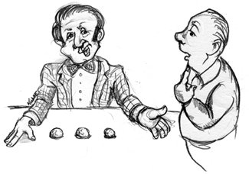
Liskov Substitution Principle (LSP)
Subtypes must be substitutable for their base types.
These are the questions addressed by the Liskov Substitution Principle (LSP).
What are the design rules that govern this particular use of inheritance?
What are the characteristics of the best inheritance hierarchies?
What are the traps that will cause us to create hierarchies that do not conform to OCP?
If for each object o₁ of type S there is an object o₂ of type T such that for all programs P defined in terms of T, the behavior of P is unchanged when o₁ is substituted for o₂ then S is a subtype of T. [Barbara Liskov]

Slide 8
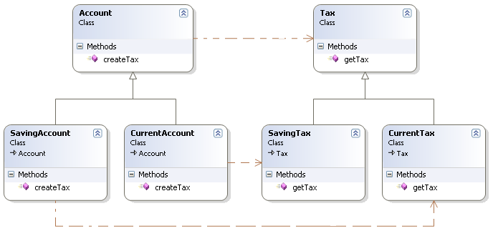
void DoJob(Account obj)
{
Tax tax = obj.createTax();
tax.getTax();
}

Slide 9
Low Coupling
Problem : How to support low dependency and increased reuse?
Solution : Assign a responsibility so that coupling remains low.
Coupling is a measure of how strongly one class is connected to, has knowledge of, or relies upon other classes; “too many” is context dependent but will be examined.
A class with high (or strong) coupling relies upon many other classes. Such classes are undesirable; they suffer from several problems.
Notes:
High coupling classes are undesirable because:
Changes in related classes force local changes.
Harder to understand in isolation.
Harder to reuse because its use requires the additional presence of the classes it is dependent upon.

Slide 10
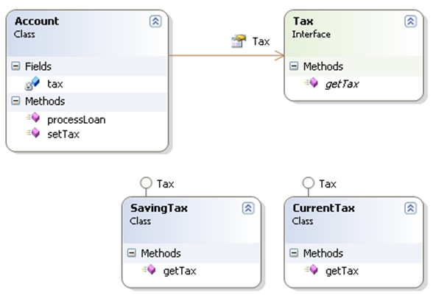
void ProcessLoan()
{
//… code
t= tax.getTax();
//…. code
}
void main()
{
Acccount acc = new Account();
acc.setTax(new SavingTax());
Acc.processLoan();
}

Slide 11
void DoJob(Account obj)
{
Tax tax = obj.createTax();
tax.getTax();
}

Slide 12
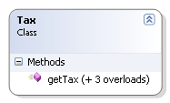
double getTax(Account obj)
{
//…. Code
}
double getTax(SavingAccount obj)
{
//…. Code
}
double getTax(CurrentAccount obj)
{
//…. Code
}
void DoJob(Account obj)
{
Tax tax = new Tax();
tax.getTax(obj);
}

Slide 13
double getTax(Account obj)
{
//…. Code
}
double getTax(SavingAccount obj)
{
//…. Code
}
double getTax(CurrentAccount obj)
{
//…. Code
}
Void DoJob(Account obj)
{
Tax tax = new Tax();
tax.getTax( (???) obj);
}

Slide 14
void DoJob(Account obj)
{
Tax tax = new Tax();
if(type(obj) == type(Account))
return tax.getTax( obj );
if(type(obj) == type(SavingAccount))
return tax.getTax( (SavingAccount) obj);
if(type(obj) == type(CurrentAccount))
return tax.getTax( (CurrentAccount) obj);
}
getTax(Account obj)
{
//…. Code
}
getTax(SavingAccount obj)
{
//…. Code
}
getTax(CurrentAccount obj)
{
//…. Code
}

Slide 15
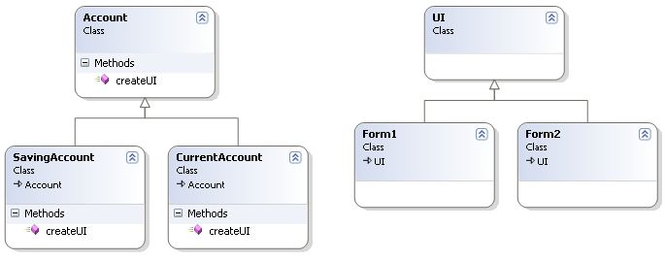
void showUI(Account obj)
{
UI ui;
if(type(obj) == type(Account))
ui = new UI();
if(type(obj) == type(SavingAccount))
ui = new Form1();
if(type(obj) == type(CurrentAccount))
ui = new Form2();
ui.render();
}

Slide 16
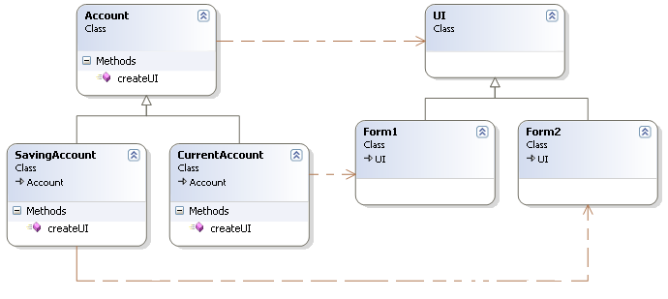
void createUI()
{
return new Form1;
}
void showUI(Account obj)
{
UI ui= obj.createUI();
ui.render();
}

Slide 17
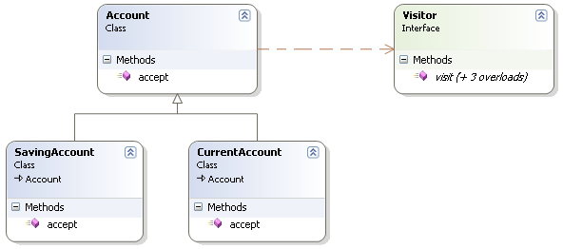
void accept(Visitor v)
{
v.visit(this);
}
void visit(Account obj)
void visit(SavingAccount obj)
void visit(CurrentAccount obj)
void accept(Visitor v)
{
v.visit(this);
}
void accept(Visitor v)
{
v.visit(this);
}

Slide 18
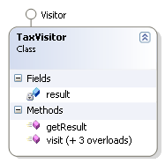
void DoJob(Account obj)
{
TaxVisitor v= new TaxVisitor();
v.visit(obj);
return v.getResult();
}
void visit(Account obj)
{
result = ….
}
void visit(SavingAccount obj)
{
result = …
}
void visit(CurrentAccount obj)
{
result = ….
}

Slide 19
void DoJob(Account obj)
{
TaxVisitor v= new TaxVisitor();
//v.visit(obj); ← will not work
obj.accept(v);
return v.getResult();
}
void visit(Account obj)
{
result = ….
}
void visit(SavingAccount obj)
{
result = …
}
void visit(CurrentAccount obj)
{
result = ….
}

Slide 20
void visit(Account obj)
void visit(SavingAccount obj)
void visit(CurrentAccount obj)
void accept(Visitor v)
{
v.visit(this);
}
void DoJob(Account obj)
{
TaxVisitor v= new TaxVisitor();
obj.accept(v);
return v.getResult();
}
void visit(Account obj){
result = ….
}
void visit(SavingAccount obj){
result = …
}
void visit(CurrentAccount obj){
result = ….
}
//v.visit(obj); ← will not work

Slide 21

void visit(Account obj)
void visit(SavingAccount obj)
void visit(CurrentAccount obj)
void accept(Visitor v)
{
v.visit(this);
}
showUI(Account obj)
{
UIVisitor v= new UIVisitor();
obj.accept(v);
UI ui = v.getResult();
ui.render();
}
void visit(Account obj){
result = new UI();
}
void visit(SavingAccount obj){
result = new Form1();
}
void visit(CurrentAccount obj){
result = new Form2();
}

