Slide 1
References:
Applying UML and patterns
Craig Larman
Patterns in Java, volume 2
Mark Grand

Slide 2
What are patterns?
Principles and solutions codified in a structured format describing a problem and a solution
A named problem/solution pair that can be applied in new contexts
It is advice from previous designers to help designers in new situations

Slide 3
The idea behind design patterns is simple:
Write down and catalog common interactions between objects that programmers have frequently found useful.
Result:
Facilitate reuse of object-oriented code between projects and between programmers.

Slide 4
Some definitions of design patterns
“Design patterns constitute a set of rules describing how to accomplish
certain tasks in the realm of software development.” (Pree, 1994)
“Design patterns focus more on reuse of recurring architectural design
themes, while frameworks focus on detailed design… and
implementation.” (Coplien & Schmidt, 1995).
“A pattern addresses a recurring design problem that arises in specific
design situations and presents a solution to it” (Buschmann, et. al. 1996)
“Patterns identify and specify abstractions that are above the level of
single classes and instances, or of components.” (Gamma, et al., 1993)

Slide 5
Characteristics of Good patterns
It solves a problem
It is a proven concept
The solution isn't obvious
It describes a relationship
The pattern has a significant human component
Notes:
It solves a problem: Patterns capture solutions, not just abstract principles or strategies.
It is a proven concept: Patterns capture solutions with a track record, not theories or speculation.
The solution isn't obvious: Many problem-solving techniques (such as software design paradigms or methods) try to derive solutions from first principles. The best patterns generate a solution to a problem indirectly -- a necessary approach for the most difficult problems of design.
It describes a relationship: Patterns don't just describe modules, but describe deeper system structures and mechanisms.
The pattern has a significant human component .... All software serves human comfort or quality of life; the best patterns explicitly appeal to aesthetics and utility.

Slide 6
Types of patterns
Architectural Patterns
  Expresses a fundamental structural organization or schema for software systems.
  Design Patterns
  Provides a scheme for refining the subsystems or components of a software system, or the relationships between them.
Idioms
  An idiom describes how to implement particular aspects of components or the relationships between them using the features of the given language.
Notes:
Architectural Patterns
An architectural pattern expresses a fundamental structural organization or schema for software systems. It provides a set of predefined subsystems, specifies their responsibilities, and includes rules and guidelines for organizing the relationships between them.
Design Patterns
A design pattern provides a scheme for refining the subsystems or components of a software system, or the relationships between them. It describes commonly recurring structure of communicating components that solves a general design problem within a particular context.
Idioms
An idiom is a low-level pattern specific to a programming language. An idiom describes how to implement particular aspects of components or the relationships between them using the features of the given language.

Slide 7
Describing patterns
Name : It must have a meaningful name.
Problem: A statement of the problem.
Context: This tells us the pattern's applicability.
Forces: A description of the relevant forces and constraints and how they interact/conflict with one another..
Solution: Static relationships and dynamic rules describing how to realize the desired outcome.
Consequences: Implications( good and bad) of using the solution.
Examples: One or more sample applications of the pattern .
Notes:
Name
It must have a meaningful name. This allows us to use a single word or short phrase to refer to the pattern, and the knowledge and structure it describes. It would be very unwieldy to have to describe or even summarize the pattern every time we used it in a discussion. Good pattern names form a vocabulary for discussing conceptual abstractions. Sometimes a pattern may have more than one commonly used or recognizable name in the literature. In this case it is common practice to document these nicknames or synonyms under the heading of Aliases or Also Known As. Some pattern forms also provide a classification of the pattern in addition to its name.
Problem
A statement of the problem which describes its intent: the goals and objectives it wants to reach within the given context and forces. Often the forces oppose these objectives as well as each other (one might think of this as a "wicked problem" reminiscent of DeGrace and Stahl, in their book Wicked Problems, Righteous Solutions).
Context
The preconditions under which the problem and its solution seem to recur, and for which the solution is desirable. This tells us the pattern's applicability. It can be thought of as the initial configuration of the system before the pattern is applied to it.
Forces
A description of the relevant forces and constraints and how they interact/conflict with one another and with goals we wish to achieve (perhaps with some indication of their priorities). A concrete scenario which serves as the motivation for the pattern is frequently employed (see also Examples). Forces reveal the intricacies of a problem and define the kinds of trade-offs that must be considered in the presence of the tension or dissonance they create. A good pattern description should fully encapsulate all the forces which have an impact upon it. A list of prospective pattern forces for software may be found in the answer to question 11 of Doug Lea's Patterns-Discussion FAQ.
Solution
Static relationships and dynamic rules describing how to realize the desired outcome. This is often equivalent to giving instructions which describe how to construct the necessary work products. The description may encompass pictures, diagrams and prose which identify the pattern's structure, its participants, and their collaborations, to show how the problem is solved. The solution should describe not only static structure but also dynamic behavior. The static structure tells us the form and organization of the pattern, but often it is the behavioral dynamics that make the pattern "come alive". The description of the pattern's solution may indicate guidelines to keep in mind (as well as pitfalls to avoid) when attempting a concrete implementation of the solution. Sometimes possible variants or specializations of the solution are also described.
Examples
One or more sample applications of the pattern which illustrate: a specific initial context; how the pattern is applied to, and transforms, that context; and the resulting context left in its wake. Examples help the reader understand the pattern's use and applicability. Visual examples and analogies can often be especially illuminating. An example may be supplemented by a sample implementation to show one way the solution might be realized. Easy-to-comprehend examples from known systems are usually preferred (see also Known Uses).
Resulting Context
The state or configuration of the system after the pattern has been applied, including the consequences (both good and bad) of applying the pattern, and other problems and patterns that may arise from the new context. It describes the postconditions and side-effects of the pattern. This is sometimes called resolution of forces because it describes which forces have been resolved, which ones remain unresolved, and which patterns may now be applicable (see the answer to question 12 of Doug Lea's Patterns-Discussion FAQ for an excellent discussion of resolution of forces). Documenting the resulting context produced by one pattern helps you correlate it with the initial context of other patterns (a single pattern is often just one step towards accomplishing some larger task or project).
Rationale
A justifying explanation of steps or rules in the pattern, and also of the pattern as a whole in terms of how and why it resolves its forces in a particular way to be in alignment with desired goals, principles, and philosophies. It explains how the forces and constraints are orchestrated in concert to achieve a resonant harmony. This tells us how the pattern actually works, why it works, and why it is "good". The solution component of a pattern may describe the outwardly visible structure and behavior of the pattern, but the rationale is what provides insight into the deep structures and key mechanisms that are going on beneath the surface of the system.
Related Patterns
The static and dynamic relationships between this pattern and others within the same pattern language or system. Related patterns often share common forces. They also frequently have an initial or resulting context that is compatible with the resulting or initial context of another pattern. Such patterns might be predecessor patterns whose application leads to this pattern; successor patterns whose application follows from this pattern; alternative patterns that describe a different solution to the same problem but under different forces and constraints; and codependent patterns that may (or must) be applied simultaneously with this pattern.
Known Uses
Describes known occurrences of the pattern and its application within existing systems. This helps validate a pattern by verifying that it is indeed a proven solution to a recurring problem. Known uses of the pattern can often serve as instructional examples

Slide 8
GRASP Patterns
Which class, in the general case is responsible?
You want to assign a responsibility to a class
You want to avoid or minimize additional dependencies
You want to maximise cohesion and minimise coupling
You want to increase reuse and decrease maintenance
You want to maximise understandability
…..etc.

Slide 9
GRASP patterns
General Responsibility Assignment Software Patterns
Expert
Creator
Low Coupling
High Cohesion
Controller
Polymorphism
Pure Fabrication
Indirection
Law of Demeter

Slide 10
Expert
Problem:
What is the most basic principle by which responsibilities are assigned in object-oriented design?
Solution:
Assign a responsibility to the class that has the information necessary to fulfil the responsibility.

Slide 11
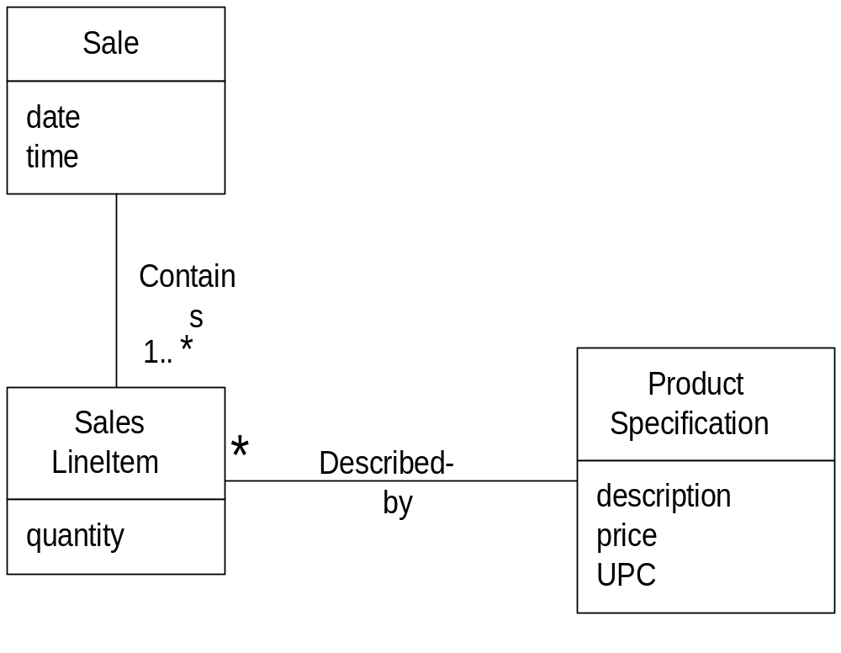
Expert : Example
Who is responsible for knowing the grand total of a sale in a typical Point of Sale application?
Notes:
Expert
Which class, in the general case is responsible?
.
• You want to assign a responsibility to a class
• You want to assign the responsibility to a class that is already present in your design if possible
• A class already has access to the information required to carry out the responsibility
• You want to avoid or minimize additional dependencies

Slide 12
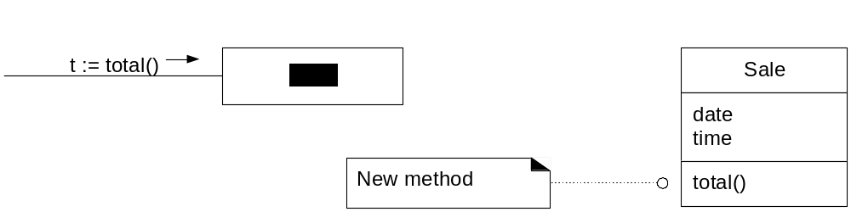
Expert : Example
Need all SalesLineItem instances and their subtotals. Only Sale knows
this, so Sale is the information expert.
Hence

Slide 13
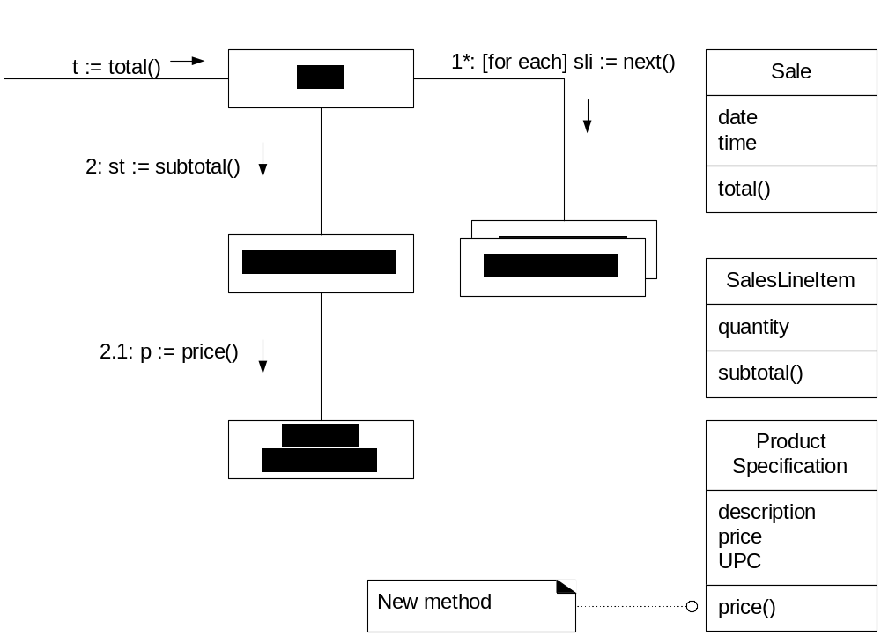
Expert : Example
But subtotals are needed for each line item(multiply quantity by price).
By Expert, SalesLineItem is expert, knows quantity and has association
with ProductSpecification which knows price.

Slide 14
Expert : Example
Hence responsibilities assign to the 3 classes.
Class
Responsibility
Sale
knows sale total
SalesLineItem
knows line item subtotal
ProductSpecification
knows product price

Slide 15
Expert
Maintain encapsulation of information
Promotes low coupling
Promotes highly cohesive classes
Can cause a class to become excessively complex

Slide 16
Creator
Problem:
Assign responsibility for creating a new instance of some class?
Solution:
Determine which class should create instances of a class based on the relationship between potential creator classes and the class to be instantiated.

Slide 17
Creator
who has responsibility to create an object?
By creator, assign class B responsibility of creating instance of class A if
B aggregates A objects
B contains A objects
B records instances of A objects
B closely uses A objects
B has the initializing data for creating A objects
where there is a choice, prefer
B aggregates or contains A objects

Slide 18
Creator : Example
Who is responsible for creating SalesLineItem objects?
Look for a class that aggregates or contains SalesLineItem objects.

Slide 19
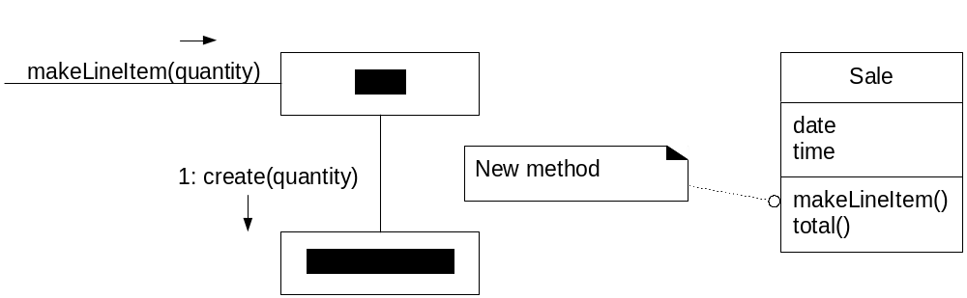
Creator : Example
Creator pattern suggests Sale.
Collaboration diagram is

Slide 20
Creator
Promotes low coupling by making instances of a class responsible for creating objects they need to reference
By creating the objects themselves, they avoid being dependent on another class to create the object for them

Slide 21
Low Coupling
Problem:
To support low dependency and increased reuse?
Solution:
Assign responsibilities so that coupling
remains low.

Slide 22
In object oriented languages, common form of coupling from TypeX to TypeY include:
TypeX has an attribute (data member or instance variable) that refers to a TypeY instance, or TypeY itself.
TypeX has a method which references an instance of TypeY, or TypeY itself, by any means. These typically include a parameter or local variable of type TypeY, or the object returned from a message being an instance of TypeY.
TypeX is a direct or indirect subclass of TypeY.
TypeY is an interface, and TypeX implements that interface.

Slide 23
Low coupling
Classes are easier to maintain
Easier to reuse
Changes are localised

Slide 24
Low Coupling
How can we make classes independent of other classes?
changes are localised
easier to understand
easier to reuse
Who has responsibility to create a payment?

Slide 25
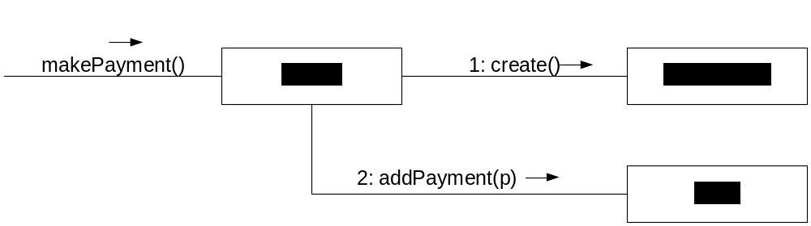
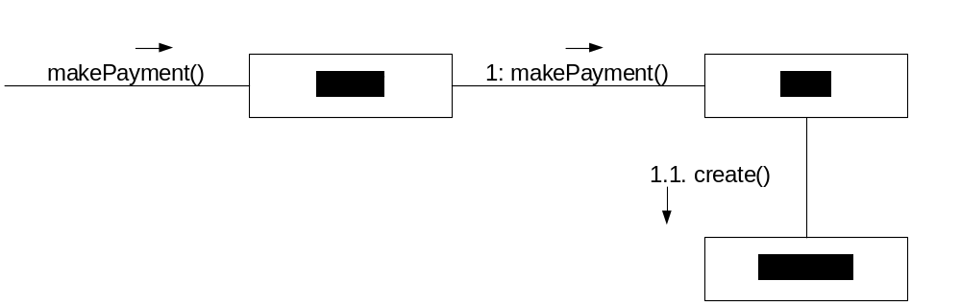
Low Coupling
Two possibilities:
1. Post
2. Sale
Low coupling suggests Sale because Sale has to be coupled to Payment anyway (Sale knows its total).

Slide 26
High Cohesion
Problem:
To keep complexity manageable?
Solution:
Assign responsibilities so that cohesion
remains high.

Slide 27
Some examples:
Very Low Cohesion: A Class is solely responsible for many things in very different functional areas
Low Cohesion: A class has sole responsibility for a complex task in one functional area.
High Cohesion. A class has moderate responsibilities in one functional area and collaborates with classes to fulfil tasks.

Slide 28
High cohesion
Classes are easier to maintain
Easier to understand
Often support low coupling
Supports reuse because of fine grained responsibility

Slide 29
High Cohesion
Who has responsibility to create a payment?
1.Post
looks OK if makePayement considered in isolation, but adding more system operations, Post would take on more and more responsibilities and become less cohesive.

Slide 30
High Cohesion
Giving responsibility to Sale supports higher cohesion in Post, as well as
low coupling.

Slide 31
Controller
Problem:
To assign responsibility for handling a system event?
Solution:
If a program receive events from external sources other than its graphical interface, add an event class to decouple the event source(s) from the objects that actually handle the events.

Slide 32
The Controller pattern provides guidance for generally acceptable choices.
Assign the responsibility for handling a system event message to a class representing one of these choices:
1. The business or overall organization (a façade controller).
2. The overall "system" (a façade controller).
3. An animate thing in the domain that would perform the work (a role controller).
4. An artificial class (Pure Fabrication representing the use (a use case controller).

Slide 33
Benefits:
Increased potential for reuse. Using a controller object keeps external event sources and internal event handlers independent of each other’s type and behaviour.
Reason about the states of the use case. Ensure that the system operations occurs in legal sequence, or to be able to reason about the current state of activity and operations within the use case.

Slide 34
Controller : Example
System events in Buy Items use case
enterItem()
endSale()
makePayment()
who has the responsibility for enterItem()?

Slide 35
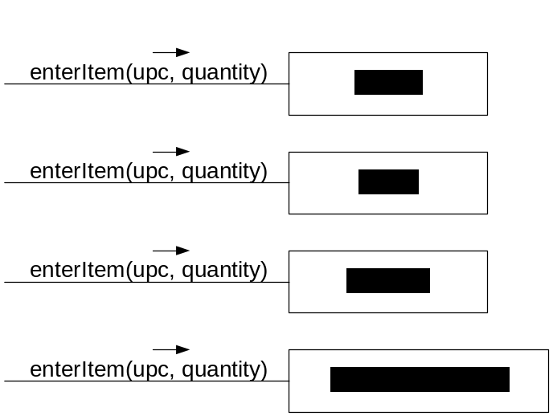
Controller : Example
By controller, we have 4 choices
the overall system Post
the overall business Store
someone in the real world
who is active in the task Cashier
an artificial handler of all system
events of a use case BuyItemsHandler
The choice of which one to use will be influenced by other factors such as cohesion and coupling

Slide 36
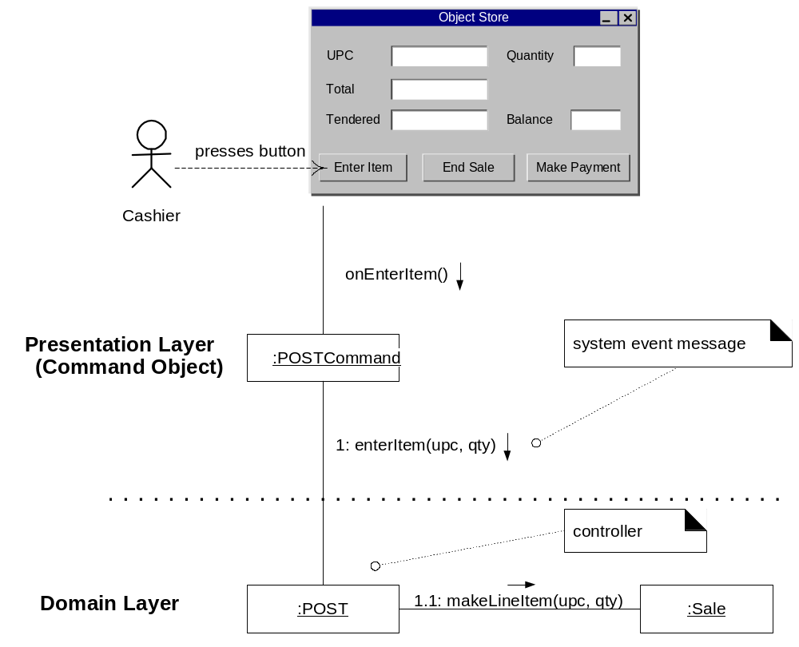
Good design
- presentation layer decoupled from problem domain
Notes:
Assigning the responsibility for system operations to objects
in the domain layer rather than presentation layer supports
increased reuse potential.
• It also makes it easier to unplug the interface layer and use
a different interface technology, or to run the system in an
off-line “batch” mode.

Slide 37
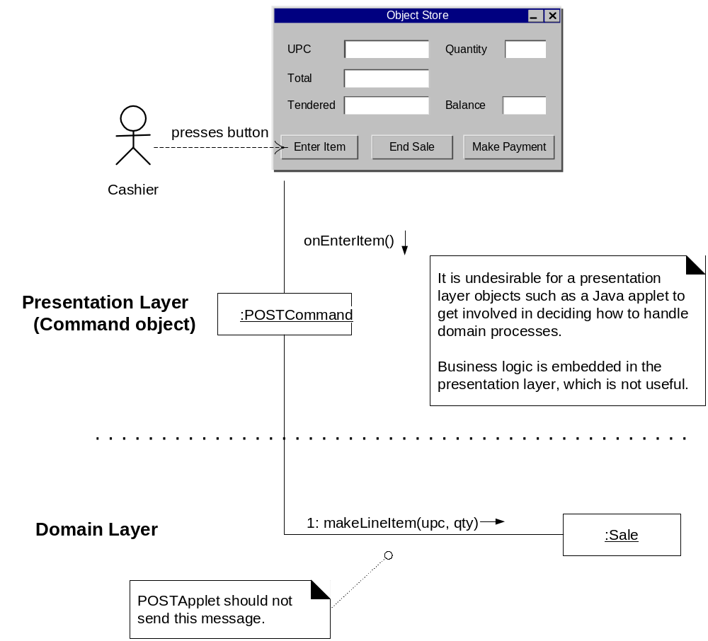
Bad design
– presentation layer coupled to problem domain

Slide 38
Controller
Using a controller object keeps external event sources and internal event handlers independent of each other’ type and behaviour
The controller objects can become highly coupled and uncohesive with more responsiblities

Slide 39
Polymorphism
Problem:
To handle alternatives based on types?
Solution:
When alternate behaviours are selected based on the type of an object, use polymorphic method call to select the behaviour, rather than using if statement to test the type.
Notes:
polymorphism
has definition A property of object oriented software by which an abstract operation may be performed in different ways in different classes
exists when several classes which each implement the operation either have a common superclass in which the operation exists, or else implement an interface that contains the operation
gets power from dynamic binding
is one of the fundamental features of the object oriented paradigm
dynamic binding
has definition The process of binding a call to a particular method. This is performed dynamically at run-time due to the presence of polymorphism
gives power to polymorphism
is needed when the compiler determines that there more than one possible method that could be executed by a particular call
is a kind of process
prevents programmers from having to write conditional statements to explicitly choose which code to run

Slide 40
Polymorphism : Example
Payment
amount
CashPayment
CreditPayment
CheckPayment
authorize()
authorize()
authorize()
By Polymorphism, each
payment should
authorize itself
Notes:
In the point -of -sale application, who should be responsible
for authorising different kinds of payments?
– Note: Payments may be in
• cash (authorising involves determining if it is
counterfeit)
• credit (authorising involves communication with bank)
• check (authorising involves driver license record)

Slide 41
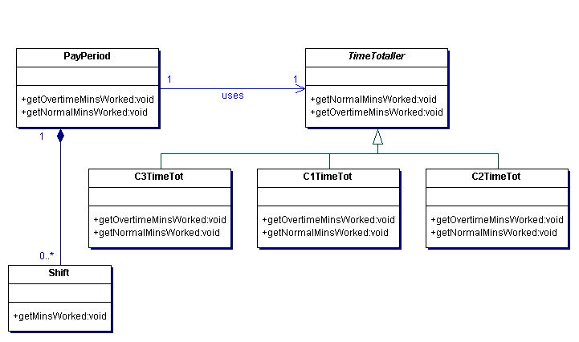
Example : Polymorphism

Slide 42
Polymorphism
Easier and more reliable then using explicit selection logic
Easier to add additional behaviours later on
Increased the number classes in a design
May make the code less easier to follow
Notes:
Lessons from Polymorphism
• Future extensions required for unanticipated new
variations are easy to add.
• Avoid “case /switch” statements or “if” conditionals on
type.
• The objects work on themselves
– Example: payments authorise themselves
• Also known as: “Do it myself”, “Choosing Message” and
“don’t ask ‘what kind?’”

Slide 43
Pure Fabrication
Problem:
To not violate High Cohesion and Low Coupling?
Solution:
Assign a highly cohesive set of responsibilities to an artificial class that does not represent anything in the problem domain, in order to support high cohesion, low coupling, and reuse.

Slide 44
Benefits:
High cohesion is supported because responsibilities are factored into a class that only focuses on a very specific set of related tasks.
Reuse potential may be increased because of the presence of fine grained Pure Fabrication classes.

Slide 45
Example
Suppose, in the point of sale example, that support is needed to save Sale instances in a relational database. By Expert, there is some justification to assign this responsibility to Sale class. However.
The task requires a relatively large number of supporting database-oriented operations and the Sale class becomes incohesive.
The sale class has to be coupled to the relational database increasing its coupling.
Saving objects in a relational database is a very general task for which many classes need support. Placing these responsibilities in the Sale class suggests there is going to be poor reuse or lots of duplication in other classes that do the same thing.

Slide 46
Pure Fabrication : Example
By Pure Fabrication
PersistentStorageBroker
save()
The Sale remains well design, with high cohesion and low coupling
The PersistentStorageBroker class is itself relatively cohesive
The PersistentStorageBroker class is a very generic and reusable object
Notes:
Example of Fabrication
• It is needed to save the Sale instances in a relational
database. By EXPERT, there is some justification that a
Sale knows how to save itself.
• Can Sale do this job?
Problems for Sale to do the job
• Large number of supporting database-oriented operations
will be attached to the Sale class.
• The Sale class becomes coupled with the RDB-interface,
so its coupling goes up.
• Saving an object is a very general task, many classes will
need this type of support.
– Placing these responsibilities in the Sale class will
result in poor reuse or duplication.

Slide 47
Pure Fabrication
Preserves low coupling and high cohesion of classes
Improve reusability of classes
Notes:
Lessons from Fabrication
• A Pure Fabrication should be designed with high
potential for reuse.
– The responsibilities must remain small and
cohesive.
• It is partitioned on related functionality, and so is a
kind of function-centric object.
• Many existing object-oriented patterns are examples
of Pure Fabrication.
• High Cohesion is supported if functions are highly related
• Reuse potential should increase
• DANGER: may lead to function or process-oriented analysis
and design implemented in an OO language
– The spirit must remain object-centric
• there is a somebody in charge of this

Slide 48
Indirection
Problem:
To avoid direct coupling?
To de-couple objects so that Low coupling is supported and reuse potential remains high?
Solution:
Assign the responsibility to an intermediate object to mediate between other components or services, so that they are not directly coupled.

Slide 49
Example : PersistentStorageBroker
The Pure fabrication example of de-coupling the Sale from the relational database services through the introduction of a PersistentStorageBroker is also an example of assigning responsibilities to support Indirection. The PersistentStorageBroker acts as a intermediary between the Sale and database

Slide 50
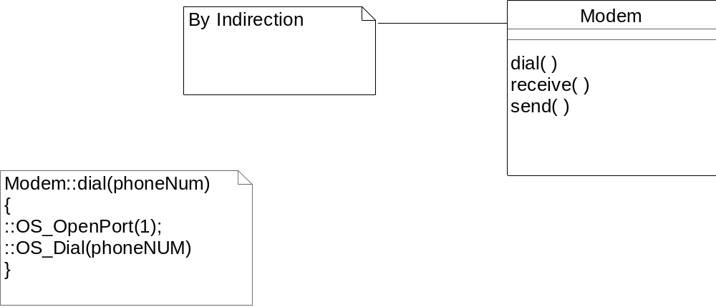
Indirection : Example
authorize(payment)
CreditAuthorizationService
1:dial(phoneNum)
Modem
Notes:
Assume that :
A point-of-sale terminal application needs to manipulate a modem in order to transmit credit payment request
The operating system provides a low-level function call API for doing so.
A class called CreditAuthorizationService is responsible for talking to the modem
If CreditAuthorizationService invokes the low –level API function calls directly, it is highly coupled to the API of the particular operating system. If the class needs to be ported to another operating system, then it will requiure modification.
Add an intermediate Modem class between the CreditAuthorizationService and the modem API. It is responsible for translating abstract modem requests to the API and creating an Indirection between the CreditAuthorizationService and the modem.

Slide 51
Indirection
Low coupling
Promotes reusability

Slide 52
Law of Demeter
Problem:
To avoid knowing about the structure of indirect objects?
Solution:
If two classes have no other reason to be directly aware of each other or otherwise coupled, then the two classes should not directly interact.

Slide 53
Law of Demeter
It states that within a method, messages should only be sent to the following objects:
The this object (or self)
A parameter of the method
An attribute of self
An element of a collection which is an attribute of self
An object created within the method

Slide 54
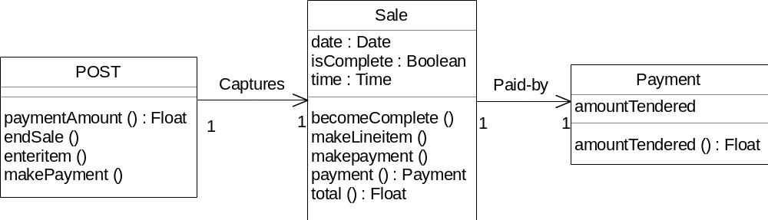
Law of Demeter : Example
Notes:
In a point-of-sale application, assume that a Post instance has an attribute referring to a sale, which has an attribute referring to a payment.
Also,
Post instances support the paymentAmount operation, which returns the current amount tendered for the payment.
Sale instances support the payment operation, which returns the Payment instance associated with the sale.

Slide 55
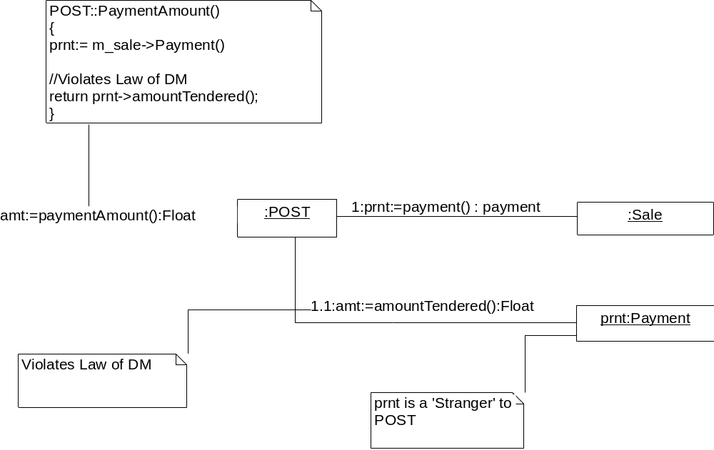
Violates Law of Demeter : Example
Notes:
The solution is a violation of this law because the POST instances is sending a message to an indirect object --- the Payment is not one of the five candidates ‘familiars’.

Slide 56
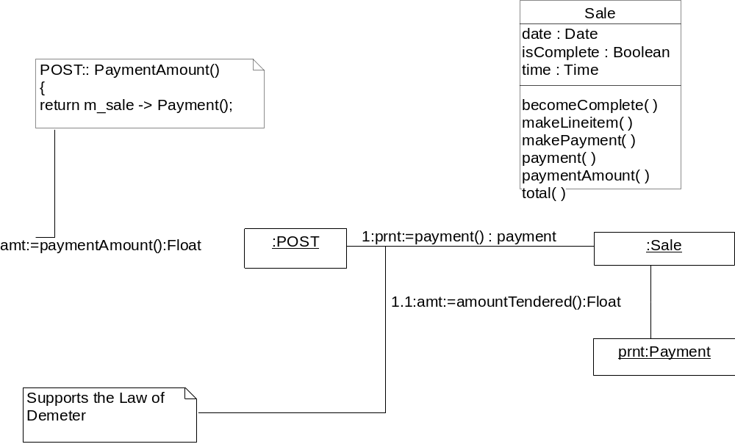
Support Law of demeter
Notes:
The solution as the pattern suggests, is to add the responsibilityto the direct object – the sale in this case – to return the payment amount to the POST. This is known as promoting the interface, which is the general solution to support this principle. Therefore , a paymentAmount operation is added to sale so that the POST does not have to talk to a stranger.

Slide 57
Law of Demeter
Keeps coupling between classes low and makes a design more robust
Adds a small amount of overhead in the form of indirect method calls

Slide 58
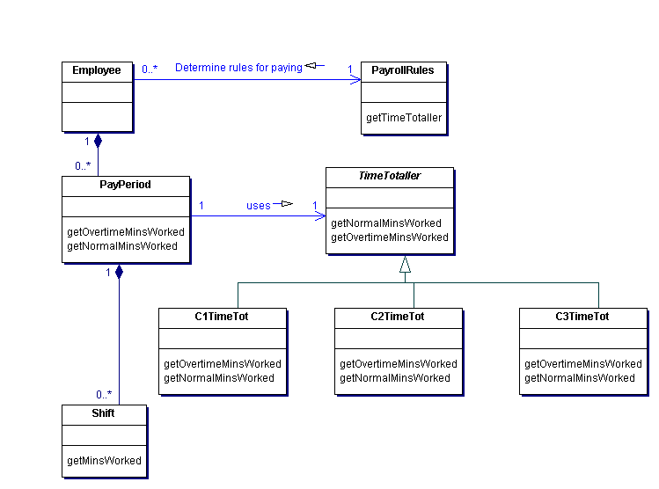
Law of Demeter – Time totalling example

Slide 59
Time totalling example
Employee - Instances of the Employee class represent an employee.
PayrollRules – The rules for paying an employee vary with the laws that apply to the location where the employee works. Instances of the PayrollRules class encapsulate the pay rules that apply to an employee.
PayPeriod – Instances of the Payperiod class represent a range of days for which an employeee is paid in the same pay slip.
Shift – Instances of the Shift class represent ranges of time that the employee worked.
TimeTotaller – The Timetotaller class is an abstract class that the PayPeriod class uses to break the total hours worked during a pay period into normal and overtime minutes.
C1TimeTot,C2TimeTot,C3TimeTot – Concrete subclasses for different location of TimeTotaller that encapsulate the rules for breaking total minutes worked into normal and overtime minutes worked.

Slide 60
The following interaction must occur:
The pay period must become associated with an instance of the subclasss of TimeTotaller appropriate for the employee when the PayPeriod object is created.
The TimeTotaller object must be able to examine each shift in the pay period to learn the number of minutes worked in each shift.

Slide 61
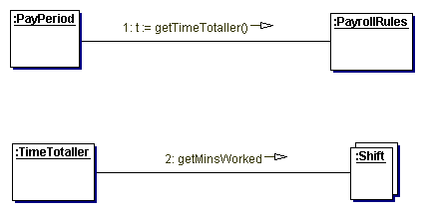
Bad time-totalling collaboration
PayPeriod class has no reason to know anything about the PayrollRules class
For TimeTotaller to have direct access to the collection of shifts that it needs
implies violation of the Shift class’s encapsulation of how it aggregates
Collection of shifts -- resulting in higher level of coupling

Slide 62
Good time-totalling collaboration
To preserve the level of cohesion and coupling a less direct interaction may be used.
This is done as shown by the following collaboration diagram and the creation of additional methods.

Slide 63
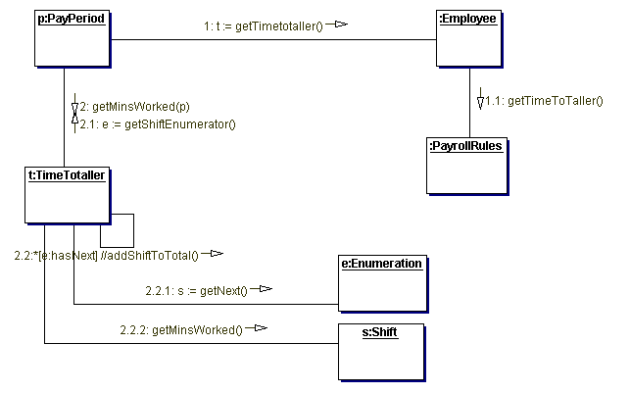
Good time-totalling collaboration

Slide 64
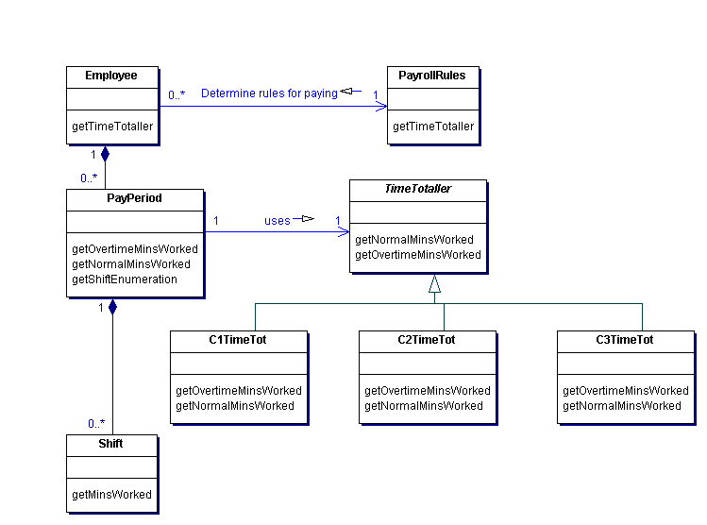
Law of Demeter – Time totalling example with added operations

Slide 65
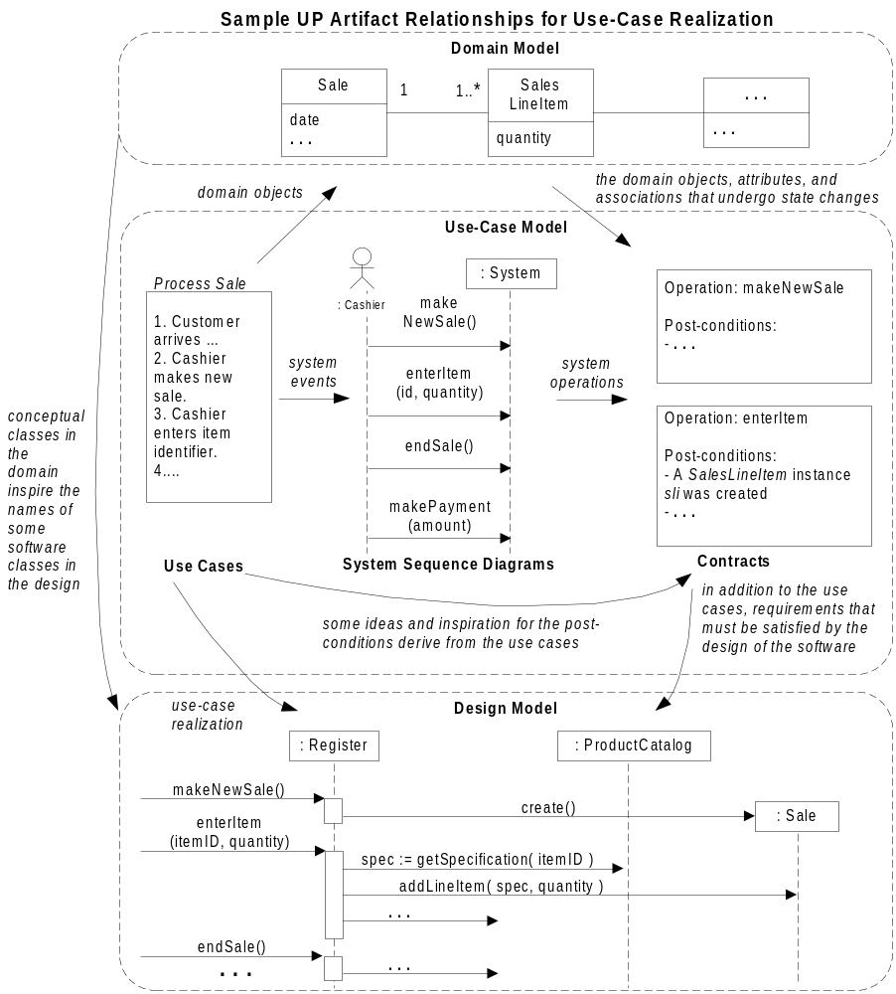

Slide 66
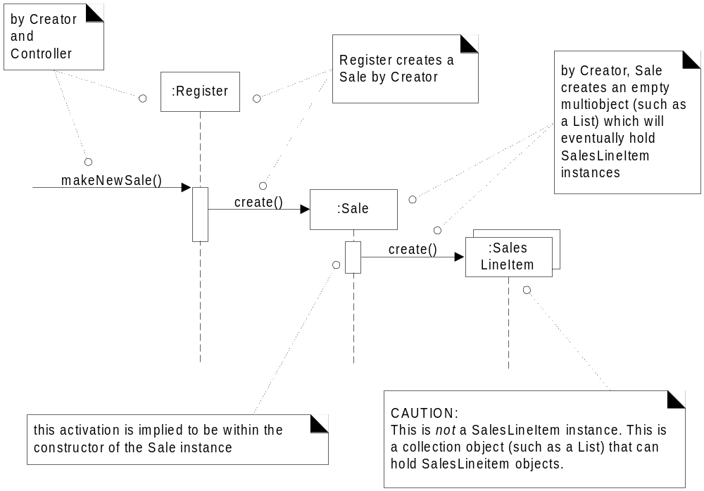

Slide 67
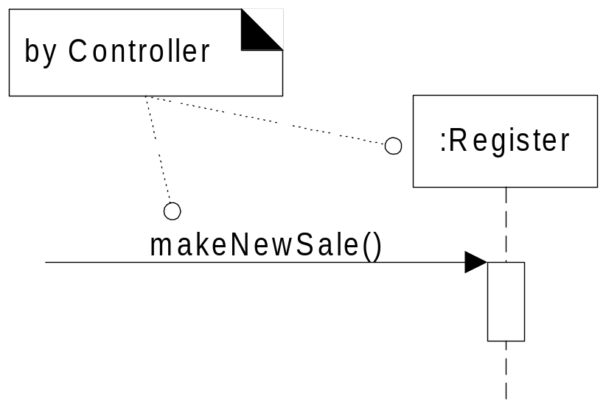

Slide 68
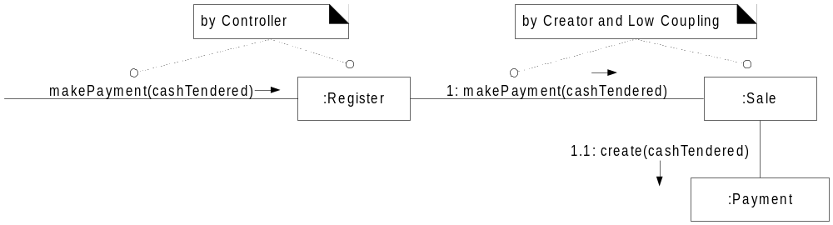

Slide 69
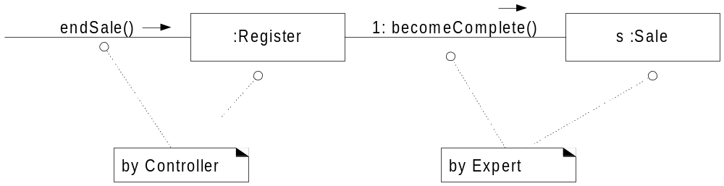

Slide 70
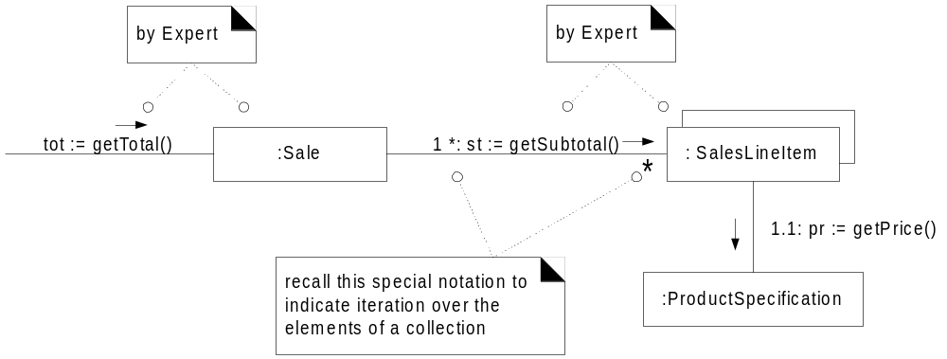

Slide 71
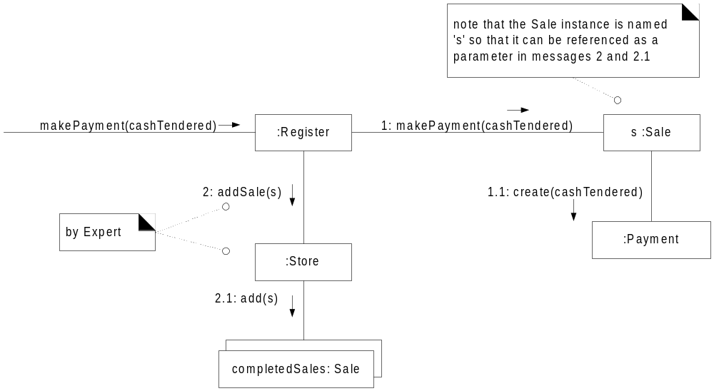

Slide 72
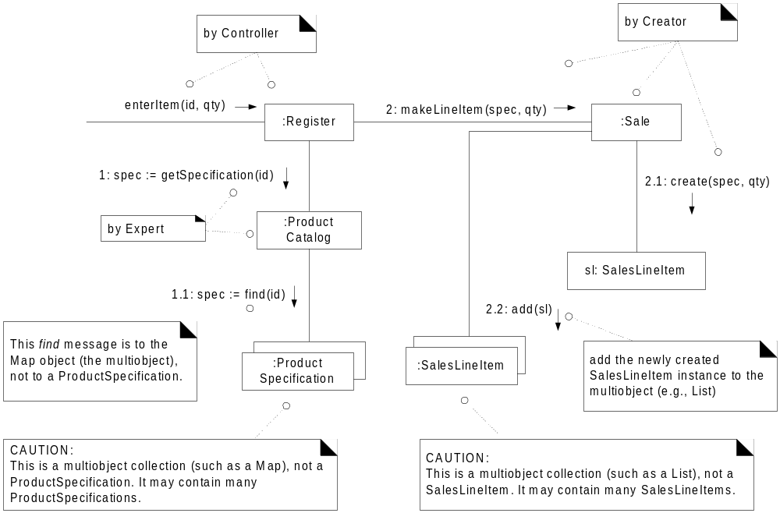

Slide 73
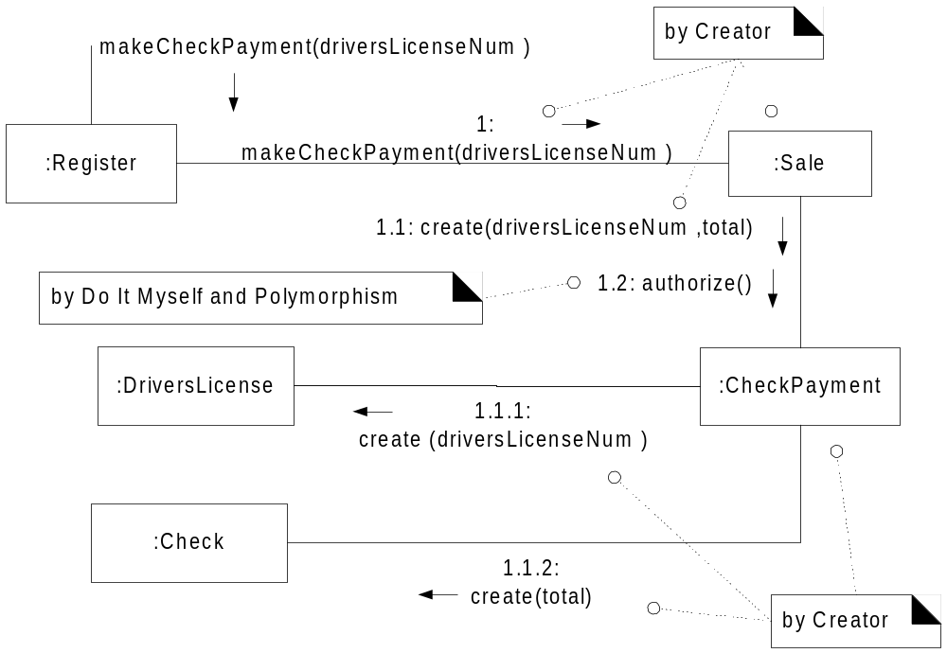

Slide 74
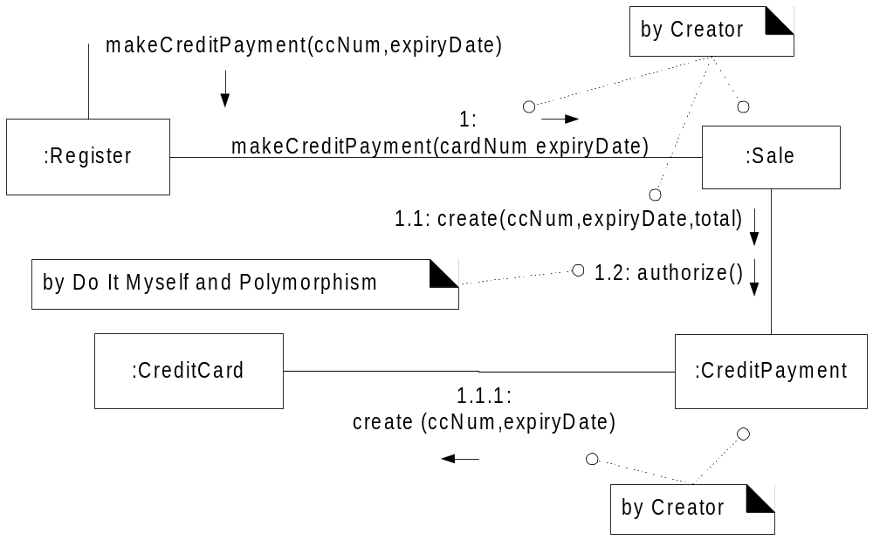

Slide 75
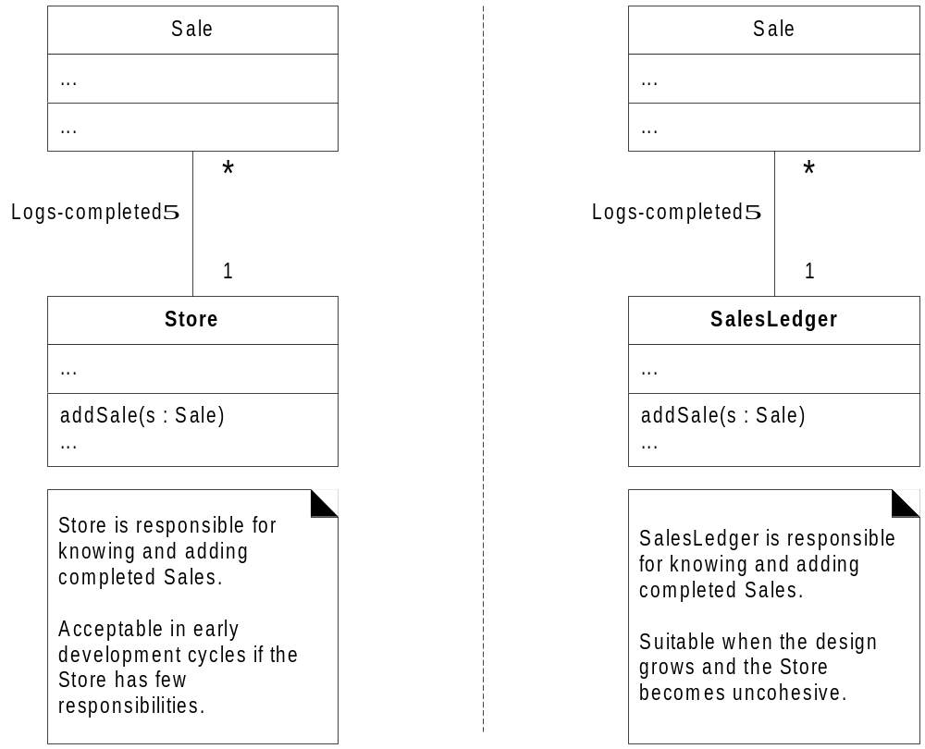

Slide 76
