Slide 1
Creational Design Patterns:

Slide 2
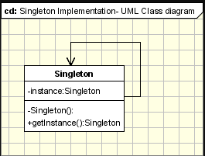
Singleton - Ensure that only one instance of a class is created and Provide a global access point to the object.

Slide 3
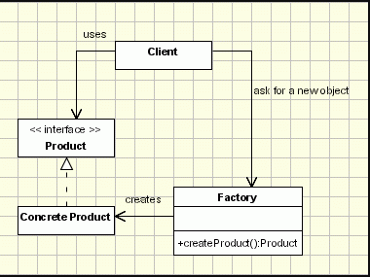
Factory(Simplified version of Factory Method) –
Creates objects without exposing the instantiation logic to the client and Refers to the newly created object through a common interface.

Slide 4
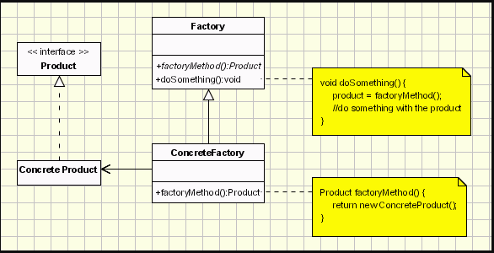
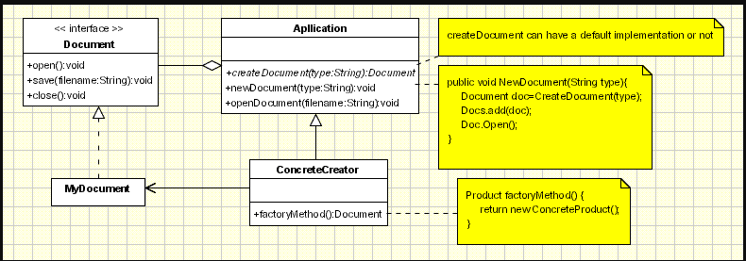
Factory Method –
Defines an interface for creating objects, but let subclasses to decide which class to instantiate and Refers to the newly created object through a common interface.

Slide 5
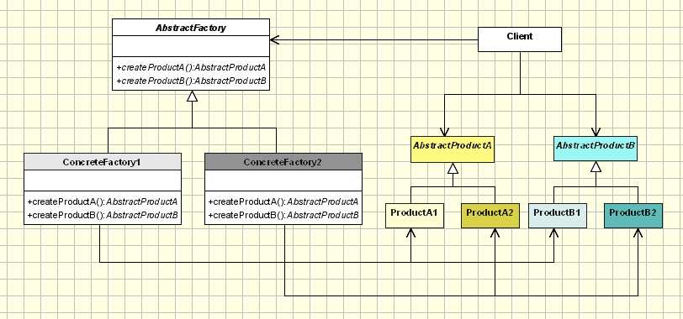
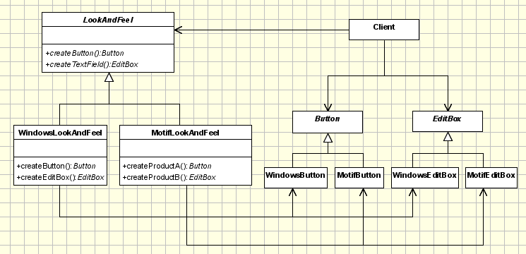
Abstract Factory –
Offers the interface for creating a family of related objects, without explicitly specifying their classes.

Slide 6
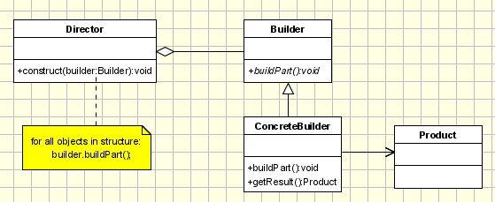
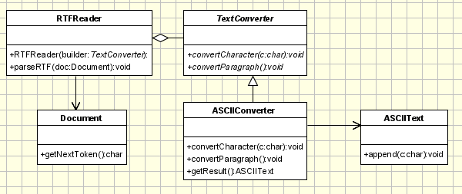
Builder - Defines an instance for creating an object but letting subclasses decide which class to instantiate and Allows a finer control over the construction process.

Slide 7
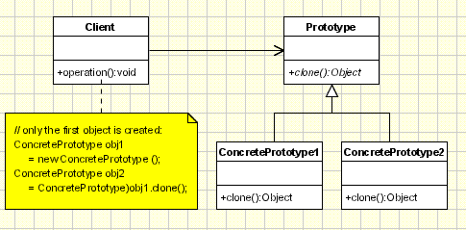
Prototype - Specify the kinds of objects to create using a prototypical instance, and create new objects by copying this prototype

Slide 8
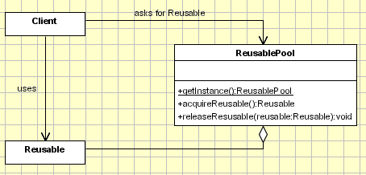
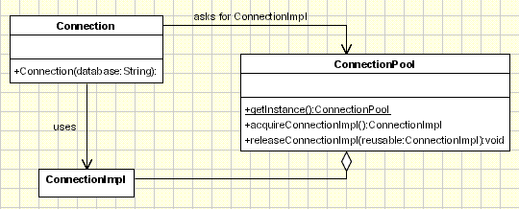
Object Pool - reuses and shares objects that are expensive to create..

Slide 9
Behavioral Design Patterns:

Slide 10
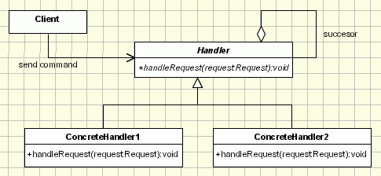
Chain of Responsibiliy - It avoids attaching the sender of a request to its receiver, giving this way other objects the possibility of handling the request too.
- The objects become parts of a chain and the request is sent from one object to another across the chain until one of the objects will handle it.

Slide 11
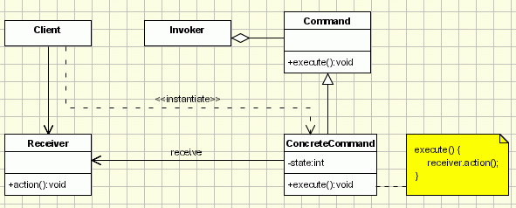
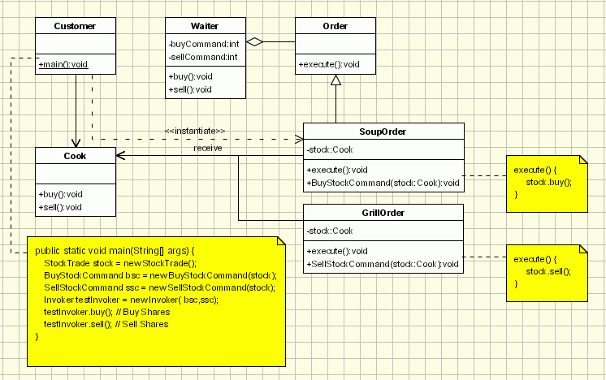
Command - Encapsulate a request in an object, Allows the parameterization of clients with different requests and Allows saving the requests in a queue.

Slide 12
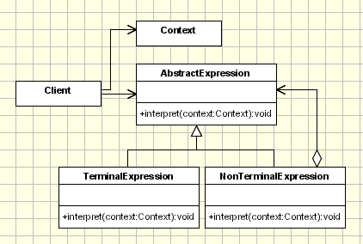
Interpreter - Given a language, define a representation for its grammar along with an interpreter that uses the representation to interpret sentences in the language / Map a domain to a language, the language to a grammar, and the grammar to a hierarchical object-oriented design

Slide 13
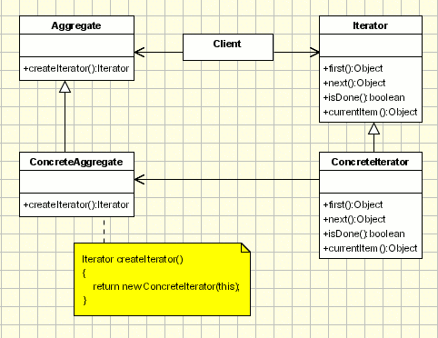
Iterator - Provide a way to access the elements of an aggregate object sequentially without exposing its underlying representation.

Slide 14
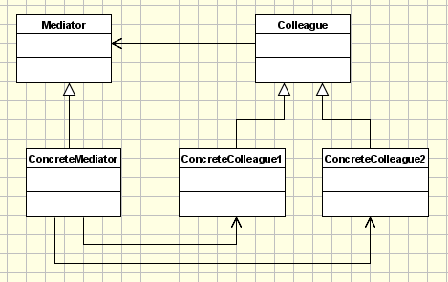
Mediator - Define an object that encapsulates how a set of objects interact. Mediator promotes loose coupling by keeping objects from referring to each other explicitly, and it lets you vary their interaction independently.

Slide 15
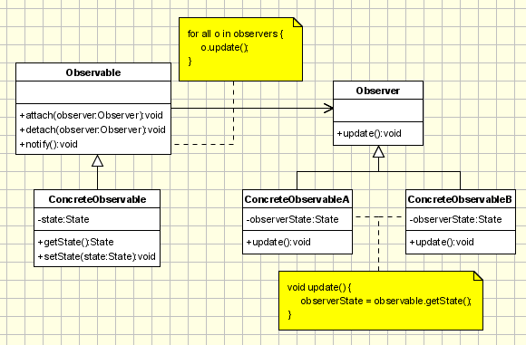
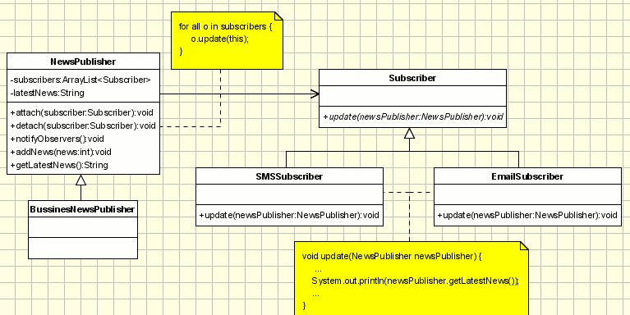
Observer - Define a one-to many dependency between objects so that when one object changes state, all its dependents are notified and updated automatically.

Slide 16
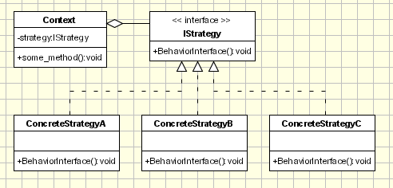
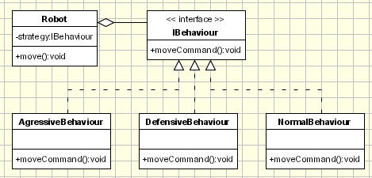
Strategy - Define a family of algorithms, encapsulate each one, and make them interchangeable. Strategy lets the algorithm vary independently from clients that use it.

Slide 17
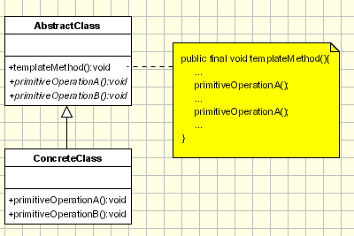
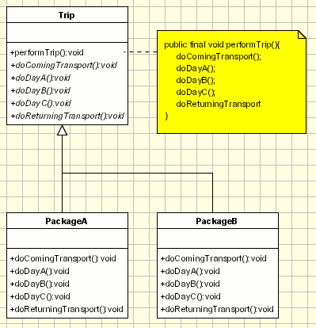
Template Method - Define the skeleton of an algorithm in an operation, deferring some steps to subclasses / Template Method lets subclasses redefine certain steps of an algorithm without letting them to change the algorithm's structure.

Slide 18
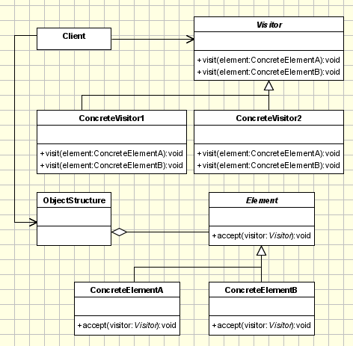
Visitor - Represents an operation to be performed on the elements of an object structure / Visitor lets you define a new operation without changing the classes of the elements on which it operates.

Slide 19
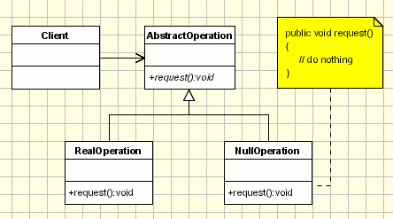
Null Object - Provide an object as a surrogate for the lack of an object of a given type. / The Null Object Pattern provides intelligent do nothing behavior, hiding the details from its collaborators.

Slide 20
Structural Design Patterns:

Slide 21
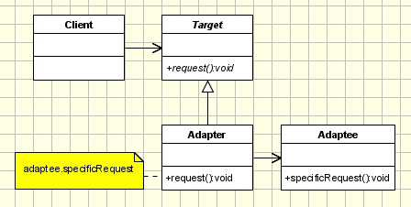
Adapter - Convert the interface of a class into another interface clients expect. / Adapter lets classes work together, that could not otherwise because of incompatible interfaces.

Slide 22
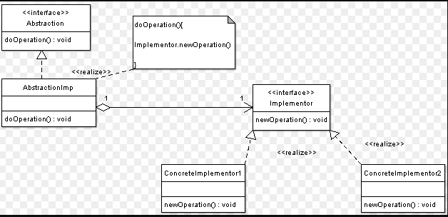
Bridge - Compose objects into tree structures to represent part-whole hierarchies. / Composite lets clients treat individual objects and compositions of objects uniformly.

Slide 23
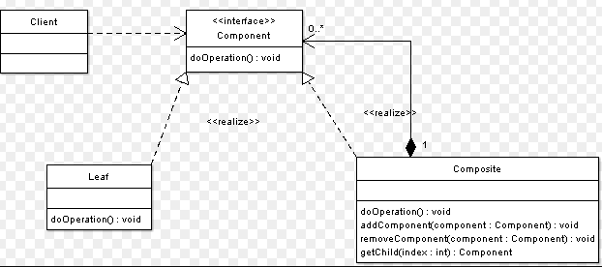
Composite - Compose objects into tree structures to represent partwhole hierarchies. / Composite lets clients treat individual objects and compositions of objects uniformly.

Slide 24
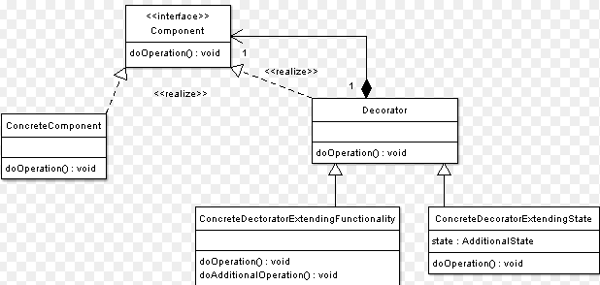
Decorator - add additional responsibilities dynamically to an object.

Slide 25
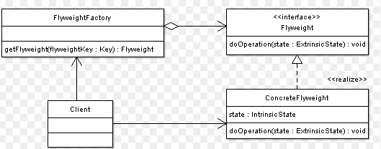
Flyweight - use sharing to support a large number of objects that have part of their internal state in common where the other part of state can vary

Slide 26

Memento - capture the internal state of an object without violating encapsulation and thus providing a mean for restoring the object into initial state when needed.

Slide 27
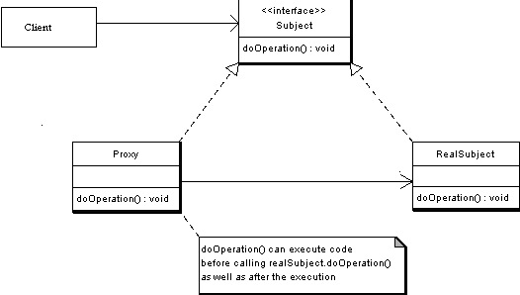
Proxy - provide a “Placeholder” for an object to control references to it.

