Slide 1



Customer Shopping Behavior Analysis
Turning Customer Transaction Data into Actionable Business Insights
PYTHON
POSTGRESQL / SQL
POWER BI

Slide 2

Understanding What Drives Customer Shopping Behavior
Business Challenge
Strategic Objectives
The retail company seeks to understand changing customer purchasing patterns across demographics, product categories, sales channels, discounts, reviews, and subscription behavior.
Identify behavioral trends across customer segments
Core Question
Improve customer engagement and retention
"How can the company leverage consumer shopping data to identify trends, improve customer engagement, and optimize marketing and product strategies?"
Optimize marketing strategy and targeting
Strengthen product strategy and positioning

Slide 3
From Raw Customer Data to Business Insights
Dataset Overview
3,900
18
Purchase Records
Columns
Customer transactions spanning demographics, products, discounts, reviews, shipping, and subscriptions
Capturing the complete customer transaction lifecycle
Analytical Workflow
01
02
Python
PostgreSQL / SQL
Data cleaning, exploratory analysis, feature engineering
Structured business analysis and customer segmentation
03
04
Power BI
Insights
Interactive visualization and stakeholder dashboards
Actionable business recommendations

Slide 4



Building a Reliable Analytical Foundation
Python — Data Preparation
SQL / PostgreSQL — Business Analysis
Inspection & Profiling
Missing Value Treatment
Customer Segmentation
Data profiling using pandas; duplicate and quality checks
Structured relational analysis across loyalty tiers and demographics
37 missing Review Rating values identified and imputed using category-level median ratings
Revenue Analysis
Repeat-purchase, subscription, and age-group revenue analysis
Standardization
PostgreSQL Integration
Product & Discount Evaluation
Data-type correction, categorical standardization, and feature engineering: age_group, purchase_frequency_days
Clean dataset loaded for downstream structured analysis
Category performance and discount rate analysis by product
Python prepared the data; SQL translated business questions into measurable insights.

Slide 5
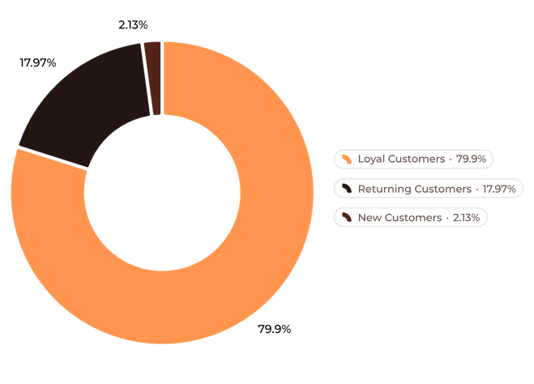
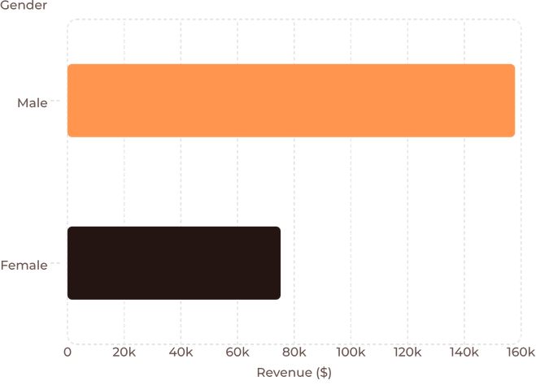
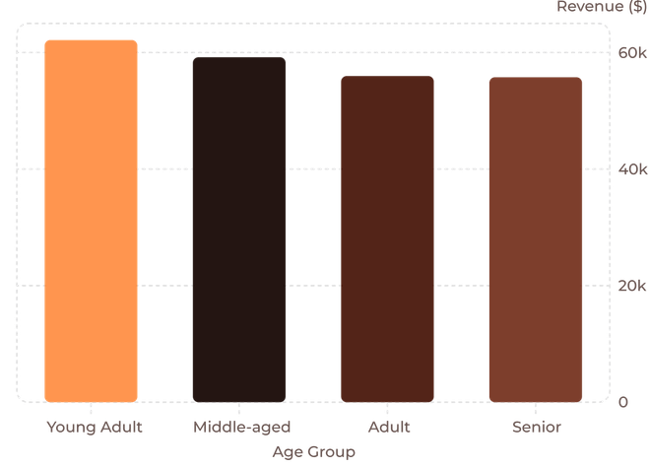
Customer Loyalty Is a Major Value Driver
Revenue by Gender
Revenue by Age Group
Young Adult and Middle-aged customers generate the highest reported revenue among the age groups analyzed.

Slide 6
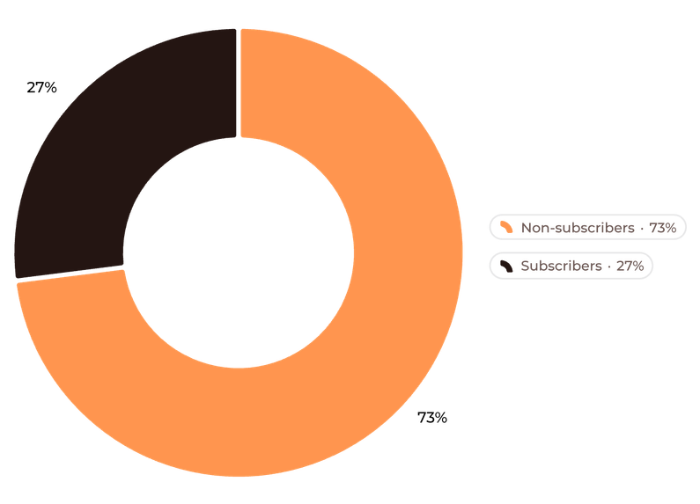
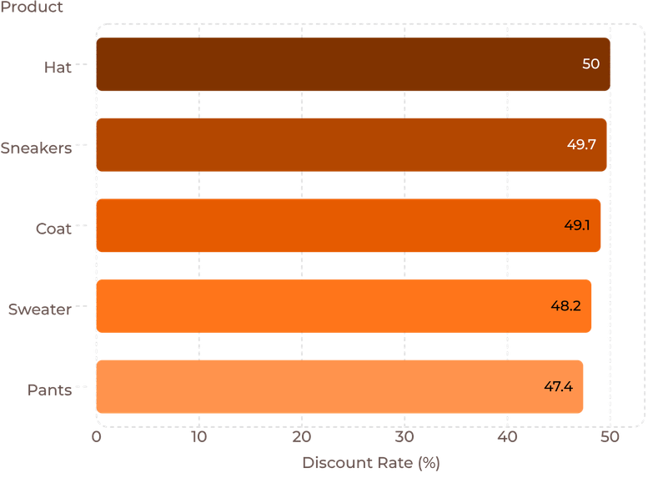
Subscription Adoption and Discount Behavior
Subscription Status
Top Products by Discount Rate
839 customers used discounts while spending above the average purchase amount — an opportunity to evaluate promotional effectiveness and optimize discount strategy.
Subscribers
Non-subscribers
Avg: $59.49 | Revenue: $62,645
Avg: $59.87 | Revenue: $170,436

Slide 7
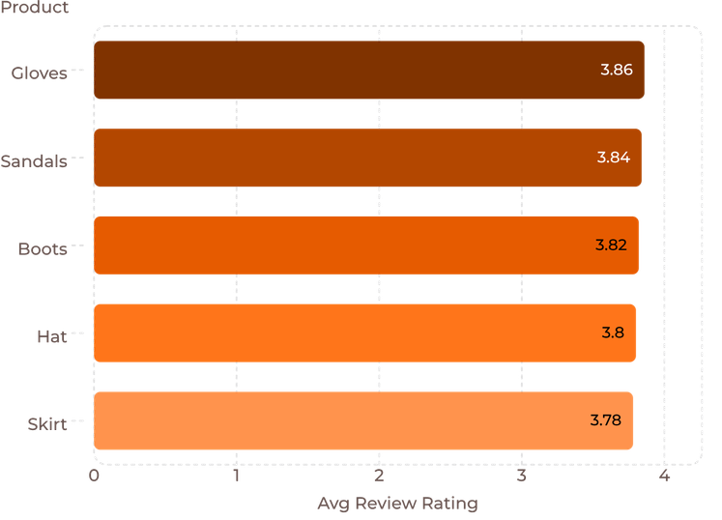
Product Performance Reveals Merchandising Opportunities
Top-Rated Products
Top Products by Category
Category | Top Products (Orders)
Accessories | Jewelry (171), Sunglasses (161), Belt (161)
Clothing | Blouse (171), Pants (171), Shirt (169)
Footwear | Sandals (160), Shoes (150), Sneakers (145)
Outerwear | Jacket (163), Coat (161)
Highly rated and frequently purchased products provide useful signals for product positioning, merchandising, and marketing decisions.
Shipping Impact on Purchase Amount
Standard Shipping
Express Shipping
$58.46 avg purchase
$60.48 avg purchase

Slide 8




Power BI — Turning Analysis into Interactive Insights
KPI Metrics
Total Customers · Total Orders · Average Purchase Amount · Average Review Rating
Analysis Dimensions
Revenue by Category · Sales by Category · Revenue by Age Group · Subscription Status
Interactive Filters
Subscription Status · Gender · Category · Shipping Type · Season
Power BI transformed analytical results into an interactive stakeholder-facing dashboard for faster exploration and decision-making.

Slide 9
From Customer Insights to Business Actions
Subscription Growth
1
Insight: Only 27% of customers are subscribers
Action: Promote exclusive subscription benefits and targeted conversion campaigns
Customer Retention
2
Insight: 3,116 loyal and 701 returning customers represent a strong engagement base
Action: Develop targeted loyalty initiatives to strengthen repeat customer relationships
Discount Optimization
3
Insight: Several products carry discount rates near 50%
Action: Evaluate promotional effectiveness and balance discounts with margin considerations
Product Marketing
4
Insight: Several products show strong order volume and ratings
Action: Prioritize high-performing products in marketing and merchandising campaigns
Targeted Marketing
5
Insight: Young Adult and Middle-aged groups generate highest reported revenue
Action: Develop targeted campaigns for these segments while maintaining broader strategies

Slide 10

End-to-End Analytics: From Data to Decisions
Complete Value Chain
Technology Stack
Python
pandas · Data Cleaning · EDA · Missing Value Treatment · Feature Engineering · Data Validation
Raw Data
Analysis
Clean Data
PostgreSQL / SQL
Relational Analysis · Business Queries · Aggregations · Customer Segmentation · Revenue Analysis
Project Value
Power BI
Translate business problems into analytical questions
Prepare and validate real-world data
Perform structured SQL analysis
Communicate insights visually
Convert findings into actionable business recommendations
Interactive Dashboards · KPI Development · Data Visualization · Slicers / Filters · Business Storytelling
"Turning customer data into decisions that support smarter marketing, stronger engagement, and better product strategy."
GitHub Repository: [INSERT LINK]

