Slide 1



Blue Rose
JILD SMART SKINCARE SOLUTION
Your Skin's Smart Companion

Slide 2



Blue Rose
Problem Statement
Overwhelming number of skincare products leads to confusion.
Lack of personalized guidance for individual skin concerns
Solutions Ahead

Slide 3

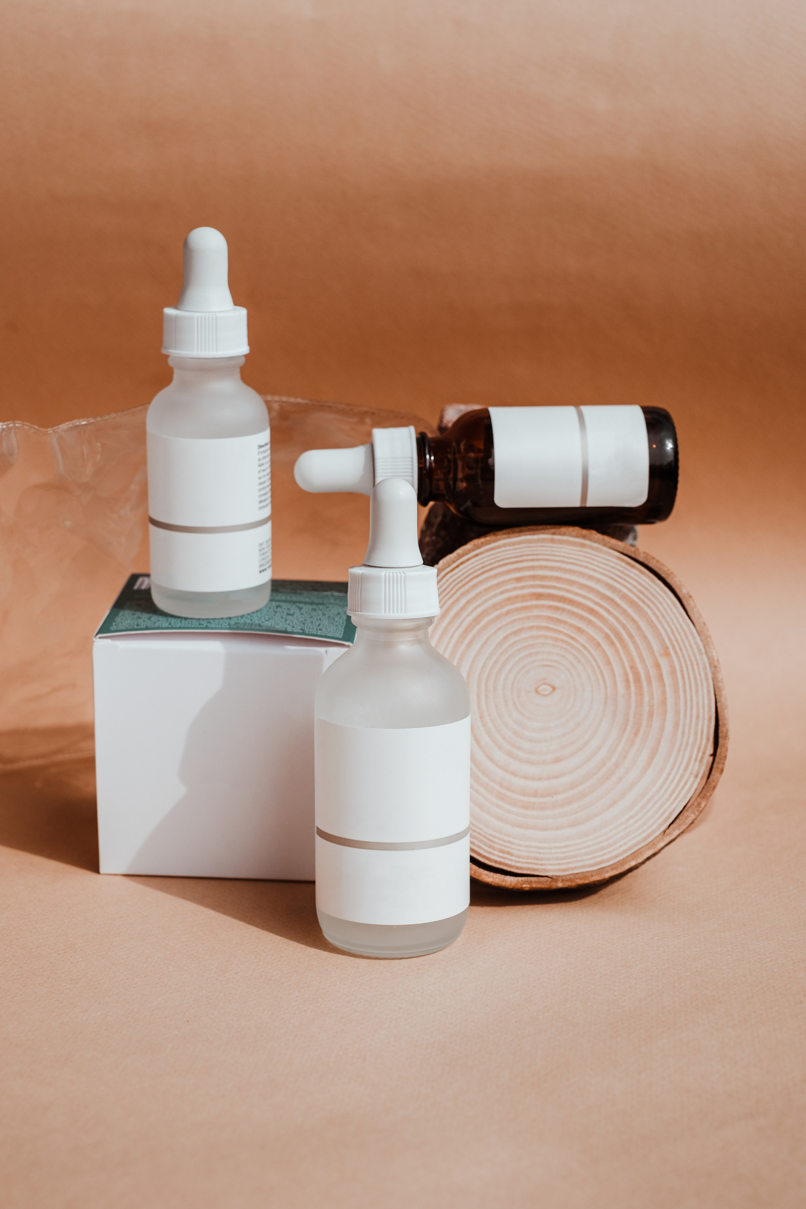

Blue Rose
Proposed Solutions
Solution # 1
AI-driven analysis provides tailored skincare recommendations.
Solution # 2
Easy-to-use platform for identifying suitable products quickly.
AI-driven analysis to find the perfect skincare solutions for your unique skin needs

Slide 4


Blue Rose
OBJECTIVE
100,00
TARGET # 1
Aim to reach 10,000 users within a year by offering personalized, AI-driven skincare solutions.
Develop an AI-powered skincare application that analyzes skin conditions, recommends personalized skincare routines and products based on user lifestyle and concerns.
95%
TARGET # 2
Achieve 95% user satisfaction by delivering accurate skin analysis, effective product recommendations, and personalized skincare routines.

Slide 5















Blue Rose
TECHNOLOGY STACK

Slide 6
Blue Rose
The user uploads a clear photo of their face, and our AI model analyzes it to detect visible skin concerns such as acne and dark circle. The results are then used to personalize the user’s skincare routine.
FACE ANALYSIS

Slide 7

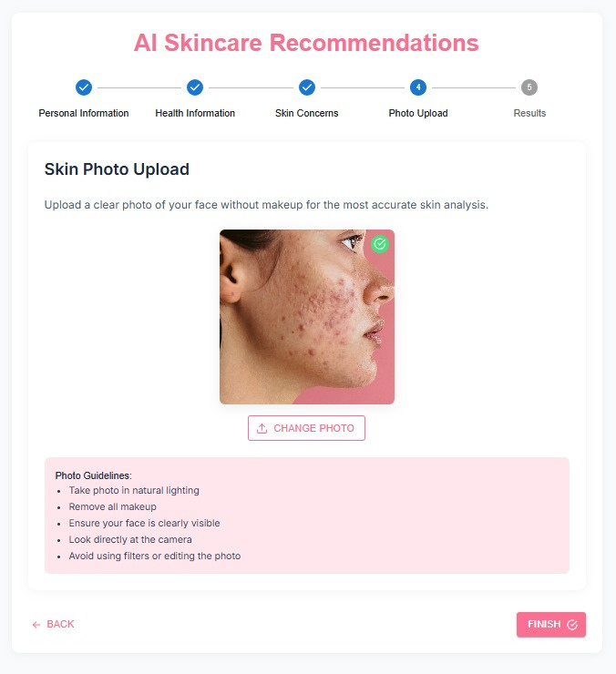
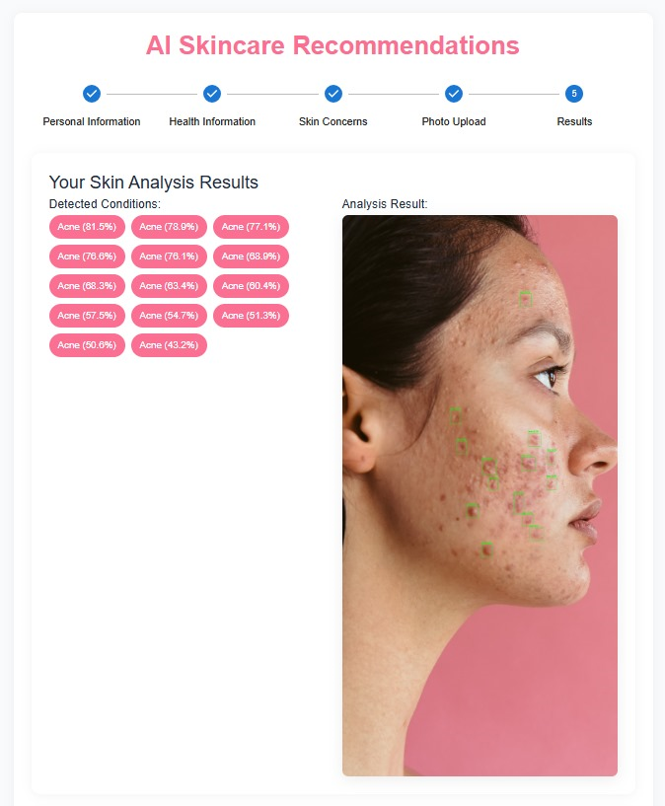
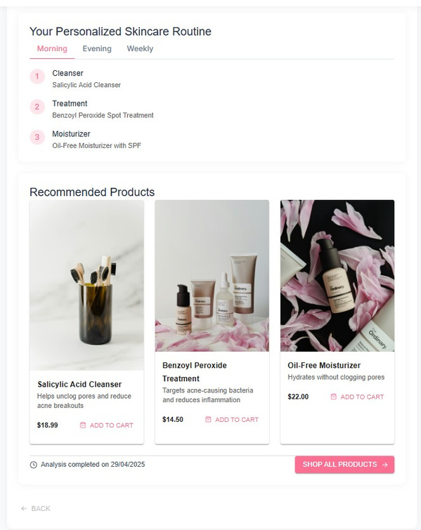
Blue Rose

Slide 8
Blue Rose
Devops

Slide 9




Blue Rose
Future Features
Cycle-based Skin Tracking
Daily Skincare Reminders
Progress Monitoring
Product Refill Alerts

Slide 10

Blue Rose
Thank You

