Slide 1
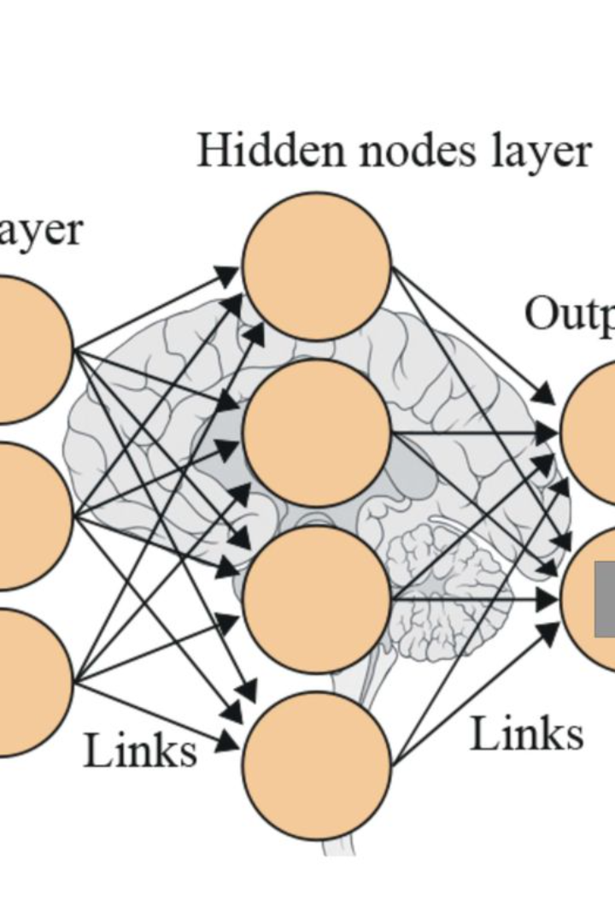
Introduction to Neural Networks
Neural networks are a key component of modern machine learning, mimicking the human brain to process data and make predictions. They have revolutionized fields such as image recognition, natural language processing, and more.
ss
by sunny singh

Slide 2
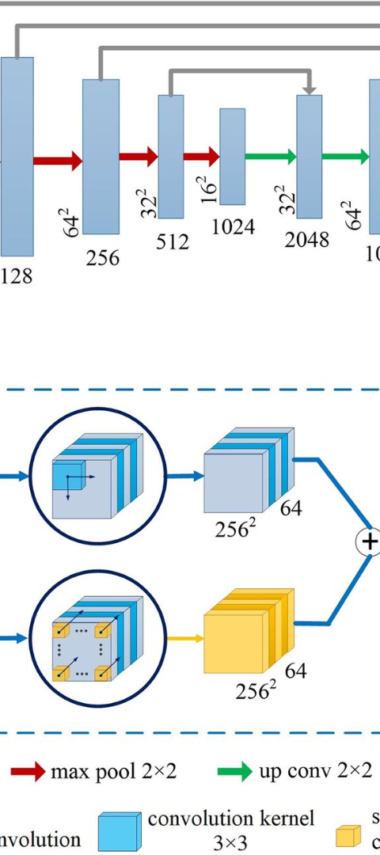
What are Convolutional Neural Networks?
1
Specialized for Images 🖼️
2
Feature Extraction 🌟
Convolutional neural networks (CNNs) are designed to analyze visual data, making them ideal for tasks such as image recognition and computer vision.
CNNs use convolutional layers to extract features from input images, enabling them to learn patterns and structures within the data.
3
Shared Weights 🤝
By sharing weights, CNNs can efficiently process large images and generalize well to new, unseen data.

Slide 3
Architecture of CNNs
1
Input Layer
Receives the raw input, typically an image or a feature map from a previous layer.
2
Convolutional Layers
Extracts features through convolution operations, applying filters to the input data.
3
Fully Connected Layers
Neurons in this layer connect to all activations in the previous layer, providing high-level reasoning.

Slide 4
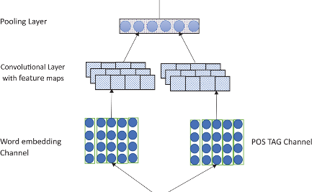
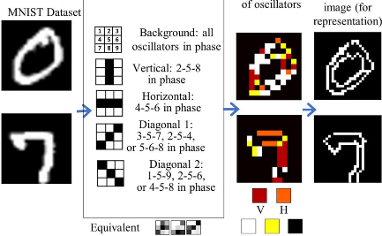
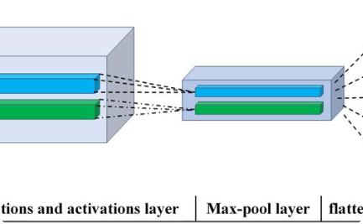
Convolutional Layers
Feature Extraction
Filter Visualization
Receptive Field
The convolutional layers apply various filters to the input image, extracting different features such as edges, patterns, and textures.
Each filter in the convolutional layer focuses on learning specific patterns, helping the network recognize complex structures.
The receptive field of a neuron in the convolutional layer represents the area of the input image that influences its activation.

Slide 5
Pooling Layers
Pooling Operation
Types of Pooling
Downsampling
Pooling layers reduce the spatial dimensions of the convolutional layers, summarizing the presence of features in a region.
Common types include Max Pooling, Average Pooling, and Global Pooling, which aggregate information in diverse ways.
Pooling layers help in downsampling the feature maps, making the network more computationally efficient.

Slide 6



Activation Functions
Importance
Common Functions
Output Layer
Activation functions introduce non-linearity, enabling the network to learn complex patterns and make non-linear transformations.
Popular activation functions include ReLU, Sigmoid, and Tanh, each with its own characteristics and use cases.
The activation function in the output layer depends on the task, such as Softmax for classification or Linear for regression.

Slide 7
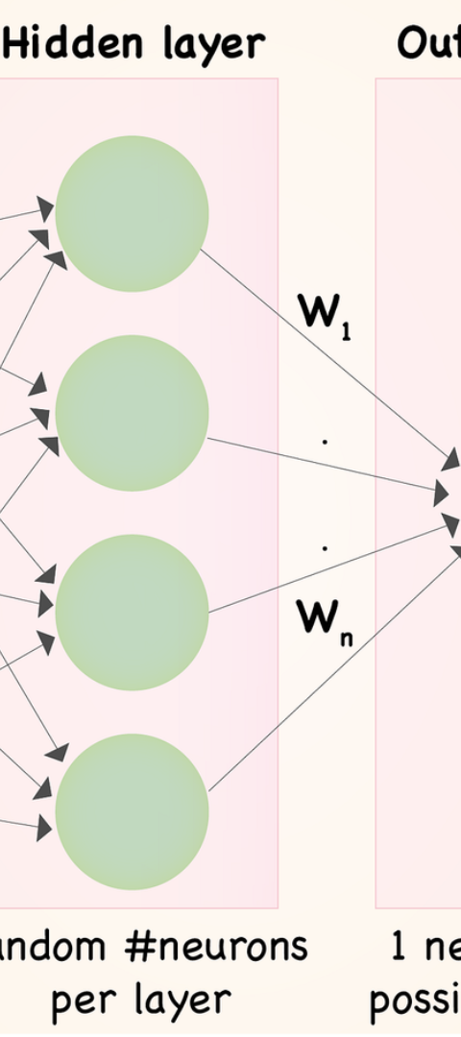
Fully Connected Layers
Neuron Interconnections
High-Level Features
Fully connected layers connect every neuron from the previous layer to each neuron in the following layer.
These layers extract high-level features, combining the learned features from earlier layers for complex reasoning.
Classification and Output
The fully connected layers map the learned features to the final output, crucial for tasks like image classification.

Slide 8
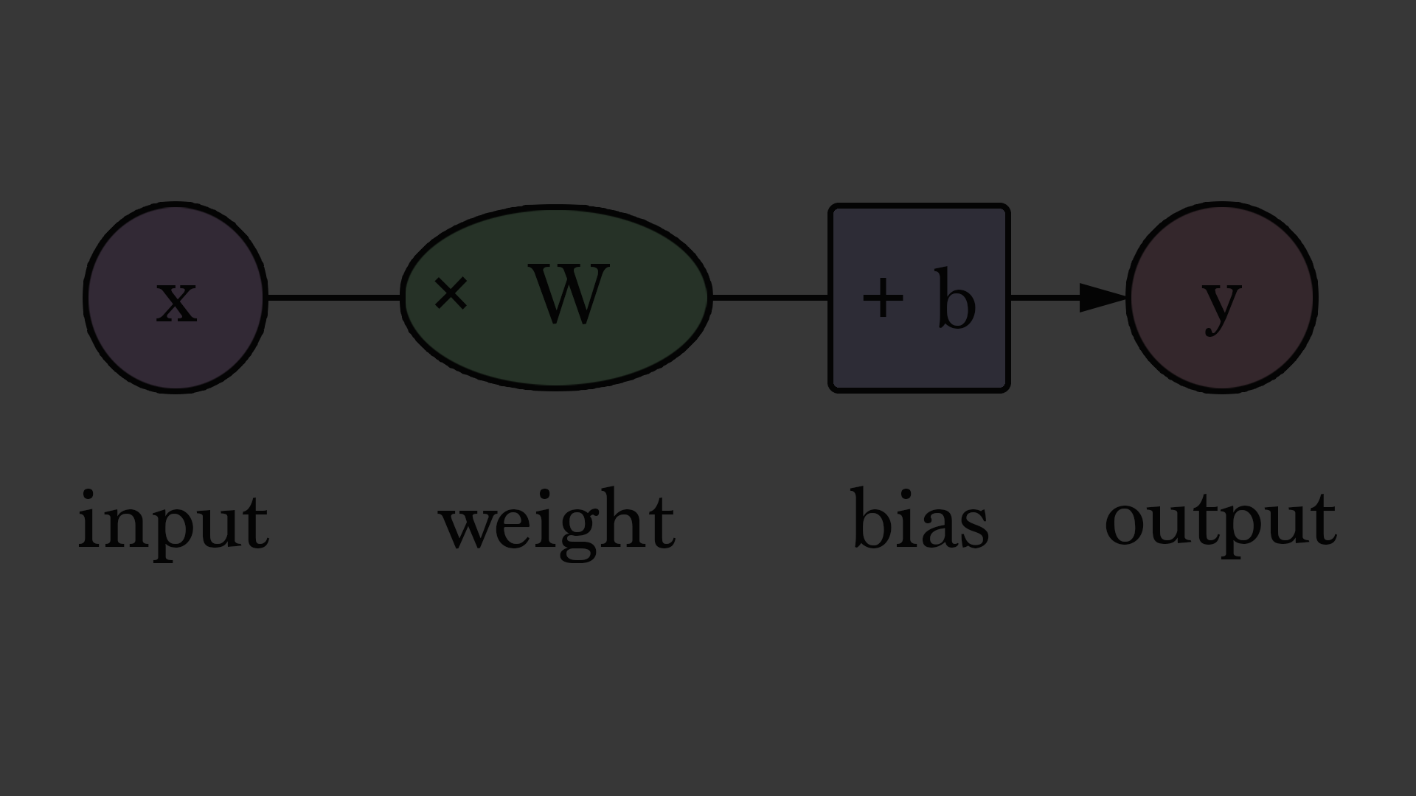
Training CNNs
Data Optimization

Slide 9
Applications of CNNs
Image Classification
Object Detection
Image Segmentation
CNNs in Healthcare

Slide 10
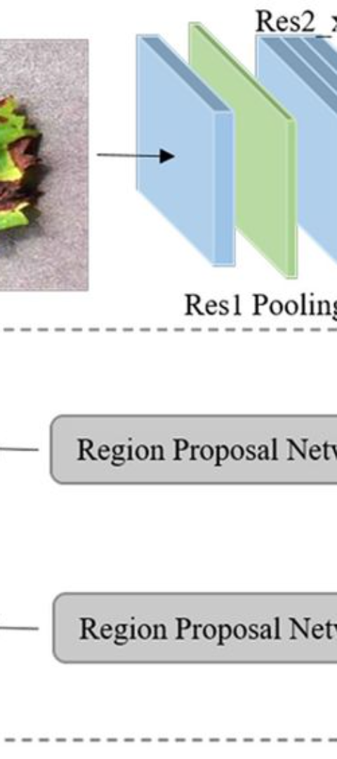
Challenges and Future Trends
1
Overfitting
2
Interpretability
Addressing overfitting remains a key challenge, requiring strategies like regularization and data augmentation.
The black-box nature of CNNs poses challenges in interpreting their decisions, sparking research in explainable AI.
3
Future Trends
Novel architectures, attention mechanisms, and transfer learning are driving the future of CNNs and deep learning.

Slide 11
Conclusion
Impactful Technology
Continuous Advancements
Convolutional neural networks have transformed the way we process and understand visual data, revolutionizing various industries.
As research and development in CNNs continue, we can expect even more powerful and versatile applications in the future.

