Slide 1

LIFEVISION
A pool camera that notices
LifeVision
→ Finds people in pool footage
→ Keeps one ID on each person
→ Warns when someone stays out of sight
Sunny · David · Rohan · Joanne · Sam
01
Notes:
Cover asset is an AI-generated integration concept, not deployed hardware. Team names supplied by project materials.

Slide 2
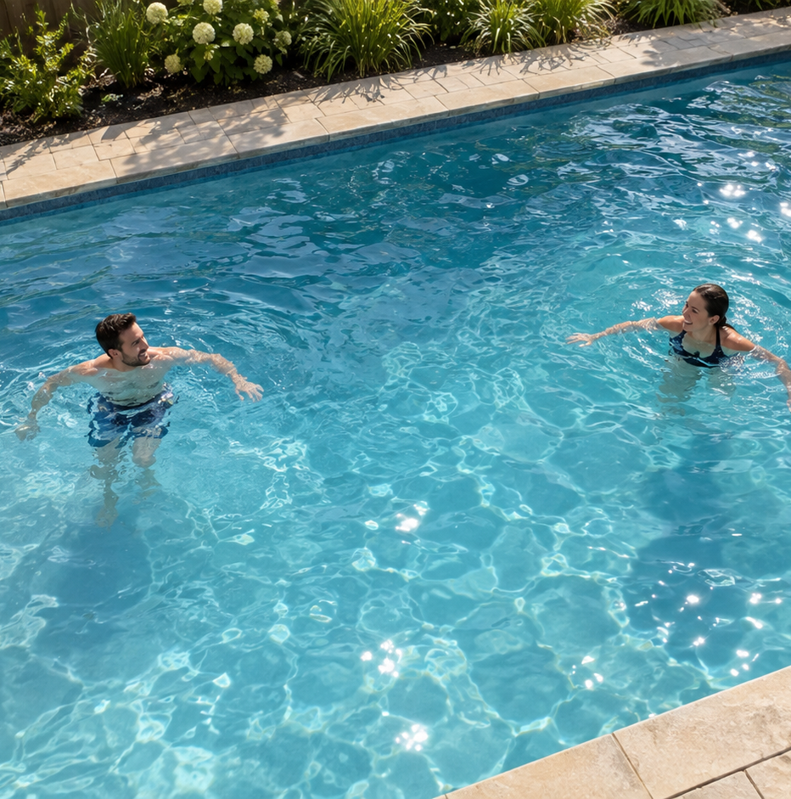
THE PROBLEM
Drowning is silent
#1
+28%
cause of death
for U.S. children ages 1 to 4
higher drowning death rate
ages 1 to 4, 2022 vs. 2019
→ We chose pool safety before factory falls
02
Notes:
CDC Vital Signs May2024: https://www.cdc.gov/vitalsigns/drowning/index.html . +28% compares U.S. ages1–4 rate2022vs2019; no claim of uninterrupted trend after2022. Pool image is a generated illustrative safe scene.

Slide 3
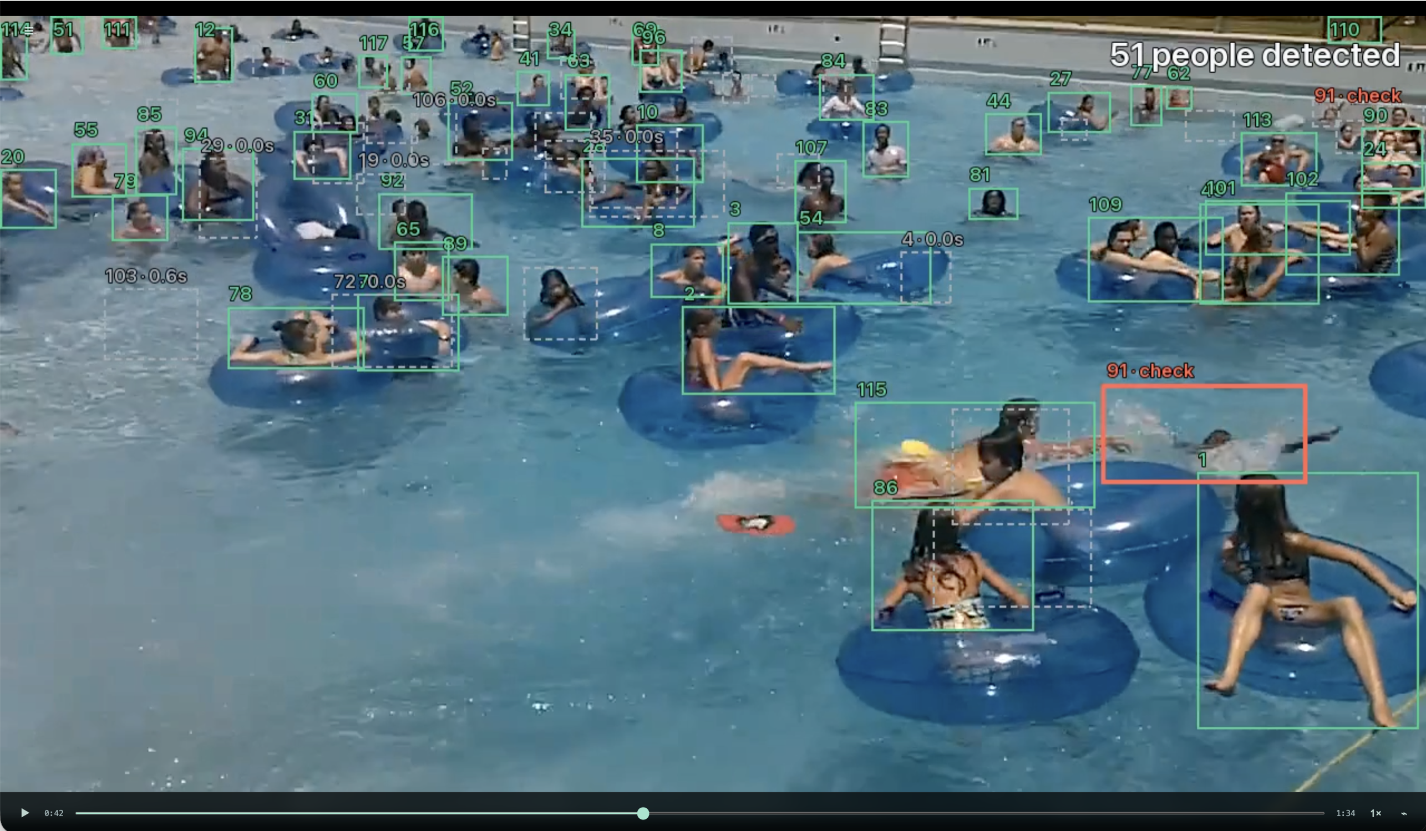
OUR PRODUCT
Uses the camera you already own
→ Finds people and keeps one ID each
→ Head state drives the alert timer
→ Lost inside the pool is a backup
5 s warning
12 s alarm
Prototype thresholds. An adult responds
03
Notes:
Project architecture: head not above water primary; lost inside pool backup. 5s and12s are configurable prototype thresholds, not a validated rescue window. Existing provider-camera integration is planned; current build uses prerecorded video.

Slide 4
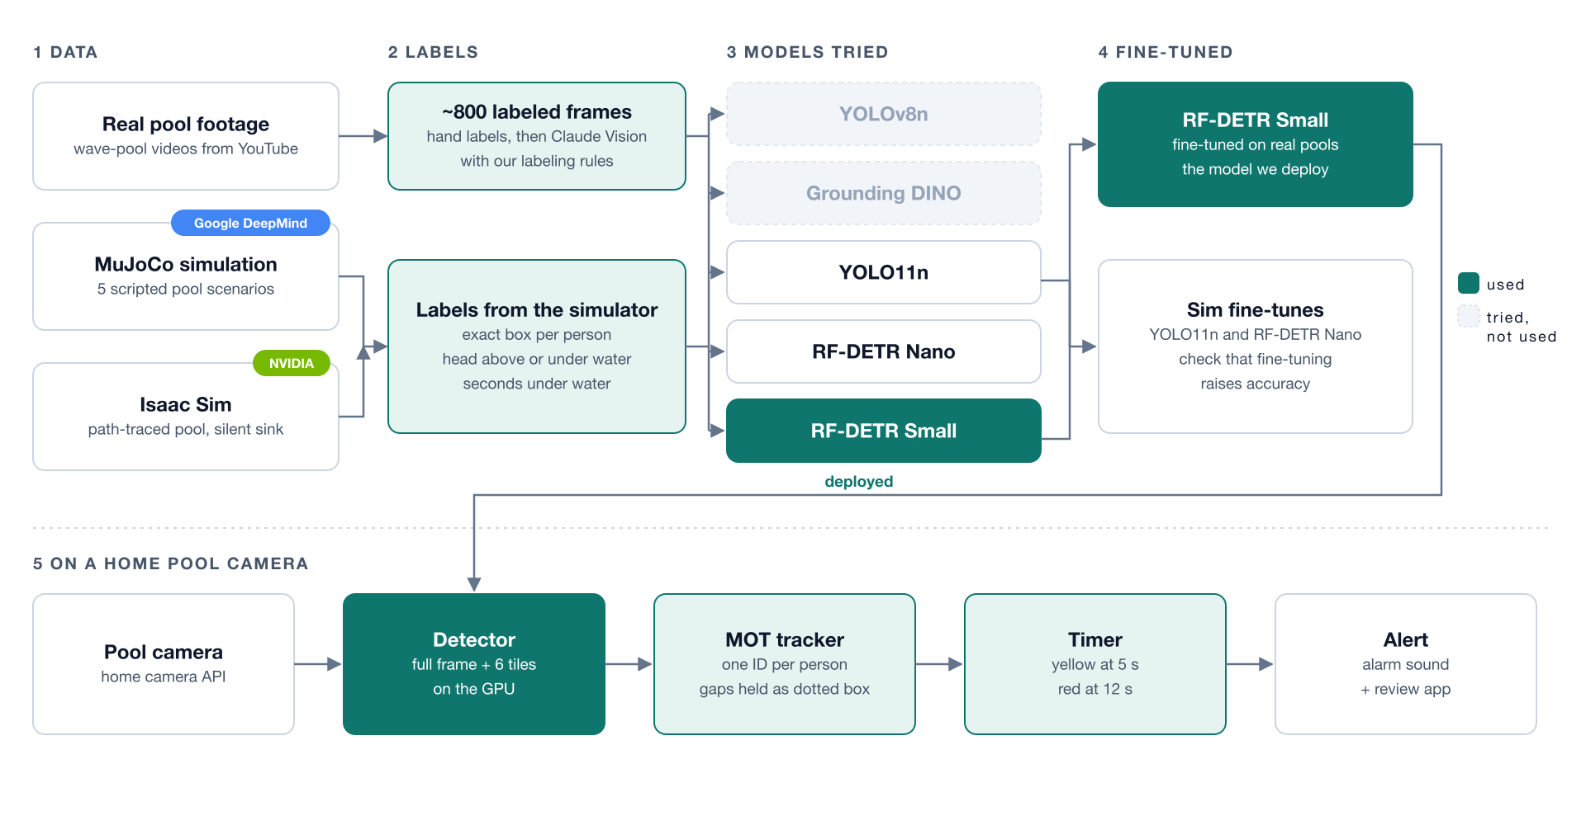
HOW IT WORKS
The full pipeline
04
Notes:
Pipeline graphic supplied by user. Model and deployment branches describe the overall build and proposed provider-camera route. See repository docs/global/architecture.md and presentation/technical-story.md.

Slide 5
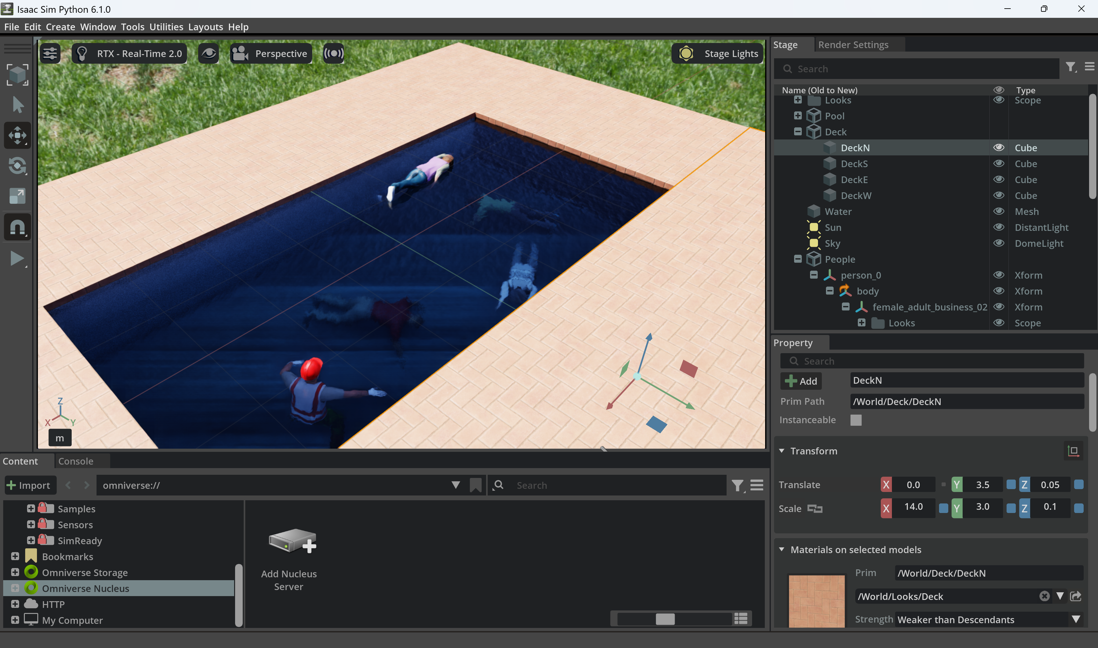


THE GAP
Bridging simulation and real pools
→ We did not have suitable child footage
→ We cannot ethically film drowning
→ Simulation supplies labeled scenarios
MuJoCo
Isaac Sim
05
Notes:
Project sim/README.md: MuJoCo and Isaac Sim support synthetic scenarios. Avoid absolute claim that no drowning dataset exists. NVIDIA logo from https://nvidianews.nvidia.com/multimedia/corporate/nvidia-logos . Google DeepMind logo source: https://storage.googleapis.com/gdm-deepmind-com-prod-public/media/images/0xBk-c8kzB5UTrWs/nav__gdm-lockup__light.height-25.svg

Slide 6
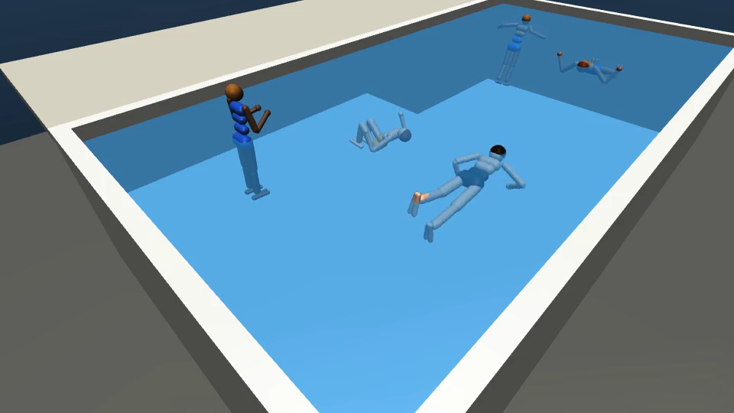
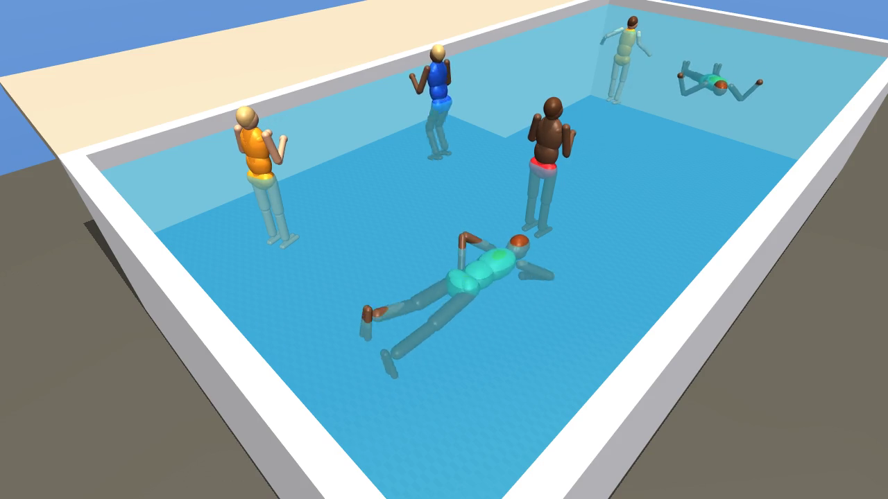
SIMULATION
Data we could not film
MuJoCo
Higher-quality simulated scene
16% → 95%
Stock YOLO11n vs. our Isaac-trained model
Head underwater recall, on simulation
06
Notes:
Metric source model/README.md: stockYOLO11n16% vsIsaac-trainedYOLO11n95% recall headfullyunderwater,20s held-out clip235 submerged boxes. Photos are MuJoCo examples; metric is explicitly Isaac Sim. Synthetic train/test same scene andcharacters; not real pool accuracy.

Slide 7
FINE-TUNING
Trained on a real wave pool
F1
0.39
→ 0.75
Hand labels, then Claude Vision with our rules
16 validation frames from the same source video
07
Notes:
Native editable chart recreates data-results.png in teal/grey using model/README.md exactvalues. RFDETRSmall person threshold.25. Samevideo train+valid: optimistic forotherpools. Original user chart preserved in assets/data-results.png.

Slide 8
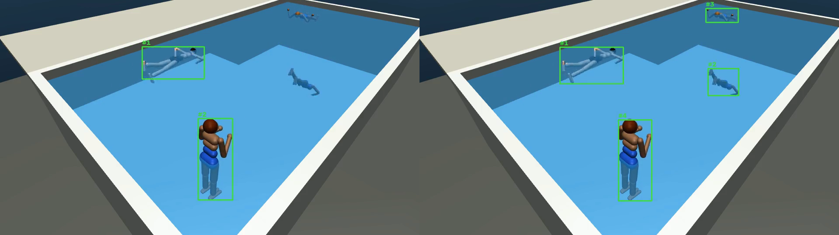
TRACKING
One ID per person
Stock model: 18 IDs
Our tracker: 4 IDs
→ Briefly lost boxes stay dotted and keep their ID
08
Notes:
18→4 IDs for4realpeople on simulation,resurface scenario. RFDETRN fine-tuned onMuJoCo plus edge logic. Source presentation/data/sim_results.csv and technical-story.md. Dotted hold is a configurable gap grace period, not universal fixed under1s.

Slide 9
LIVE DEMO
See it run
LifeVision review app
→ Switch to the working demo
Recorded backup ready
09
Notes:
Screenshot supplied by user. Explicitly state liveinference vsprerecordedinference vsscriptedoutput during demo. Title unchanged as requested; app label should read LifeVision.

Slide 10
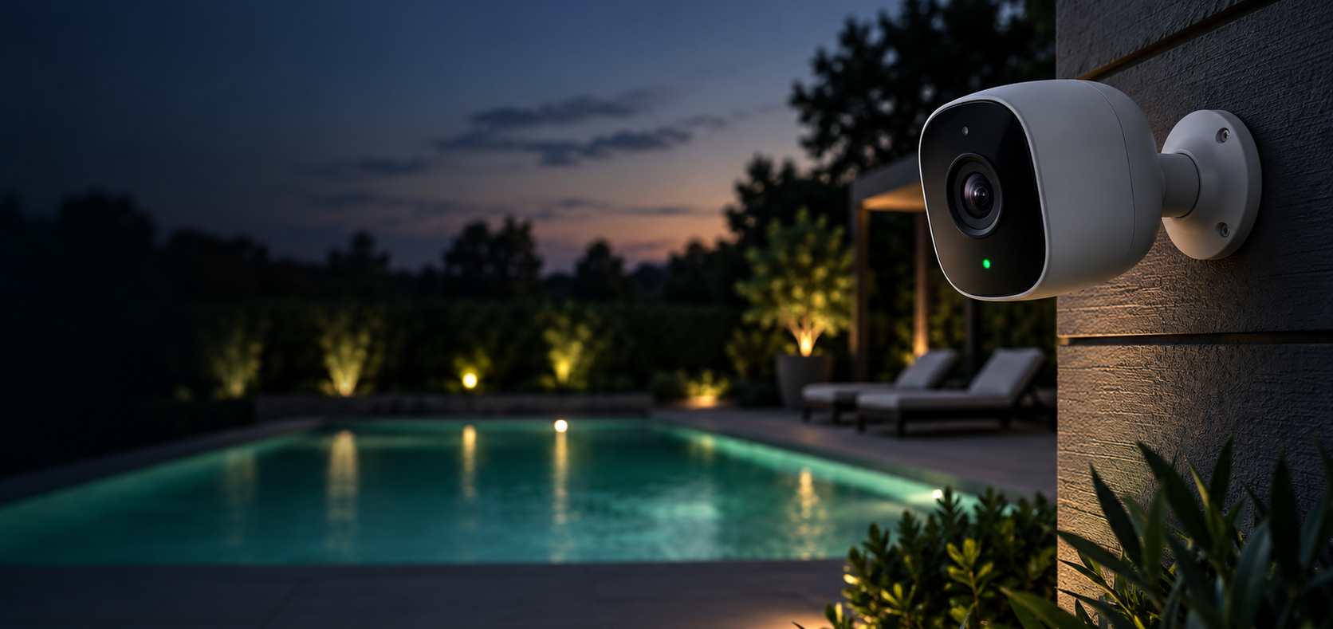
DEPLOYMENT
Two ways to bring it home
→ Local today: footage stays home
Configurable
alert timer
→ Cloud route: proposed
→ Provider camera APIs: planned
10
Notes:
Local prerecorded reviewapp implemented. Cloud and camera providerAPI routes futuredeploymentoptions. No evidence forcheaper/faster comparativeclaim. No validatedlifeguardwindow claimed. Asset AI-generated integrationconcept.

Slide 11
WHAT’S NEXT
From pools to every camera
→ Keep fine-tuning on real pools
Factories
→ More edge cases from Isaac Sim
→ Camera partners with privacy first
Home cameras
A supervision aid, not a replacement
for watching children
Pools today
11
Notes:
Future scope per suppliedbrief. No detectionofdrowningclaim. Closing supervisioncaveat required. Native nestedcircles are editable requesteddiagram.

