Slide 1

LIFE VISION
Explainable pool-risk monitoring
for cameras families already own
Hackathon prototype
David · Rohan · Sunny · Joanne · Sam
Notes:
Imagine you are at a backyard pool with friends or family. For one moment, everyone looks away. The camera keeps recording, but recording alone cannot tell you when normal play has turned into danger. Life Vision adds that missing layer. It watches each person over time and warns the adult when someone's head has stayed below the water too long.
Sources:
- Concept image generated for this presentation. It does not depict a real incident.

Slide 2
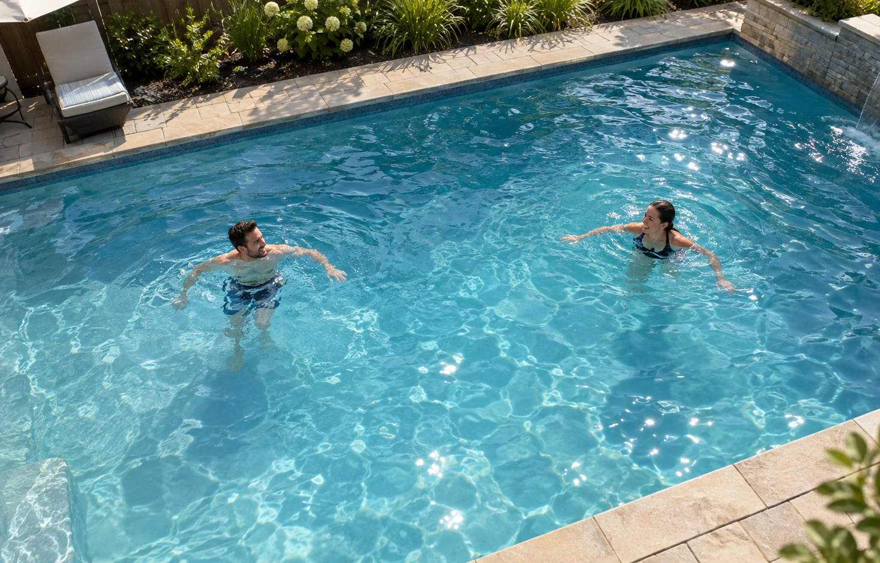
THE USE CASE
02
A short gap in supervision can become a pool emergency
61%
of reported pool and spa fatalities involving children under five were associated with a gap in adult supervision
FIRST USE CASE
Backyard pool · existing camera · responsible adult nearby
CPSC 2024 REPORT · REPORTED FATALITIES, 2019–2021
Notes:
The Consumer Product Safety Commission reviewed reported pool and spa fatalities involving children under five. Sixty-one percent involved a gap in adult supervision, meaning an adult lost contact with the child long enough for the child to reach the water. Many of these homes already have a backyard camera. Our first use case is simple: turn that existing view into a second set of eyes, while keeping supervision and physical pool barriers as the primary protections.
Sources:
- U.S. CPSC, Pool or Spa Submersion: Estimated Nonfatal Drowning Injuries and Reported Drownings, 2024 Report, Table 14: https://www.cpsc.gov/s3fs-public/Pool-or-Spa-Submersion-Estimated-Nonfatal-Drowning-Injuries-and-Reported-Drownings-2024-Report.pdf
- Pool image generated for this presentation. It depicts safe staged activity, not a real incident.

Slide 3
USER INTERACTION
03
Every alert shows who, why, and for how long
Head evidence changes
Condition persists
PERSON 02
GREEN
tracked normally
YELLOW
warning timer
RED
check the pool
HEAD NOT ABOVE
3.1 s
1 Choose video or camera
2 Activate monitoring
3 Select alert preference
A brief Matrix-style scan marks the moment analysis starts. Demo thresholds are always labeled.
RESEARCH PROTOTYPE · SYNTHETIC RESULTS WHERE NOTED
Notes:
The user selects a prerecorded clip for the hackathon, then presses Activate Monitoring. We intentionally made activation theatrical, with a quick Matrix-style scan, so the audience can see exactly when analysis starts. Every person receives a stable ID and a green box. If a head remains below the surface, a timer starts. The box turns yellow at the warning threshold, then red if the condition persists. The interface always explains the decision, for example head not above water for 3.1 seconds. The user chooses yellow and red alerts, red only, or on-screen alerts.
Sources:
- Repository frontend: frontend/index.html, frontend/styles.css, frontend/app.js

Slide 4
TECHNICAL ARCHITECTURE
04
One pipeline separates perception from the safety decision
VIDEO
source
PERSON + HEAD
detector
TRACK +
ID stitching
EVENT
engine
APP
overlay
SIMULATION TEST BENCH
training frames · exact boxes · head height · scoring
Prerecorded video and timestamped JSON keep the hackathon demo local and reliable.
RESEARCH PROTOTYPE · SYNTHETIC RESULTS WHERE NOTED
Notes:
The source reads a video with media timestamps. The detector finds each person and the available evidence for the head. ByteTrack links detections across frames. Our own identity layer handles short losses and resurfacing, because tracker IDs alone do not survive every dive. The event engine owns the timers, missing-person registry, and entry alert. It writes results as timestamped JSON, and the frontend draws those results over the video. For the demo this all runs locally from files, so network or cloud failures cannot break the presentation.
Sources:
- Repository architecture: docs/global/architecture.md

Slide 5
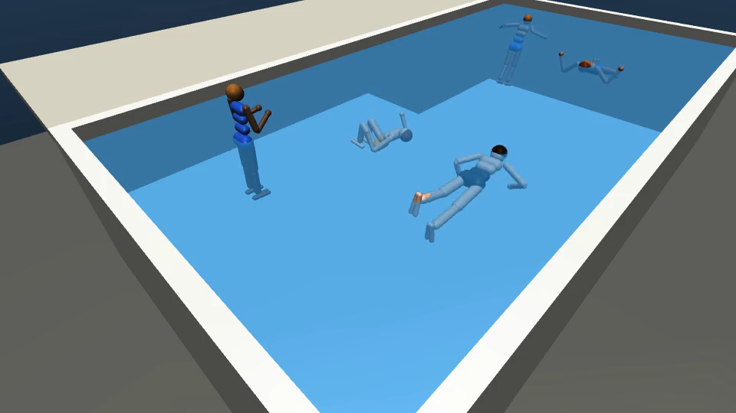
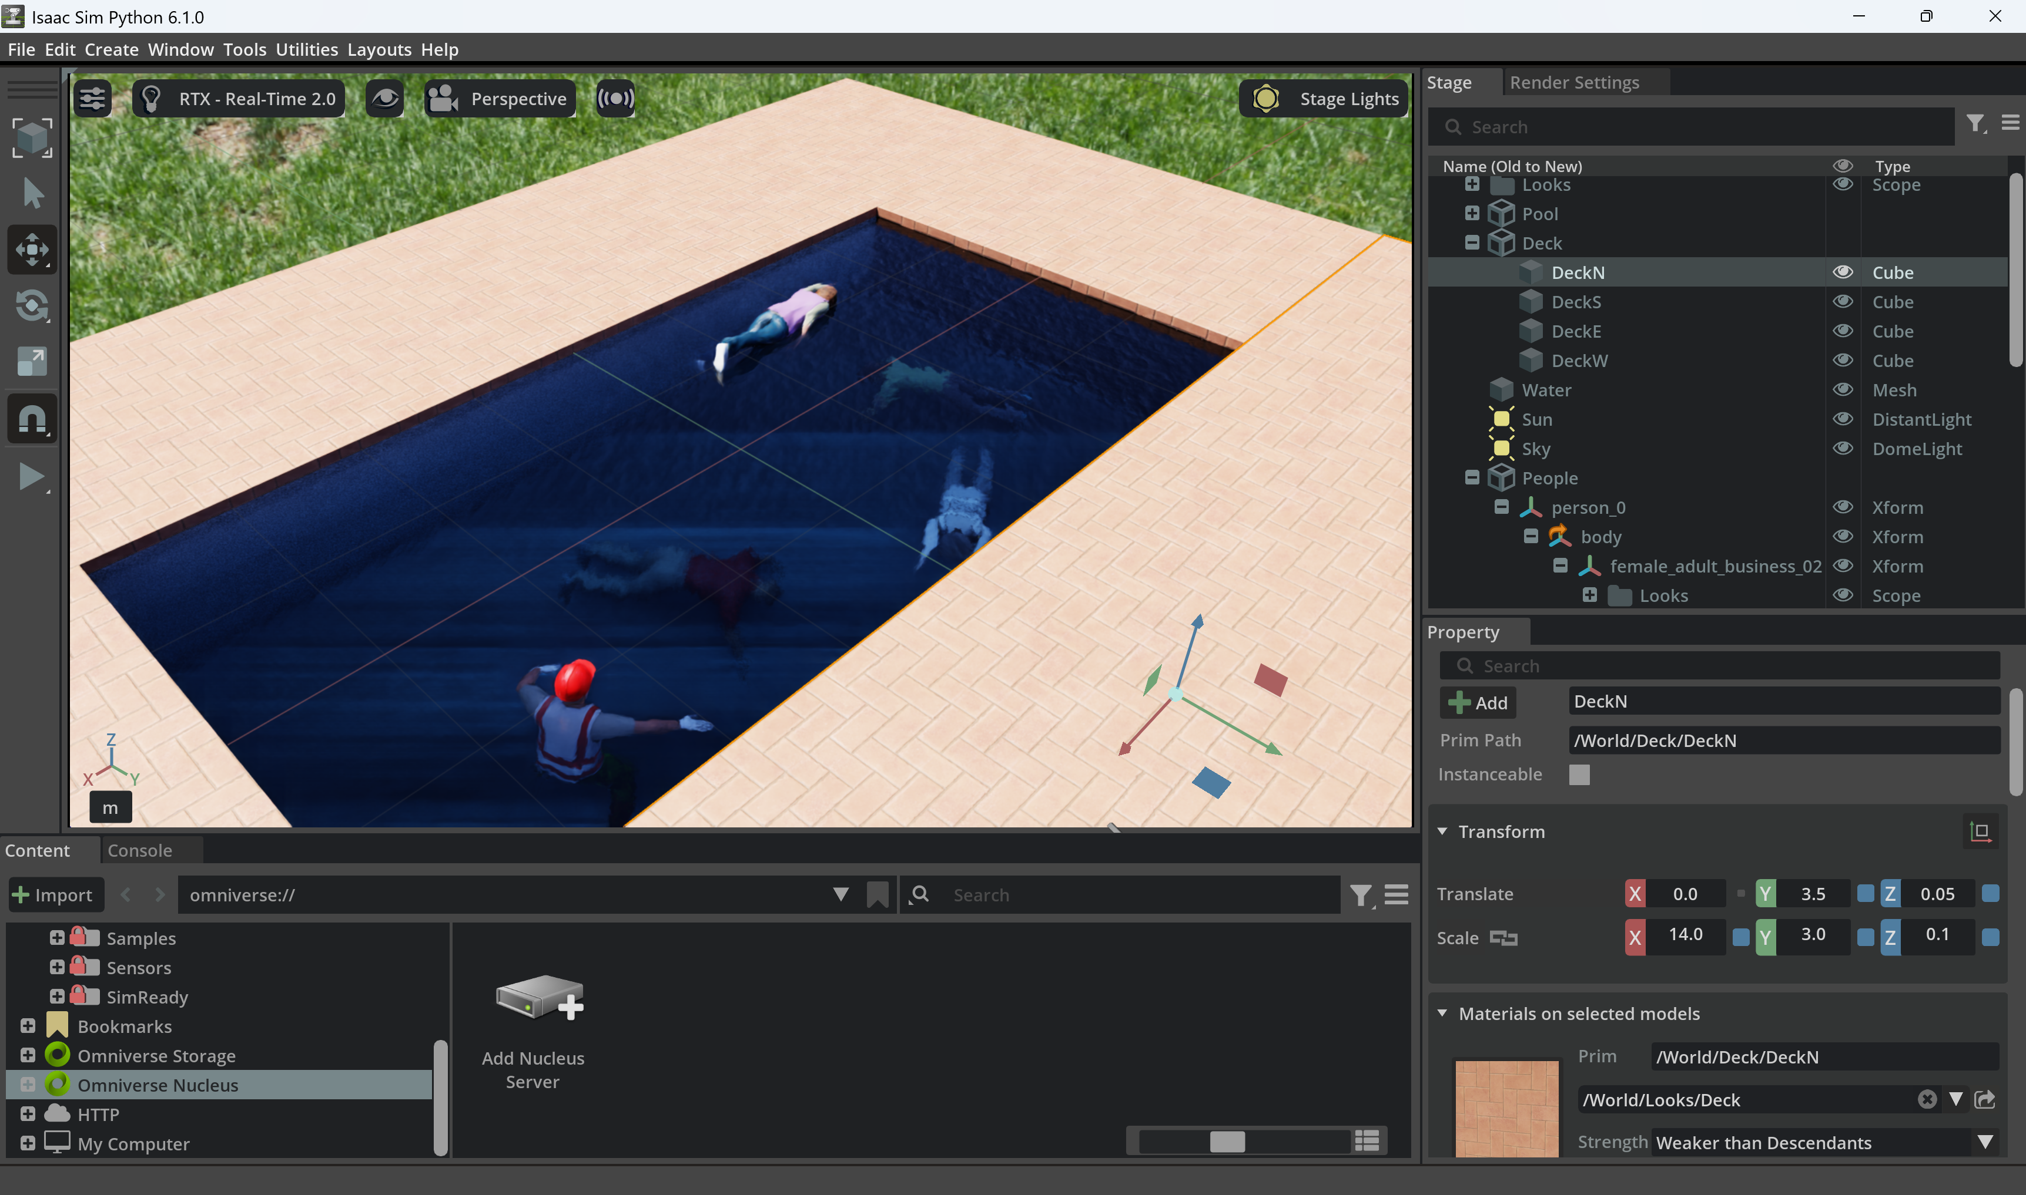
TEST DATA
05
Simulation gives exact answers for cases we cannot film safely
MUJOCO
ISAAC SIM
Physics, buoyancy, exact boxes and head height
More realistic people, lighting, water and held-out video
SAFE TESTING · AUTOMATIC LABELS · SYNTHETIC ONLY
Notes:
We built a MuJoCo test bench with a shallow end, a deep end, buoyancy, and scripted behaviors such as swimming, resurfacing, collapse, entry, and a silent sink. The simulator gives us exact boxes and exact head height in every frame, so we can test the tracker and event logic without hand labeling. We also built an Isaac Sim scene with more realistic people, lighting, and water. Simulation lets us test dangerous cases safely, but it does not replace real pool footage.
Sources:
- Repository simulation details: docs/global/simulation.md
- Isaac results: model/README.md

Slide 6
MODEL EVIDENCE
06
Fine-tuning improved underwater recall on held-out synthetic footage
95%
underwater recall
Precision: 95%
261 Isaac training frames
Held-out seed-0 clip
Synthetic-only result. Same scene and character set. This validates the pipeline, not real-world accuracy.
HELD-OUT ISAAC SIM CLIP · 526 BOXES WITH HEAD FULLY UNDER WATER
Notes:
This chart shows recall specifically when the head is fully below water on our held-out Isaac Sim clip. Stock YOLO11n found only sixteen percent. Stock RF-DETR-S found seventy-five percent. A YOLO model trained on the older MuJoCo characters transferred better at eighty-three percent. Our YOLO model fine-tuned on 261 Isaac frames reached ninety-five percent. Precision remained ninety-five percent. These are synthetic results from one scene and character set. They prove that our training and evaluation pipeline works. They do not predict real-world accuracy.
Sources:
- Repository measured results: model/README.md, held-out seed-0 clip

Slide 7
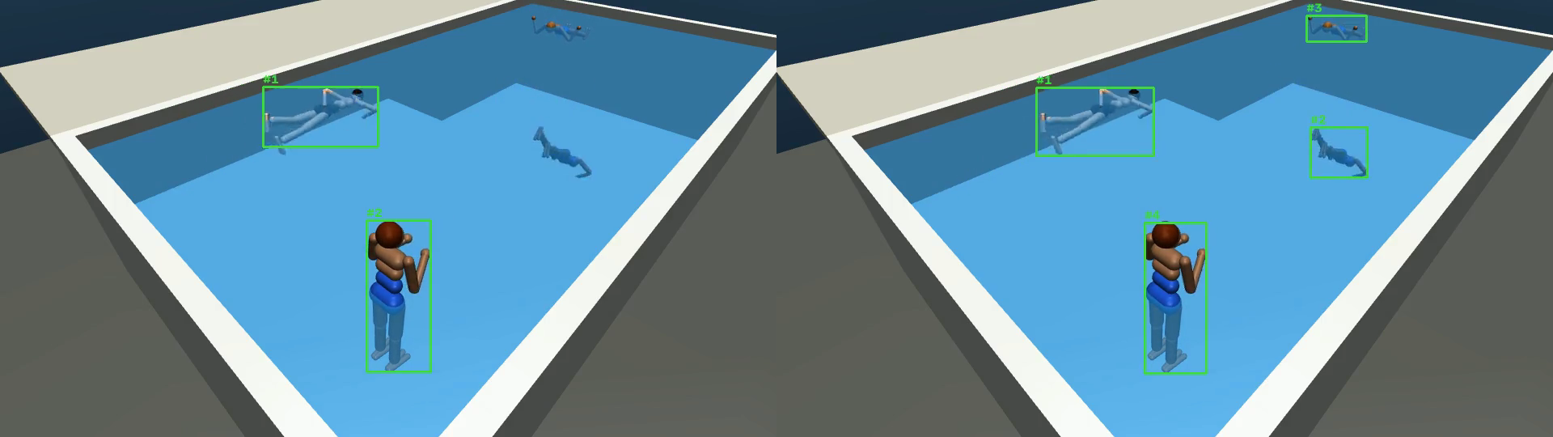
TRACKING
07
A strong detector still failed when the identity changed
18
IDs for four people
became
4
IDs with zero switches
DEFAULT TRACKER
BOX CLEANUP + ID STITCHING
FIVE MUJOCO SCENARIOS · SYNTHETIC ONLY
Notes:
The default tracker produced eighteen IDs for four people. That makes a per-person timer useless. We added three layers: box cleanup removes duplicate and partial detections, an ID starts only after several consistent frames, and identity stitching gives a resurfacing person their previous ID when the timing and location agree. On the five MuJoCo scenarios, the fine-tuned detector plus these rules produced one ID per person with zero switches. We also learned that a submerged body remains visible in clear water, so the alarm must time the head rather than wait for the whole box to disappear.
Sources:
- Repository tracking results: docs/global/simulation.md
- Visual: presentation/images/before_after_tracking.png

Slide 8
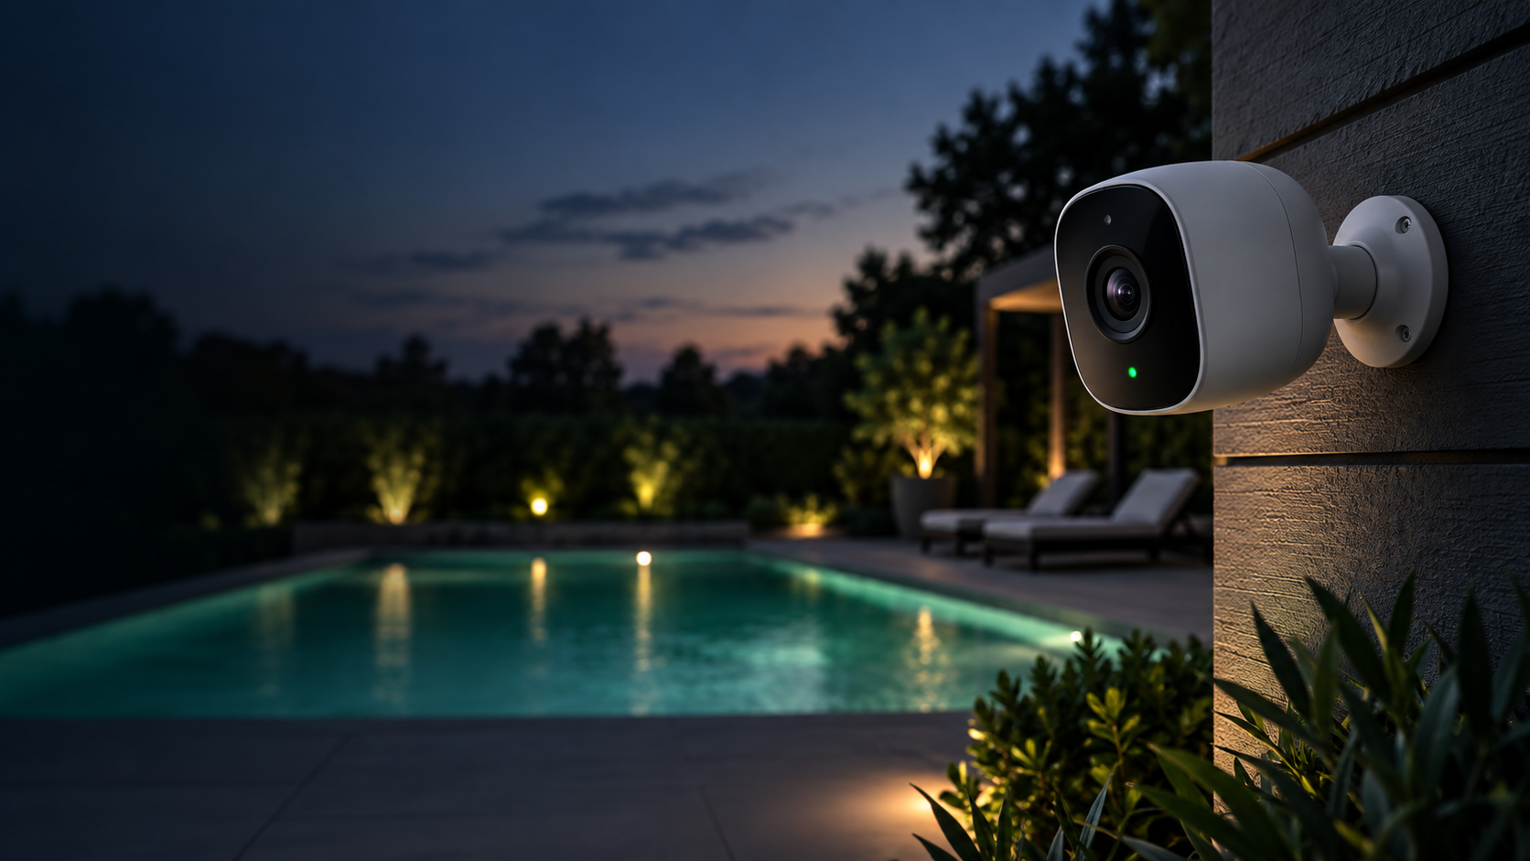
CAMERA INTEGRATION
08
One source adapter supports local video today and camera APIs later
NOW
Uploaded video
NEXT
Webcam and RTSP
LATER
Ring WebRTC/WHEP
LATER
Nest WebRTC or RTSP
The overlay appears in our application. The native Ring or Google Home screen remains unchanged.
AUTHORIZED ACCESS · ACCOUNT LINKING · PRIVACY REVIEW
Notes:
Every camera enters through the same source adapter. The hackathon uses uploaded video first, then a webcam. A compatible IP camera can provide an RTSP stream. Ring now offers an official developer platform with authorized device access, webhooks, and WebRTC video. Google Nest provides WebRTC or RTSP through Device Access, depending on the model. The colored overlay appears in our application, not inside the native Ring or Google Home screen. Account authorization and commercial review come later.
Sources:
- Ring Developer Experience: https://developer.amazon.com/docs/ring/get-started.html
- Google Nest supported devices: https://developers.google.com/nest/device-access/supported-devices
- Camera concept image generated for this presentation. It does not show a branded product.

Slide 9
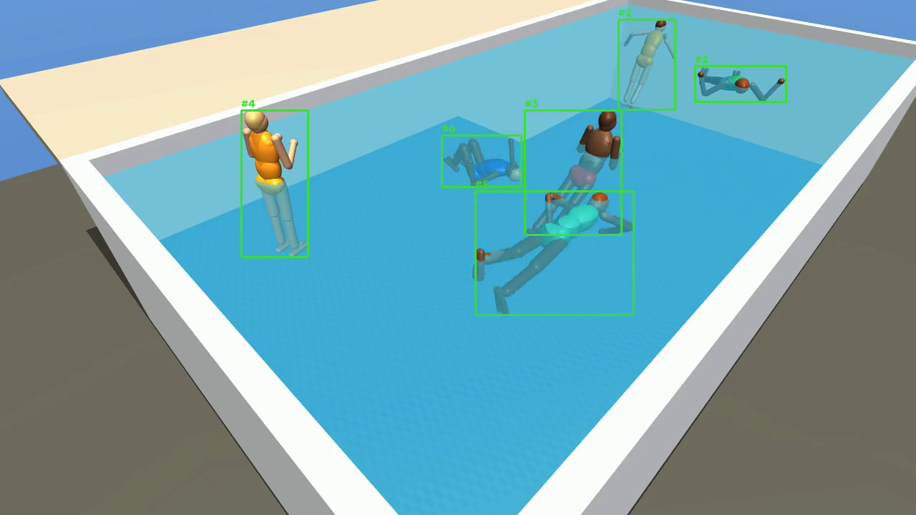
LIVE DEMO
09
Watch the state change, not just the box
DEMO RUN
01
Activate monitoring
02
Green becomes yellow
03
Timer reaches red
04
Explain and replay
STATE THE MODE
Real · recorded · scripted
SWITCH TO THE LOCAL FRONTEND NOW
Notes:
This is our prerecorded pool clip. We use staged behavior in shallow water with a dedicated observer. When I activate monitoring, the scan starts and the system assigns each person an ID. Watch Person 02. The box starts green. As the head-submersion evidence persists, the timer appears and the box changes to yellow. At the demo alarm threshold, it turns red and the alert fires. The timeline records what changed and why. State accurately whether the run uses real model inference, a recording of a pipeline run, or scripted interface results. Never describe scripted boxes as live model inference.
Sources:
- Frontend: frontend/index.html
- Fallback visual: presentation/images/demo_hq_tracking_still.png

Slide 10
WHAT COMES NEXT
10
The next test is real footage, separated by recording session
LIMITS TODAY
NEXT EXPERIMENT
Synthetic accuracy only
Record and label real pool clips
No real glare, splash, compression or crowded-pool occlusion
Fine-tune on training sessions and test only on separate sessions
One person class
Measure operational errors
No age-specific claim and no medical diagnosis
Detection delay · missed events · false warnings per hour · ID continuity
A supervision aid. It does not replace watching children, pool fences, or lifeguards.
LIFE VISION · SECOND SET OF EYES, NOT A SAFETY GUARANTEE
Notes:
Every accuracy number in this presentation comes from synthetic footage. The simulator lacks real glare, splashing, occlusion, camera compression, and the diversity of real people. Our next experiment is real pool footage split by recording session. We will label whether each head is above or below the surface, fine-tune on the training sessions, and evaluate only on separate sessions. We will report detection delay, missed events, false warnings per monitored hour, and identity errors. Life Vision remains a supervision aid. It does not replace watching children, pool fences, or lifeguards. We are not asking families to buy another camera. We are testing whether the camera they already have can recognize when the water stops looking normal.
Sources:
- Repository decisions: docs/global/decisions.md
- Evaluation plan: docs/global/architecture.md

