Slide 1

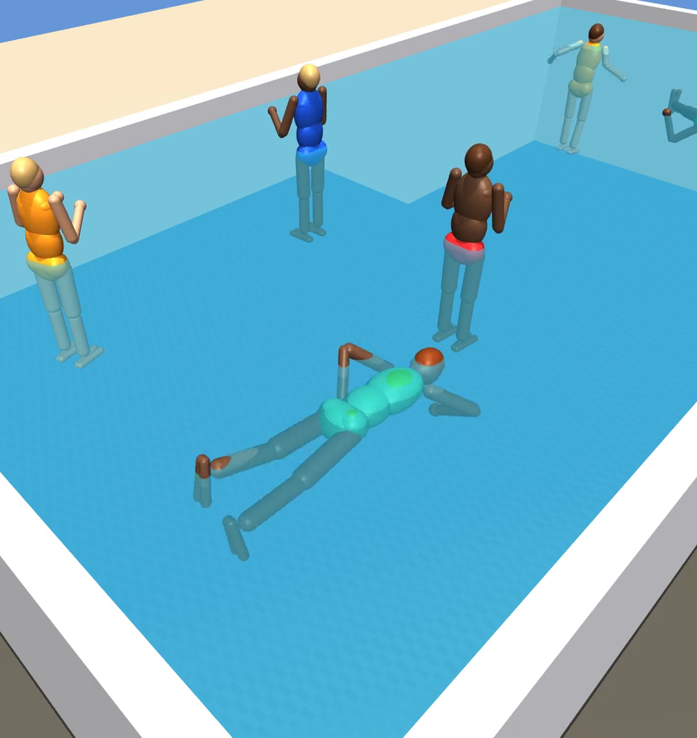
POOL CAMERA ASSISTANT
PARENTS LOSE TRACK FOR A FEW SECONDS
62%
of pool deaths of children under 5 happened when the adult lost track of where the child was.
CPSC, 2020–2022

Slide 2
OUR IDEA
TIME HOW LONG EACH HEAD IS UNDER
HEAD ABOVE WATER
5 S UNDER: WARNING
12 S UNDER: ALERT
MONITORING ACTIVE
YELLOW BOX
RED AUDIBLE ALARM
Head comes back up, the timer resets. Also flags someone entering the pool.
Pool alarm test standard uses 20 s. CPSC says 20 s is too late.

Slide 3
HOW IT WORKS
PIPELINE
CAMERA VIDEO
DETECTOR
BOX CLEANUP
TRACKER
EVENT ENGINE
APP
SIMULATOR
exact labels for training and scoring
Runs locally on a laptop. The video never leaves the device.

Slide 4

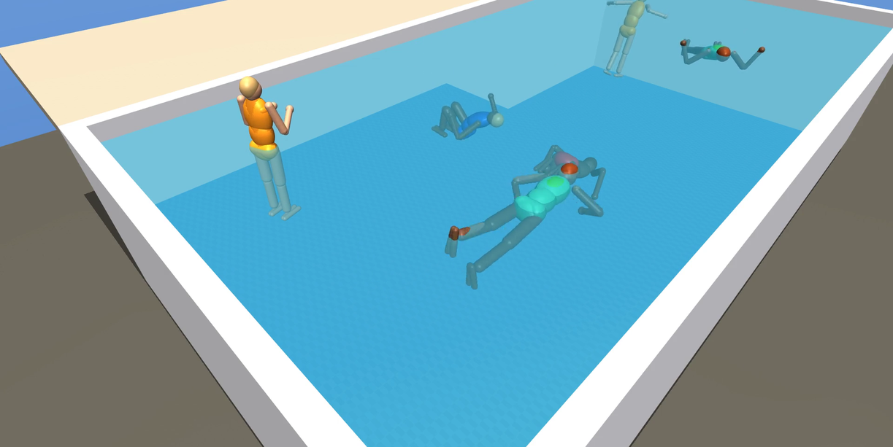

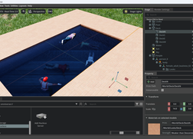
NO DROWNING FOOTAGE
WE BUILT A TEST BENCH
Physics simulator (MuJoCo) with a shallow and deep end, and buoyancy
Swim, float, dive, silent sink, collapse, fall in from the deck
Exact labels for every frame, no hand labeling
Isaac Sim version

Slide 5
STOCK MODELS, ON SIMULATION
YOLO BARELY SEES OUR PEOPLE
People found
Fully under water
RF-DETR NANO
79% · 60%
YOLO
CNN trained on everyday photos. Guesses boxes everywhere, then removes duplicates.
YOLO11N
25% · 2%
RF-DETR
Transformer with a DINOv2 backbone. Each of 300 queries claims at most one object.
YOLOV8N
12% · 31%

Slide 6
RF-DETR NANO, ON SIMULATION
FINE-TUNING ON SIM FRAMES
Test video | Stock | Fine-tuned
Held-out scenario | 79% | 100%
New-looking render | 76% | 93%
79% → 100%
people found on a scenario it never saw, after 1 epoch (about 2 minutes on a laptop)
A render with new textures cost accuracy. Real footage will be a bigger change.

Slide 7

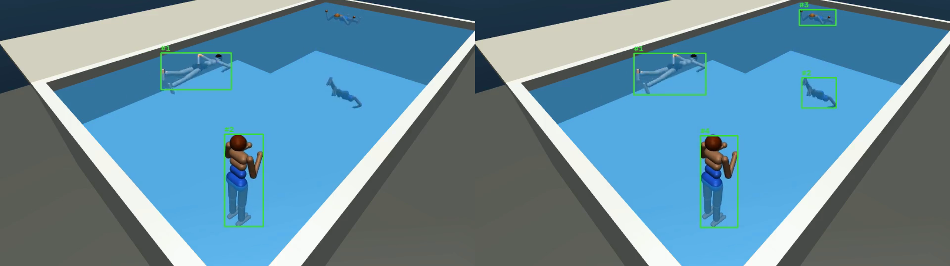
TRACKING
A GOOD DETECTOR STILL BROKE THE IDS
18 → 4
IDs on screen for 4 people. Zero ID switches after our fixes.
BEFORE
AFTER

Slide 8

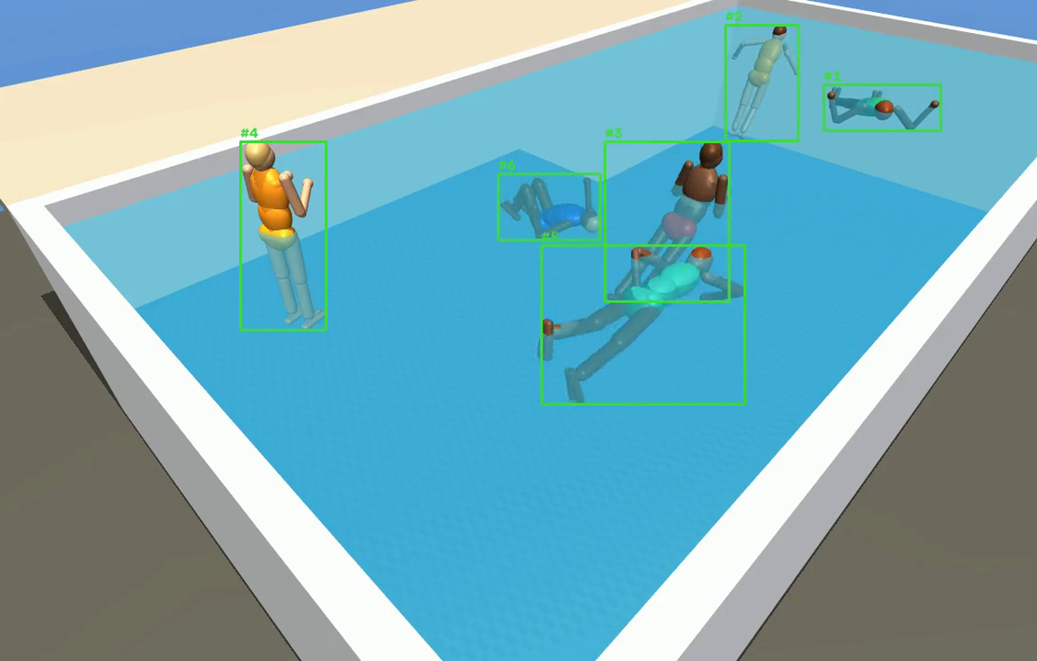
DEMO (PLACEHOLDER)
LIVE DEMO
FALLBACK: TRACKING ON SIMULATION
APP RECORDING GOES HERE.
4 camera feeds, then Enable monitoring
Green, yellow, red boxes with timer and reason
Alert and incident replay

Slide 9

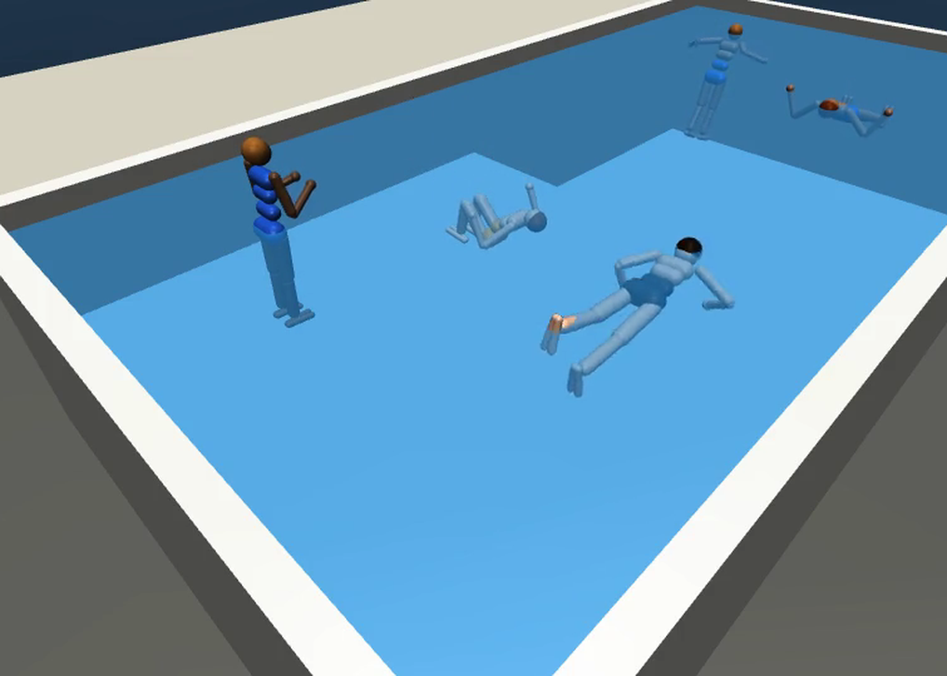
HONEST NUMBERS
LIMITS, AND MISTAKES WE CAUGHT
01
All numbers are on simulation: simple bodies, flat water, no splash or glare.
02
We caught 2 bugs that made scores look too good, fixed them, and re-measured everything.
03
Daylight only. One person class, no child vs adult yet.

Slide 10
NEXT
NEXT STEPS
01
02
03
RECORD
FINE-TUNE
CONNECT
Real pool footage, label each head above or below water
Same method, tested only on real clips
Head timer drives the app's colors and alerts
A supervision aid that detects prolonged head submersion. It does not replace watching children, pool fences, or lifeguards.
SUNNY · JOANNE · SAM · ROHAN · DAVID

