Slide 1
Hastings Direct
Claims Prediction task
Sunny Chugh

Slide 2
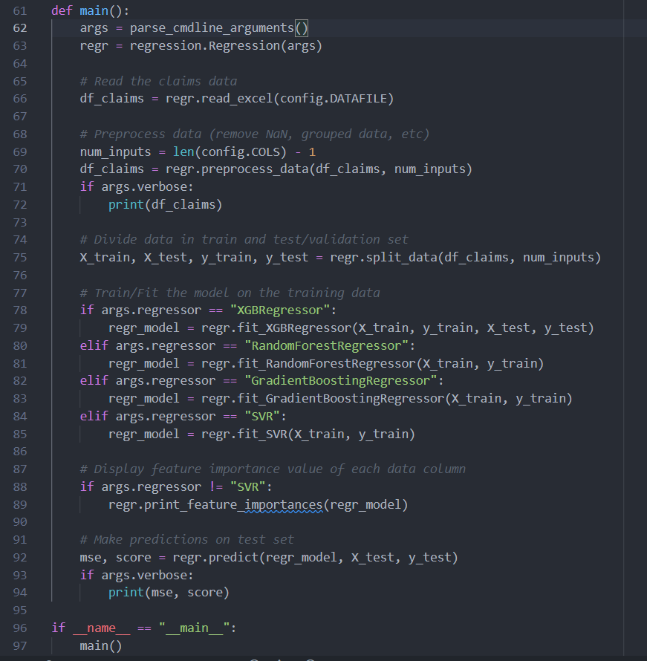
Working code
Main code task is broken in subtasks:
Read excel sheet data
Preprocess the data (remove NaN, etc)
Create train and test set
Decide/Fit the type of Machine Learning model to the data
Calculate the feature importance values of different columns
Predict on the test set
Doc Strings have not been written right now to save space as needing screenshots

Slide 3
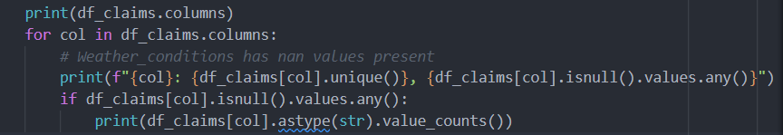
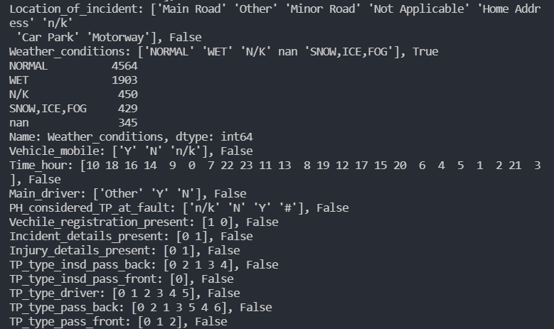
Issues Identified
345 NA/NaN values (in Weather_conditions)
Zero values of Incurred for different inputs
Feature encoding- process of turning categorical data in a dataset into numerical data
Similar values for inputs rows

Slide 4
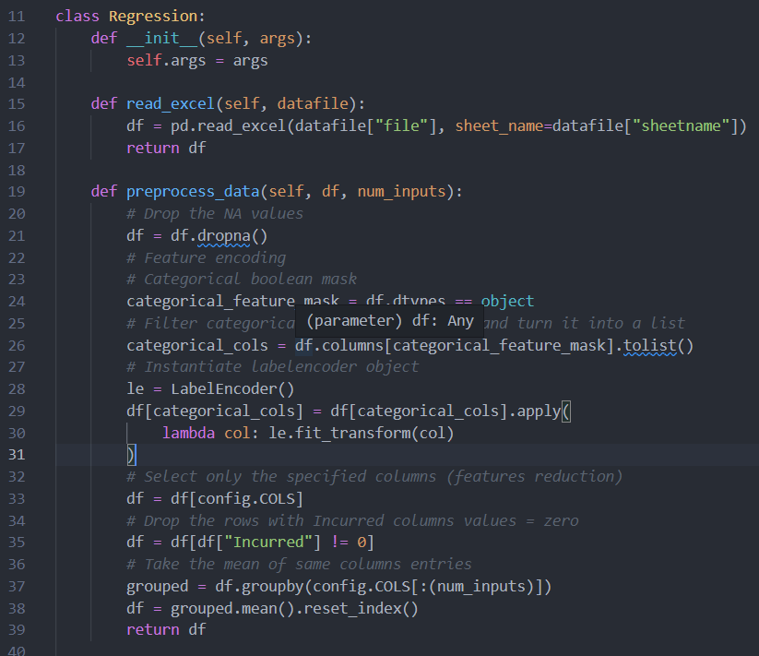
Issues Identified
345 NA/NaN values (in Weather_conditions)
Zero values of Incurred for different inputs
Feature encoding- process of turning categorical data in a dataset into numerical data
Similar values for inputs rows
Solutions
Removed NA/NaN/ Zero values of Incurred rows. Could have take mean or median values
Feature encoding- process of turning categorical data in a dataset into numerical data
Looks like a lot of columns might not needed so only selected a few columns
Taken the mean of the similar rows

Slide 5
Data Cleansing
NA values = remove, 0, mean or median
Remove outliers or capped the outliers
Grouped input rows with same values

Slide 6
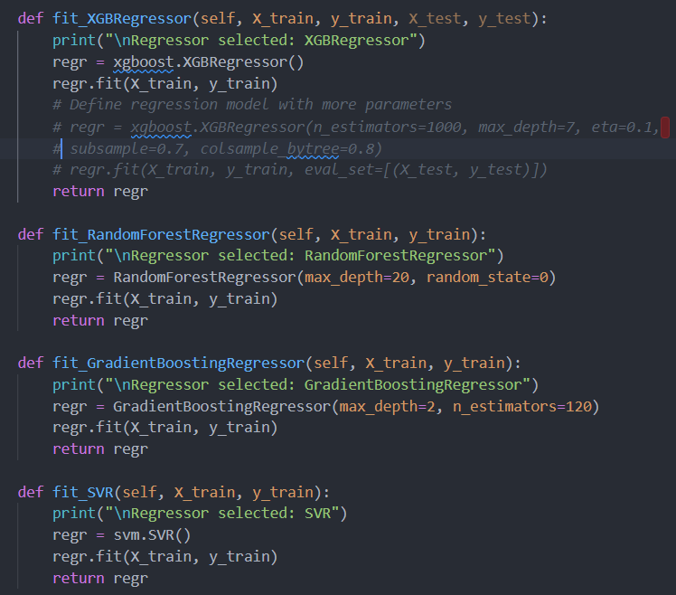
Models
Xgboost
Random forest
SVR
MLP

Slide 7
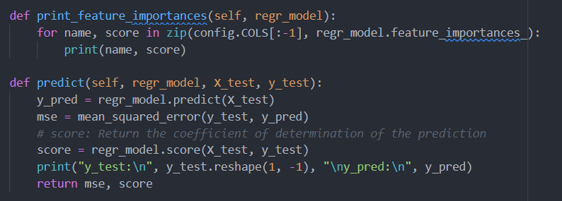
Model assessment
Feature_importances
There are error metrics that are commonly used for evaluating and reporting the performance of a regression model; they are:
Mean Squared Error (MSE).
Root Mean Squared Error (RMSE).
Mean Absolute Error (MAE)

Slide 8
Suggestions for model improvements
Implement MLP using PyTorch and use Dropouts
Hyperparameters tuning
Grid search for optimized parameters
GridSearchCV
Could use MLflow to compare various model and reach the best optimized model
Could have added unit tests (but avoided for now)
Practical challenges for implementing your model
Poor Quality of Data
Irrelevant/Unwanted Features

