Slide 1
Calendly Marketing
Ebd-to-end Project #6
By Betty Zhang
10-09-2025

Slide 2
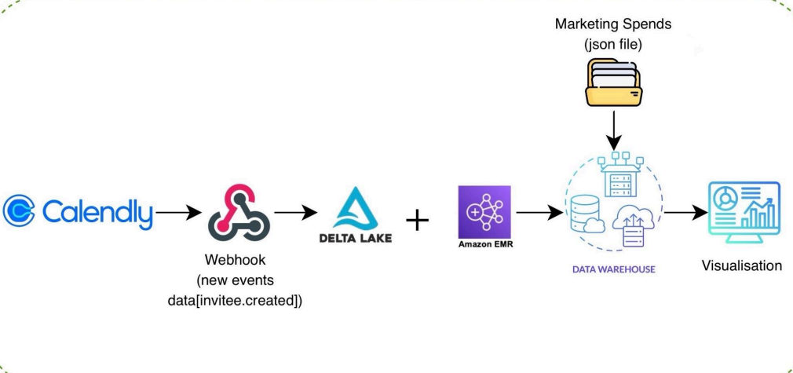
Architecture

Slide 3
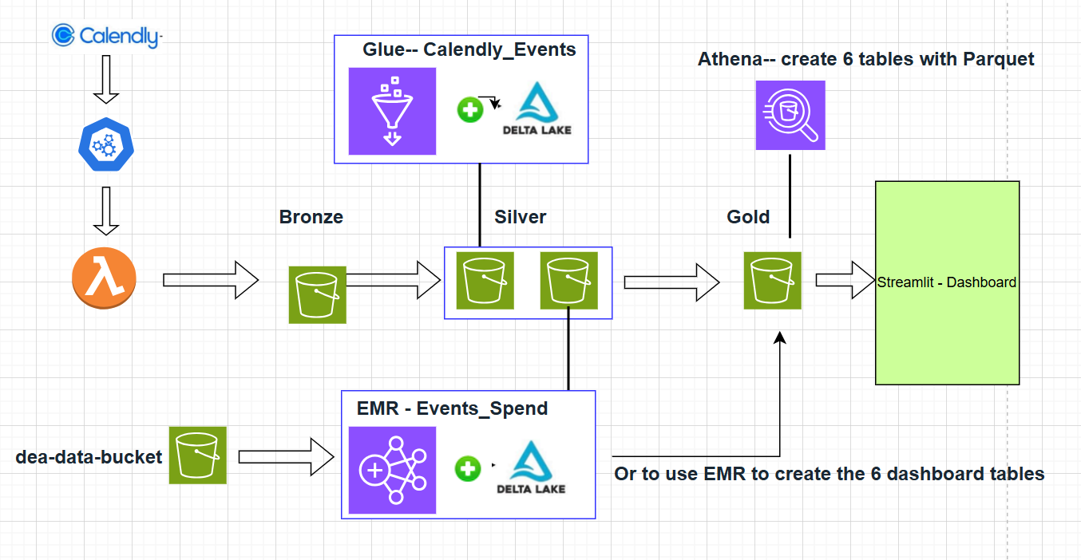
Data Flow – Note: this project can be completed in GLUE/EMR, I did both approaches for learning and comparing purposes.

Slide 4
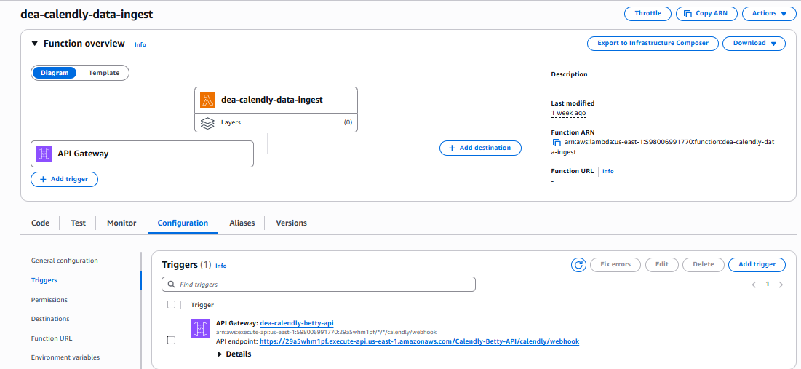
STEP 1- Calendly ➔ API ➔ (Trigger) ➔ Lambda ➔S3 Bronze

Slide 5
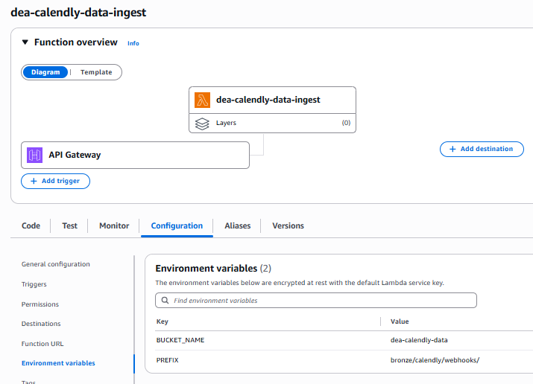
STEP 1 Calendly ➔ API ➔ Lambda ➔ S3 Bronze S3://dea-calendly-data/bronze/calendly/webhooks/

Slide 6
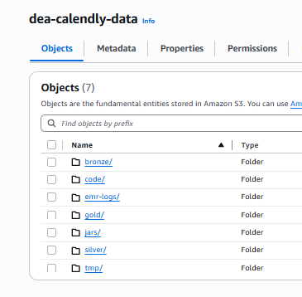
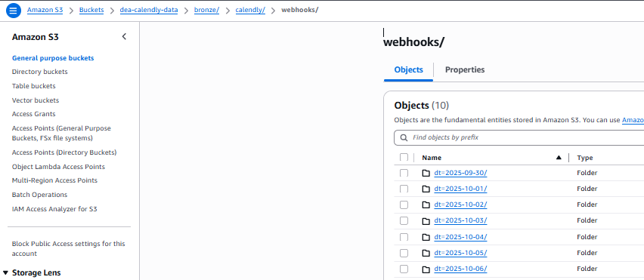
Bronze – S3://dea-calendly-data/bronze/calendly/webhooks/

Slide 7
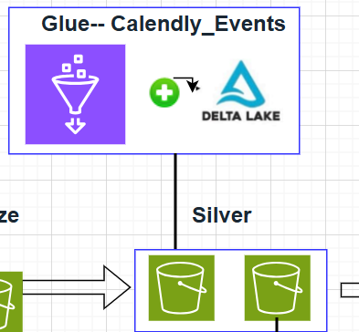
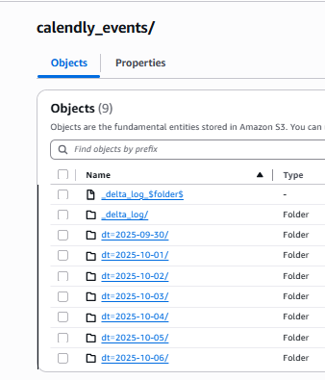
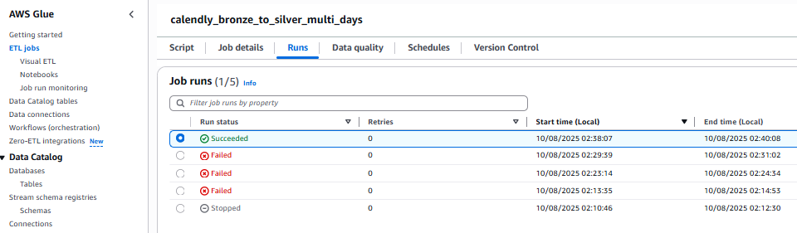
Silver – GLUE to generate Calendly_Events

Slide 8
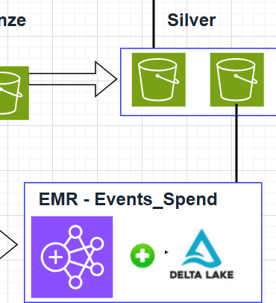
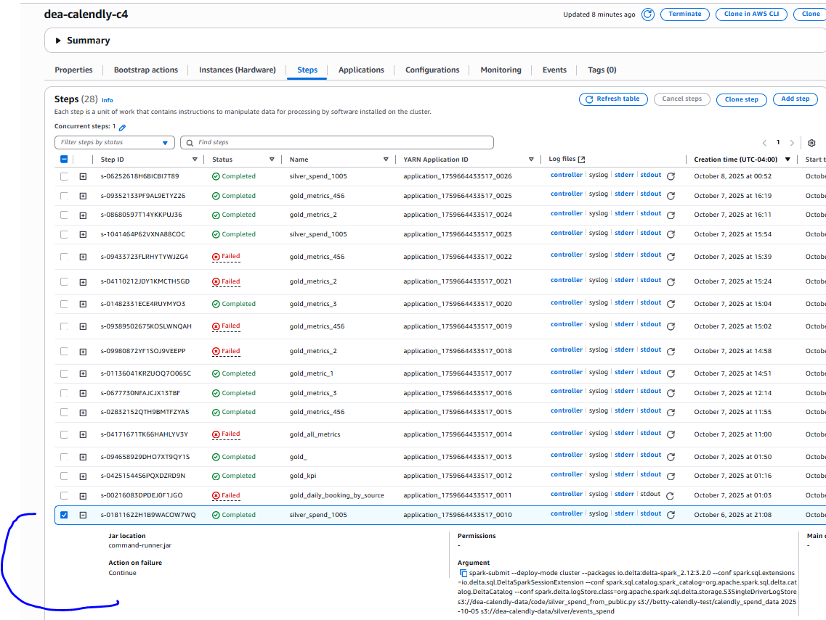
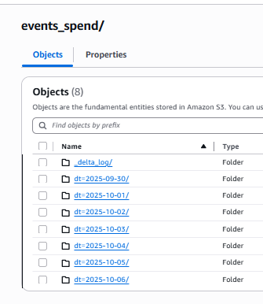
Silver – EMR to generate Events_Spend

Slide 9
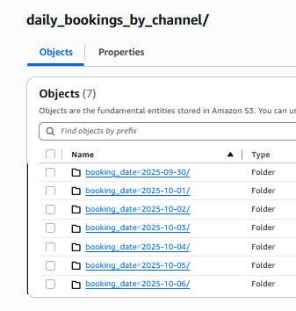
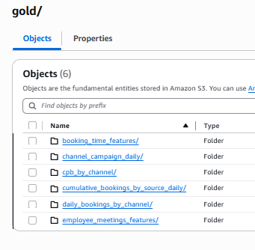
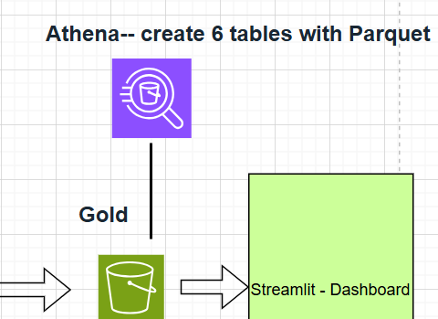
Gold --

Slide 10
Reports

Slide 11
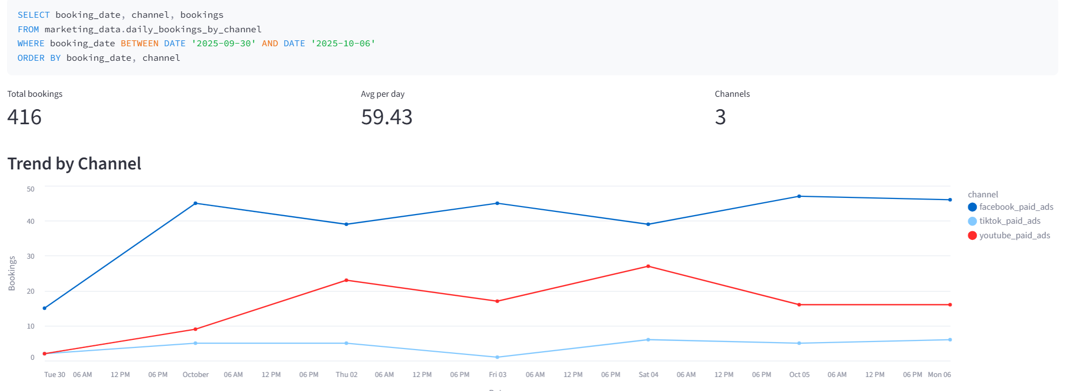
1.1 Daily Calls Booked by Source (2025/09/30 – 2025/10/06)

Slide 12
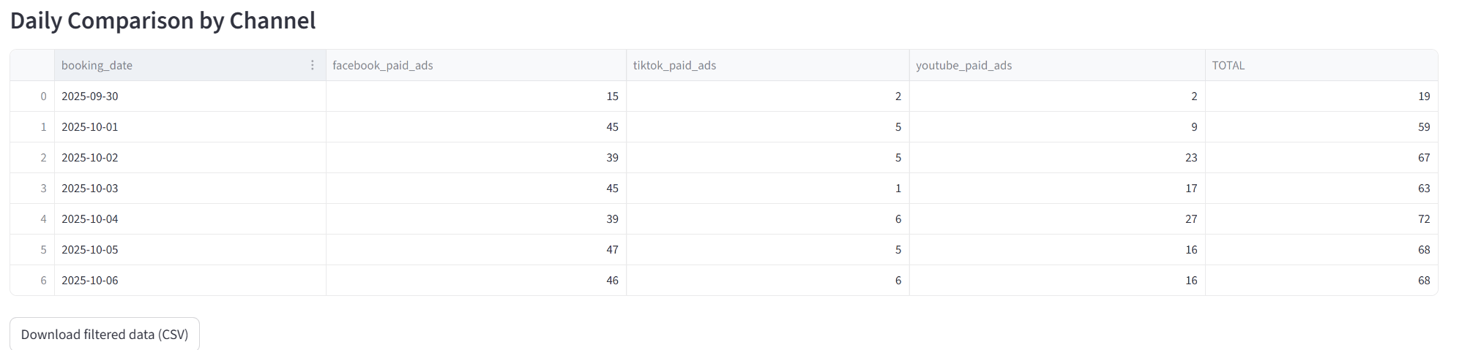

Slide 13
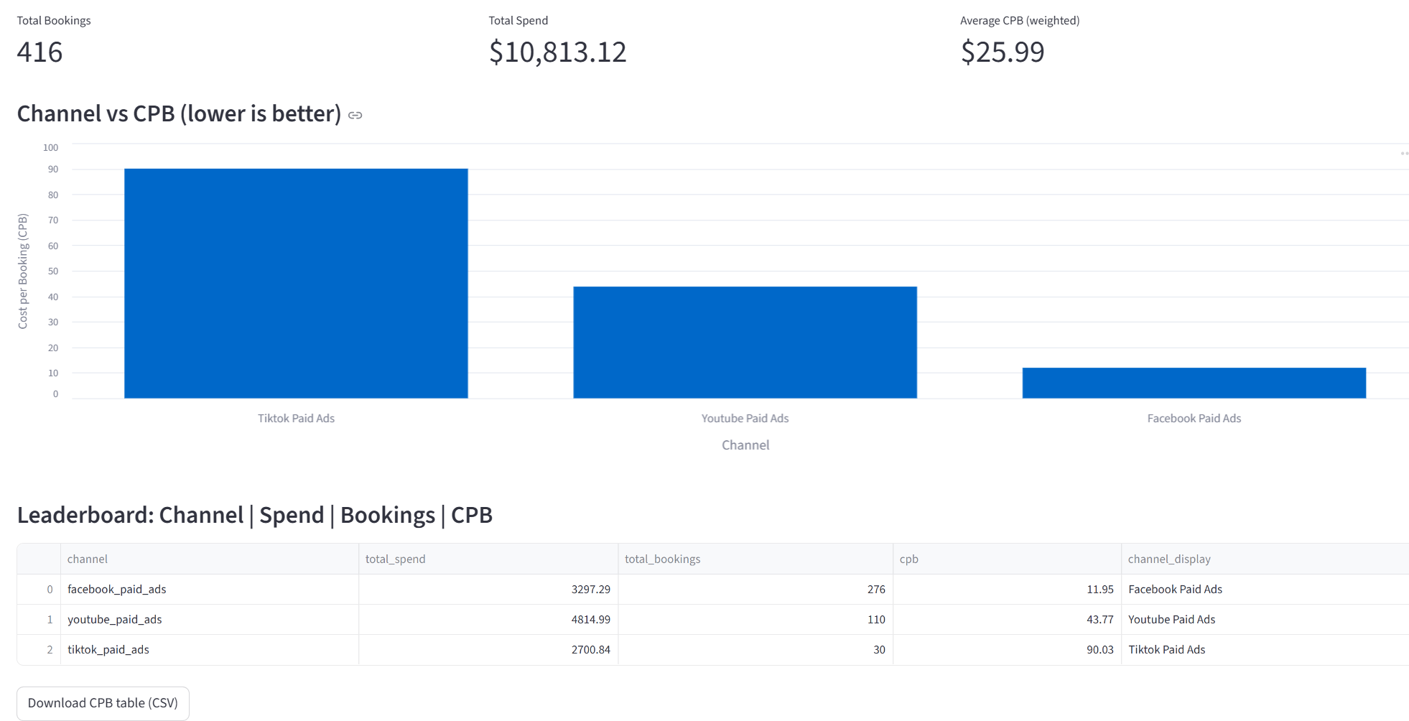
1.2 Cost Per Booking (CPB) by Channel (2025/09/30 – 2025/10/06)

Slide 14
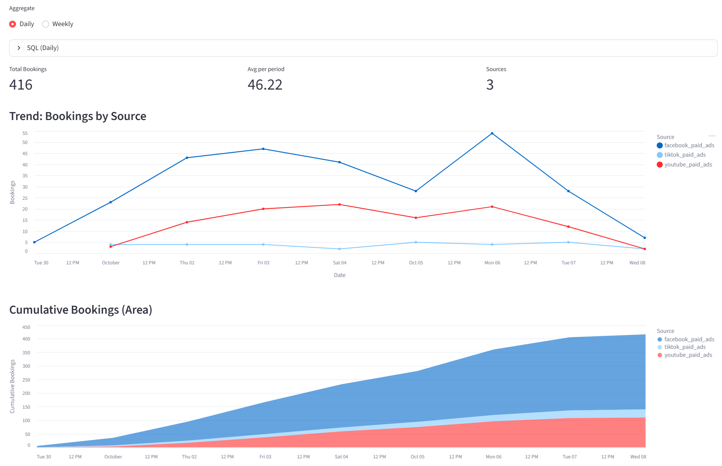
1.3 Bookings Trend Over Time (2025/09/30 – 2025/10/06) - daily

Slide 15
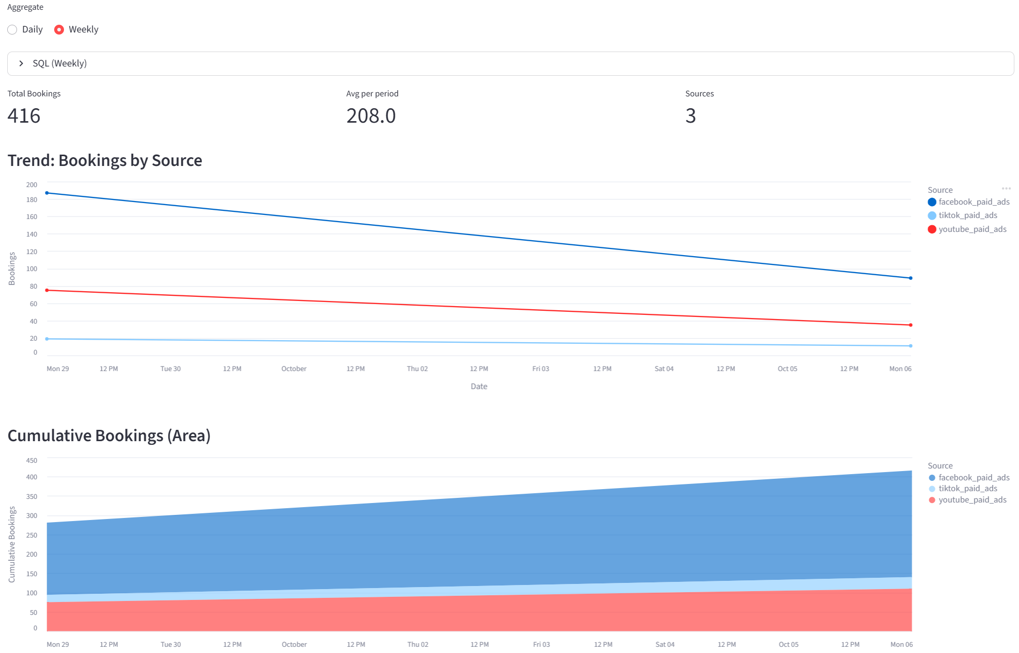
1.3 Bookings Trend Over Time (2025/09/30 – 2025/10/06) - Weekly

Slide 16
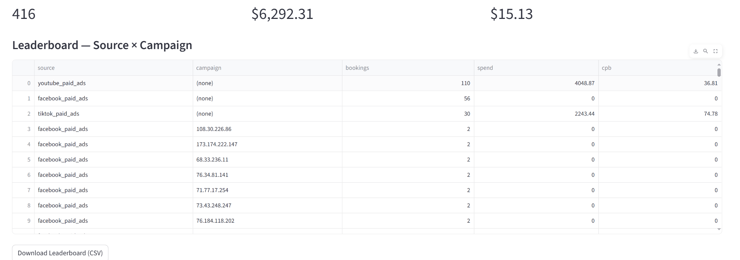
1.4 Channel Attribution (CPB & Volume Leaderboard) (2025/09/30 – 2025/10/06)

Slide 17
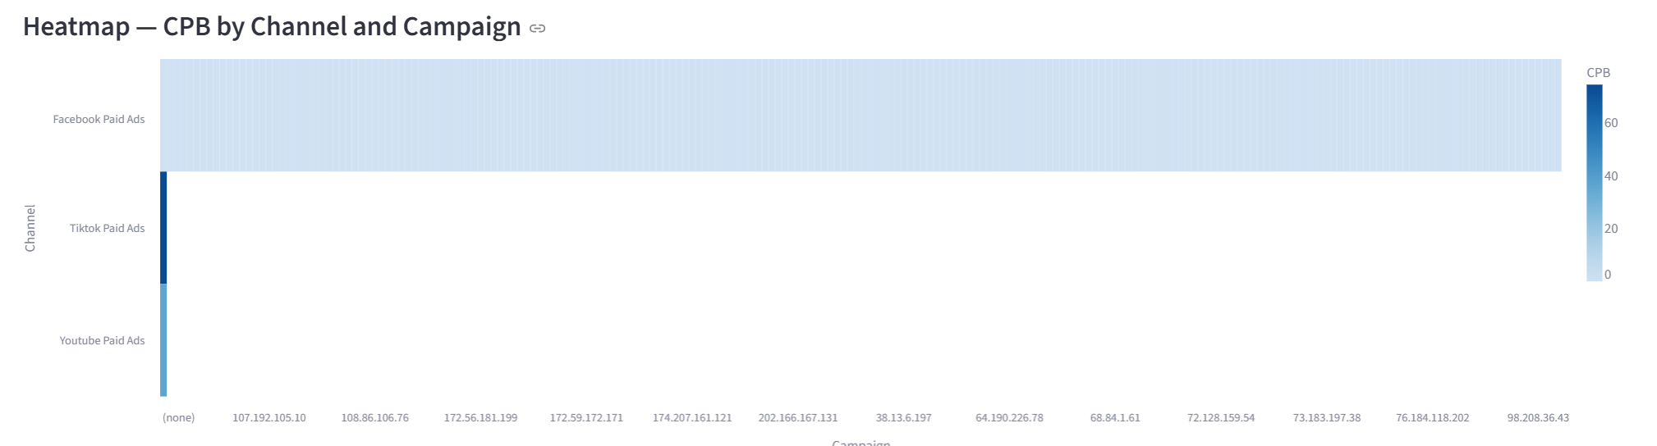
1.4 Channel Attribution (CPB & Volume Leaderboard) (2025/09/30 – 2025/10/06)

Slide 18
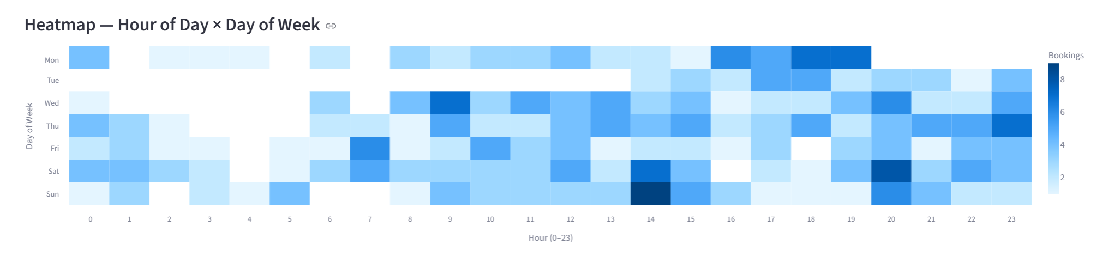
1.5 Booking Volume by Time Slot / Day of Week (2025/09/30 – 2025/10/06)

Slide 19
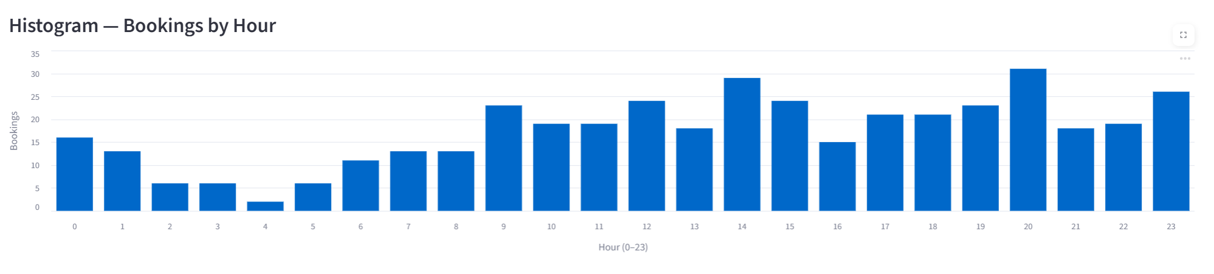
1.5 Booking Volume by Time Slot / Day of Week (2025/09/30 – 2025/10/06)

Slide 20
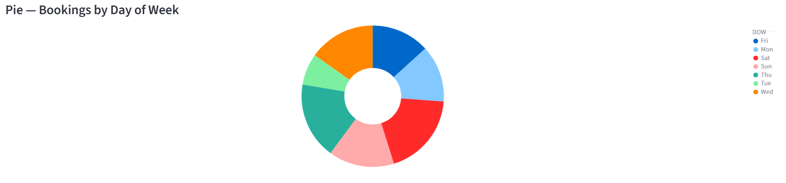
1.5 Booking Volume by Time Slot / Day of Week (2025/09/30 – 2025/10/06)

Slide 21
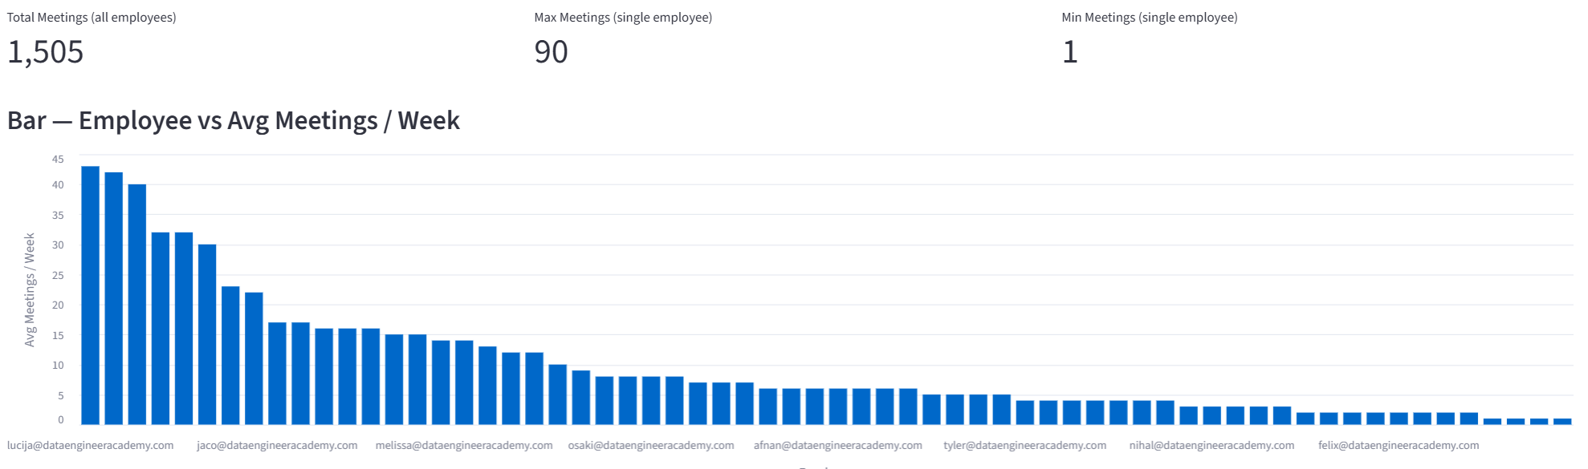
1.6 Understand Meeting Load per Employee (2025/09/30 – 2025/10/06)

Slide 22
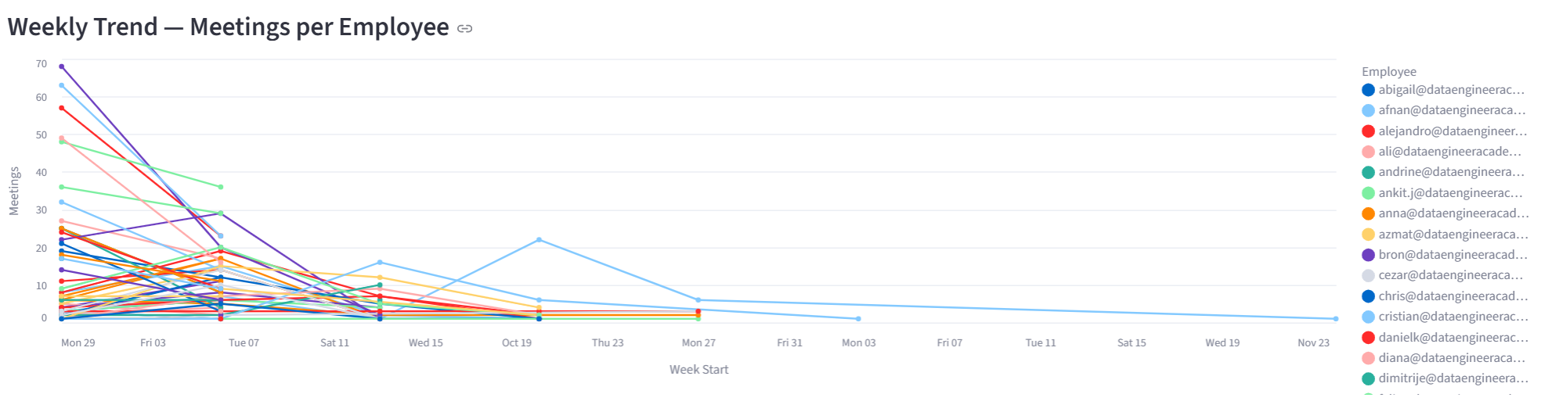
1.6 Understand Meeting Load per Employee (2025/09/30 – 2025/10/06)

