Slide 1


Automation Testing by Selenium
Presented By: Sunny Dhokane

Slide 2
Features of Selenium
Selenium is a popular open-source tool for automating web browsers. It is widely used by software testers to automate web application testing.
Cross-Browser Compatibility
Multiple Programming Languages
Open-Source
Selenium is an open-source tool, which means it is free to use and modify.
Selenium supports multiple browsers, including Chrome, Firefox, Safari, and Internet Explorer.
Selenium can be used with various programming languages, including Java, Python, C#, and Ruby.

Slide 3

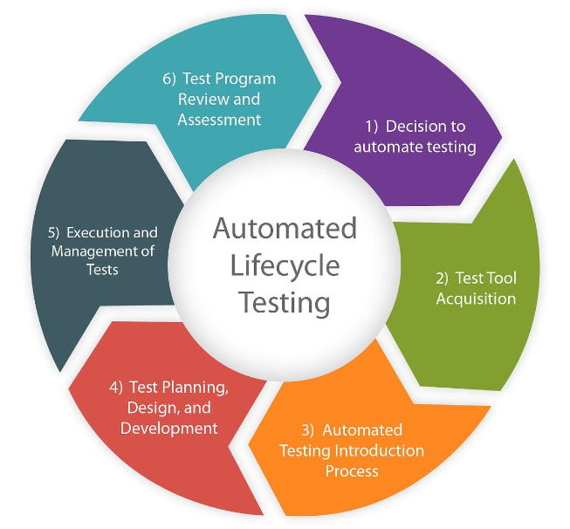
Advantages of Selenium
Selenium offers several advantages for software testers, making it a valuable tool for automating web application testing.
Reduced Testing Time
Selenium can automate repetitive tasks, saving time and effort for testers.
Improved Test Coverage
Selenium allows testers to execute a wider range of tests, ensuring comprehensive test coverage.
Increased Accuracy
Selenium reduces the risk of human error, leading to more accurate test results.

Slide 4

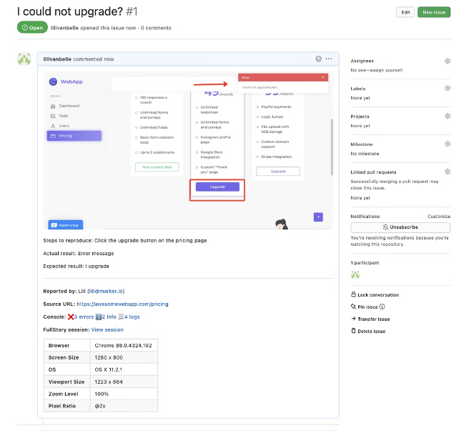


Disadvantages of Selenium
While Selenium offers numerous benefits, it also has some drawbacks that testers should be aware of.
Maintenance Overhead
Selenium tests require regular maintenance to keep them up-to-date with changes in the application.
Learning Curve
Selenium can be challenging to learn and use, requiring a good understanding of web development concepts.

Slide 5


Automated Automation Exercise Website
This presentation will demonstrate how to automate the Automation Exercise website using Selenium. We will cover the process of setting up Selenium, writing test scripts, and executing tests.
1
Benefits
Selenium is a powerful tool for automating web applications. It is open-source, cross-platform, and supports multiple programming languages.
2
Drawbacks
Selenium can be challenging to learn and use. It requires a good understanding of web development concepts and programming languages.

Slide 6

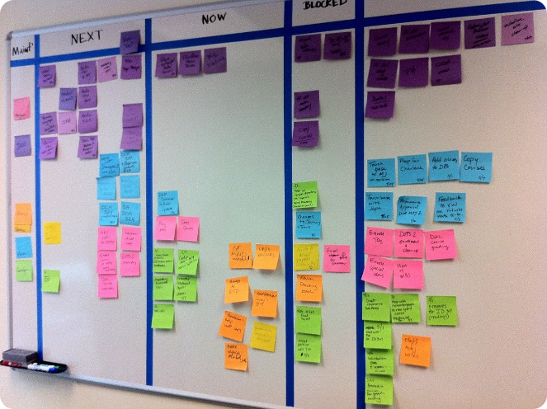
Project Details
This project will focus on automating the Automation Exercise website using Selenium. We will create a suite of test cases to cover various functionalities of the website.
1
User Registration
This test case will verify the user registration functionality of the website.
2
Login
This test case will verify the user login functionality of the website.
3
Search Product
This test case will verify the product search functionality of the website.
4
Contact Form
This test case will verify the contact form functionality of the website.

Slide 7
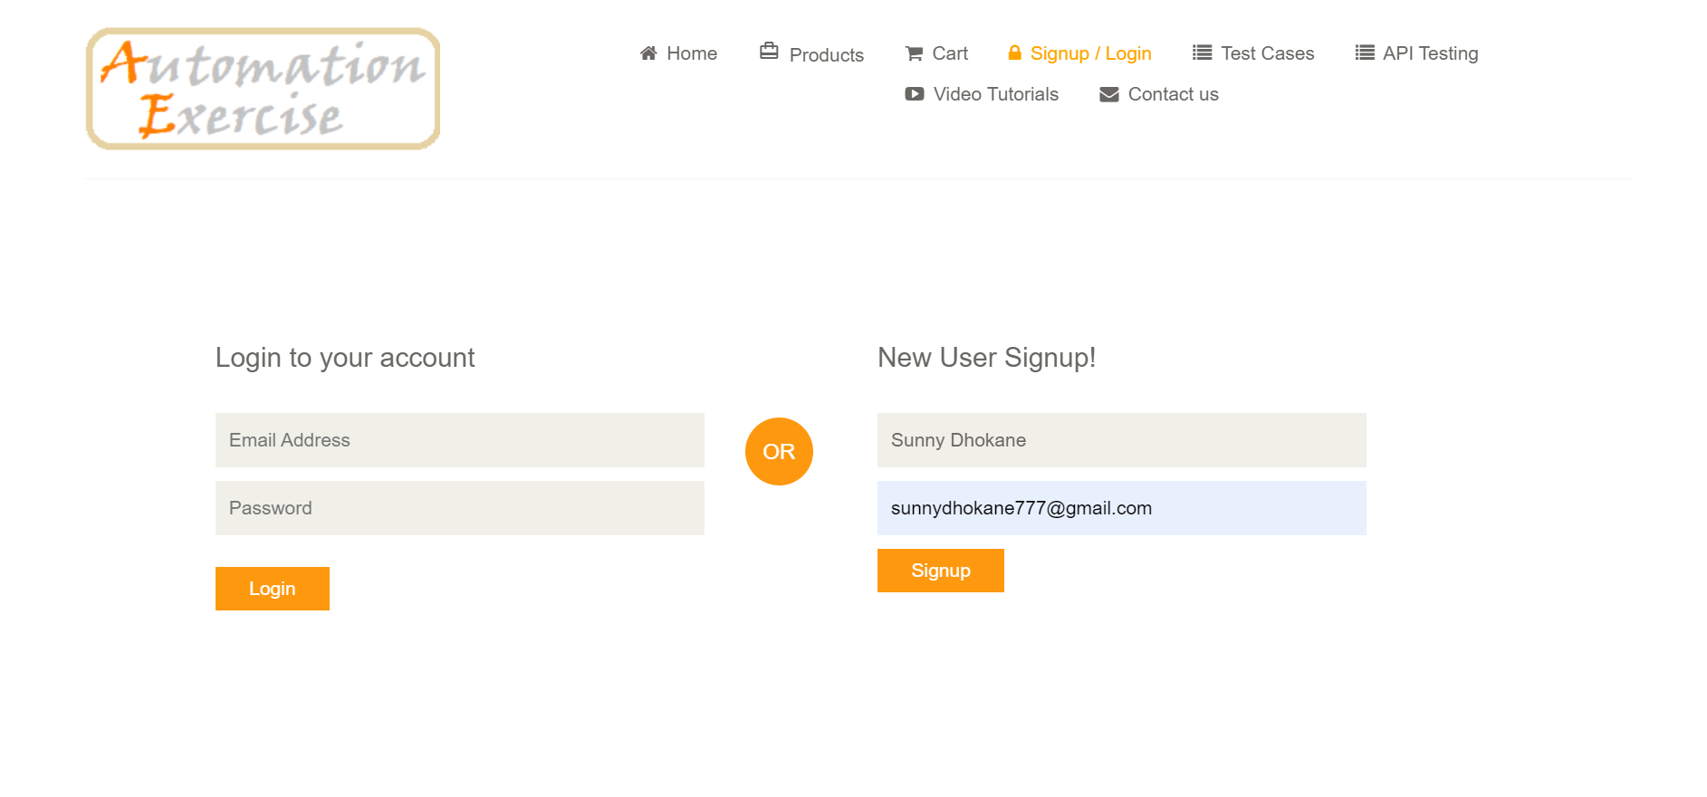
Test Case 1: User Registration

Slide 8




Test Case 2: Login
This test case will verify the user login functionality of the website. It will involve entering valid credentials and verifying that the user is successfully logged in.
Step 1
Navigate to the login page
Step 2
Enter valid username and password
Step 3
Click the login button
Step 4
Verify that the user is logged in

Slide 9
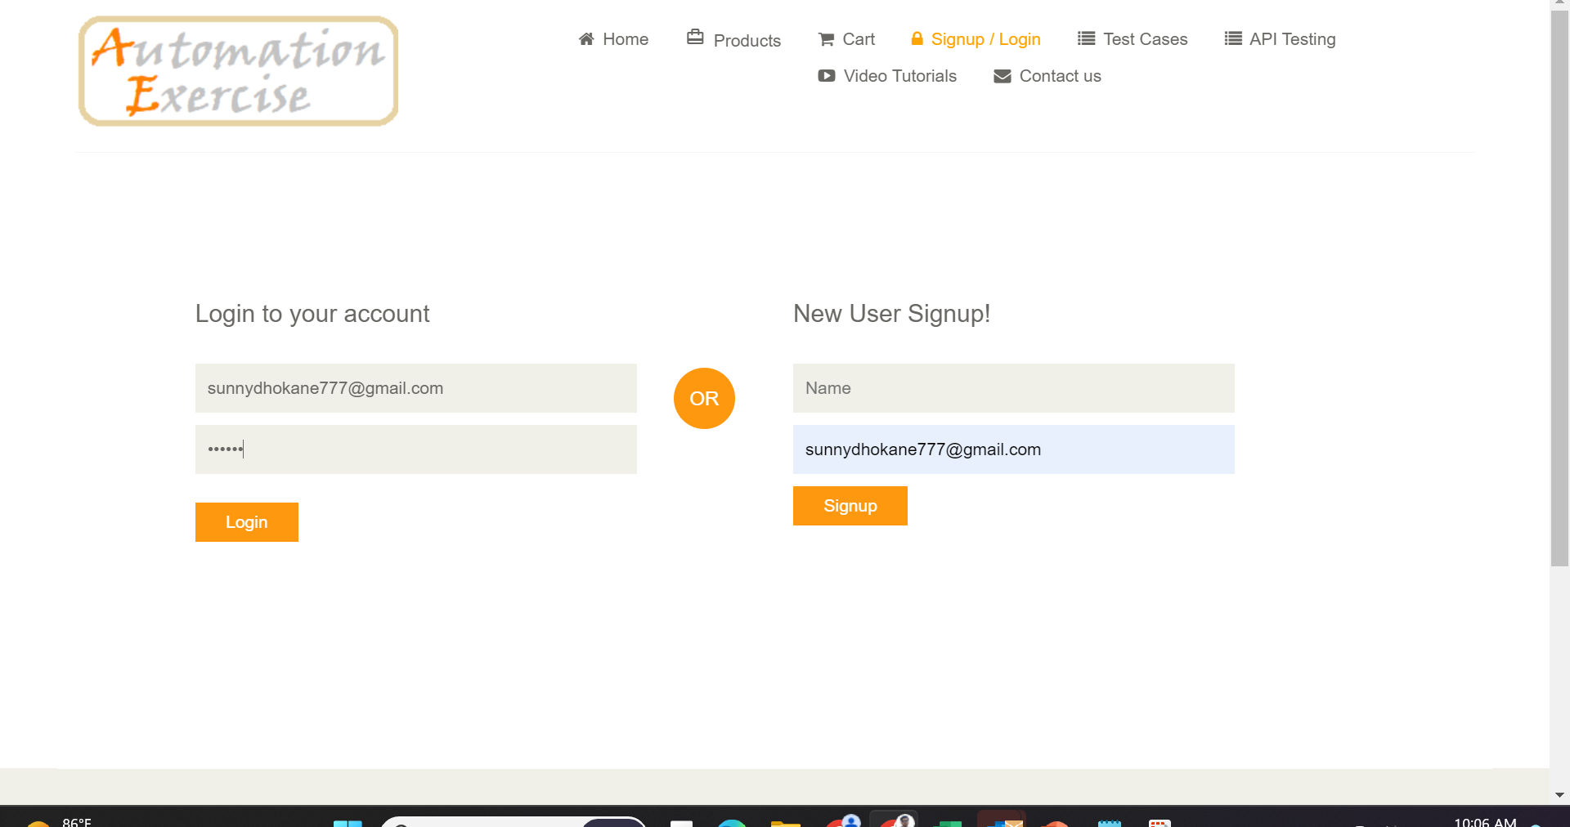
Test Case 2: Login

Slide 10

Product Search and Contact Form
After login, navigate through slides on searching for products and completing a contact form. Learn how to efficiently search for products and effectively interact with the contact form.
1
Search Product
2
Contact Form
Explore the search functionality to find products quickly.
Learn how to fill out and submit the contact form with ease.

Slide 11
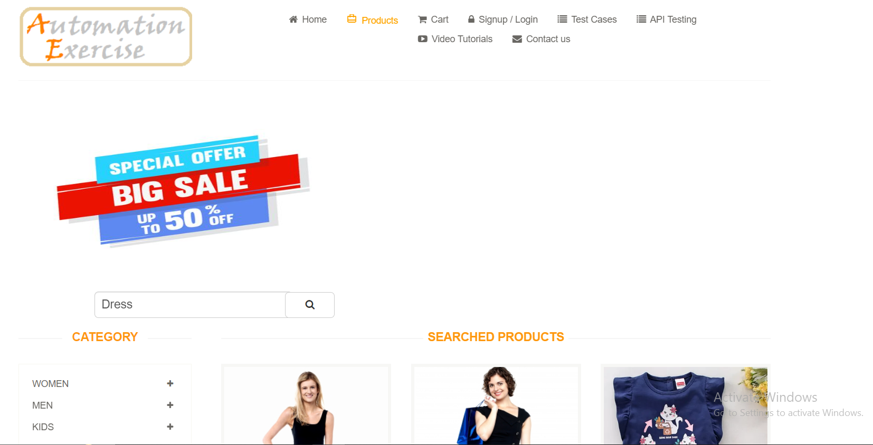
Test Case 3:Search Product

Slide 12
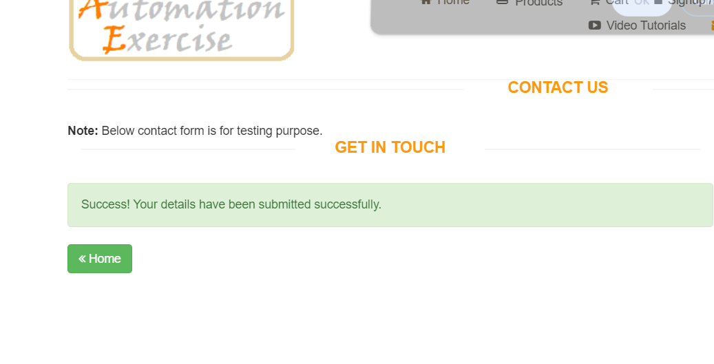
Test Case 4: Contact Us Form

Slide 13
Thank You

