Slide 1
연구실 홈페이지 만들기
Sun ah Kim
Mini Project with Angular2

Slide 2
Bioinformatics & Biostat
Home: 대표 이미지, 연구실에 대한 간략한 정보
Research: 연구 분야에 대한 간략한 소개
Members: 구성원 소개
Publication: 논문 리스트
Software: 소프트웨어, 패키지 및 매뉴얼
Contact: 문의

Slide 3
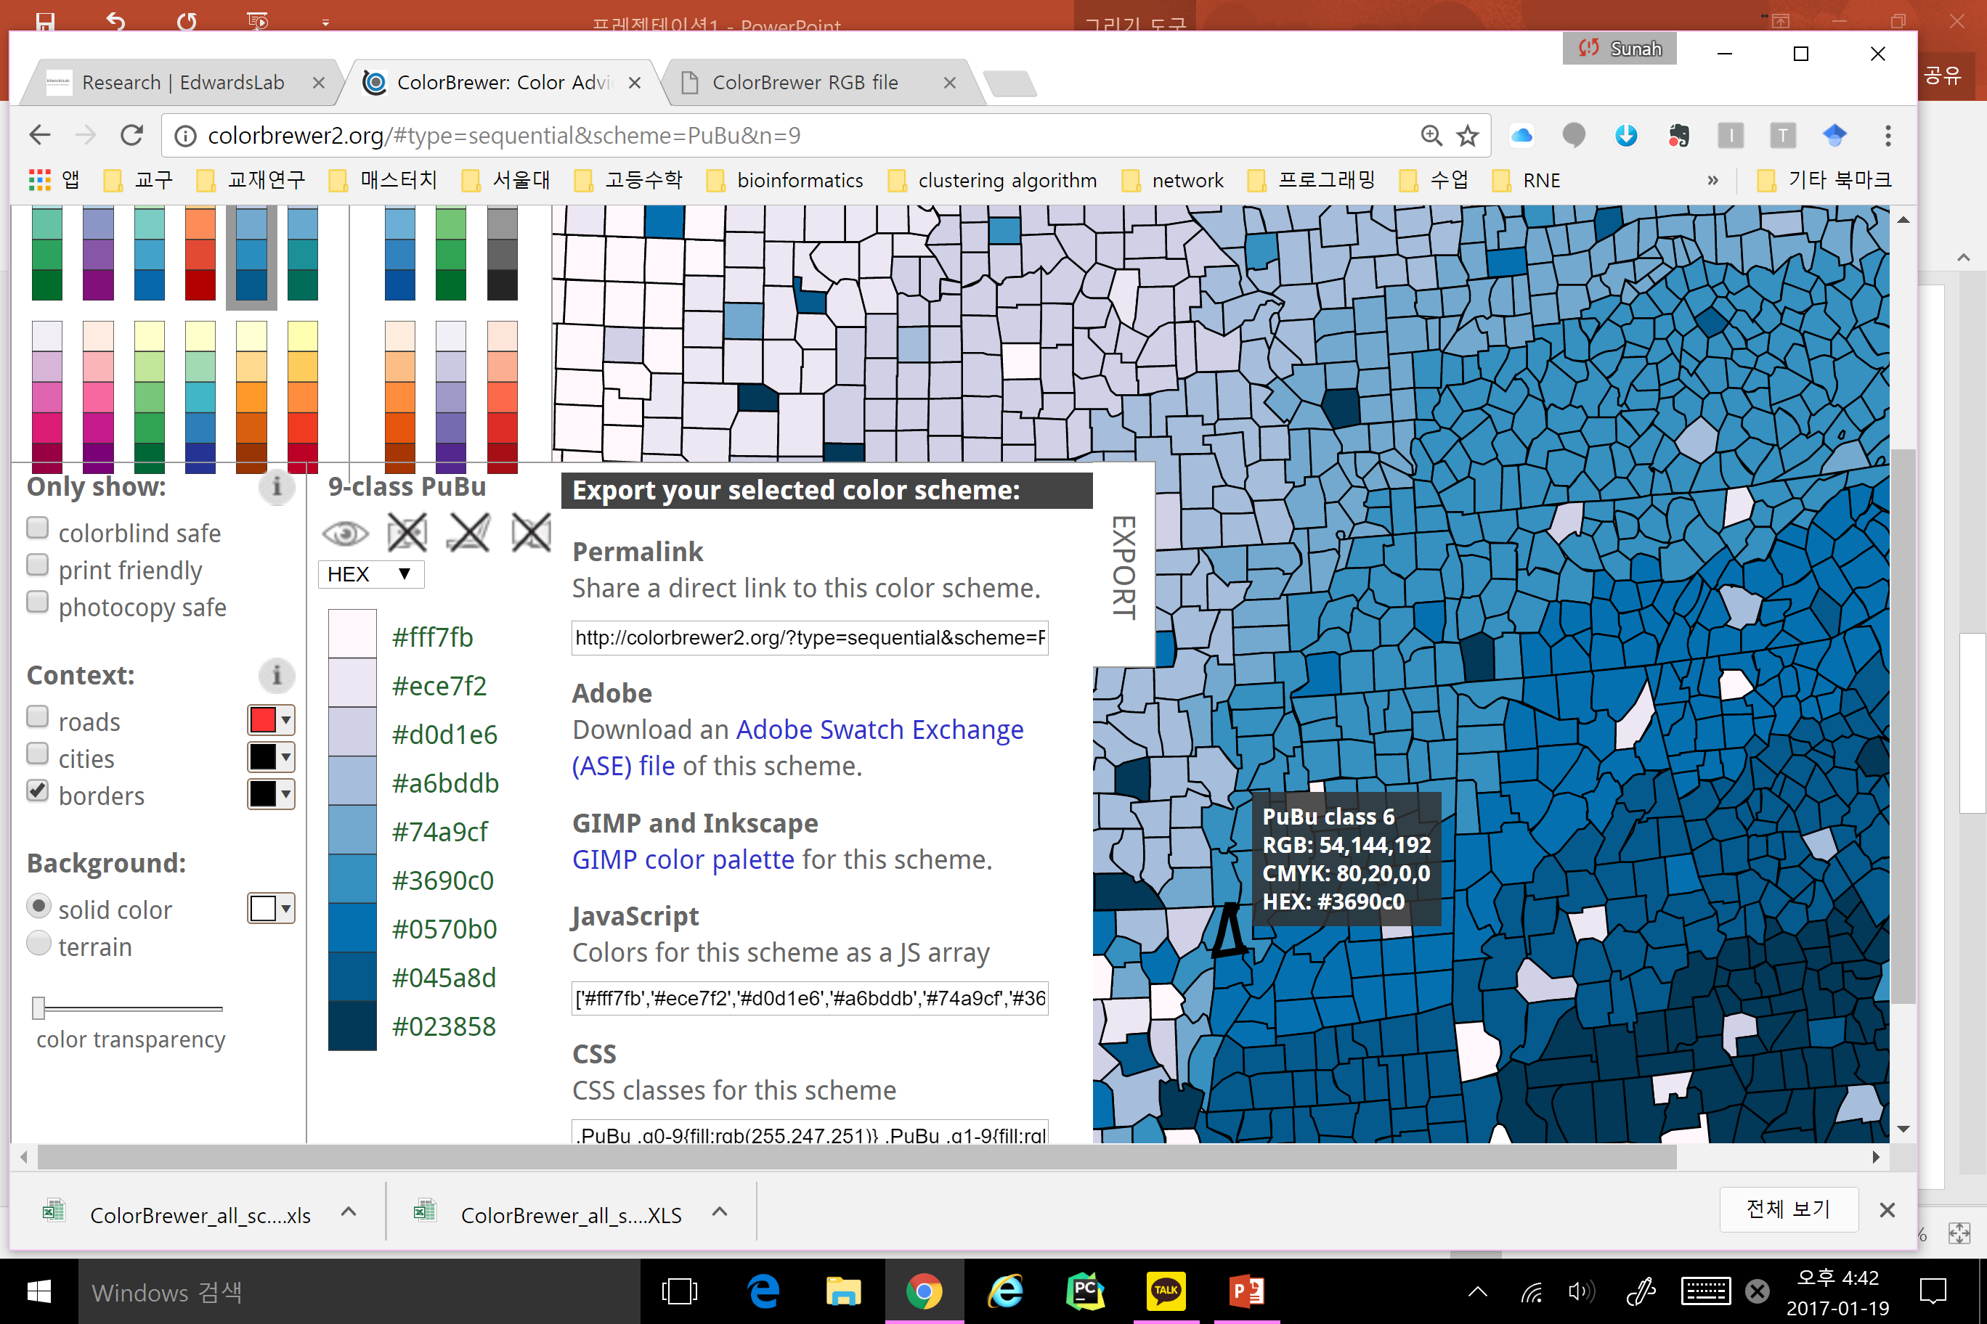
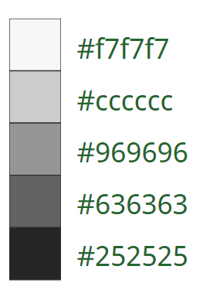
Color & Font
Background color
Text2 : This is an apple (Calibri)
Text : This is an apple (Calibri)
Menu_not selected (Arial Black)
links fulltext (Calibri)
Menu_selected (Arial Black)
Homepage Title (Arial Black) | Page titles (Calibri, Bold)

Slide 4
Bioinformatics & BioStat
Home
Members
Publications
Software
Research
Contact Us
Posters
2013
search
BIBM 2013: sequence analysis and applications (PPT)
Authors : Sunah Kim, lulu Lee
Abstract : This is banana. This is banana. This is banana. This is banana. This is banana. This is banana. This is banana. This is banana. This is banana. This is banana
2015
BIBM 2015: Big-LD and its applications blablabla (PPT)

Slide 5
Bioinformatics & BioStat
Home
Members
Publications
Software
Research
Contact Us
Publications
Posters
Posters
Talks
2013
search
BIBM 2013: sequence analysis and applications (PPT)
Authors : Sunah Kim, lulu Lee
Abstract : This is banana. This is banana. This is banana. This is banana. This is banana. This is banana. This is banana. This is banana. This is banana. This is banana
2015
BIBM 2015: Big-LD and its applications blablabla (PPT)

Slide 6
sdfsd
Bioinformatics & BioStat
Home
Members
Publications
Software
Research
Contact Us
R cran
Posters
GitHub
2013
search
BIBM 2013: sequence analysis and applications (PPT)
Authors : Sunah Kim, lulu Lee
Abstract : This is banana. This is banana. This is banana. This is banana. This is banana. This is banana. This is banana. This is banana. This is banana. This is banana
2015
BIBM 2015: Big-LD and its applications blablabla (PPT)

Slide 7
Home
Members
Main image
Introduction texts
address
Profile pic
Name, affiliation, address, research field, email, homepage cv download link
Principal Investigator/ phD students / master student / Lab Alumni

Slide 8
Research
Publications
Research fields introduction
Publications authors (year) title, journal (full text link) abstract related works
Posters conference (year) title (PDF link) authors / abstract
Talks conference (year) title (PDF link) authors / abstract

Slide 9
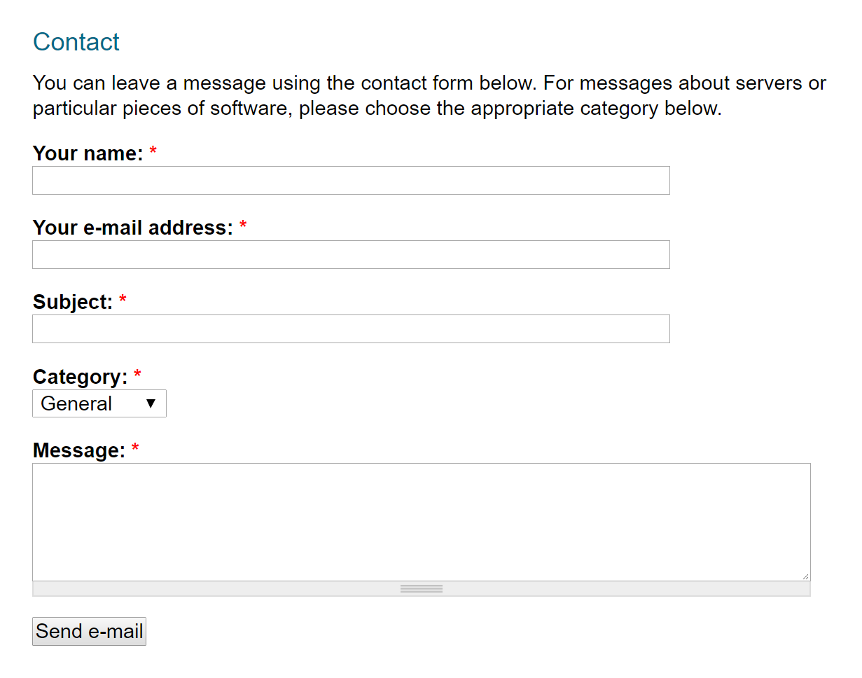
Software
Contact us
Software name (software link), brief introduction, authors (email), reference (full text link), manuals (download link)
Contact information
Email : sss@sss.sss

