Slide 1
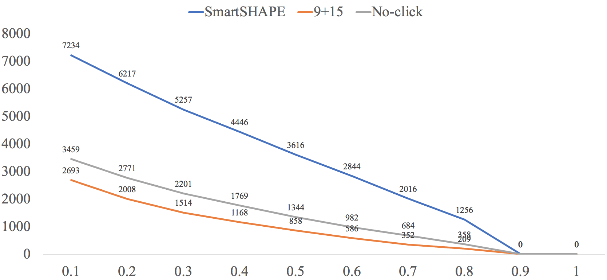
Transcript numbers
Ratio of icShape coverage

Slide 2
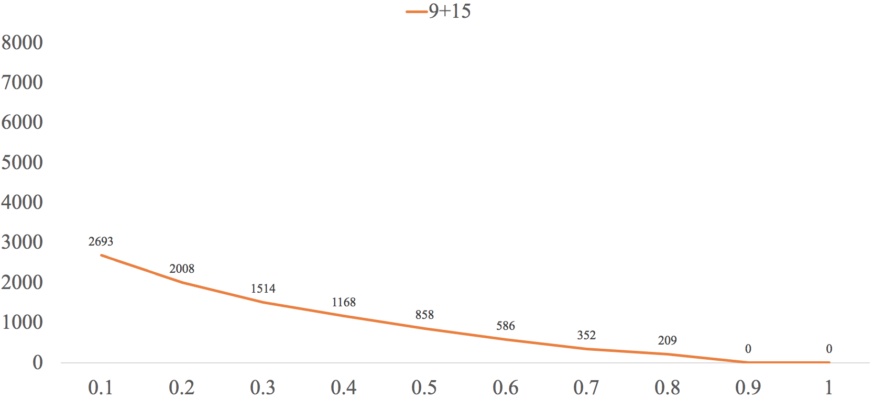
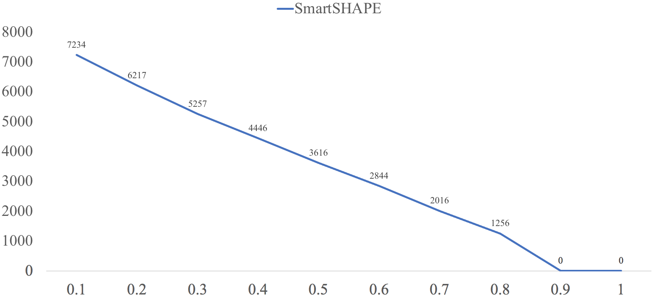
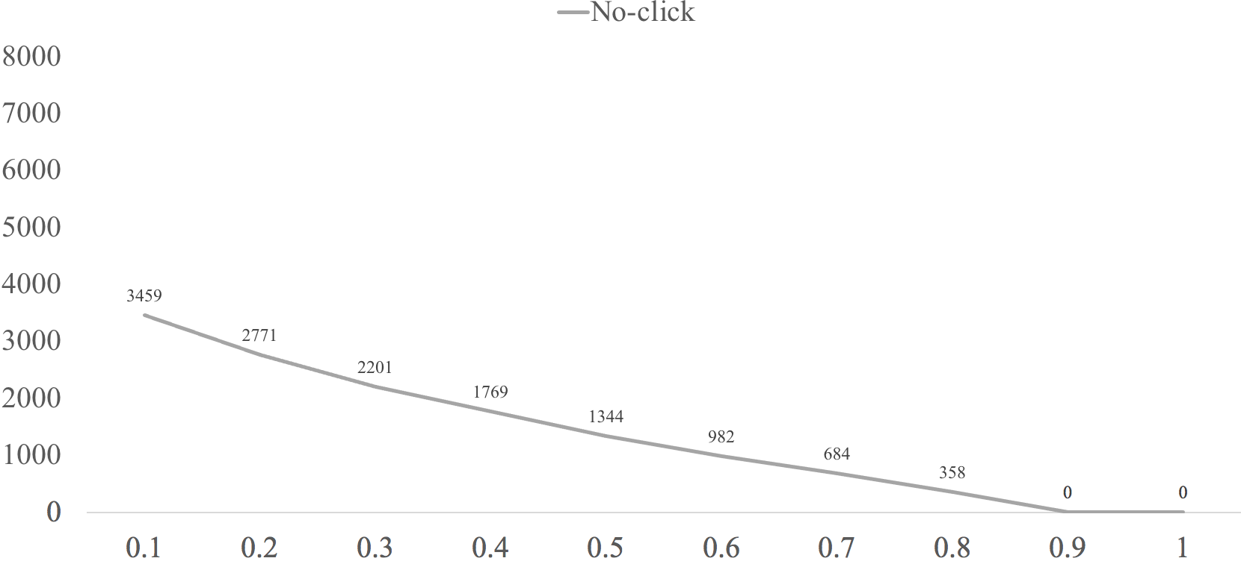
Transcript numbers
Ratio of icSHAPE coverage
Transcript numbers
Transcript numbers
Ratio of icSHAPE coverage
Ratio of icSHAPE coverage

Slide 3
9+15 vs 10ng
smartSHAPE
noclick

