Slide 1
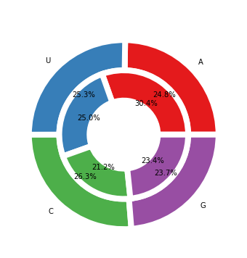
No click
18S
28S

Slide 2
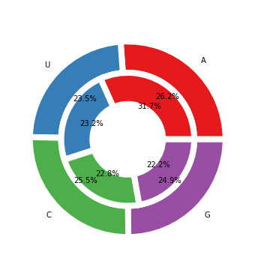
SmartSHAPE
18S
28S

Slide 3
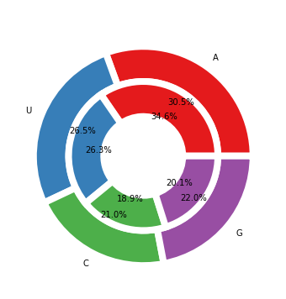
9+15
18S
28S

Slide 4
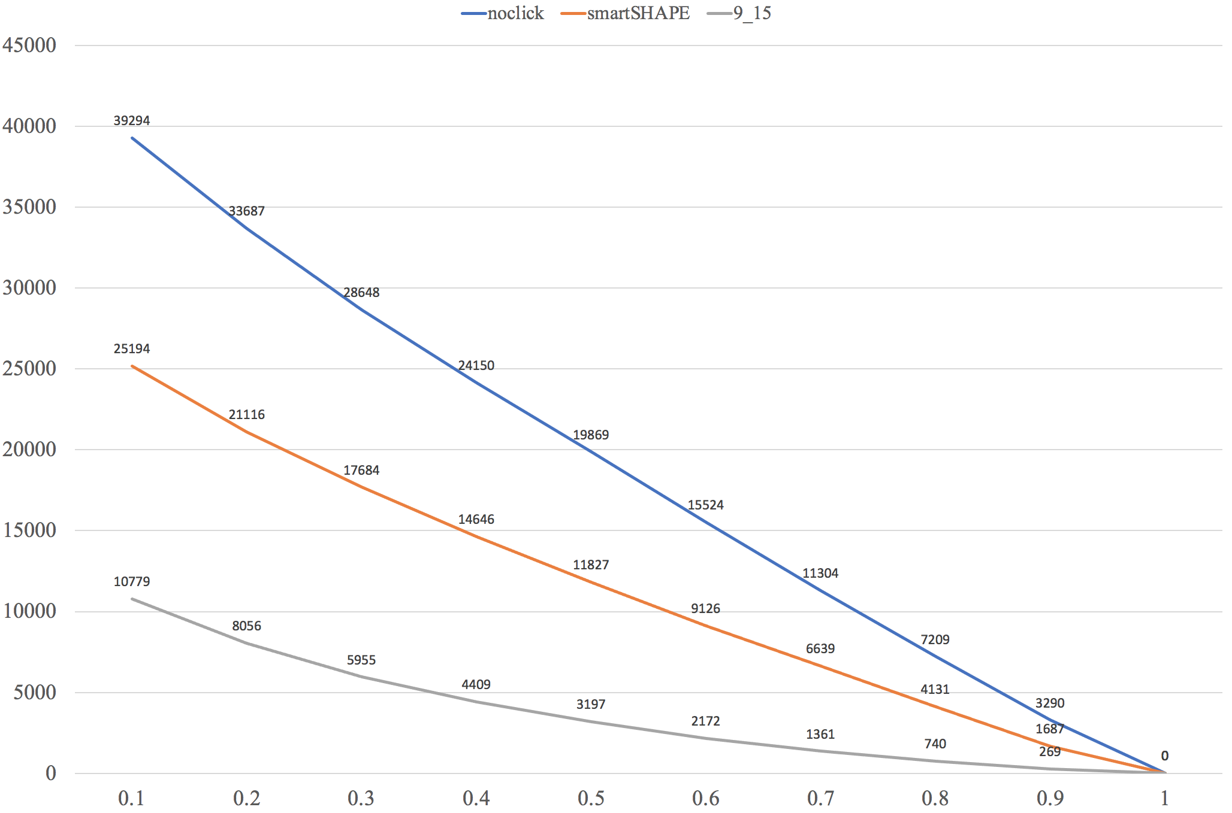

Slide 5
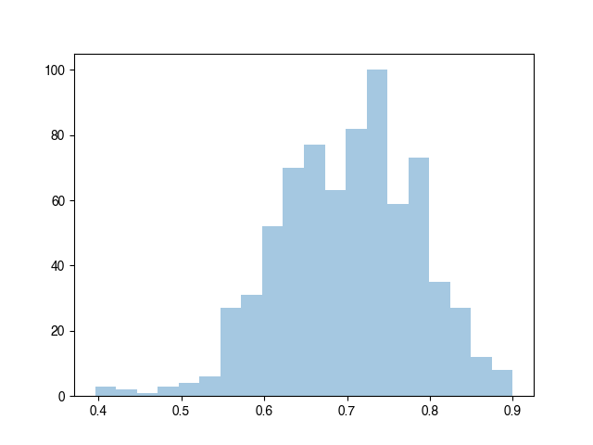
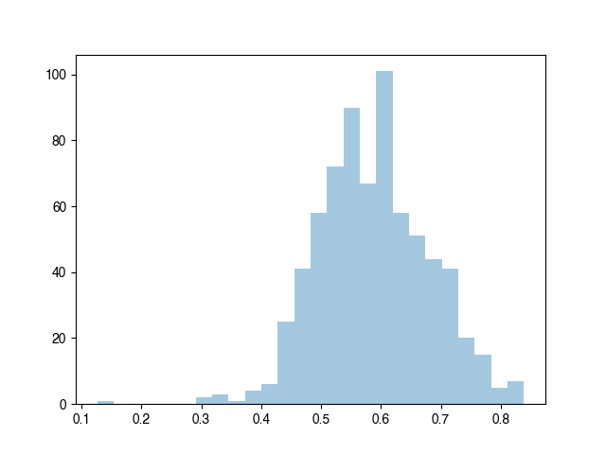
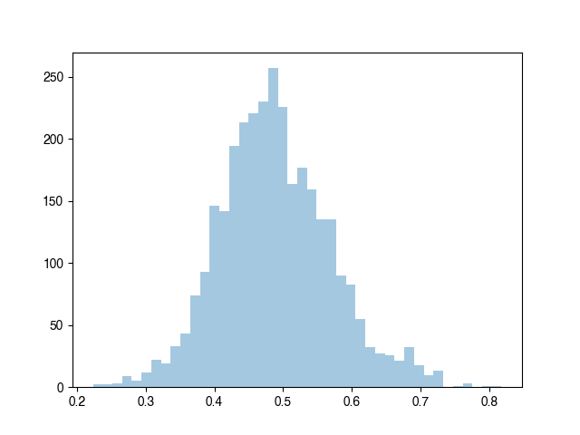
smartSHAPE vs 9+15
735 overlap
Noclick vs 9+15
712 overlap
smartSHAPE vs Noclick
3129 overlap

