Slide 1
import torch.nn.functional as F
param = config.set(drug_encoding,
target_encoding,
result_folder = "./result/",
hidden_dim_drug = 128,
hidden_dim_protein = 128,
cls_hidden_dims = [1024,512,256],
batch_size =64,
train_epoch = 100,
LR = 0.001, adjusted LR
cnn_target_filters = [32,64,128],
cnn_target_kernels = [4,6,8], #odd
num_workers=0
)

Slide 2
SPU

Slide 3
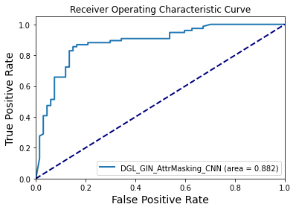
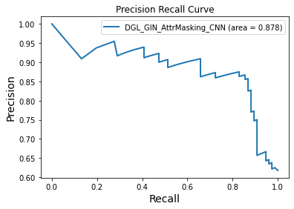
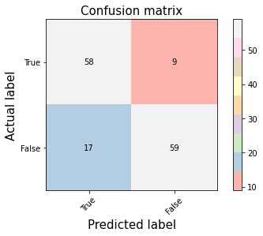
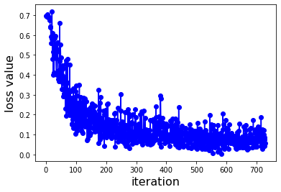
Dock6

Slide 4
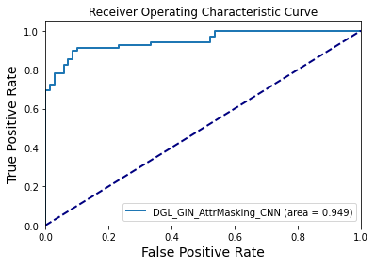
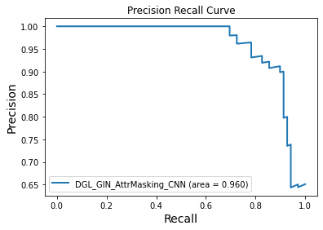
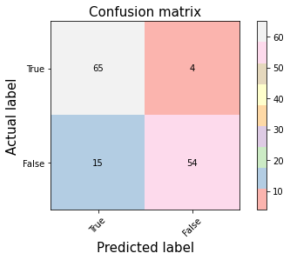
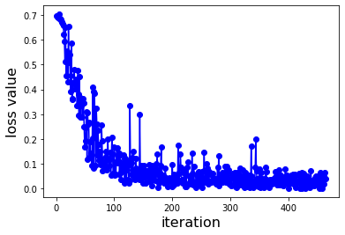
AutoDock

Slide 5
SPUK

Slide 6
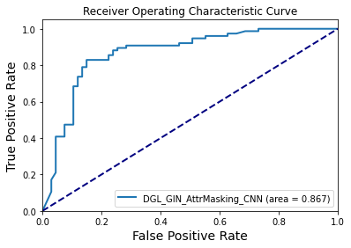
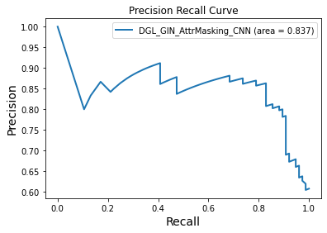
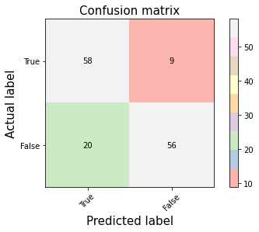
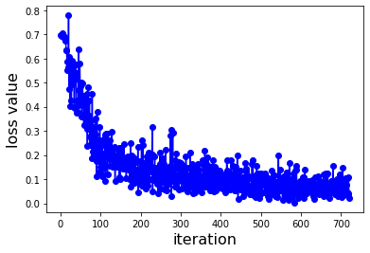
Dock6

Slide 7
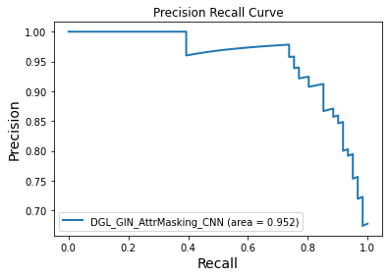
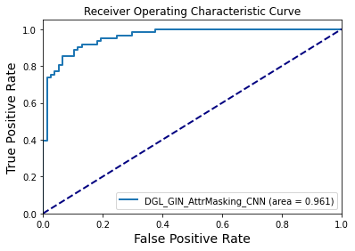
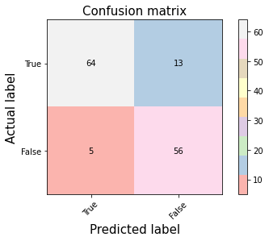
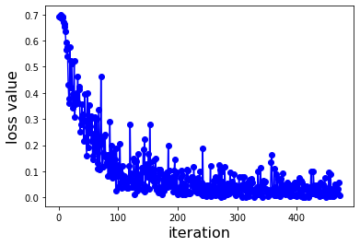
Autodock

Slide 8
SPUK2

