Slide 1
ZooKeeper

Slide 2
Challenges
Distributed systems needs some form of coordination.
Data sharing
Race condition.
Deadlock.
Partial data inconsistency.
And more…

Slide 3
ZooKeeper
  A centralized service which is highly available, scalable & replicated synchronization.
Availability
Consistency
Partition
Tolerance
Where ZooKeeper stands in CAP?

Slide 4
ZooKeeper Guarantees
Sequential Consistency - Updates from a client will be applied in the order that they were sent.
Atomicity - Updates either succeed or fail. No partial results.
Single System Image - A client will see the same view of the service regardless of the server that it connects to.
Reliability - Once an update has been applied, it will persist from that time forward until a client overwrites the update.
Timeliness - The clients view of the system is guaranteed to be up-to-date within a certain time bound.

Slide 5
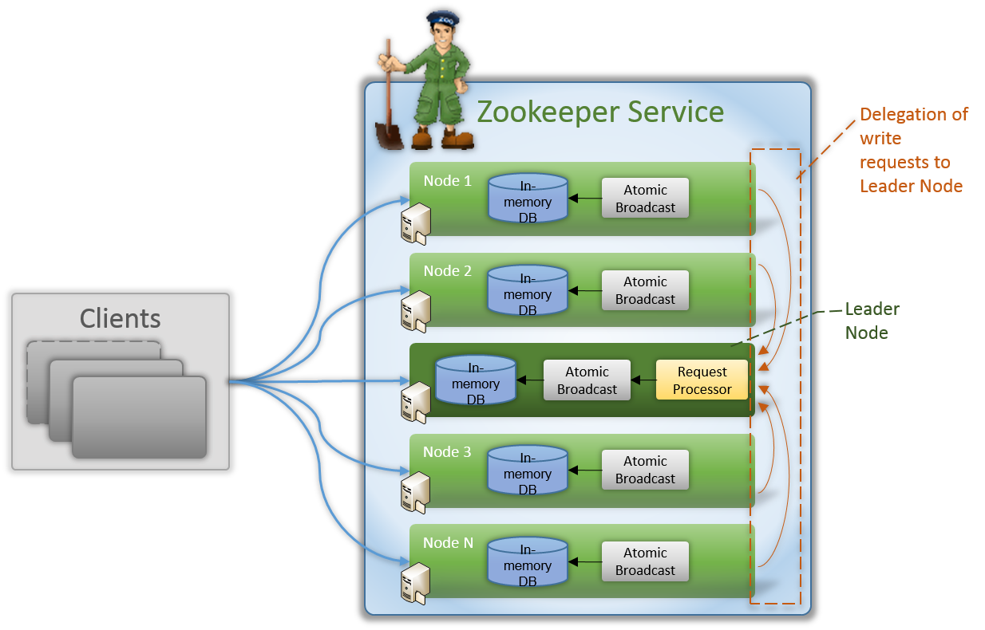
Architecture

Slide 6
Components
  Leader Node - Node that gets highest number of votes is elected as Leader. Serves write requests.
  Follower Nodes - All nodes other than Leader. Serves read requests on its own.
  Request Processor - This component is only active in Leader Node and is responsible for processing write requests originating from client or follower nodes.
  Atomic Broadcast - Leader broadcasts Followers catches
  In memory DB - Every node contains its own database that enables them to server read requests. Data is first written to file system providing recoverability in case of any problems with cluster, then DB is updated.

Slide 7
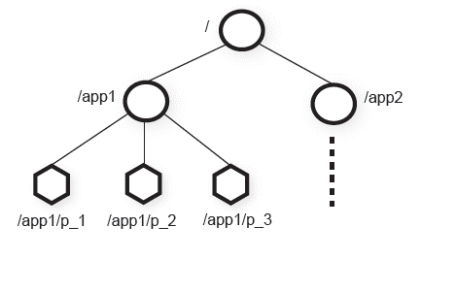
ZooKeeper Data Model
Each node called Znode can have its own data and child Znodes.
Path is represented as canonical absolute path (i.e. no relative path)
e.g. /app1/p_1
Znode maintain a stat structure.
Znode Types :
  Persistent
  Ephemeral
  Sequential

Slide 8
ZooKeeper Data Model
Sequential Znodes – The name of a Znode can be sequential, meaning that the name the client provides when creating the Znode is only a prefix: the full name is also given by a sequential number chosen by the ensemble. This is useful, for example, for synchronization purposes: if multiple clients want to get a lock on a resources, they can each concurrently create a sequential Znode on a location: whoever gets the lowest number is entitled to the lock.
Ephemeral Znodes – It is destroyed as soon as the client that created it disconnects. This is mainly useful in order to know when a client fails, which may be relevant when the client itself has responsibilities that should be taken by a new client.

Slide 9
ZooKeeper Watches
A watch as a side effect of Znode change
One-time trigger
Watches are ordered
The data for which the watch was set.
  getData() and exists() – trigger data watches.
  getChildren() – trigger child watches.
  create() – trigger data watch for the Znode being created & child watch for the parent Znode
  delete() – trigger data watch and a child watch (since there can be no more children) for a Znode being deleted as well as a child watch for the parent Znode.

Slide 10
Some Use Cases
Naming service − Identifying the nodes in a cluster by name.
Configuration management − Latest and up-to-date configuration information of the system for a joining node.
Cluster management − Joining / leaving of a node in a cluster and node status at real time.
Leader election − Electing a node as leader for coordination purpose.
Locking and synchronization service − Shared locks.
Highly reliable data registry − Availability of data even when one or a few nodes are down.
Event Notifications/workflow management.

Slide 11
Thanks

