Slide 1

Kafka
Architecture
Why Kafka ?
Zookeeper in Kafka
Kafka Streams
Kafka Connect
Use Cases
QuickStart

Slide 2
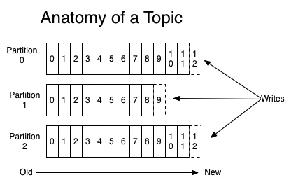
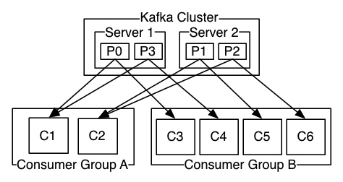
Architecture
Distributed Streaming platform having cluster of servers.
It lets you publish and subscribe to streams of records.
The Kafka cluster stores streams of records in categories called topics.
Topics are logs of messages.
Each topic can have multiple partitions.
Each Partition has one server as a leader and a number of servers as followers
Each partition has offset corresponding to consumer group.

Slide 3
Why Kafka ?
1.Scalable
2.Distributed
3.High throughput
4.Automatic failover & High availability
5.Load balancing
6.Persistence of messages on disk
7.Messages Sequencing
8.Offset based control. Consumer can re-read messages using offset.
9.Replication
10.Can add new consumer group and process events from the beginning.

Slide 4
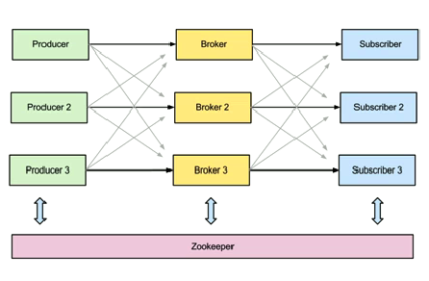
Zookeeper in Kafka cluster

Slide 5
Use Cases
1.Event Sourcing and CQRS
2.Metrics
3.Data Pipelines-Yelp
4.Website Activity Tracking

Slide 6
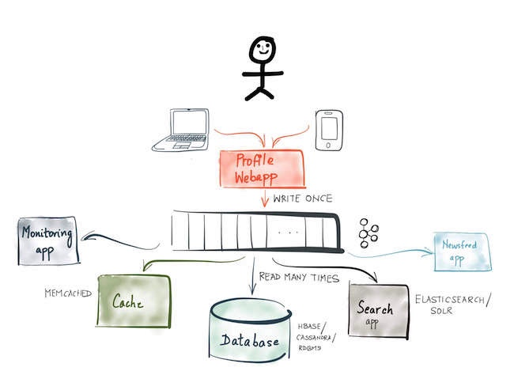
Event Sourcing

Slide 7
Kafka Streams :Client library for building microservices input and output data are stored in kafka cluster.
Kafka Connect- There are several connectors available can be used to stream data from and to various databases.
S3 connectors
Hadoop Connectors
Mysql connectors

Slide 8
QuickStart
1.Download the tar and un-tar it.
tar -xzf kafka_2.11-1.0.0.tgz
2. Start the server
bin/zookeeper-server-start.sh config/zookeeper.properties
Now start the Kafka server:
bin/kafka-server-start.sh config/server.properties
3. Create a topic
bin/kafka-topics.sh --create --zookeeper localhost:2181 --replication-factor 1 --partitions 1 --topic test
4.Post message
bin/kafka-console-producer.sh --broker-list localhost:9092 --topic test
This is a message
This is another message
5.Start a consumer
bin/kafka-console-consumer.sh --bootstrap-server localhost:9092 --topic test --from-beginning

