Slide 1
GRAMENER EDA CASE STUDY SUBMISSION
Harendra Singh
Ashwathi Ravindran
Kaushik Deb
Vikash Kumar

Slide 2
A consumer finance company wants to identify the drivers for loan default
The consumer finance company specializes in lending various types of loans to urban customers.
The company has to make a decision for loan approval based on the applicant’s profile. There are 2 types of risks available
If the applicant is likely to repay the loan, then not approving the loan results in a loss of business to the company
If the applicant is not likely to repay the loan, i.e. he/she is likely to default, then approving the loan may lead to a financial loss for the company
The aim is to identify driving factors (or driver variables) behind loan default. An EDA is done to understand how consumer attributes and loan attributes influence the tendency of default.
This information can then be used for taking actions such as denying the loan, reducing the amount of loan, lending (to risky applicants) at a higher interest rate, etc
There are 2 types of decisions
Our analysis is limited to identifying factors influencing “Charged off
Decision
Loan accepted
Loan Rejected
Fully paid
Current
Charged off

Slide 3
The following steps have been followed in EDA process
Data source : loan data for all loans issued through the time period 2007 to 2011
Data cleaning & preparation
Loans data downloaded
Univariate & Segmented univariate analysis
To decide which factors have a relationship with ‘Default’
Bivariate analysis
Study correlation between metrics
Removed columns with high missing value
Derived metrics
Identified derived metrics that helps identify default
Summary
Key drivers identified
Removed null value columns
Removed columns having just one value throughout
Are there any segments within a particular column with high default?
High correlated metrics are identified and removed to retain only one instance
Plotting correlation metrics
Combination of categorical variables with high default %
Date variables are treated

Slide 4
Data preparation
Loan.csv
Rows = 39,717
Columns = 111
Removed all columns with 100% null values
Columns with high missing values are
next_pymnt_d (97%)
mths_since_last_record (93%)
mths_since_last_delinq (65%)
desc (32%)
Emp title (6%)
Columns with only one value in them
policy_code
application_type
pymnt_plan
url
Etc.,.
Important Date variables
Issue date
earliest_cr_line
last_pymnt_d
last_credit_pull_d
Removed columns with very high missing values and rows with missing values in fields
Removed columns with only “0” or “NA
Removed columns with only one value
Removed loans with “Current” loans as these outcomes are still unknown
Final dataset for EDA
Rows = 37,433
Columns = 46

Slide 5
Univariate analysis summary (continued)
Of all the variables identified, the following 17 variables seem to have impact on ‘default’ cases
A derived metrics, “Default %” is calculated as = “Charge off”/(”Charge off” + “Fully paid”)
We are also looking at “% distribution” to understand the quantity of data within a particular category to ensure the if the % default is high then we can make valid conclusions about it
Variable | Description | Trend observed/insight observed
loan_amnt | The listed amount of the loan applied for by the borrower. If at some point in time, the credit department reduces the loan amount, then it will be reflected in this value. | High loan amount -> Higher default cases
term | The number of payments on the loan. Values are in months and can be either 36 or 60. | % default is higher for the 60months than 36 months
int_rate | Interest Rate on the loan | Higher rate -> higher % default
sub_grade | LC assigned loan subgrade | Higher grade -> higher % default
annual_inc | The self-reported annual income provided by the borrower during registration. | Higher income-> higher % default
verification_status | Indicates if income was verified by LC, not verified, or if the income source was verified | “Verified” has the highest % of default
issue_d | The month which the loan was funded | Extracted year from the date and Year 2007 seems to have the highest % of default
purpose | A category provided by the borrower for the loan request. | Highest default % is for “Small business”
addr_state | The state provided by the borrower in the loan application | Highest default % is seen for Nebraska(NE). Florida and California is also high default & high number of loan cases
dti | A ratio calculated using the borrower’s total monthly debt payments on the total debt obligations, excluding mortgage and the requested LC loan, divided by the borrower’s self-reported monthly income. | Highest default % is seen for Higher DTI bands

Slide 6
Univariate analysis summary
Of all the variables identified, the following variables seem to have impact on ‘default’ cases
Variable | Description | Trend observed/insight observed
delinq_2yrs | The number of 30+ days past-due incidences of delinquency in the borrower's credit file for the past 2 years | High # of delinquencies -> high % defaults
earliest_cr_line | The month the borrower's earliest reported credit line was opened | Credit lines reported in years 2007 & 2008 had the highest default
inq_last_6mths | The number of inquiries in past 6 months (excluding auto and mortgage inquiries) | More enquires -> higher default%
pub_rec | Number of derogatory public records | More enquires -> higher default%
revol_util | Revolving line utilization rate, or the amount of credit the borrower is using relative to all available revolving credit. | Higher % utilization of revolving balance band -> higher default rate
total_pymnt | Payments received to date for total amount funded | If payment made is lesser -> higher chances of default
last_credit_pull_d | The most recent month LC pulled credit for this loan | % default is higher towards recent years
pub_rec_bankruptcies | Number of public record bankruptcies | Higher number records -> higher default. This column is highly correlated to “Pub_rec” field

Slide 7
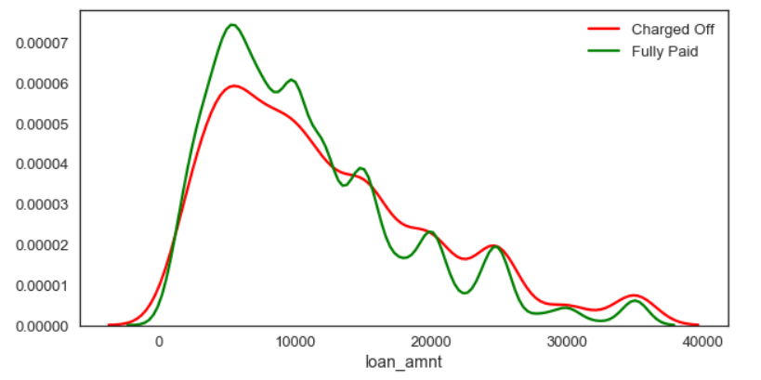
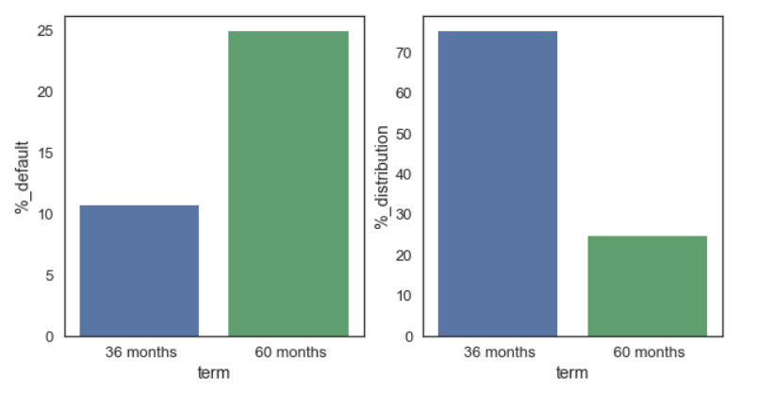
Loan amount histogram Higher the loan amount , more case of default
Term % default is higher for the 60months than
36 months

Slide 8
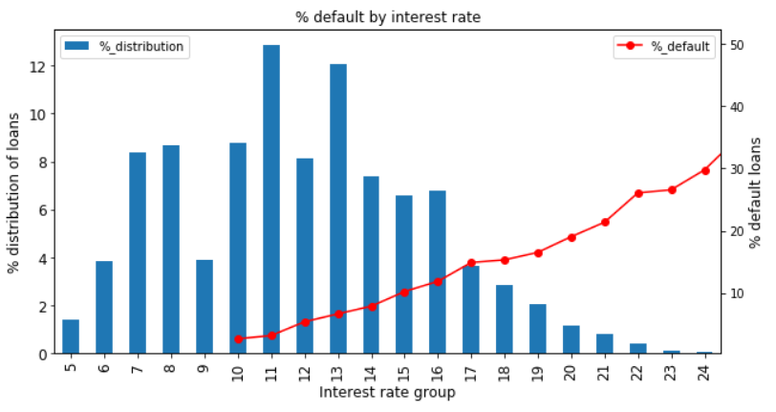
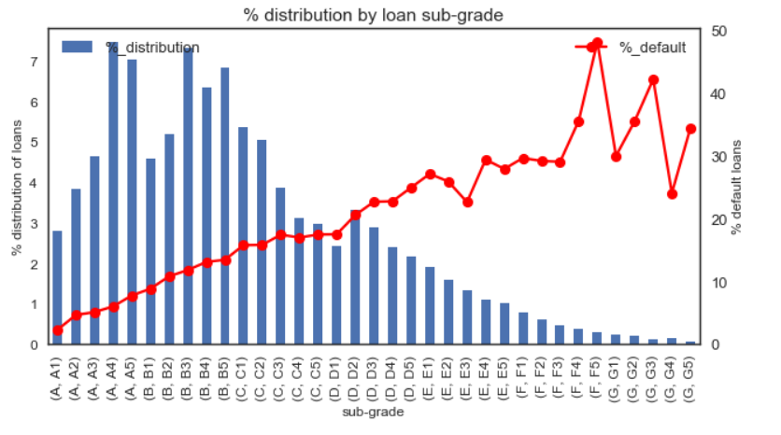
Interest rate Higher rate seem to have higher % default
Loan subgrade Higher grade (a – g) is seeing higher % default

Slide 9
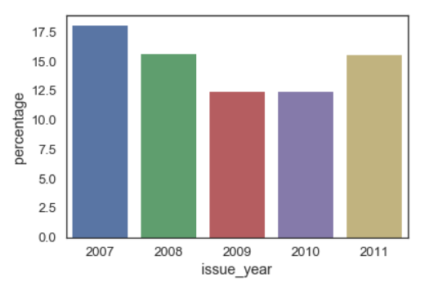
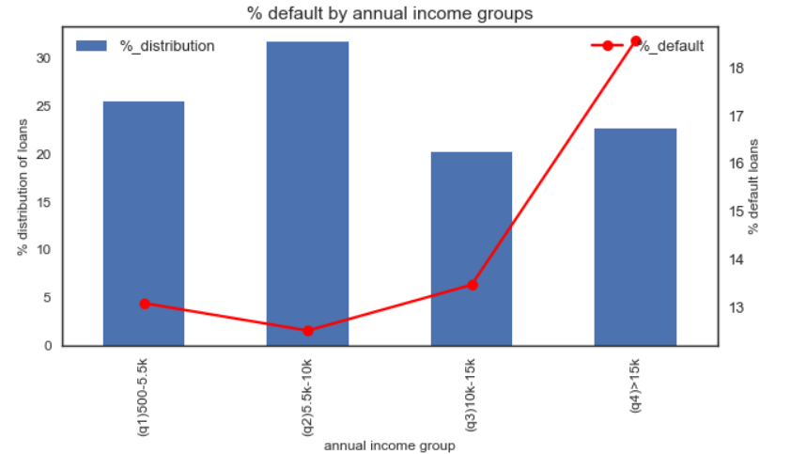
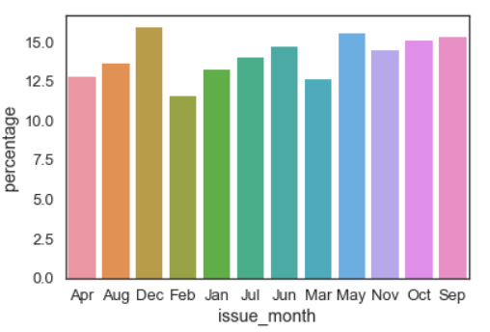
Annual Income (by quantile bands) Higher income bands (a – g) is seeing higher % default
Issue date After extracting year field ‘2007’ has the highest default %. However, no trend observed at monthly trends

Slide 10
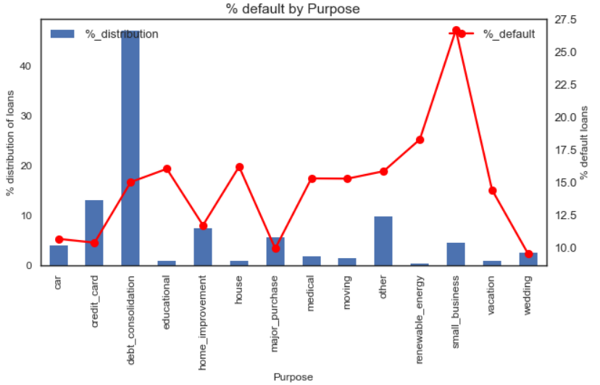
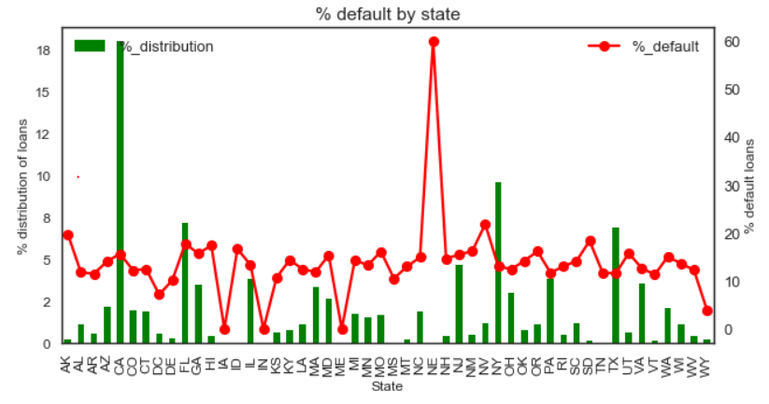
Purpose Highest default % is seen for “Small business”
Address state Highest default % is seen for Nebraska(NE) however has very few data points. Nevada(NV), Florida (FL) & California also have high % defaults & more data

Slide 11
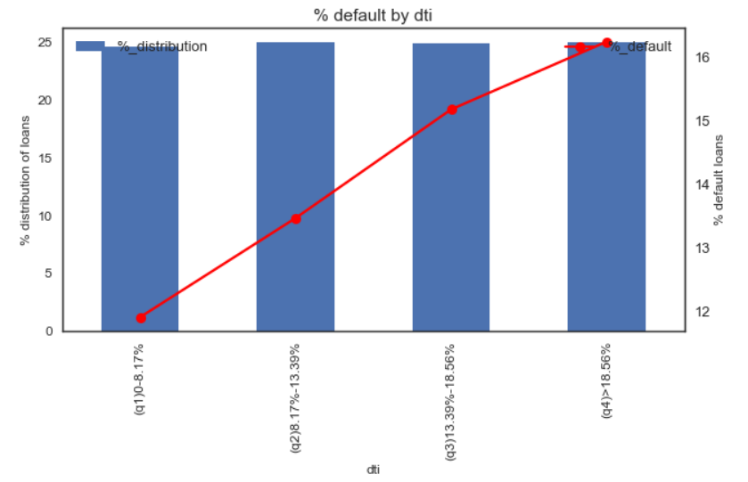
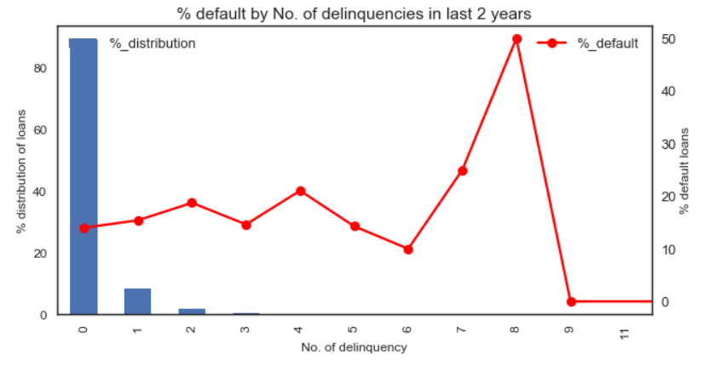
No of delinquencies Highest default % is seen for Higher number of delinquencies
Dti Highest default % is seen for Higher DTI bands

Slide 12
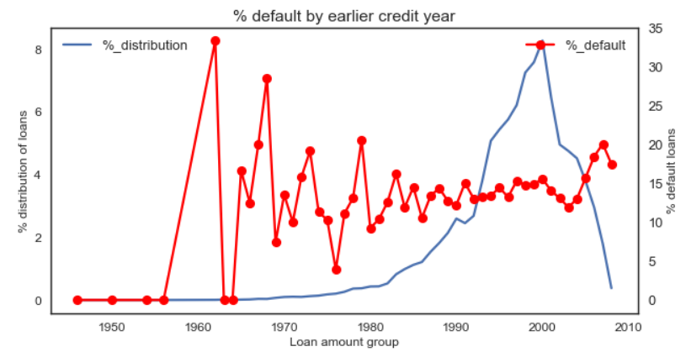
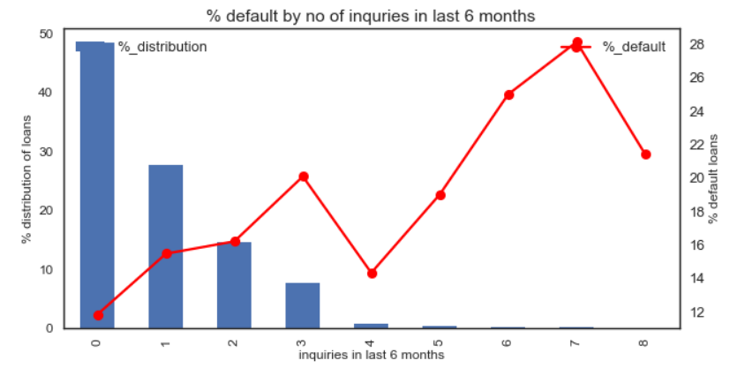
Earliest credit line opened month Based on the year credit line was opened, 2007 & 2008 has highest default %
No. of enquiries in last 6 months loans that had more enquires had higher default %

Slide 13
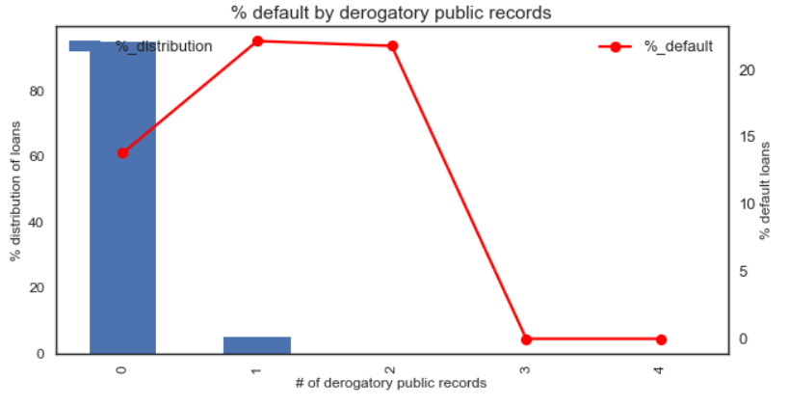
No. of derogatory public records loans that had more derogatory records had higher default %
No. of enquiries in last 6 months loans that had more enquires had higher default %
The variable “pub_rec_bankruptcies“ ie.,. No of public records of bankruptcies” is highly correlated with this variable

Slide 14
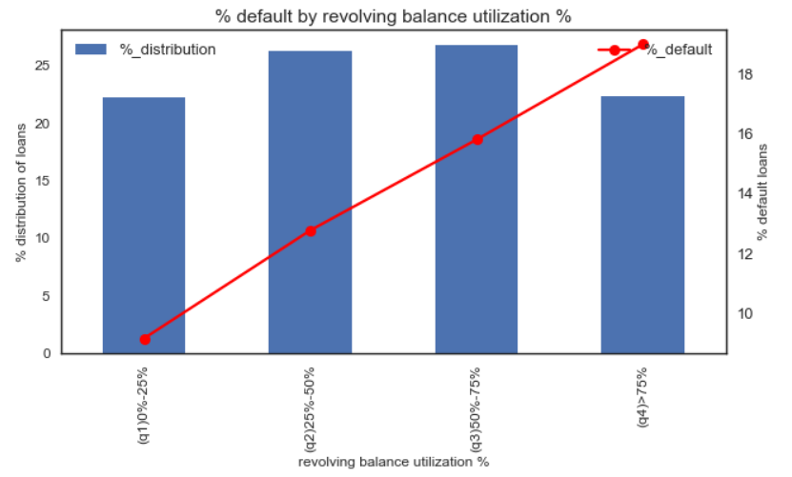
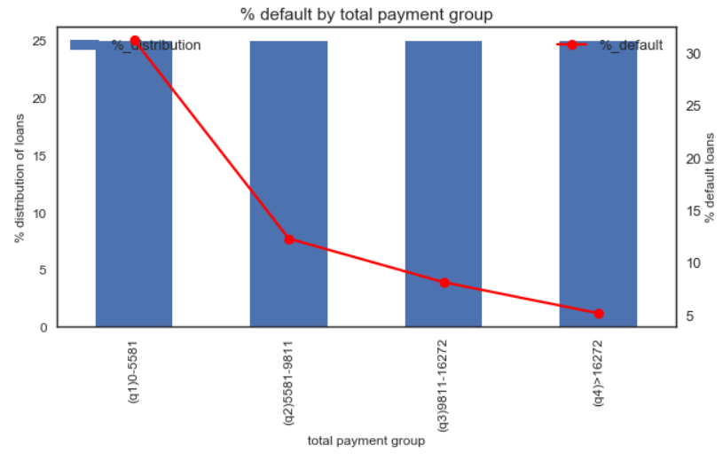
% revolving balance utilization loans that had % utilization had higher default %. Higher % utilization of revolving balance shows a risky account
Total payment made lesser payment made is a good indicator of high default

Slide 15
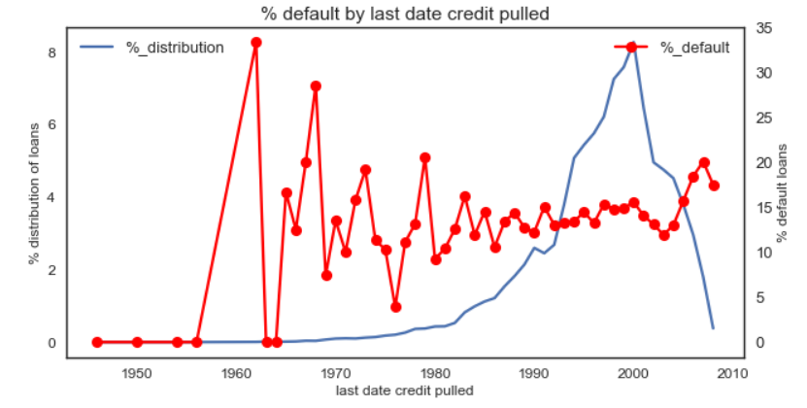
Last credit date pulled % default is higher towards later years

Slide 16
Derived metrics and summary
We have identified 2 derived metrics
Bivariate analysis have been considered for certain combinations as shown below
Variable | Description | Trend observed/insight observed
Emi_annual_inc_ratio | Ratio of monthly installment to annual income | Default % is high for higher emi_annual_inc_ratio
loan_amnt_annual_inc_ratio | Loan amount to annual income ratio | As the loan_amnt_annual_inc_ratio goes beyond 20 the probablity of being a loan charged off is much more higher

Slide 17
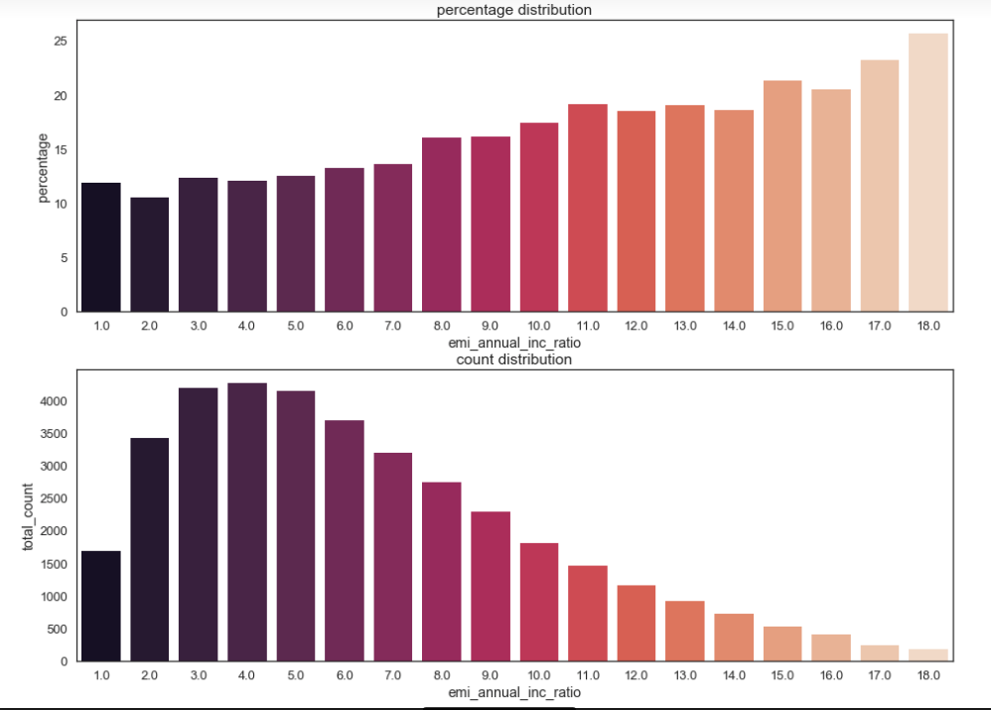
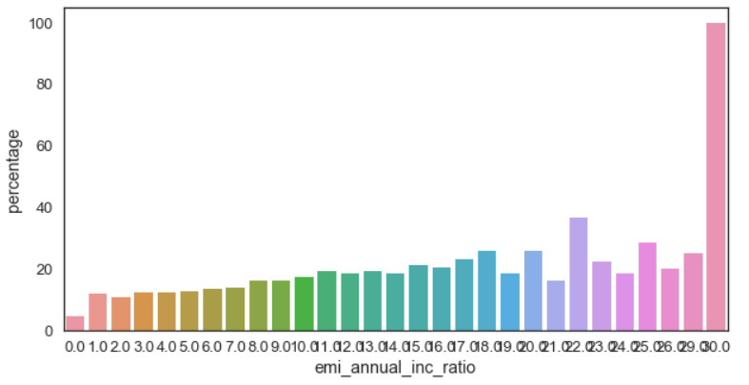
EMI –annual income ratio Default % is high for higher emi_annual_inc_ratio

Slide 18

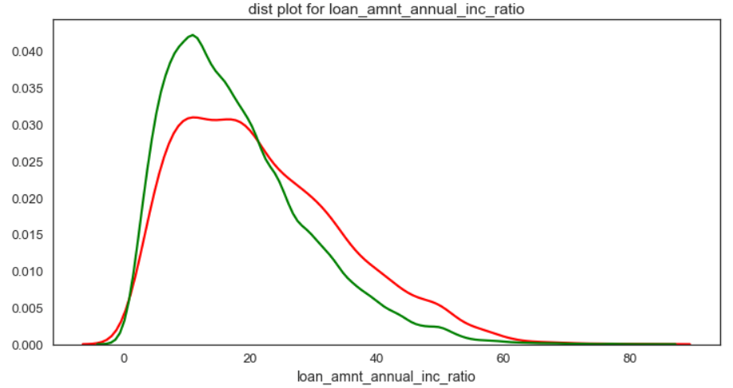
Loan amount to annual income ratio As the loan_amnt_annual_inc_ratio goes beyond 20 the probablity of being a loan charged off is much more higher
loan_amnt_annual_inc_ratio = 100 *loan_amnt / annual_inc

Slide 19
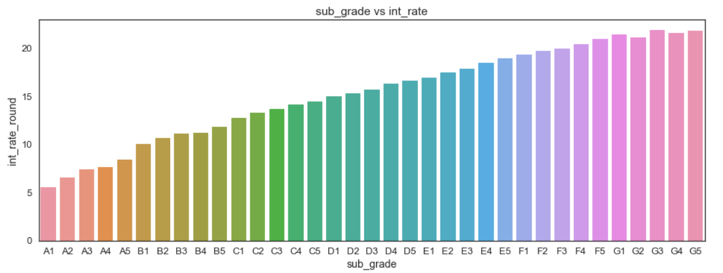
Sub grade vs Interest rate (rounded) Lower the sub_grade higher the interest_rate
Notes:
subGradeVsintRound:
Bar graph between sub_grade and interest_rate.
Lower the sub_grade higher the interest_rate

Slide 20
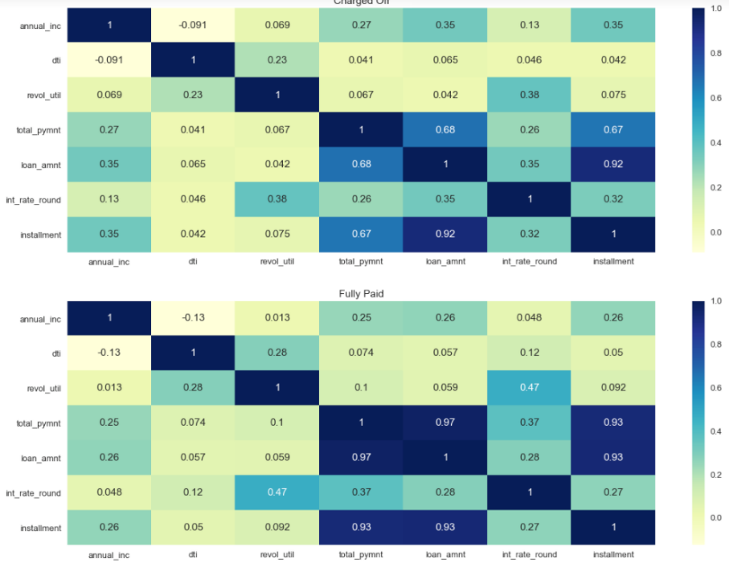
Correlation Heat maps across columns
Total _amount and total_payment is highly corelated in fully_paid loan. But not in charged_off.
Total_payment and installment is also highly corelated in fully_paid loan.But not in charged_off
Notes:
corrheatMap:
Correlation heatMap for annual_inc, dti, 'revol_util', 'total_pymnt', 'loan_amnt', 'int_rate_round', 'installment'

Slide 21
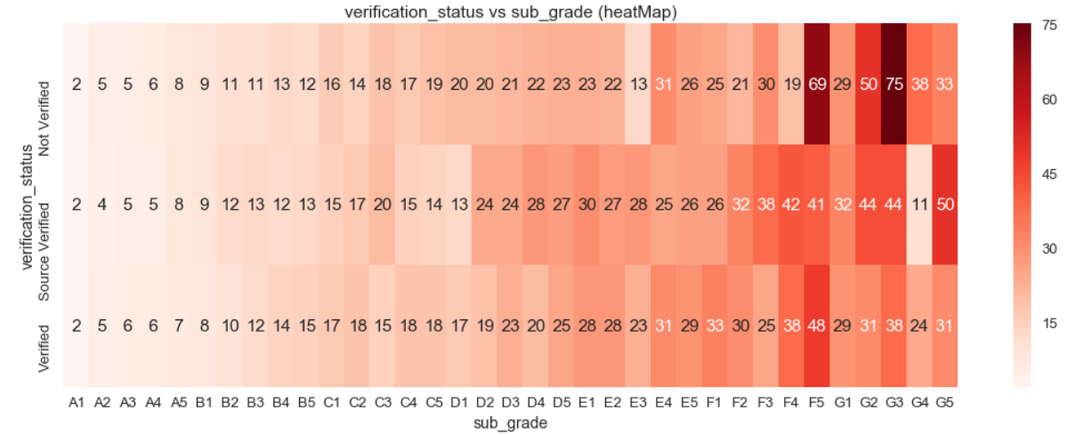
% default (Verification status vs Sub grade) Lower sub_graders are having high percentage despite the verification status being “Verified”

Slide 22
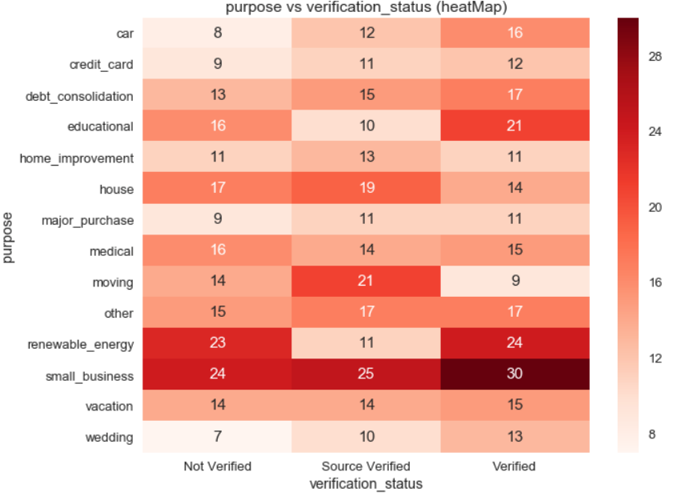
% default (Verification status vs Purpose) “Small_business” purpose & “Verified” group standing out in their default%

Slide 23
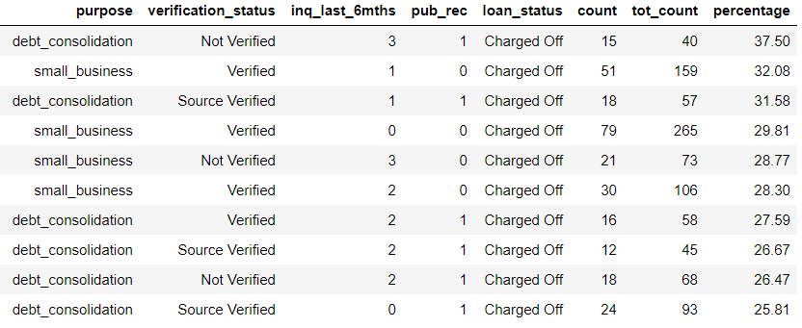
Some hotspots for defaults have been identified with multiple column combinations

Slide 24
Conclusion
Based on the various analysis done, following are the few key take aways –
Sub Grade is a very good indicator of default %. A1 – G5 the % default increase continuously
Ratio between instalment and annual income (emi_annual_inc _ratio) is a good indicator as with the increase in ratio, the default % increases
Loan amount & annual income ratio could help the company in identifying defaults as higher ratio could mean a risk of default
Purpose – “Small business” has very significant high % cases of default
Higher term loans run the risk of higher default
Number of delinquencies, public record of derogatory or bankruptcies are a key indicator of loan default

