Slide 1
ITP219
CONTENT MANAGEMENT SYSTEM | WEEK 7

Slide 2
Creating registration and login form
1. Now that we have created our register.php and login.php, it’s time that we create our registration form have it interact with our database.
The registration will serve as the initial point where users can post and interact with other users in our cms.
2. After the user has registered, the user can now login and see the dashboard.

Slide 3
Registration form
1. Inside your cms > actions create a file called user_accounts.actions.php, and add the following code as seen on the next slide.

Slide 4
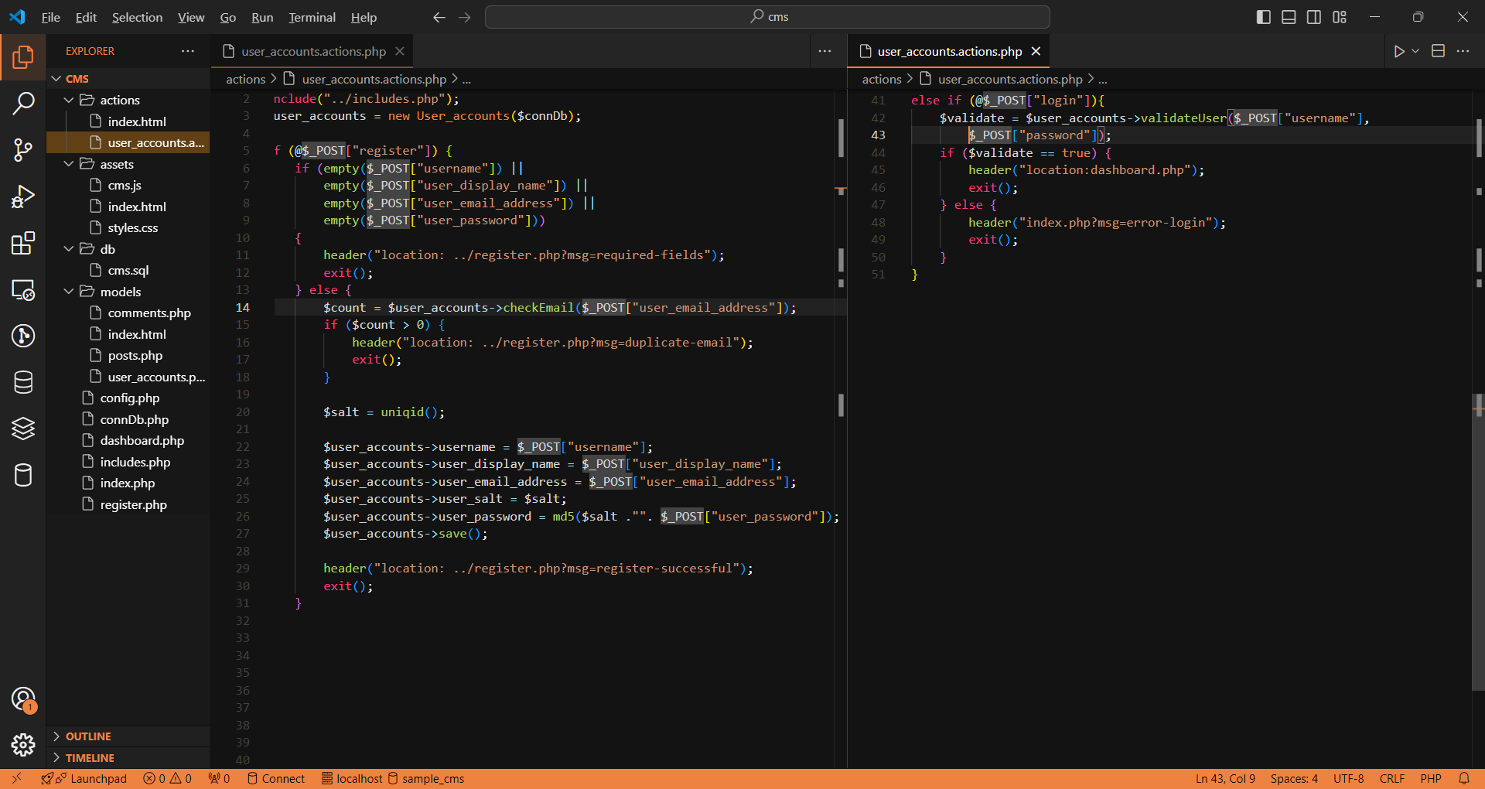

Slide 5
Create the model file
1. inside the models folder create a file called user_accounts.php and add the following code as seen on the next slide.

Slide 6
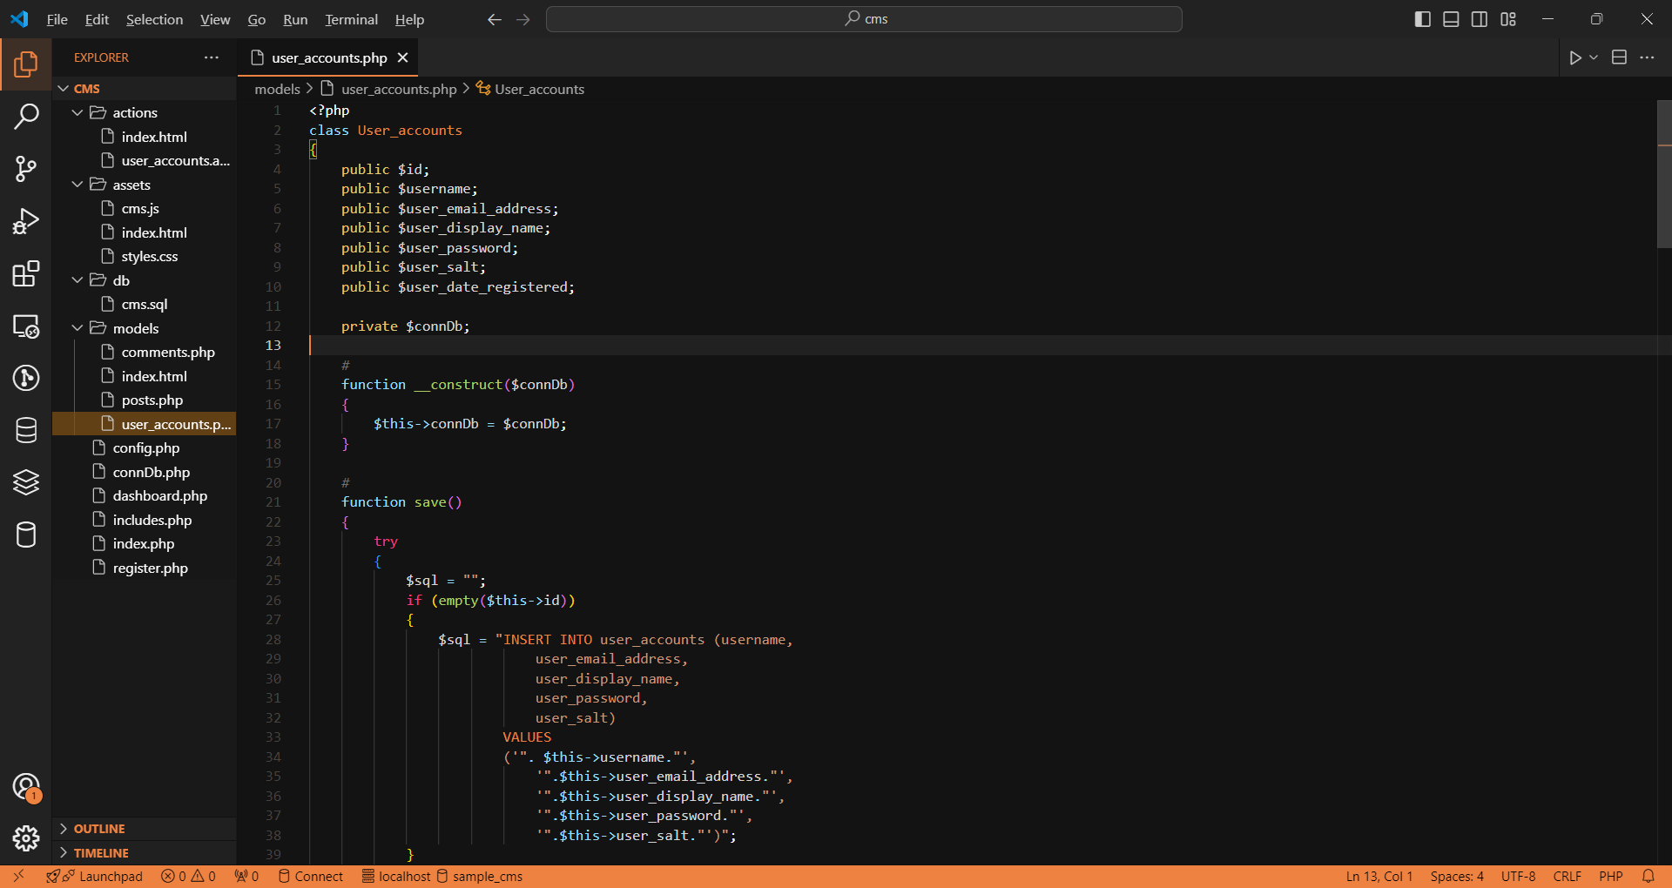

Slide 7
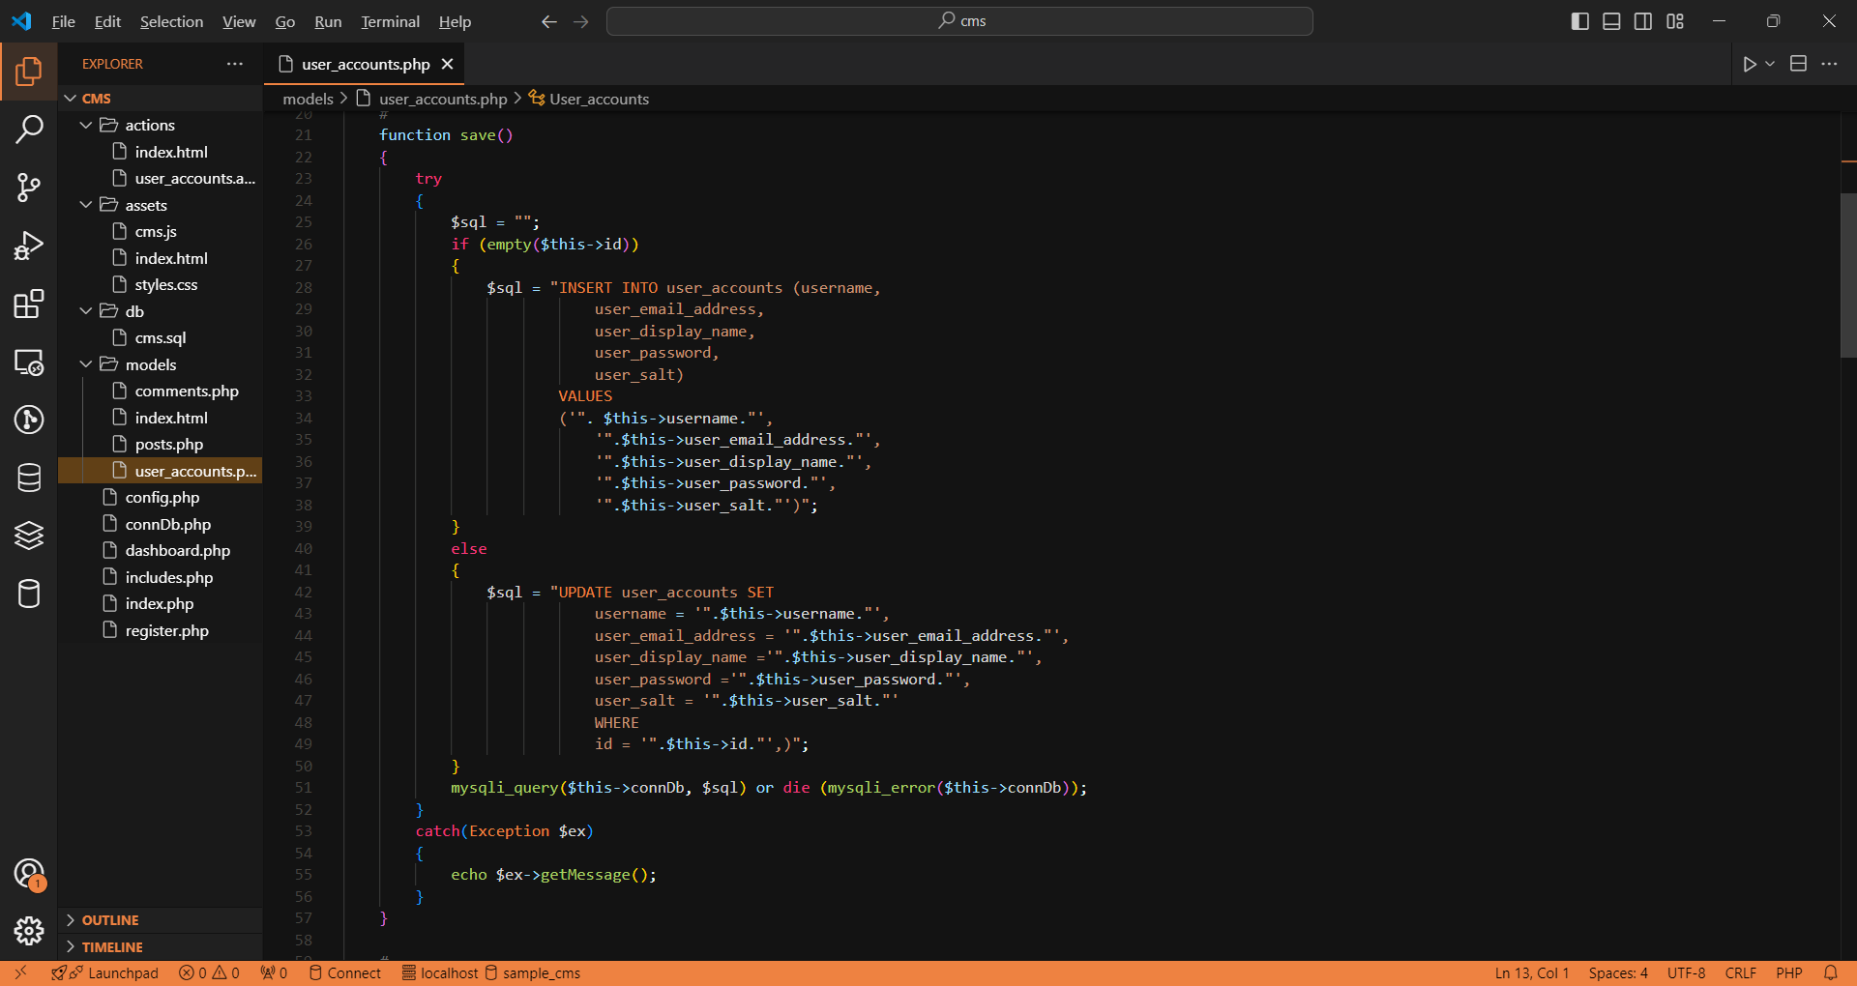

Slide 8
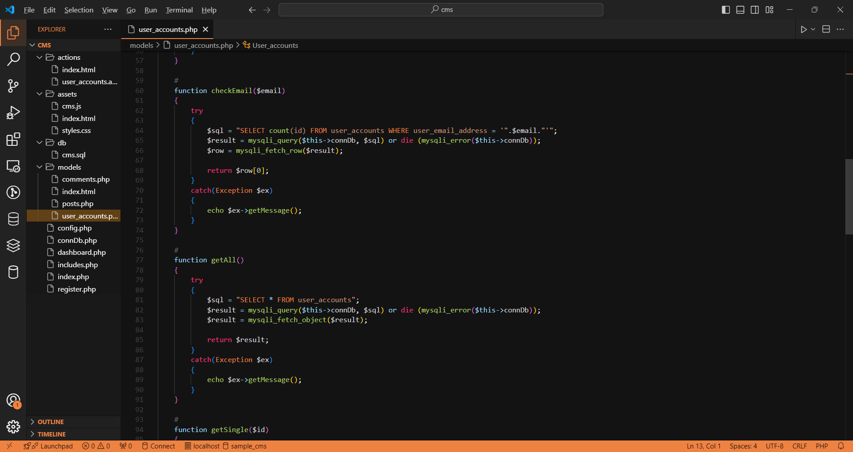

Slide 9
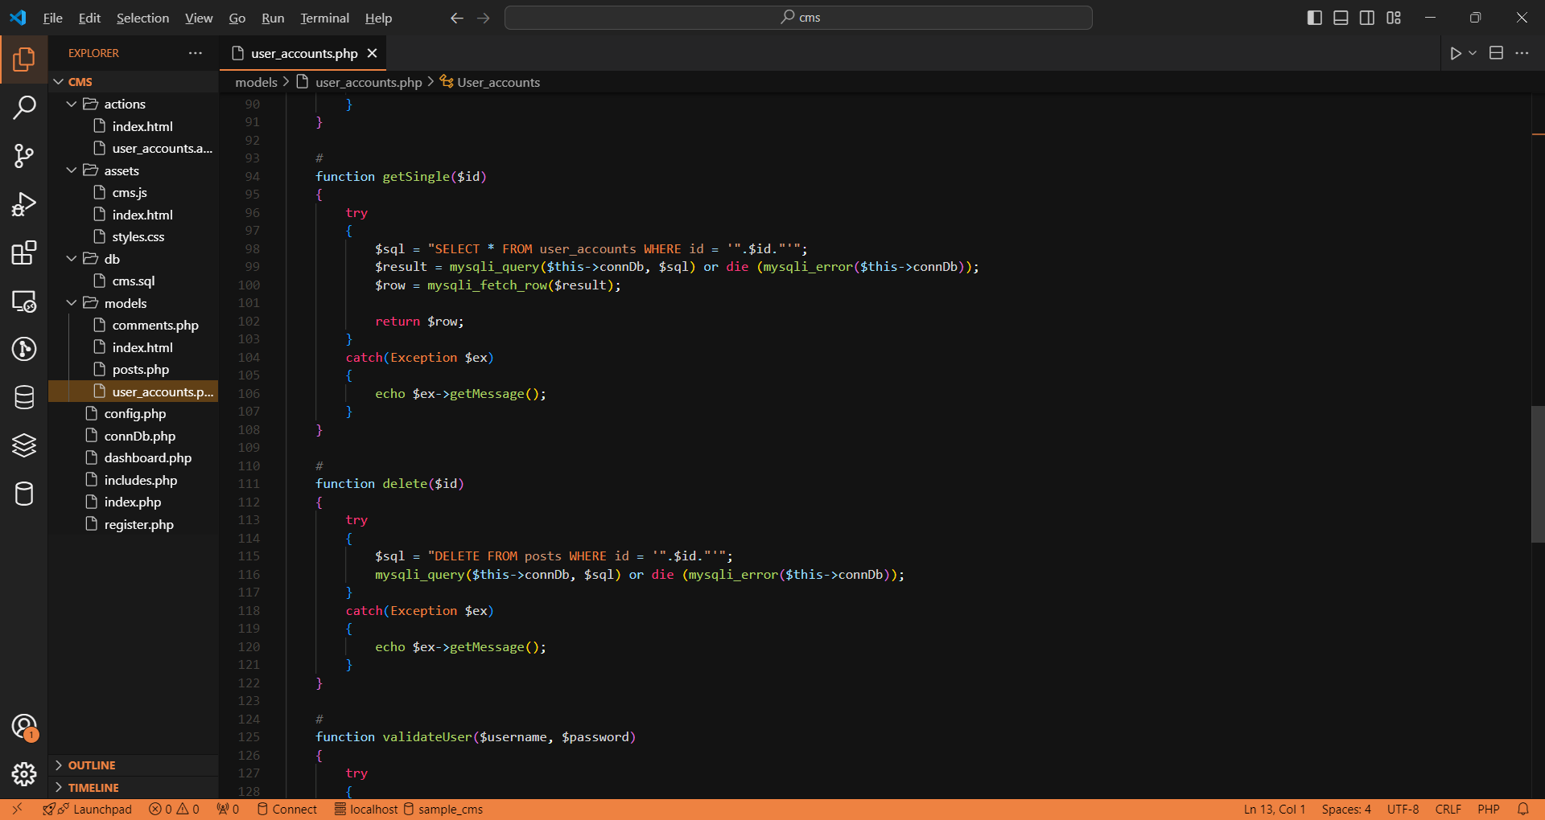

Slide 10
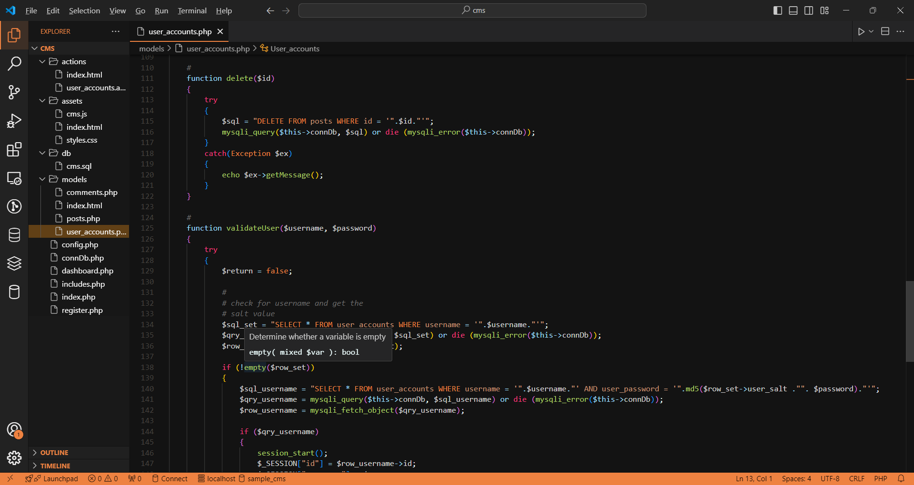

Slide 11
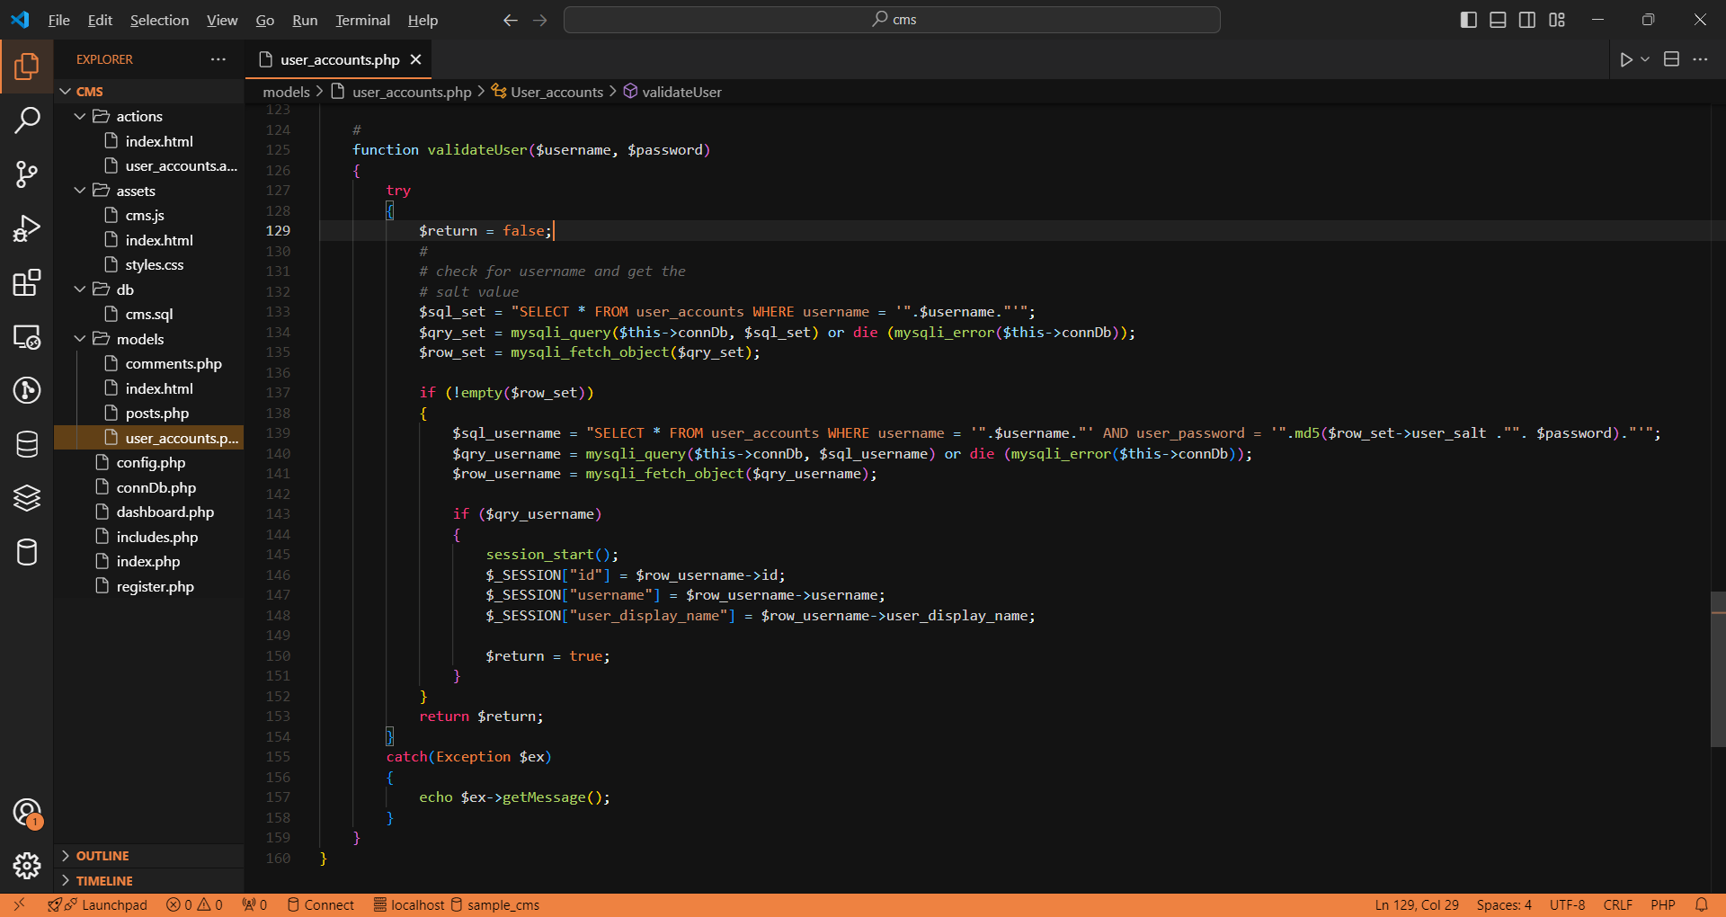

Slide 12
Action file
1. Inside actions folder create a file and rename it as user_accounts.php. This is where the action takes place everytime we press the submit button. Add the following code as seen on the next slide.

Slide 13
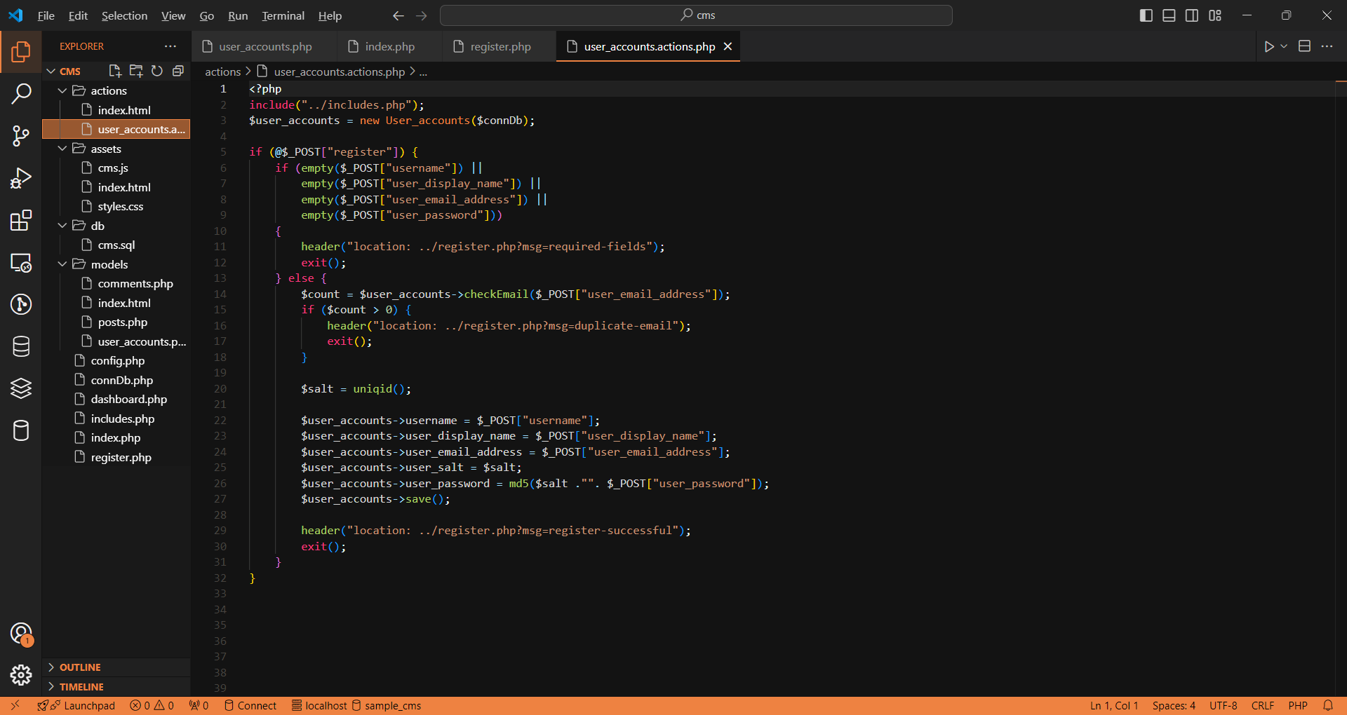

Slide 14
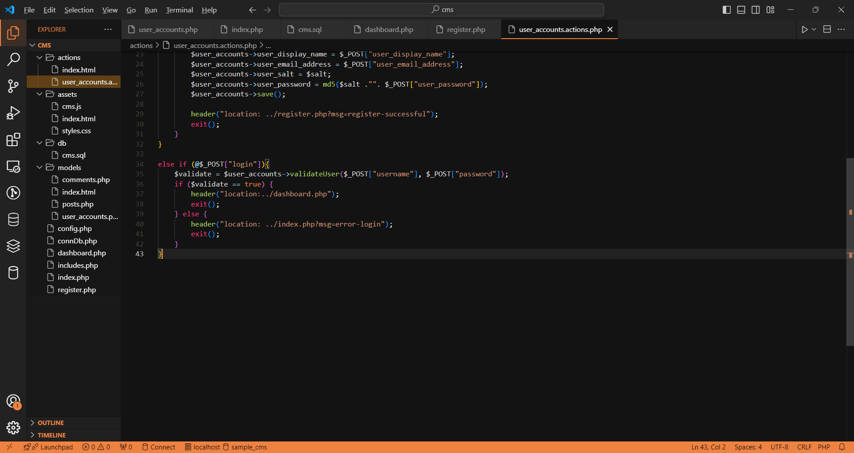

Slide 15
action file
2. Modify your register.php as well as your index.php and add the following code as seen on the next slide.

Slide 16
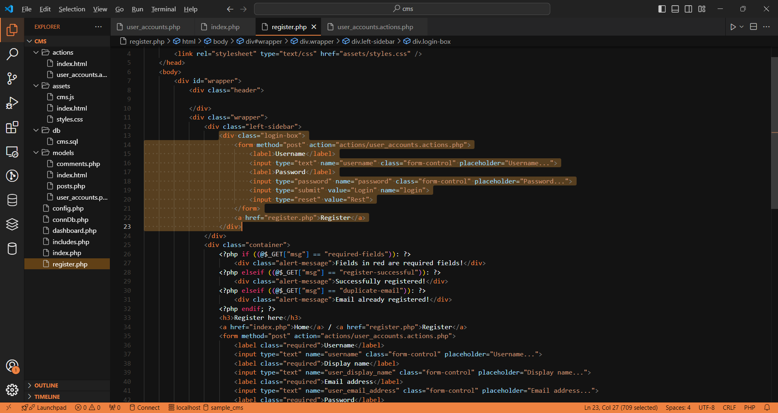

Slide 17
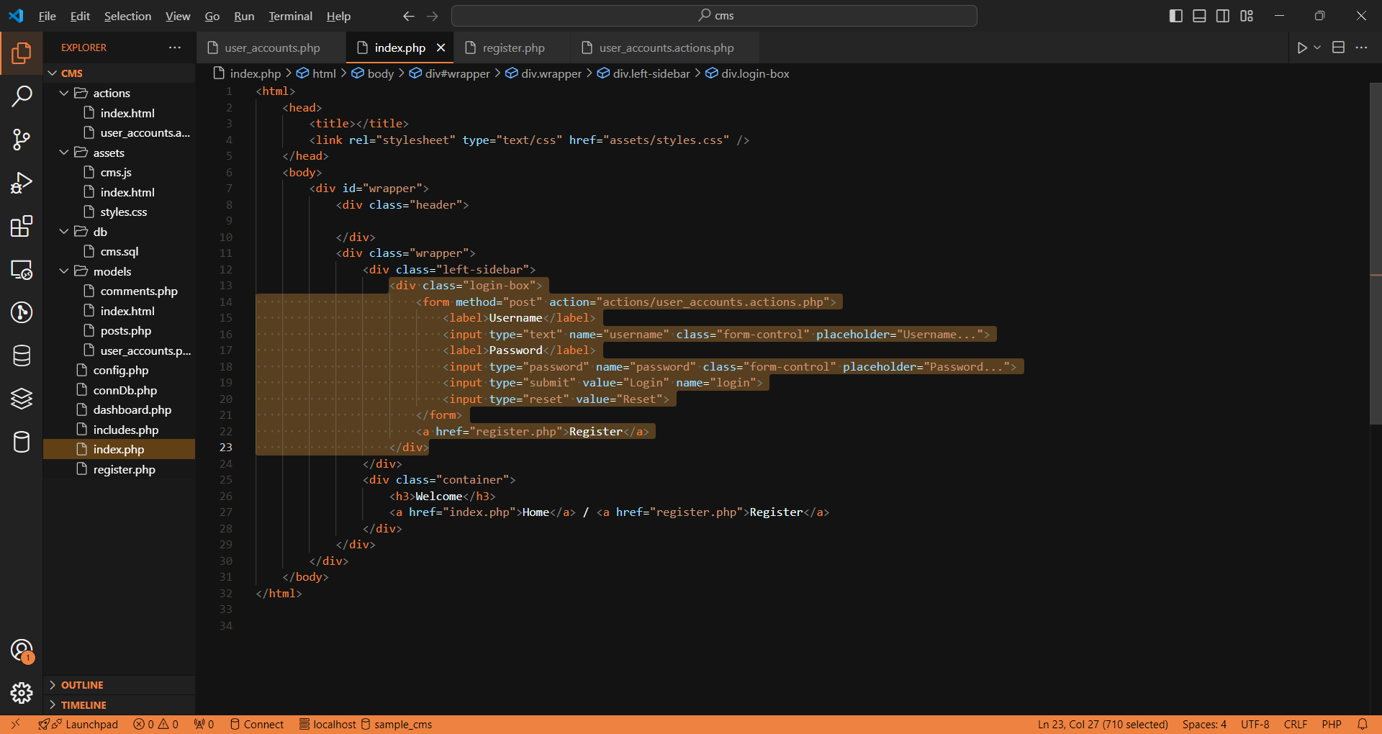

Slide 18
Testing the registration and login
1. Test the registration form by adding the needed and required information.
2. Once the fields are populated, click submit and check your database. If the registration is successful, you will have a red prompt stating that the registration is successful.

Slide 19
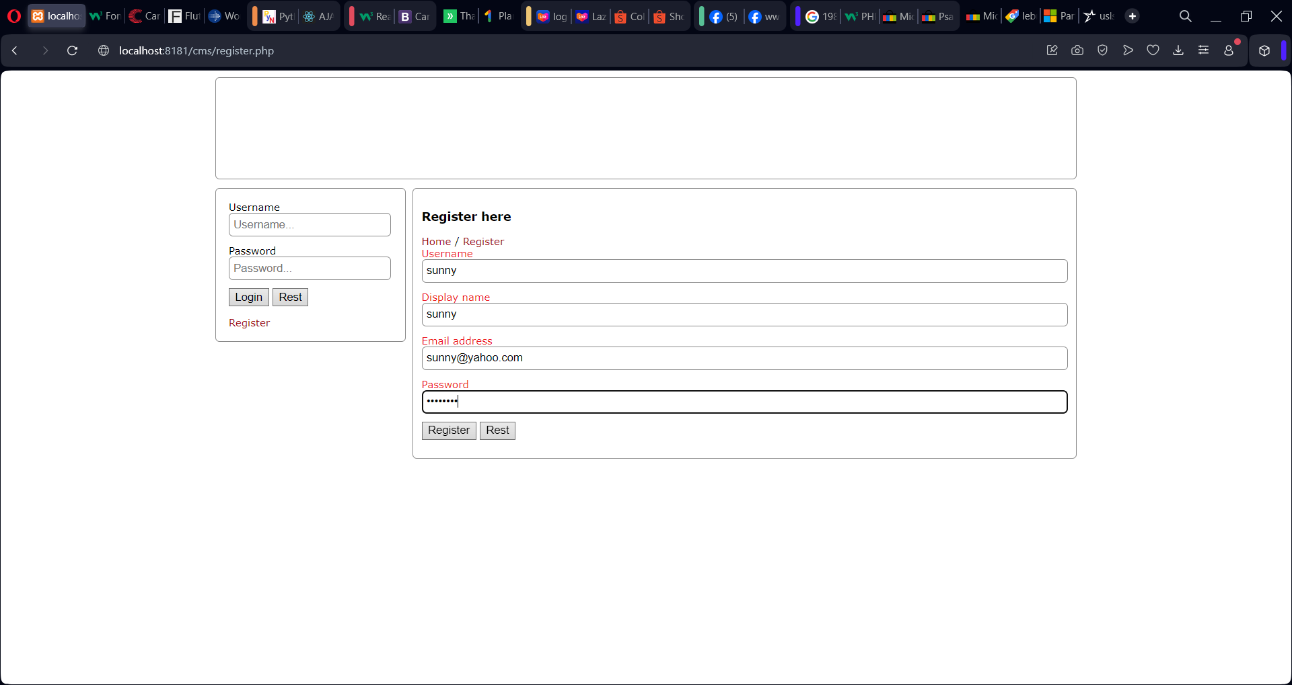

Slide 20
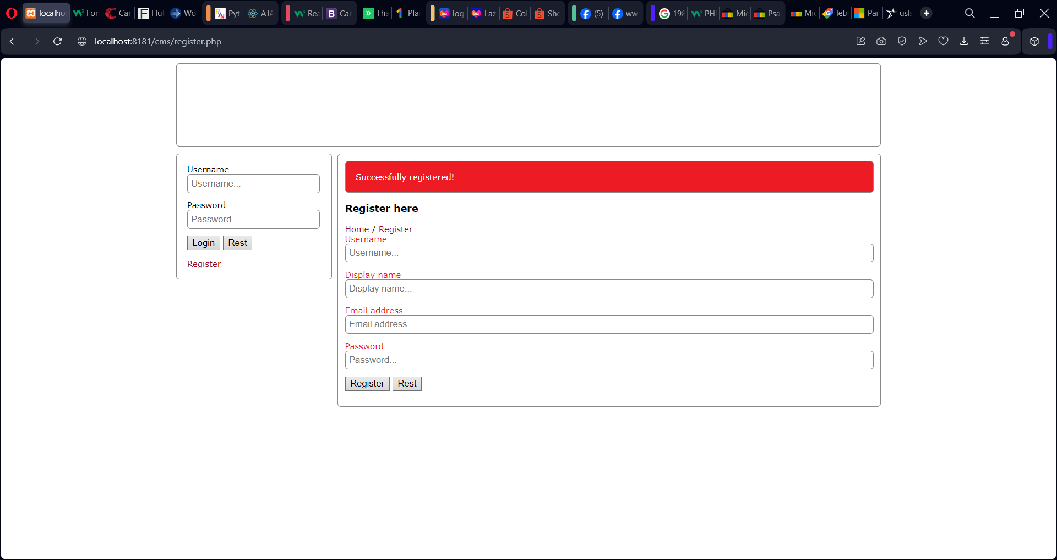

Slide 21
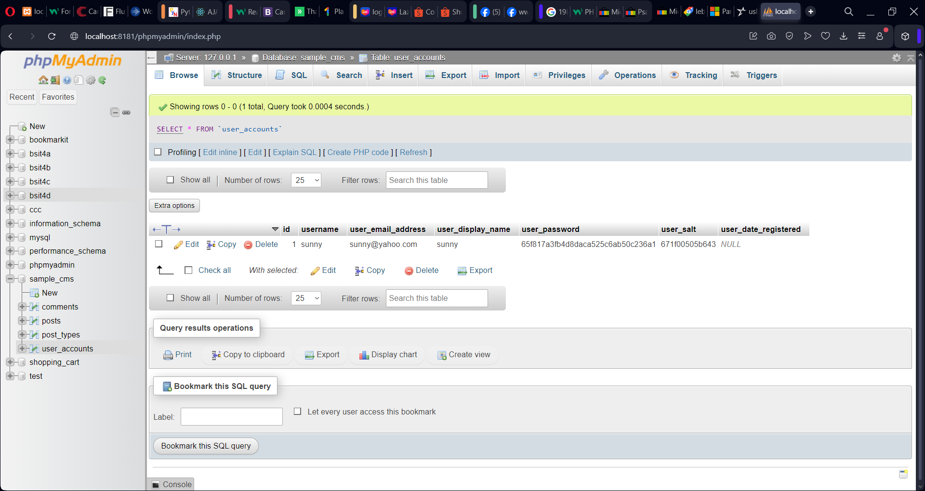

Slide 22
User login
1. Create file and on the root folder and rename it dashboard.php. This will serve as your landing page once the user has successfully logged in. Add the following code as seen on the next slide.

Slide 23
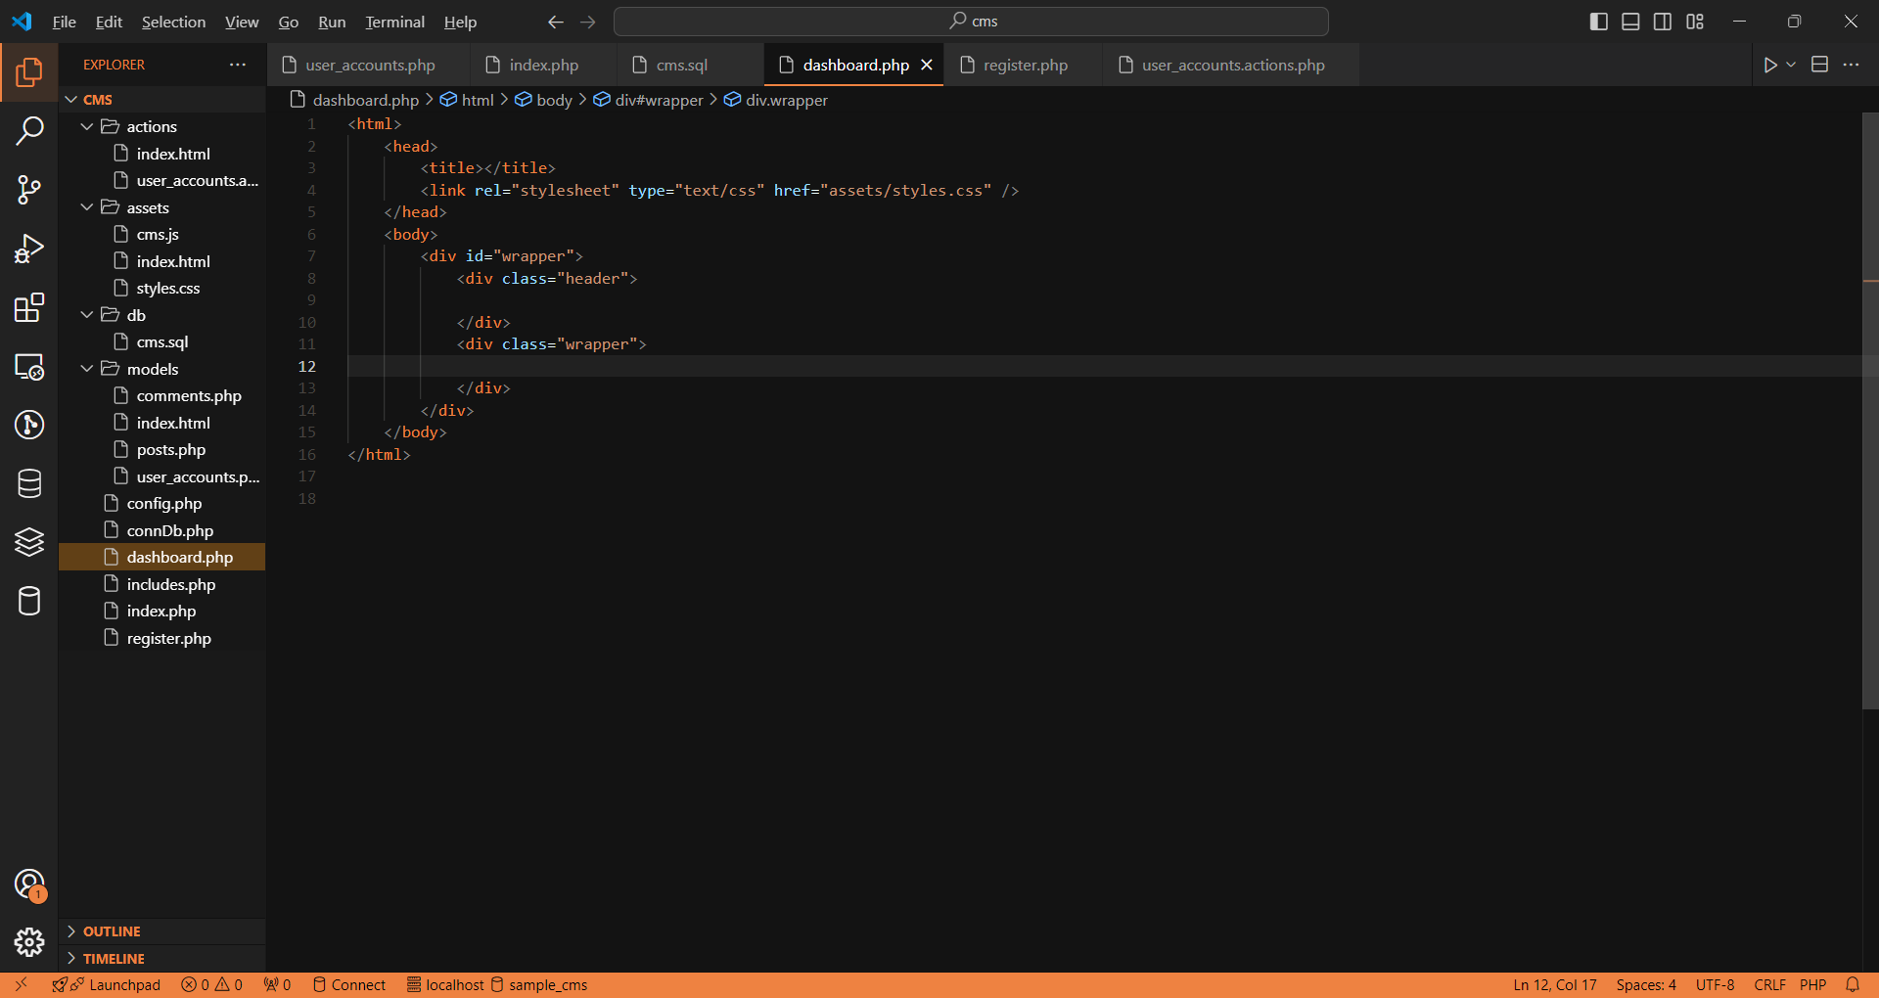

Slide 24
User login
1. Enter the credentials that you have previously registered, and click submit, then click submit.

Slide 25
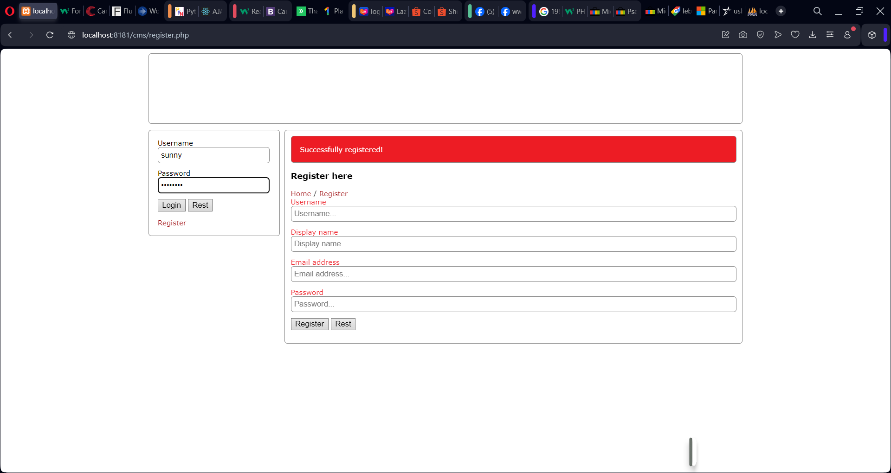

Slide 26
User login
If the login is successful you will be redirected on the index page or index.php.

Slide 27
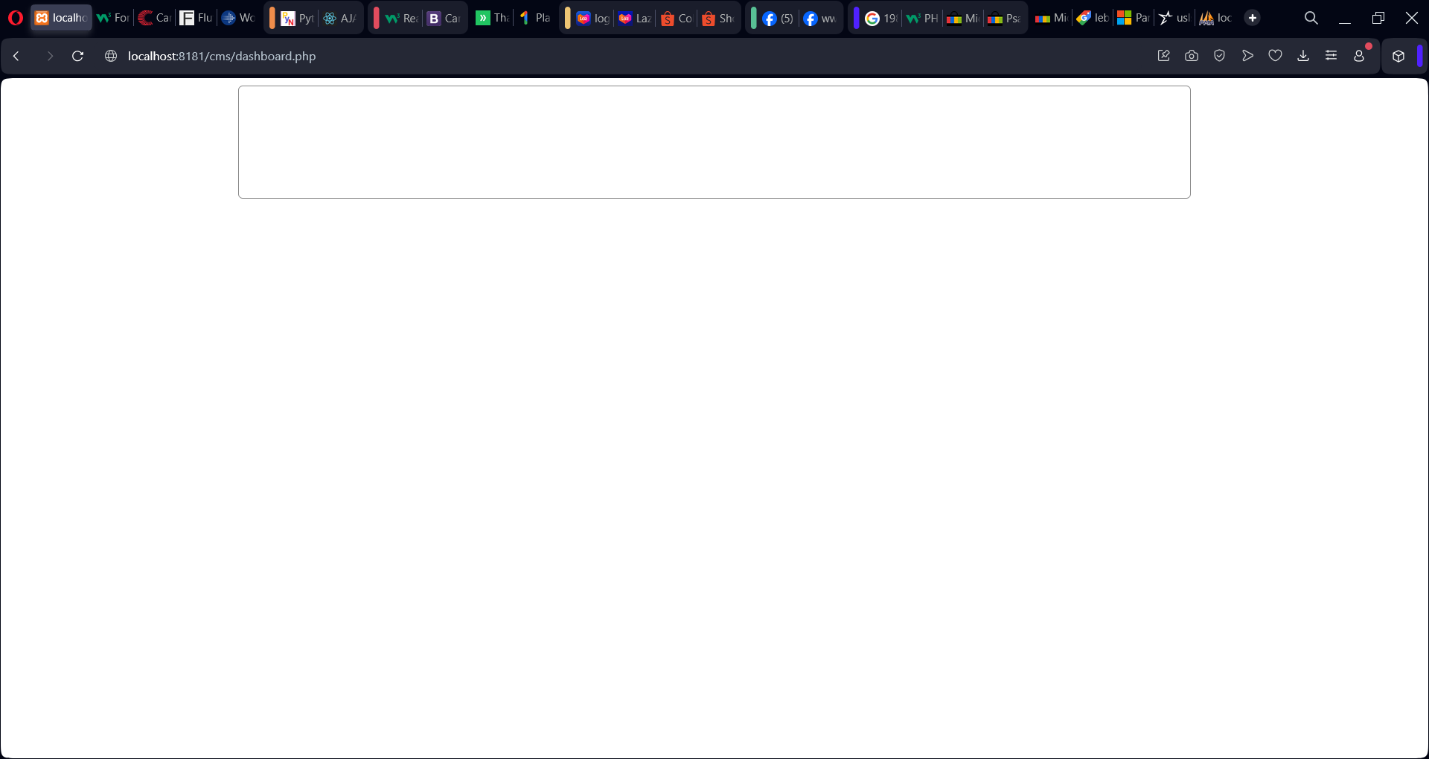

Slide 28
Configuration file
1. Create a file and name it as config.php. Add the following code as seen on the next slide.

Slide 29
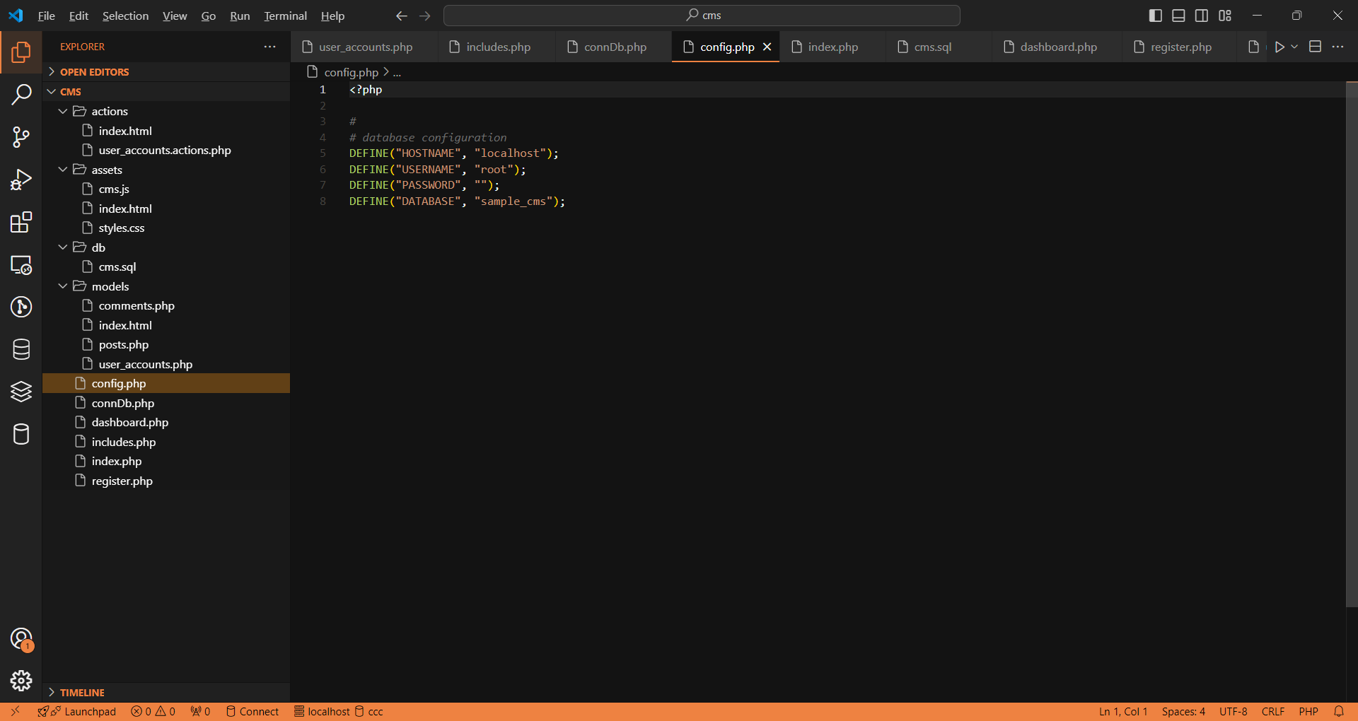

Slide 30
Database connection
1. Create a file and name it as connDb.php. Add the following code as seen on the next slide.

Slide 31
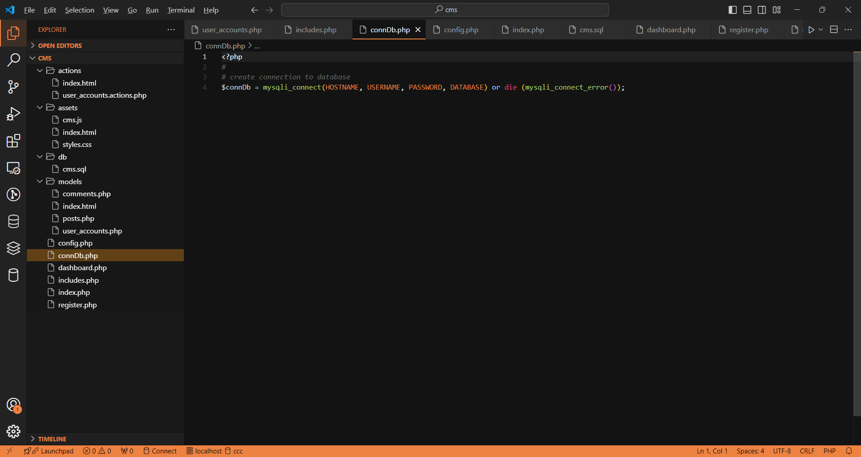

Slide 32
includes
1. create a file and name it as includes.php. Add the following code as seen on the next slide.

Slide 33
