Slide 1
ITP219
CONTENT MANAGEMENT SYSTEM | WEEK 1

Slide 2
What is Content Management System?
A content management system (CMS) is software that helps users create, manage, and modify content on a website without the need for technical knowledge. In other words, a CMS lets you build a website without needing to write code from scratch (or even know how to code at all).

Slide 3
What is Content Management System?
A content management system (CMS) is a web application or software that manages digital content, allowing multiple contributors to create, edit and publish from a single dashboard. Content in a CMS is typically stored in a database and displayed in a presentation layer based on a set of templates like a website.

Slide 4
How does a CMS work?
To give you an idea of how a content management system works, we’re going to take a whirlwind tour of the WordPress (a good example of a CMS) interface.
Let’s start with creating a piece of content. Without a content management system, you’d need to write a static HTML file and upload it to your server (sounds complicated, right?).
With a content management system like WordPress, you can just write your content in an interface that looks a good bit like Microsoft Word:

Slide 5
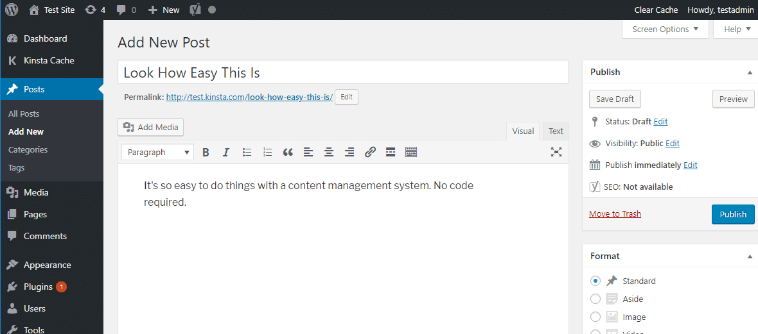
How does a CMS work?

Slide 6
What are the different features of a CMS?
Intuitive dashboard
Responsive themes
Content editing and publishing tools
Version controls and backups
Built-in SEO tools
Robust integration
Premade templates
Content staging
Security

Slide 7
What makes up a CMS?
A content management system is made up of two core parts
A content management application (CMA) – this is the part that allows you to actually add and manage content on your site.
A content delivery application (CDA) – this is the backend, behind-the-scenes process that takes the content you input in the CMA, stores it properly, and makes it visible to your visitors.

Slide 8
Benefits of using a CMS
One major advantage of a CMS is its collaborative nature. Multiple editors can contribute, schedule or manage content to be published. Because the user interface is usually browser-based, a CMS can be accessed from anywhere by any number of users.
The second major advantage of a CMS is that it allows users who don’t have a background in web development or web design to streamline the web page creation process.
The drag-and-drop editors of a typical content management platform allows content editors to enter text and upload images without needing to know any HTML, CSS implementation, or technical knowledge of website construction.

Slide 9
Benefits of using a CMS
When a company uses a CMS to publish its web pages, it reduces its reliance on front-end and back-end developers to make changes to the website, making it quicker and easier to publish new web pages such as articles and landing pages, improving the digital experience for users and visitors.
When a company uses a CMS to publish content to other channels - like social, mobile apps and ecommerce, it can drastically reduce the amount of development a company needs to do and make it easier to distribute content to different channels simultaneously.

Slide 10
Some samples of CMS
Wordpress
Drupal
Magento
Joomla
Shopify
Woocommerce
Prestashop

