Slide 1
ITP219
CONTENT MANAGEMENT SYSTEM | WEEK 3

Slide 2
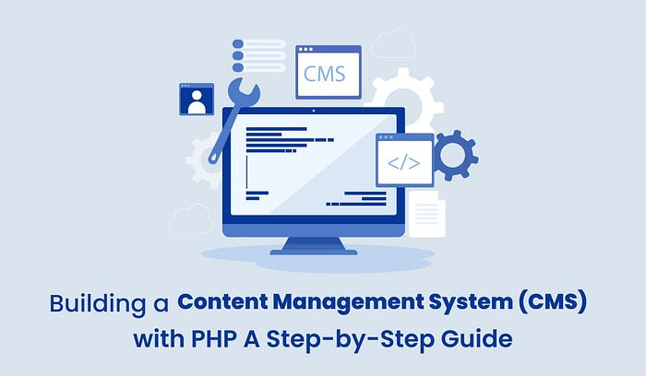
Building your own cms

Slide 3
Building your own cms
In the digital age, having a robust and flexible Content Management System (CMS) is crucial for websites of all sizes. PHP, a server-side scripting language, is an excellent choice for building a CMS due to its simplicity, efficiency, and wide support. This comprehensive guide will take you through the steps to create a basic yet functional CMS using PHP.

Slide 4
Building your own cms
SETTING UP THE DEVELOPMENT ENVIRONMENT
PLANNING YOUR CMS
CREATING THE DATABASE
BUILDING THE CMS BACKEND
DEVELOPING THE FRONT END
DEVELOPING THE FRONT END
INTEGRATING A RICH TEXT EDITOR
IMPLEMENTING SECURITY MEASURES
TESTING YOUR CMS
DEPLOYING YOUR CMS
MAINTENING AND UPDATING YOUR CMS
ADVANCED FEATURES AND CUSTOMIZATION

Slide 5


Building your own cms | SETTING UP THE DEVELOPMENT ENVIRONMENT
Install a Local Server: Use software like XAMPP or MAMP to set up a local PHP server.
Text Editor: Choose a text editor like Visual Studio Code or Sublime Text for writing your PHP code.

Slide 6
Building your own cms | planning your cms
Define Features: List the features you want in your CMS, such as a user login, content editor, file manager, etc.
Database Structure: Plan the structure of your database. Typically, you’ll need tables for users, posts, and settings.

Slide 7
Building your own cms | creating the database
Connecting to the Database: Write a PHP script to connect to your MySQL database.
Creating Login System: Develop a user authentication system for secure access.
CRUD Operations: Implement Create, Read, Update, and Delete (CRUD) functionalities for content management.
Admin Dashboard: Design an admin dashboard for managing content.

Slide 8
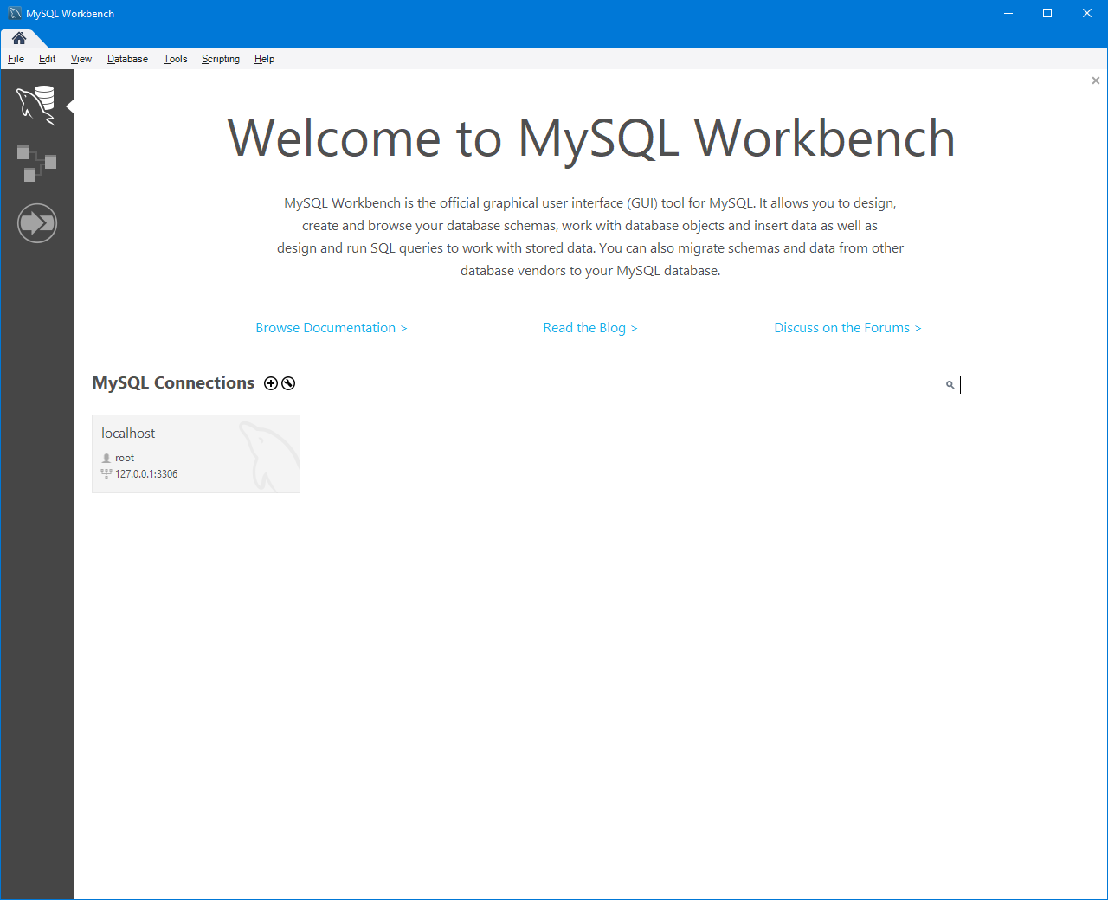
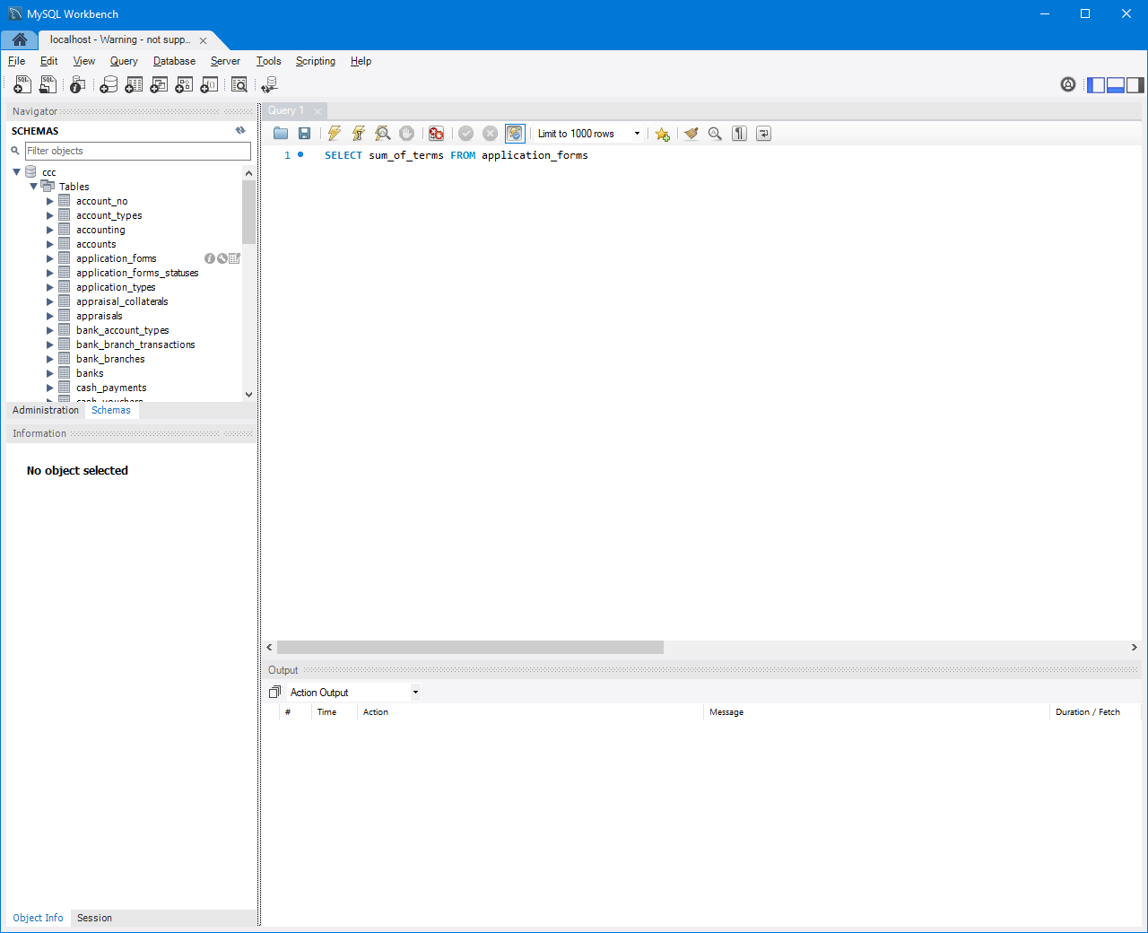
Building your own cms | creating the database

Slide 9
Building your own cms | developing the front end
HTML/CSS Templates: Create HTML templates and style them with CSS.
Displaying Content: Write PHP scripts to fetch and display content from the database on web pages.
User Interface: Ensure the user interface is intuitive and user-friendly.

Slide 10
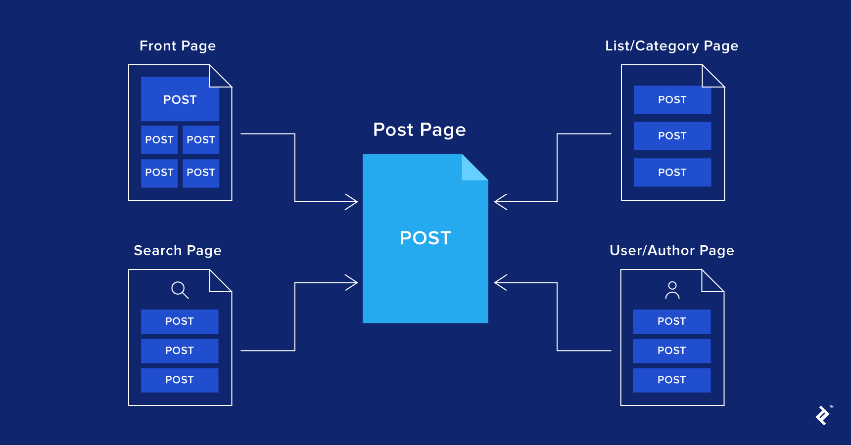
Building your own cms | developing the front end

Slide 11
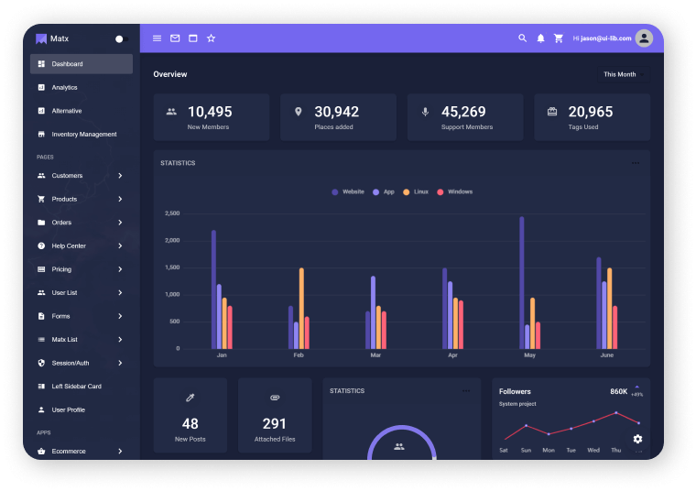
Building your own cms | developing the front end

Slide 12
Building your own cms | integrating rich text editor
Choose an Editor: Select a rich text editor like TinyMCE or CKEditor.
Integration: Embed the editor in your CMS for a better content creation experience.

Slide 13
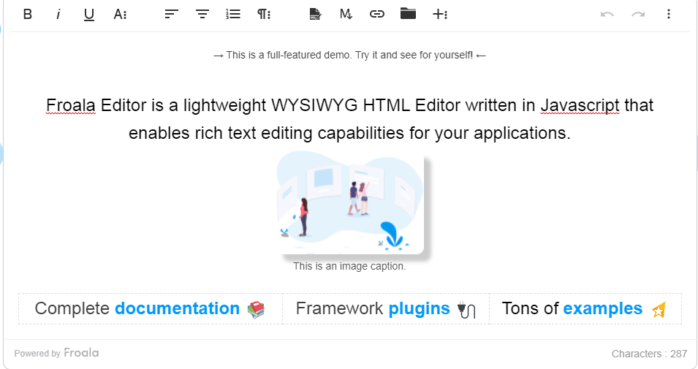
Building your own cms | integrating rich text editor

Slide 14
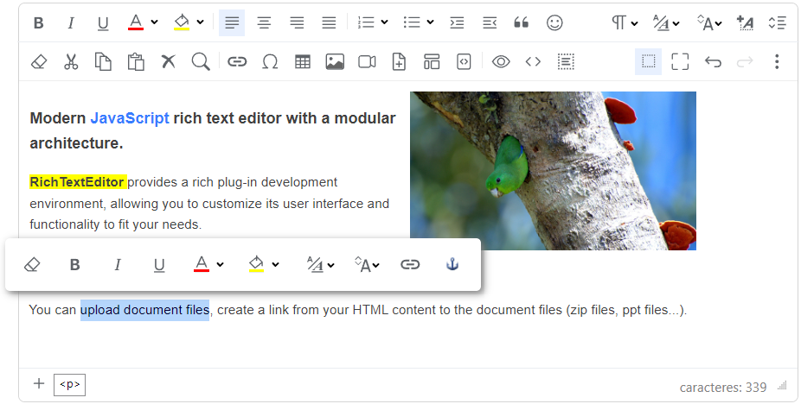
Building your own cms | integrating rich text editor

Slide 15
Building your own cms | implementing security measures
Input Validation: Implement input validation to prevent SQL injection and XSS attacks.
Password Security: Use PHP’s password hashing functions for secure password storage.
Secure Sessions: Ensure that user sessions are managed securely.

Slide 16
Building your own cms | testing the cms
Functionality Testing: Test all features extensively to ensure they work as intended.
Performance Testing: Check the loading times and responsiveness of your CMS.
Security Testing: Perform security audits to identify vulnerabilities.

Slide 17
Building your own cms | deploying the cms
Choose a Hosting Service: Select a web hosting provider that supports PHP and MySQL.
Upload Files: Use FTP or a similar service to upload your CMS files to the server.
Configure Database: Set up your MySQL database on the hosting service and import your local database.

Slide 18
Building your own cms | maintaining and updating cms
Regular Updates: Keep your PHP version and plugins updated for security and performance.
Backup: Regularly backup your CMS database and files.
User Feedback: Collect feedback from users and make improvements accordingly.

Slide 19
Building your own cms | advanced features and customization
Plugins and Extensions: Consider developing plugins for added functionalities.
Themes: Implement a theming system to allow for visual customizations.
SEO Optimization: Add features to enhance the SEO of content created with your CMS.

Slide 20
Building your own cms | conclusion
Building a CMS with PHP is a rewarding project that not only improves your coding skills but also gives you complete control over your web content management. While the process requires time and effort, the end result is a tailor-made CMS perfectly suited to your specific needs. This step-by-step guide provides a solid foundation, but remember, the world of web development is always evolving. Stay curious, keep learning, and continue to enhance your CMS with new features and technologies as you grow.

