Slide 1
ITP219
CONTENT MANAGEMENT SYSTEM | WEEK 4

Slide 2
DATABASE DESIGN OF A CMS WEBSITE
The Content Management System (CMS) allows setting and managing user access with the help of the role-based access control feature and this way users can register themselves, login, and access features depending on their roles.
The functionality of content building and dealing lets users generate various content types, like articles blogs, and so on, using titles, descriptions, and options to be informative such as tags and categories for the organization. The consumers can interact with the content via comments and likes.

Slide 3
DATABASE DESIGN OF A CMS WEBSITE
First of all, it is imperative to analyze the target database and subsequently, to figure out the CMS requirements. These requirements typically include:
User Management: Let users sign up, providing their username, email address, and password, which should be unique. Set in place the role-based access control (RBAC) that will enable you to determine who can access or perform certain authorization levels based on their roles.
Content Creation and Management: Give the users the possibility to deal with multiple types of content involving: articles, blogs, etc. Arouse admins to give titles, descriptions, assignee categories and tags to classify and organize the content properly.

Slide 4
DATABASE DESIGN OF A CMS WEBSITE
Content Organization: Let users organize content in several categories to improve navigation and reconstruction. Integrating a tag function into content will provide better organization and searchability for content creators.
Commenting System: Guarantee creating opportunities for users to share their thoughts on content plus comments in that case they can be more engaged and provide their feedback. Implementing moderate features will help to manage and moderate the comments, approving, deleting, and flagging improper words.

Slide 5
DATABASE DESIGN OF A CMS WEBSITE
Customization and Personalization: Let people upload their profile pictures, and modify their preferences, likes or dislikes, and notification settings. Provide personalized content recommendations tailored to the interests and viewing history of every user, using different metrics to determine engagement. Provide the administrators with an opportunity to configure the look of the CMS to fit the companies’ style and taste.
Content Publishing Workflow: Implement business processes for content creation including work-flow schedules for review and approval platforms, especially in shared setting. Content writers can predefine post dates and workflows of content to be published at a certain time.

Slide 6
Entities and attributes for CMS

Slide 7
Entities and attributes for CMS
1. User: Represents users of the CMS.
UserID (Primary Key): Unique identifier for each user.
Username: Username of the user.
Email: Email of the user.
Password: Password of the user.
RoleID (Foreign Key): Reference to the role.

Slide 8
Entities and attributes for CMS
2. Role: Defines different roles within the system.
RoleID (Primary Key): Unique identifier for each role.
RoleName: Name of the role.
3. Content: Abstract entity representing various types of content.
ContentID (Primary Key): Unique identifier for each content.
ContentType: Type of the content like article, blog, etc.
Title: Title of the content.
ContentDescription: Description of the content.

Slide 9
Entities and attributes for CMS
4. Category: Represents categories to which content can be assigned.
CategoryID (Primary Key): Unique identifier for each category.
CategoryName: Name of the category.
5. Tag: Represents tags associated with content.
TagID (Primary Key): Unique identifier for each tag.
TagName: Name of the tag.

Slide 10
Entities and attributes for CMS
6. Comment Entity: Comments given by users.
CommentID (Primary Key): Unique identifier for each comment.
ContentID (Foreign Key): Reference to the content.
UserID (Foreign Key): Reference to the user.
CommentText: Text of the comment.
CommentDate: Date of the comment.

Slide 11
Relationship between entities

Slide 12
Relationship between entities
1. User – Role Relationship:
Each user in CMS has multiple roles. (one-to-many)
Multiple roles are assigned to one user through RoleID foreign key in the User table.
This relationship allows users to have specific permissions and access levels based on their roles within the system. So this is one-to-may relationship.

Slide 13
Relationship between entities
2. Content – User Relationship:
Each piece of content (e.g., article, blogs) in the CMS is authored by a user. (one-to-many)
This relationship links the content to its author, facilitating attribution and tracking of content ownership.

Slide 14
Relationship between entities
3. Content – Category Relationship:
Each content can belong to multiple categories.(many-to-many)
Each category can have multiple content associated with it.
This relationship allows for organizing and classifying content into various categories for easier navigation and retrieval.

Slide 15
Relationship between entities
4. Content – Tag Relationship:
Each piece of content can have multiple tags.(many-to-many)
Each tag can be associated with multiple pieces of content.
This relationship facilitates content organization and improves searchability within the CMS.

Slide 16
Relationship between entities
5. Comment – User Relationship:
A single user can made multiple comments.(many-to-one)
This relationship allows for tracking comments made by users within the CMS.

Slide 17
Relationship between entities
6. Comment – Content Relationship:
Each comment is associated with a specific piece of content.(many-to-many)
This relationship allows for organizing comments based on the content they are related to within the CMS.

Slide 18
Entities structures in sql format

Slide 19
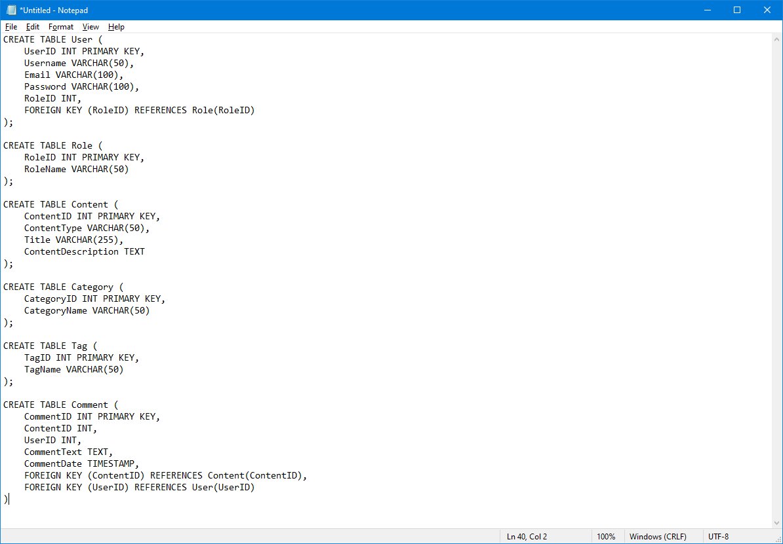

Slide 20
DATABSAE MODEL FOR CMS

Slide 21
Database model for cms

Slide 22
EXERCISE ½ crosswise
1. Create a database design for your own CMS.
2. It should contain posts and roles as well as users and categories.
3. Use an ER diagram to design your database.

Slide 23
END

