Slide 1
ITP219
CONTENT MANAGEMENT SYSTEM | WEEK 6

Slide 2
BUILDING YOUR OWN CMS
1. Pre-requisite when developing your own CMS.
  Make sure that you have already installed xampp.
  Use your preferred code editor (e.g VSCode, Notepad ++).
  Use your preferred MySQL browser. (e.g PhpMyAdmin, MySQL Workbench)

Slide 3
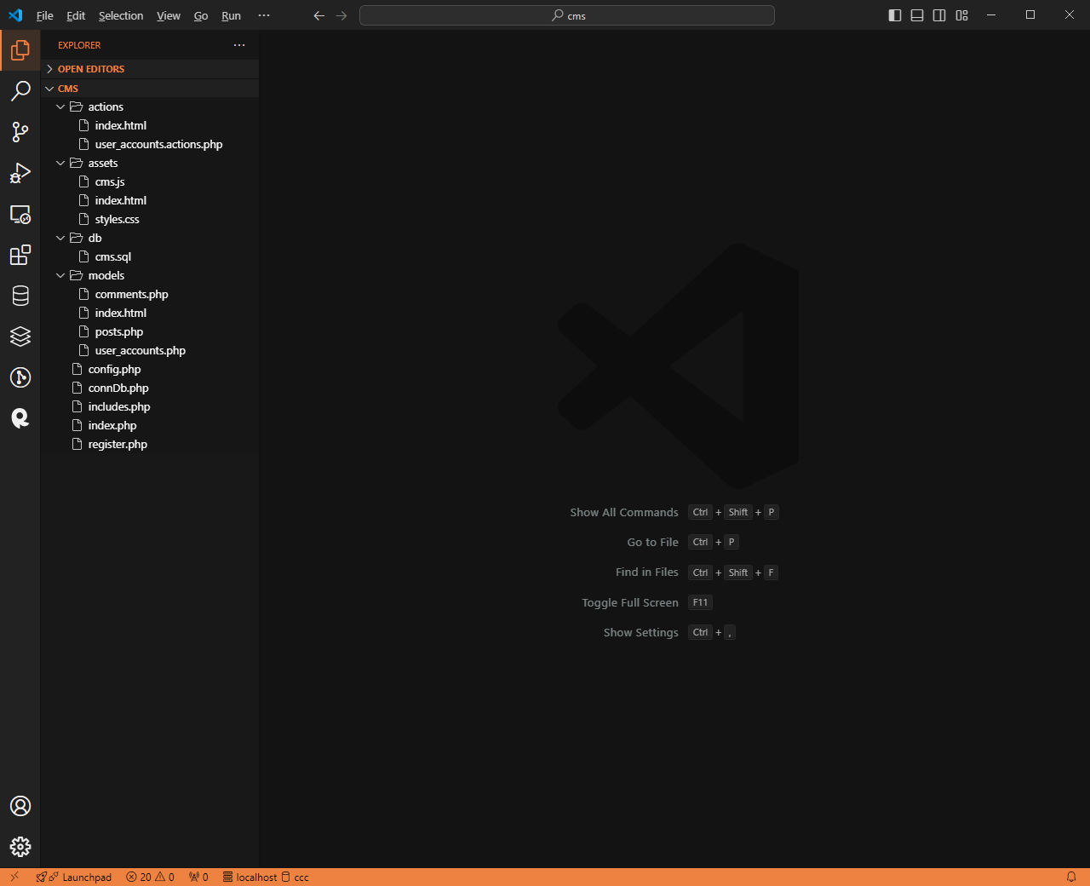
FOLDER
STRUCTURE
1. Inside your xampp > htdocs create a folder and call it cms
2. Inside your cms folder create the following folders
actions, assets, and models

Slide 4
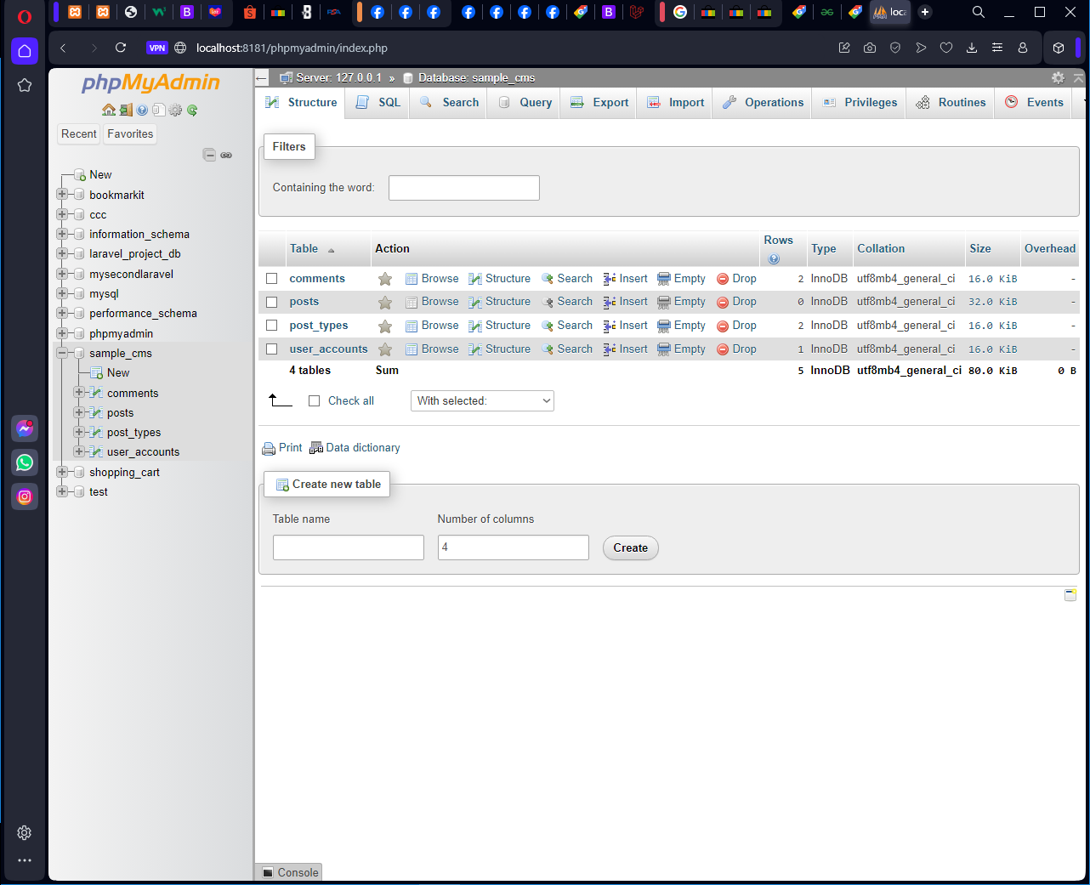
database
STRUCTURE
3. Once done with your folder structure, open your phpMyAdmin and create your database. Name it as sample_cms

Slide 5
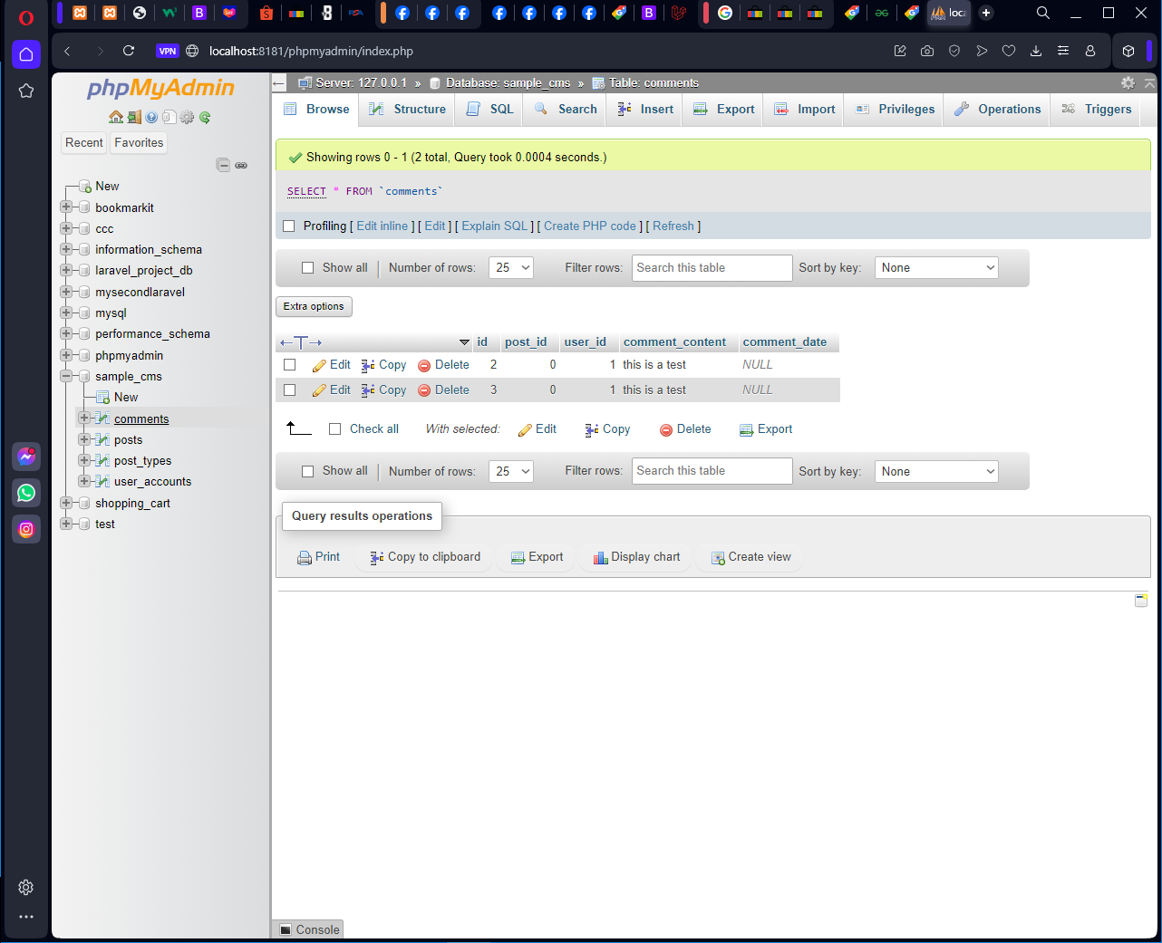
database
STRUCTURE
4. Create a table and name it as comments. Follow it’s fields and attributes.

Slide 6
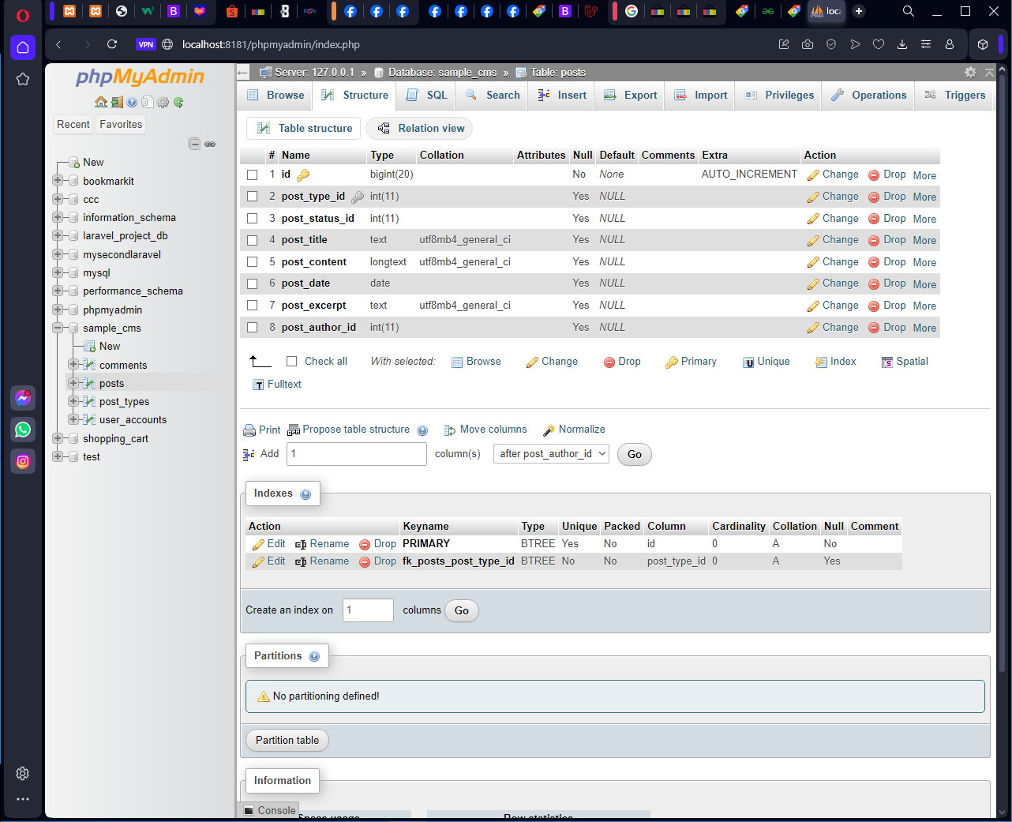
database
STRUCTURE
5. Create a table and name it as posts. Follow it’s fields and attributes.

Slide 7
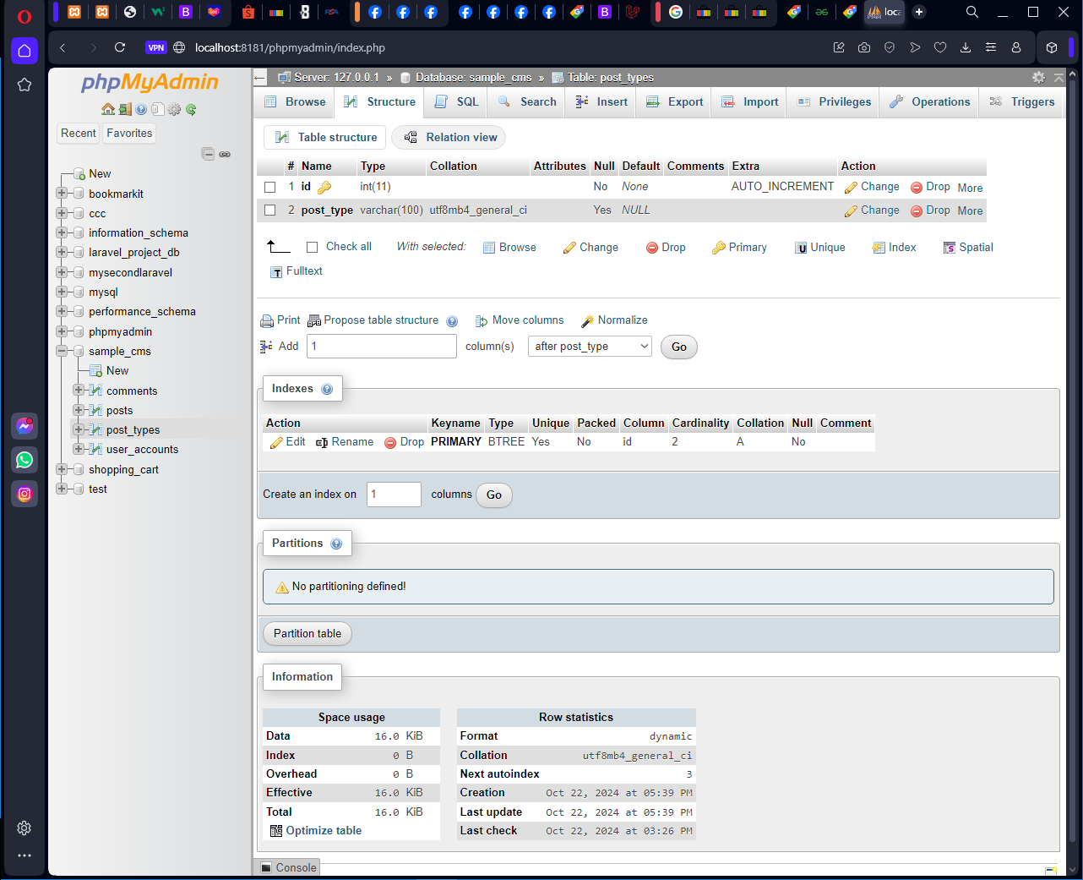
database
STRUCTURE
6. Create a table and name it as post_types. Follow it’s fields and attributes.

Slide 8
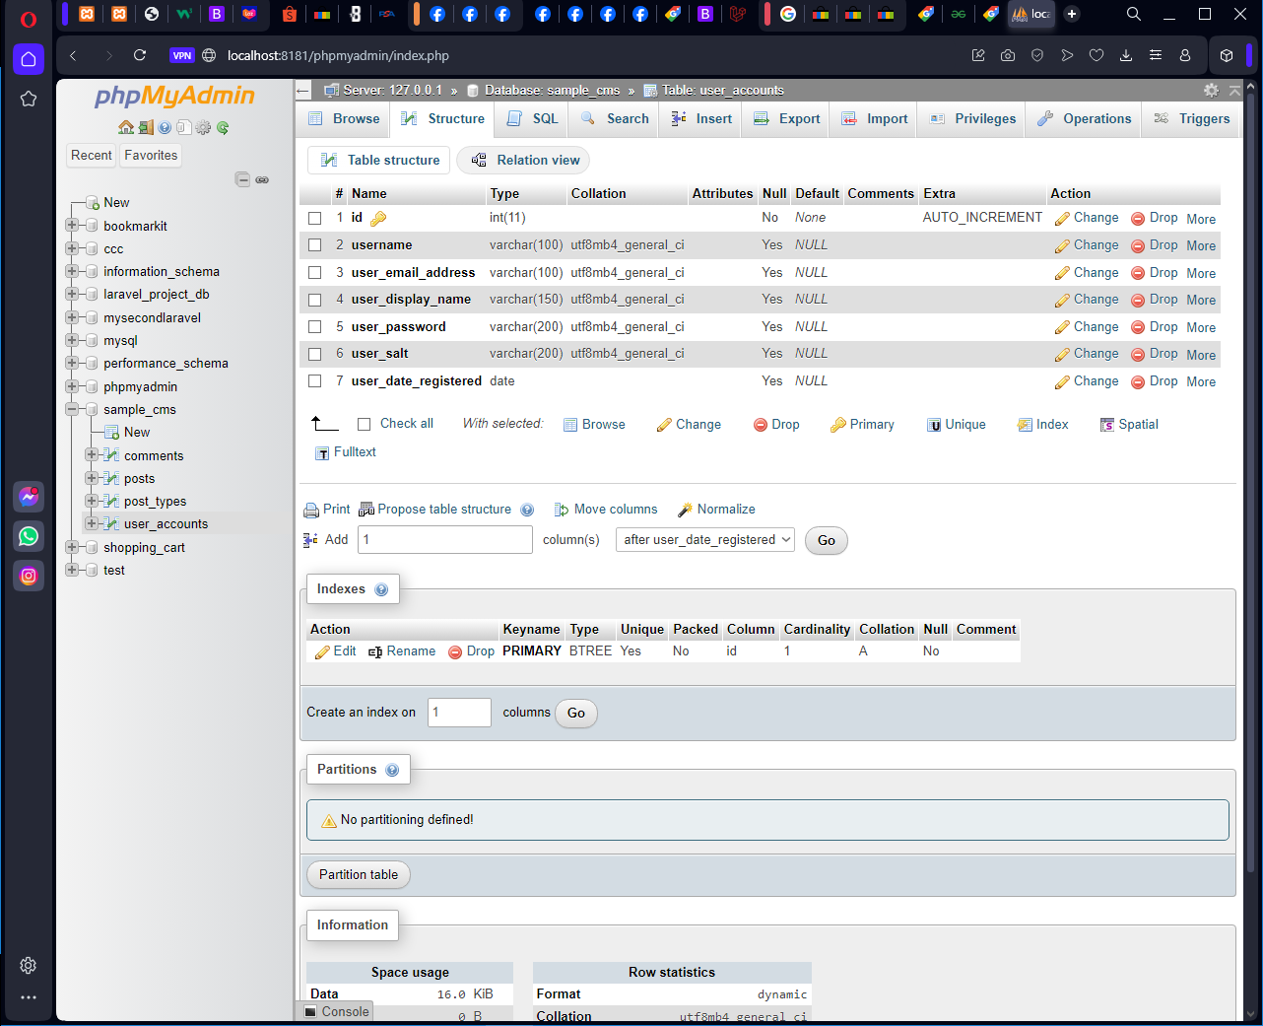
database
STRUCTURE
7. Create a table and name it as user_accounts. Follow it’s fields and attributes.

Slide 9
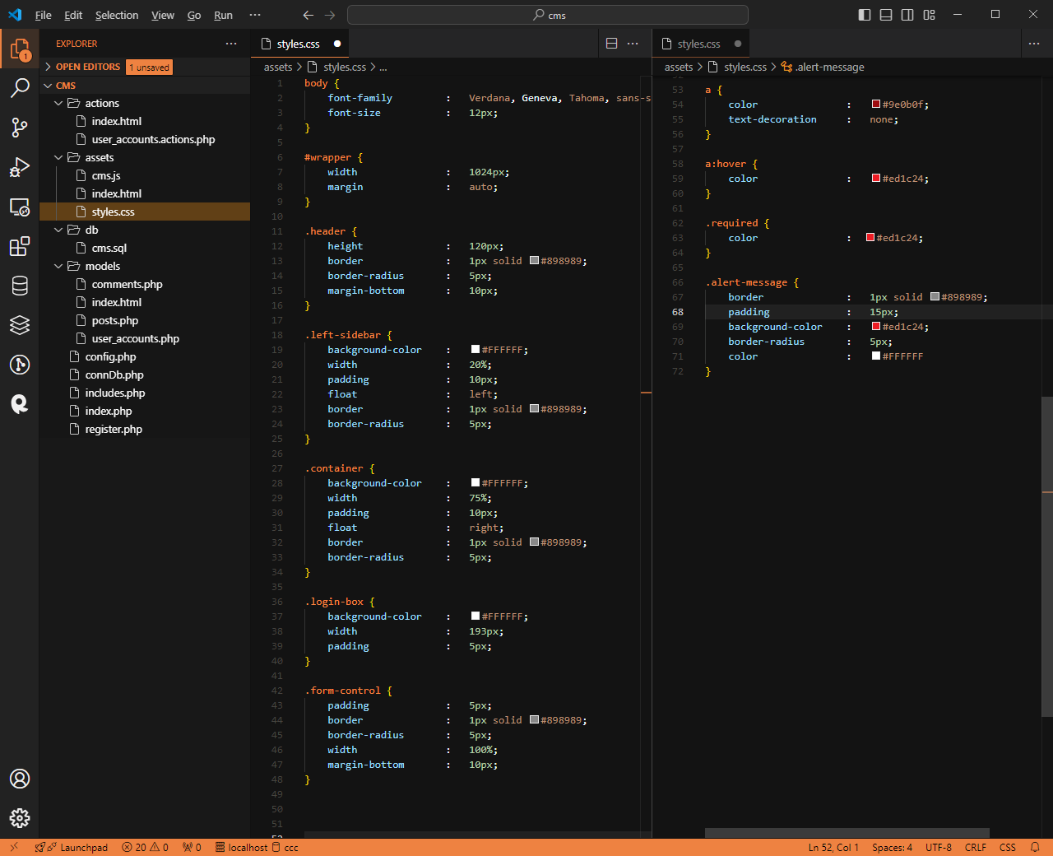
CSS
8. Inside your css folder, create a file and name it styles.css
and
9. Copy the following code

Slide 10
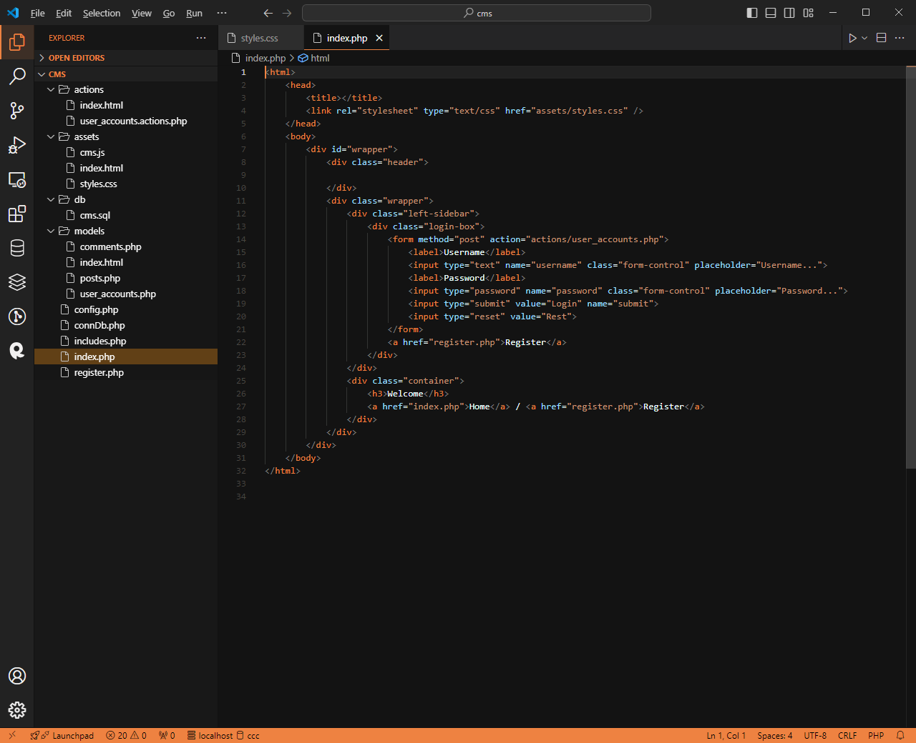
Index file
10. Create the index file and name if as index.php
and
11. Copy the following code

Slide 11
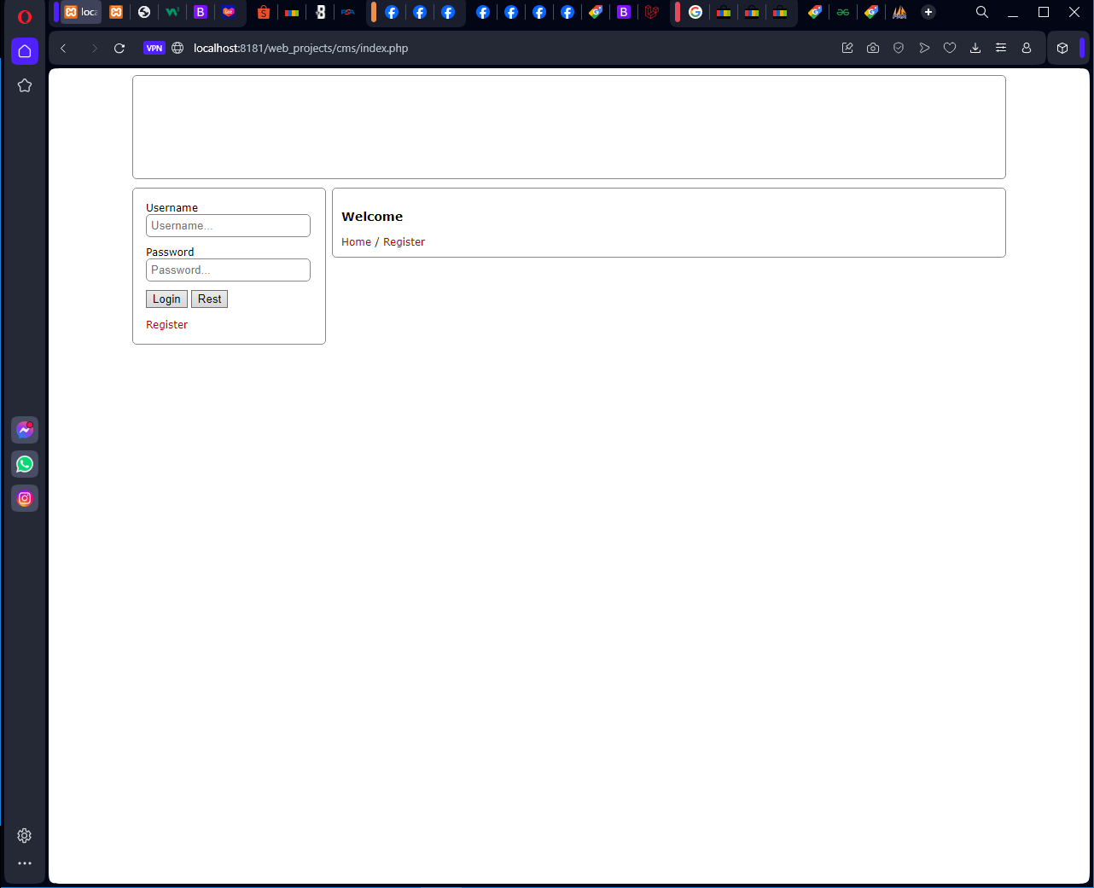
Index file
Your index page should look like this.

Slide 12
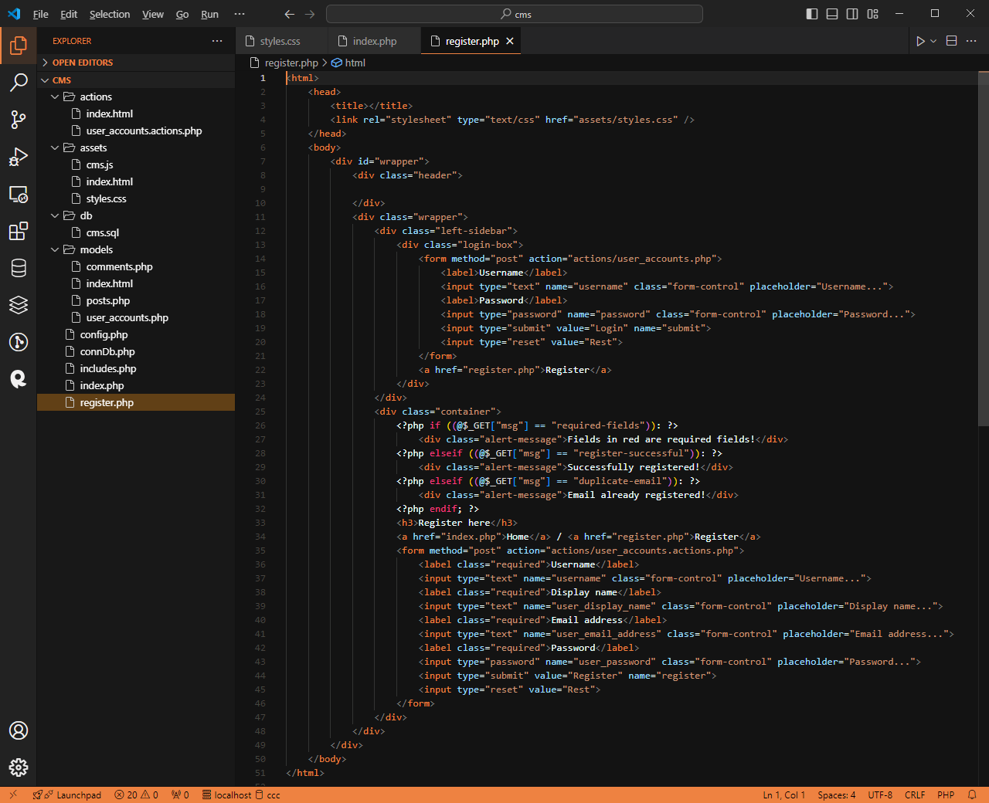
register file
12. Create another file and name it as register.php
and
13. Copy the following code

Slide 13
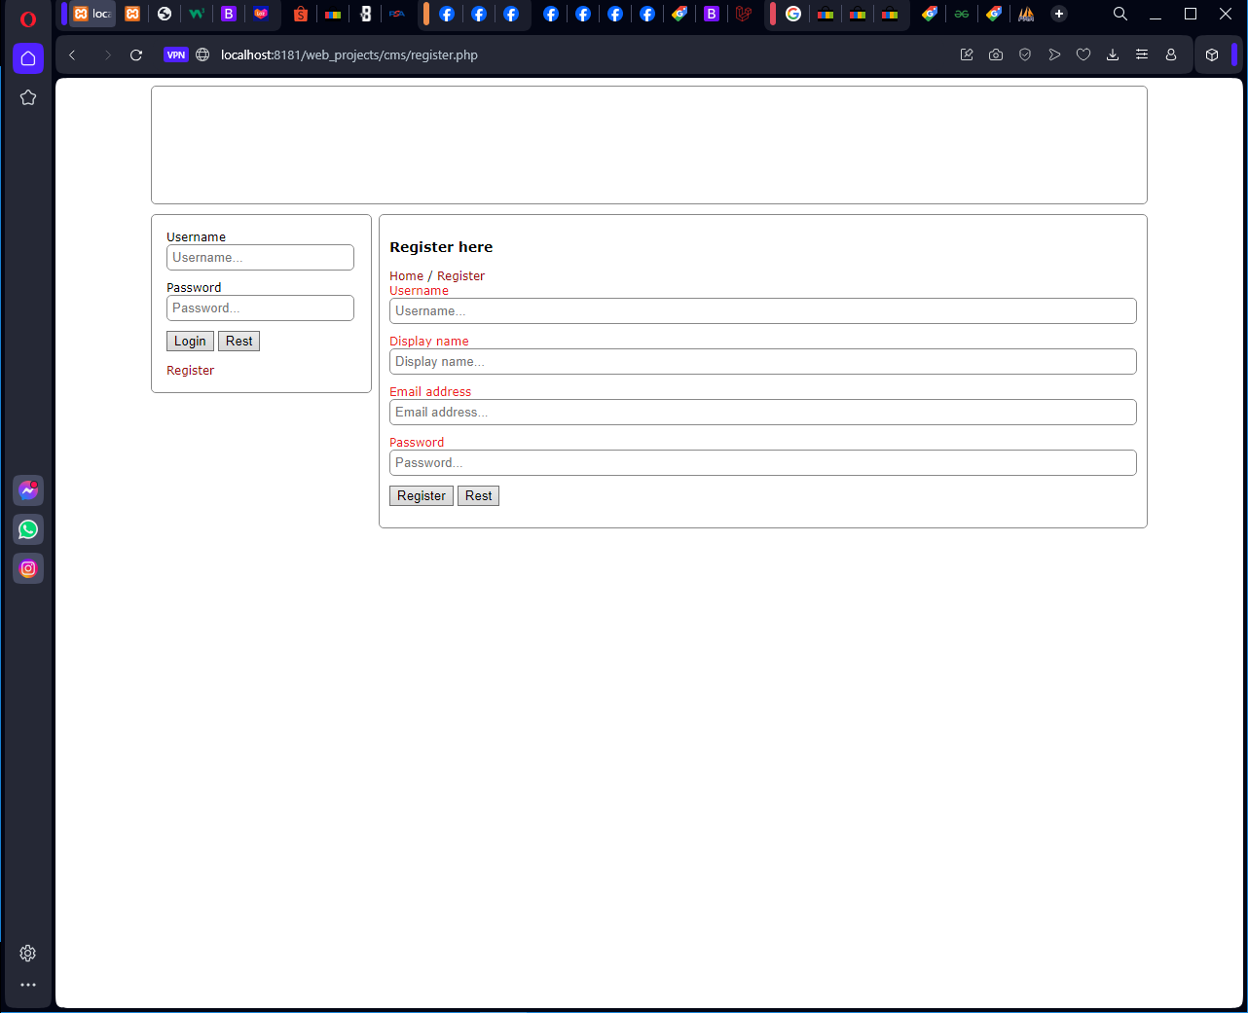
register file
Your register page should look like this.

