Slide 1
ITP219
CONTENT MANAGEMENT SYSTEM | WEEK 8

Slide 2
Creating Posts form
1. Under models folder create a file rename it as posts.php. This will be used to communicate with our posts table on our database. Copy the following code on the next slide.

Slide 3
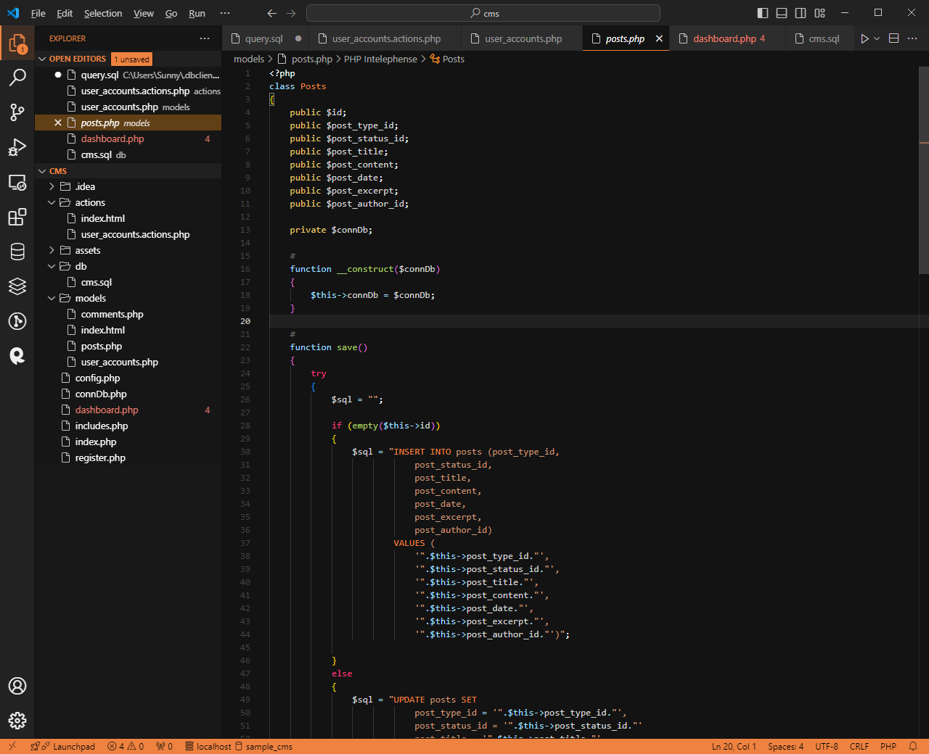

Slide 4
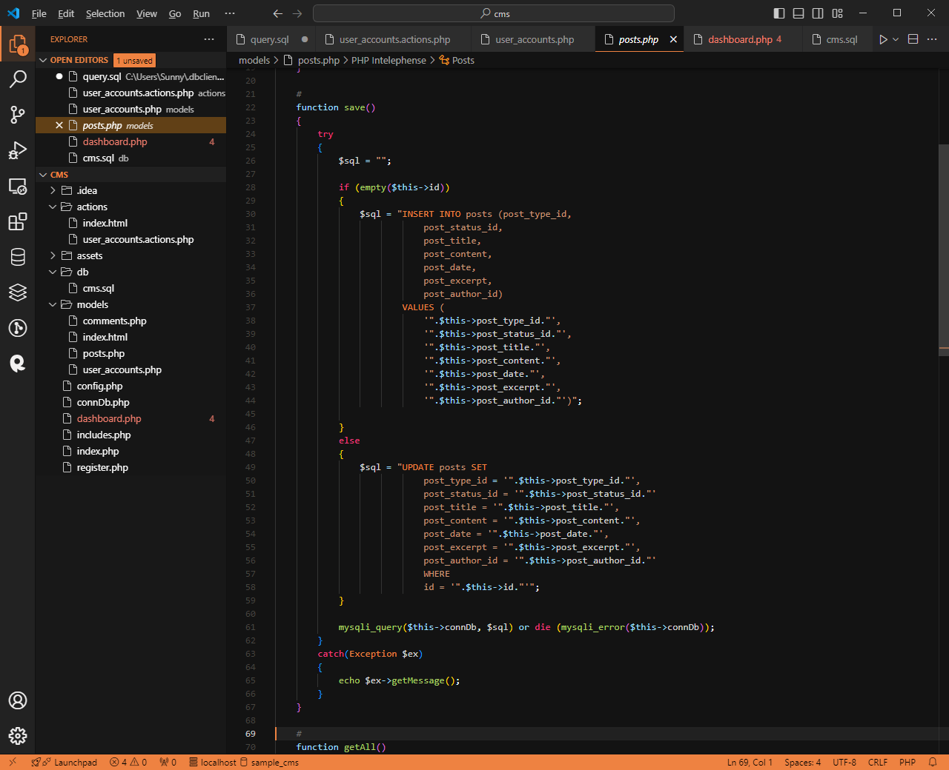

Slide 5
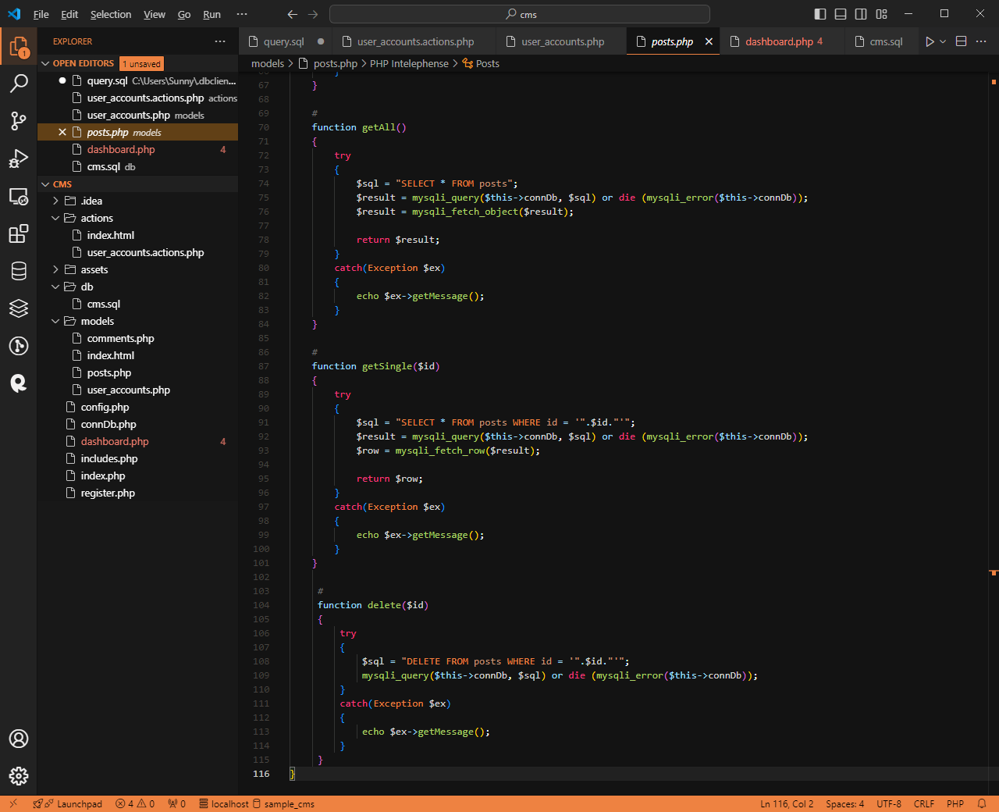

Slide 6
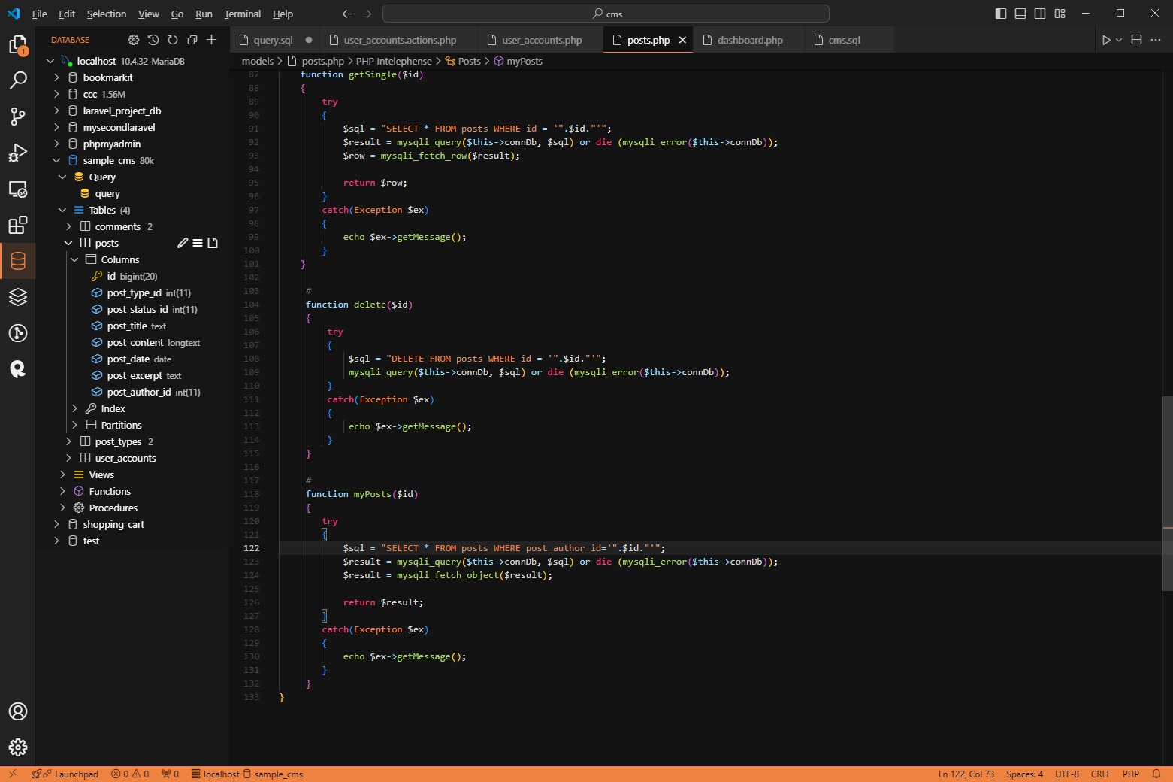

Slide 7
Creating Posts form
2. Modify dashboard.php and add the following code.

Slide 8
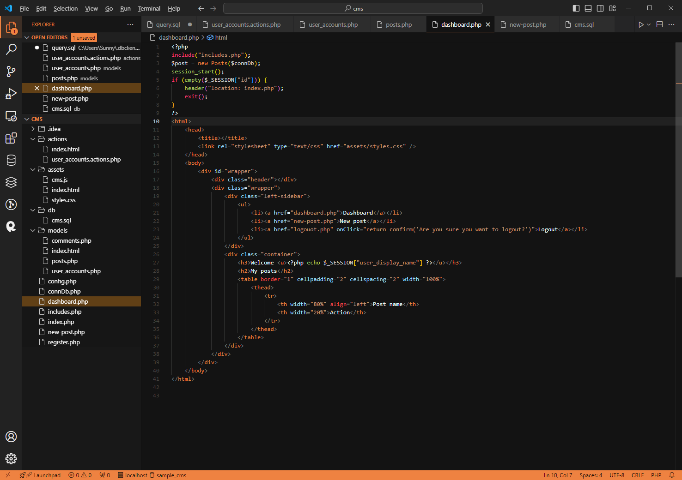

Slide 9
Creating Posts form
3. Create a file and name it as new-post.php. Copy the following code on the next slide.

Slide 10
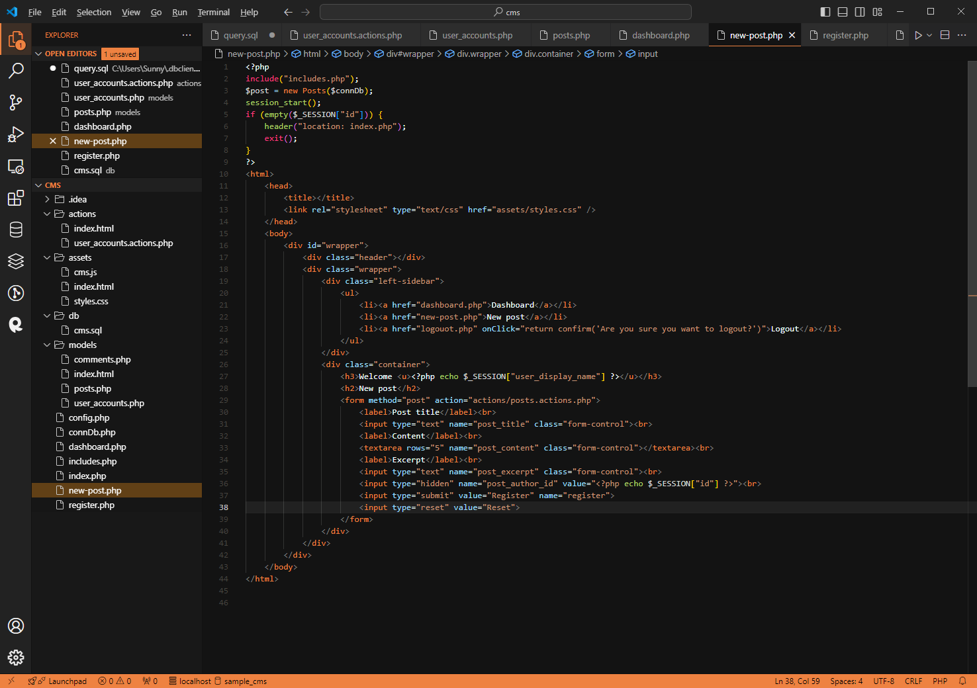

Slide 11
Creating Posts form
4. Once done it should look like what is on the next slide.

Slide 12
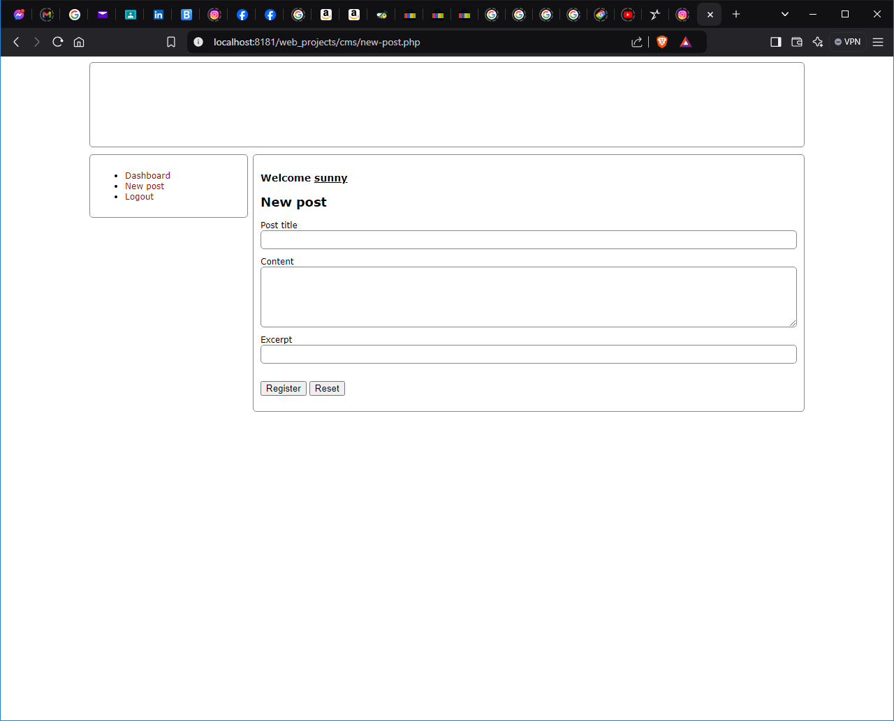

Slide 13
Download complete presentation here
https://github.com/sunnyhlopez/cms_class

