Slide 1
ITP219
CONTENT MANAGEMENT SYSTEM | WEEK 9

Slide 2
ADDING THE POSTs and comments CLASS
1. Under models create a file and name it as comments.php.
2. Copy the following code on the next page.
3. Modify also the includes.php and add the following code.

Slide 3
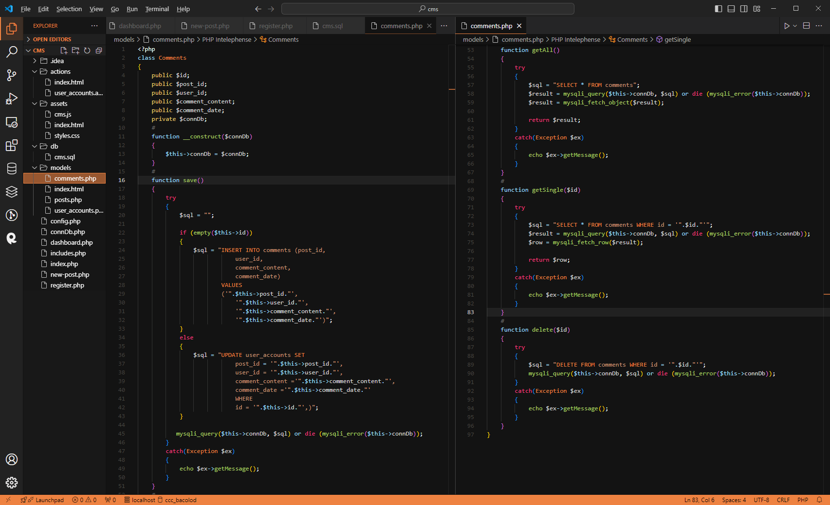

Slide 4
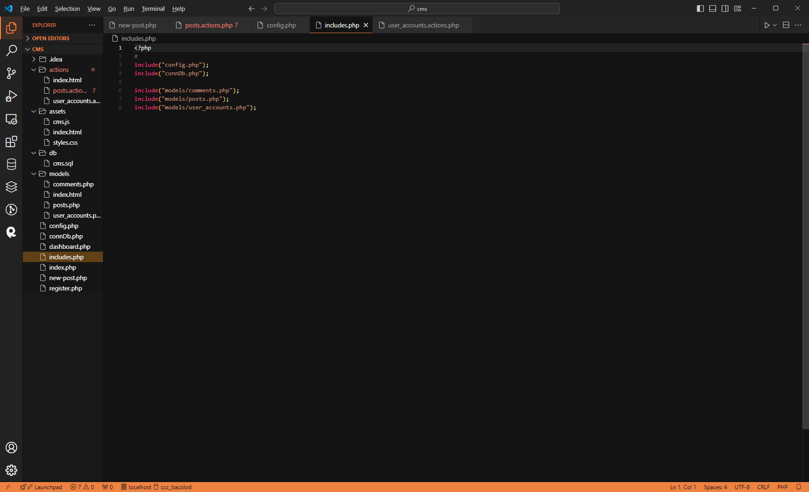

Slide 5
Adding actions to posts
1. Add on the action property of the form the following form.
2. Add another file on actions folder and rename it as posts.actions.php.
3. Modify also the file new-post.php.

Slide 6
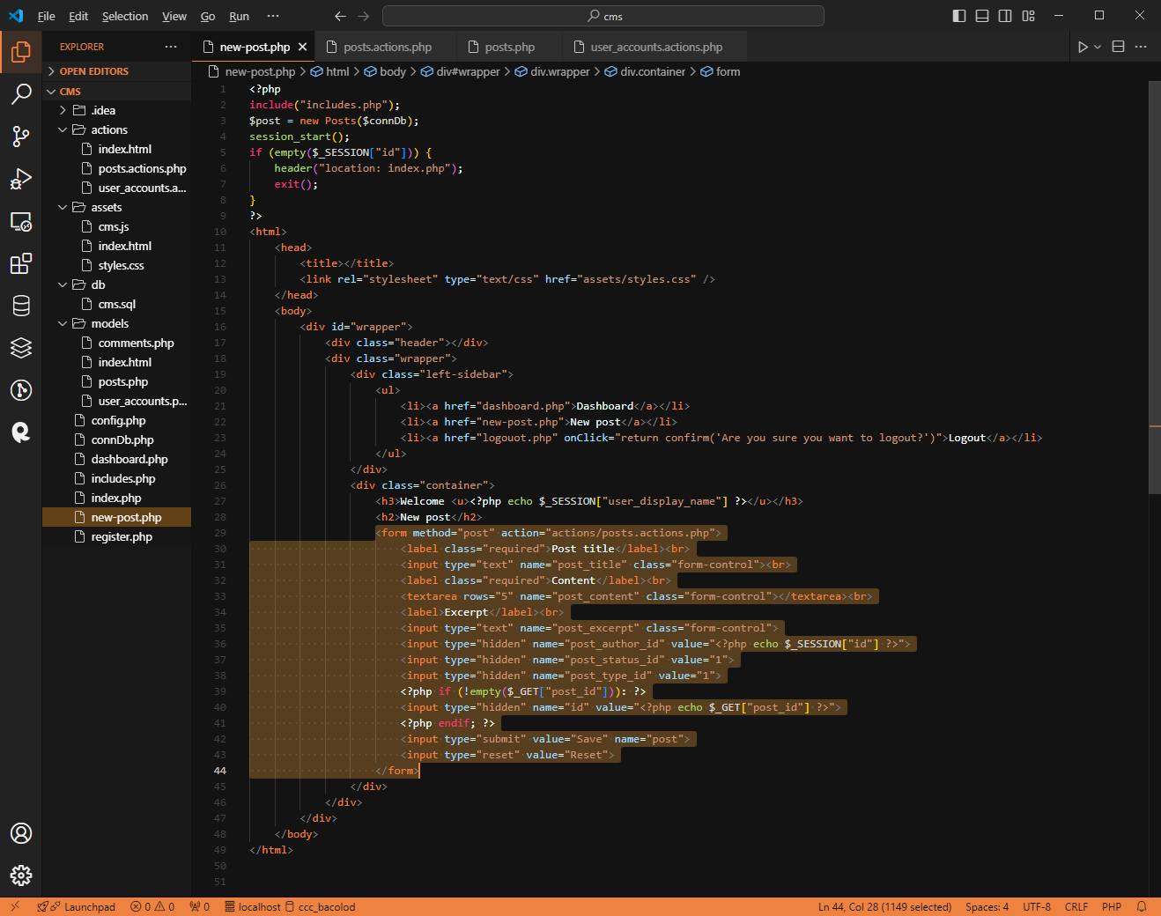

Slide 7
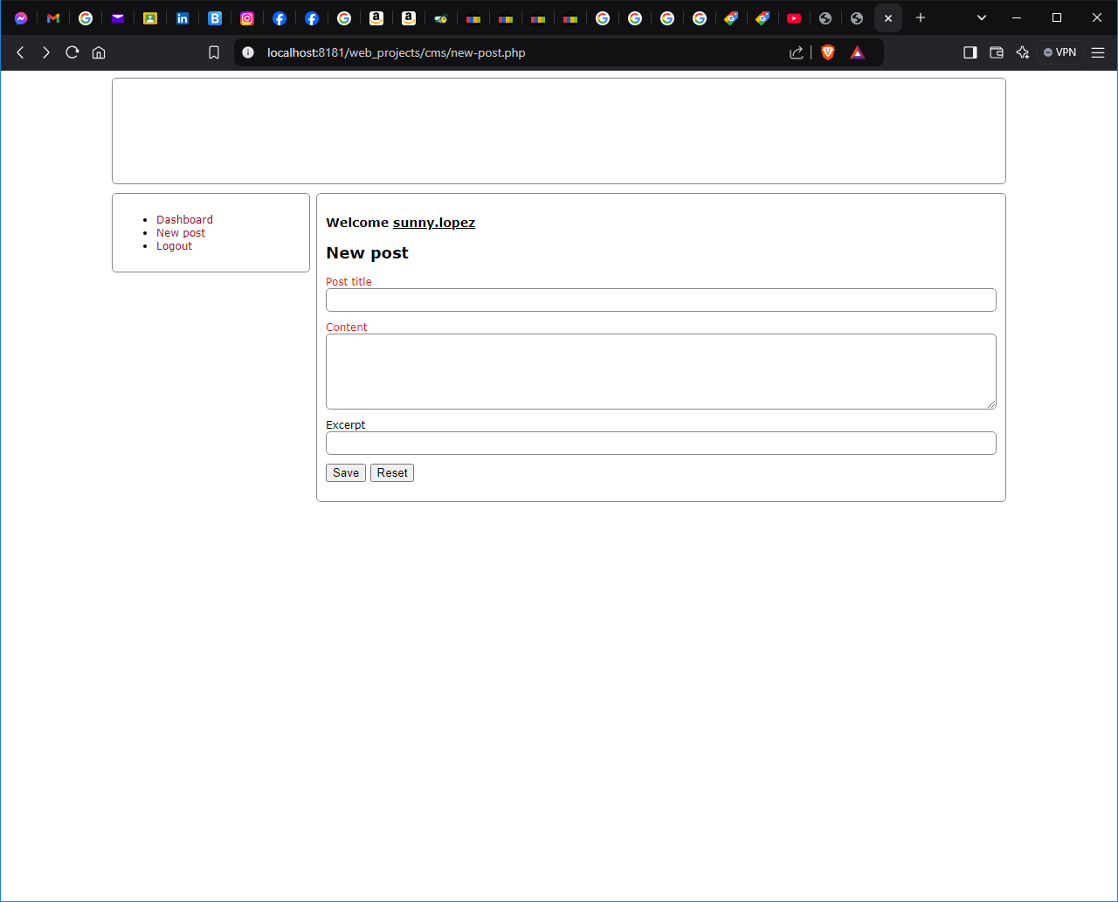
Output

Slide 8
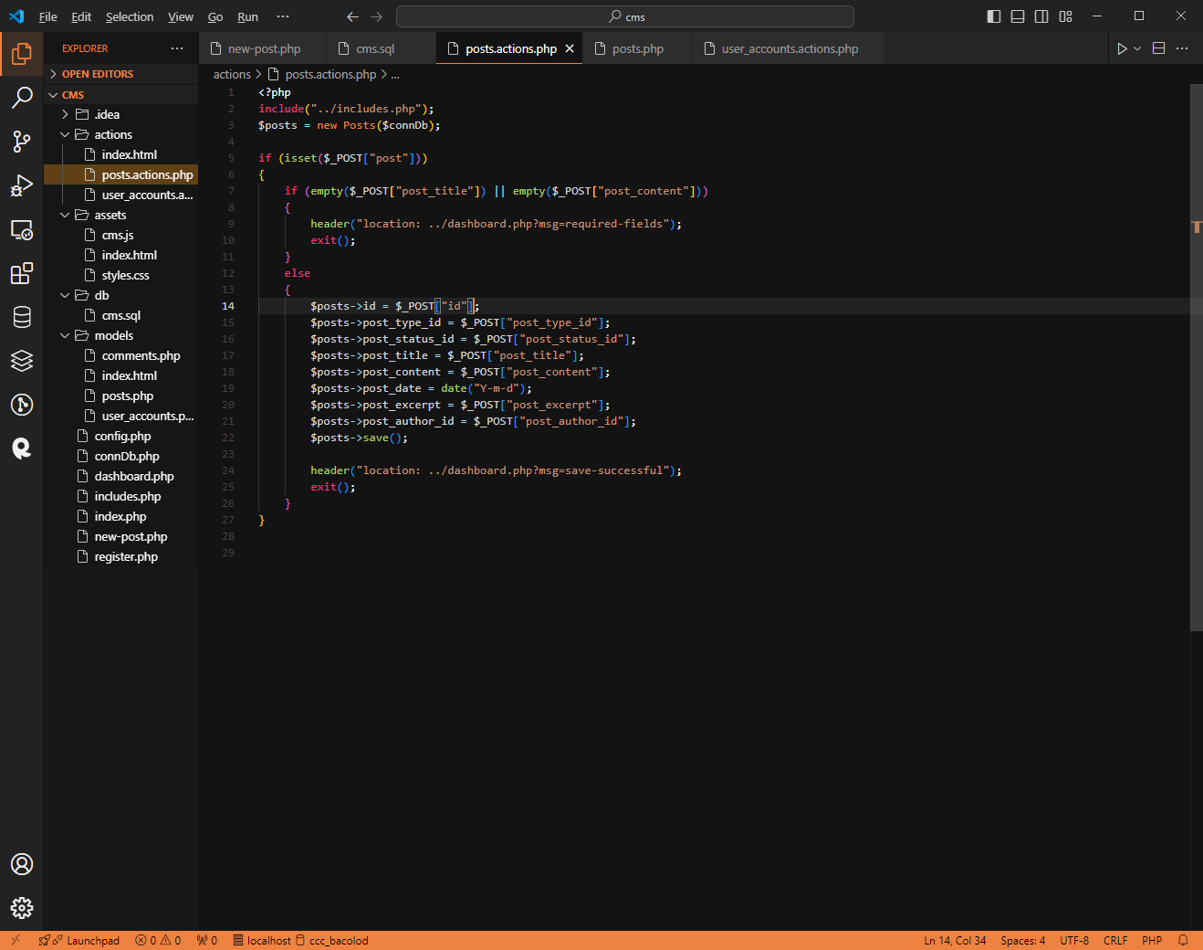

Slide 9
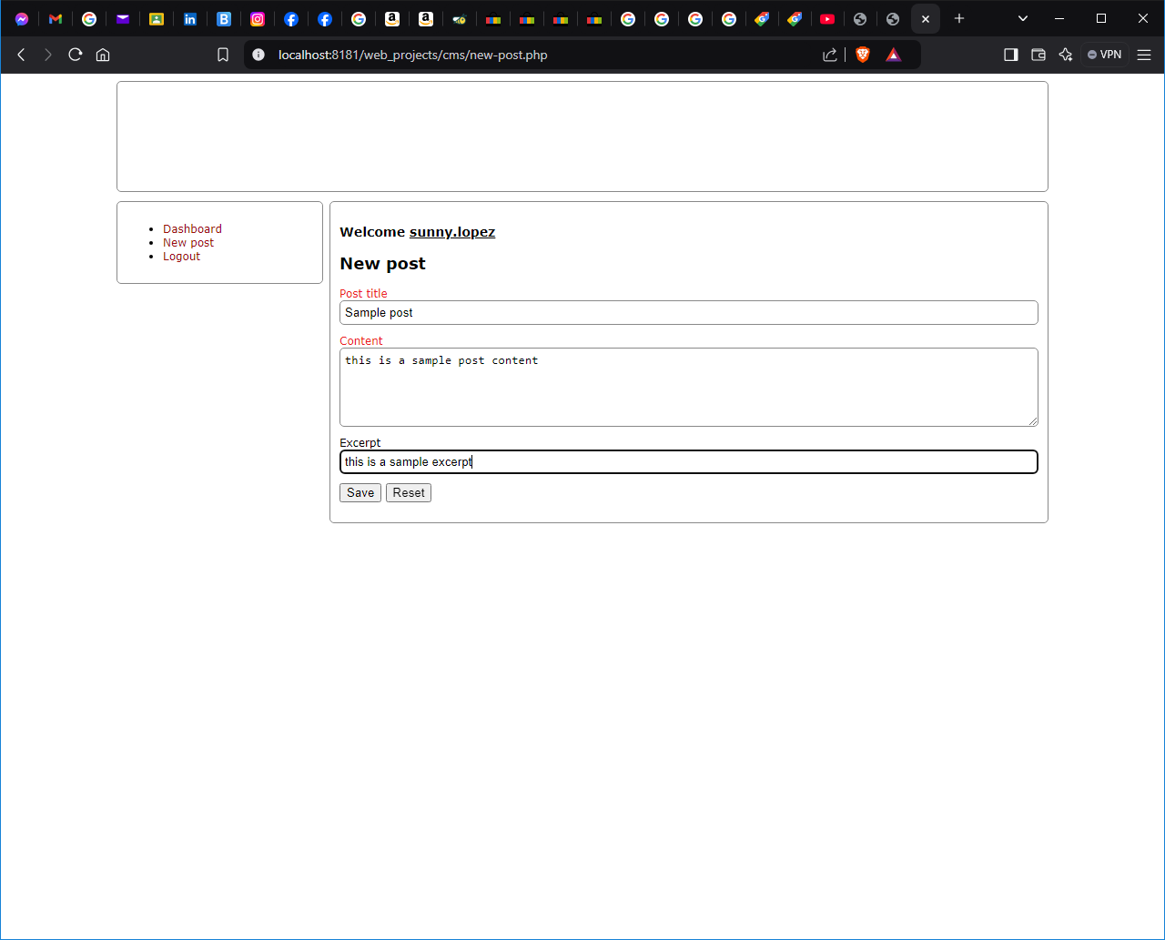
To test
1. To test if you can
already post add the
following in the
new post field.
2. Check your
Database and should
contain the same
values.

Slide 10
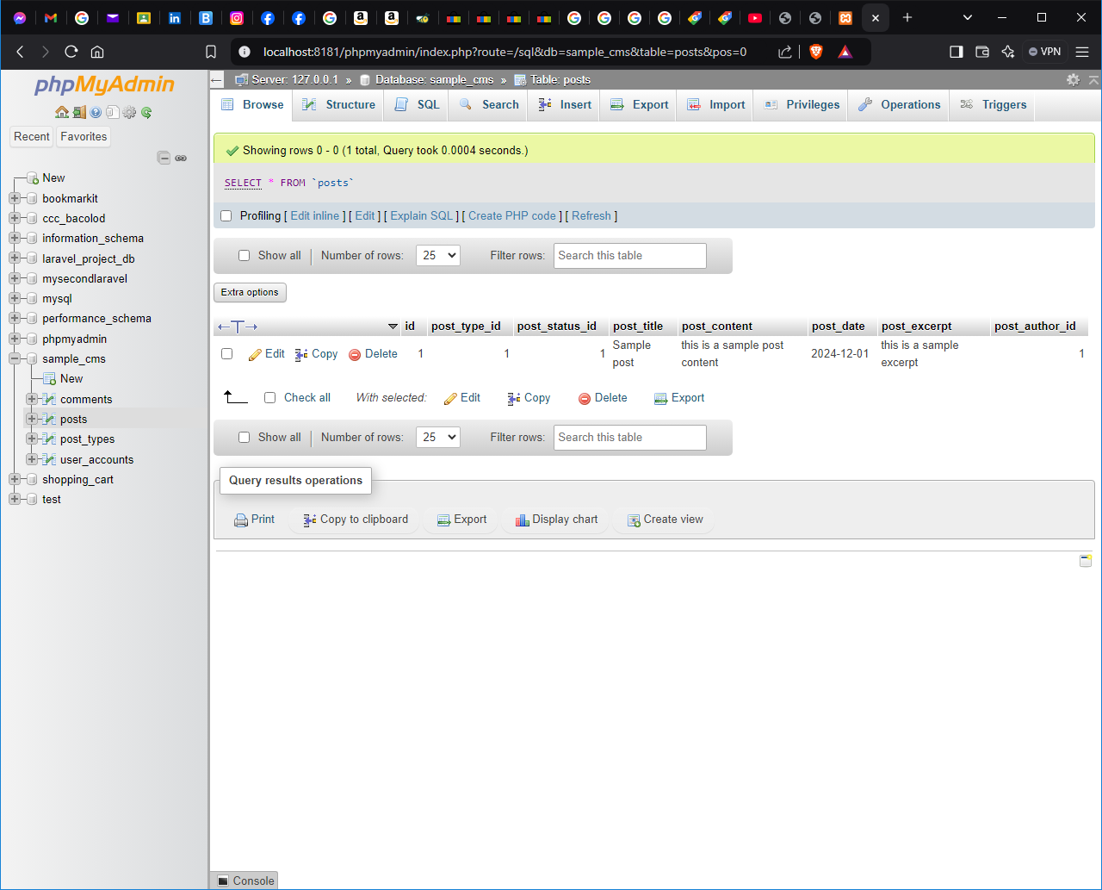

Slide 11
Display on the dashboard
1. Modify the dashboard.php and add the following code to display what was entered on the new-post form.
2. Modify also models/posts.php.

Slide 12
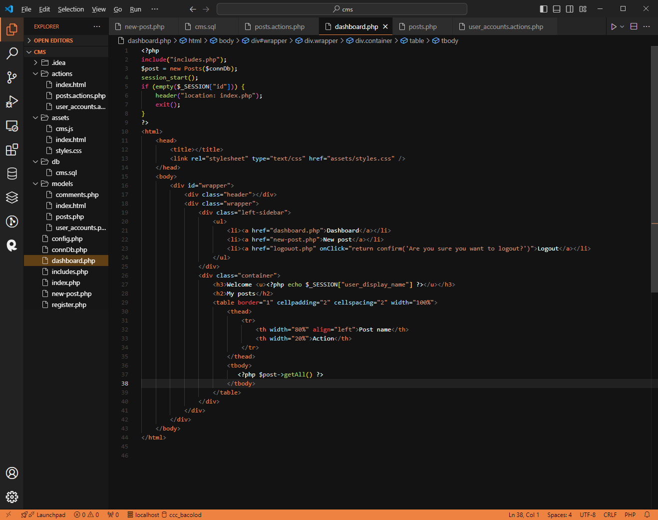

Slide 13
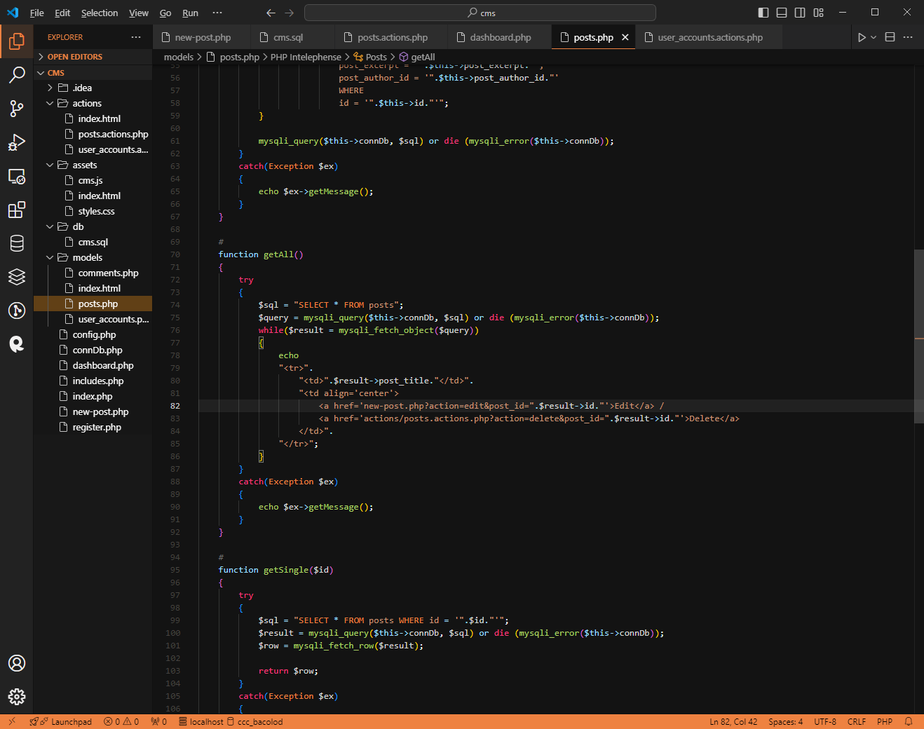

Slide 14
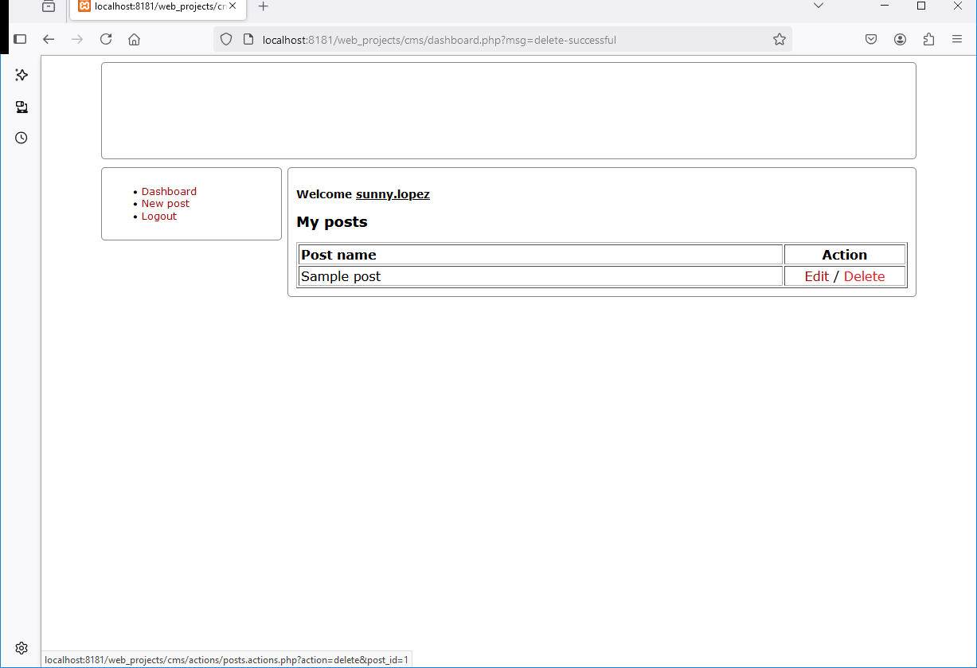
Delete post
1. Check
if the
posts
entered
Is
deleted.

Slide 15
Delete post
1. Open actions/posts.actions.php and edit the code.

Slide 16
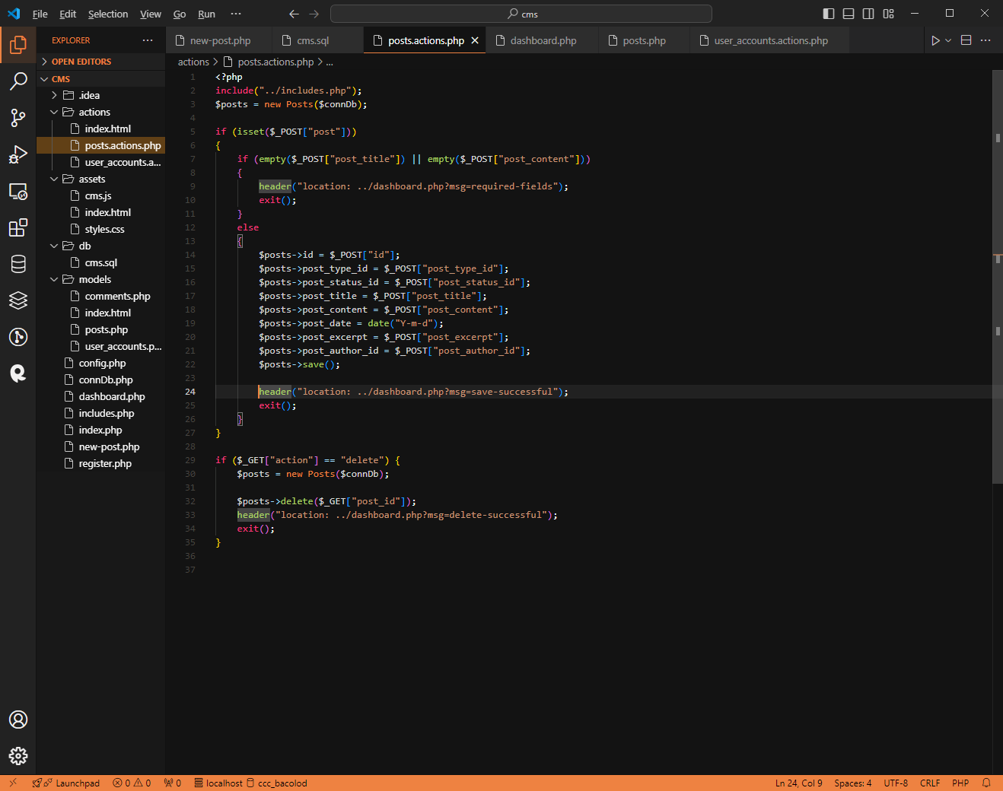

Slide 17
Edit post
1. Edit new-post.php, to display a single post for editing.

Slide 18
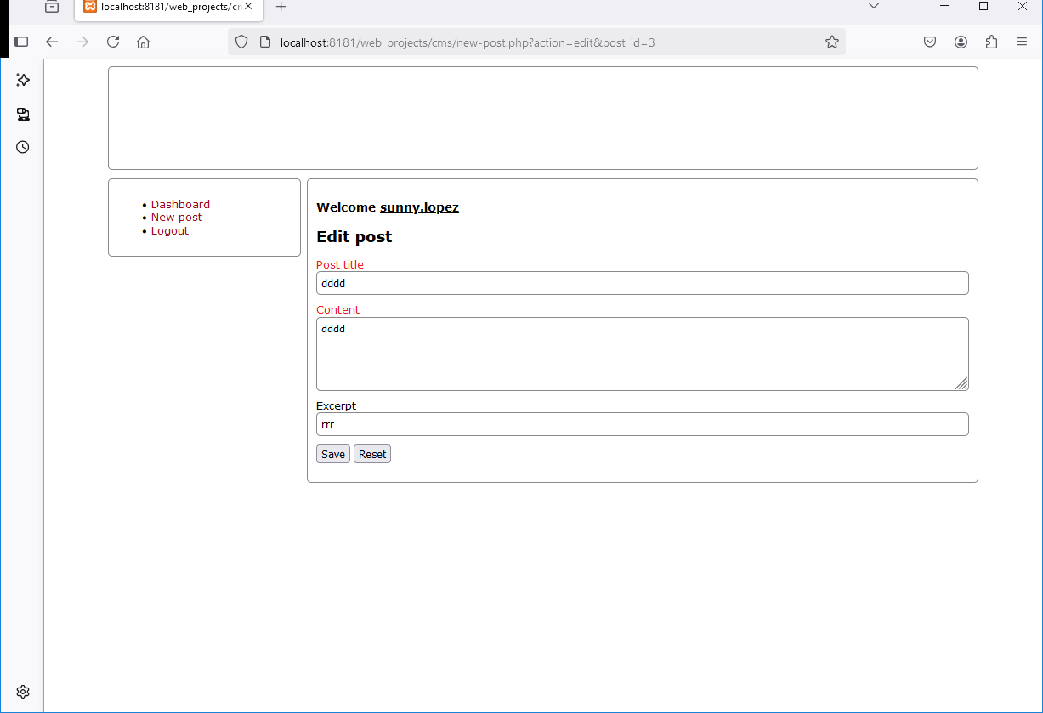

Slide 19
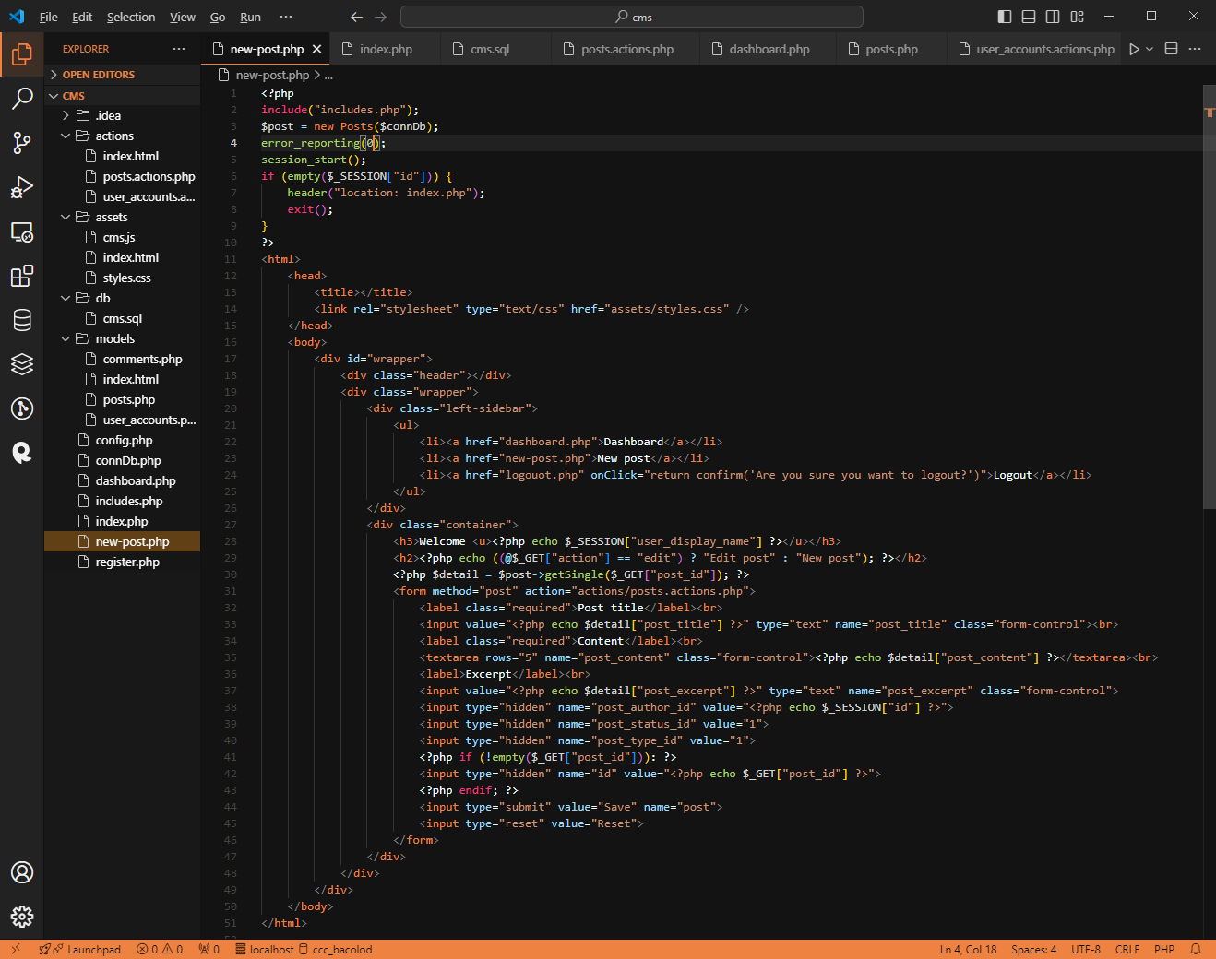

Slide 20
Edit post
1. Make some changes on the post and submit. If changes has reflected update is successful otherwise check again.

Slide 21
Display the post entry on the index.php
1. Modify the methos myPosts in models/posts.php
2. Modify also index.php

Slide 22
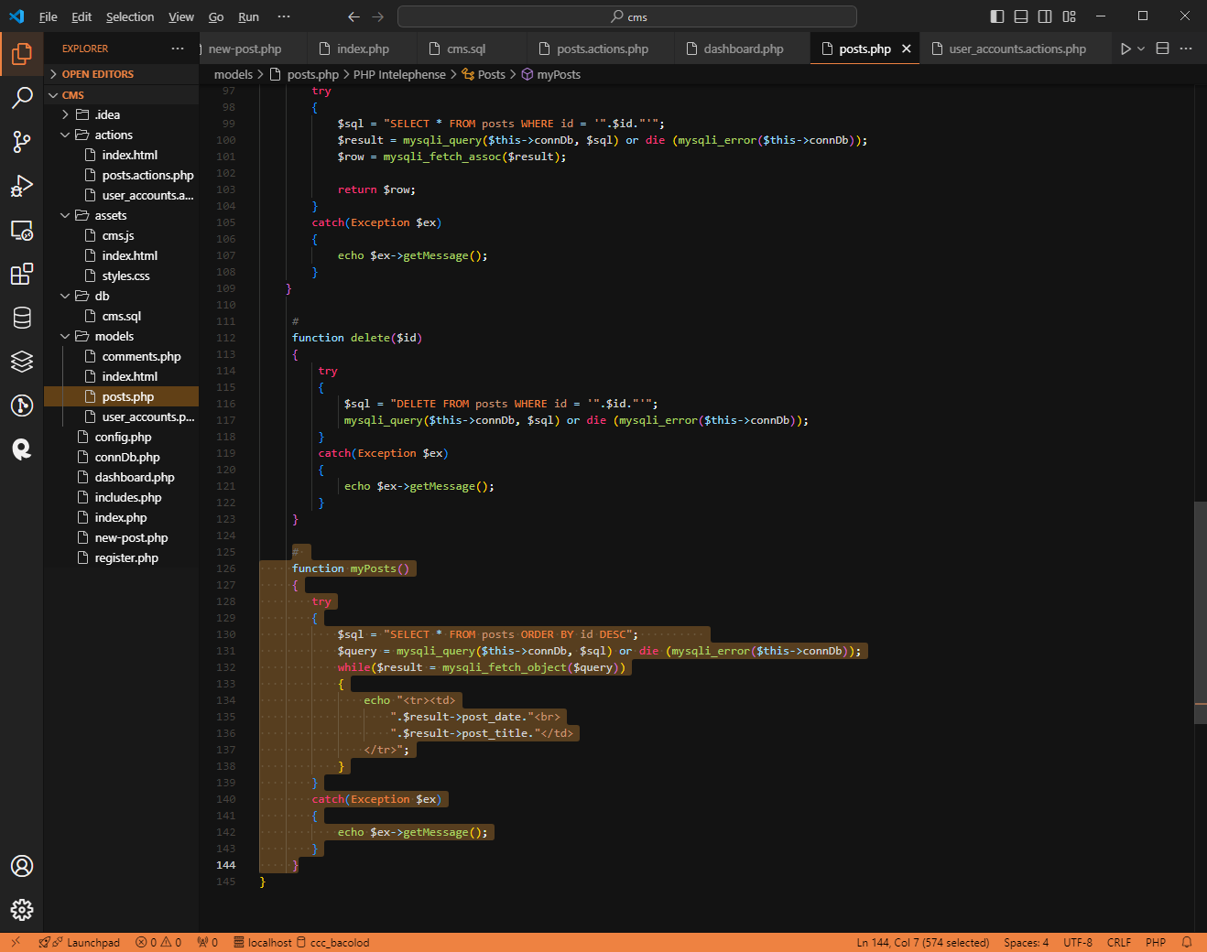

Slide 23
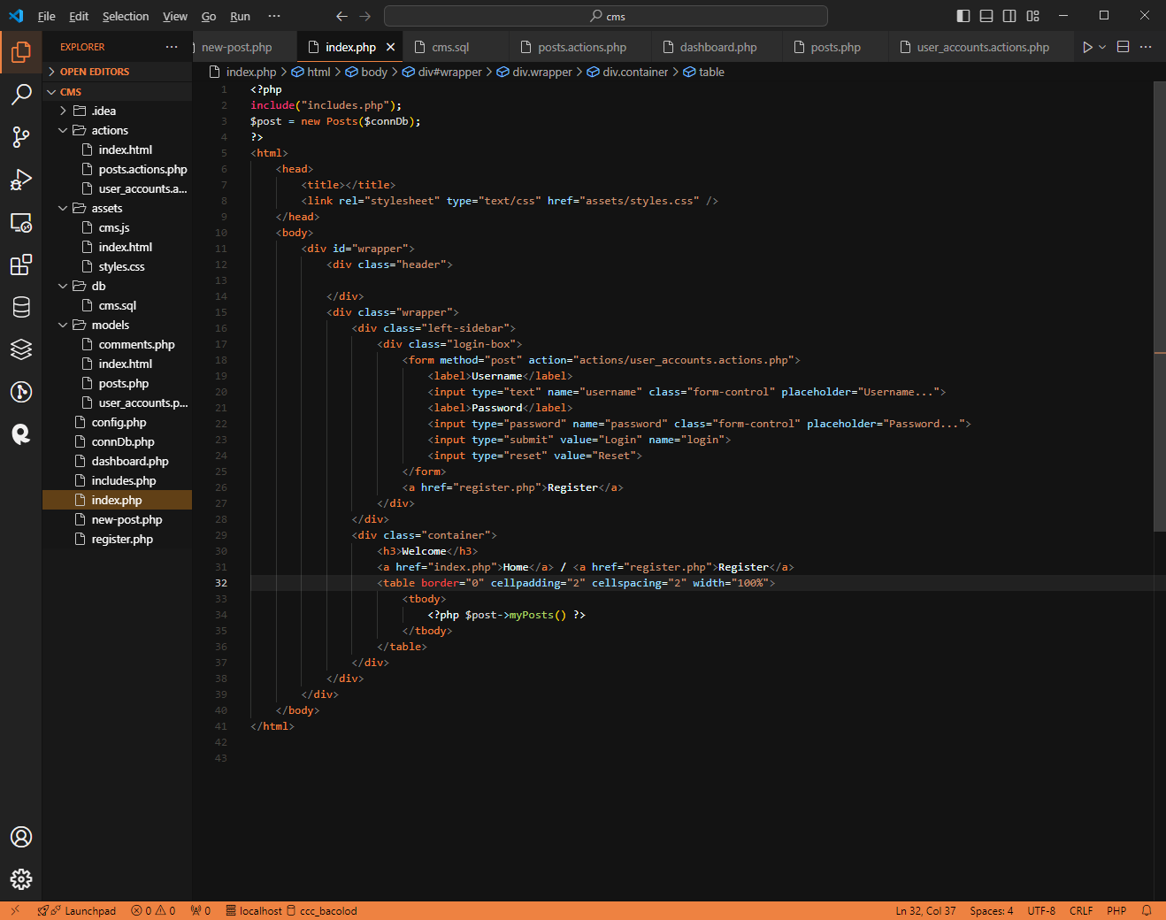

Slide 24
Download powerpoint in github
https://github.com/sunnyhlopez/cms_class/

