Slide 1
Introduction to Data Analytics
Understanding Data Analytics, Its Lifecycle & Real-World Applications

Slide 2
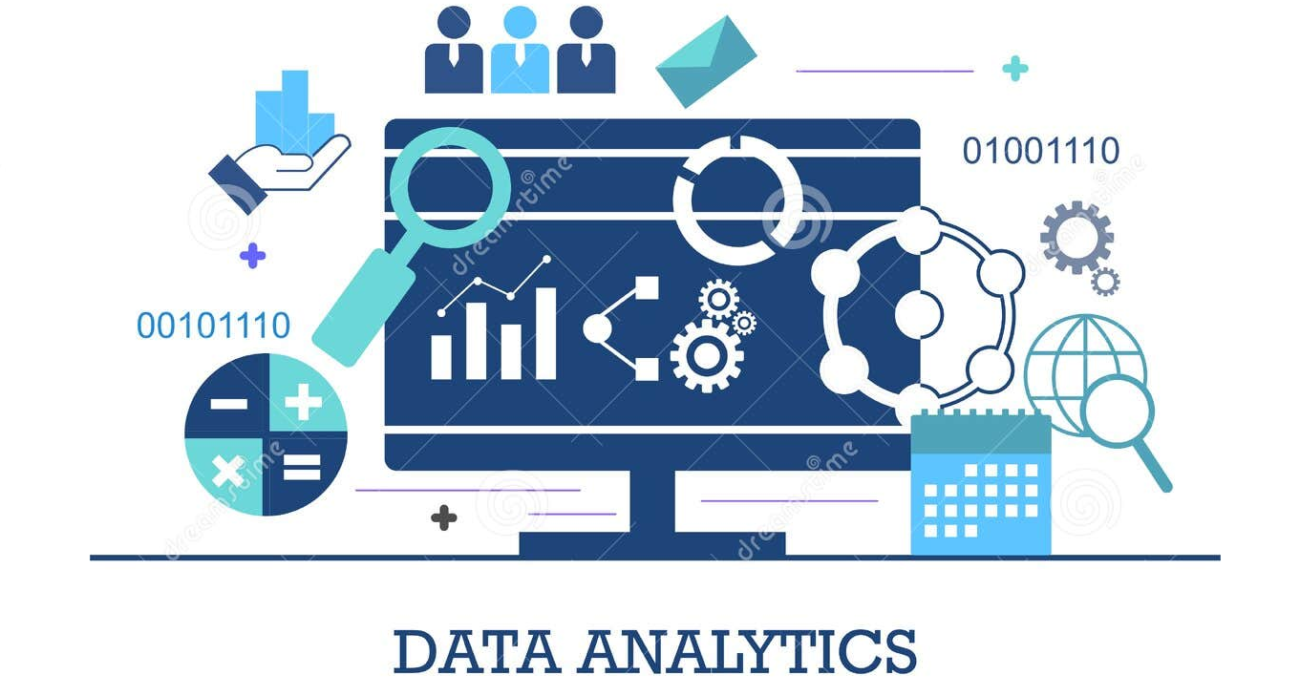

Slide 3
What is Data Analytics?
Data Analytics is the process of collecting, processing, analyzing, and interpreting data to make informed decisions.
It helps organizations find patterns, predict outcomes, and optimize operations.

Slide 4
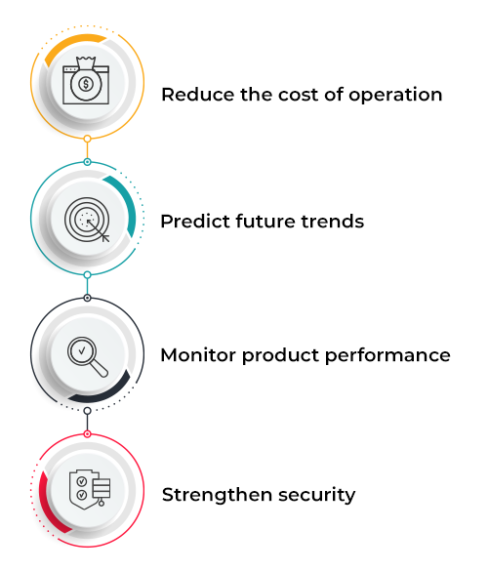
Why is Data Analytics Important?
Helps businesses make data-driven decisions.
Improves efficiency and productivity.
Predicts trends and customer behavior.
Enhances healthcare, finance, sports, and other industries.
Reduces risks and fraud detection.

Slide 5
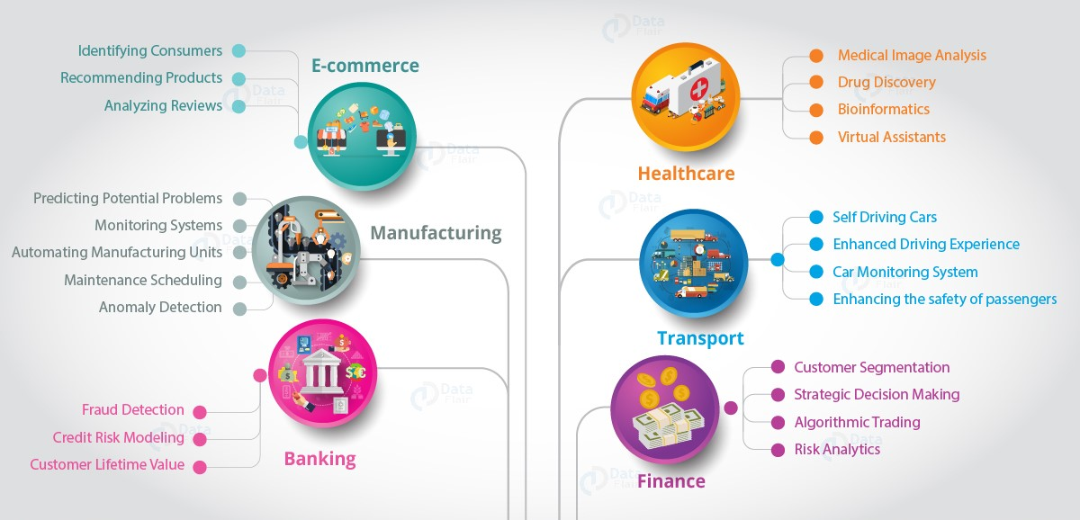
Real-World Applications of Data Analytics

Slide 6
Data Analytics Lifecycle
1. Collect Data: Gather raw data from various sources.
2. Process Data: Remove inconsistencies, errors, and duplicates.
3. Analyze Data: Use statistics and machine learning to identify patterns.
4. Visualize Data: Represent data using graphs, charts, and dashboards.
5. Interpret Data & Make Decisions: Derive insights and take action.

Slide 7
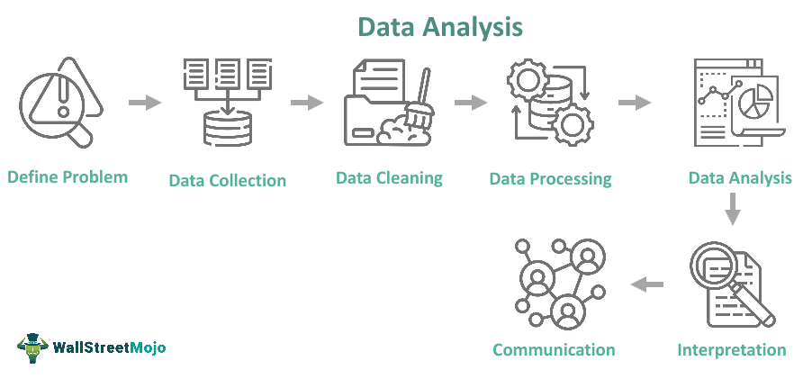

Slide 8
Everyday Data-Driven Decisions?

Slide 9
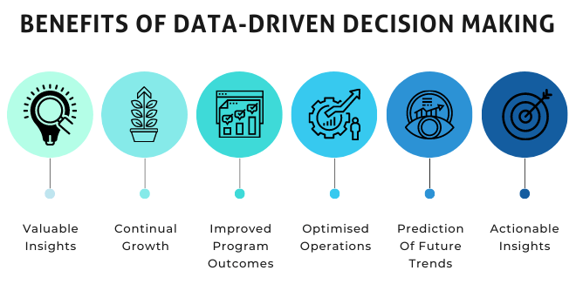

Slide 10
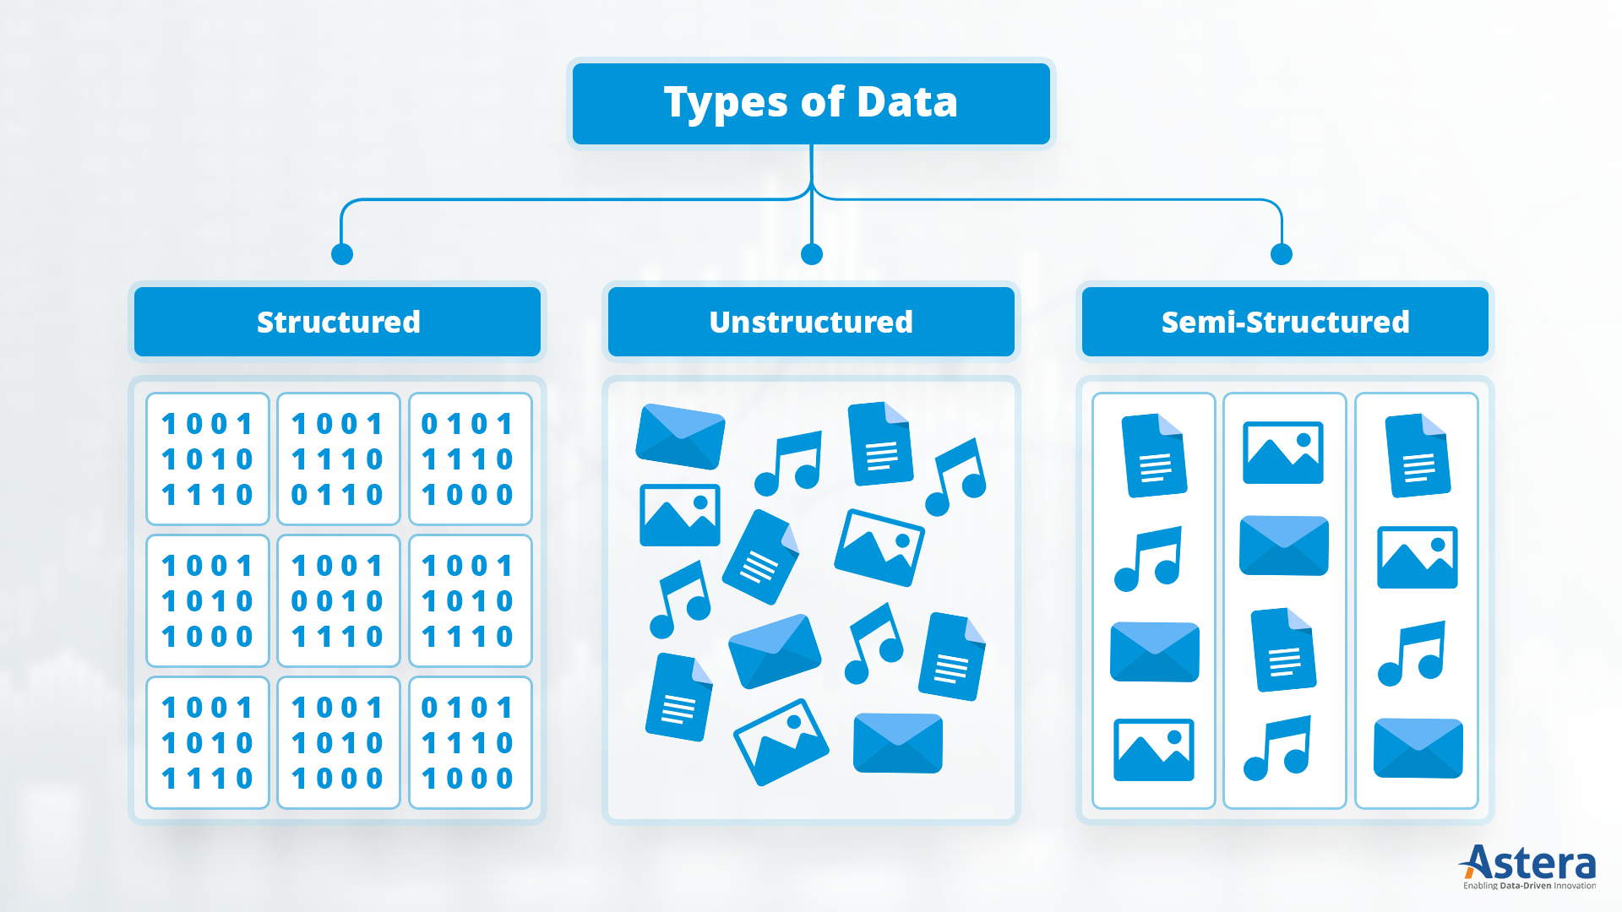
Types of Data

Slide 11

Structured Data
Well-organized, stored in relational databases.
Examples: Banking transactions, employee records, e-commerce orders.

Slide 12

Semi-Structured Data
Partially organized, lacks a rigid schema.
Examples: Emails, social media posts.

Slide 13

Unstructured Data
No fixed format, difficult to store in databases.
Examples: Images, videos, audio recordings.

