Slide 1
Python Introduction

Slide 2
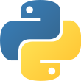
What is Python?
Python is an interpreted, object-oriented, high-level programming language with dynamically typed.
Python is an easy language to learn because of its simple syntax

Slide 3
Key Features of Python
Easy to Learn & Use – Python has a simple syntax similar to the English language.
Interpreted Language – Python code is executed line by line, making debugging easier.
Object-Oriented – Supports OOP concepts like classes and objects.
Platform-Independent – Runs on multiple platforms (Windows, Linux, Mac).
Extensive Libraries – Provides built-in modules for tasks like web development, data analysis, and machine learning.

Slide 4
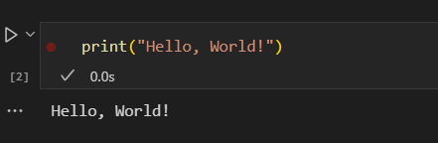
First python program

Slide 5
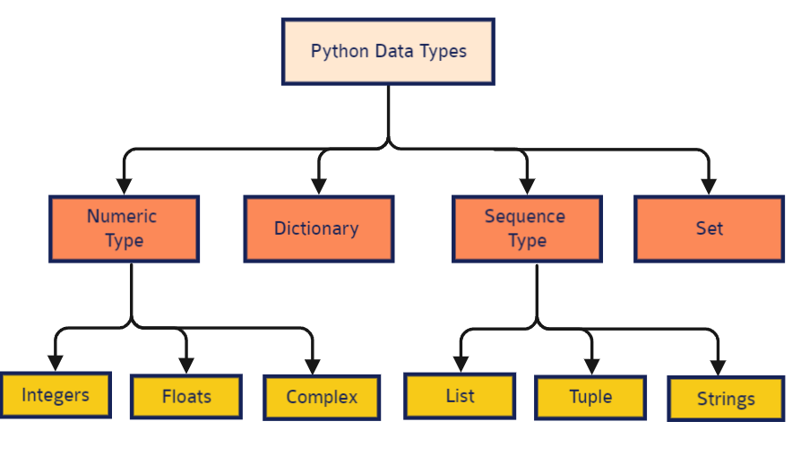
Data Types

Slide 6
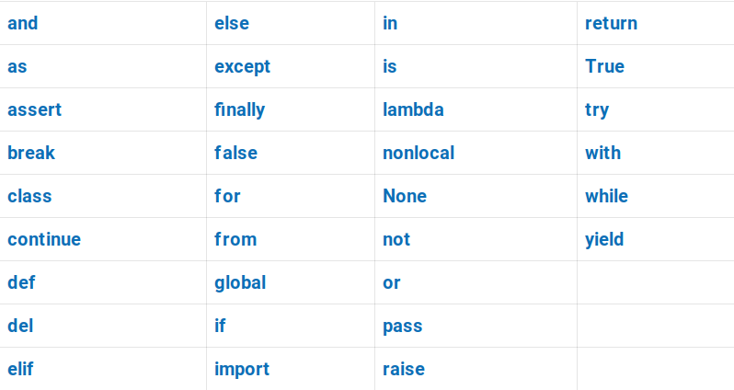
Keywords

Slide 7
Types of Operators:
Type | Operators
Arithmetic operators | +, -, *, /, %, //, **
Comparison operators | >, <, ==, !=, >=, <=
Logical operators | and, or, not
Bitwise Operators | &, |, -, ^, >>, <<
Assignment Operators | =, +=, -=, *=, /=, %=
Identity Operators | is, is not
Membership operators | in, not in

Slide 8
Variables
A variable is a reference to a value stored in a computer’s memory.
Variables can be sorted into a variety of data types such as numbers (int/float etc), Boolean values (true/false), and sequences (strings, lists etc).
To use variables effectively, we must follow Python’s naming rules:
Variable names can only contain letters, digits and underscores (_).
A variable name cannot start with a digit.
Variable names are case-sensitive (myVar and myvar are different).
Avoid using Python keywords (e.g., if, else, for) as variable names.

