Slide 1


Video Games
Bryce Du, Bryce Kratzer, Sunny Jin

Slide 2

Intro

Slide 3
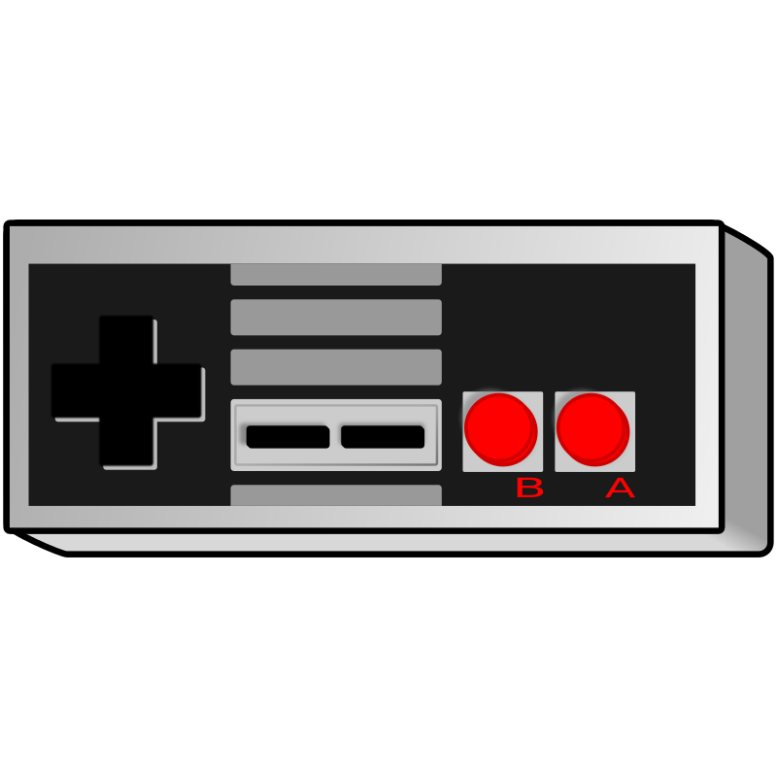
Research Rationale
Research question: What makes a blockbuster video game?
Maximize sales/profits

Slide 4
2. Data Set Description

Slide 5
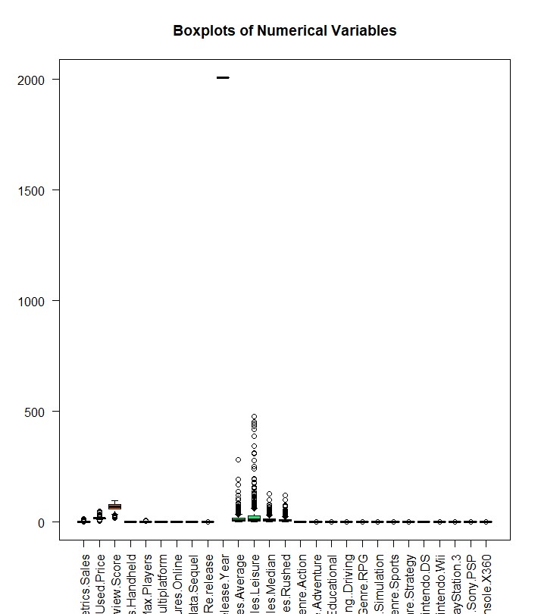
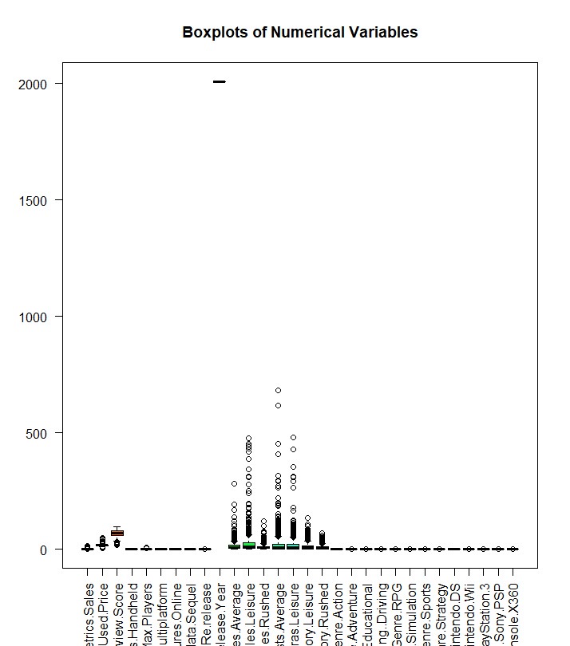
Numerical Variable Boxplots

Slide 6
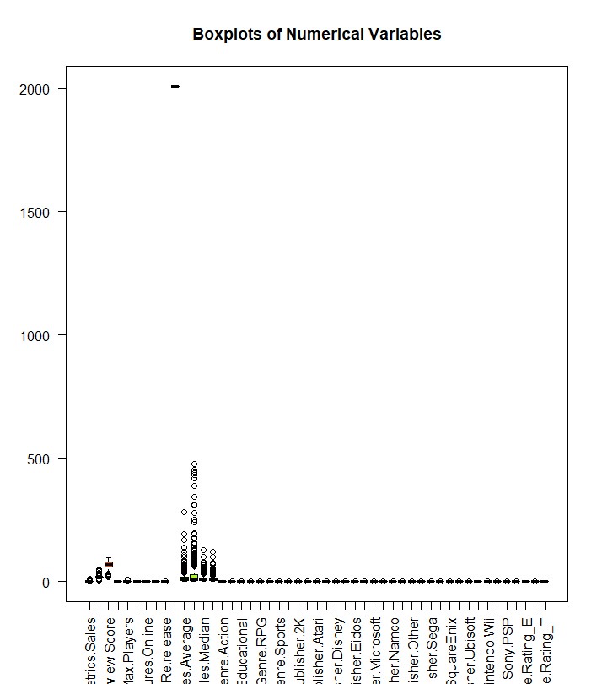
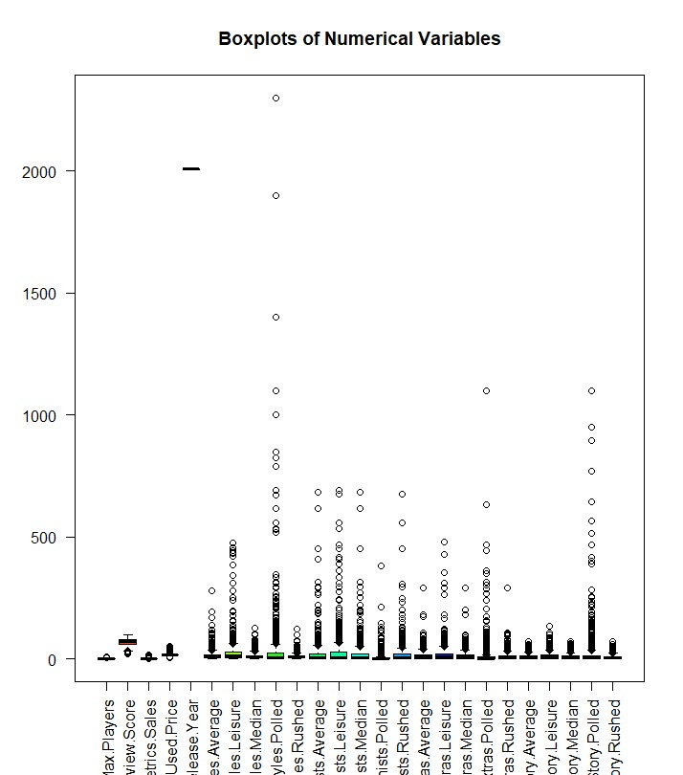
Numerical Variable Boxplots

Slide 7
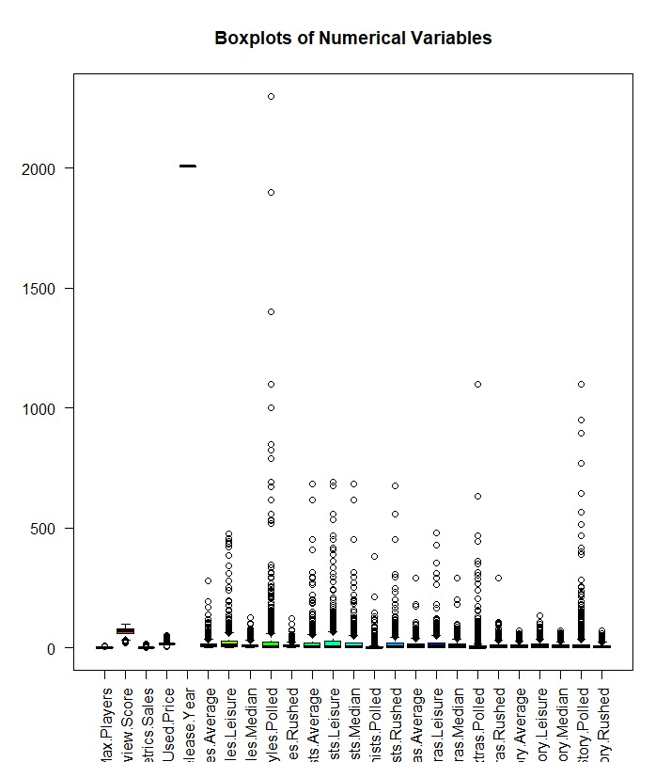
Full Model

Slide 8
3. Building Model and Model Validation

Slide 9


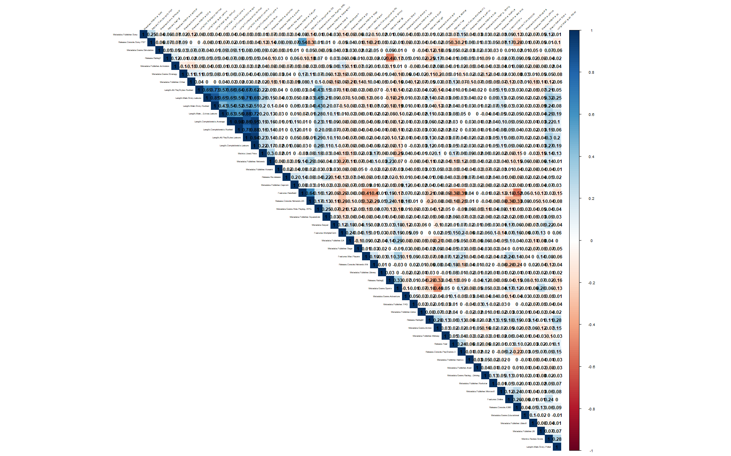
Cleaning the data
Filled Empty Cells
Removed Erroneous Publishers
Corrected boolean Statements
Corrected game ratings
Checked for multicollinearity

Slide 10
Feature Selection
-Created dummy variables for categorical variables
- Utilizing LASSO for feature selection
- Iteratively adding interactions between variables

Slide 11
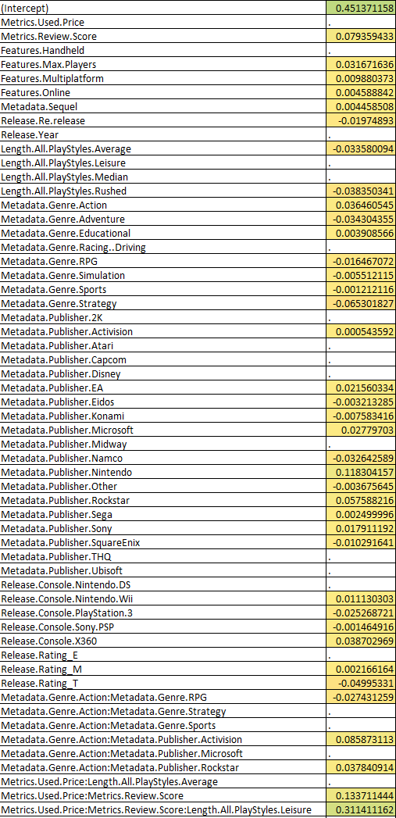
Final Model
- 57 variables down from 65
-Out of the different Genres, Action games are most likely to sell better, and Strategy games are most likely to sell worse.
-Nintendo is the most influential publisher (the only publisher with absolute coefficients value > 0.1)
-Interaction terms: Used.Price:Review.Score has a significant impact; so do Used.Price:Review.Score:PlayStyles.Leisure (largest coefficient)
- Price & Review Score has a very high impact to the game price, and even higher when the game has a Leisure PlayStyle.

Slide 12
4. Model Diagonostics

Slide 13
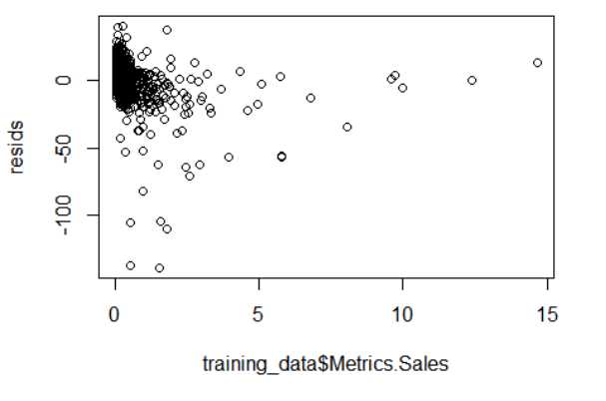
Check Linearity Assumption - Residual Plot
No visible non-linear trend.

Slide 14
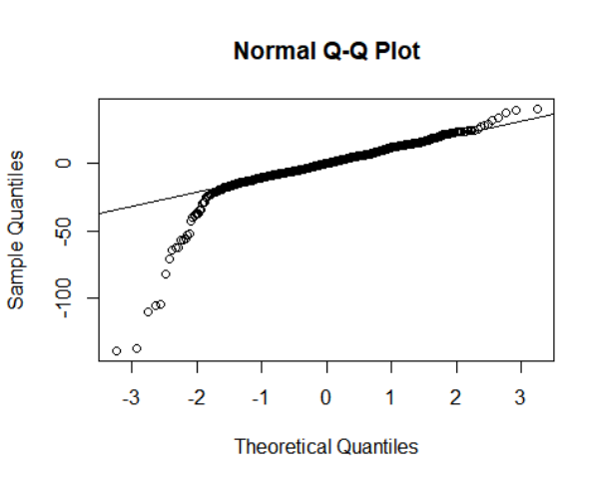
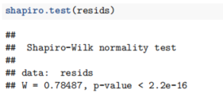
Check Normality Assumption - Normal QQ Plot

Slide 15

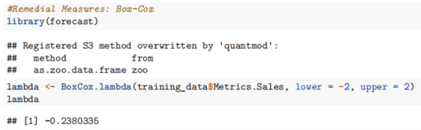
Equal Variance of Errors Assumption - BF test
And Remedial Measure - Box Cox Transformation
BF test result suggest that Equal Variance of Errors assumption is violated.
Remedy: Box-Cox Transformation, λ = -0.2380335

Slide 16
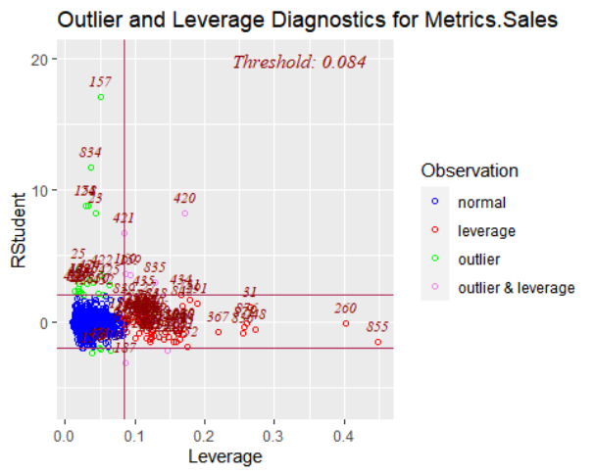

Transformed Model, and Outliers
Adjusted R² = 0.33 is still far from ideal.
Outstanding outliers from Outlier & Leverage Diagnostics graph: # 23, 24, 134, 157, 420, 421, 834 (More on them on the next pages…)

Slide 17
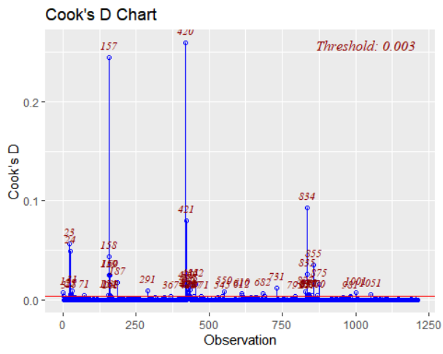
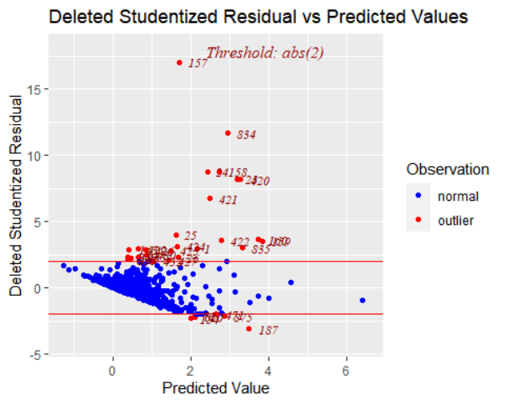
Outliers - Studentized Residuals and Cook’s Distance

Slide 18
The 7 Most Influential Outliers
## [1] "Game Name" "Studentized Residual" "Cook's D"
## [,1] [,2] [,3] ## 23 "Mario Kart DS" "8.19888651544466" "0.0566198809176657" ## 24 "Nintendogs" "8.76562044497503" "0.0496393598907225" ## 157 "Wii Play" "17.049159381426" "0.244477081793348" ## 158 "New Super Mario Bros." "8.78652529546772" "0.043839456389043" ## 420 "Wii Fit" "8.19747354735298" "0.259131742623072" ## 421 "Halo 3" "6.76469951294258" "0.079813494272085" ## 834 "Mario Kart Wii" "11.6607745146173" "0.0926492483962602"
Note that 6 of them are published by Nintendo, and 1 by Microsoft.
These outliers would be excluded from the dataset to produce the final model.

Slide 19
R² and R_{adj}²
MSE, R² and R_{adj}² of the model including outliers:
## [1] 0.7277747 0.3636303 0.3310384
MSE, R² and R_{adj}² of the model excluding outliers:
## [1] 0.2824093 0.4641607 0.4365498
Significant increase in R_{adj}² ! (By 10%)

Slide 20
5. Conclusion

Slide 21
Concluding Remarks
Action games are most likely to sell better, and Strategy games are most likely to sell worse.
Nintendo is the most influential publisher (supported by Nintendo being vast majority of outliers & high coefficient for publish=Nintendo)
Price & Review Score has a very high impact to the game price, and even higher when the game has a Leisure PlayStyle.

