Slide 1
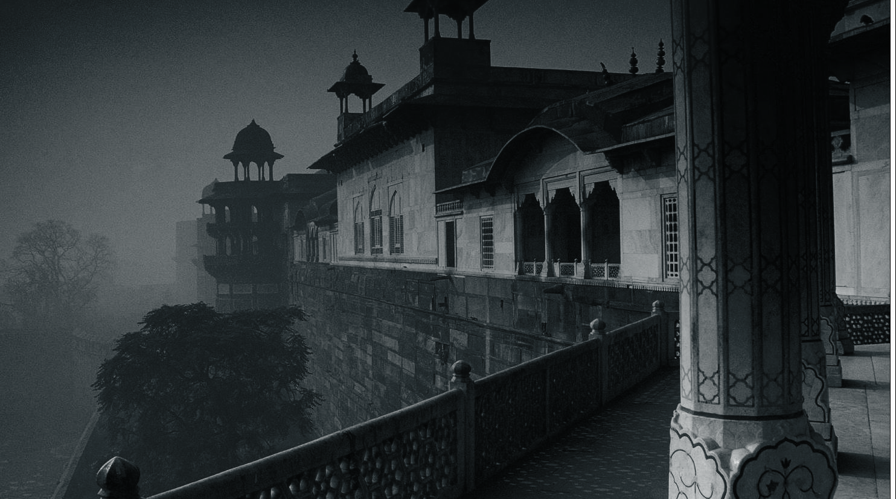
TOUR MATE
From planning to journey
From journey to destination
“A Complete Mobile Travel companion”
Sunny Kachhia
Dhruv Nahar

Slide 2
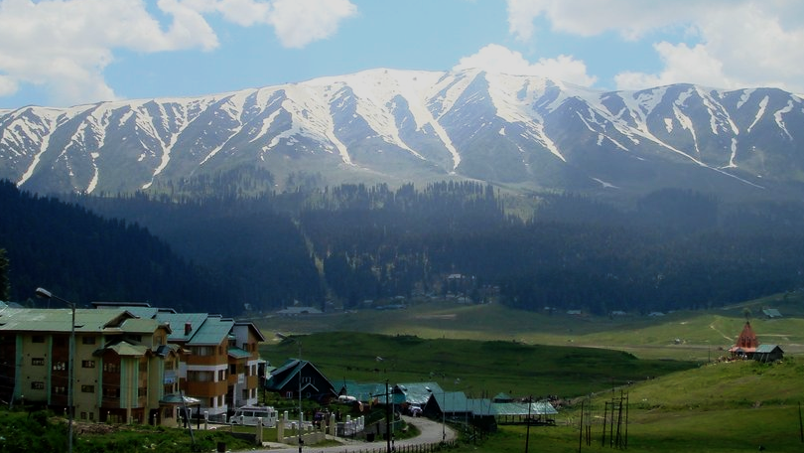
How Tour Mate works
Planning Phase
Travel Phase
Trip Phase
Everything a person would need to do from the moment she plans her journey to the point where she sits in her mode of transportation.
Mode of Transit
Hotels
Destination City
Shopping
When anyone travels alone, they need something or the other to kill the travel time. We provide them the best options of entertainment and enjoyment based on their current state of mind.
After one reaches the destination city and if she is visiting that city for the first time, they would definitely want to know a lot of things about that place like lifestyle, food outlets, etc. We try to provide a comprehensive list of same.

Slide 3
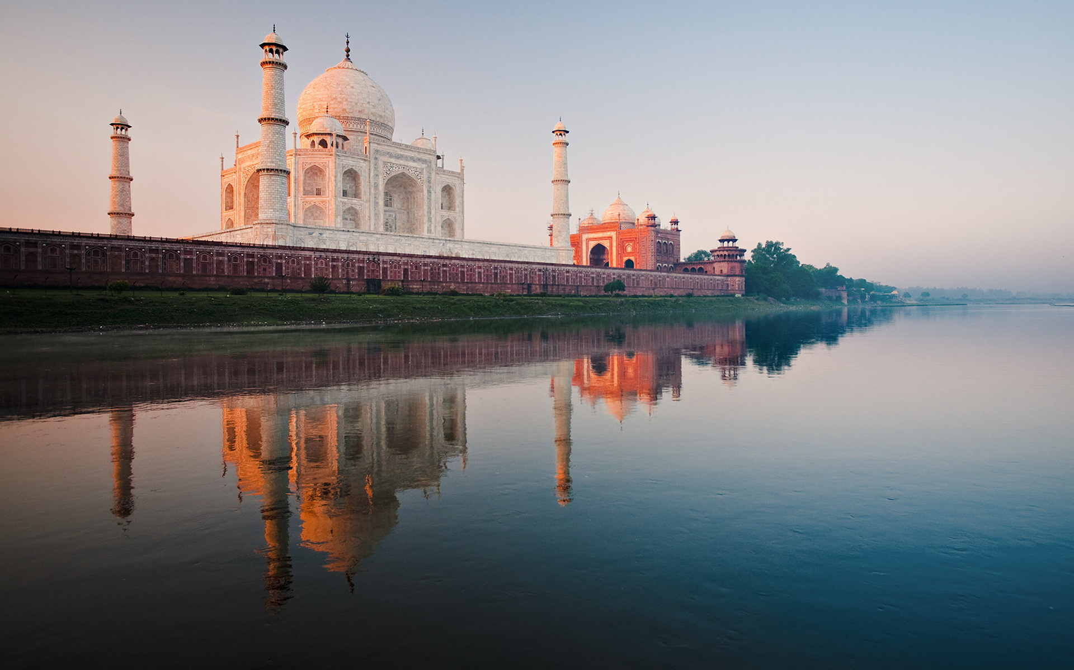
Planning Phase
Before your actual
Journey begins

Slide 4
Accommodation
If your trip is longer than one day, you need to stay somewhere. We fetch you the best hotel deals from the city for you to choose from.
Selecting / Exploring City
Before you finalize your trip, we give you options across the country. You can “virtually” explore the city through our app
Mode of Transit
You can look for and hence book Bus or Train tickets. Else you can go pick your own car and make the trip fully customized
Shopping
You may need to buy new Shoes, bag or a pair of jeans. You can simply get the best prices at a single click.

Slide 5
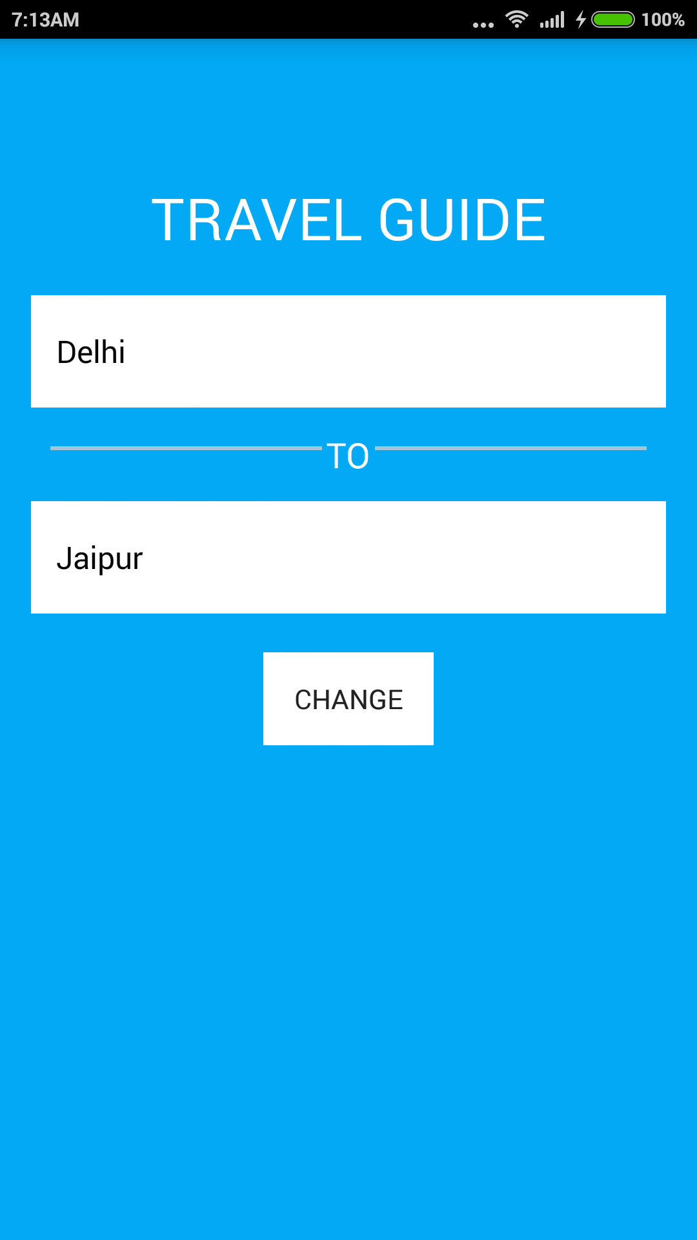
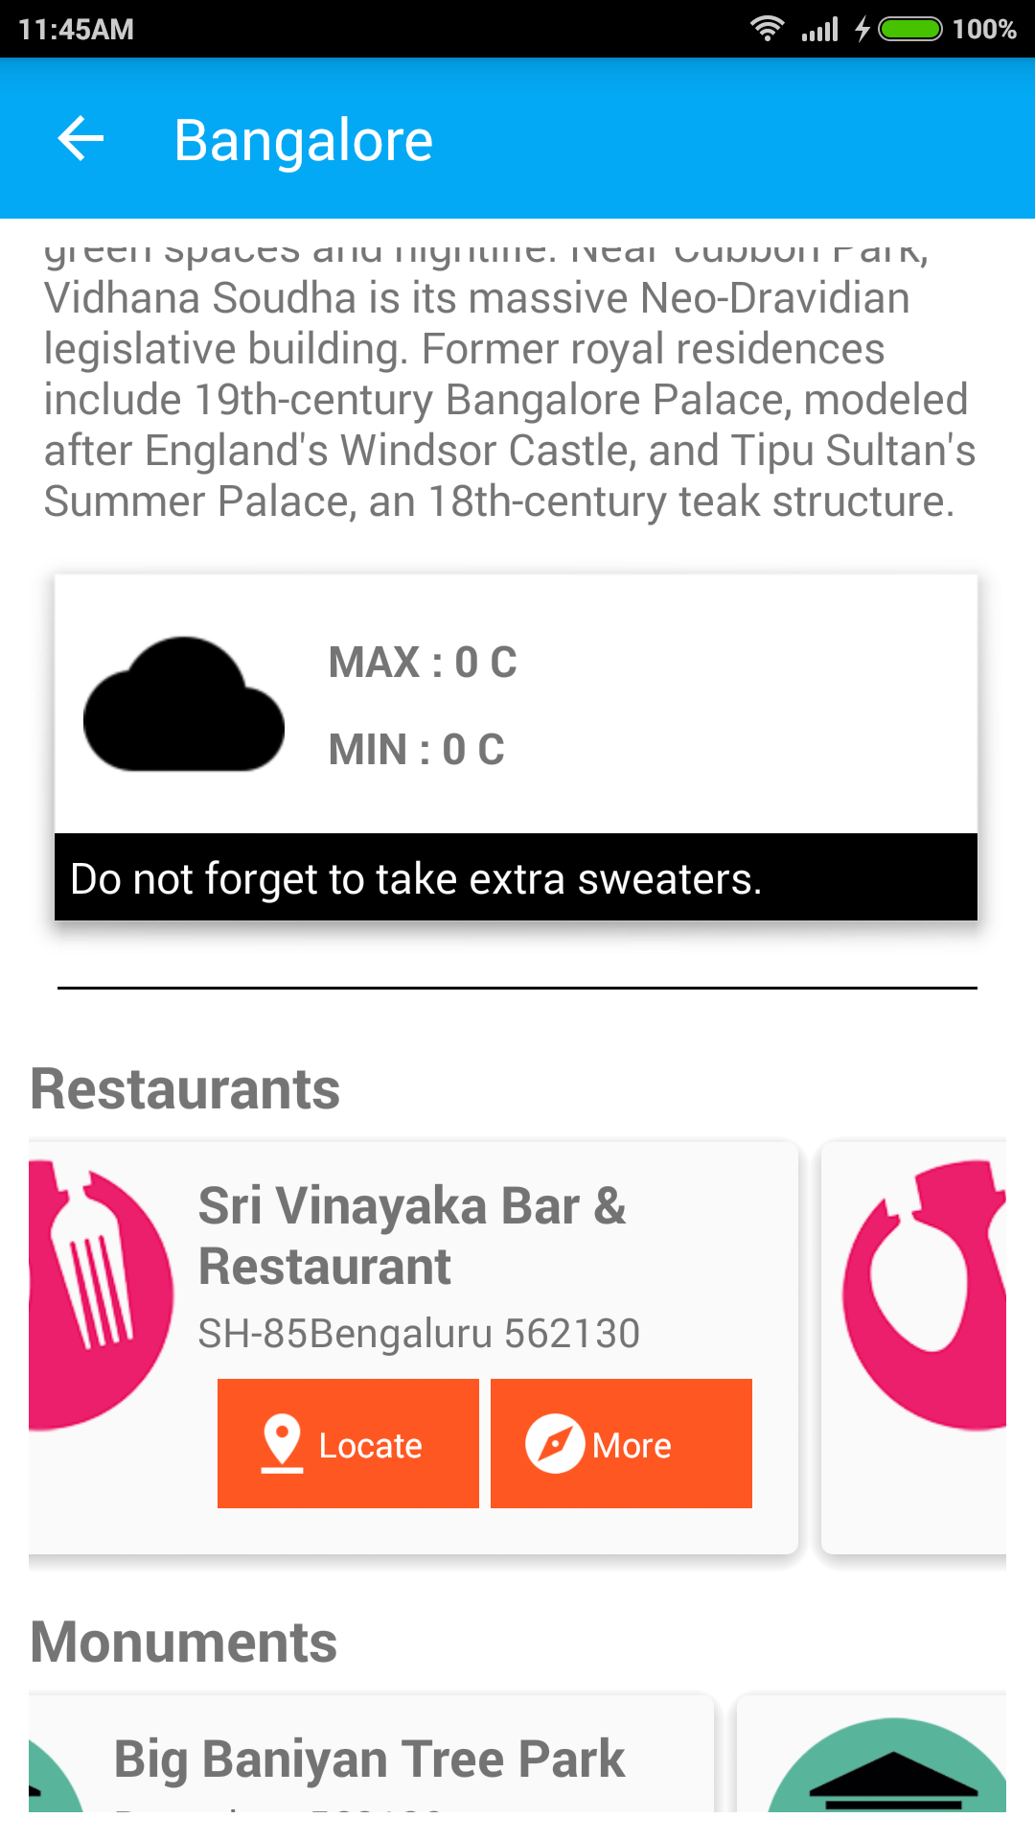
Explore City
Choose your destination City (Jaipur here) and get to know about many important things in the city.
Climate
Culture
Restaurants
Hangout Places
Monuments (if any)
Shopping Complexes

Slide 6
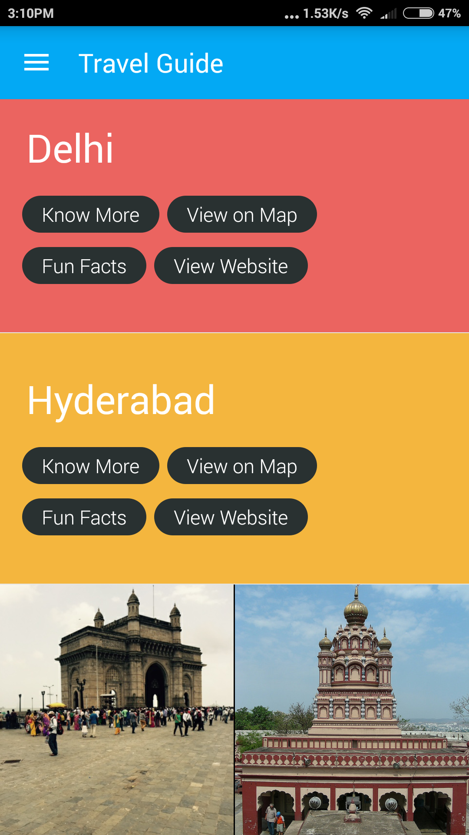
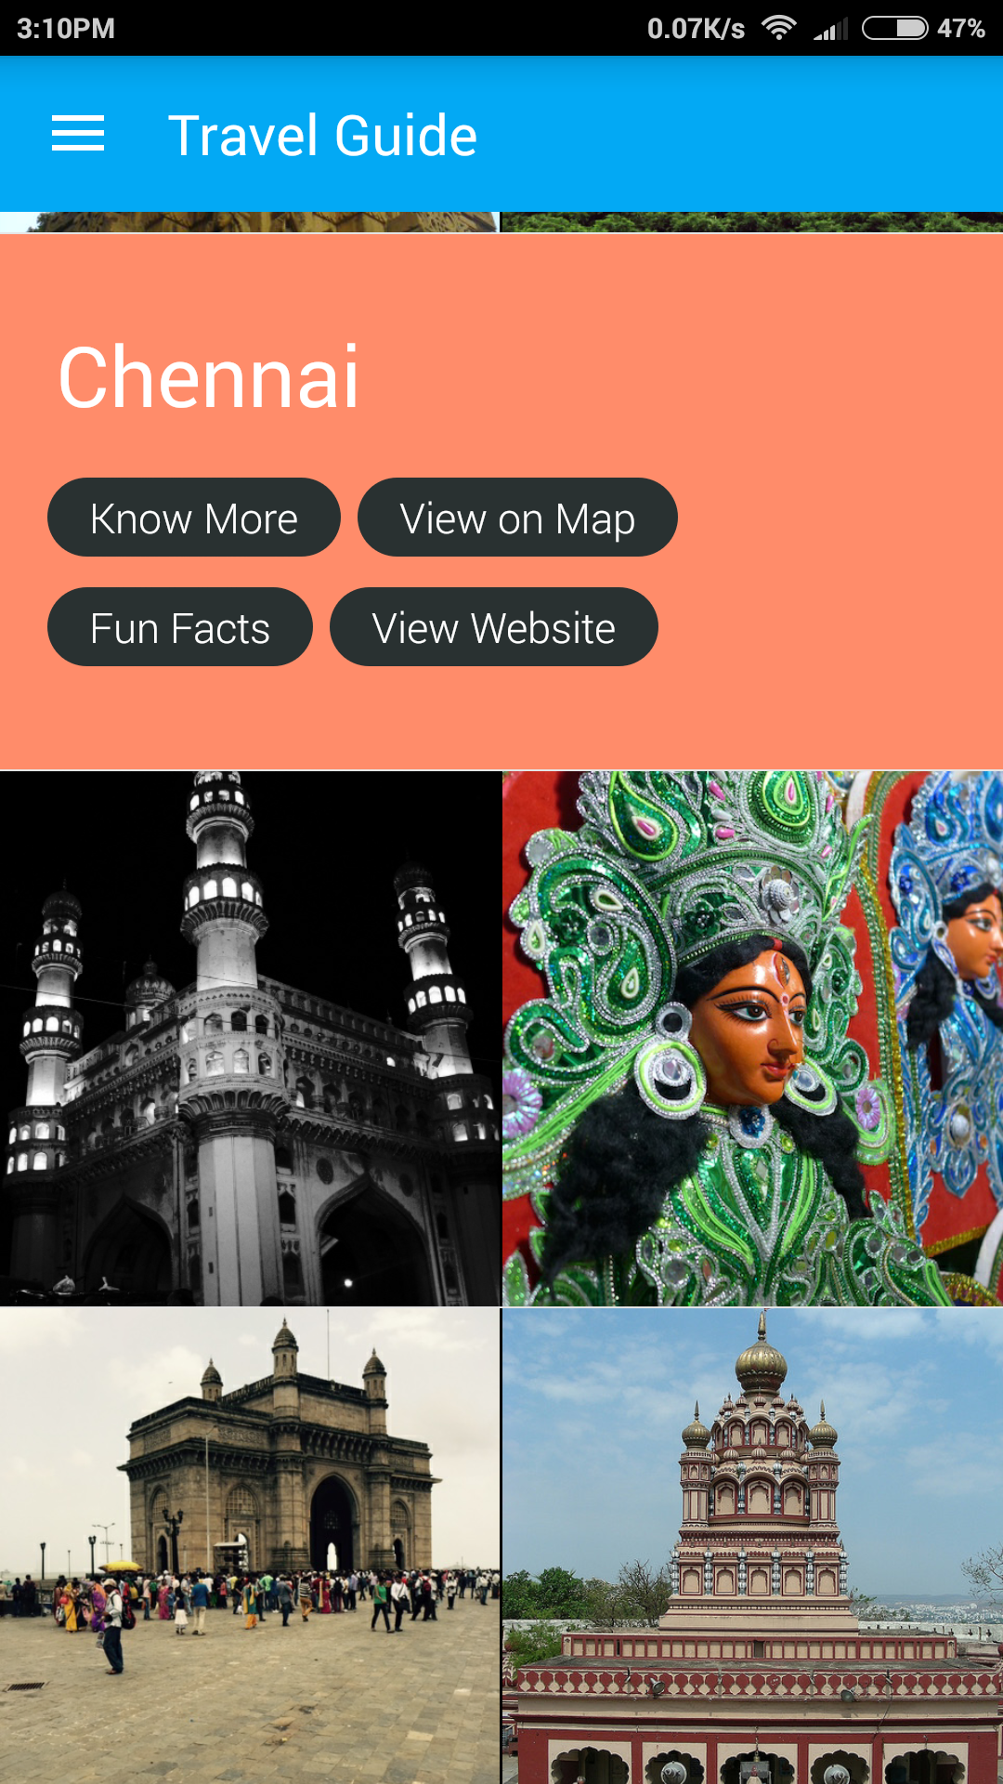
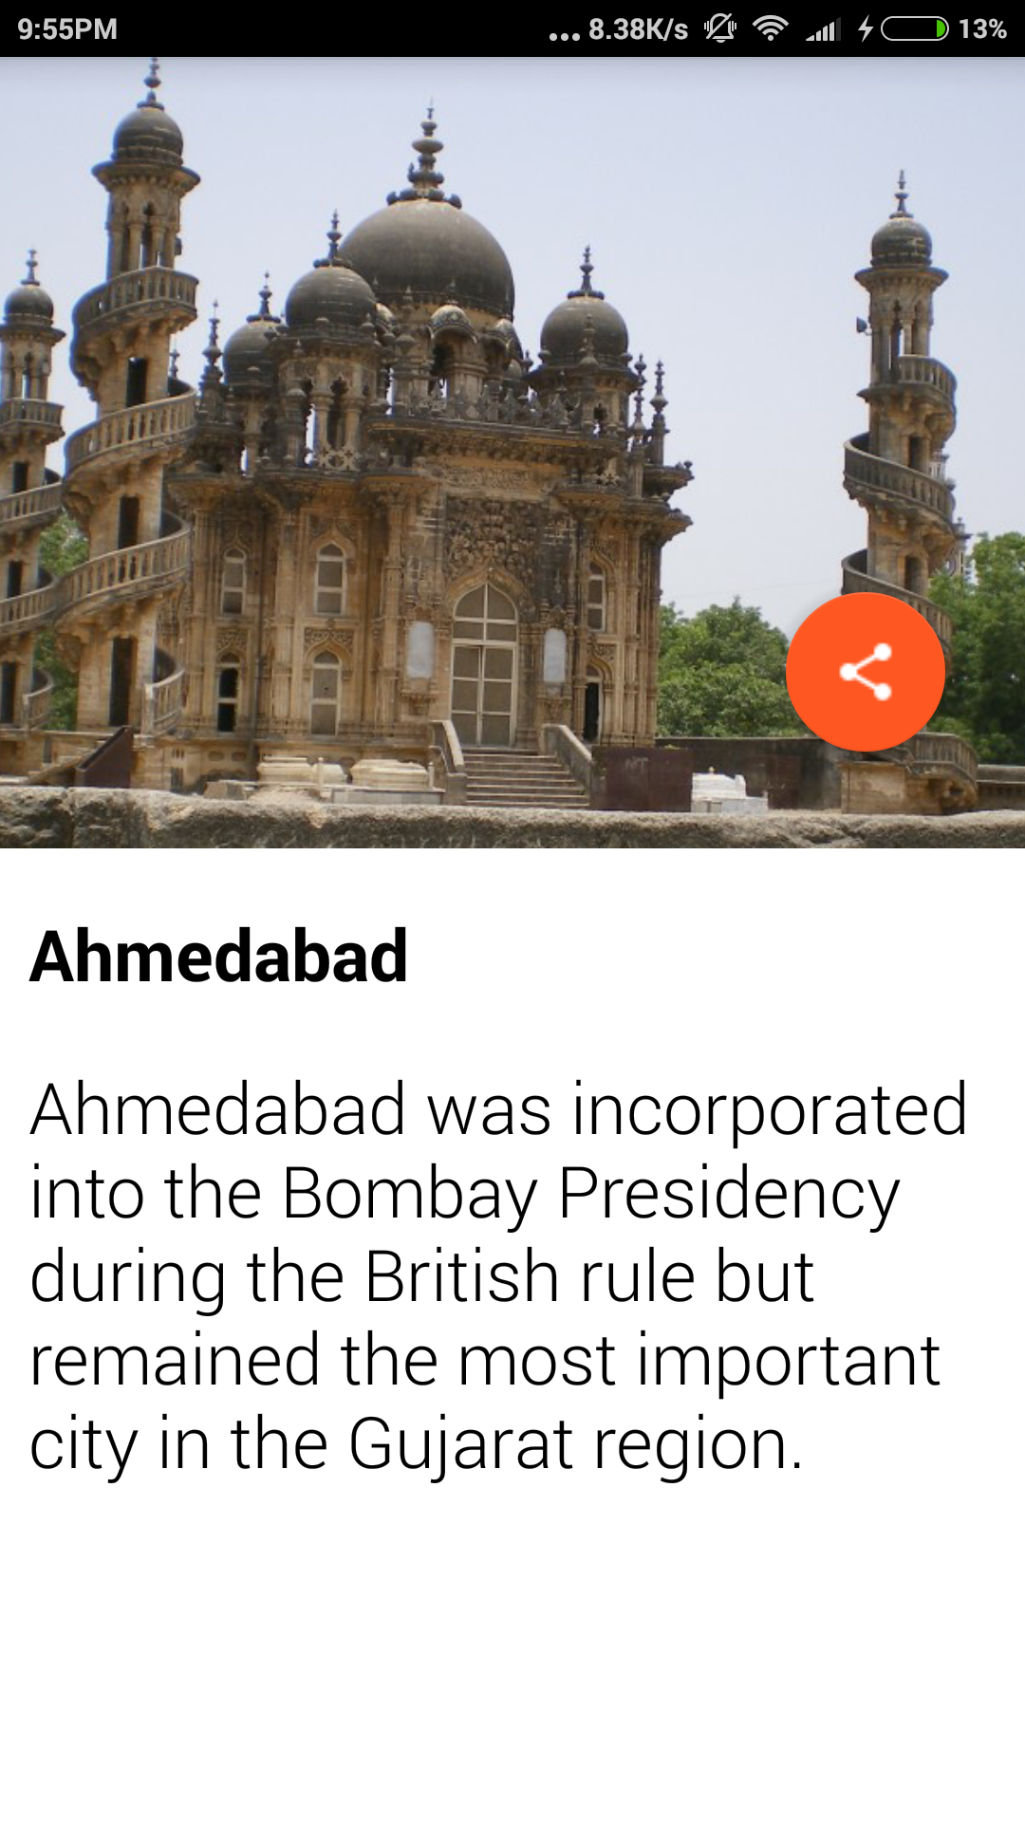
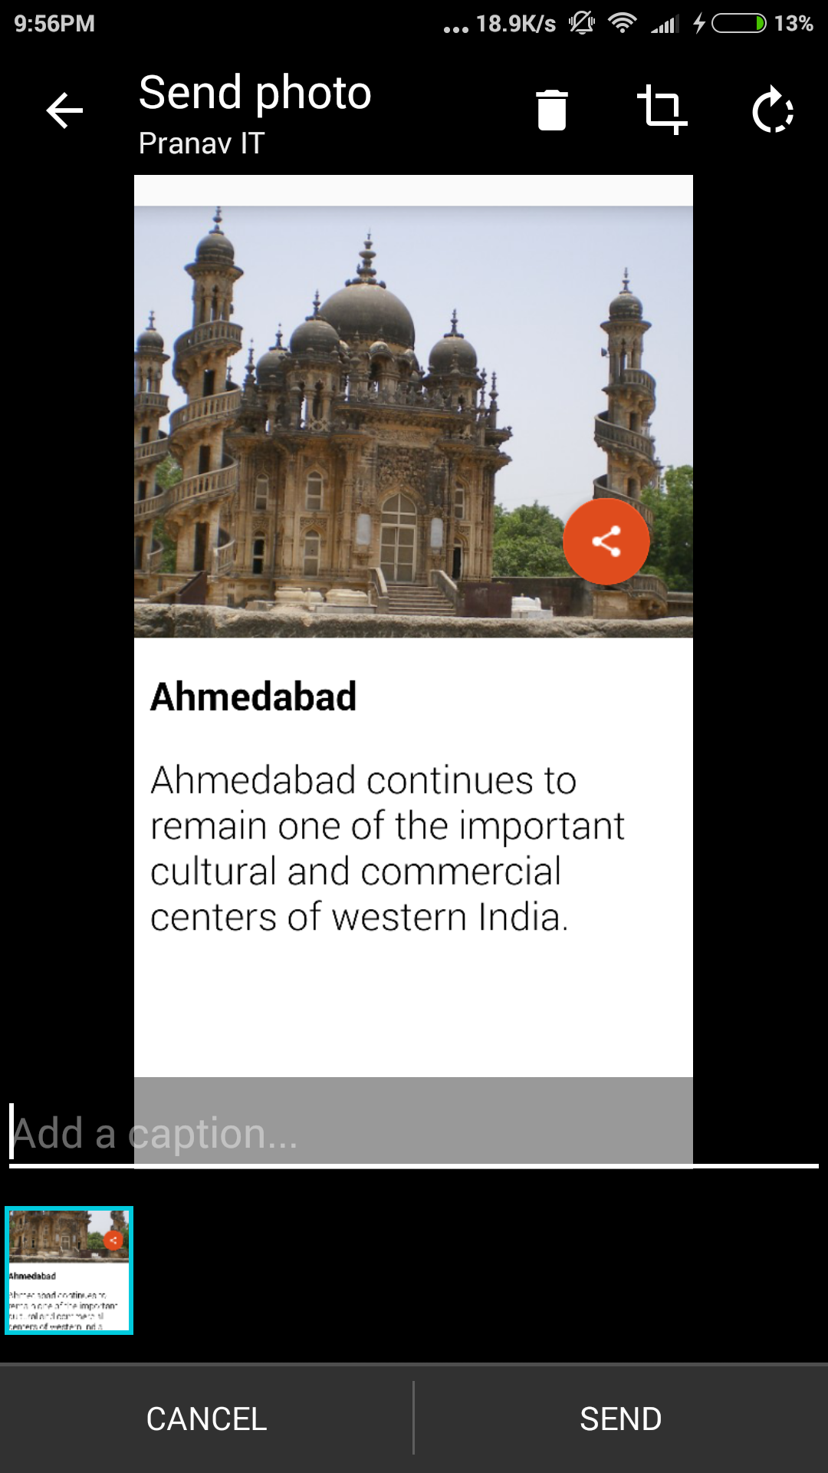
Get fun facts about cities on the go
People can find cool facts about the city they are travelling to.
UI has been made quite fun so that user doesn’t get bored and wants to go on!

Slide 7
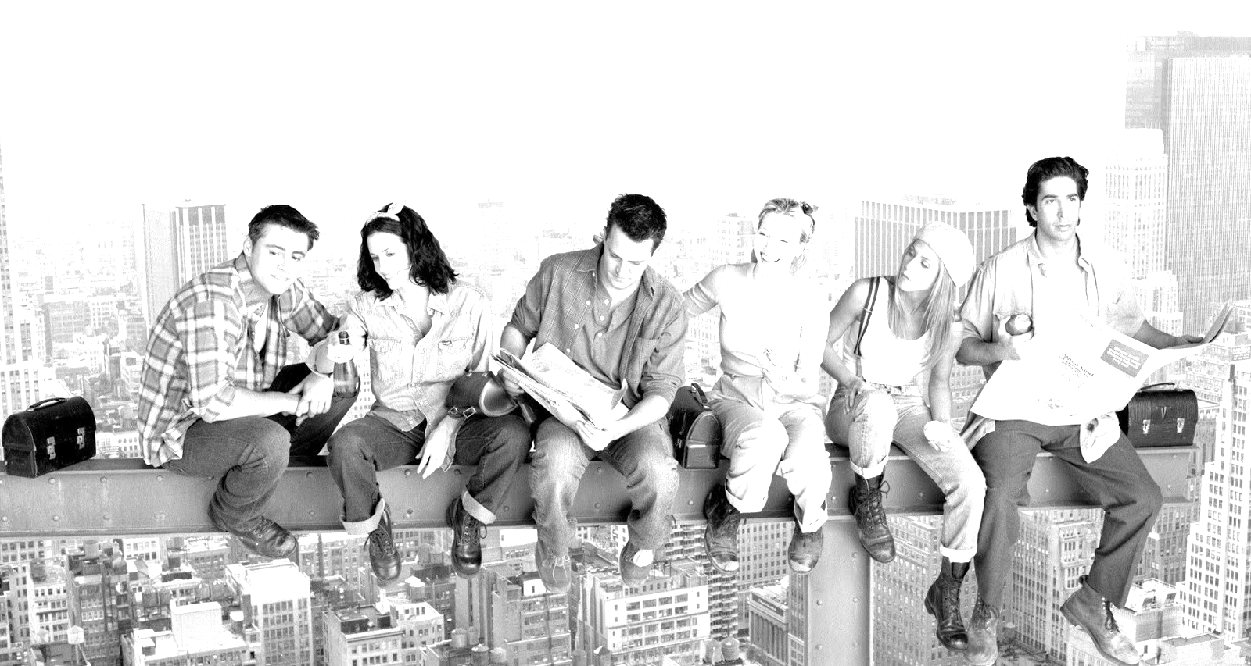
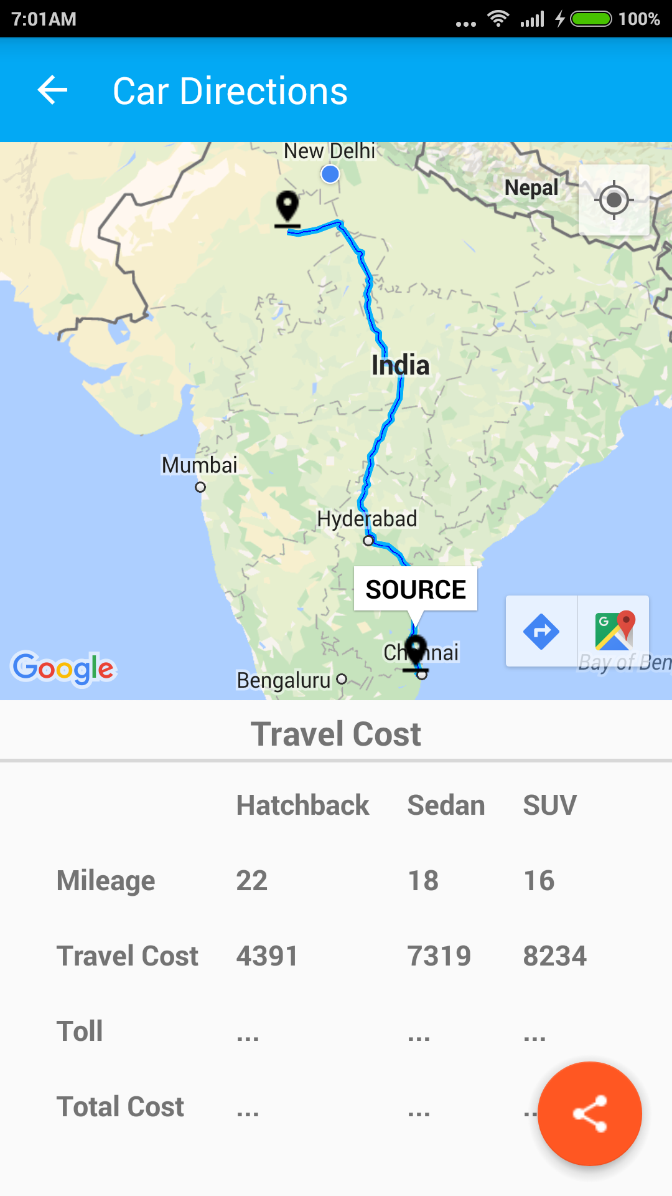
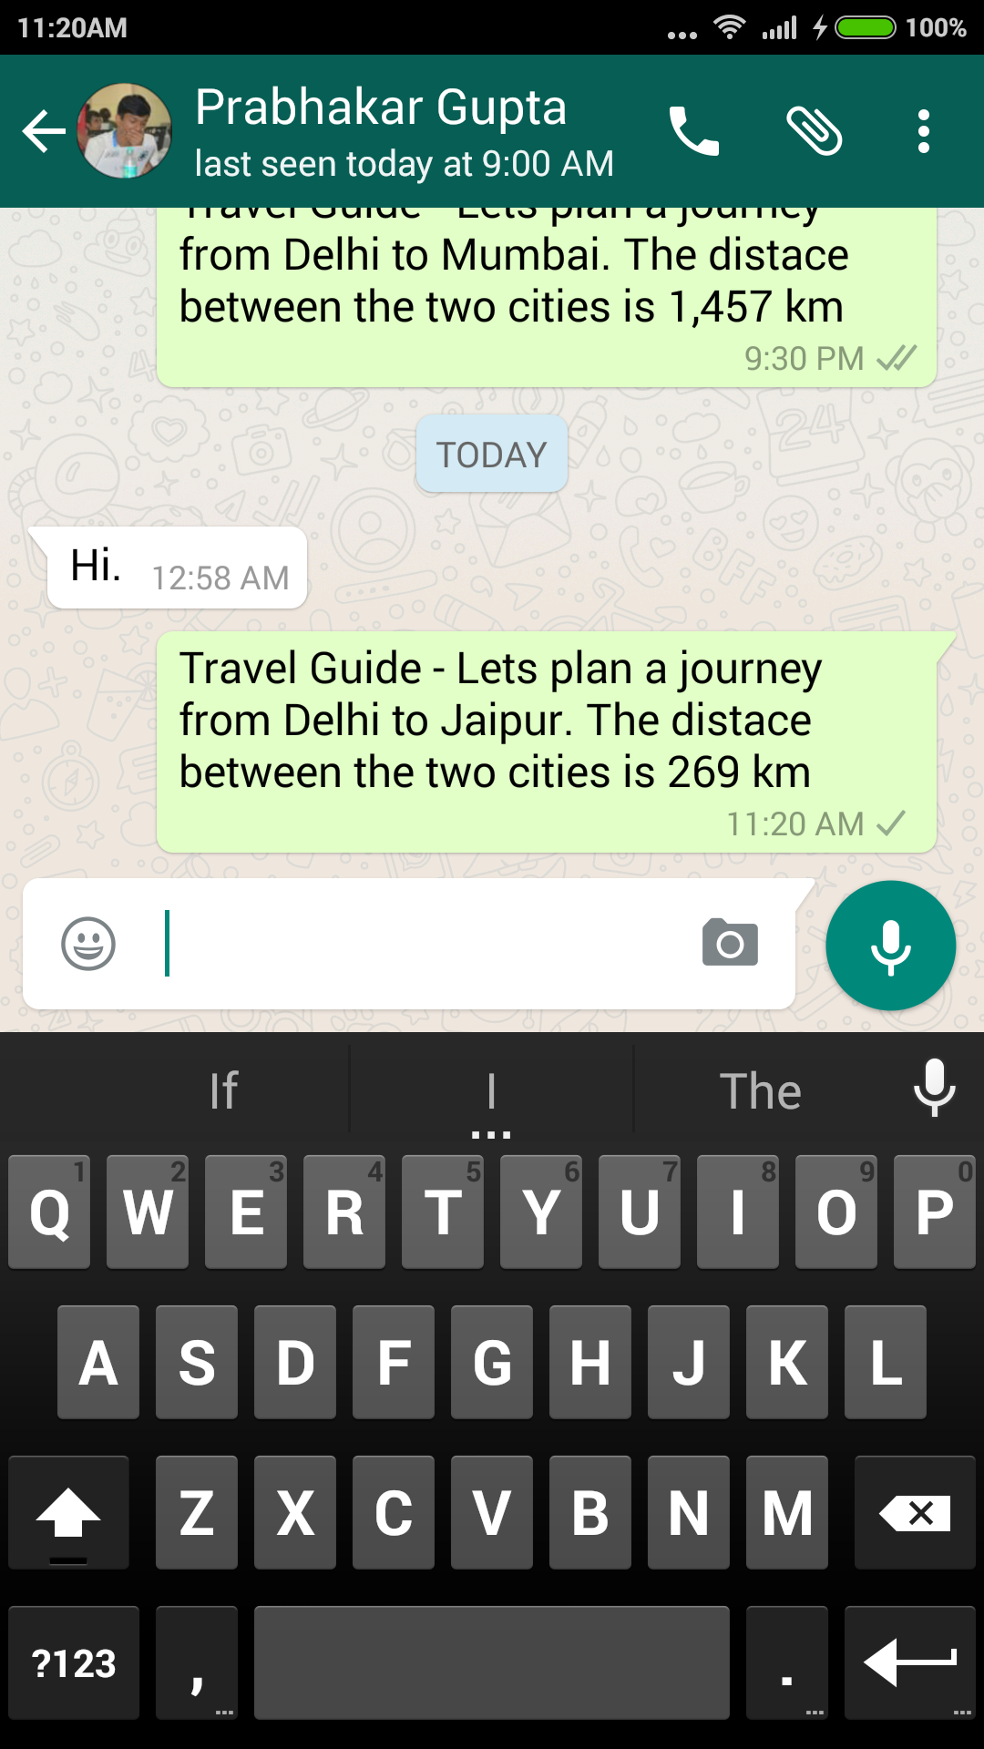
Car Directions
“Everything is giving and sharing and having and receiving.”
-Joey Tribbiani
When F.R.I.E.N.D.S. want to explore the cities, first thing comes to our mind is money. We love to split it so that we don’t have to pay a penny more.

Slide 8
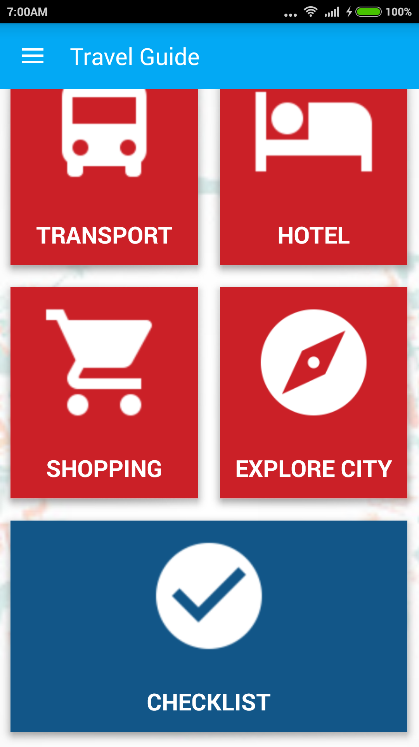
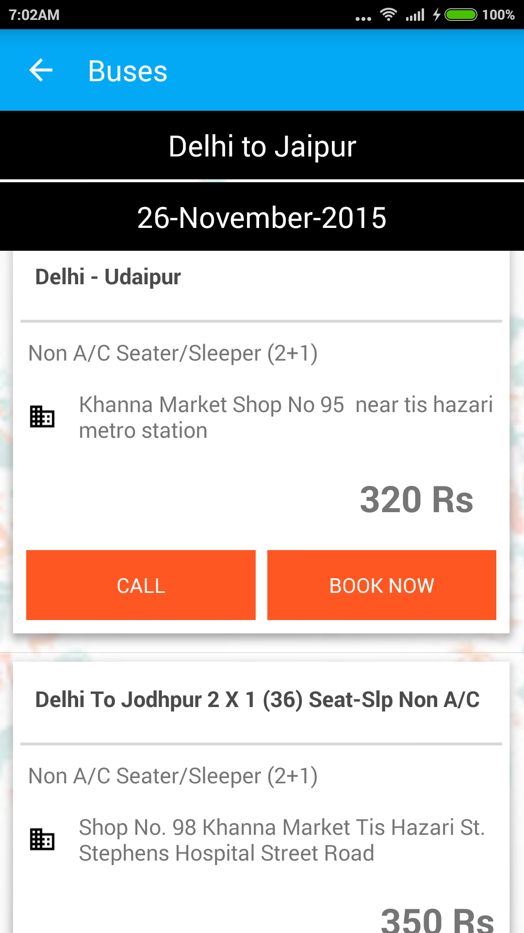
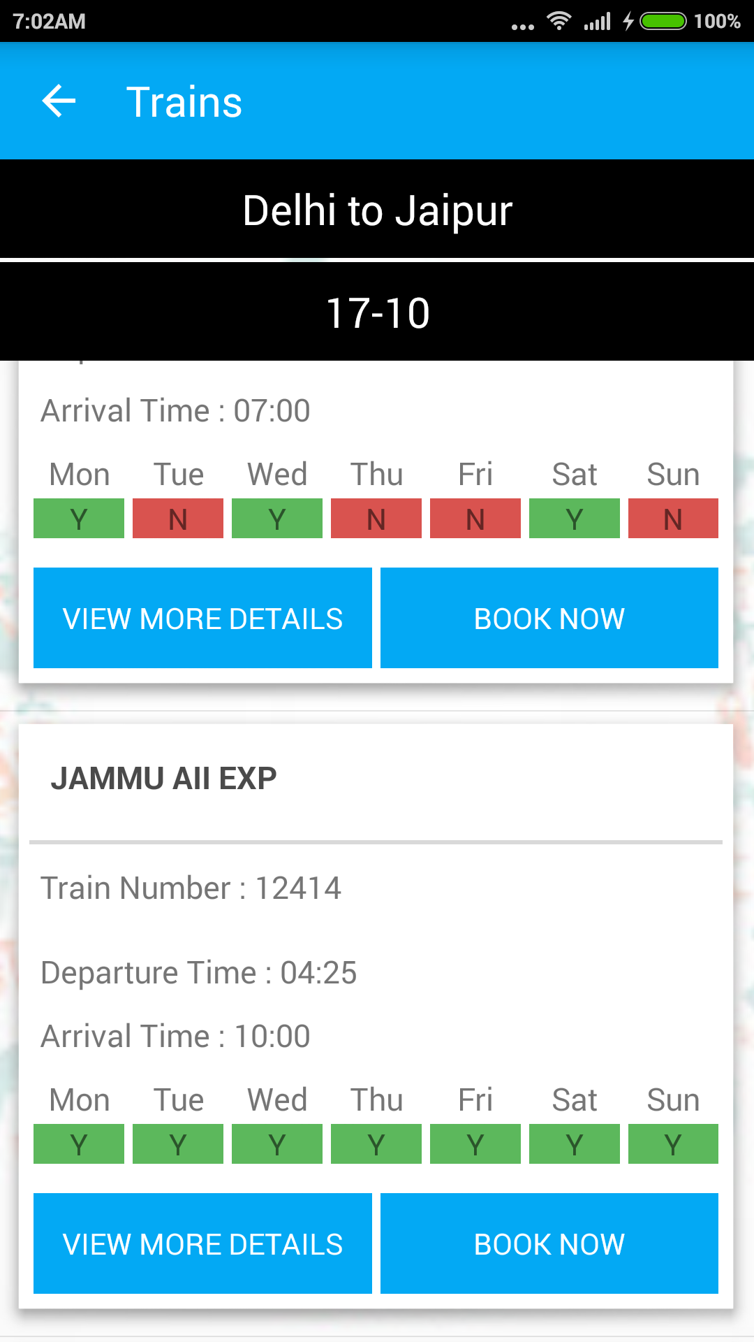
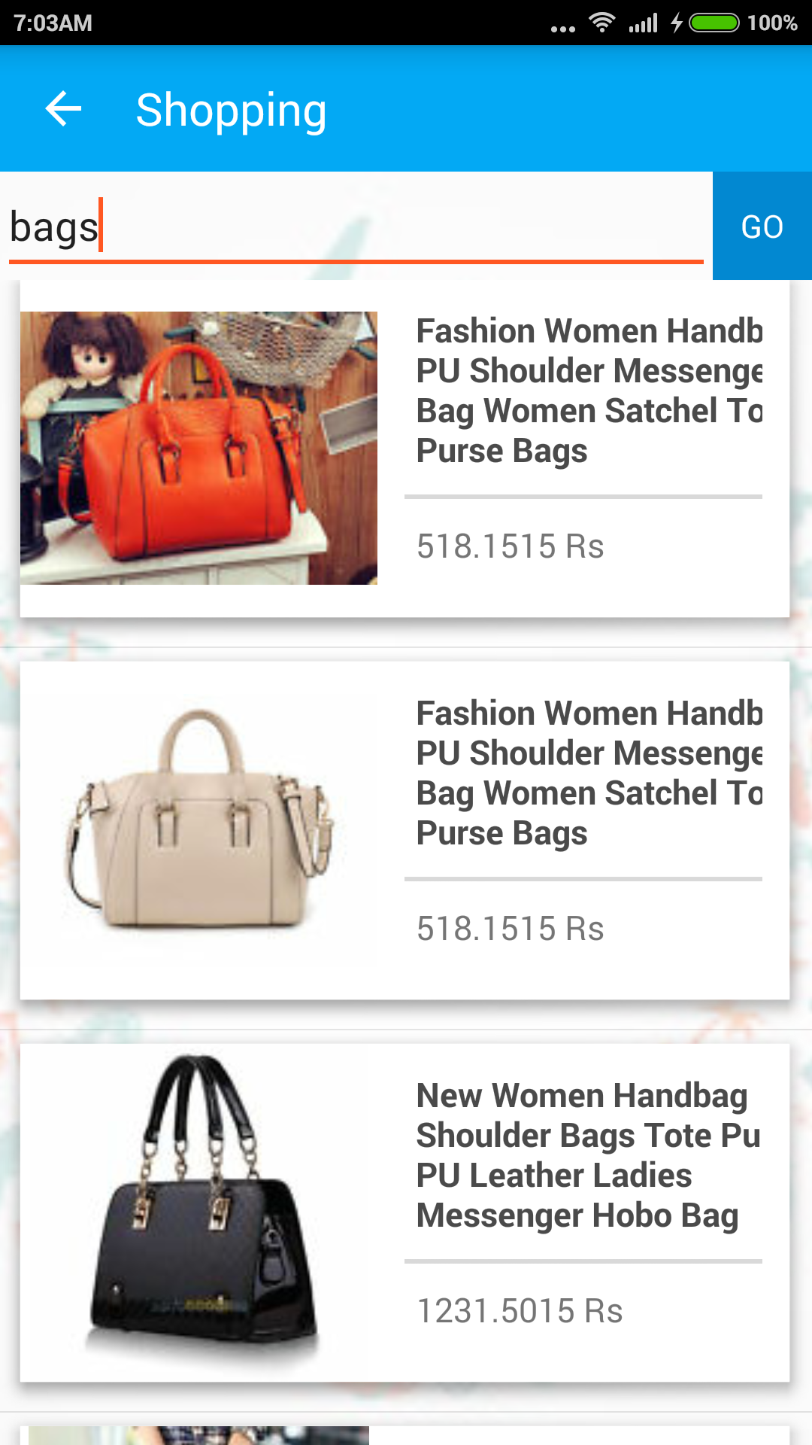
Easy User Interface to provide our traveller everything at a single click
Comprehensive list of buses sorted in the decreasing order of their rating
All available IRCTC trains from the current city of traveller to his destination city
Simple product search so that online purchase experience is faster and convenient

Slide 9

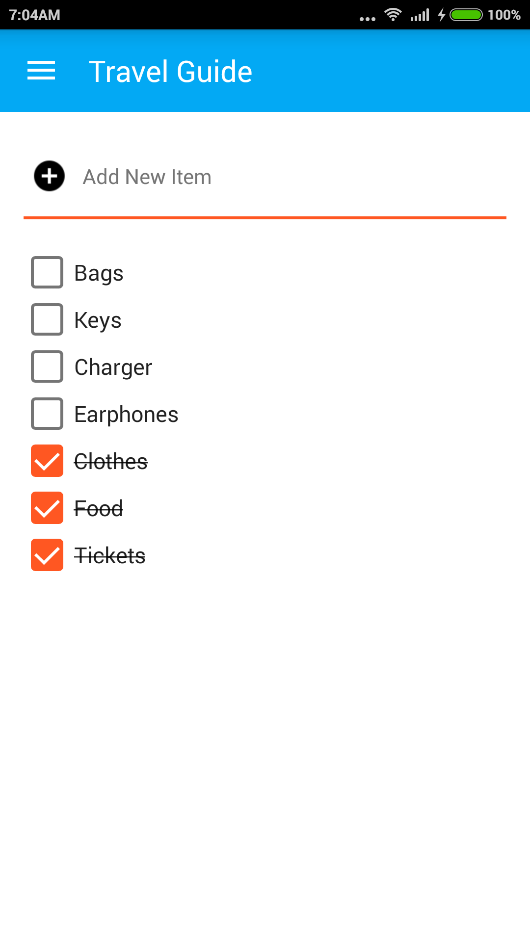
Check List
Because remembering everything required for your perfect trip is quite cumbersome.

Slide 10
Travel
Phase
During you’re travelling
to your destination

Slide 11

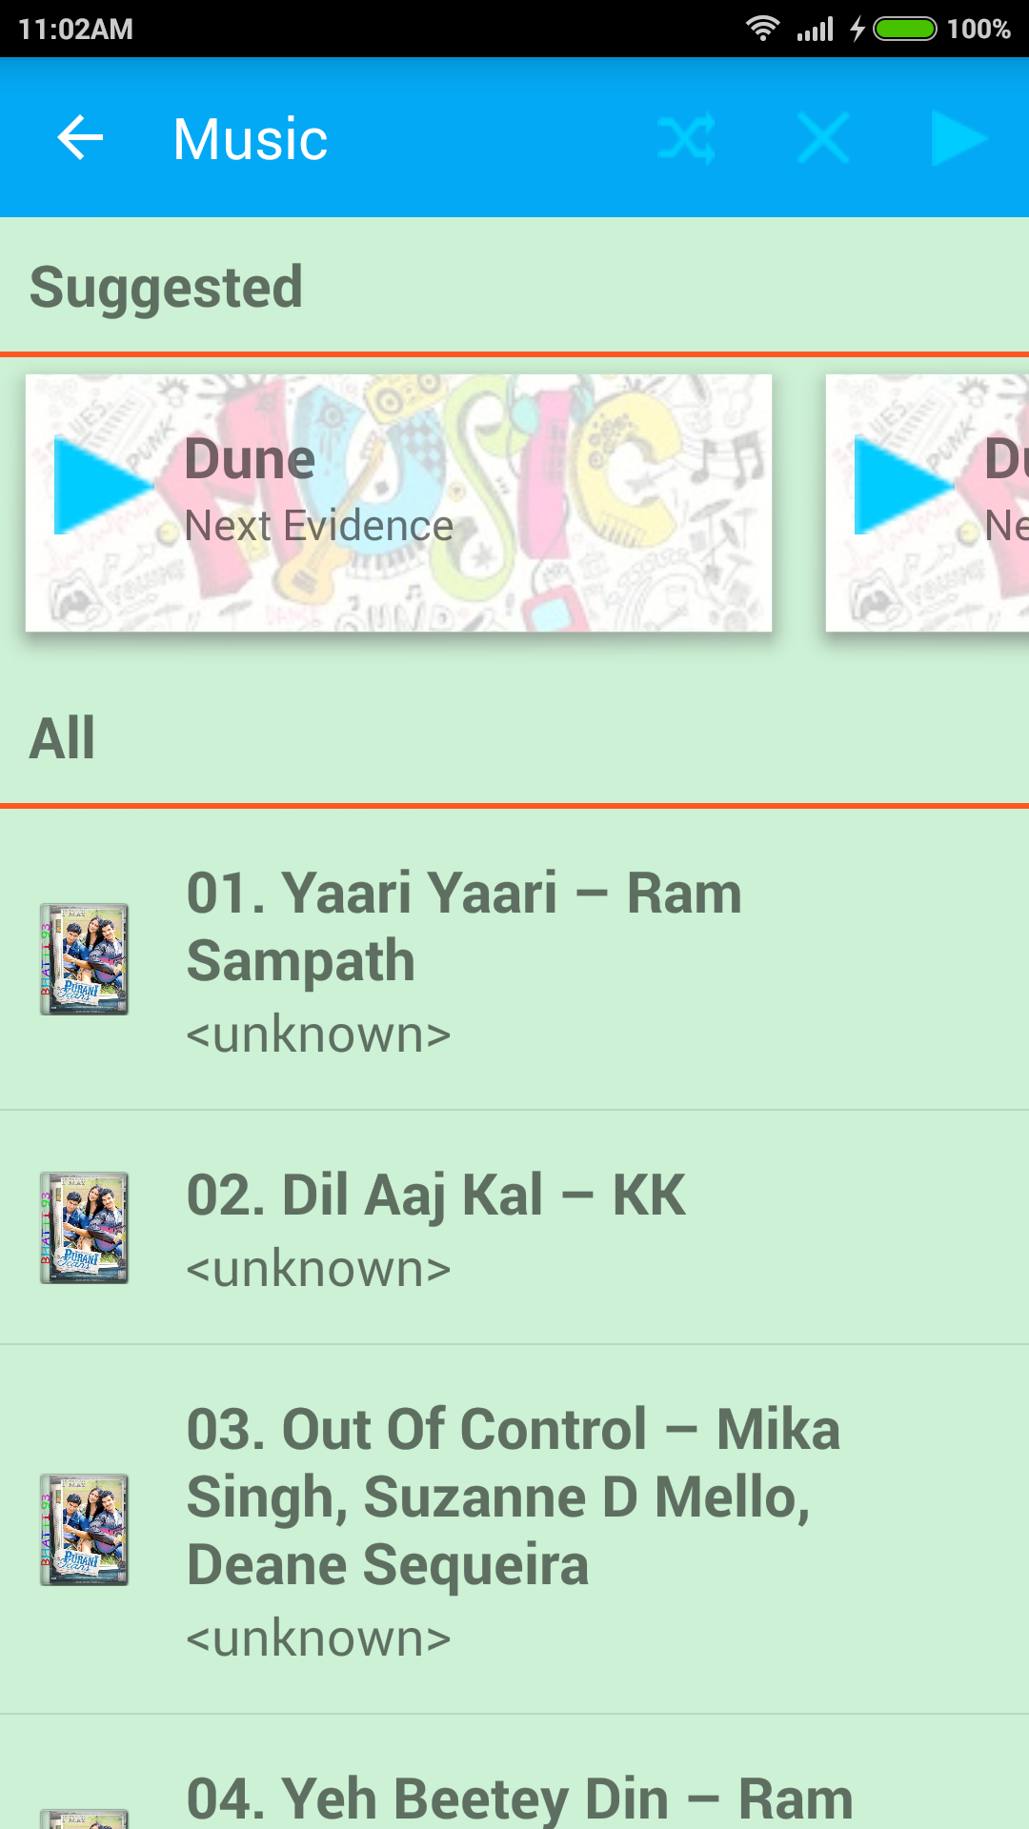
User’s Mood Detection
We try to find the current state of mind or the mood of our traveller on the basis of his activity and selections on the app and hence recommend him videos, books and songs accordingly.

Slide 12
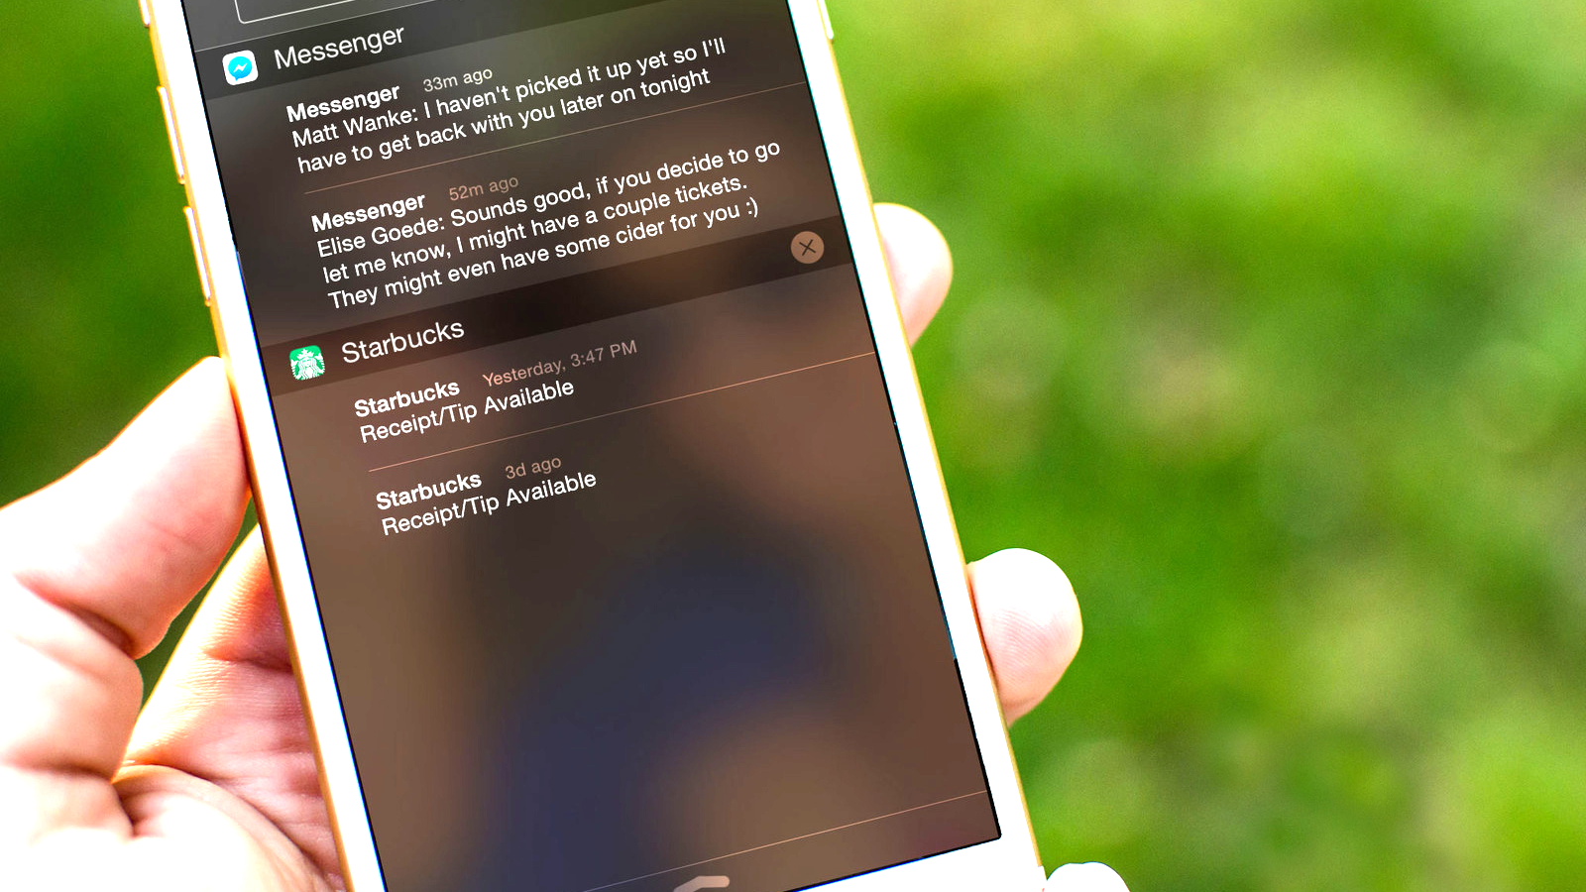
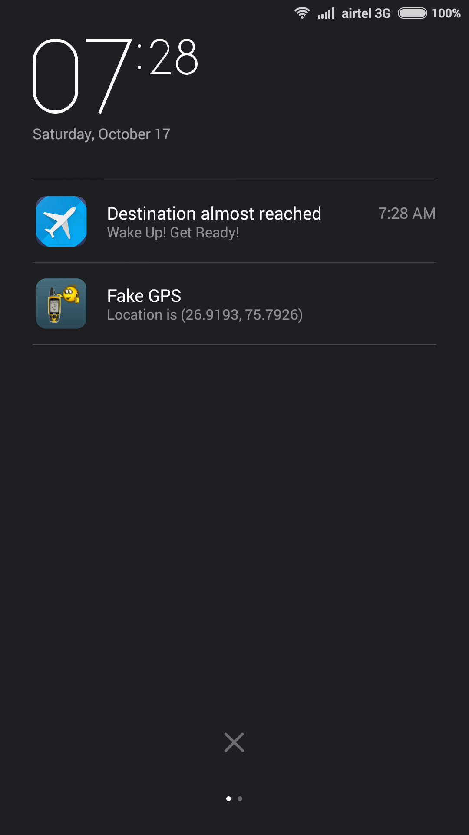
Push Notification
Travellers tend to doze off during their journey. And often either miss their destination stops
(not often, but there’s a possibility)
or miss the important stations between their source and destination cities.
We keep them updated with push notification and auto-alarm options so that even this could be taken care of.

Slide 13
Trip
Phase
After you reach your
destination city

Slide 14
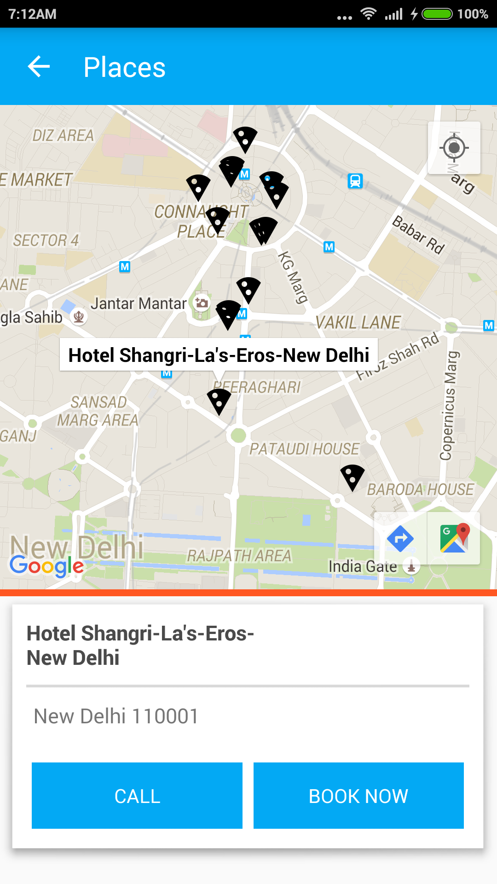
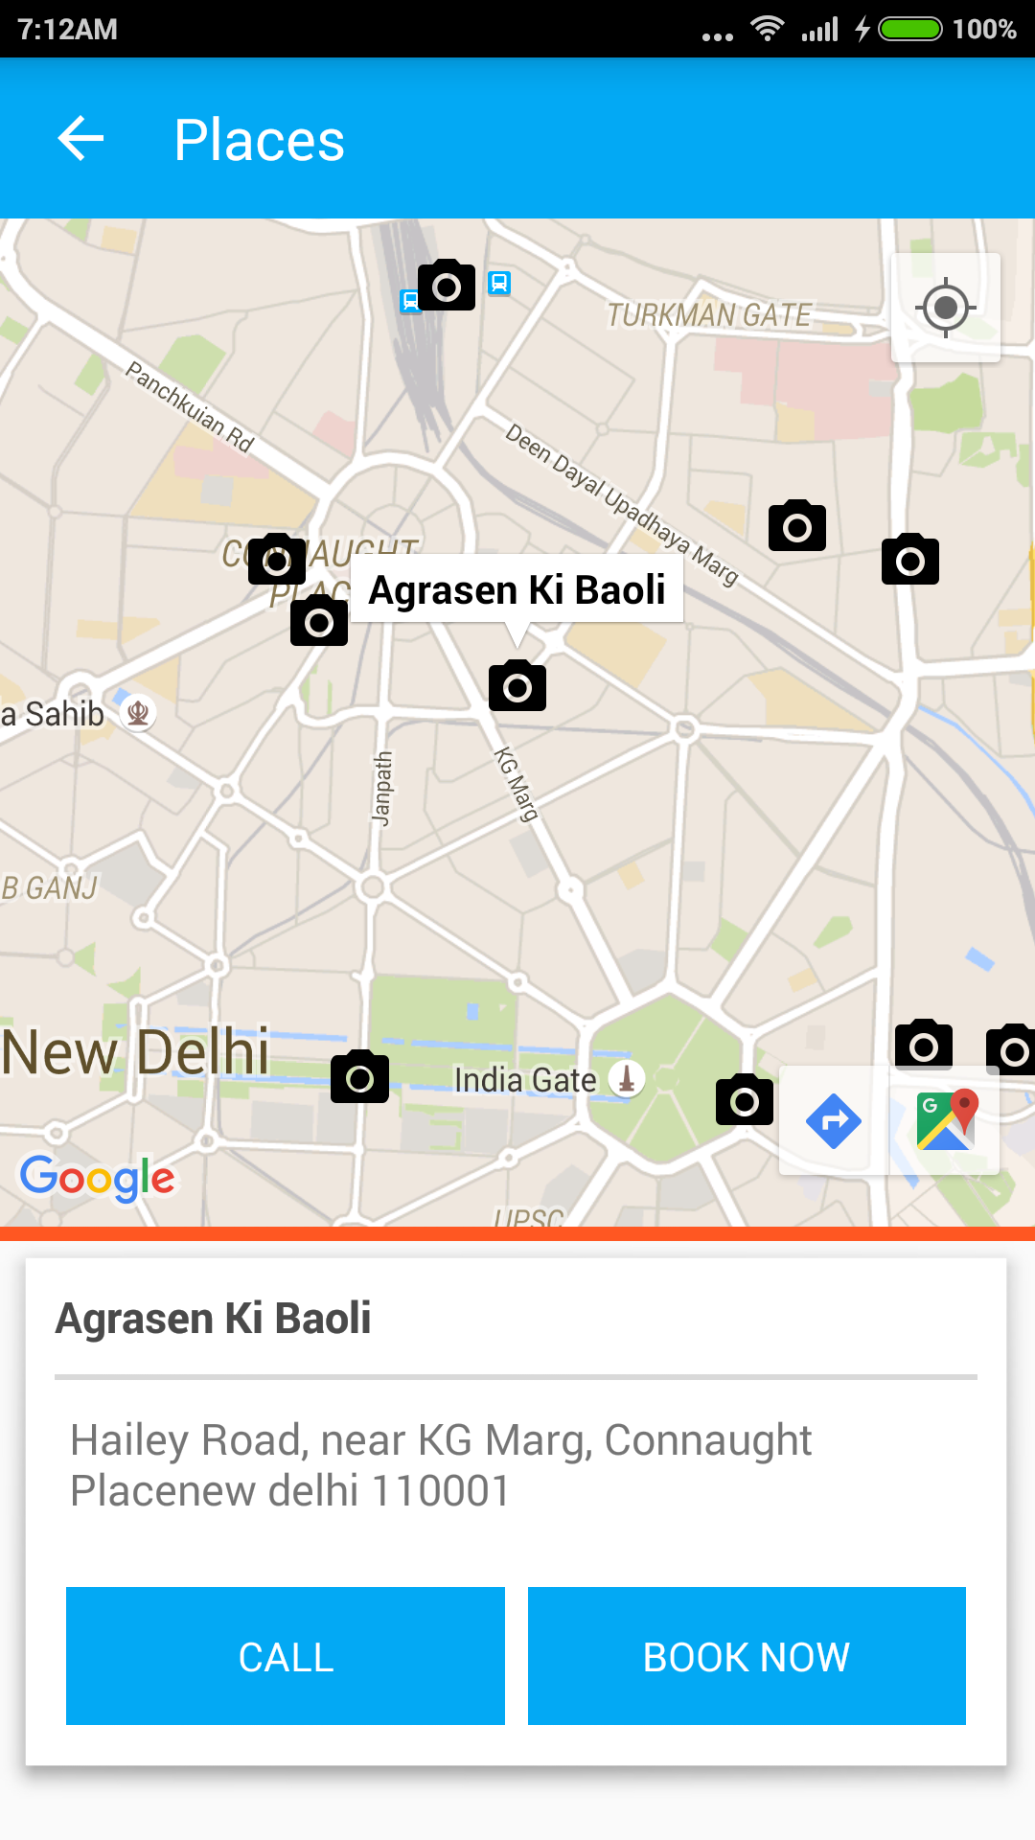
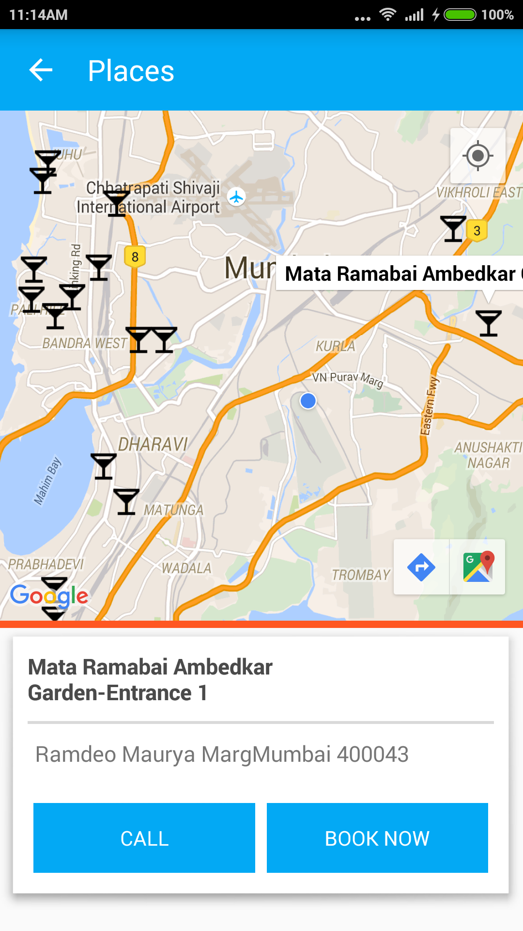
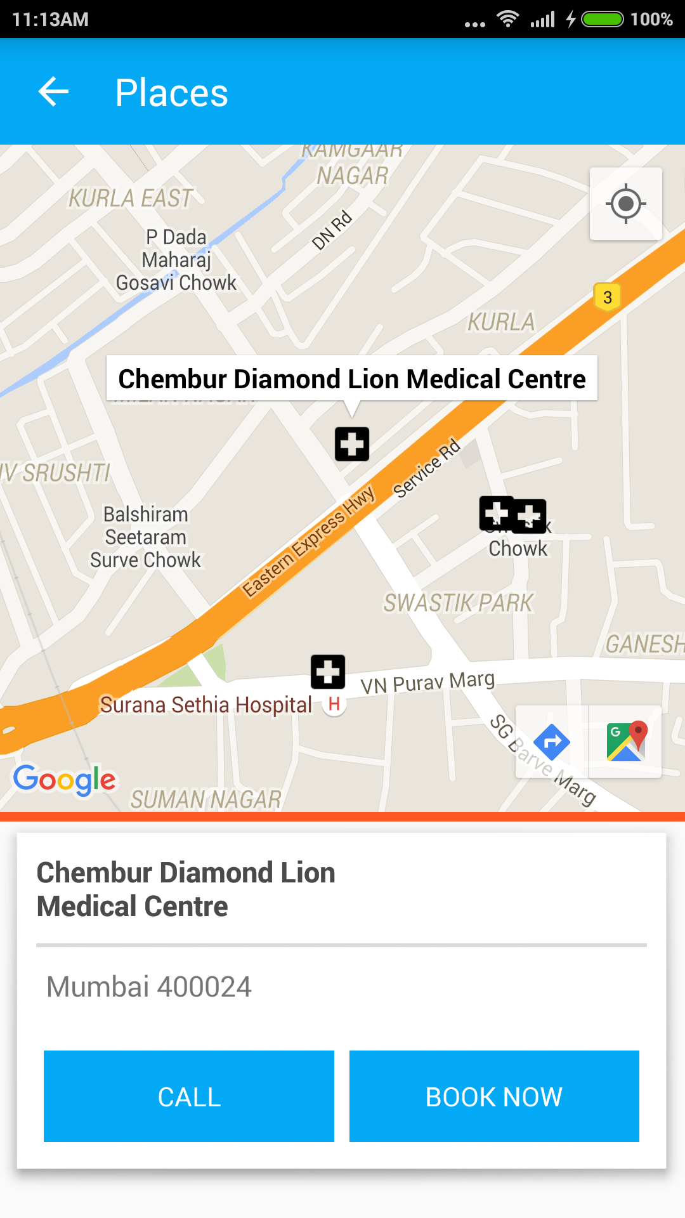
Real Time Location Data
Get the nearby locations on the go. So no more talking to strangers for directions
Be it food outlets, monuments, hangout spots, ATMs or even petrol pump.
We have pretty much everything for everyone

Slide 15
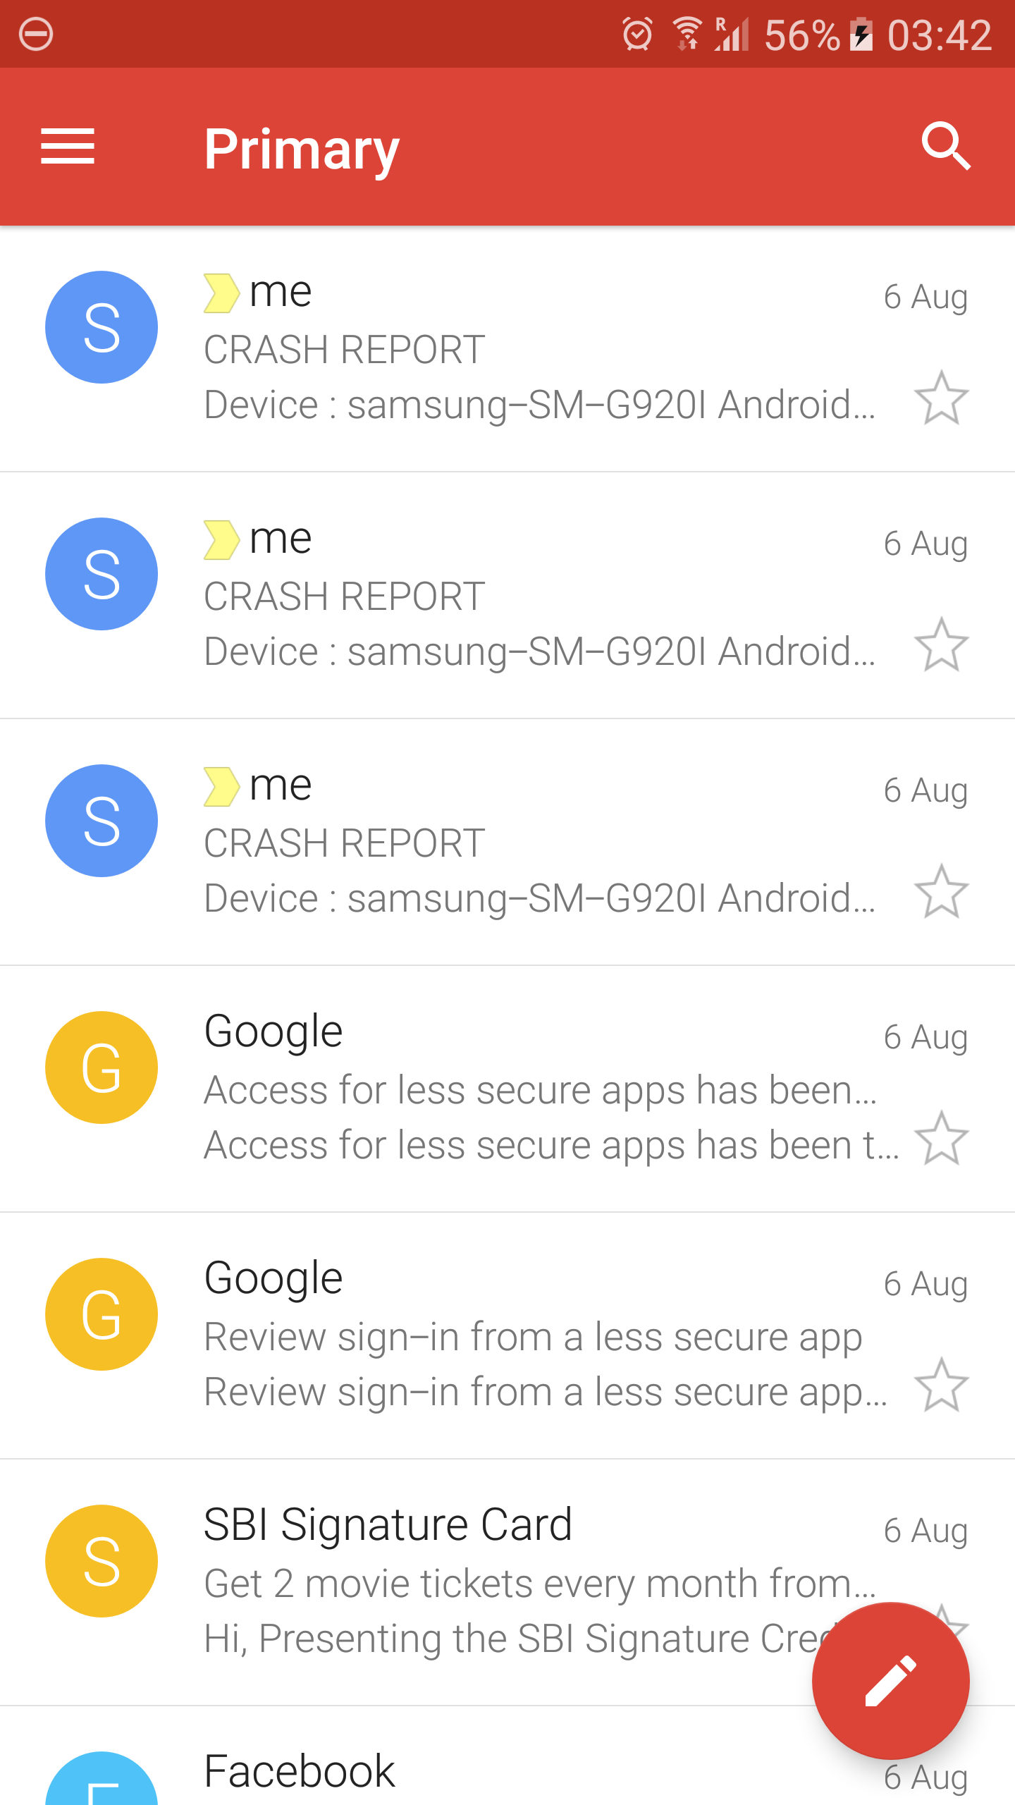
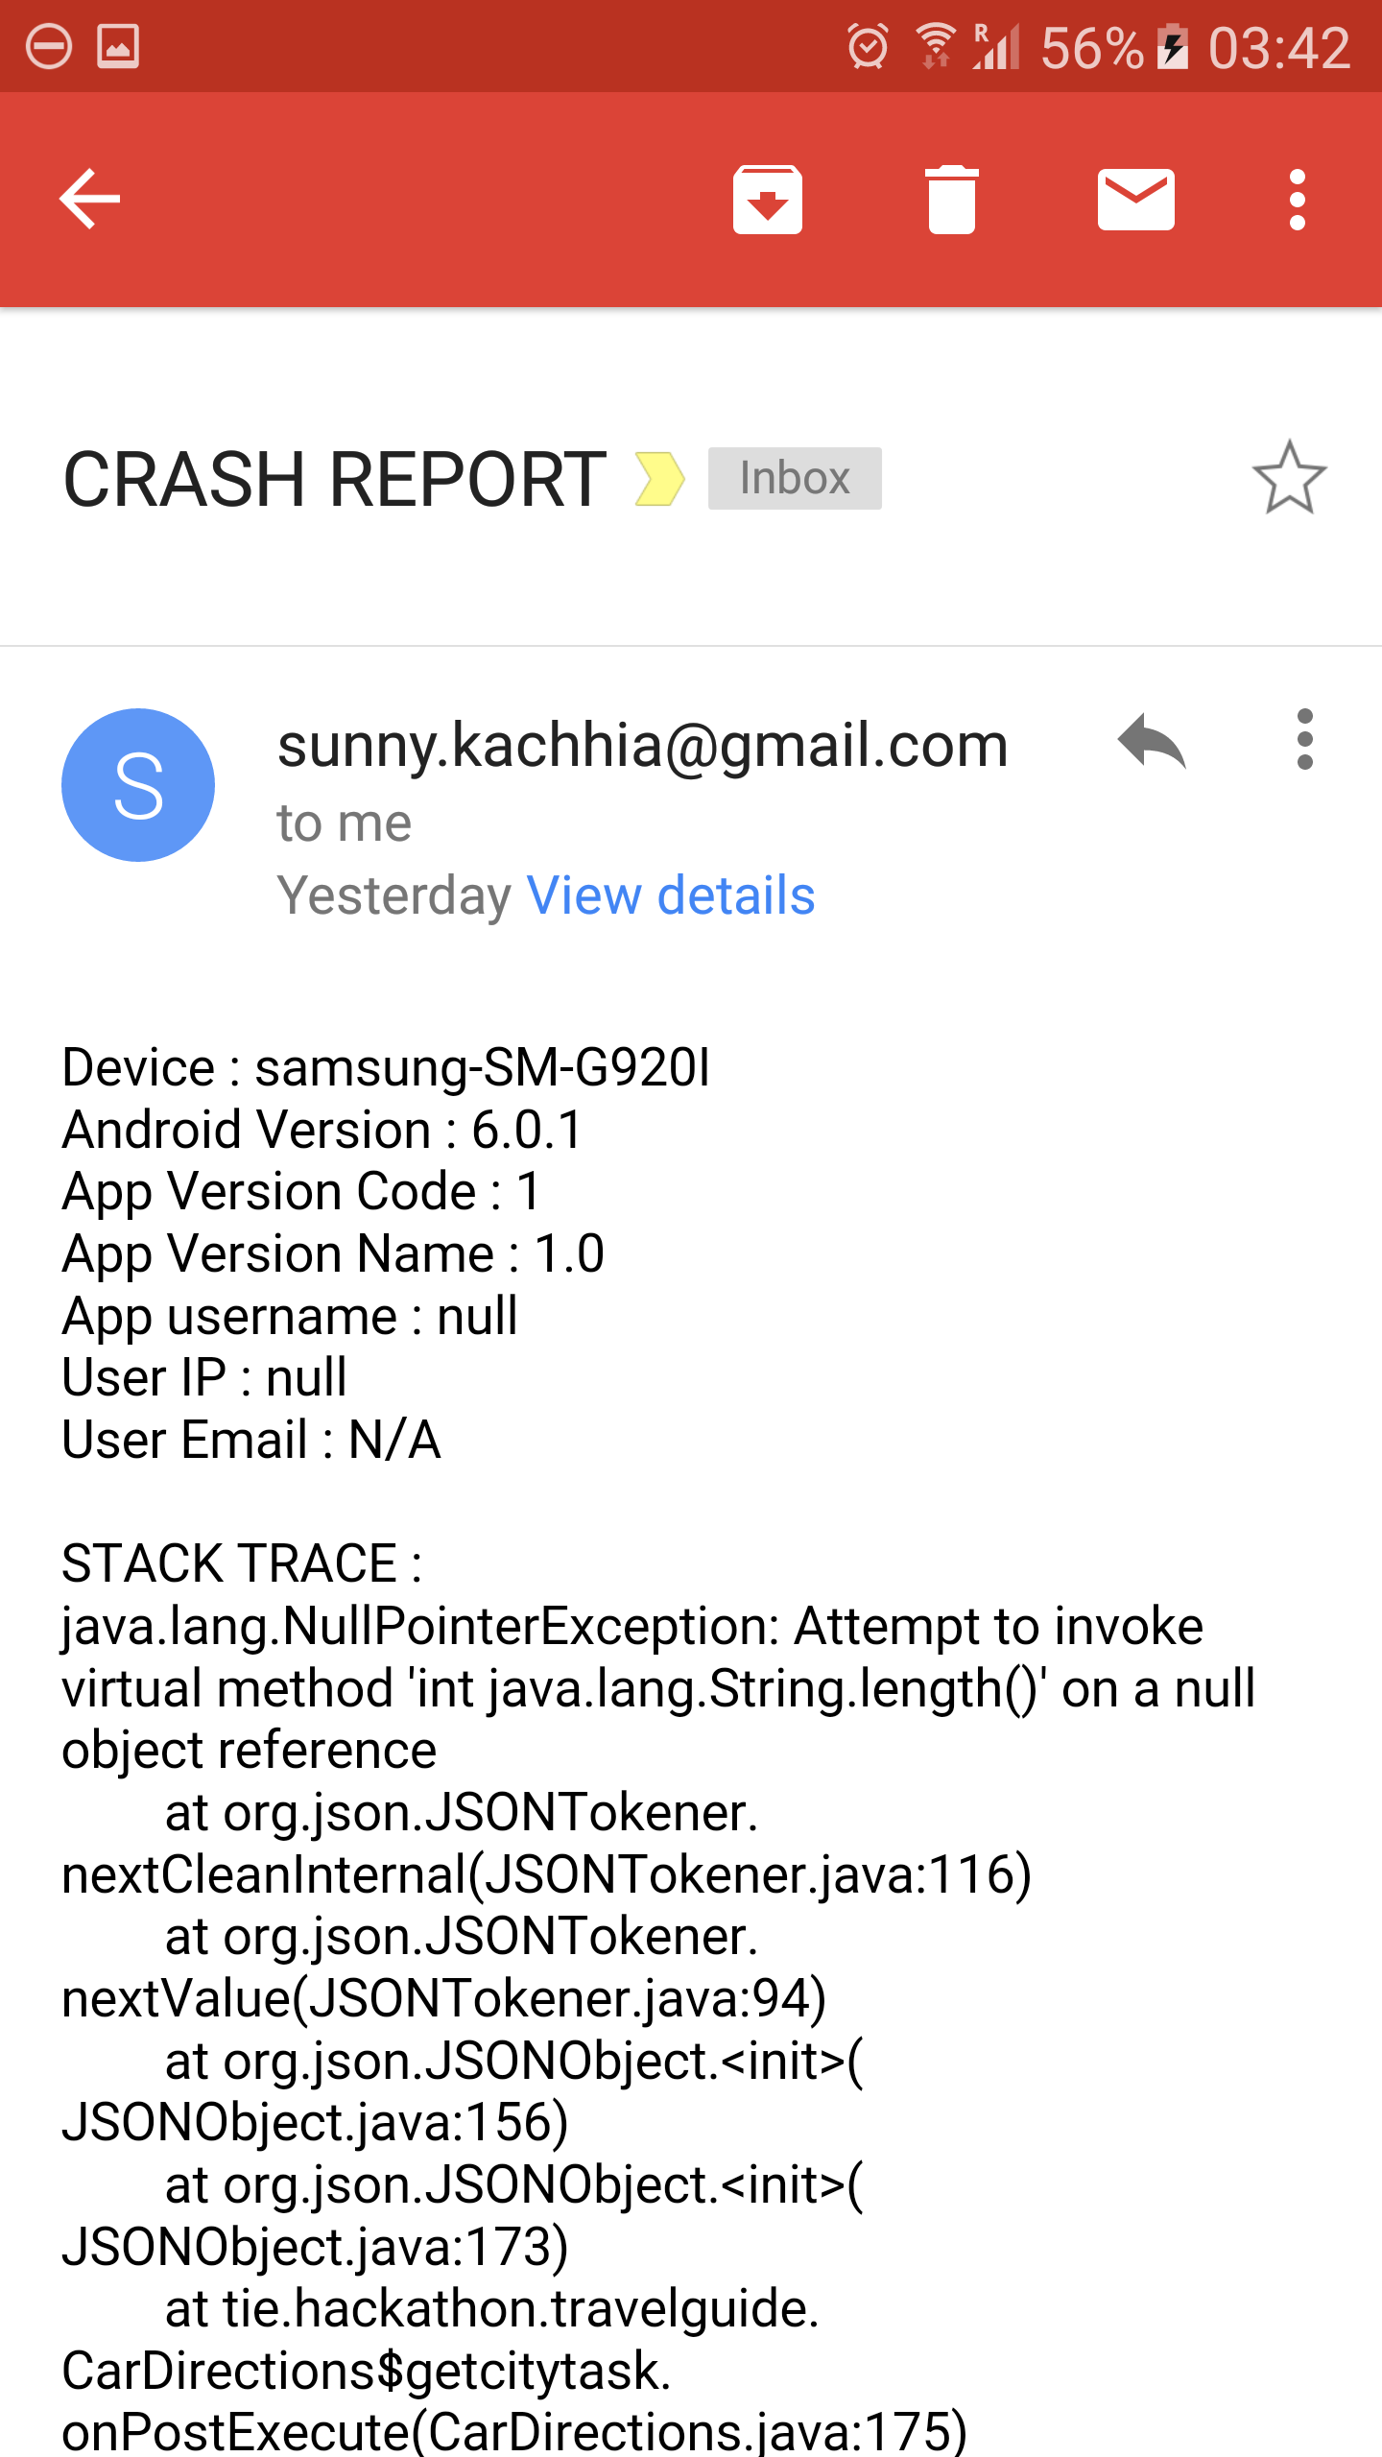
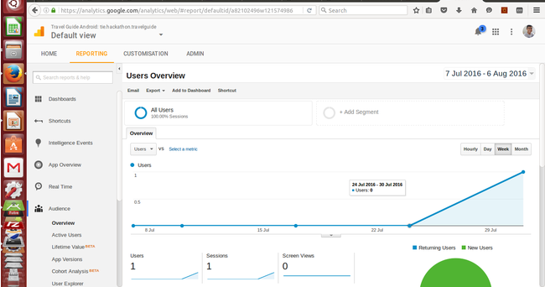
Application Monitoring and Management
ACRA crash reporting tool(open source) is implemented within the application. It provides a detailed report of the crashes occurring with the application. Also Google analytics has been embedded with the app to track app usage.

Slide 16
Thank You
Happy Journey

