Slide 1
Chapter 10
Error Detection
and
Correction

Slide 2
Note:
Data can be corrupted during transmission. For reliable communication, errors must be detected and corrected.

Slide 3
10.1 Types of Error
Single-Bit Error
Burst Error

Slide 4
Note:
In a single-bit error, only one bit in the data unit has changed.

Slide 5
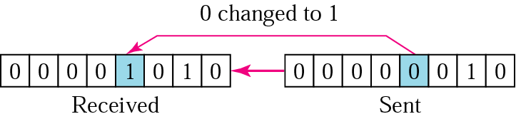
10.1 Single-bit error

Slide 6
Note:
A burst error means that 2 or more bits in the data unit have changed.

Slide 7
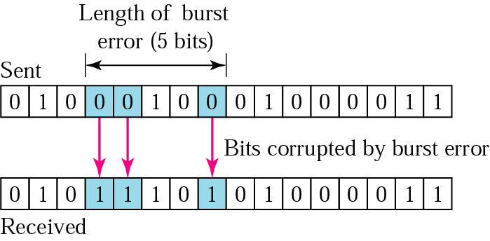
10.2 Burst error of length 5

Slide 8
10.2 Detection
Redundancy
Parity Check
Cyclic Redundancy Check (CRC)
Checksum

Slide 9
Note:
Error detection uses the concept of redundancy, which means adding extra bits for detecting errors at the destination.

Slide 10
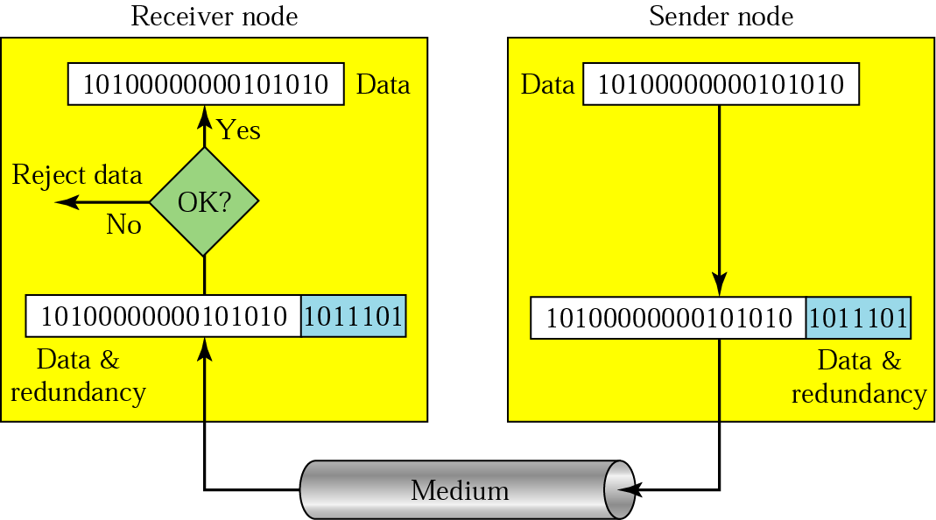
10.3 Redundancy

Slide 11
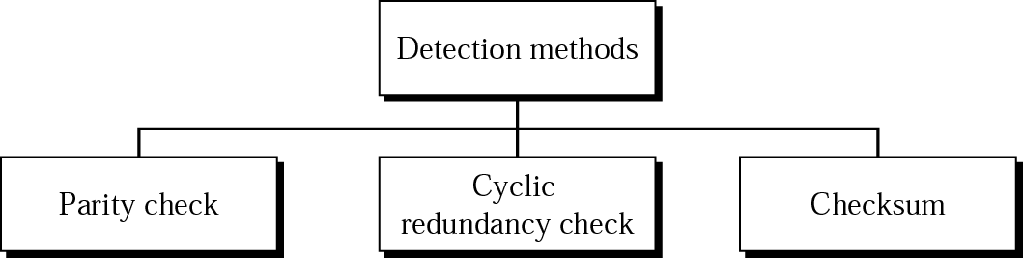
10.4 Detection methods

Slide 12
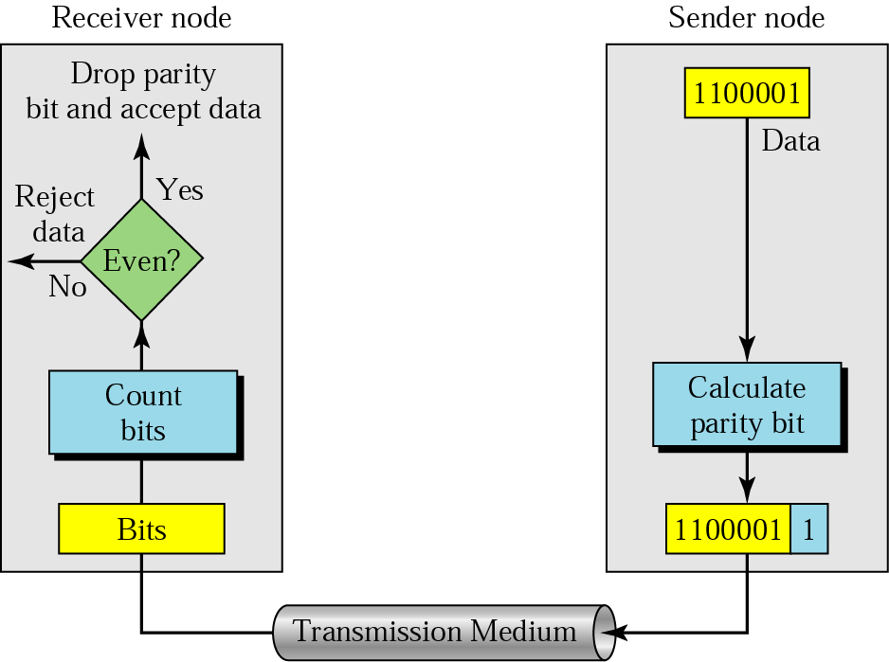
10.5 Even-parity concept

Slide 13
Note:
In parity check, a parity bit is added to every data unit so that the total number of 1s is even
(or odd for odd-parity).

Slide 14
Example 1
Suppose the sender wants to send the word world. In ASCII the five characters are coded as
1110111 1101111 1110010 1101100 1100100
The following shows the actual bits sent
11101110 11011110 11100100 11011000 11001001

Slide 15
Example 2
Now suppose the word world in Example 1 is received by the receiver without being corrupted in transmission.
11101110 11011110 11100100 11011000 11001001
The receiver counts the 1s in each character and comes up with even numbers (6, 6, 4, 4, 4). The data are accepted.

Slide 16
Example 3
Now suppose the word world in Example 1 is corrupted during transmission.
11111110 11011110 11101100 11011000 11001001
The receiver counts the 1s in each character and comes up with even and odd numbers (7, 6, 5, 4, 4). The receiver knows that the data are corrupted, discards them, and asks for retransmission.

Slide 17
Note:
Simple parity check can detect all single-bit errors. It can detect burst errors only if the total number of errors in each data unit is odd.

Slide 18
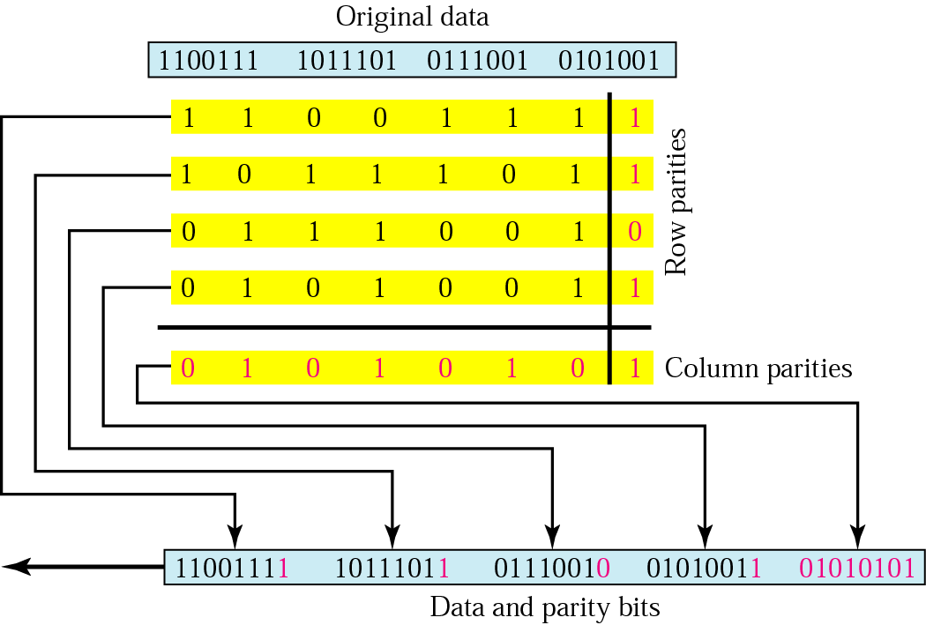
10.6 Two-dimensional parity

Slide 19
Example 4
Suppose the following block is sent:
10101001 00111001 11011101 11100111 10101010
However, it is hit by a burst noise of length 8, and some bits are corrupted.
10100011 10001001 11011101 11100111 10101010
When the receiver checks the parity bits, some of the bits do not follow the even-parity rule and the whole block is discarded.
10100011 10001001 11011101 11100111 10101010

Slide 20
Note:
In two-dimensional parity check, a block of bits is divided into rows and a redundant row of bits is added to the whole block.

Slide 21
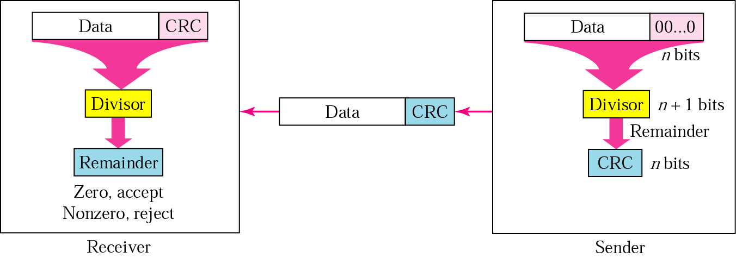
10.7 CRC generator and checker

Slide 22
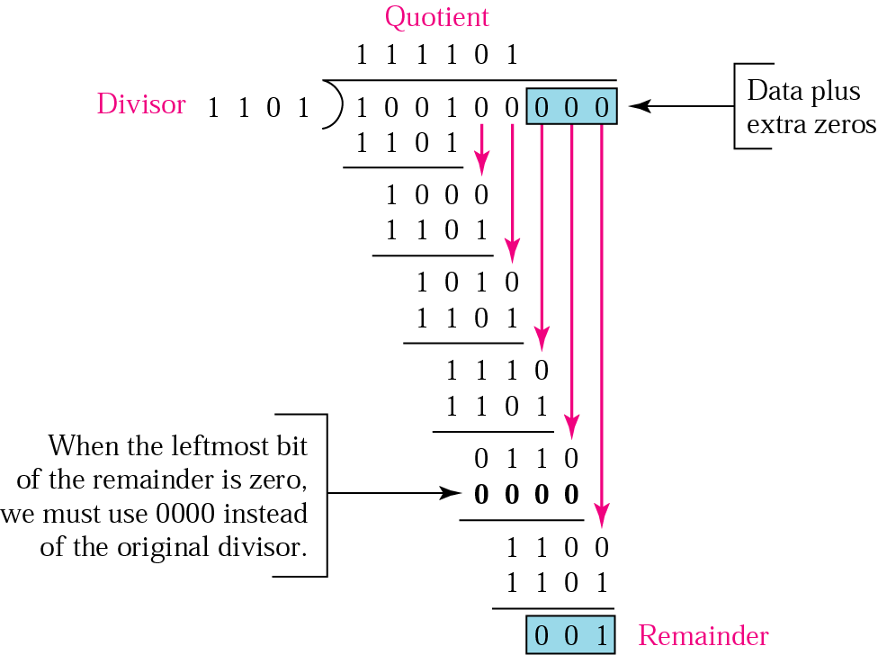
10.8 Binary division in a CRC generator

Slide 23
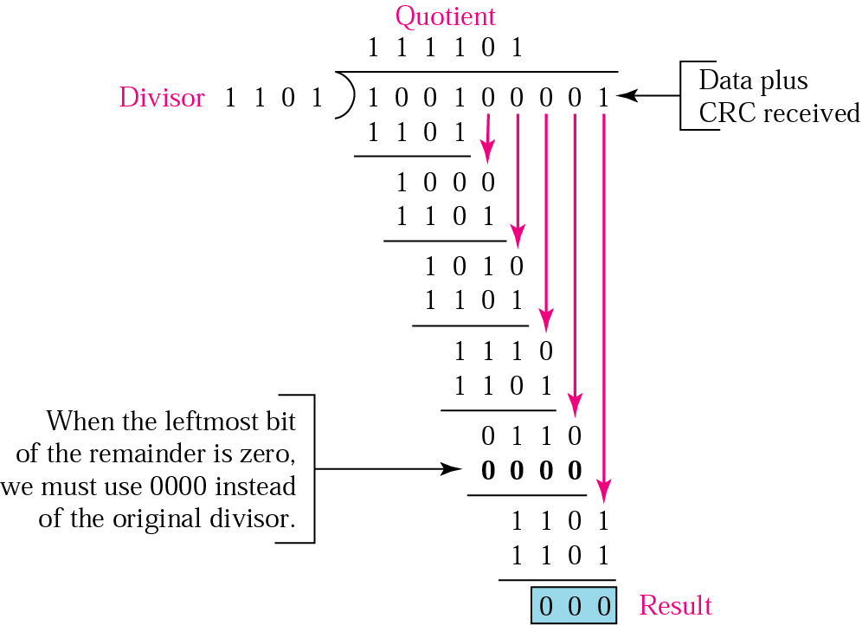
10.9 Binary division in CRC checker

Slide 24
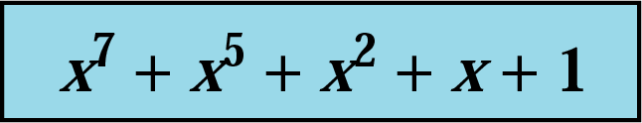
10.10 A polynomial

Slide 25
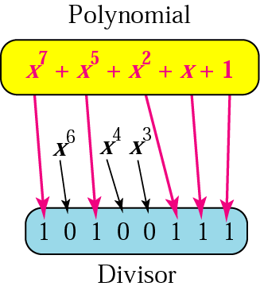
10.11 A polynomial representing a divisor

Slide 26
Table 10.1 Standard polynomials
Name | Polynomial | Application
CRC-8 | x⁸ + x² + x + 1 | ATM header
CRC-10 | x¹⁰ + x⁹ + x⁵ + x⁴ + x ² + 1 | ATM AAL
ITU-16 | x¹⁶ + x¹² + x⁵ + 1 | HDLC
ITU-32 | x³² + x²⁶ + x²³ + x²² + x¹⁶ + x¹² + x¹¹ + x¹⁰ + x⁸ + x⁷ + x⁵ + x⁴ + x² + x + 1 | LANs

Slide 27
Example 5
It is obvious that we cannot choose x (binary 10) or x² + x (binary 110) as the polynomial because both are divisible by x. However, we can choose x + 1 (binary 11) because it is not divisible by x, but is divisible by x + 1. We can also choose x² + 1 (binary 101) because it is divisible by x + 1 (binary division).

Slide 28
Example 6
The CRC-12
x¹² + x¹¹ + x³ + x + 1
which has a degree of 12, will detect all burst errors affecting an odd number of bits, will detect all burst errors with a length less than or equal to 12, and will detect, 99.97 percent of the time, burst errors with a length of 12 or more.

Slide 29
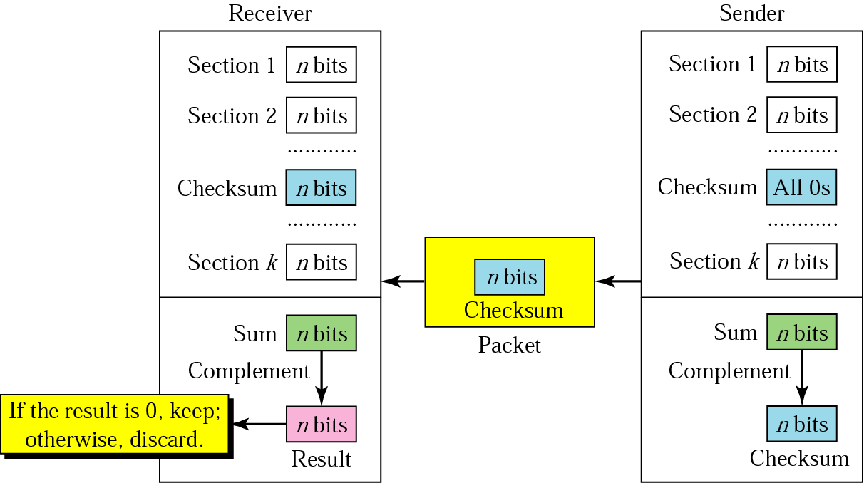
10.12 Checksum

Slide 30
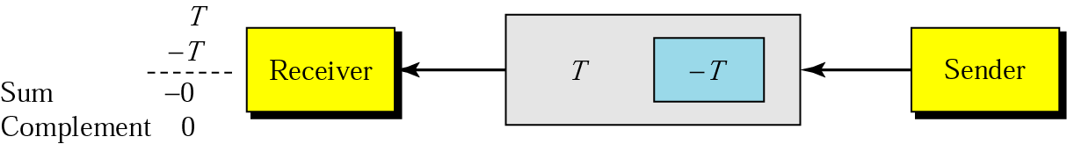
10.13 Data unit and checksum

Slide 31
Note:
The sender follows these steps:
The unit is divided into k sections, each of n bits.
All sections are added using one’s complement to get the sum.
The sum is complemented and becomes the checksum.
The checksum is sent with the data.

Slide 32
Note:
The receiver follows these steps:
The unit is divided into k sections, each of n bits.
All sections are added using one’s complement to get the sum.
The sum is complemented.
If the result is zero, the data are accepted: otherwise, rejected.

Slide 33
Example 7
Suppose the following block of 16 bits is to be sent using a checksum of 8 bits.
10101001 00111001
The numbers are added using one’s complement
10101001
00111001
------------
Sum 11100010
Checksum 00011101
The pattern sent is 10101001 00111001 00011101

Slide 34
Example 8
Now suppose the receiver receives the pattern sent in Example 7 and there is no error.
10101001 00111001 00011101
When the receiver adds the three sections, it will get all 1s, which, after complementing, is all 0s and shows that there is no error.
10101001
00111001
00011101
Sum 11111111
Complement 00000000 means that the pattern is OK.

Slide 35
Example 9
Now suppose there is a burst error of length 5 that affects 4 bits.
10101111 11111001 00011101
When the receiver adds the three sections, it gets
10101111
11111001
00011101
Partial Sum 1 11000101
Carry 1
Sum 11000110
Complement 00111001 the pattern is corrupted.

Slide 36
10.3 Correction
Retransmission
Forward Error Correction
Burst Error Correction

Slide 37
For each integer there is a code with r parity bits and 2^{r} − r − 1 >=m data bits
Table 10.2 Data and redundancy bits
Number of data bits m | Number of redundancy bits r | Total bits m + r
1 | 2 | 3
2 | 3 | 5
3 | 3 | 6
4 | 3 | 7
5 | 4 | 9
6 | 4 | 10
7 | 4 | 11

Slide 38
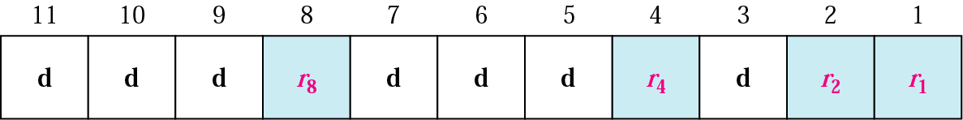
10.14 Positions of redundancy bits in Hamming code

Slide 39
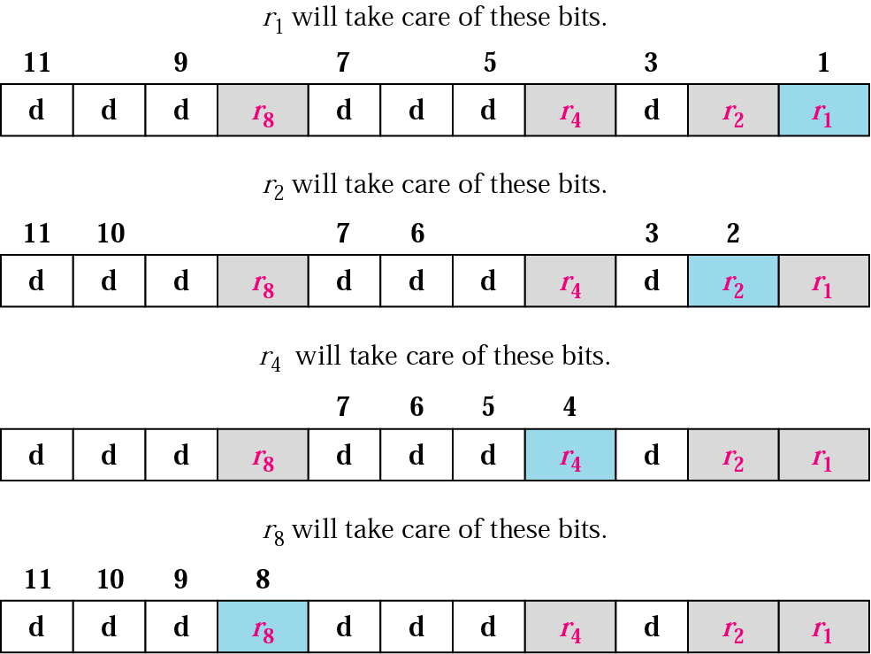
10.15 Redundancy bits calculation

Slide 40
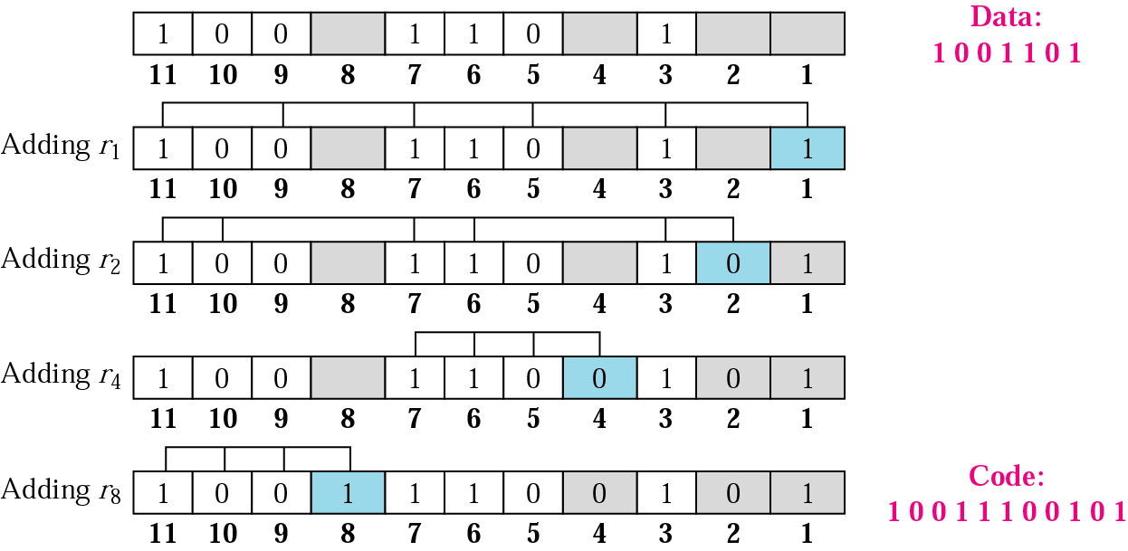
10.16 Example of redundancy bit calculation

Slide 41
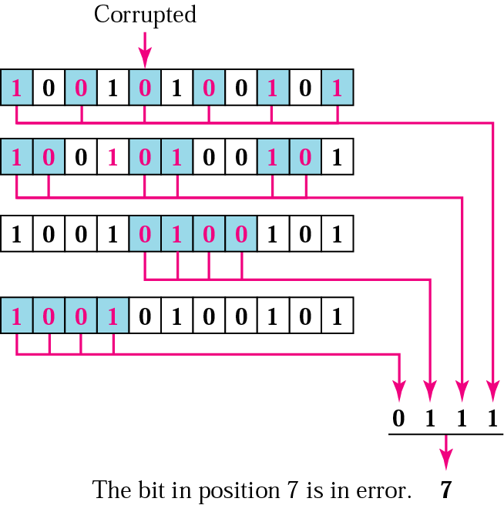
10.17 Error detection using Hamming code

Slide 42
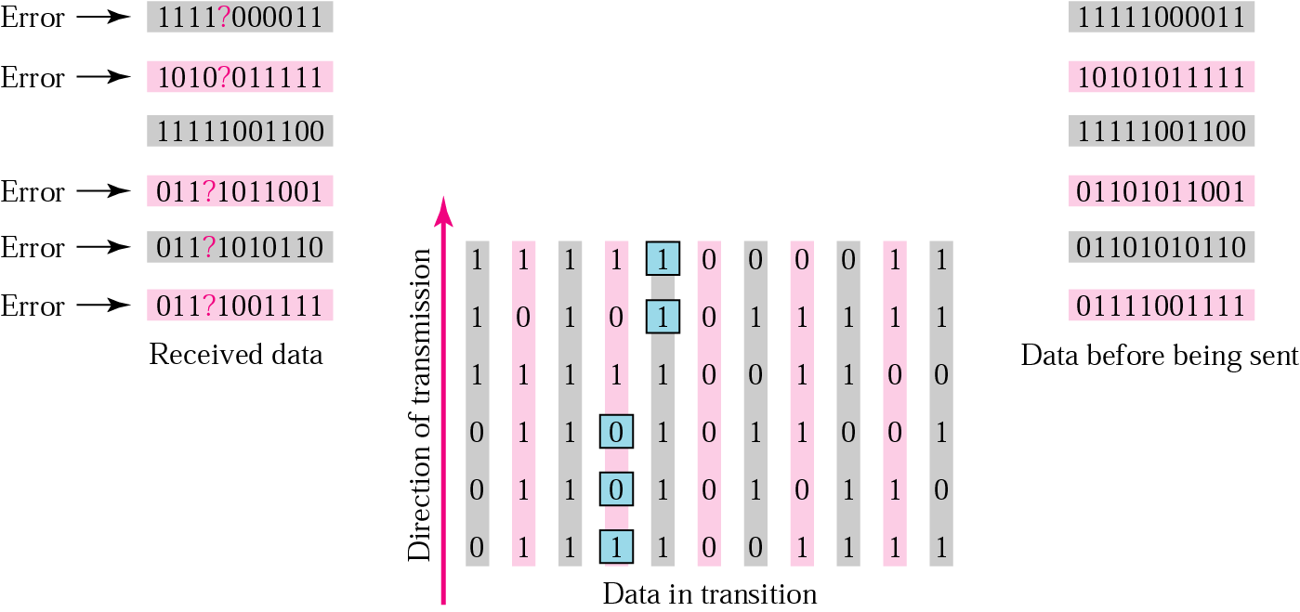
10.18 Burst error correction example

